Slide 1
Empowering young learners through a Discovery-based inquiry approach
Deborah Vietri and Vanessa Willis
ACEL Early Years Conference August 2018

Slide 2
Focus for today
Discovery-based inquiry: an approach to learning in the Early Years
The ‘Discovery Cluster’: a professional learning community of 21 schools where members learn with and from each other.

Slide 3
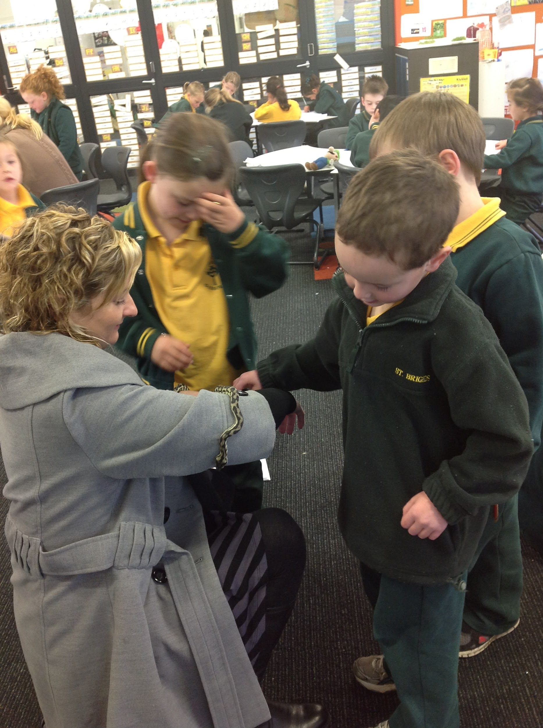
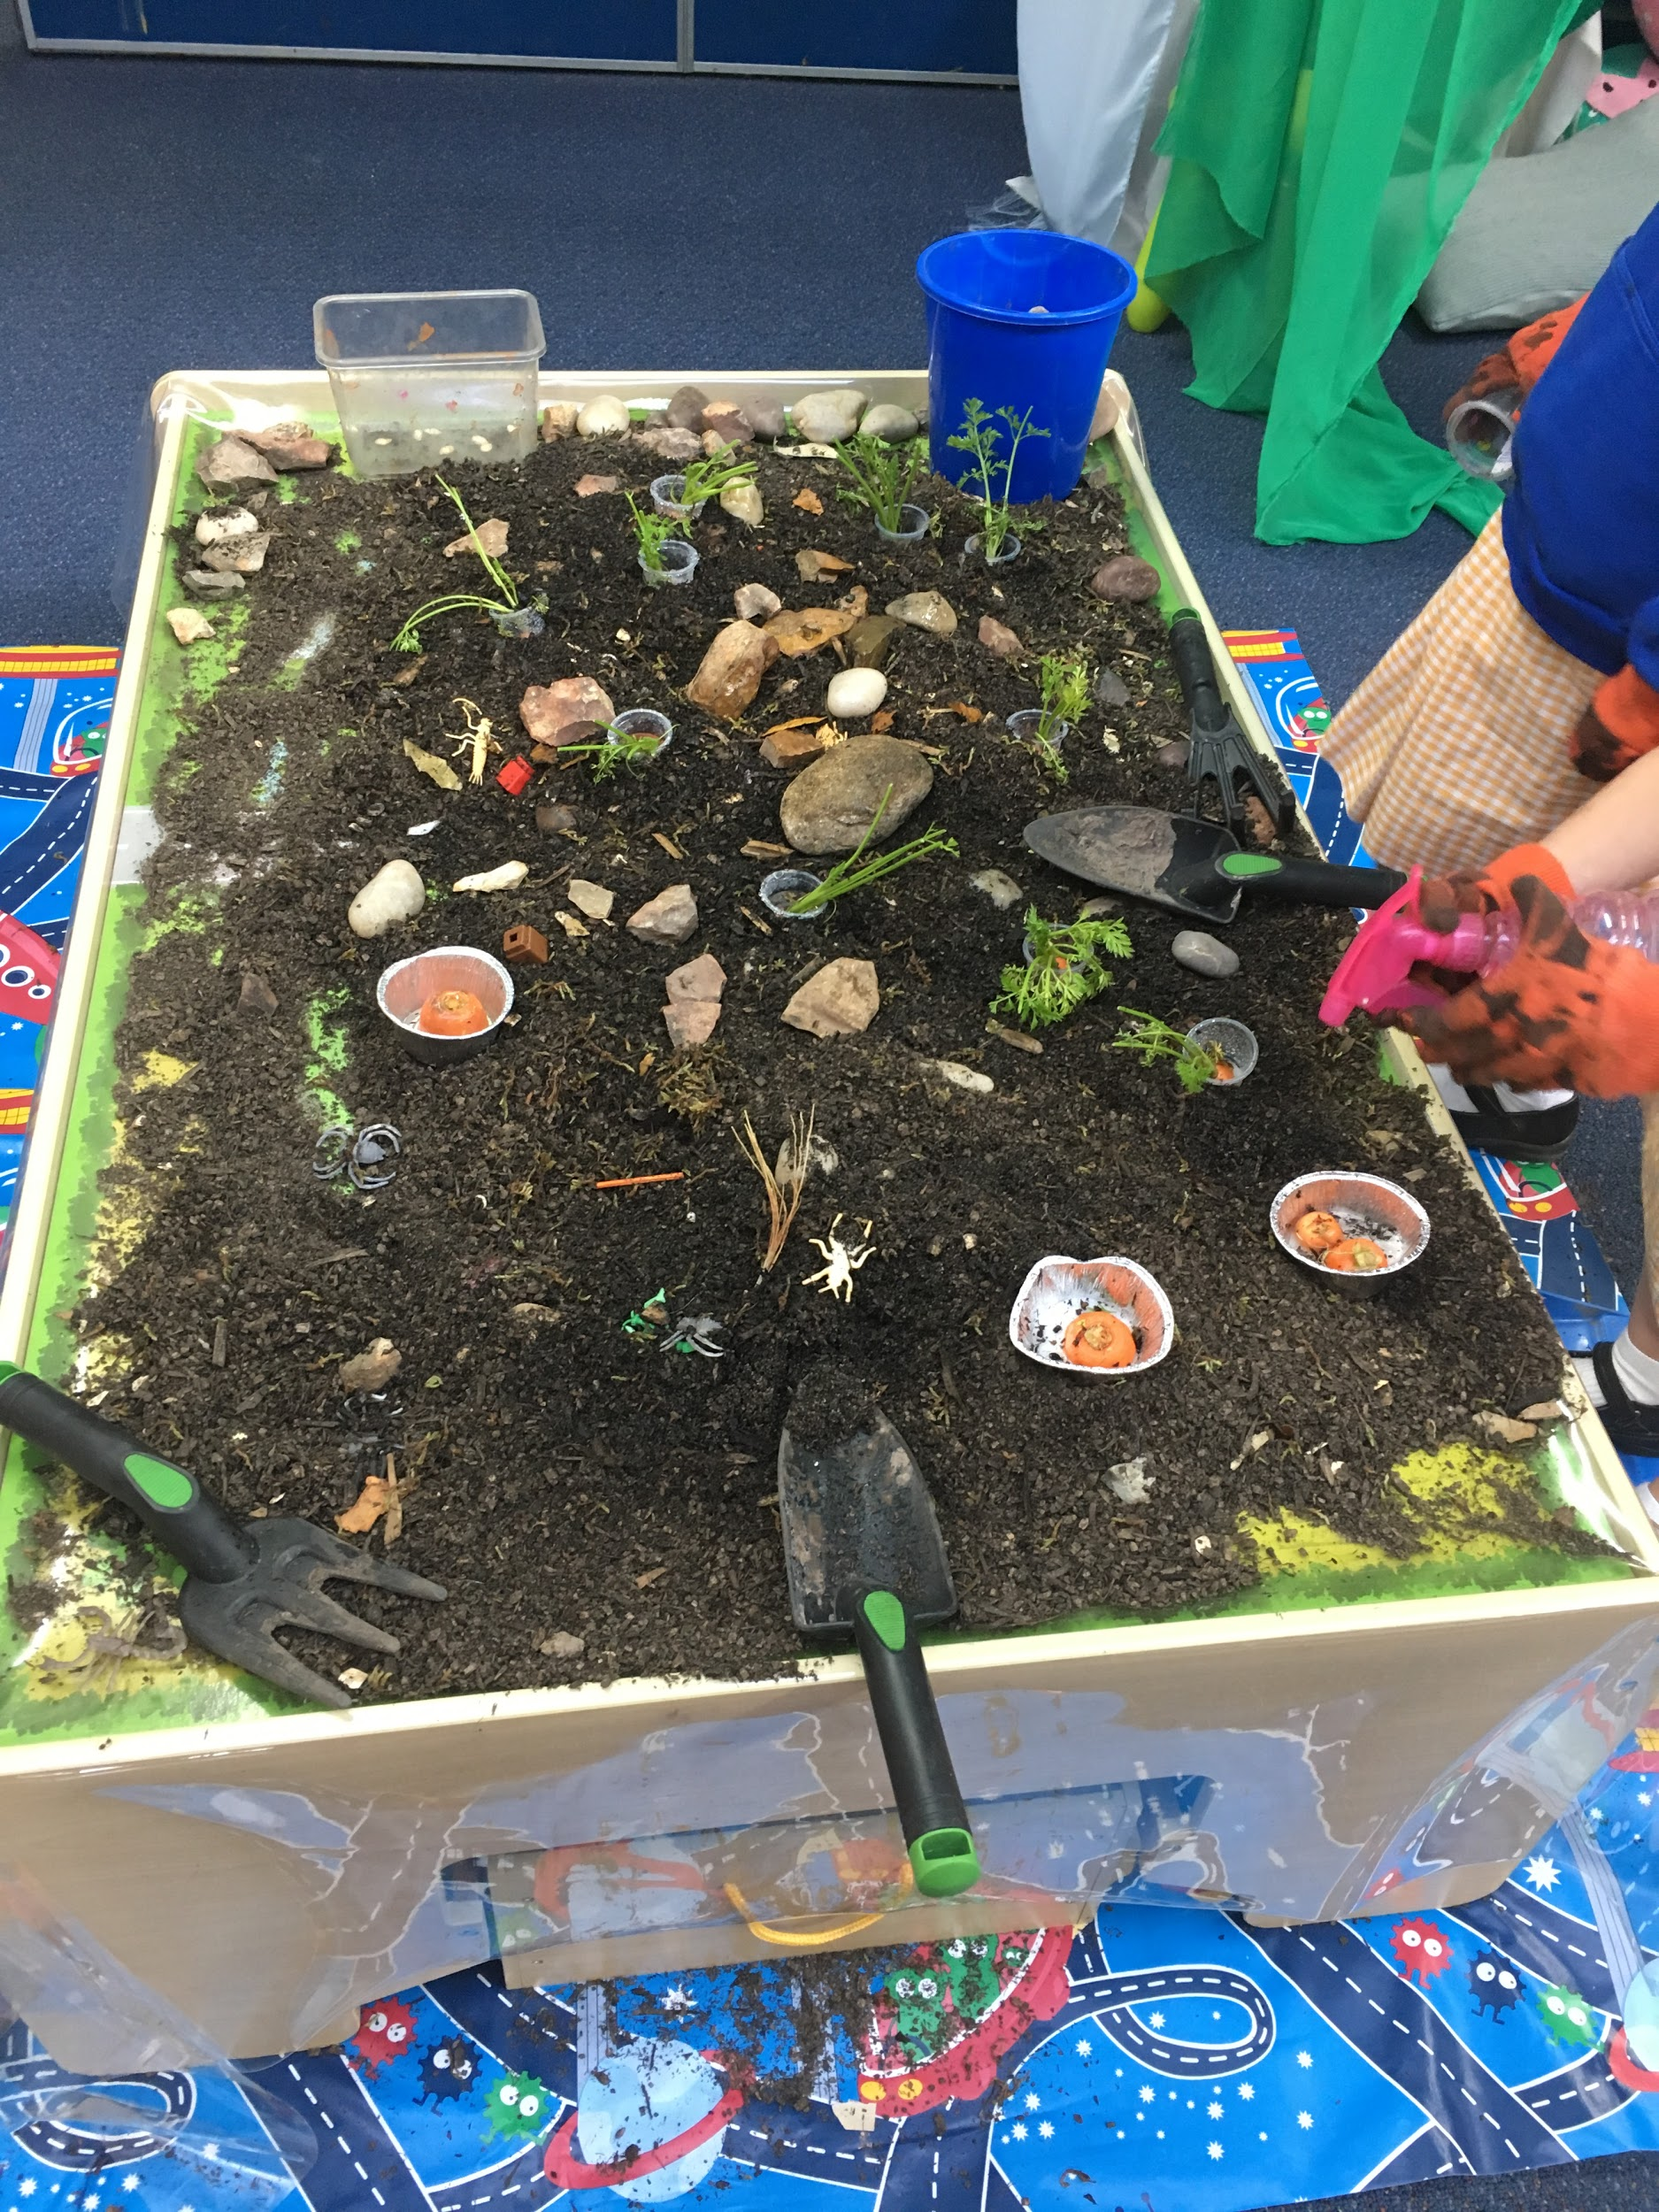
Which of these topics are the best introduction to school for 5 year olds?
Welcome to our Wonder World
Me at School

Slide 4
What is the Discovery-based inquiry approach?

Slide 5
An approach to learning (not a program):
… that values the natural curiosity and individuality of young children.
… that values the prior knowledge, interests and experiences that young children bring with them to school
… that builds new experiences as a springboard for extending children’s curiosity and scaffolding further learning
… that is underpinned by 8 core principles and looks different in every school

Slide 6
Learning
Early Years Model-
Discovery-based inquiry
Inquiry investigations
Authentic opportunities for Literacy
Authentic opportunities for Mathematics
Discovery
The Frame

Slide 7
Principles that underpin the approach
Learning dispositions empower students
A pedagogy of inquiry
The power of play: a playful pedagogy
Integrated learning and teaching
Respect for the individual
The environment is the third teacher
Look, listen and learn, assessment for learning
Feedback enhances achievement

Slide 8
Learning dispositions empower students
Our job as teachers is not to ‘prepare’ kids for something; it is to help kids learn to prepare themselves for anything. A.J Juliani
The National Goals for Australian Schooling as outlined in the Melbourne Declaration (2008) identified 2 goals for Australian students. Goal 2 is: All young Australians become successful learners, confident and creative individuals, and active and informed citizens.
Development of Australian (Victorian) Curriculum: General Capabilities
Education can equip learners with agency and a sense of purpose, and the competencies they need, to shape their own lives and contribute to the lives of others. (OECD The Future of Education and Skills 2018)
We believe: teaching students ‘how to’ learn and developing learning dispositions that will empower them to become self-motivated, self-managing learners

Slide 9
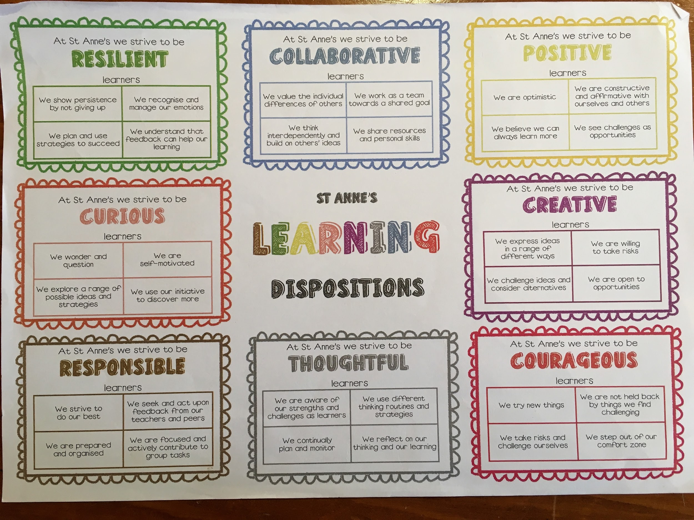
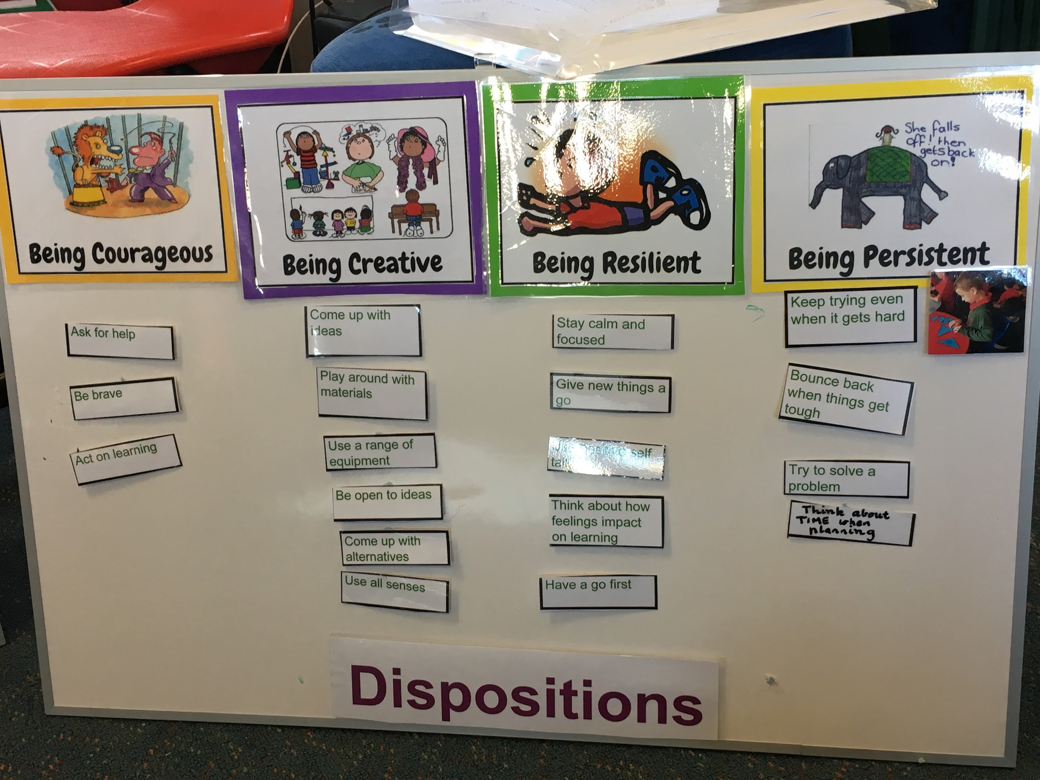
Guy Claxton calls it ‘Learning Power’ Art Costa calls them ‘Habits of Mind’ Carol Dweck’s ‘Growth Mindset’ is infused with learning dispositions.
Dispositions are mentioned as key learning in the VEYLDF, and the Australian Curriculum.
ACER through the Centre for Assessment Reform and Innovation is currently working on the development of scales for assessing and monitoring growth and improvement in general capabilities.
There is an overwhelming body of thinking that dispositions can be encouraged and developed through explicit teaching and feedback.

Slide 10
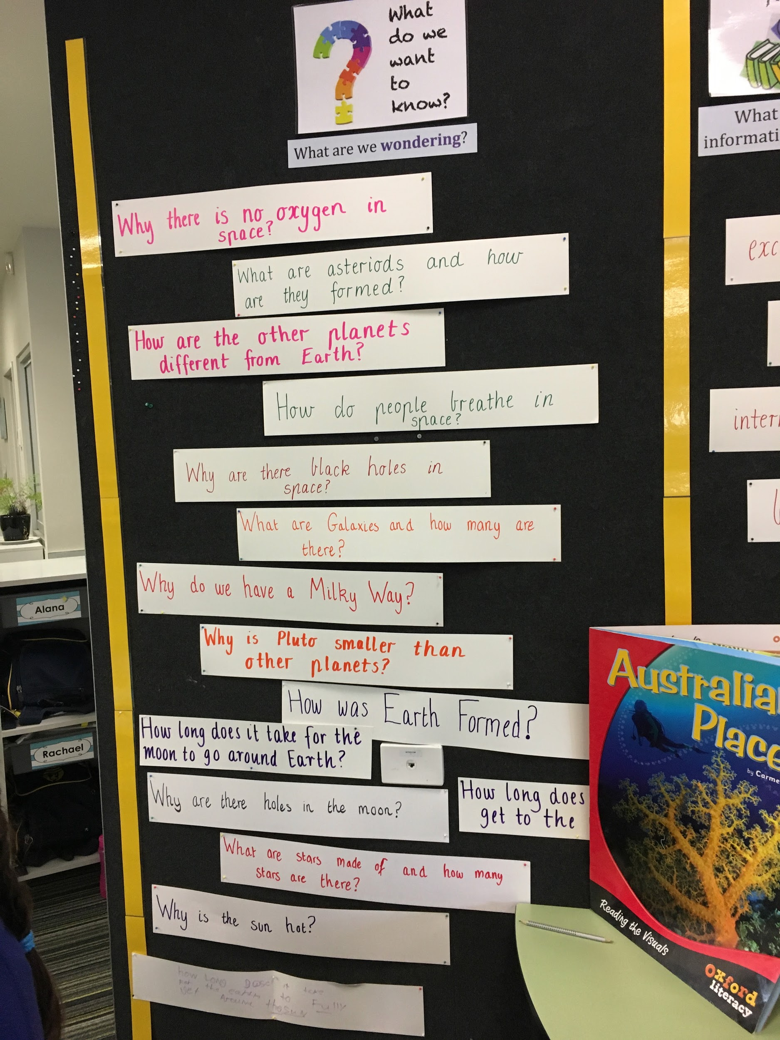
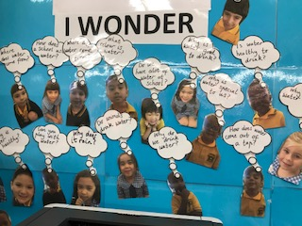
A pedagogy of inquiry
If you can light the spark of curiosity in a child, they will learn without any further assistance, very often. Children are natural learners. Sir Ken Robinson
Giving purpose to learning, harnessing children’s natural curiosity, creating wonder and awe, questioning and seeking answers enables students to construct new knowledge in a way that is meaningful
… a growing body of research suggests that students learn more deeply and perform better on complex tasks if they have the opportunity to engage in more “authentic” learning (Edutopia: Teaching for meaningful learning)

Slide 11
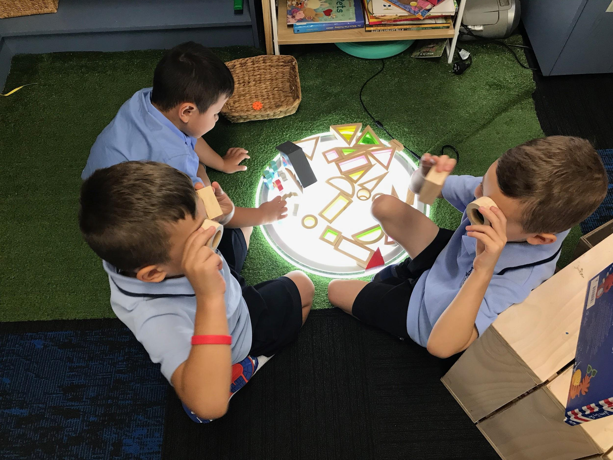
The power of play: a playful pedagogy
Play is a powerful context for early inquiry. Through play children can engage in exploring and making discoveries about:
Themselves, their identity as a person and a learner and as a social being
Living in community with others
The amazing world they live in
‘Being playful’ as a disposition when exploring, testing out ideas and working theories in a safe and familiar context, making choices without fear of failure.
Play is the highest form of research. Albert Einstein We believe that learning should be joyful and playful

Slide 12
So what does this look like in action?

Slide 13
Inquiry Investigations
Teacher-initiated
Starts with a real experience
Opportunities for students to explore their ideas and theories and own interests
Student wonderings inform the direction the investigation
Explicit teaching of inquiry skills and processes
We want to give our students time to explore what intrigues them, and we want to make sure they visit the important sites they might miss without guidance. Teachers need to map out the landscape and highlight some of the most important places to stop.
Tina Blythe.

Slide 14
Inquiry investigation into community- Reservoir
CONCEPTS: Community, place, needs and wants
UNDERSTANDINGS:
People belong to different communities where they live and work to keep others safe and happy. There are different places in each community that fulfill our needs and wants.
Different materials have different purposes and ways of working together; designers can manipulate materials to create a product.
QUESTIONS
What is a community?
What does our community look like?
Who lives and works in our community?
Why do we have different places in the community?
What are the different materials designers can use and how can they use them?
How can we design and create our own community?

Slide 15
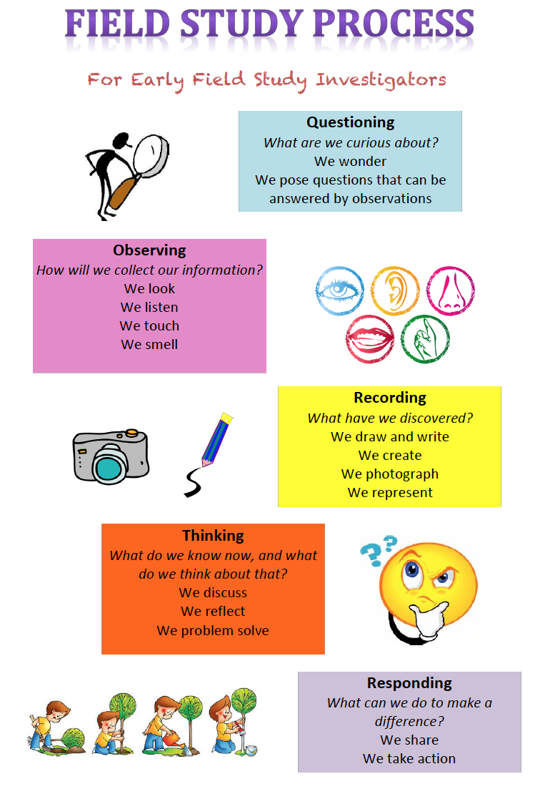
Preparing for the SHARED EXPERIENCE
Prior Knowledge Gathering
1st 2nd 3rd Thinking
Introduction of the Field Study Process
What makes up our school community?

Slide 16
Shared Experience
A walk around the local community to investigate the shops and services available and the people who work there
Explicit use of Field Study Process Skills by the students
What does our community look like?
Who lives and works in our community?

Slide 17
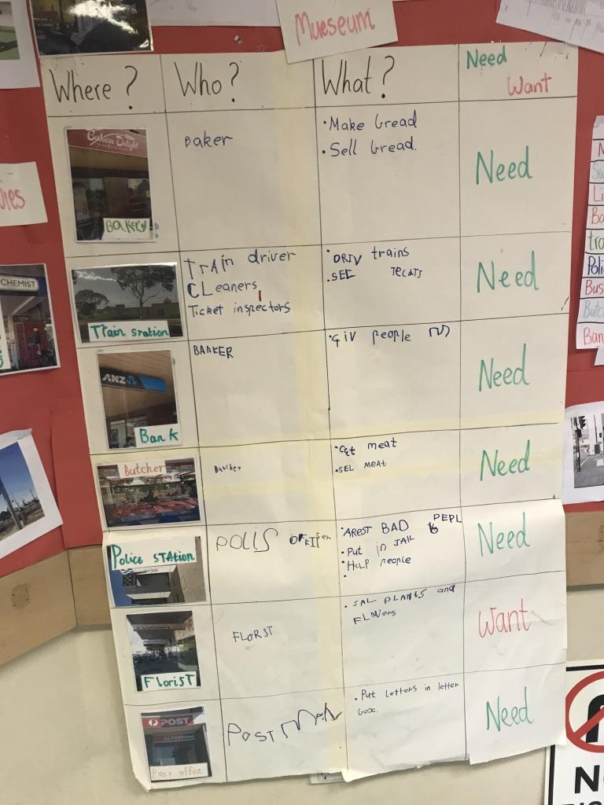
Processing the experience
Shared creation of Class Data chart to sort findings and information
Literacy Opportunities
Photographs from the Field Study were shared with the students as a picture chat - key vocabulary discussed and recorded
Students wrote about the experience
1st 2nd 3rd Thinking

Slide 18
Processing the Experience
I wonder…
How much bread the baker makes in a day?
How many people live in this community?
How the train stops?
How much money it costs to buy meat at the butcher?
How many police officers work at the station?
What the police car has inside it?
How the siren on the police car works?
How many bad guys are at the police station?
Further Inquiry
Students share what they Discovered and what they are wondering…
I discovered…
A flower shop is called a florist
People take money out of the bank
A meat shop is called a Butcher
Cars slow down and stop for people at a crossing
There is a library in our community

Slide 19
Teacher initiated question
Why do we have different places in the community?
Introduce idea of needs and wants
Complete last column of data chart
Findings: most of these services meet our needs - what else does our community have that meets our wants?
How can we find out?

Slide 20
Further Inquiry
Another walk to investigate WANTS - students had also written thank you letters to the florist and baker and hand delivered them.
Some of the students were able to research their wondering e.g. how much bread does the baker make each day?
Visit from the local police due to student interest and answer their wonderings

Slide 21
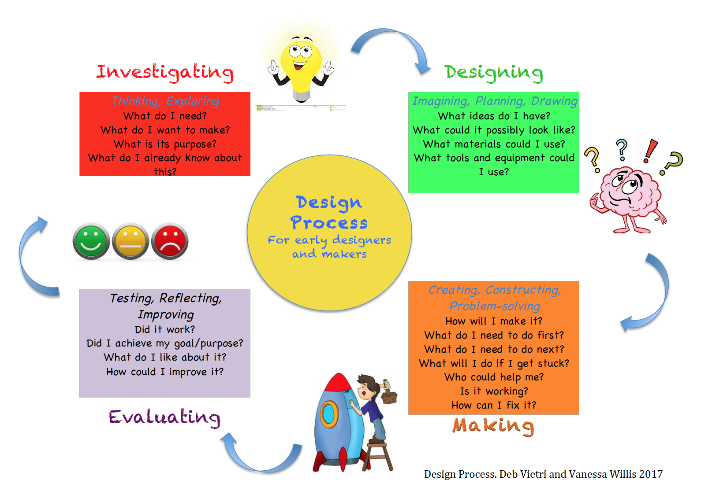
Applying the learning
What are the different materials designers use and how are they used?
How can we design and construct our own community?

Slide 22
Design Process
INVESTIGATING: What do you think we need in our community?
Class Brianstorm then voting process - most important - creating tallies and graphs (MATHS)
Surveying Year 1/2 students about wants - what is your favourite place in the community? (MATHS)
DESIGNING: Students chose an area and in small groups, designed what they wanted it to look like
Listed materials
Opportunity to investigate and play around with different materials and their properties - different joining materials etc

Slide 23
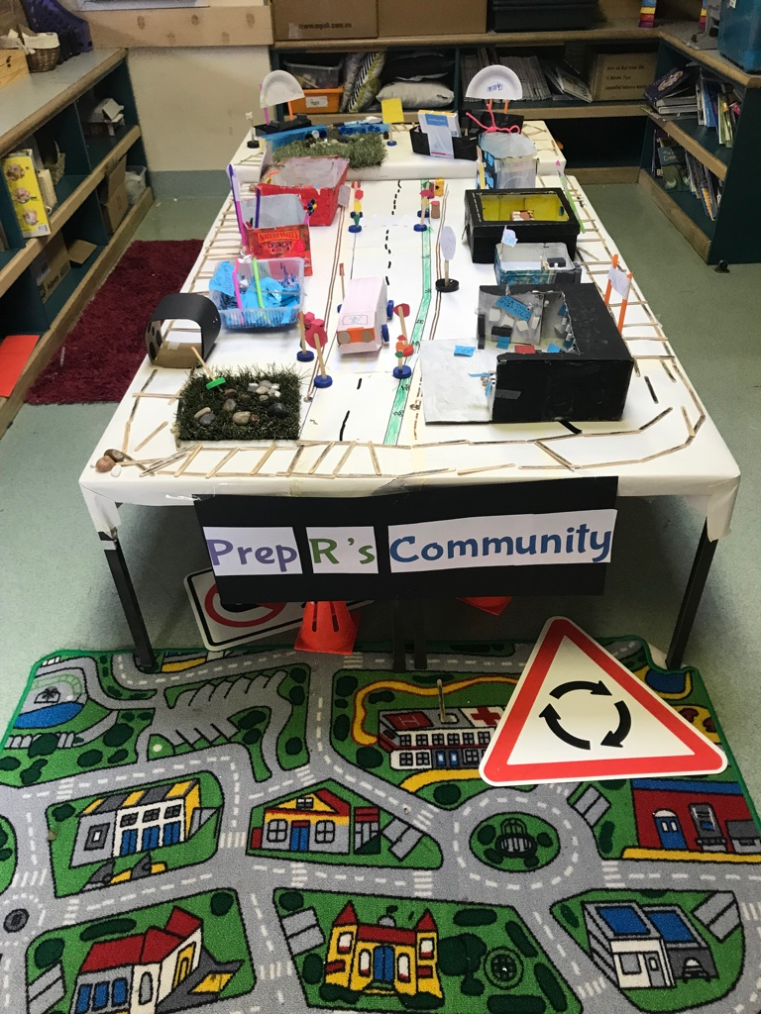
MAKING and EVALUATING
Creating Class Community and putting it together
What else do we need to consider?
Added paths, signs etc
Unveiled to the Year 1/2 students
Used for Role Play during Discovery
1st 2nd 3rd Thinking

Slide 24
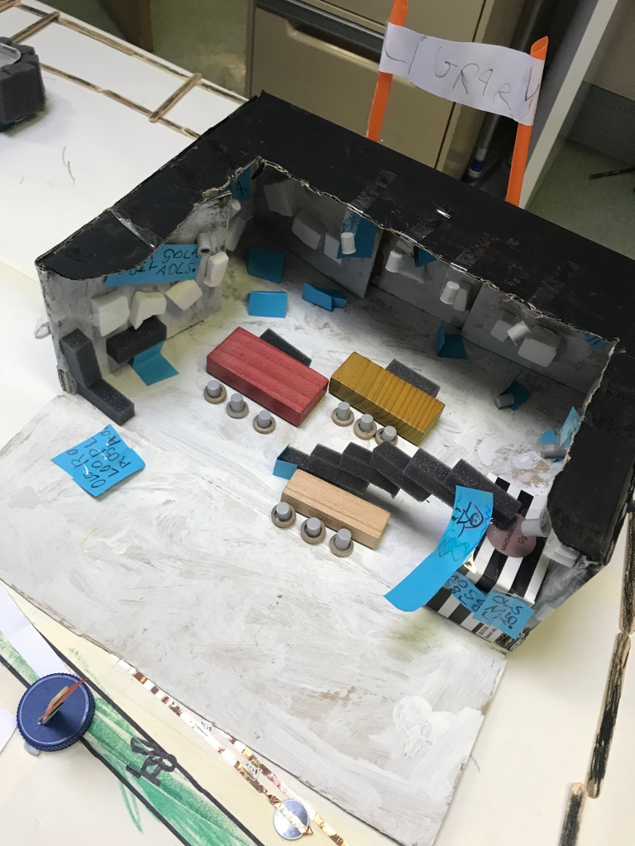
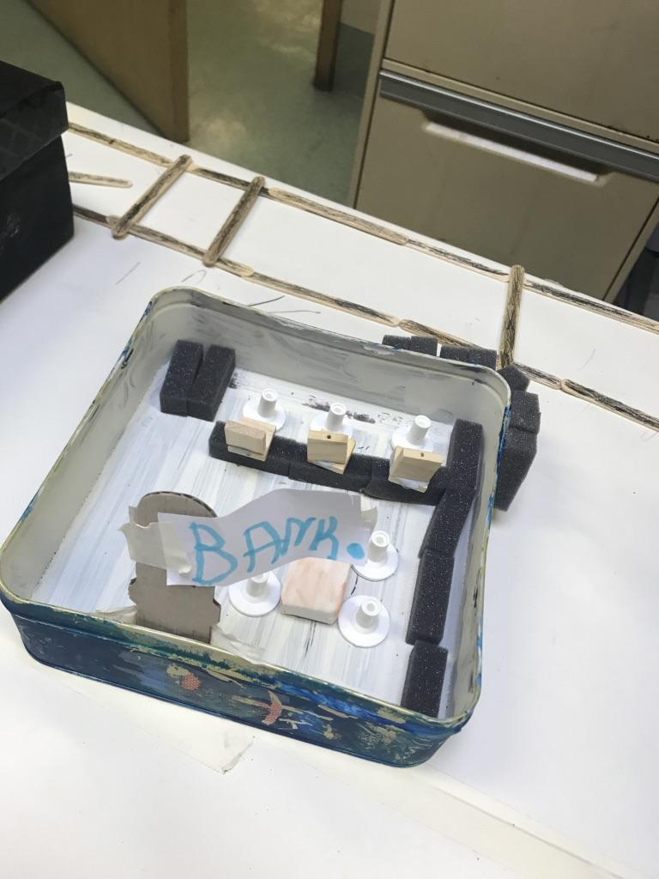

Slide 25
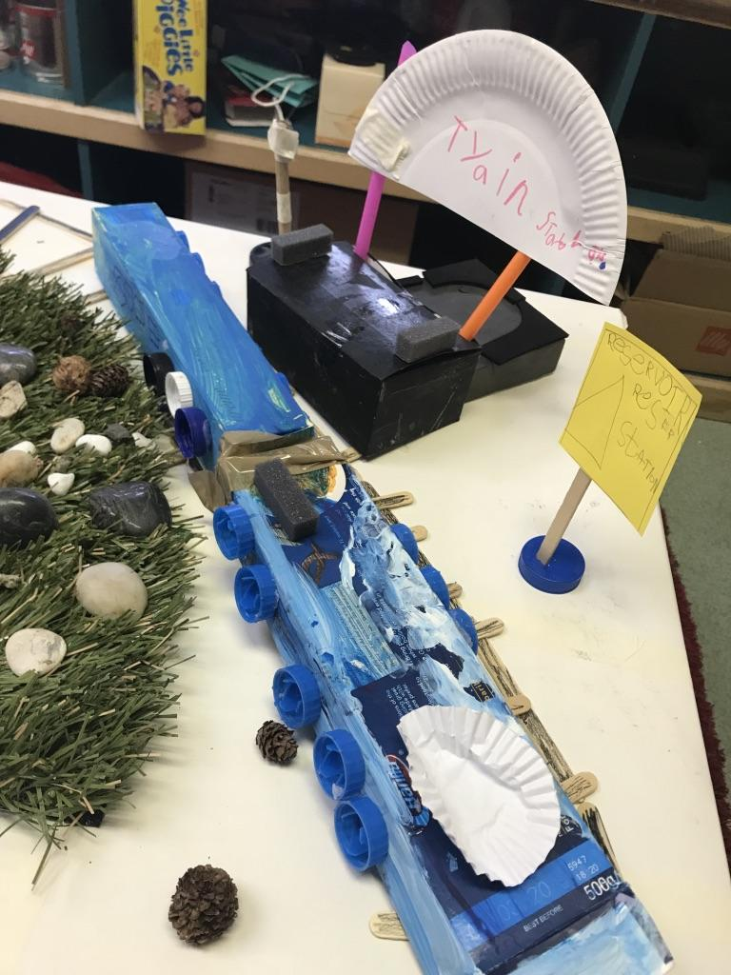
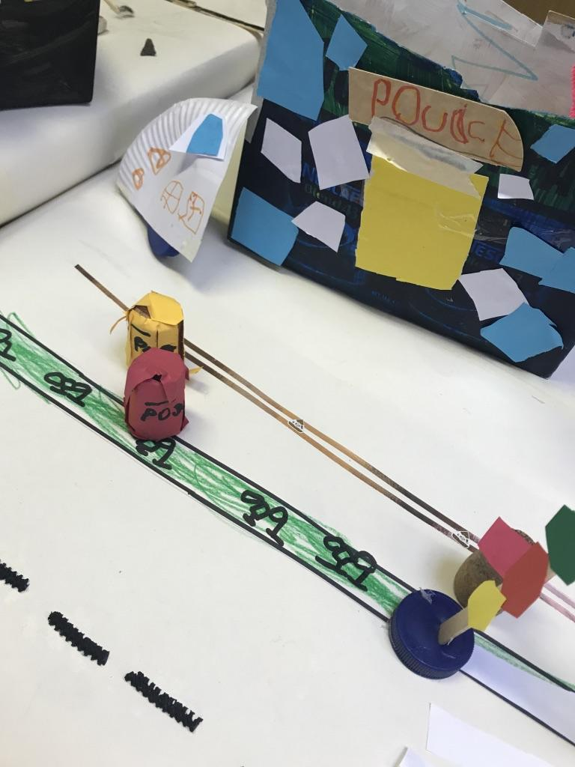

Slide 26
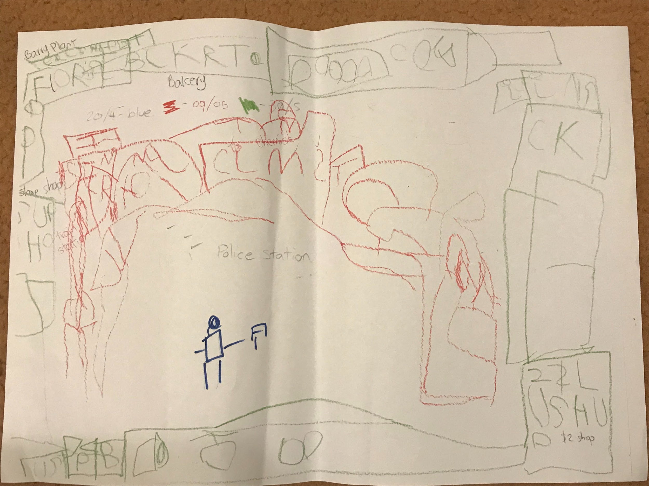
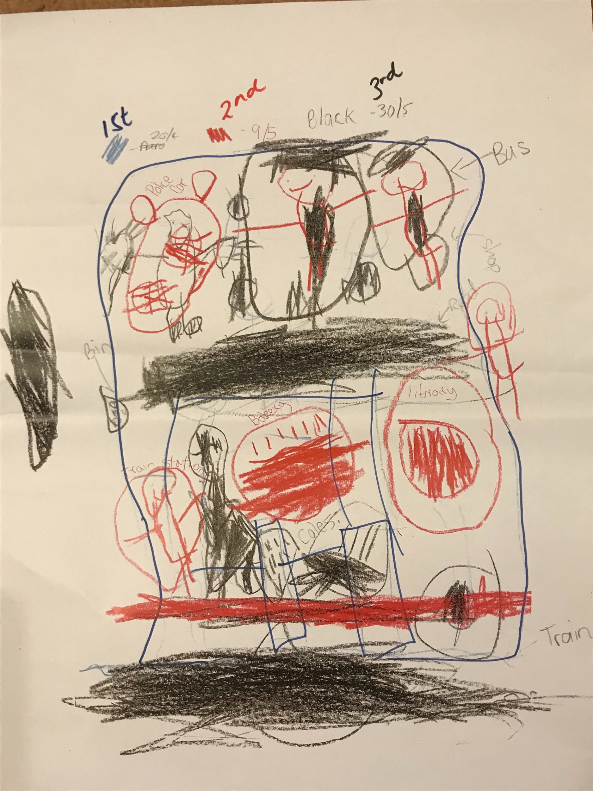
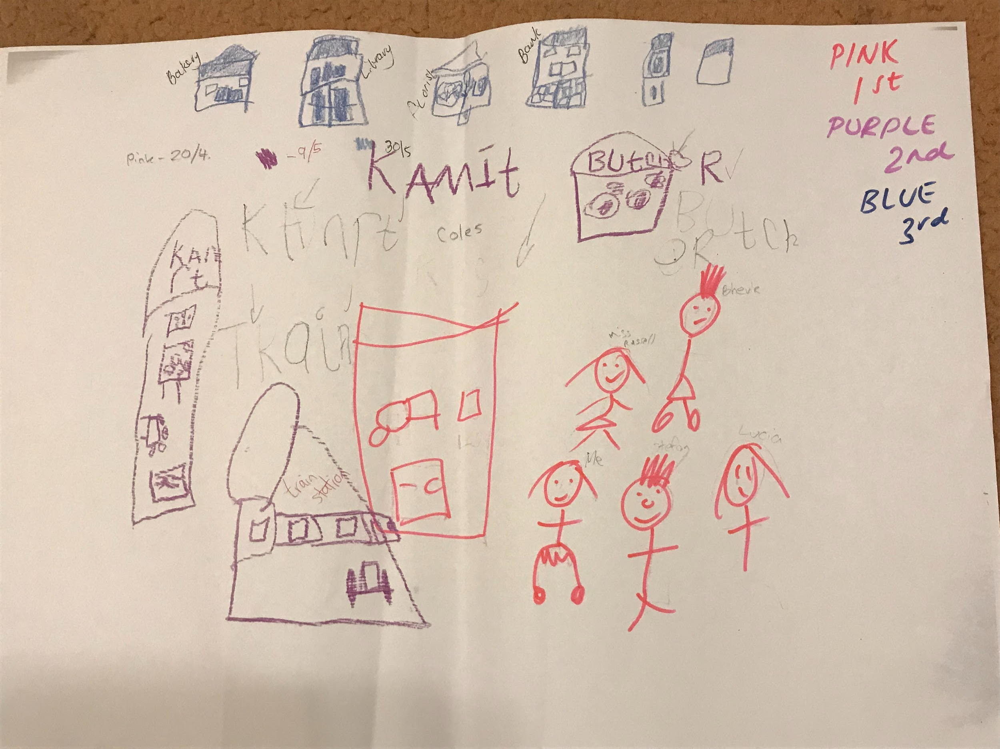

Slide 27
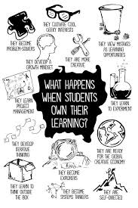
discovery
Student-initiated
Opportunities for students to explore the things that interest them
Play is the entry point
Leading towards student directed projects
Teachers play a strategic role
Learning journeys and learner dispositions are made visible

Slide 28
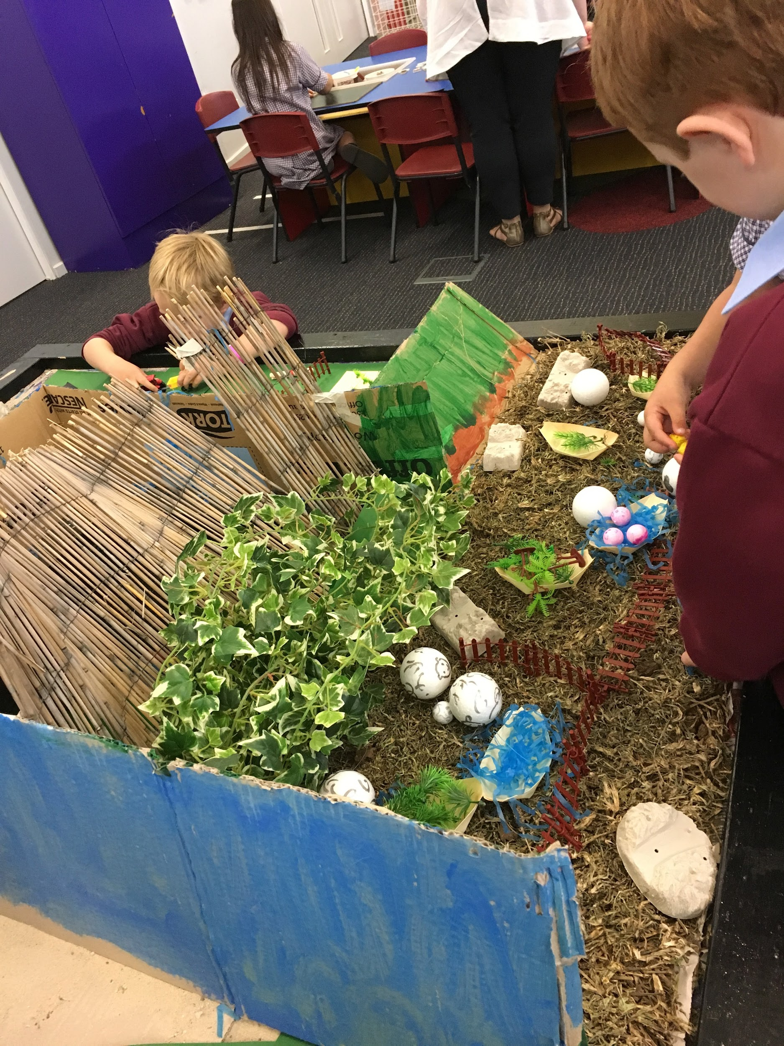
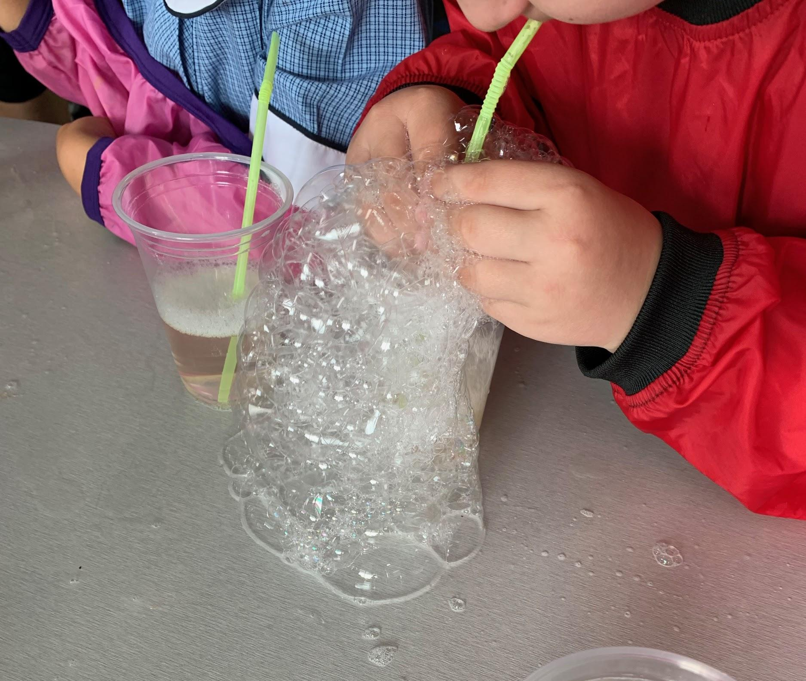
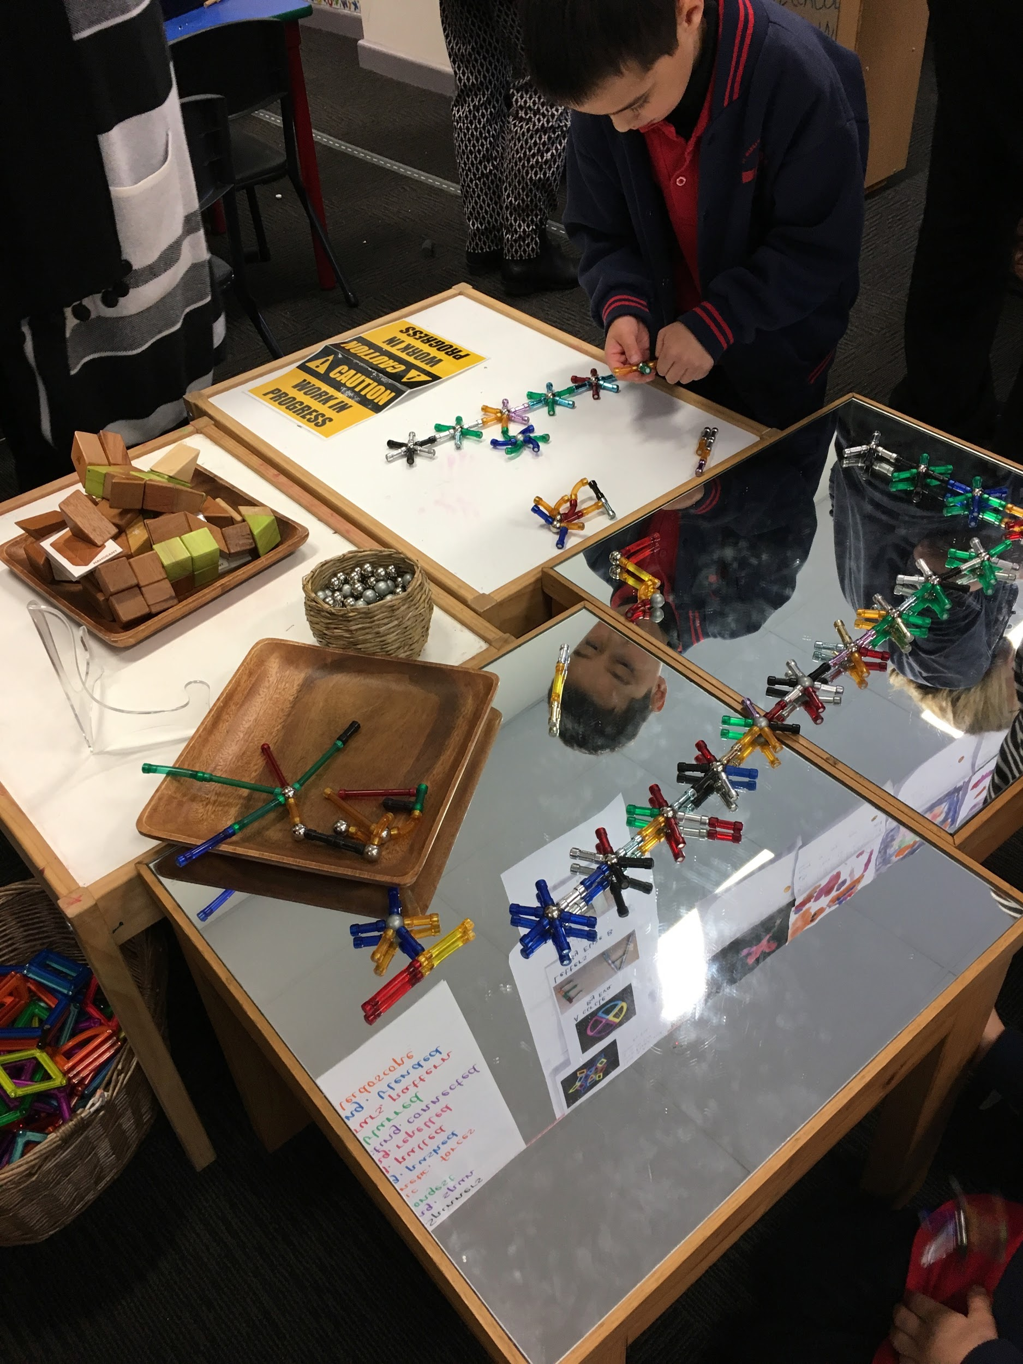
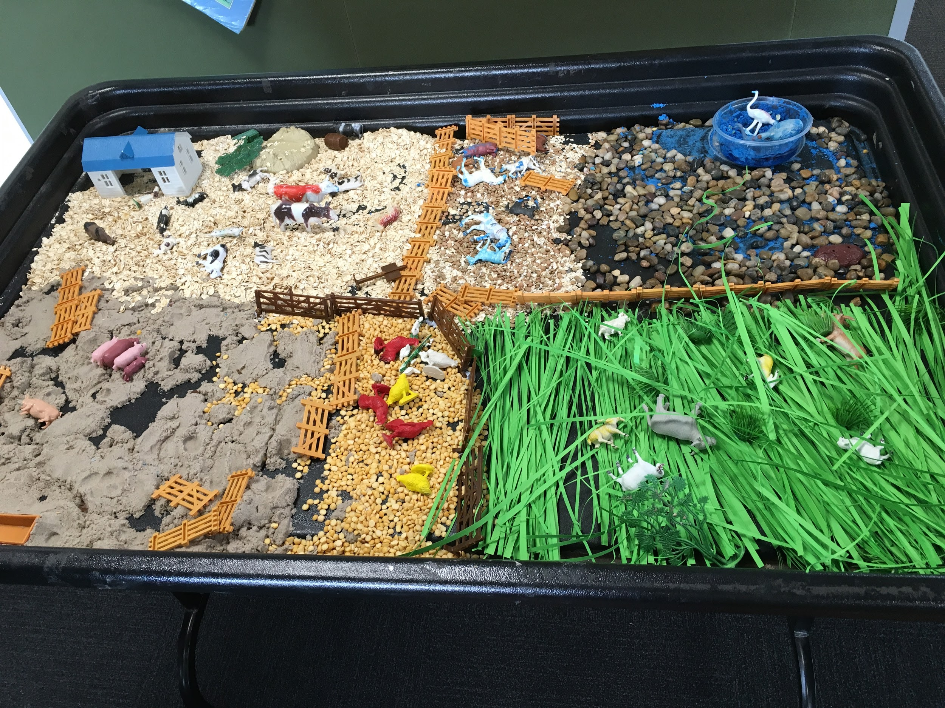
Using our senses to explore

Slide 29
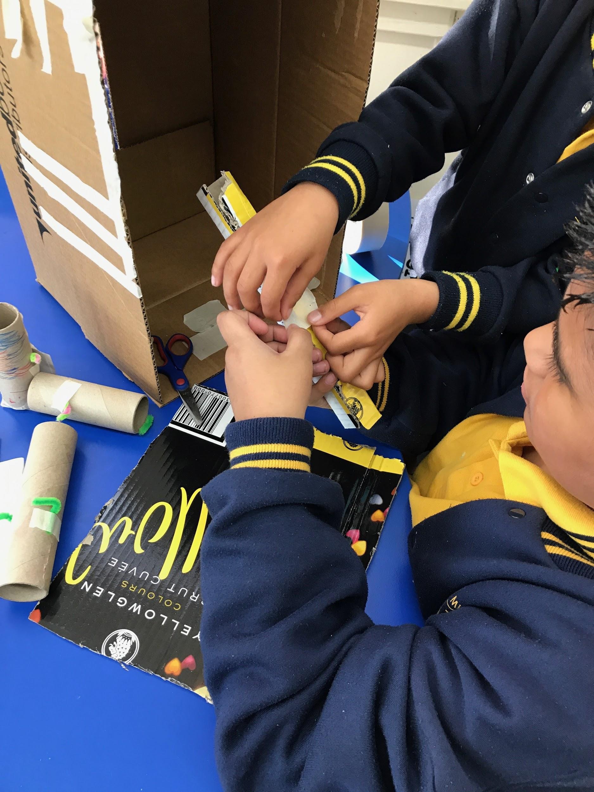
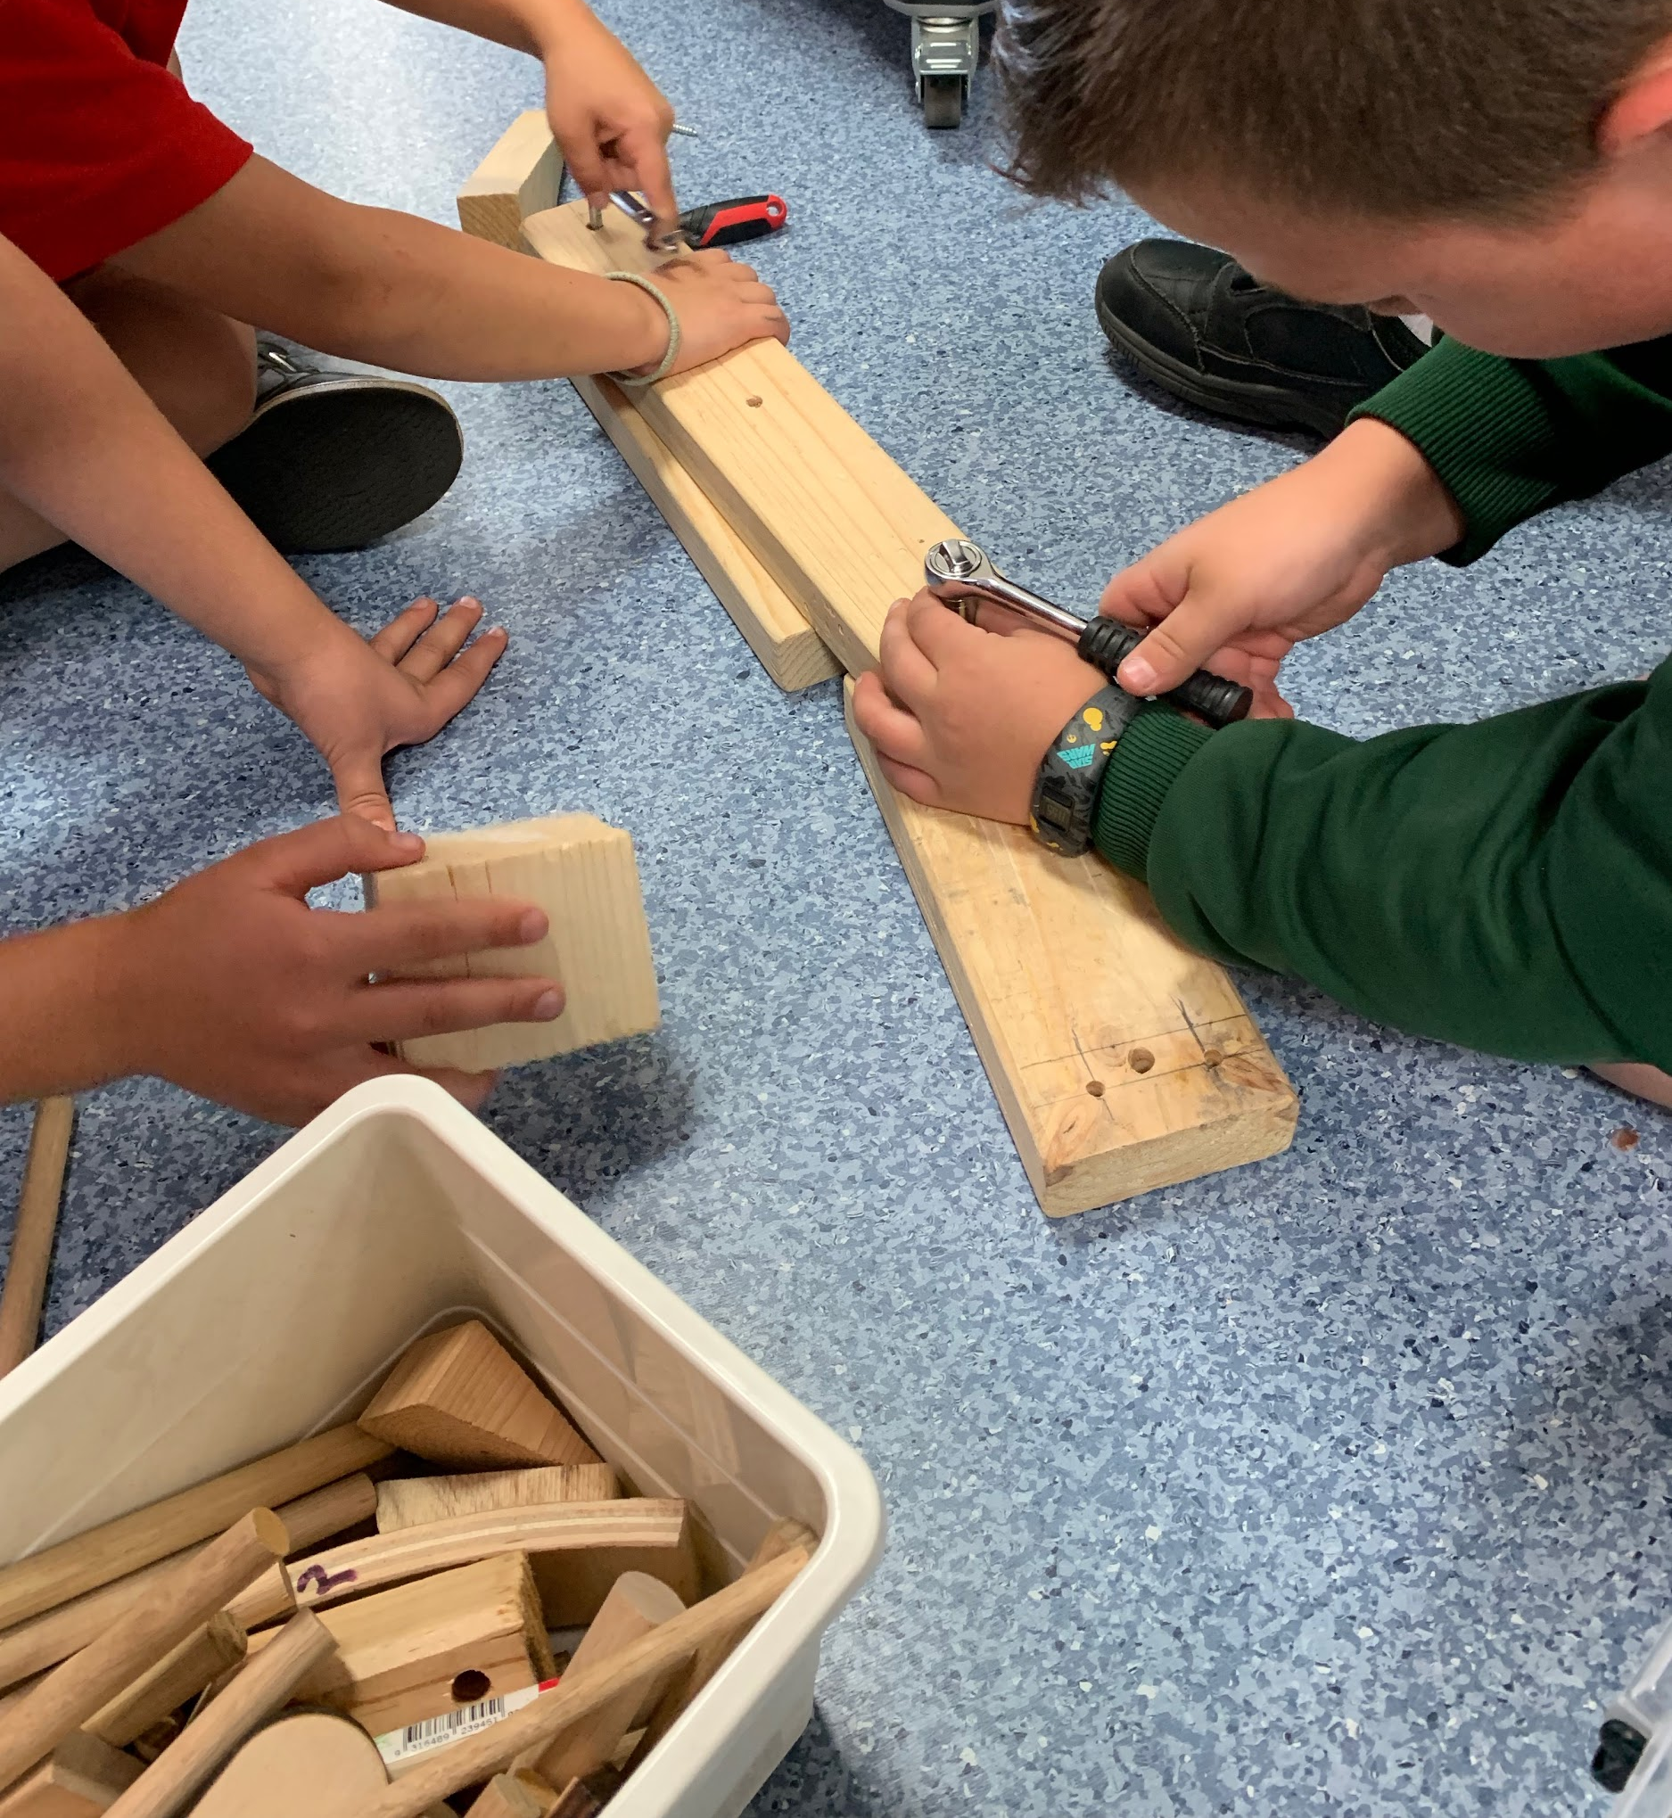
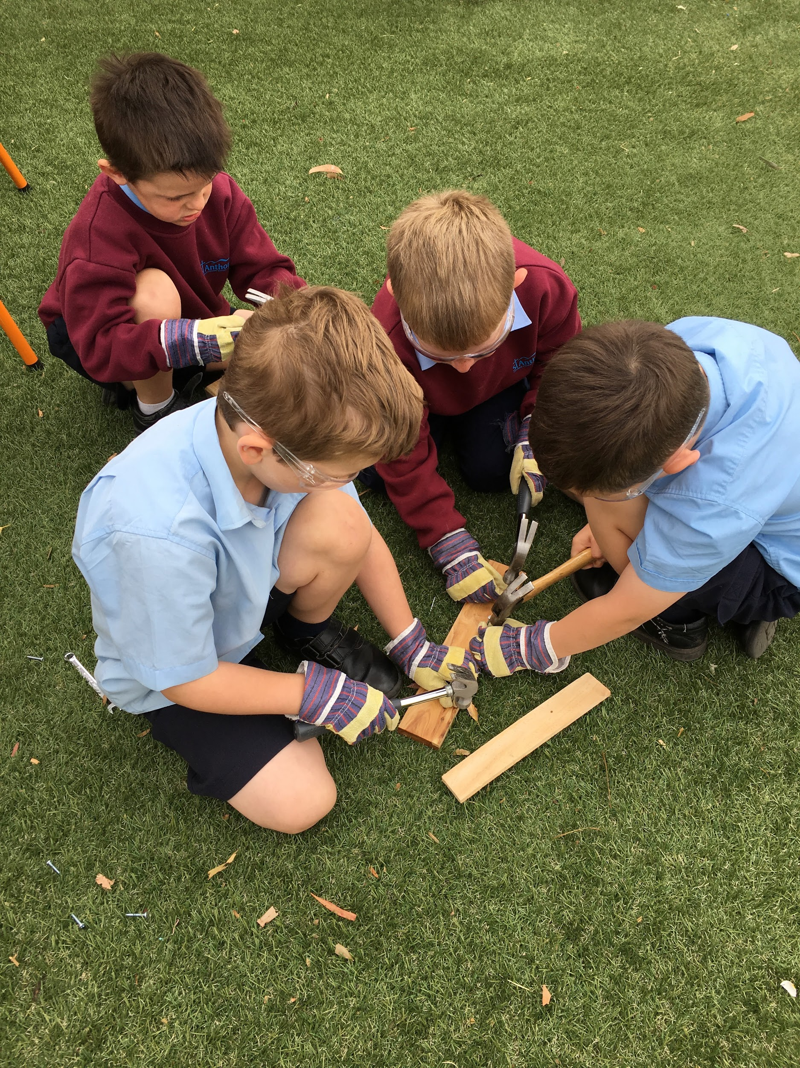
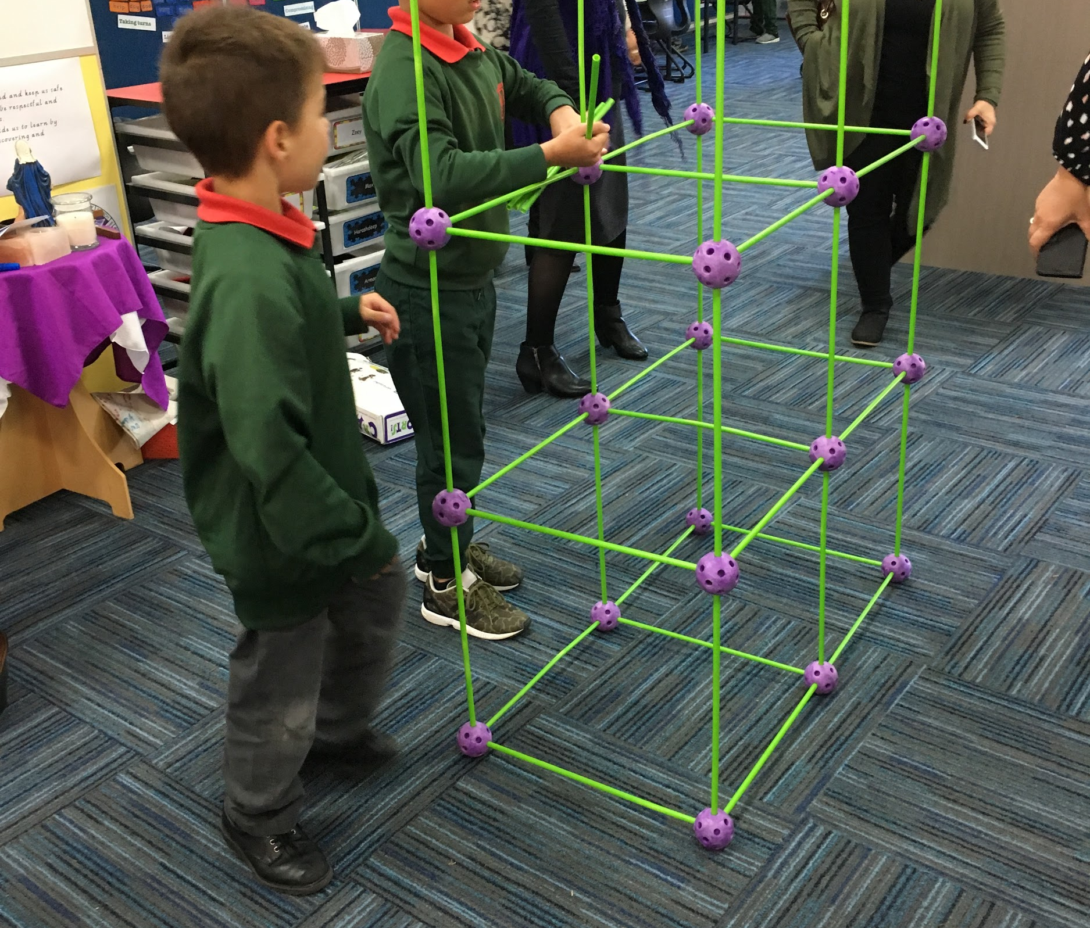
Designing, constructing and problem-solving

Slide 30
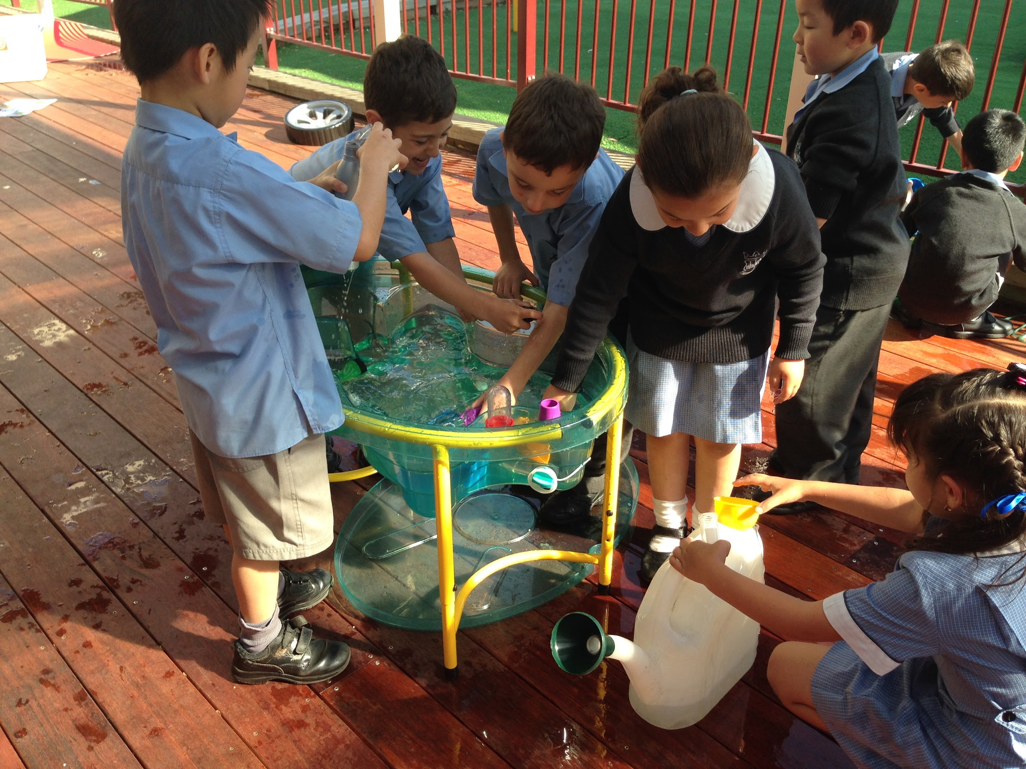
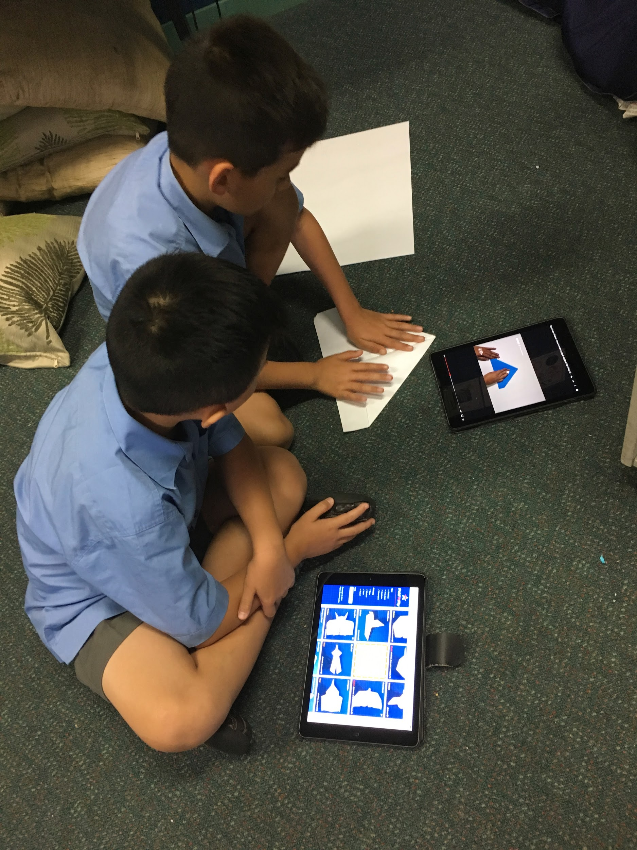
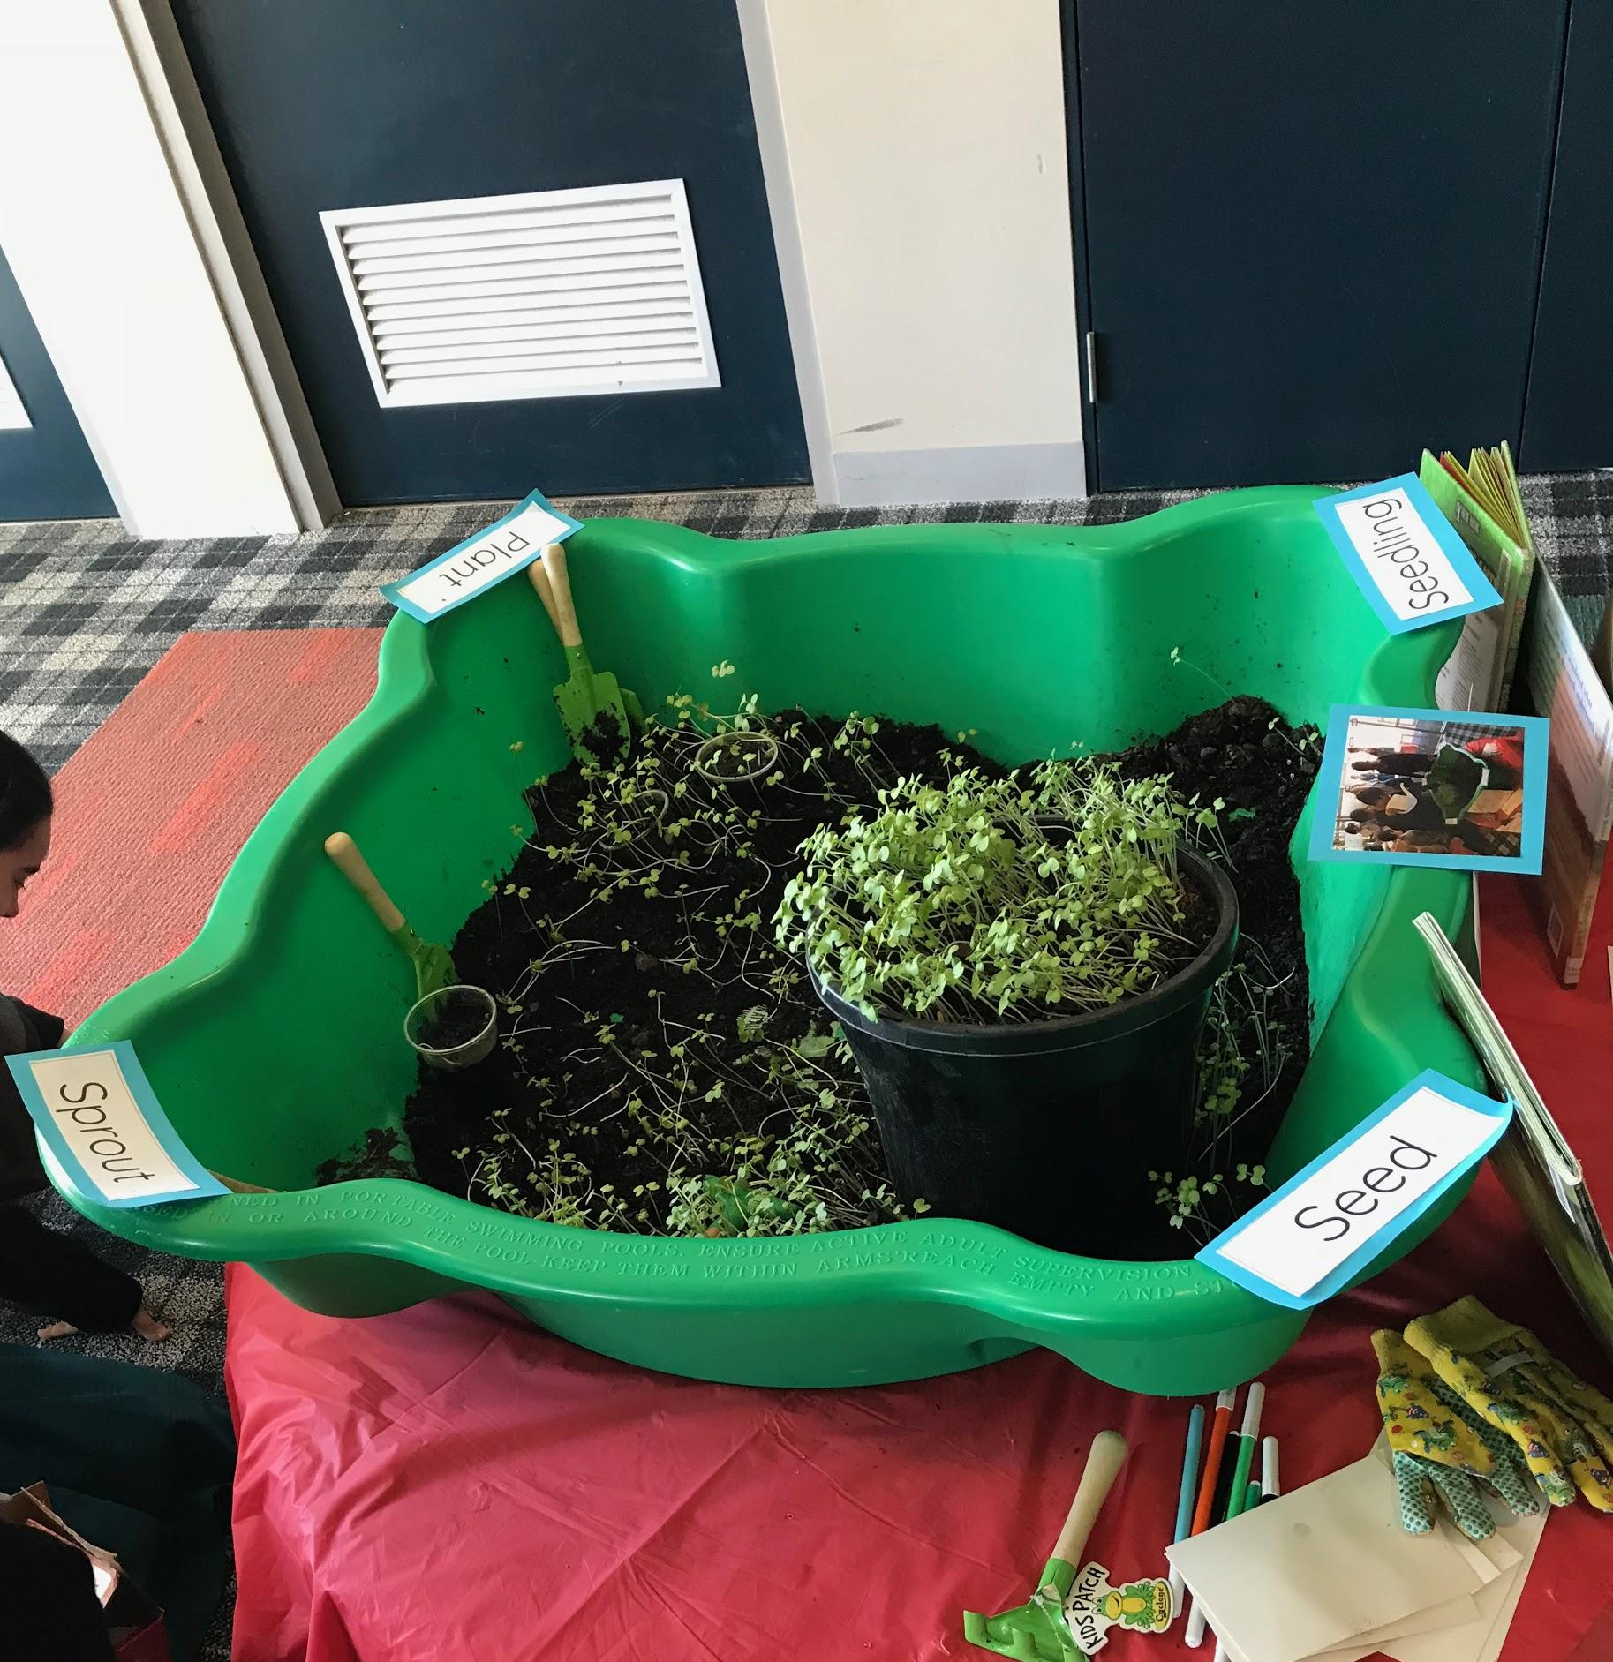
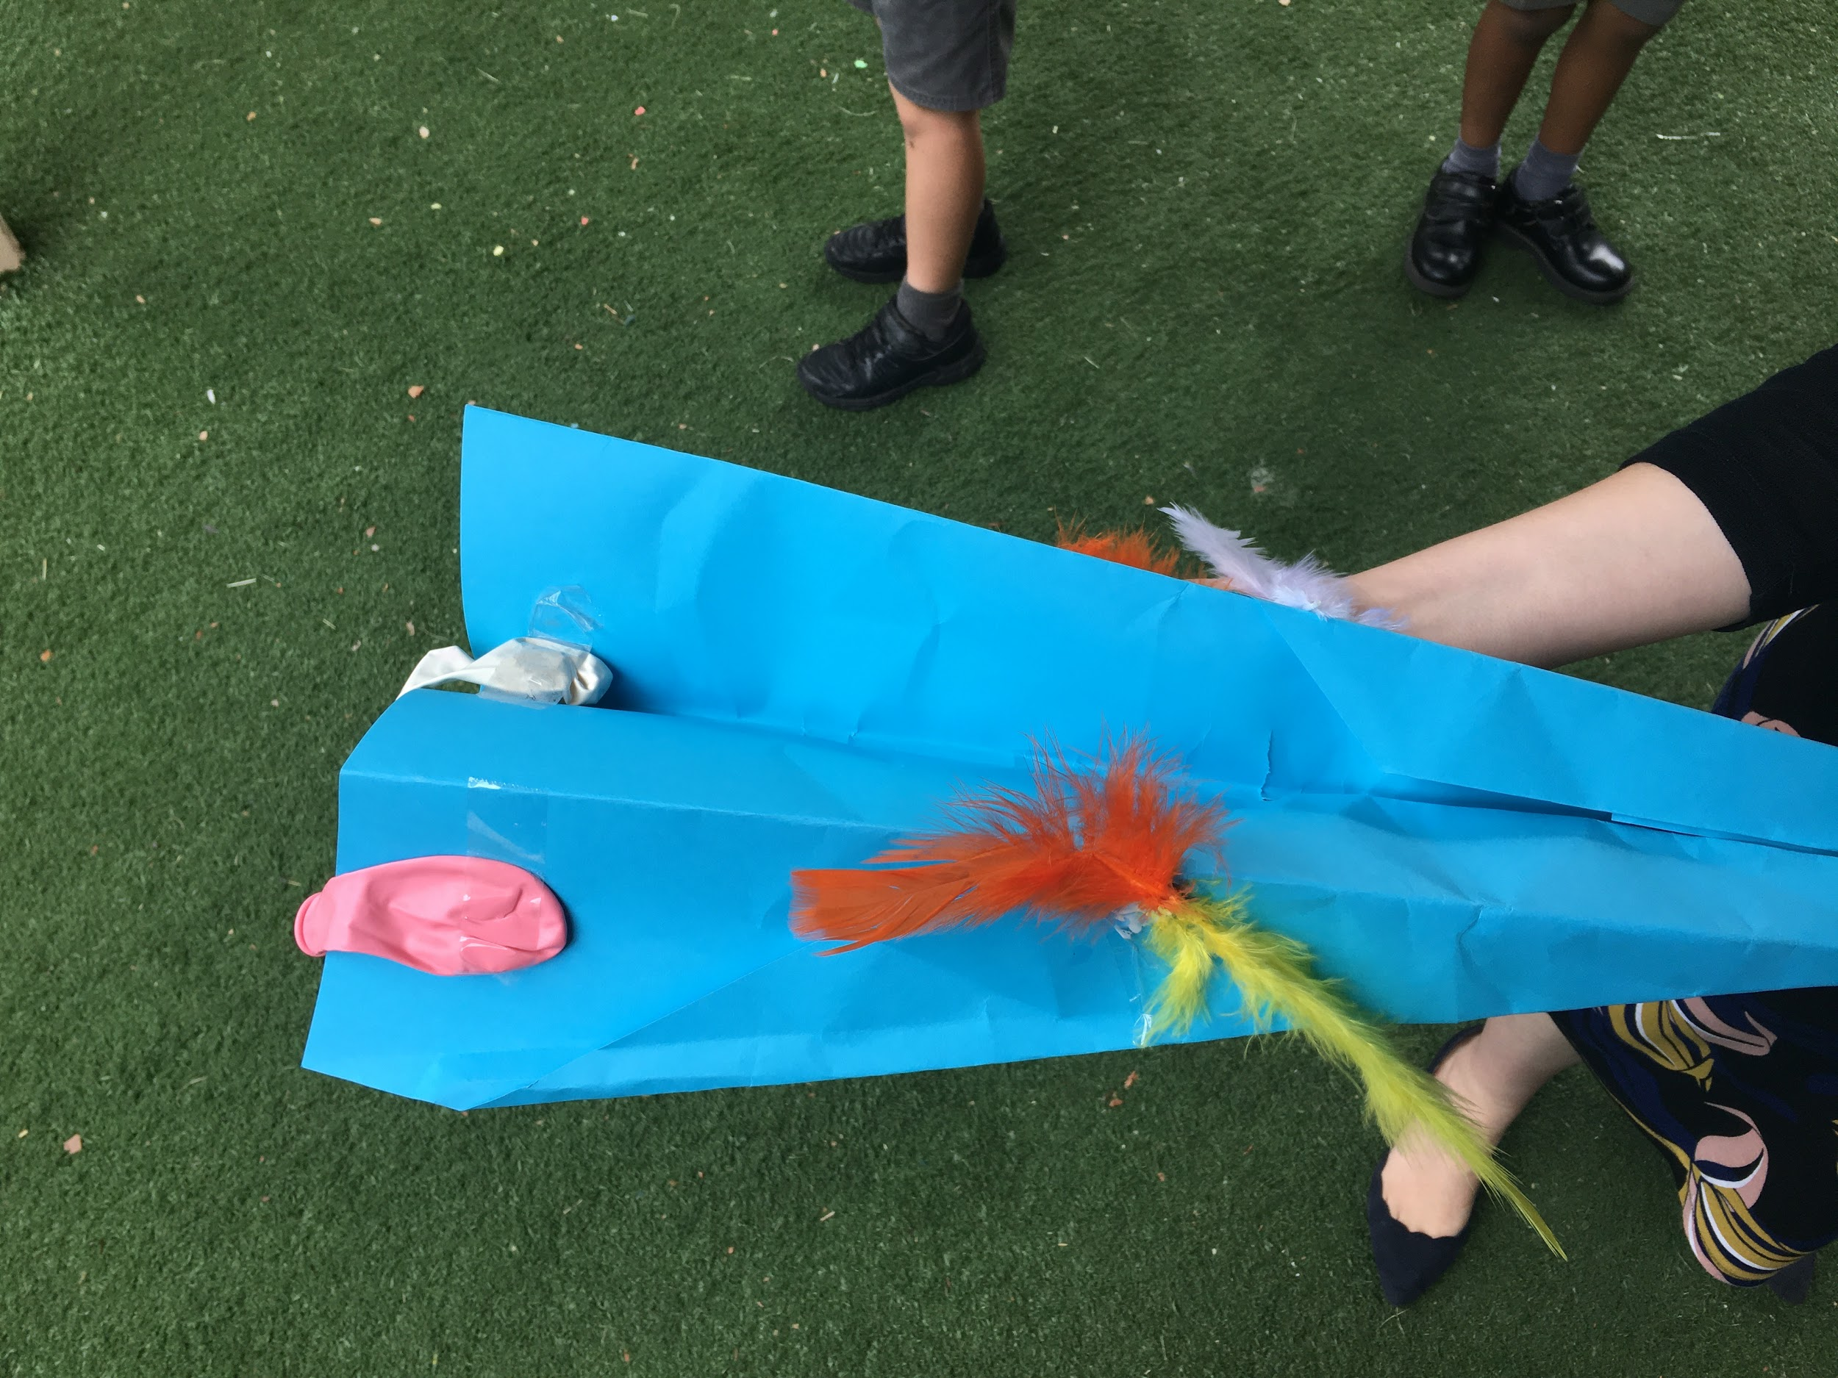
Researching and testing
like scientists

Slide 31
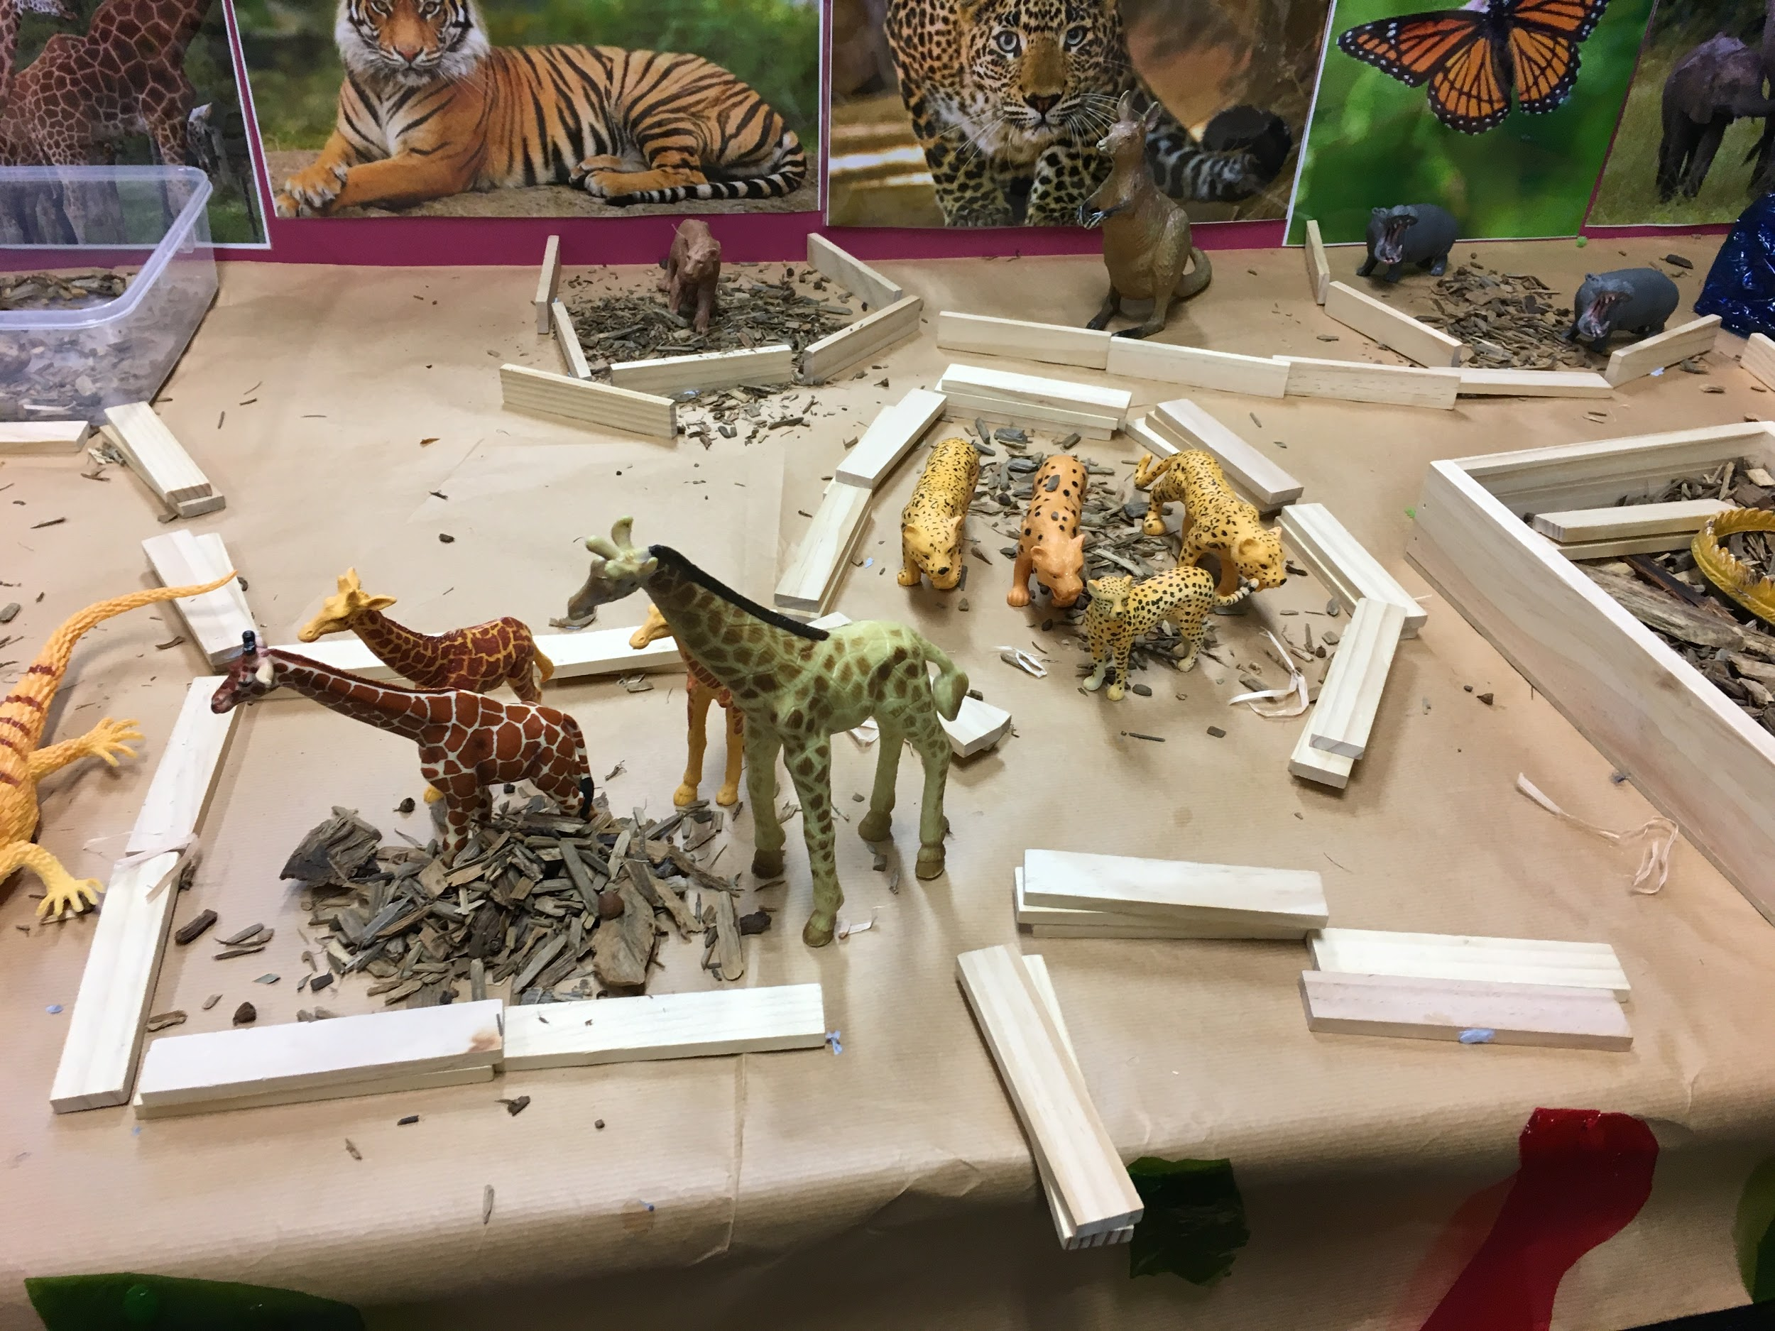
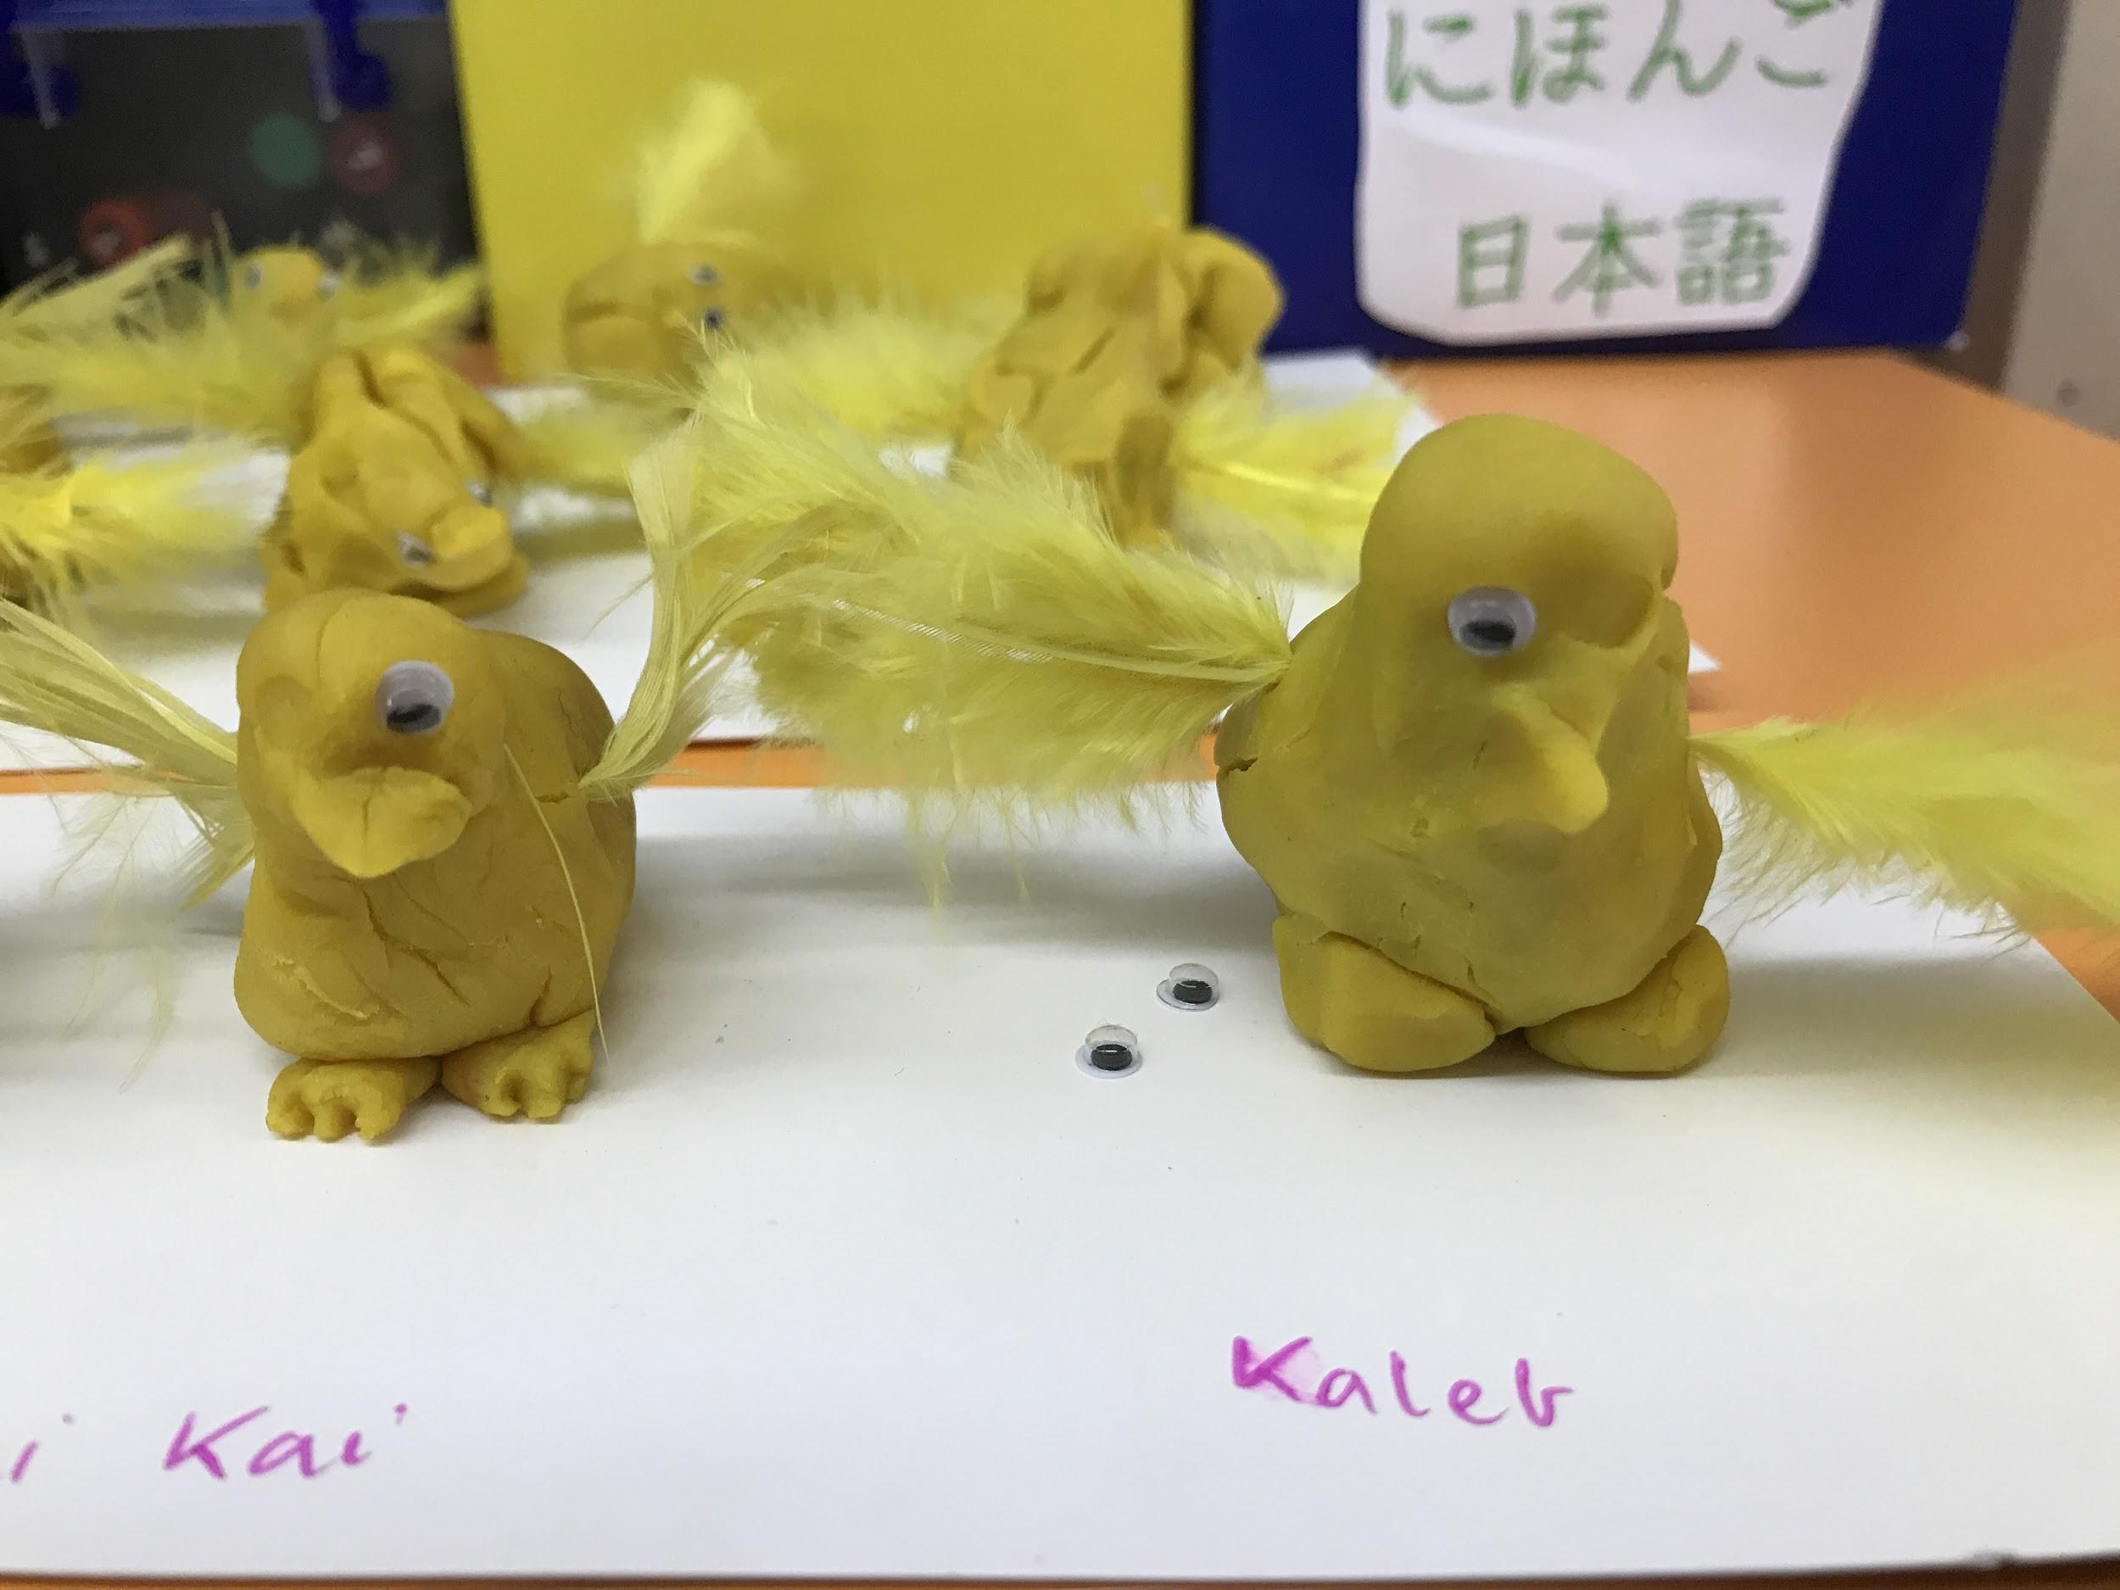
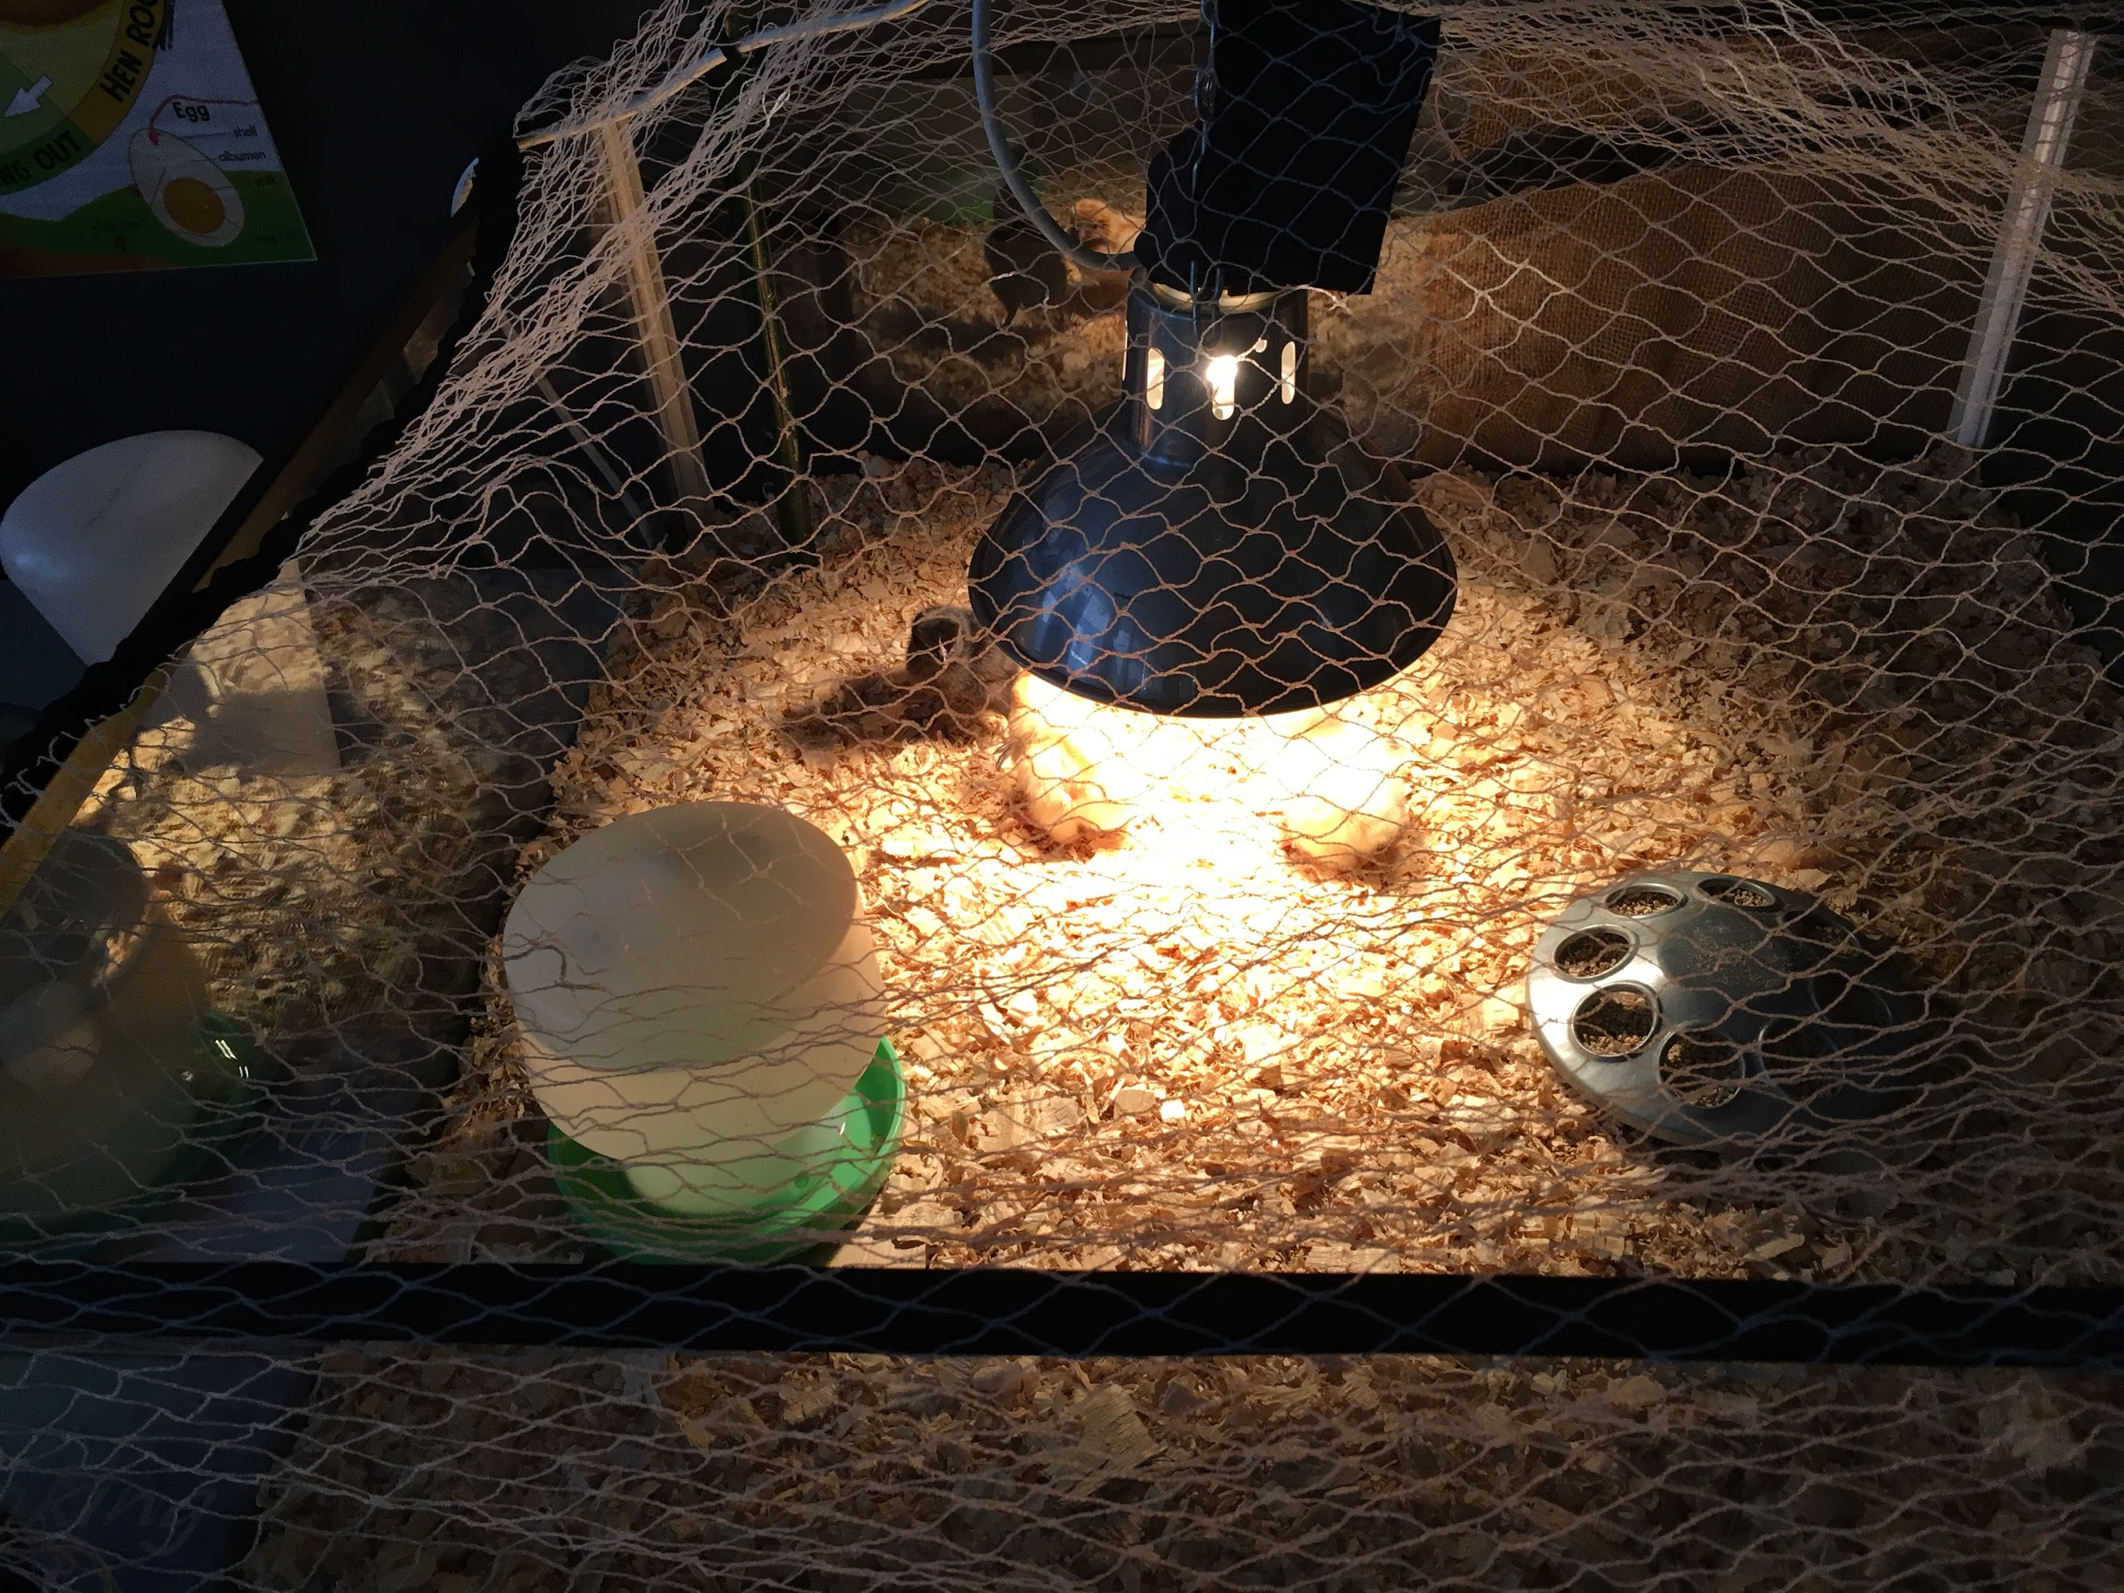
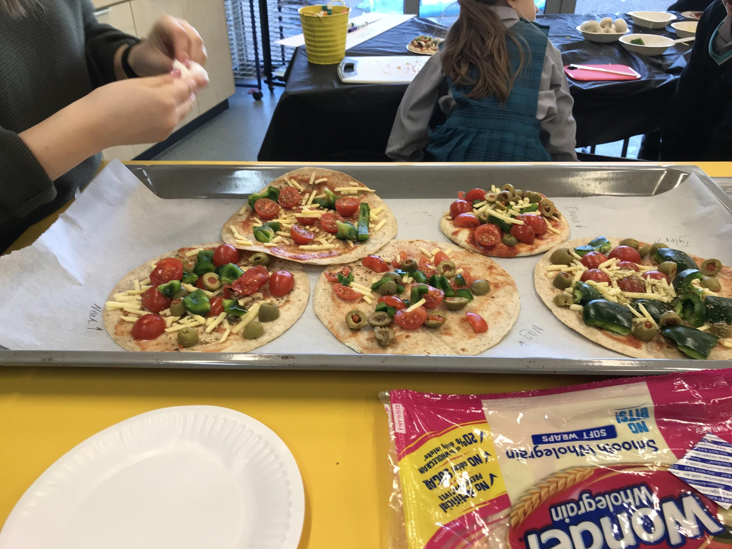
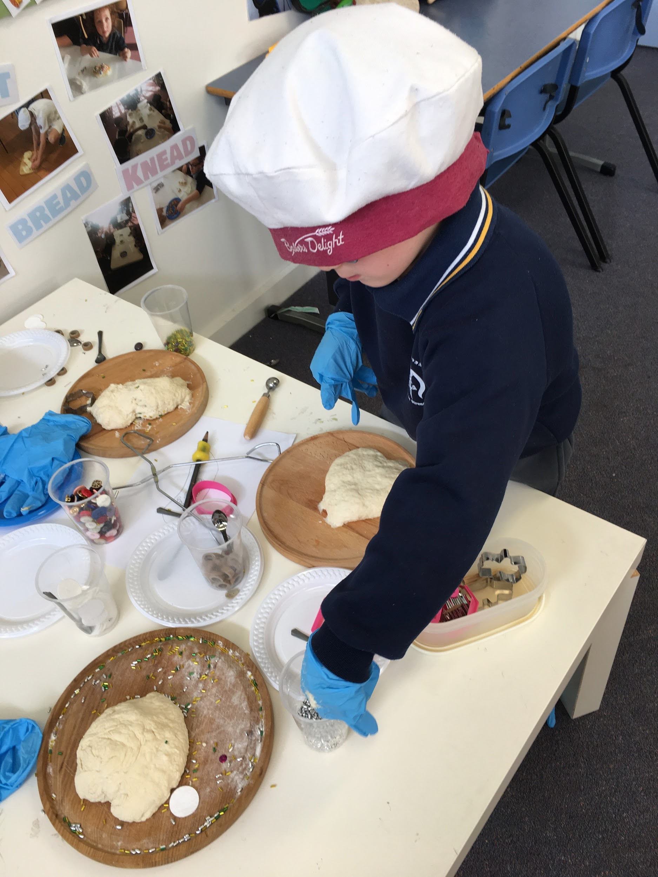
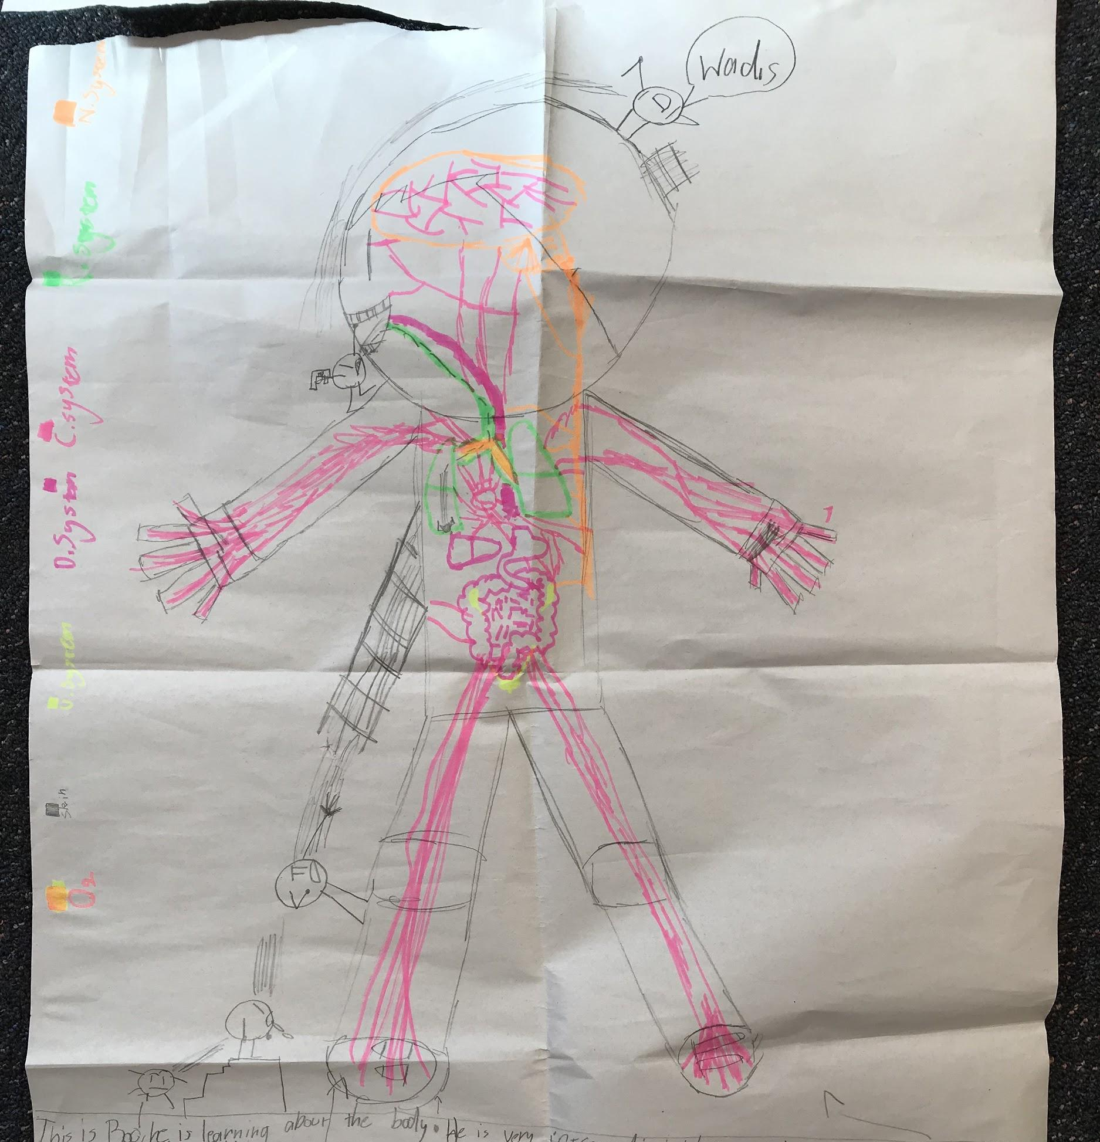
Making connections

Slide 32
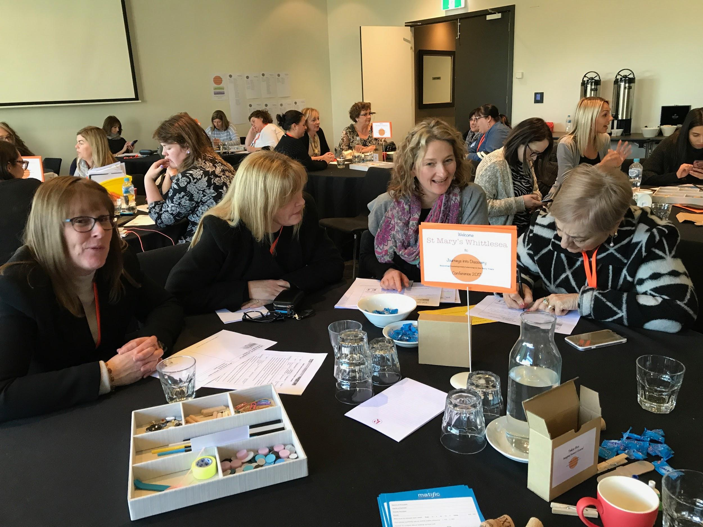
The Discovery Cluster

Slide 33
Key features of the cluster
21 Catholic Primary schools across Northern and Western regions of Melbourne
Over 150 Prep-Year 2 teachers and leaders
Choice of 3 different cluster days per term
Deb and Vanessa facilitators
Bi-annual conference
Google community for sharing of resources and ideas
Option of mentor visits and planning support
2013-2018
Commenced in 2014 with 8 schools

Slide 34
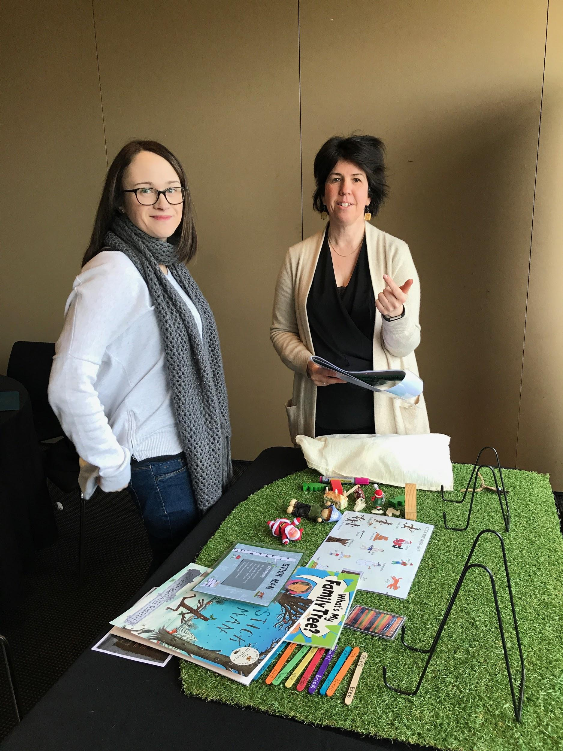
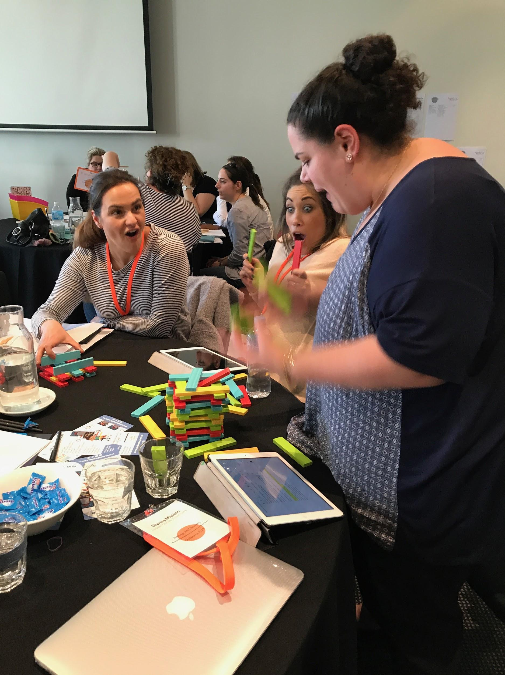
purpose of the cluster
To engage in Professional Learning with and from each other in order to explore best practice, design powerful learning, and empower our Early Years Students to become highly capable learners.

Slide 35
Format of the cluster days
Discovery Walk
Host school shares their journey
Input session based on feedback from participants
Guest speakers
Professional reading
Cross school discussions and sharing

Slide 36
Contact us
Deb Vietri
dvietri@bigpond.com
Vanessa Willis
vanessawillis06@gmail.com
Instagram @discoverybasedinquiry
Twitter
@discoverinquire
@debvietri

