Slide 1
Discovery19
How can we incorporate the General Capabilities explicitly into our planning, teaching and Assessment?
March 26th 2019

Slide 2
Outline for today
Breaking open the General Capabilities:
What are they really all about?
How do young children learn this?
What are the implications for our teaching?
Drilling down- Personal and Social Capability and Critical and Creative Thinking;
What does learning development look like in this area?
How could we assess this?
Applying our thinking: Planning for assessment

Slide 3
Personal and social capability
Critical and creative thinking
Intercultural capability
Ethical capability
What are these areas really all about?
What do you think the key elements/aims are???
If we could condense the purpose and aims into a few key words or phrases what would we say?

Slide 4
overview statements: Victorian curriculum
Read the Rationale and Aims and highlight:
1) What is it asking the learner to do
2) What is it asking the learner to become

Slide 5
Victorian curriculum
How does this connect with your thinking?
How does it extend your thinking?
What challenges your thinking?

Slide 6
Personal and social capability
Is about... how children manage themselves as people and learners both individually and with others.

Slide 7
What are the implications for learning and teaching?
Need to develop a language of learning (eg dispositions)
Noticing and naming
Opportunities to tackle a challenging task independently (beware of micro-managing and over-scaffolding)
Opportunities to work collaboratively (teach skills)
Crosses all areas of schooling BUT Discovery is a time where we can put the spotlight on P&SC for explicit teaching and assessment purposes.

Slide 8
Australian Curriculum
Victorian Curriculum
What do you notice?

Slide 9
CRITICAL AND CREATIVE THINKING
Is about...about developing children’s capacities as thinkers and learners

Slide 10
What are the implications for learning and teaching?
What do we mean by thinking- what type of thinking? Name the thinking and describe/model how to think that way. (James Anderson)
Setting ‘respectful’ and open-ended tasks (what thinking is required here?)including assessment ‘tasks’
Ask more than tell, probe deeper with follow up questions.
Teaching kids how to ask good questions
Provide lots of problem solving opportunities

Slide 11
What are the implications for learning and teaching?
Opportunities for discussion and debating, giving their point of view and justifying it.
Developmentally appropriate ways of reflecting (metacognition)
Allowing sufficient time to go deep with an idea (resisting the demands of the crowded curriculum)
Crosses all areas of schooling BUT Discovery and Inquiry investigations are times where we can put the spotlight on C&CT for explicit teaching and assessment purposes.

Slide 12
Australian Curriculum
Victorian Curriculum
What do you notice?

Slide 13
Intercultural capability
It’s about… ‘formation’ of children as inclusive and empathetic preparing them to live in the diverse world they are immersed in.
(It’s not just about learning about other cultures!) Going beyond the superficial

Slide 14
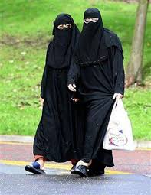
See
Think
Wonder

Slide 15
What are the implications for learning and teaching?
Going beyond ‘facts about countries’ although kids do like to know about this too!
We can make connections to IC in many different areas BUT Inquiry Investigations are a time where we can explicitly teach and assess
Giving kids authentic experiences, and choosing the right shared experience for Inquiry Investigations
Emergent inquiries or discussions can arise from Discovery with the right provocations (not only when it links to the Inquiry)

Slide 16
Australian Curriculum
Victorian Curriculum
What do you notice?

Slide 17
Ethical capability
Is about… exploring issues through a critical mindset, and making decisions using a ‘values’ lens

Slide 18
What are the implications for learning and teaching?
Providing opportunities to explore issues that are developmentally appropriate and can be looked at from different perspectives
Developing a language that includes, but also goes beyond good and bad, right and wrong
Encouraging children to look at things from a different perspective. Step into someone else’s shoes.
Exploring possible consequences of decisions. What would happen if????

Slide 19
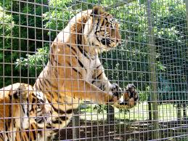
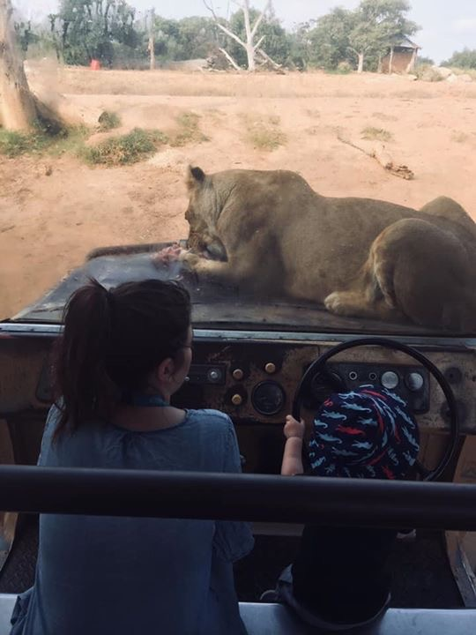
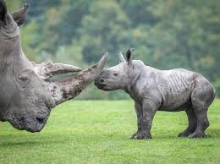
Are zoos good for animals?

Slide 20
What are the implications for learning and teaching?
In a Catholic school- strongly connected to our beliefs and Gospel Values
We can make connections to EC in many different areas BUT RE and Inquiry Investigations are times where we can explicitly teach and assess
Use quality texts to explore the actions of characters and examine situations and dilemmas
The ‘Applying’ stage where we ‘take action’ in a unit is often a response to an ethical idea (make sure we take the time to do this, and make sure it is the kids idea!)

Slide 21
Australian Curriculum
Victorian Curriculum
What do you notice?

Slide 22
Assessment, teaching and learning
Consider the learning and teaching cycle. Yes we want to be able to collect evidence of learning in these areas for the purpose of reporting because this is now mandated but that’s not our driver- wanting to develop these skills, dispositions and attitudes with students because they are crucial to their capacity to learn and act effectively in their world is!
Therefore our focus is the learning and the teaching and assessment is part of that cycle both for reasons of informing future learning as well as reporting.

Slide 23
discuss
What is your school already doing in terms of teaching, assessing, collecting evidence, and reporting on the General Capabilities?
If you have brought something to show please share.
What are the gaps in what we are already doing? What else do we need to do?

Slide 24
Session 2
Drilling down: Critical and Creative Thinking; what would be looking for and how could we assess this?

Slide 25
Key messages
Critical and creative thinking processes are fundamental to effective learning across the curriculum.
This Victorian Curriculum F-10 design assumes that knowledge and skills are transferrable across the curriculum and therefore are not duplicated. For example, where skills and knowledge such as asking questions, evaluating evidence and drawing conclusions are defined in Critical and Creative Thinking, these are not duplicated in other learning areas such as History or Health and Physical Education.
Explicit attention to and application of thinking skills enables students to develop an increasingly sophisticated understanding of the processes they can employ whenever they encounter both the familiar and unfamiliar, to break ineffective habits and build on successful ones, building a capacity to manage their thinking.
Thinking that is productive, purposeful and intentional is at the centre of effective learning and the creation of new knowledge, with the progressive development of knowledge about thinking and the practice of using thinking strategies fostering students’ motivation for, and management of, their own learning.

Slide 26
What’s in a word???
Thinking…….
What different types of thinking can you name?

Slide 27
Critical Thinking is about judging ideas
It is characterized by the comprehensive exploration of issues, ideas, artifacts, and events before accepting or formulating an opinion or conclusion.
Creative Thinking is about creating ideas
It reflects the capacity to combine existing ideas, images, or expertise in original ways; and the experience of thinking, reacting, and working in an imaginative way characterized by a high degree of innovation and risk taking.

Slide 28
Victorian curriculum aims
Critical and creative thinking capability aims to ensure that students develop:
Understanding of thinking processes and an ability to manage and apply these intentionally
Skills and learning dispositions that support logical, strategic, flexible and adventurous thinking
Confidence in evaluating thinking and thinking processes across a range of familiar and unfamiliar contexts.

Slide 29
Structure of critical and creative thinking
Victorian Curriculum:
Questions and possibilities: Explore the nature of questioning and a range of processes and techniques to develop ideas
Reasoning: Explore how to compose, analyse and evaluate arguments and reasoning
Metacognition: Explore the use of strategies to understand, manage and reflect on thinking and learning processes
Australian Curriculum:
Inquiring - identifying, exploring, and organising information and ideas
Generating ideas, possibilities and actions
Reflecting on Thinking and processes
Analysing, synthesising and evaluating reasoning and procedures

Slide 30
By the end of Level D, students answer simple questions related to their own investigation, their feelings or concept. They identify and describe an event or scientific experiment. They generate ideas based on past experience and make choices based on their personal preferences.
Students can identify some components of a point of view. They draw on previous experience to assist with their ideas, reasoning and when drawing a conclusion.
Students actively participate in structured thinking activities. They practice some learning strategies to assist them to organise and demonstrate their ideas. Students participate in problem solving activities and can articulate some possible solutions and their outcome in structured practical situations.
By the end of Level 2, students use and give examples of different kinds of questions. Students generate ideas that are new to them and make choices after considering personal preferences.
Students identify words that indicate components of a point of view. They use reasons and examples for different purposes.
Students express and describe thinking activity. They practice some learning strategies. Students demonstrate and articulate some problem-solving approaches.

Slide 31
By the end of Level 2, students use and give examples of different kinds of questions. Students generate ideas that are new to them and make choices after considering personal preferences.
Students identify words that indicate components of a point of view. They use reasons and examples for different purposes.
Students express and describe thinking activity. They practice some learning strategies. Students demonstrate and articulate some problem-solving approaches.
By the end of Level 4, students explain how to construct open and closed questions and use them for different purposes. Students select and apply techniques to generate a range of ideas that extend how problems are solved.
Students describe and structure arguments with clearly identified aims, premises and conclusions. They use and explain a range of strategies to develop their arguments. They identify the need to make distinctions and apply strategies to make these.
Students use concrete and pictorial models to facilitate thinking, including a range of visualisation strategies. They practice and apply an increased range of learning strategies, including visualisation, note-taking, peer instruction and incubation. Students select and apply a range of problem-solving strategies.

Slide 32
AUSTRALIAN CURRICULUM END OF PREP
pose factual and exploratory questions based on personal interests and experiences
identify and describe familiar information and ideas during a discussion or investigation
gather similar information or depictions from given sources
use imagination to view or create things in new ways and connect two things that seem different
suggest alternative and creative ways to approach a given situation or task
predict what might happen in a given situation and when putting ideas into action
describe what they are thinking and give reasons why
identify the main elements of the steps in a thinking process
connect information from one setting to another
identify the thinking used to solve problems in given situations
share their thinking about possible courses of action
check whether they are satisfied with the outcome of tasks or actions
AUSTRALIAN CURRICULUM END OF YEAR 2
pose questions to identify and clarify issues, and compare information in their world
identify and explore information and ideas from source materials
organise information based on similar or relevant ideas from several sources
build on what they know to create ideas and possibilities in ways that are new to them
identify and compare creative ideas to think broadly about a given situation or problem
investigate options and predict possible outcomes when putting ideas into action
describe the thinking strategies used in given situations and tasks
outline the details and sequence in a whole task and separate it into workable parts
use information from a previous experience to inform a new idea
identify reasoning used in choices or actions in specific situations
identify alternative courses of action or possible conclusions when presented with new information
evaluate whether they have accomplished what they set out to achieve

Slide 33
VICTORIAN CURRICULUM
By the end of Level 2, students use and give examples of different kinds of questions.
Students generate ideas that are new to them and make choices after considering personal preferences.
Students identify words that indicate components of a point of view. They use reasons and examples for different purposes.
Students express and describe thinking activity. They practice some learning strategies. Students demonstrate and articulate some problem-solving approaches.
AUSTRALIAN CURRICULUM END OF YEAR 2
pose questions to identify and clarify issues, and compare information in their world
identify and explore information and ideas from source materials
organise information based on similar or relevant ideas from several sources
build on what they know to create ideas and possibilities in ways that are new to them
identify and compare creative ideas to think broadly about a given situation or problem
investigate options and predict possible outcomes when putting ideas into action
describe the thinking strategies used in given situations and tasks
outline the details and sequence in a whole task and separate it into workable parts
use information from a previous experience to inform a new idea
identify reasoning used in choices or actions in specific situations
identify alternative courses of action or possible conclusions when presented with new information
evaluate whether they have accomplished what they set out to achieve

Slide 34
Session 3
Planning for Assessment

Slide 35
Brainstorm
What are some effective ways of collecting and recording assessment information?

Slide 36
Possible contexts for assessment
Observations during Discovery (with criteria or checklists)
Learning conversations either through share time or roving conferences (with criteria or checklists)
Show me your thinking (100 languages of children)
Pre and post ‘assessment’ first I thought... now I think
Graphic organisers during inquiry investigations eg PMI 6 hats, venn diagrams, cause and effect
Tracking thinking through inquiry processes

Slide 37
Which aspect of the Critical and Creative Thinking will you choose to trial at your school? How can our learning development continuum help you?
In what contexts will you conduct your assessment?
Through Discovery
As part of the Inquiry Investigation
At some other time?
How will you collect and record the information?
How will you use the information you have gathered?

Slide 38
plenary
How can we share our progress with each other?

