Slide 1
What strategic roles can adults play during Discovery?
What are the features of effective learning conversations?
A professional learning Module for Learning Support Officers
Module 1
PART B

Slide 2
PART B
What strategic roles can adults play during Discovery?

Slide 3
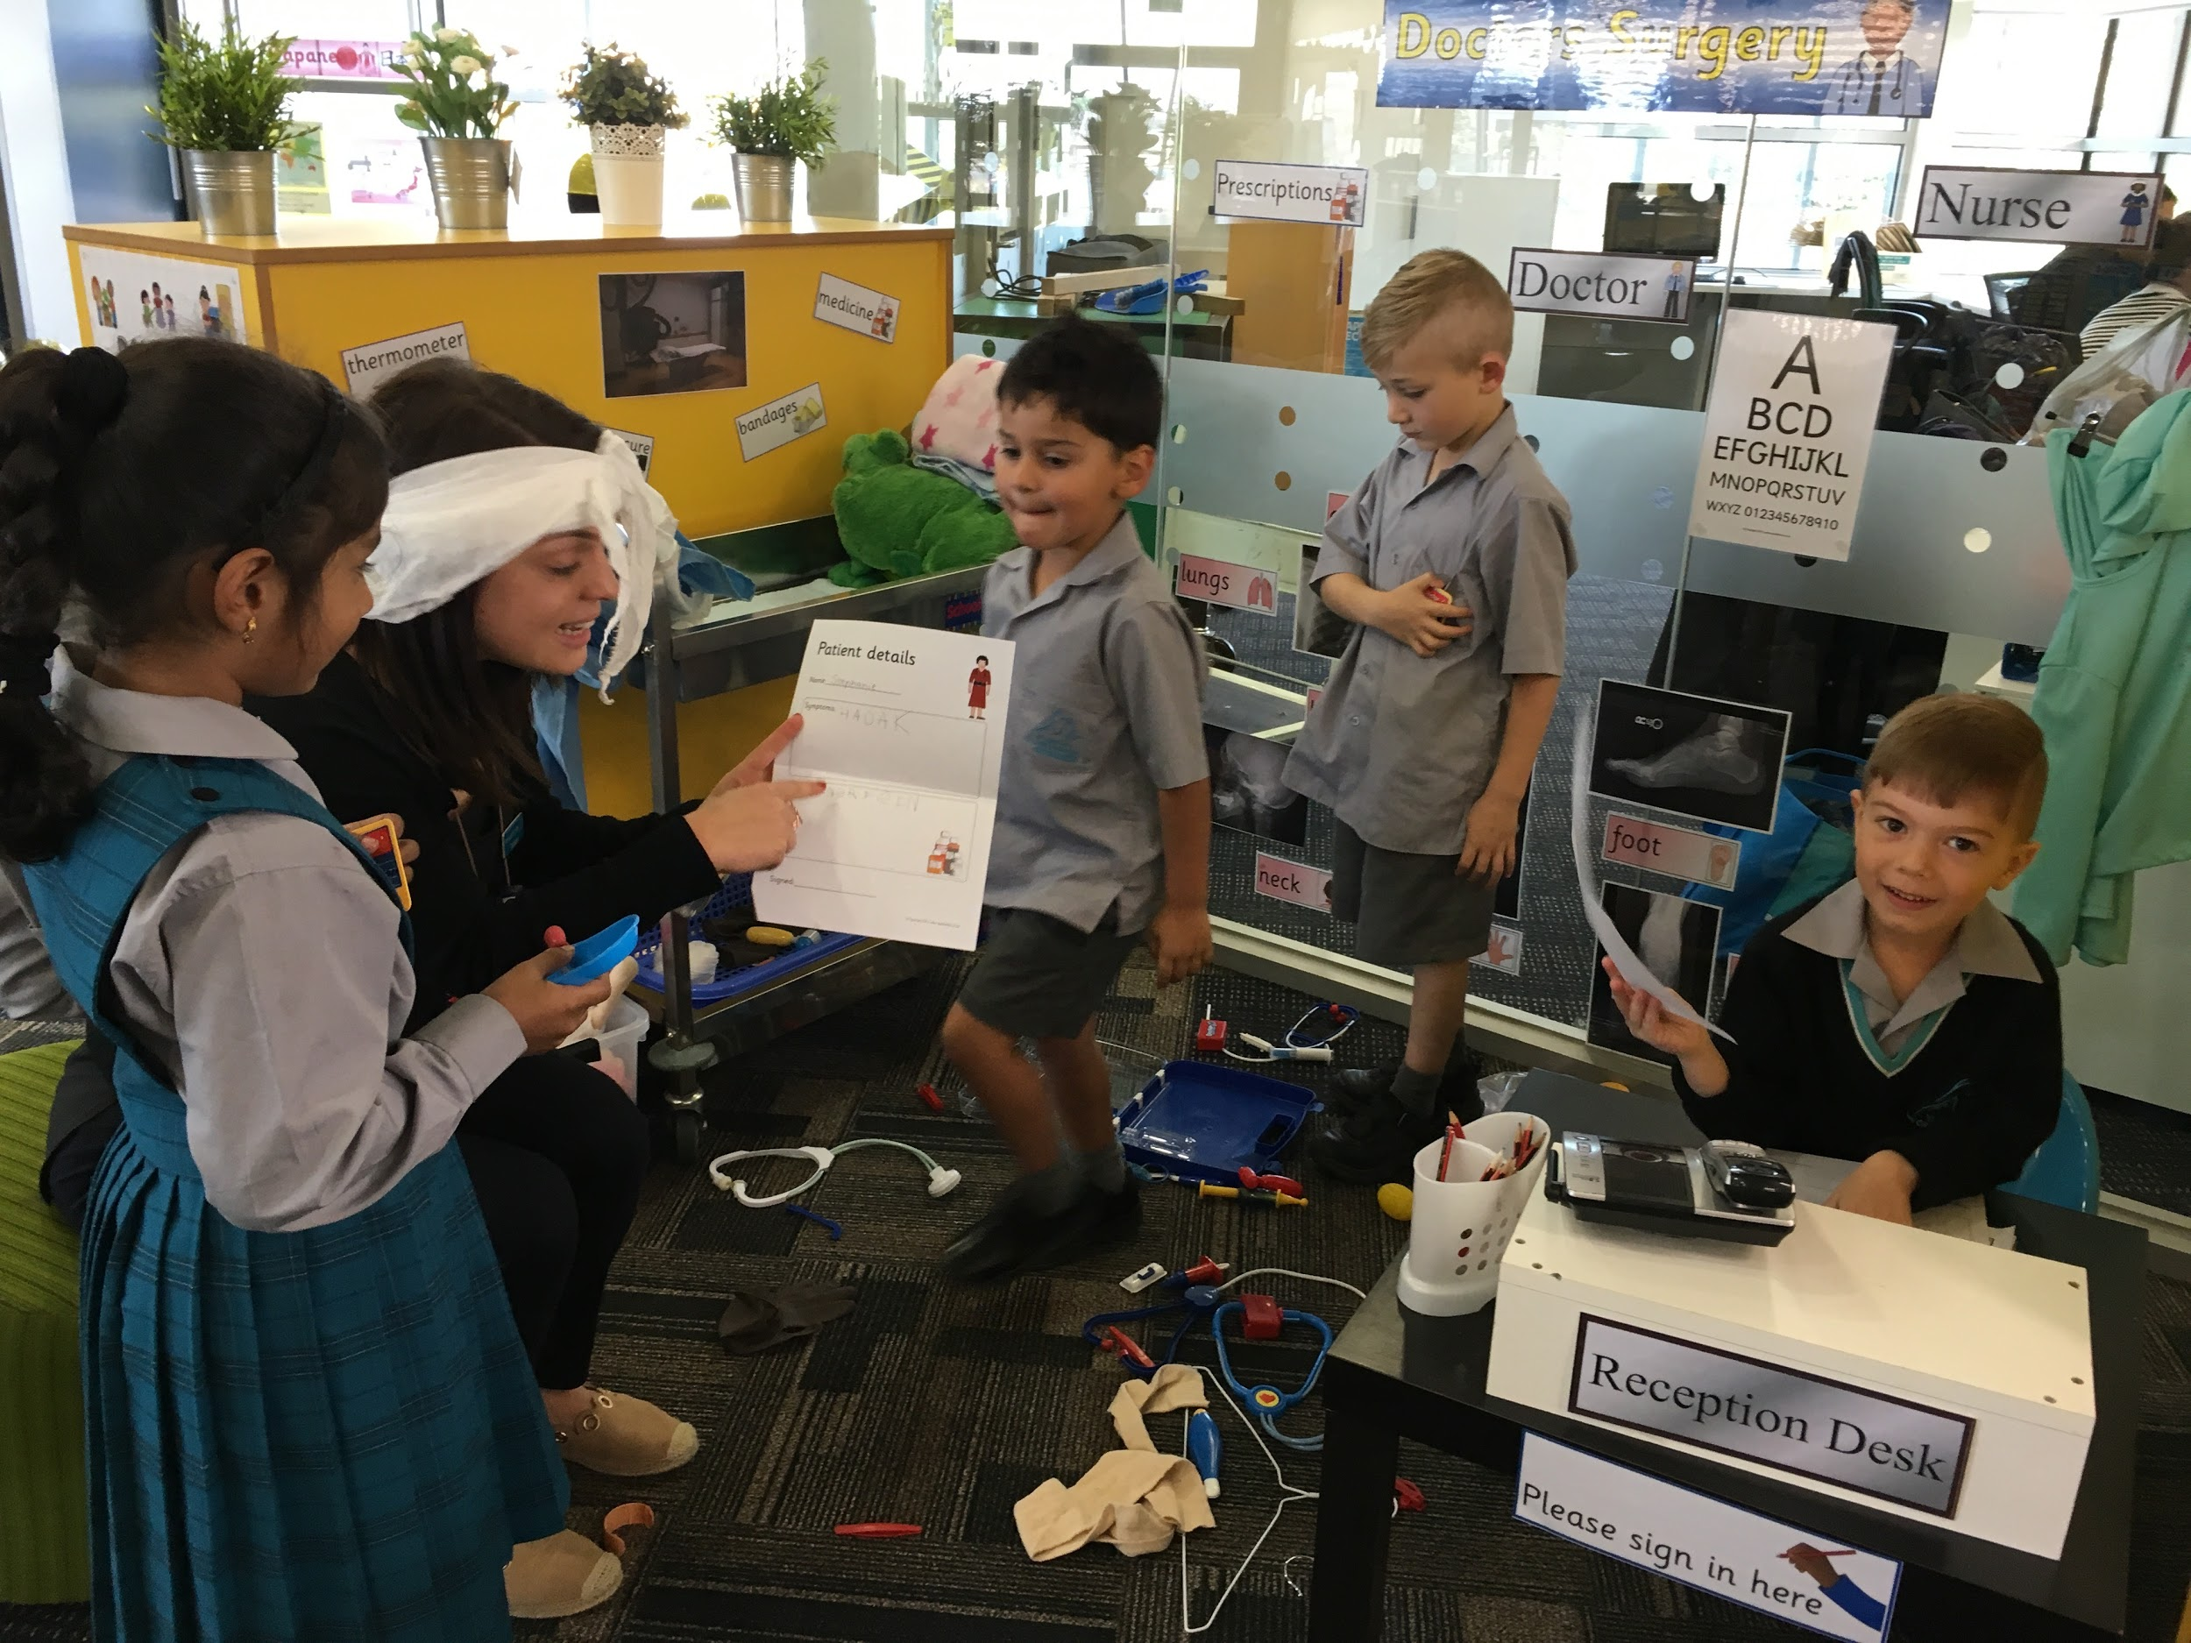
100% present 100% of the time!!!
So what might this look like?
Adults should be fully engaged
with the students at all times
during the session
Scaffolding the learning in strategic ways
Introductions and Share Times
Co playing
Observing/Researching
Influencing

Slide 4
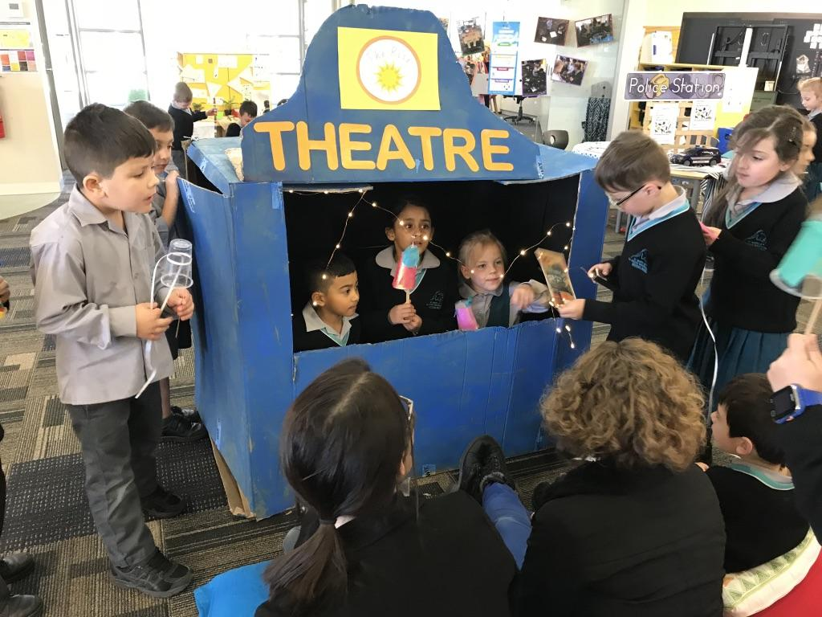
100% present 100% of the time!!!
Strategic Role: observer/researcher
What is really happening here?
What might they be thinking?
What are they demonstrating/revealing (skills, curiosities, capabilities)?
What does this tell me about the child/children?
What might they need to facilitate/extend their thinking and learning?
Documenting: anecdotal notes, google docs, sticky notes, photos, see-saw, learning stories

Slide 5
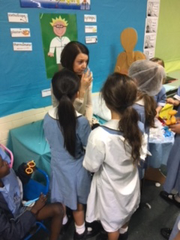
100% present 100% of the time!!!
Strategic Role: co-player
Modelling specific skills or strategies (eg problem solving, construction techniques)
Providing scaffolding to support learning and development of particular students (eg oral language, social skills)
Initiating play or joining in as required

Slide 6
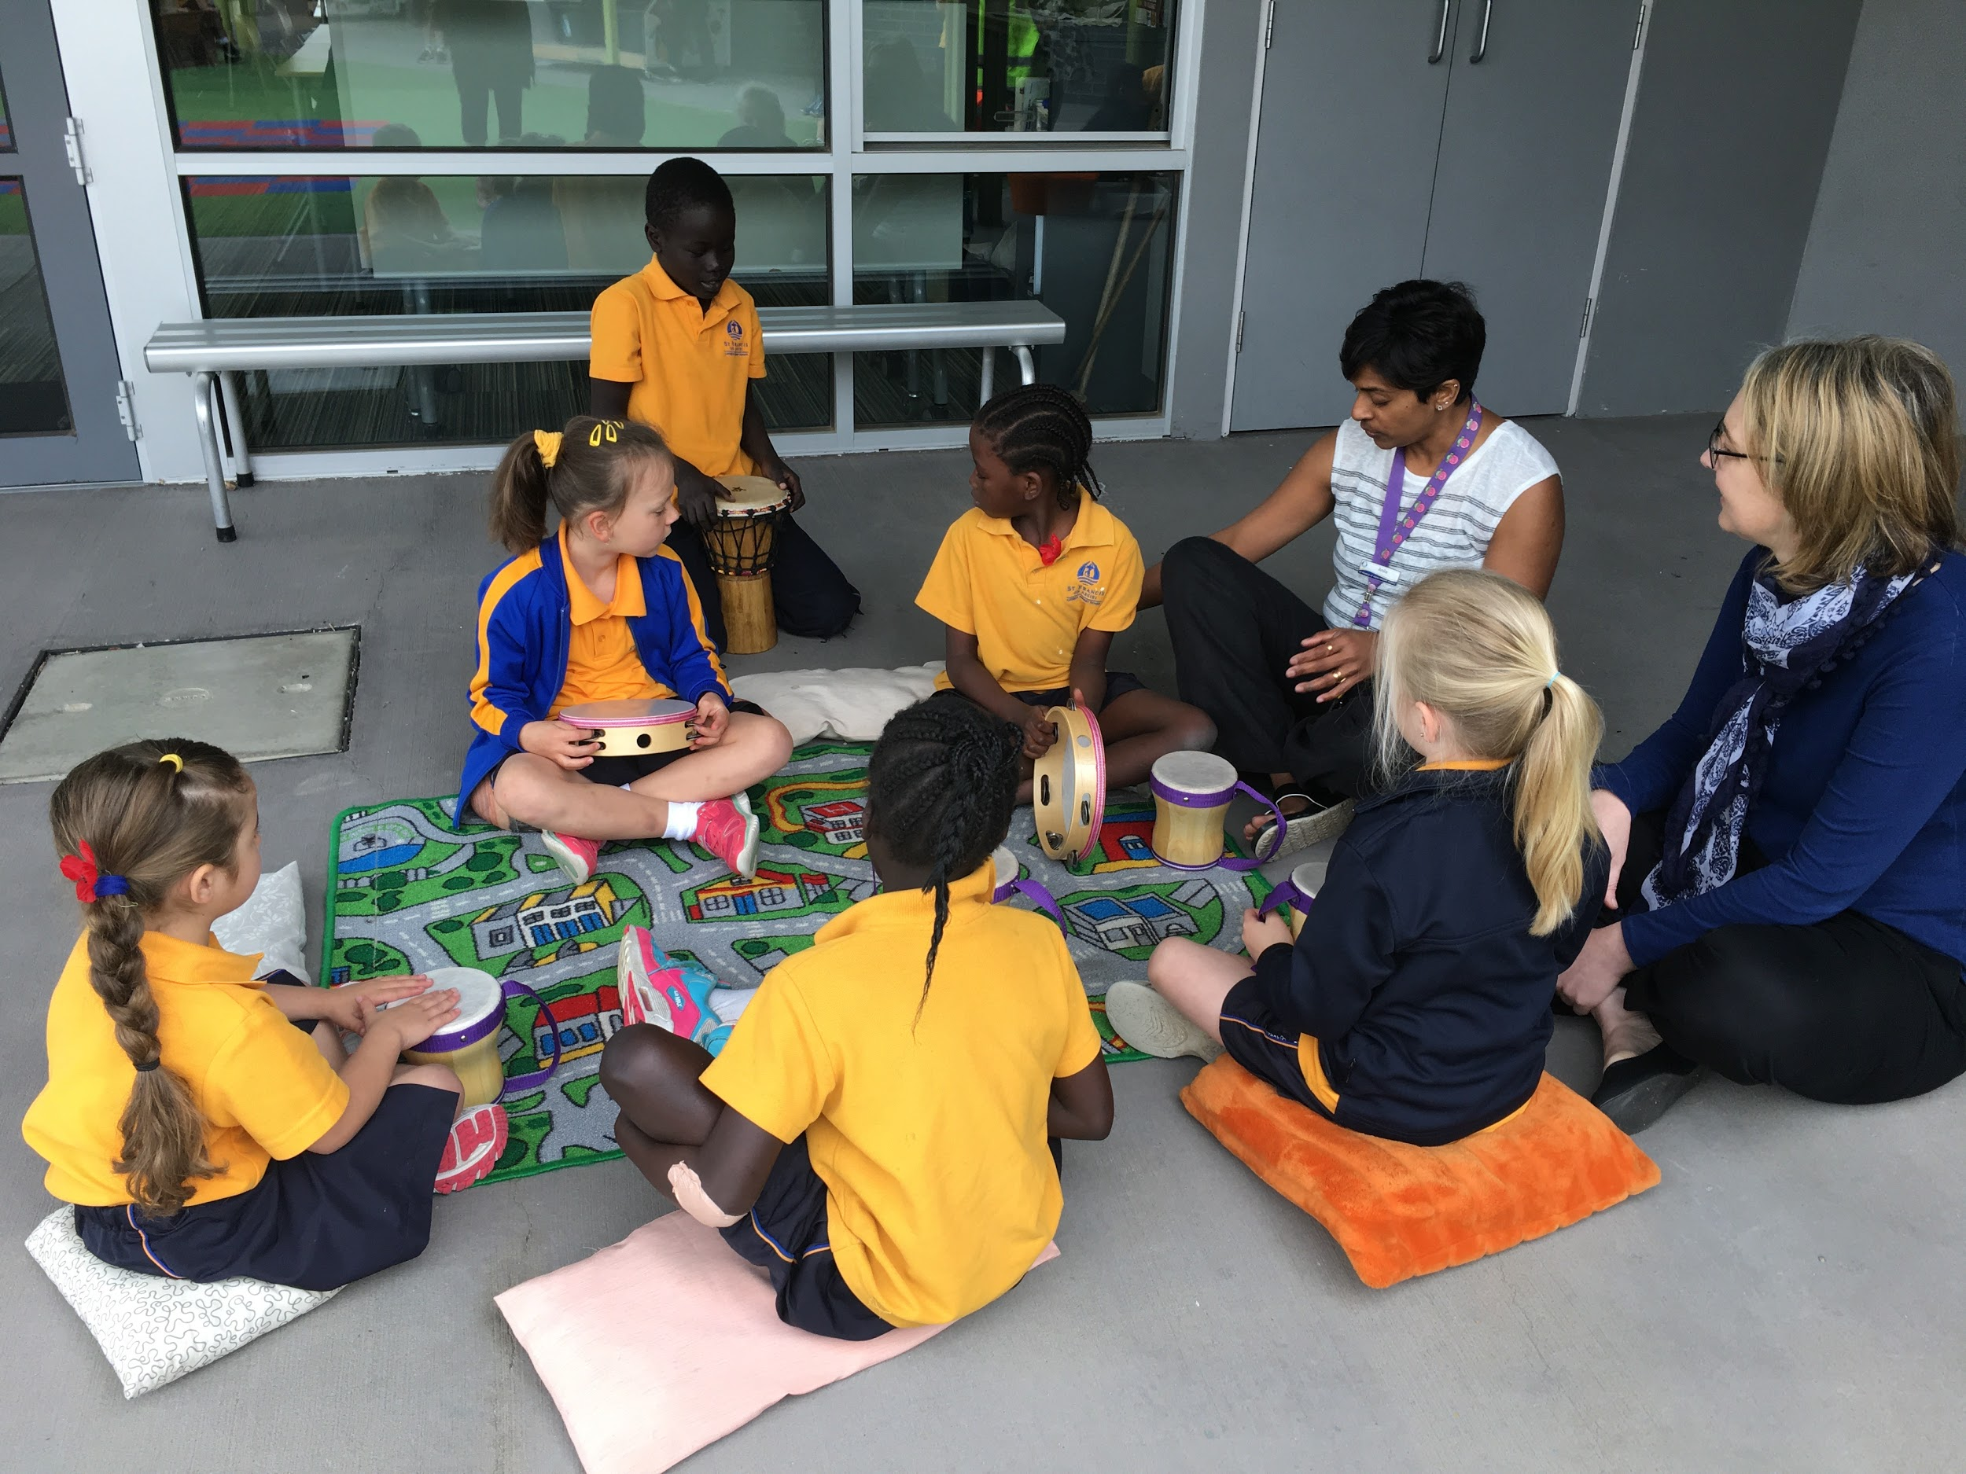
100% present 100% of the time!!!
Strategic Role: influencer
Encouraging desired behaviours & redirecting non desired behaviours
Giving feedback
‘Just in time’ teaching of a particular skill
Questioning to clarify, provoke, extend, challenge, reflect, help make connections (Learning Conversations)

Slide 7
What role might Learning Support Officers be asked to take on?
Supporting special needs child or all children
Observing and recording behaviours of specific children
Supporting a particular area requiring adult supervision or scaffolding
Co-player | Observer/Researcher | Influencer
**Initiating a play situation or enticing reluctant students into play scenarios **Modelling play, cooperative or “social” skills or strategies to students **Modelling how to interact with and use materials and props in an appropriate way | **Observation of specific children - e.g repetitive idea in their explorations or interactions **Recording what they are doing independently, what skills or strengths are they demonstrating? **How can we take their learning further? How can we bring these interests into future planning? | **Giving feedback **Noticing and Naming the learning process, skills and dispositions I noticed that you … I can see you… Looks like you… **Giving advice Perhaps you might… Maybe you could…

Slide 8
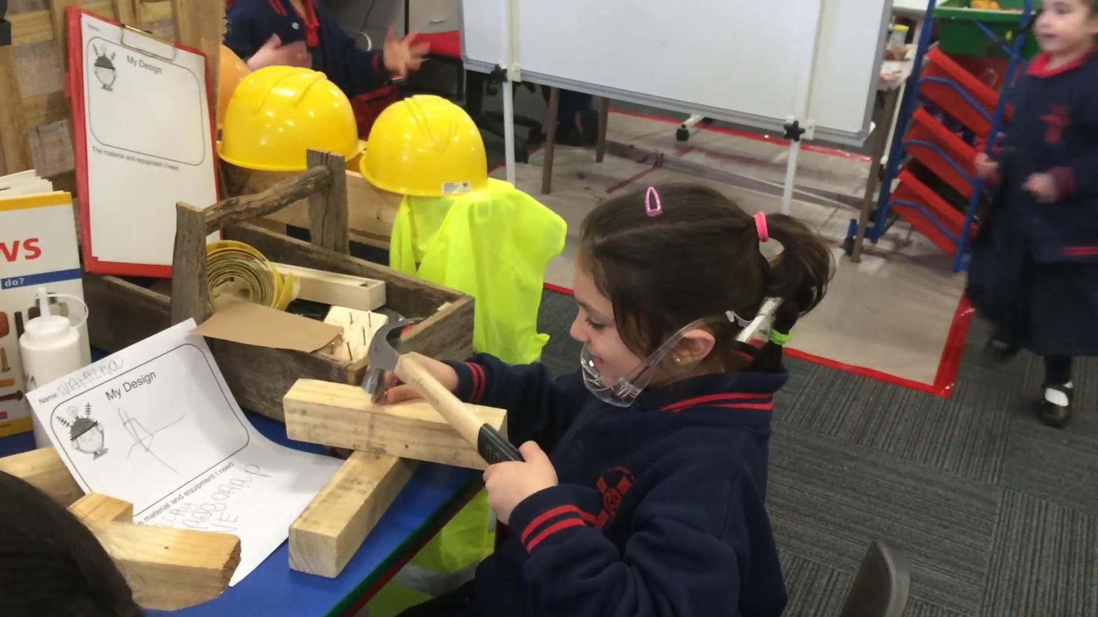
Your turn!
Watch this video clip
Observer/researcher role
What skills or strategies are these girls showing they have? (What can
they do?)
Influencer
What questions could we ask these girls to find out what they are thinking or
to take their learning further?
Co Player
How could you enter into this exploration with the girls and what might be your focus?
Record your thinking and
share with your colleagues

Slide 9
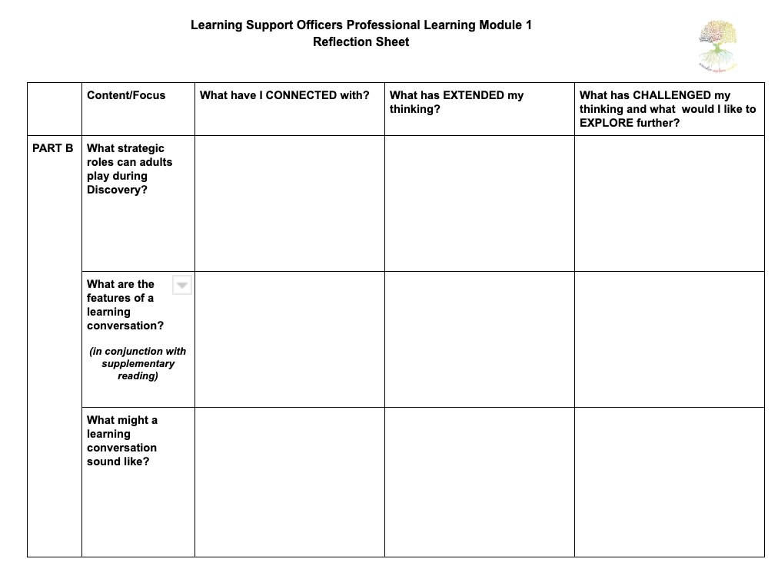
Reflect Record Discuss

Slide 10
What are the features of a Learning Conversation?

Slide 11
Learning Conversations…
An important aspect of scaffolding learning in Discovery…
Conversations will engage the thinking of young learners when they have these characteristics:
Learner’s voices are heard the most
Adult talk seeks to discover children’s ideas
Children have opportunity to talk with each other
Children have time to think
Topics connect to children’s interests, explorations and questions
Conversations are documented and interpreted to reveal thinking
Conversations are used to stretch children's thinking
Lisa Burman “Are you Listening?”

Slide 12
Adult talk seeks to discover children’s ideas
The adults role is to ask questions that seek to uncover children’s thinking rather than asking questions that tell you the answer you already know or the answer that we perceive to be “right”
The adult’s role in the learning conversation is to stretch learners thinking and understandings about themselves and the world, NOT to test children's knowledge or control their thinking and actions.
The focus here is on OPEN questions and not CLOSED
Closed: What are you making?
Open: How did you come up with that idea?

Slide 13
Children are given time to think during the
conversation
Conversations need to be at a relaxed pace giving time for thinking, reflection and sharing
Be conscious of “jumping in” too early to fill the silence
TIP: Reluctant child? Commentating the play is often a good starting point
Research shows the benefits of allowing silence during a conversation.
Thinking time allowed learners to give longer and more “on topic” responses and decreased the “I don’t know” response
(Mary Budd Rowe research, 1987)
The focus here is to allow the child time to take in information from either yourself or another student (if a small group conversation) and make connections to what they are doing and also what they think.

Slide 14
Conversations are used to stretch children’s
thinking and learning
Conversations engage children in constructing their understandings.
Through conversation, children’s prior knowledge and current understandings - or working theories - are revealed to us
The teachers role is to then ask “What learning experiences could I provide to stretch this understanding?”
Listen beyond their words and listen to their ideas.
Conversations are the vehicle for enhancing student vocabulary and oral language
Tier 1 words: everyday words - easy to use
(e.g. the fairy has gone)
Tier 2 words: less likely used in oral language contexts by children but more likely in written contexts...Tier 2 words more likely used by adults
(e.g the fairy has vanished)
Tier 3 words - more subject specific academic words e.g. circumference
We model Tier 2 and 3 words in context and when we are in conversation with the student

Slide 15
Read Reflect Discuss
Reading: Features of learning conversations
Questioning Techniques
From Lisa Burman - “Are You Listening?”

Slide 16
A Learning Conversation in action!
Tell me what you are
doing here?
Conversation aimed to discover the children’s ideas and help make connections between what they were doing and what they were thinking
Explicit focus on vocabulary
Conversation allowed wait time and inclusive of all
Conversation aimed to influence and stretch their thinking - I wonder why they used feathers? Where would they have got them?

Slide 17
A Learning Conversation in action!
YOUR TURN
Watch the video
What connections can you make between this conversation and the ideas we have explored about learning conversations?
What strategies did I use to engage the student in conversation?
What does this conversation reveal about this child’s thinking and working theories?

Slide 18
Reflect Record Discuss

Slide 19
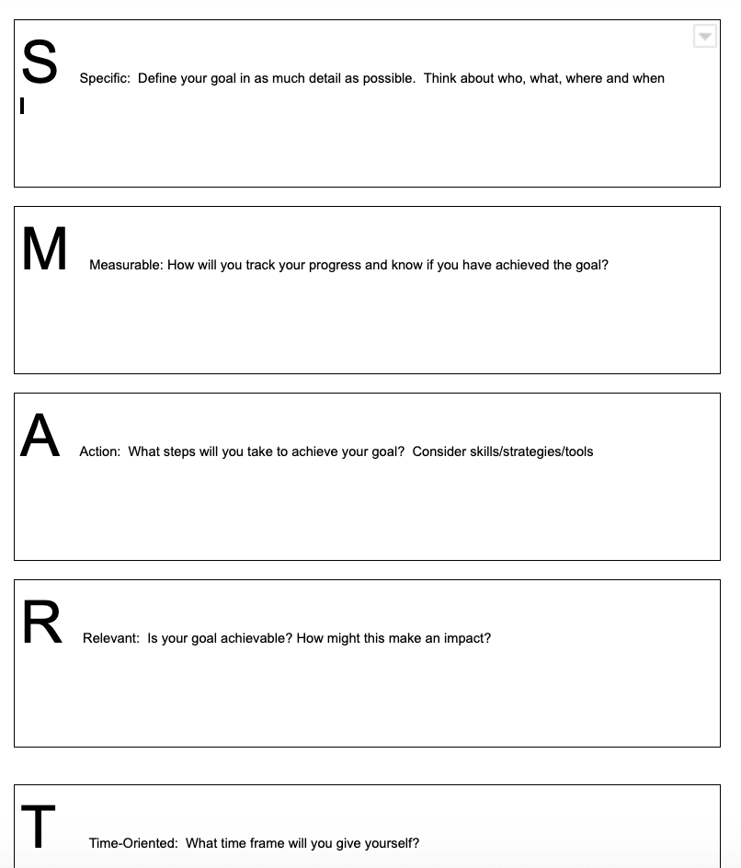
Between Module Observation
Set a goal for yourself in regards to the ideas we have uncovered in this module.
Some key ideas explored
What is Discovery?
What might students be doing during Discovery?
What are the important roles adults play in Discovery?
What are the features of a learning conversation?
Using the scaffold provided (or another of your own if you prefer) identify your goal, break your goal into actions you will trial or implement. Reflect on your experiences and think about what you noticed about both yourself and the students you were working with and how this might impact your work with students in the future.

