Slide 1
How can we support students with special needs during Discovery?
How might we solve some possible hurdles we can be faced with when working alongside our special needs students?
A professional learning Module for Learning Support Officers
Module 2
Part B

Slide 2
How might we solve some possible hurdles or challenges when working with special needs students in Discovery?

Slide 3
Common concerns/hurdles
During Discovery we may observe children who are;
not engaging with anything that is set out during the session
being disruptive
not coping with noise
not sticking at anything longer than a couple of minutes
doing the same thing all of the time

Slide 4
Common concerns/hurdles
Adult as RESEARCHER
Why do you think this might be happening?
Observe the child for a session (from afar if possible) and record what you notice
Share your observations and develop a strategy with the teacher
Set a GOAL for the student in conjunction with the teacher and share it WITH the student and explain WHY you have set that goal
Be CONSISTENT and PERSISTENT with the goal - it will take time - and the strategy you trial might need more than one session
CELEBRATE the small steps!!!!

Slide 5
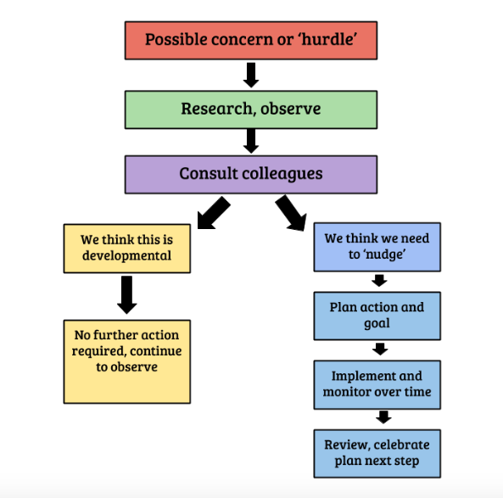
Approach the concern as a problem solver
Once you have identified you have a possible concern about the way a student is engaging with Discovery you can use this process to work it through and decide what the next step is.
Remember our view of the child and keep in mind we want to build on strengths like we saw in Felix’s story.

Slide 6
Watch and listen without judgement
Ask the child what they are thinking and feeling during Discovery
Observe the environment, and what is happening around the child
Ask yourself- I wonder why they are doing that?
Identify possible triggers and inhibitors
Class teacher and other teachers or LSOs involved in Discovery
Special needs or wellbeing staff
Does the student have a PLP?
Share the goal, the plan and the responsibility with the child. (Competent and capable)

Slide 7
What are some possible hurdles when working with special needs students in Discovery and how might we approach this?

Slide 8
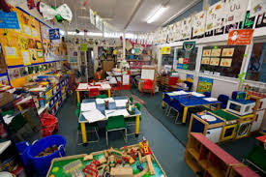
Child not engaging with anything
4 Views of the Child - Competent and Capable
Why? Perhaps they are overwhelmed with too much choice?
Perhaps the areas don’t interest them?
Perhaps they don’t have the social skills to enter into the area where other children are already playing?

Slide 9
Child not engaging with anything
Possible Strategies
Narrow down the choices to 2 or 3 options that you know they will like and help them make a choice
During the introduction you could take the child on a tour of what’s on offer and help them choose before the session starts
Find out what they are really interested in and make sure there is an area where the child can pursue this
Be a co-player in the area they choose and gradually draw back support over time

Slide 10
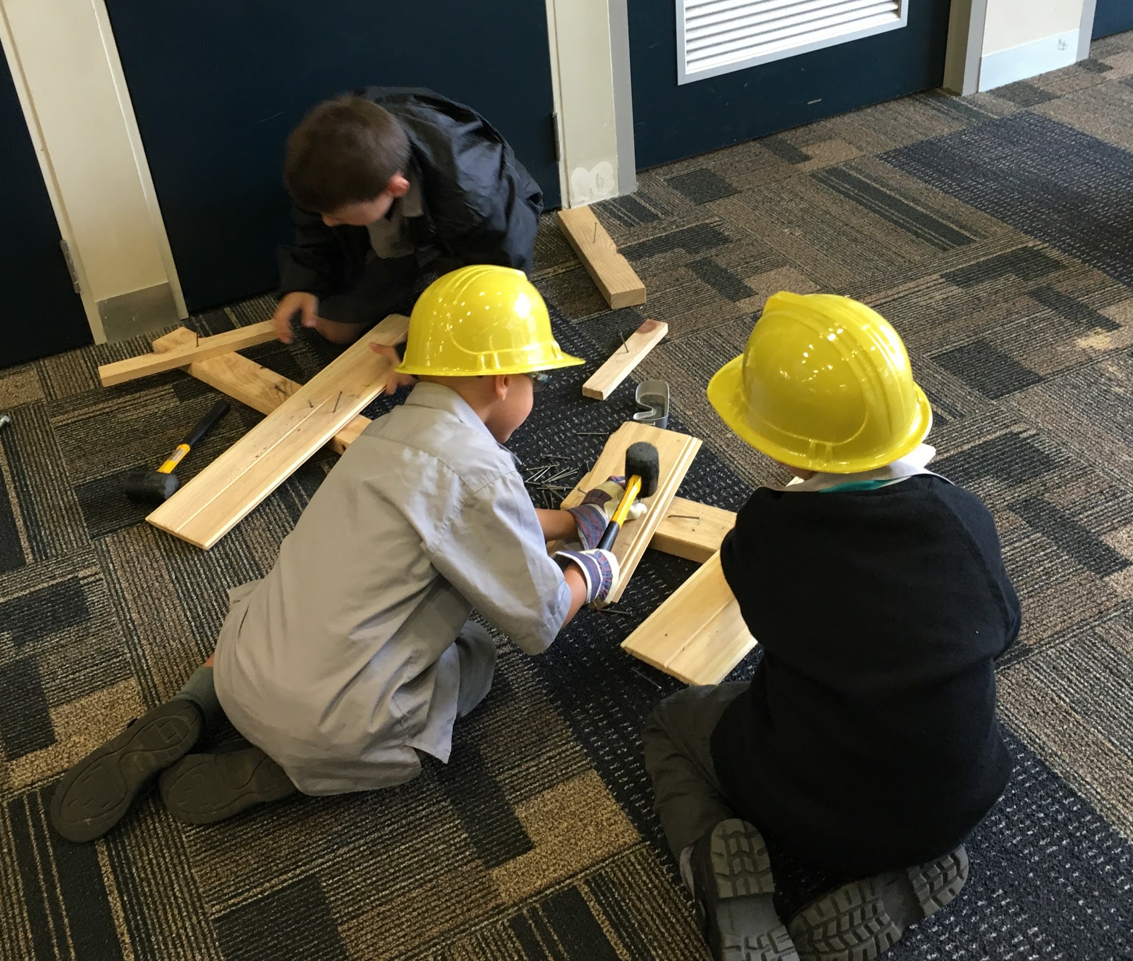
Child not coping with noise
4 Views of the Child - Competent and Capable
Why? Perhaps the noise level is actually much higher than it needs to be?
Perhaps there are too many “louder” areas/stations placed together in the same space
Perhaps the surfaces where the areas are set out don’t lend themselves to the materials being used there

Slide 11
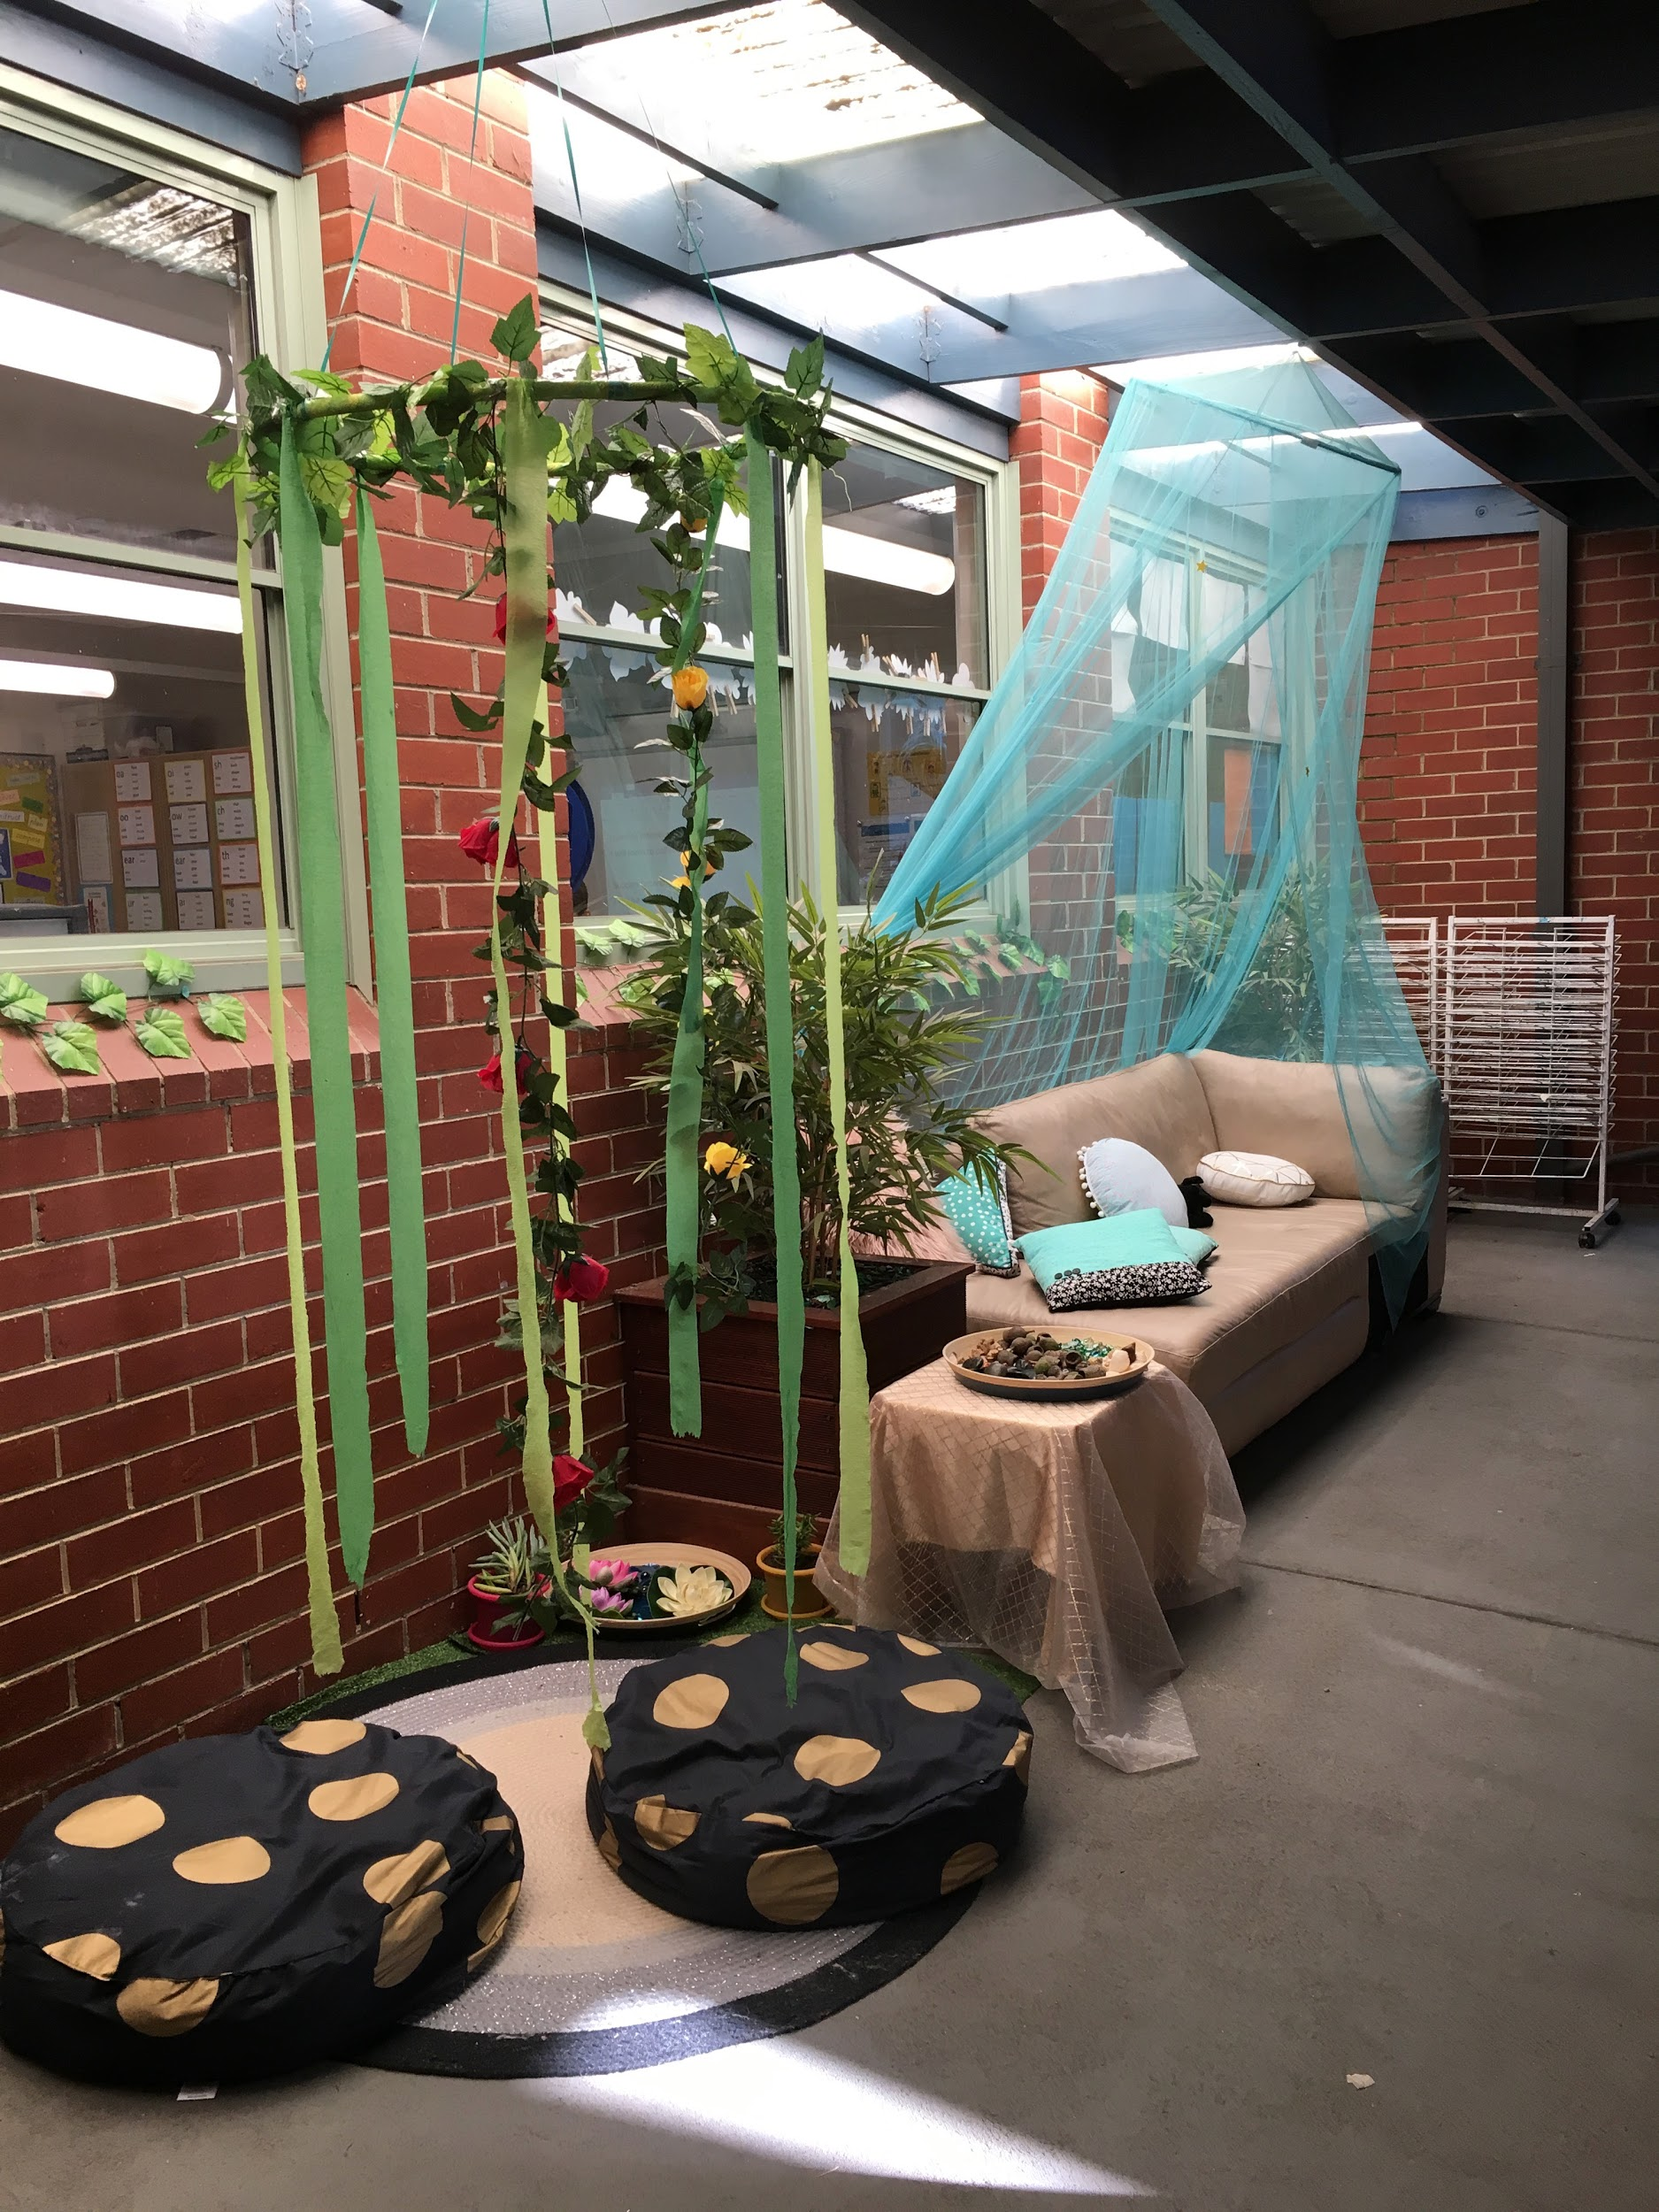
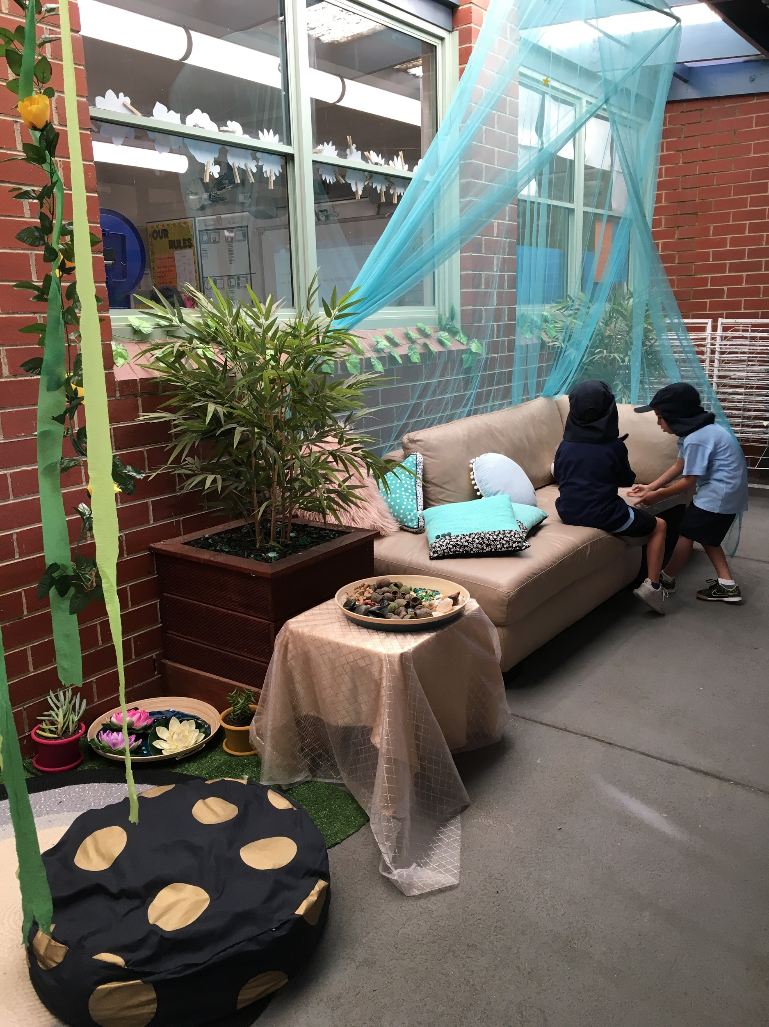
Child not coping with noise
Possible Strategies
Ensure there is a “quiet space” or an area designated during Discovery for those stations that are not as loud
Try to make use of nature and the outdoor areas as much as possible
Make use of softer surfaces for louder areas e.g. felt or table runners, cork mats

Slide 12
Child not sticking at anything for very long
4 Views of the Child - Competent and Capable
Why? Perhaps the areas don’t interest them?
Perhaps they are worried they will miss out on the other opportunities that are set out?
Perhaps they don’t feel confident with the materials or struggle with an idea to get started?
Possible Strategies
Become a co-player and commentate your play and engage the student into conversation with you
If you see the student having a problem, step in and suggest a way to solve it to encourage them to persevere
Set a timer and tell them they have to be there for the duration of the timer - start off smaller and then slowly build up the expected time
Set limits

Slide 13
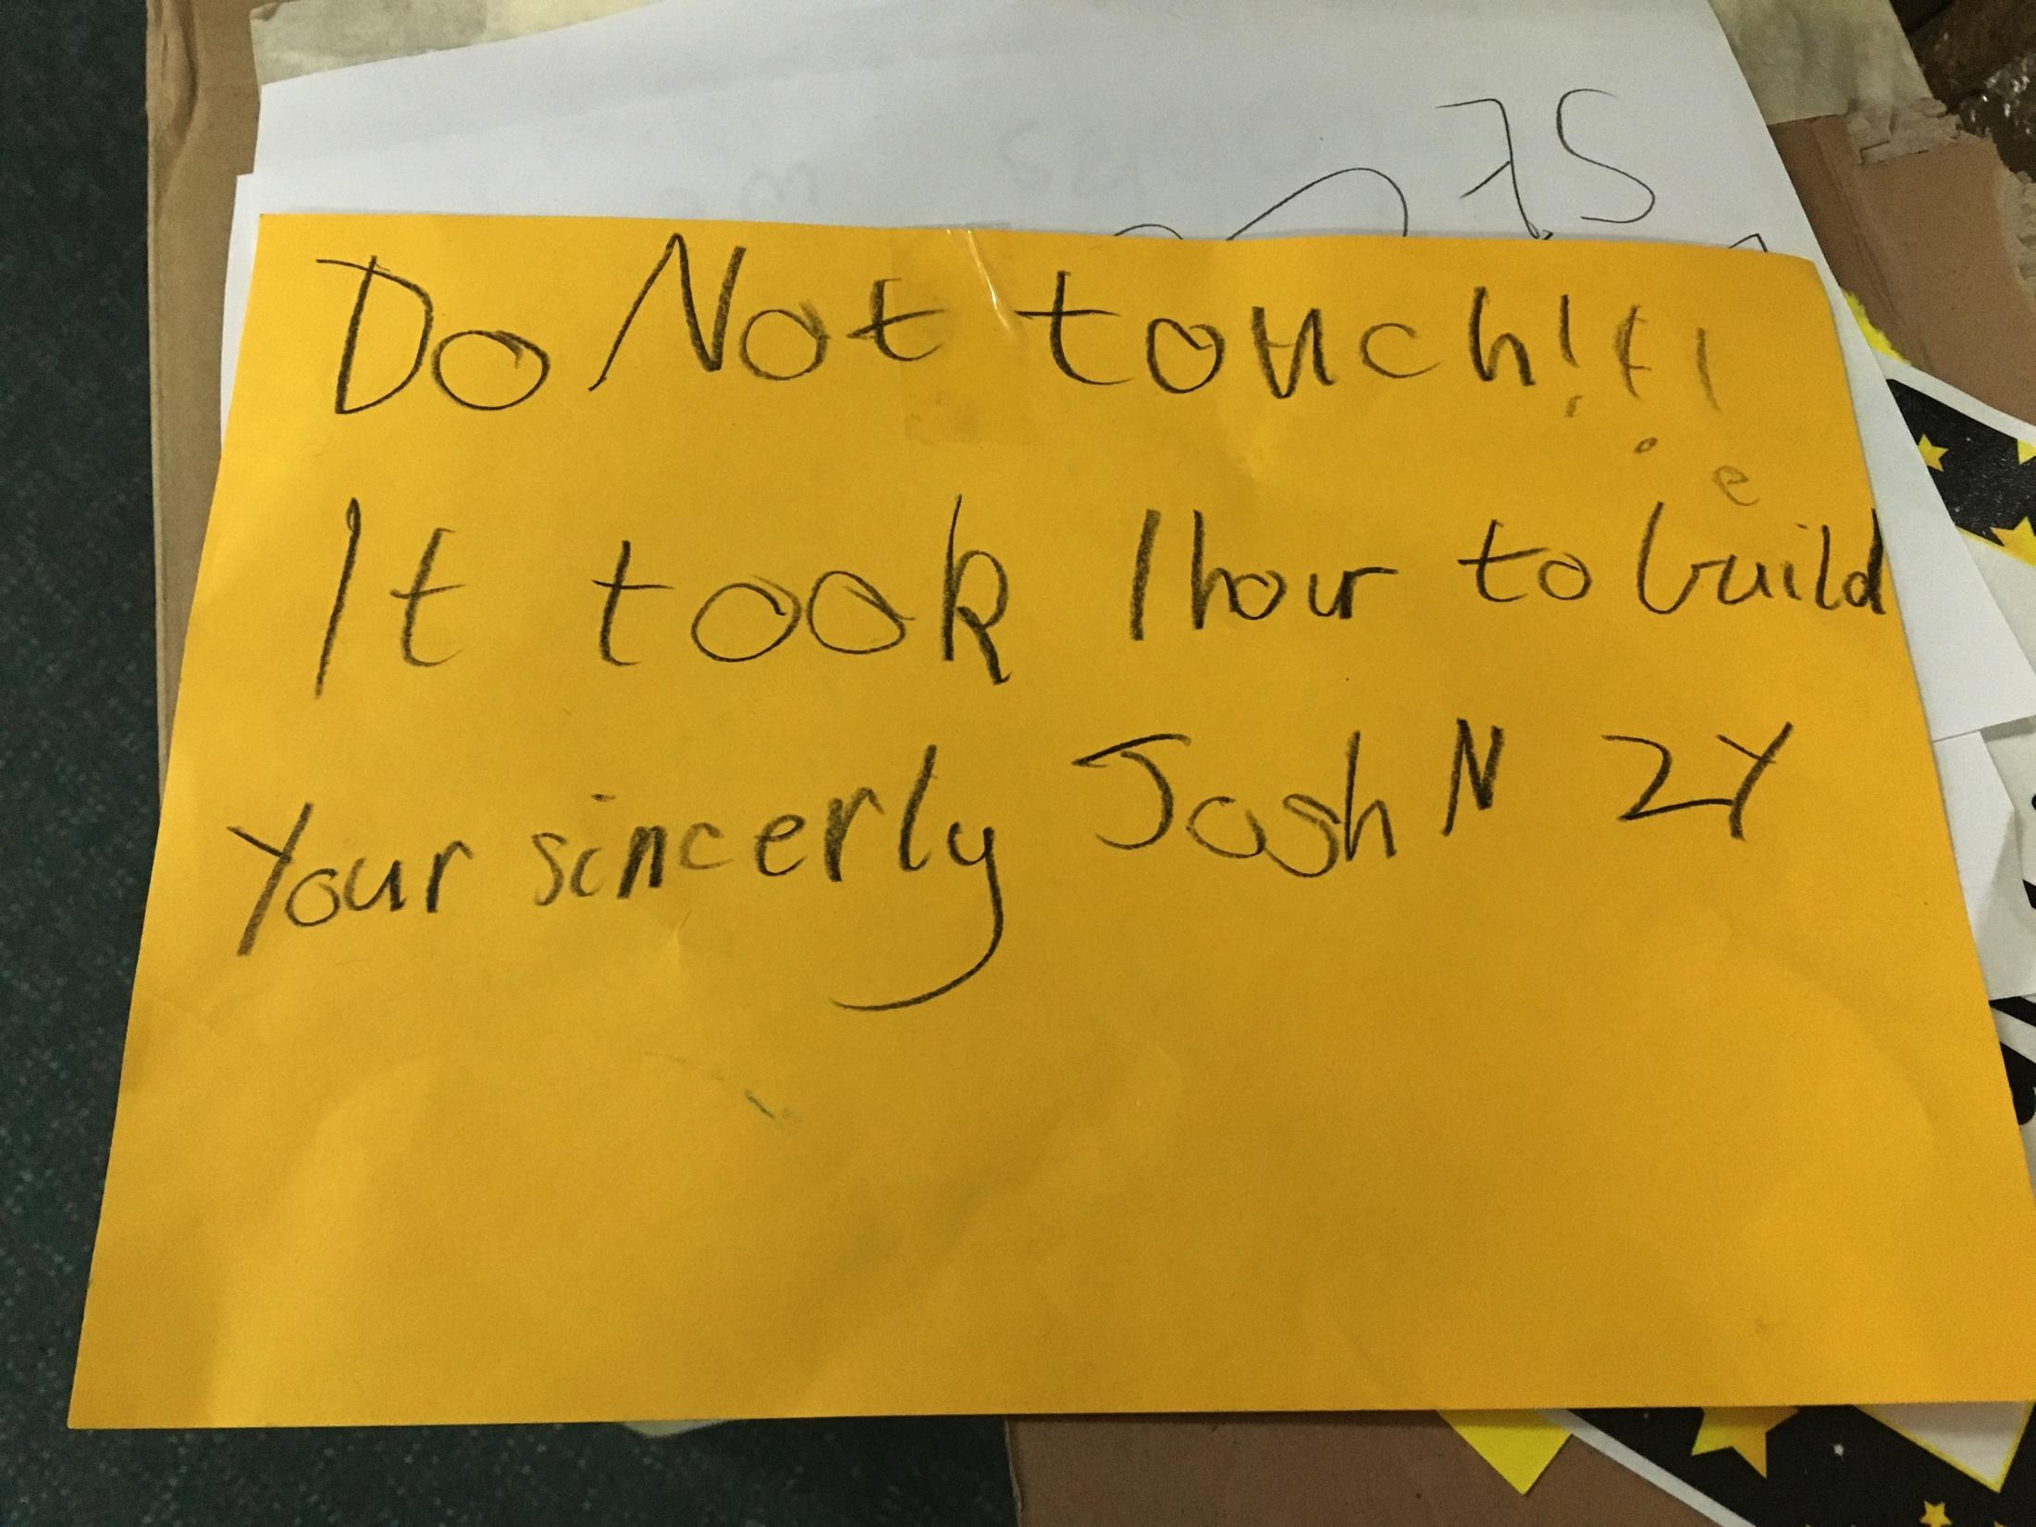
Child doing the same thing over and over
4 Views of the Child - Competent and Capable
Why? Perhaps they are exploring a different idea each time they visit?
Perhaps they aren’t given opportunity to depth their exploration when having to pack away at the end of the session?
Perhaps they are comfortable with what is familiar to them

Slide 14
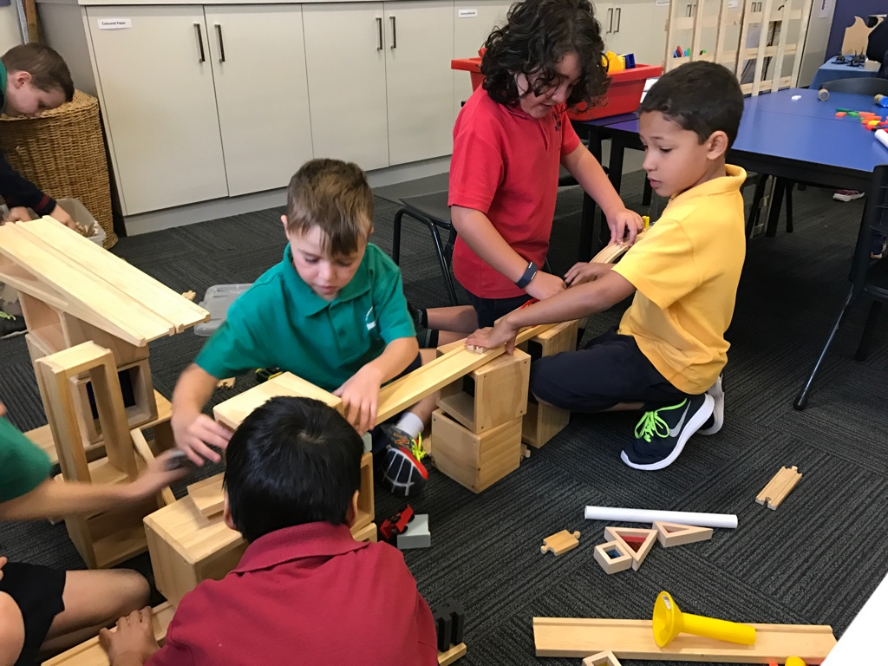
Child doing the same thing over and over
Possible Strategies
Take on researcher role and observe child over consecutive sessions and try to ascertain what they are learning or concepts they are grappling with. How can you help take this further?
Tap into their interests
Place other materials or opportunities near by or in the area to try and extend the exploration
Invite them to join you in a different area that might be similar to what they are exploring

Slide 15
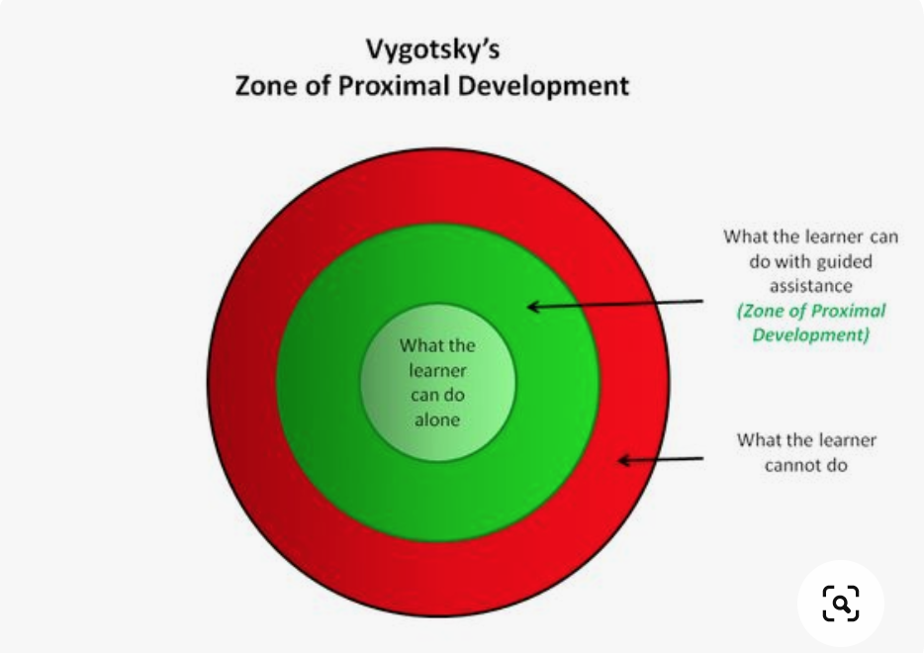
Child is being disruptive
4 Views of the Child - Competent and Capable
Why? Perhaps they don’t know how to join in with explorations that are already underway?
Perhaps the areas don’t interest them?
Perhaps the areas are not within their zone of proximal development?

Slide 16
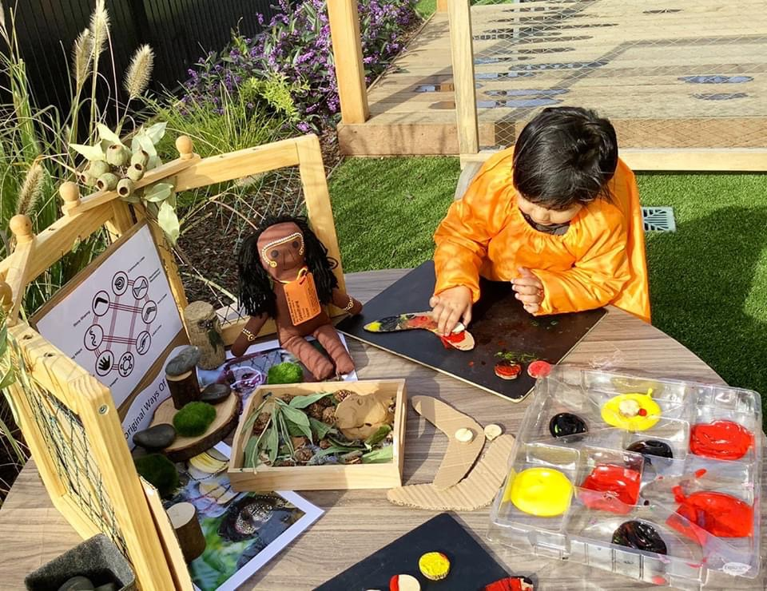
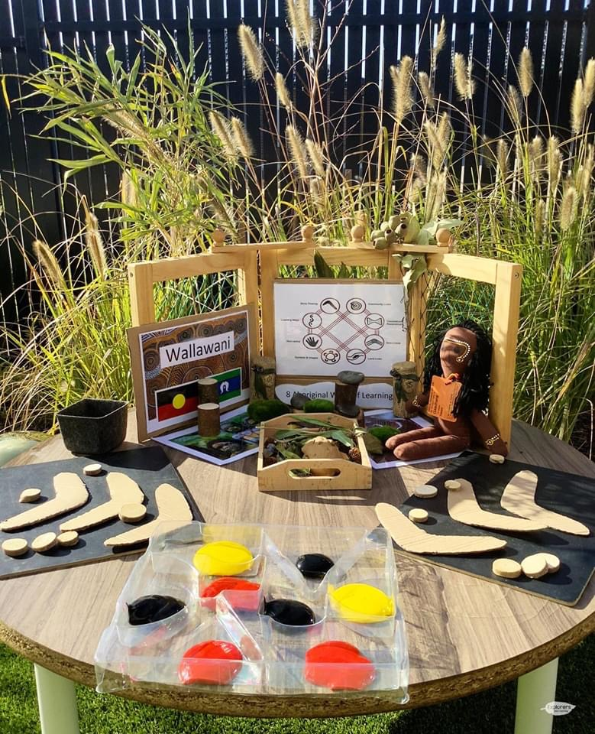
Child is being disruptive
Possible Strategies
Step in and redirect the behaviour in a positive way if possible!
Find out what they are really interested in and make sure there is an area where the child can pursue this
Ensure what is on offer is challenging enough that they are stretched to try a new skill but not too hard that they can not be successful and become frustrated

Slide 17
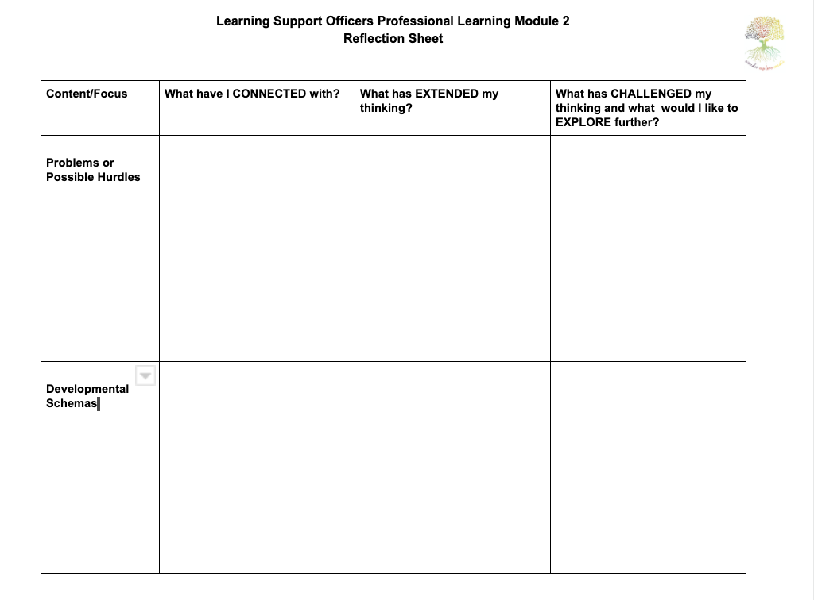
Reflect Record Discuss

Slide 18
What are the developmental schemas and how might these be revealed in a Discovery session?

Slide 19
What are Developmental Schemas?
First defined by psychologist Jean Piaget
Important developmental building blocks of the brain that help children make connections between concepts and ideas
Put simply….
Schema is really a fancy word for the urges that children have to do - things like climb, throwing objects and hiding in small places
Clare Caro - Schemas in Children's Play
http://www.nature-play.co.uk/blog/schemas-in-childrens-play

Slide 20
What are Developmental Schemas?
Children progress through the schemas at different stages and they will last for varying periods of time
They can come one at a time, in groups and may appear and disappear at different stages
Knowing about these play-urges can help us to understand why our children are so determined to do certain things that we might not understand. If we have no idea about the way in which a child exhibits signs of brain development, then we might actually think that the child is being 'difficult' or even try to stop the developmental urges themselves.
Clare Caro - Schemas in Children's Play
http://www.nature-play.co.uk/blog/schemas-in-childrens-play

Slide 21
What are Developmental Schemas?
Orientation
Positioning
Connection
Trajectory
Enclosure
Transporting
Enveloping
Rotation
Transformation

Slide 22
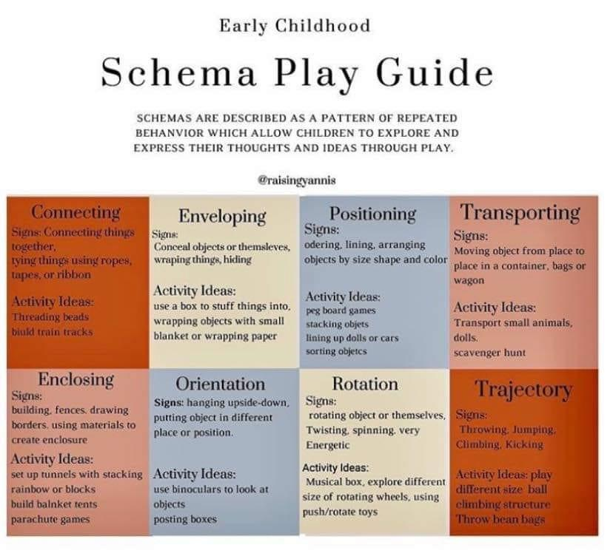

Slide 23
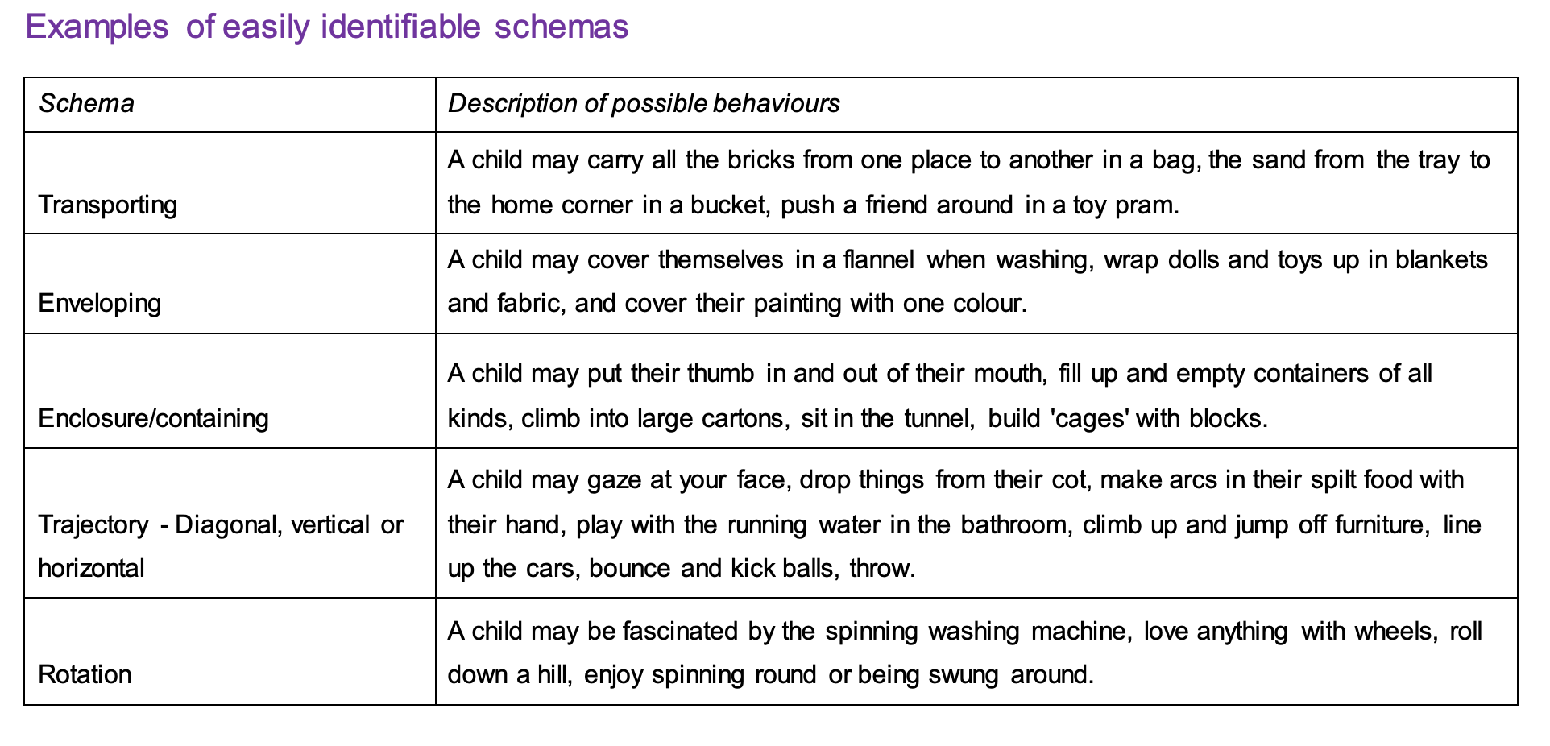
What are Developmental Schemas?

Slide 24
What are Developmental Schemas?
Credit: Dorset Early Years Service - UK
http://www.dorsetnexus.org.uk/Page/9009

Slide 25
Reflect Record Discuss

Slide 26
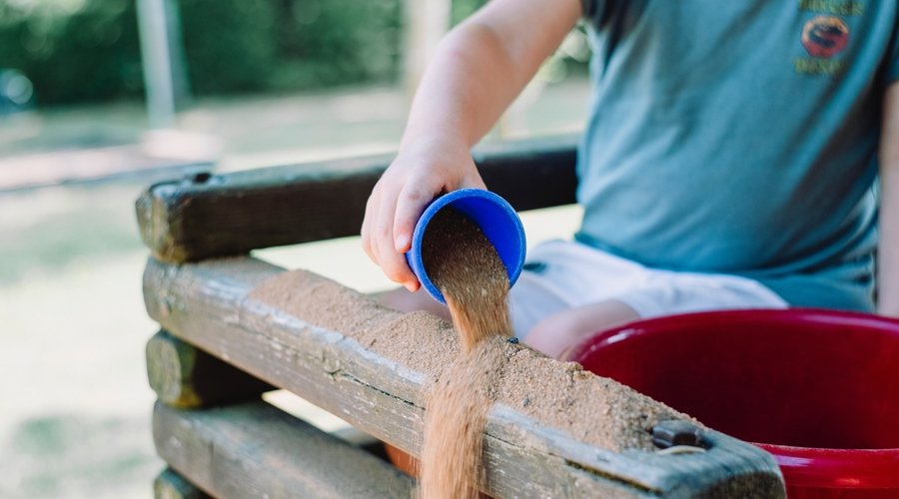
What are Developmental Schemas?
Schemas offer a key to understanding ways in which children behave. In the planning process, awareness of children's schemas can be invaluable in matching curriculum content with children's interests and needs.
Credit: Dorset Early Years Service - UK
http://www.dorsetnexus.org.uk/Page/9009

Slide 27
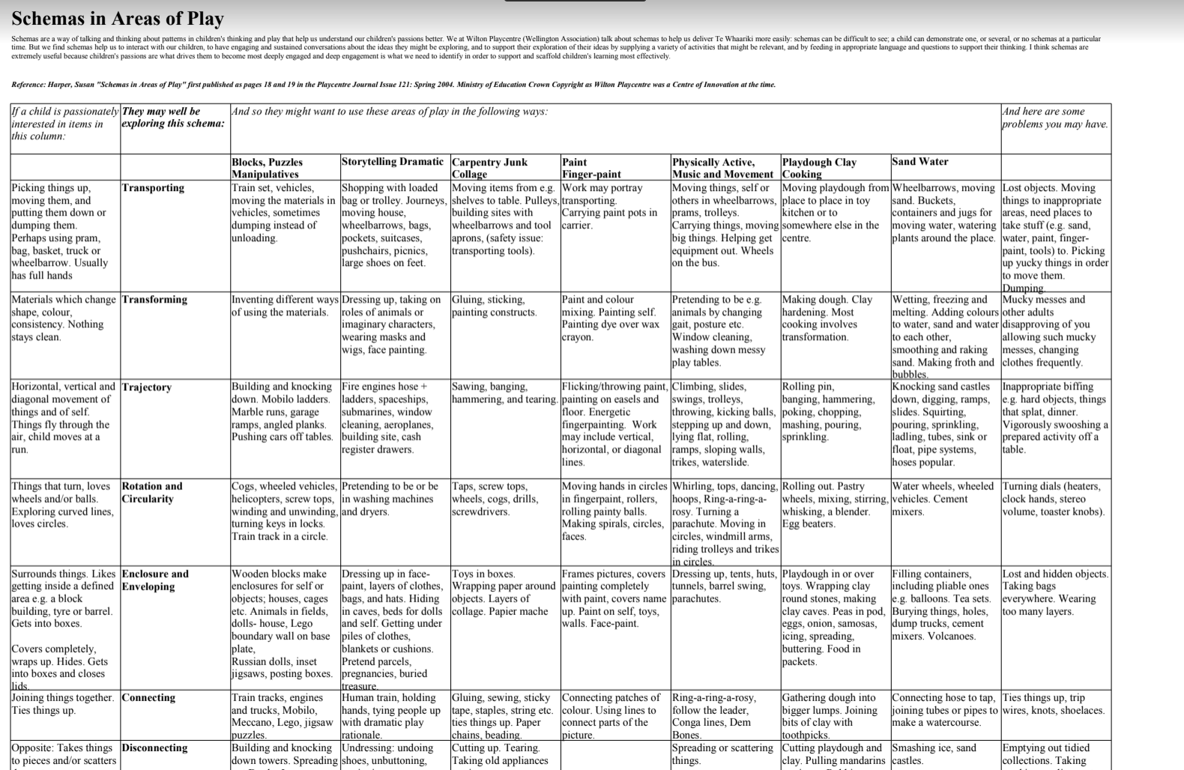
What are Developmental Schemas?

Slide 28
What has stuck with you?
Some ideas that have stuck with you…
Something that you will try to do more of…
Something you will try to do less of…
Something that you would like to investigate further….

Slide 29
Thank you!!!
Opportunity for follow up

