Slide 1
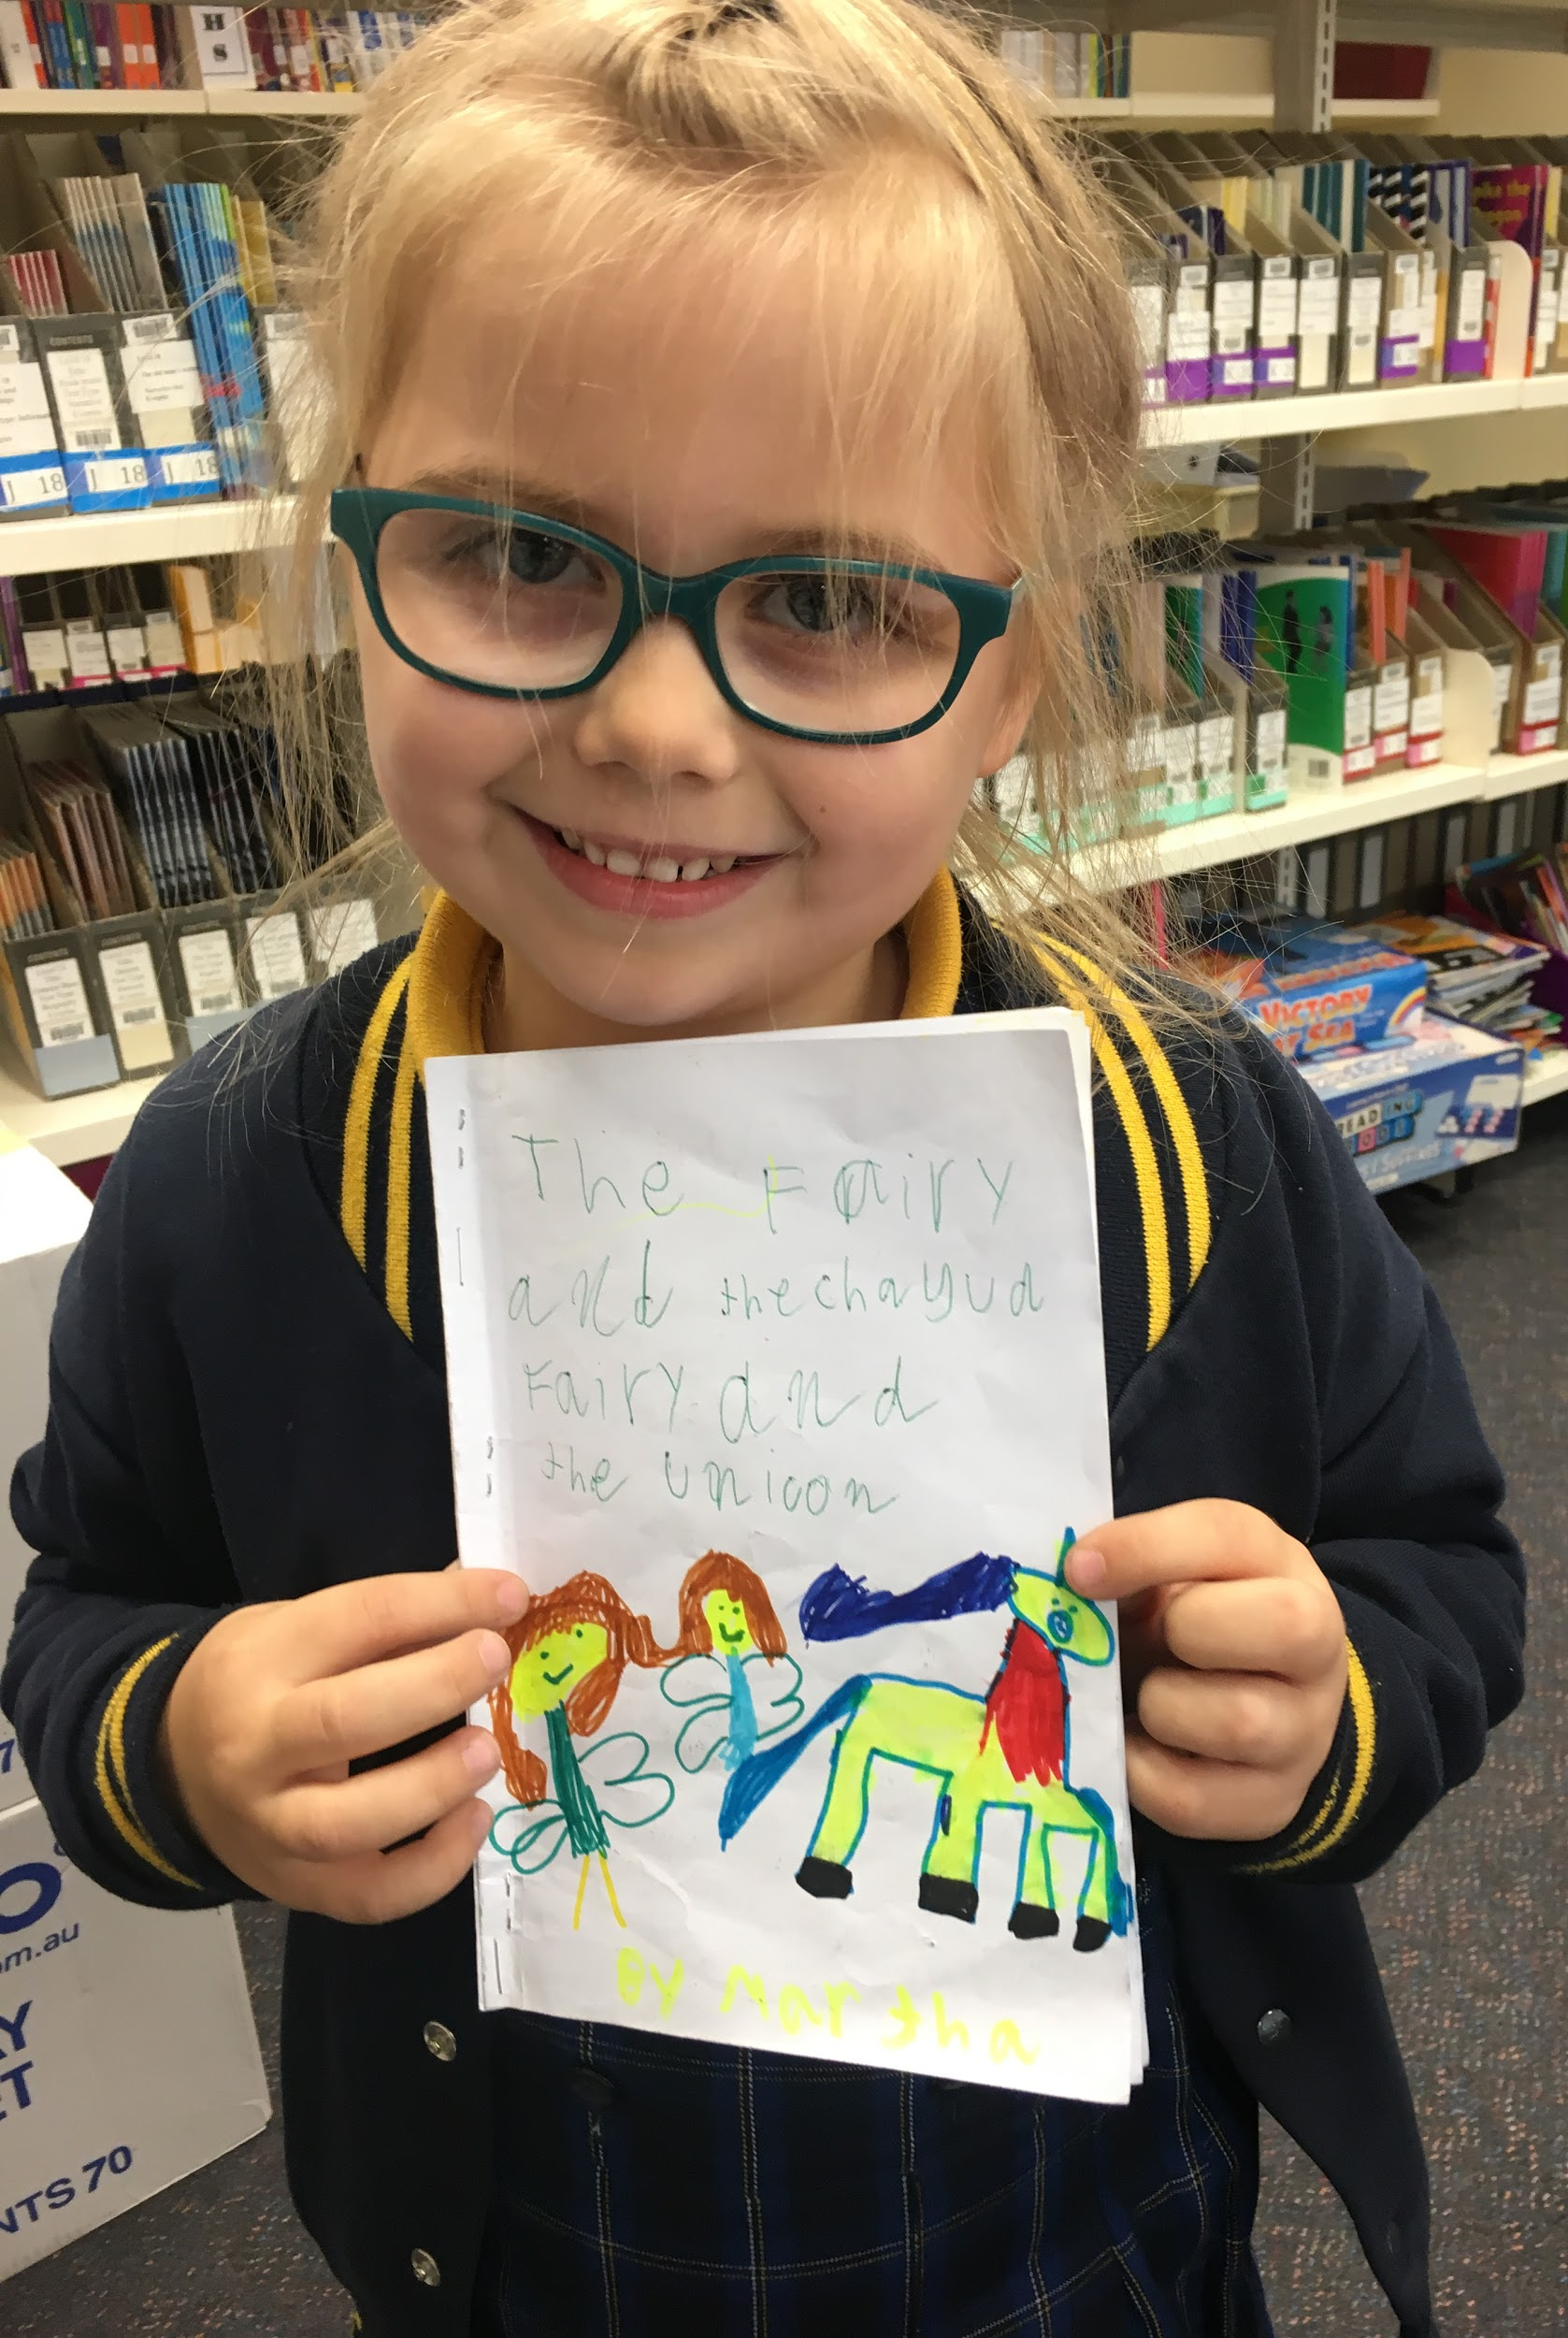
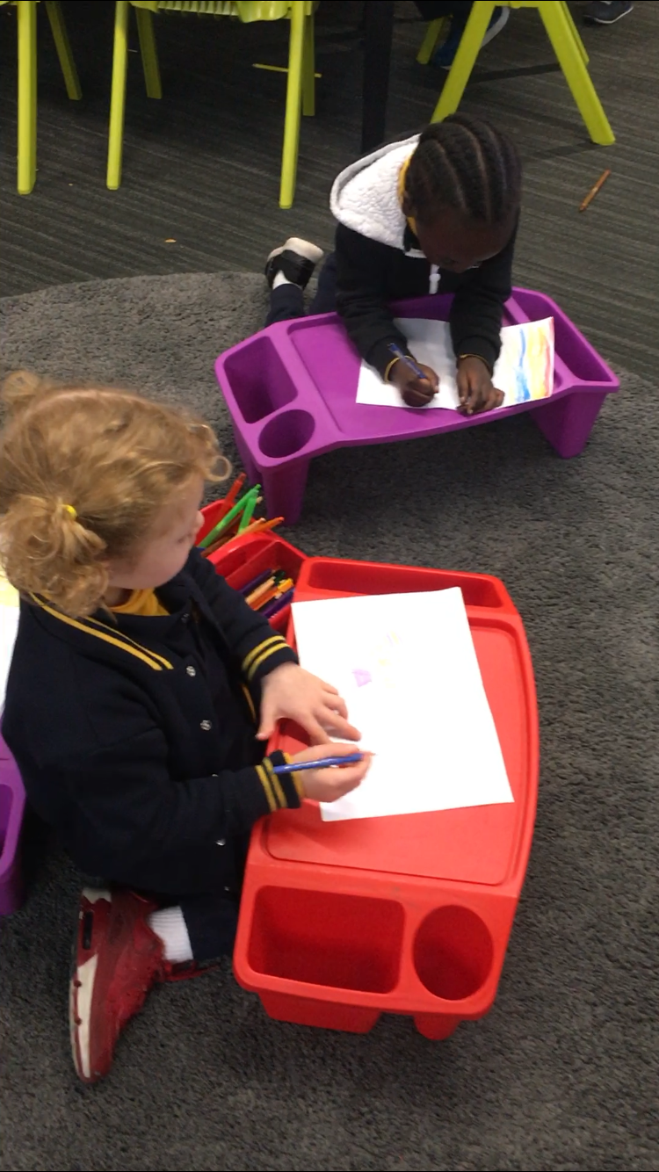
Empowering children as writers
Using a book making approach to writing Claire Mathieson Rita Totino

Slide 2
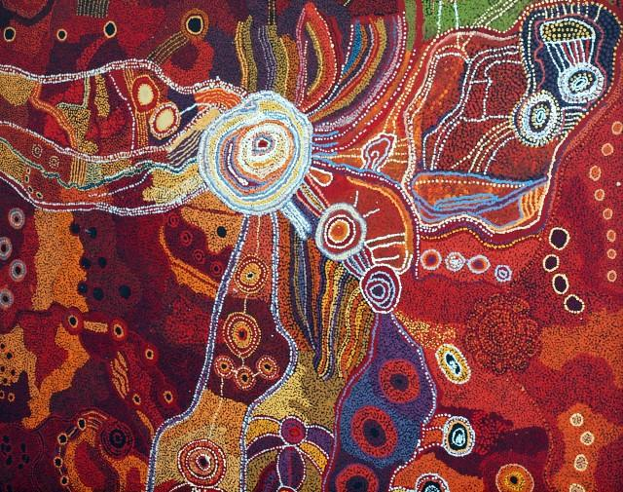
I acknowledge the traditional owners of the land we meet on today and show respect for their spiritual relationship with country. I pay my respect to Elders, past, present and future.
I acknowledge and value indigenous ways of learning, gaining inspiration from these ways of working alongside children. I reflect on the importance of community, identity, belonging and relationships in active learning.

Slide 3
By the end of this workshop you will...
have an understanding of the pedagogy of bookmaking
be exposed to the components of bookmaking
be exposed to the term ‘nudge’
have an understanding of why teachers do not scribe in bookmaking
be exposed to the mentor texts
see what children can produce when they see themselves as writers

Slide 4
Pedagogy of Writing - Bookmaking/ Writer’s Notebook
Lisa Burman
“It is an attitude or a pedagogical stance, not a lesson structure or programme.”
Bookmaking is “concerned with helping children to think like writers, act like writers and see themselves as writers... not just to be able to reproduce a certain text type.”

Slide 5
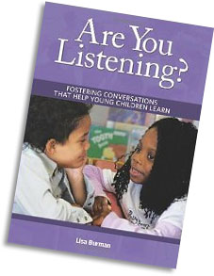
2 Days with Lisa Burman
What is the Bookmaking approach about?
strategic design of writing workshops
quality modelling, explicit teaching, feedback
investigation of texts - structure, deliberate choice of words, format, illustrations
time to develop the craft of writing - drafting, revising, editing
building students’ confidence to see themselves as writers
Building dispositions - persistence, reflection,

Slide 6
Why bookmaking?
Children see people reading books- purpose clearer
Honour the writer’s approximations
Flip our thinking - What the writer CAN do, not what they can’t do - from a competent view not a deficit
Encourages bigger thinking over time
Crafting of books is accessible learning for all children
Young children are engaged when making ‘stuff’ - things you can do when you’re ‘done’ - read to a friend, re-read, making changes
Build a connection to reading via joyful experiences with picture books

Slide 7
Components of bookmaking learning
Connection
Make connections from previous learning - Yesterday we were thinking about the purpose of our writing...
2. Learning intention
Make the learning intention clear - the focus for today’s learning

Slide 8
Components of bookmaking learning
3. Teach :Demonstrate/Model/ Explicit teaching- Mini lesson
After demonstrating…
Children have a turn at using the strategy, discussing how it works; also talk about what they plan to do in independent writing
4. Independent practice (gradually build writing stamina 35 mins)
Transfer what has been taught in the mini lesson to their independent writing - when it is the right time for the learner not for all to do t the same time

Slide 9
Components of bookmaking learning
5. Reflection
Reinforce and extend the learning intention from the mini lesson
Teacher spotlights children’s writing...talk about who used the strategy...what did you do first...how did it work for you?.. Did you get stuck?...when you were in the learning pit, what did you try to help you get out of the pit?
Children talk about the thinking they used in their writing

Slide 10
Notes:
Reflection tool sheet…
https://docs.google.com/document/d/1k566tivHZ9MdbQJmJCZdAtDPQxIQWzUZkLdO2YSg6sM/edit

Slide 11
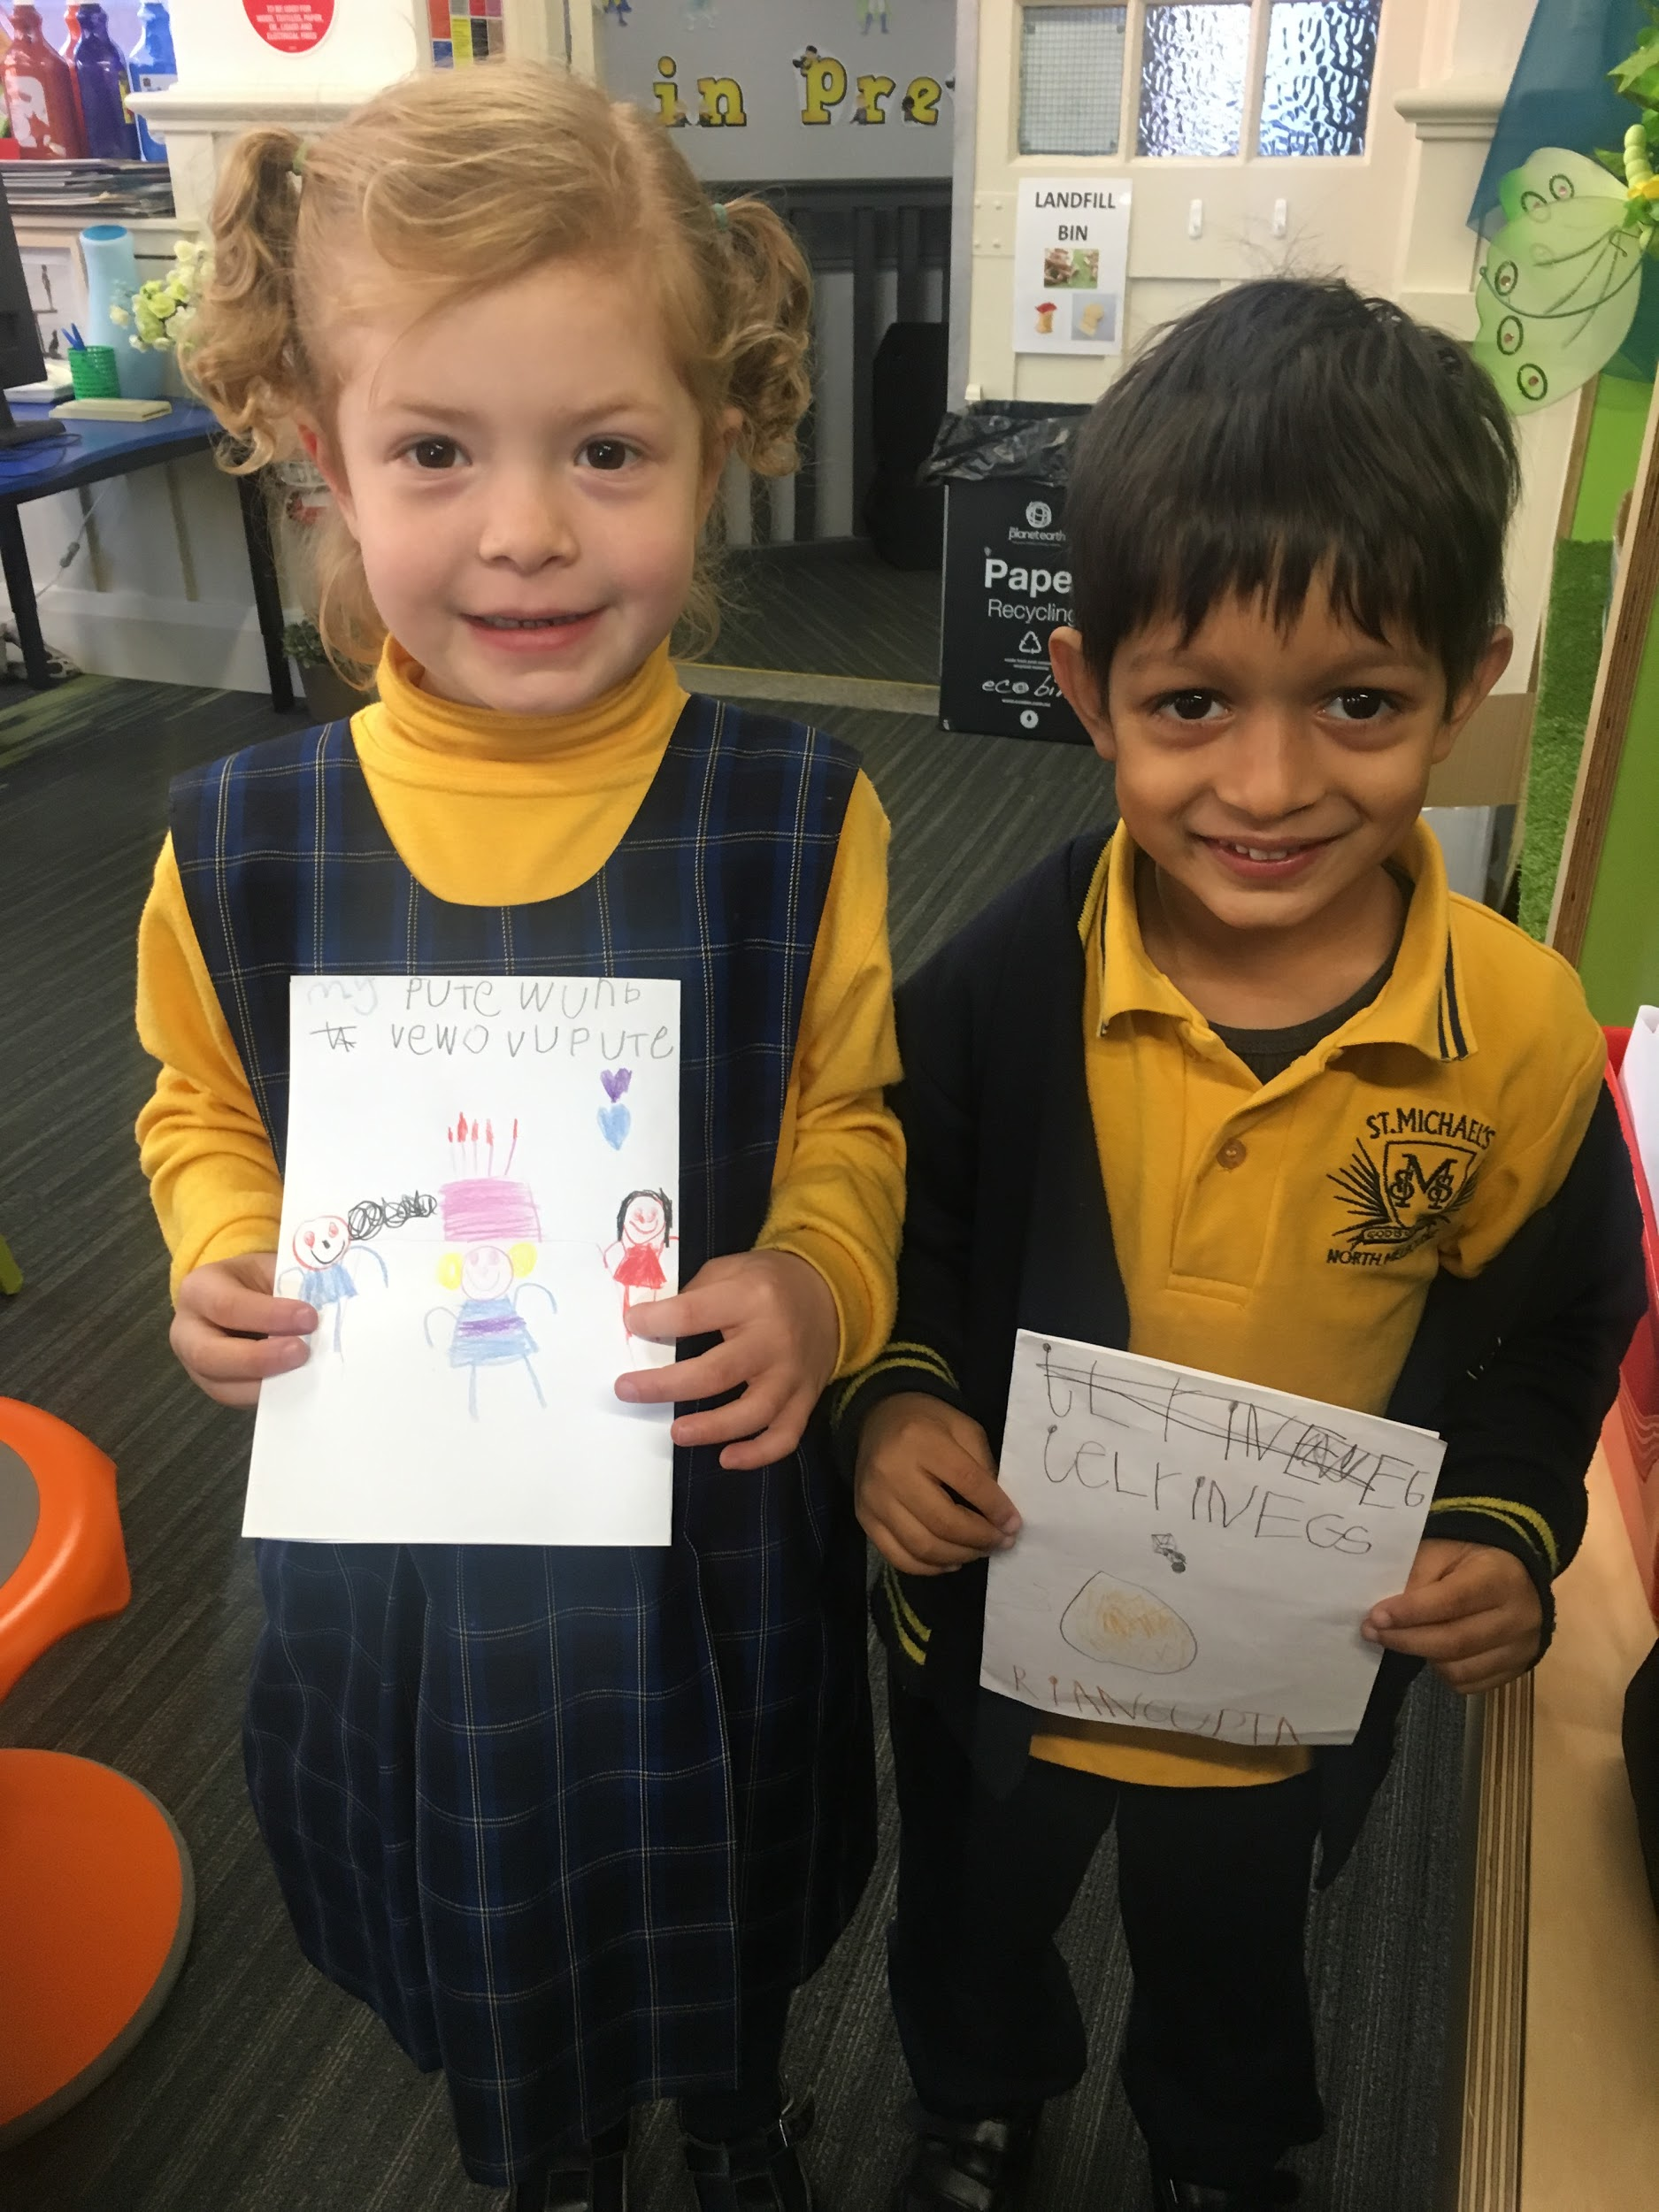
IT’S
GO TIME!!
Make your own book.

Slide 12
What is a ‘nudge’?
Nudge, don’t push
• Intention is to move writer FROM WHERE they are right now, forward
• Pushing is likely to encounter resistance... nudging generally
doesn’t
• Nudging is a co-construction between you and the writer
• Nudging works with STRENGTH based, not deficit view

Slide 13
To scribe or not to scribe...
Article:
‘Why I Choose Not to Scribe in Bookmaking.’
By Lisa Burman

Slide 14
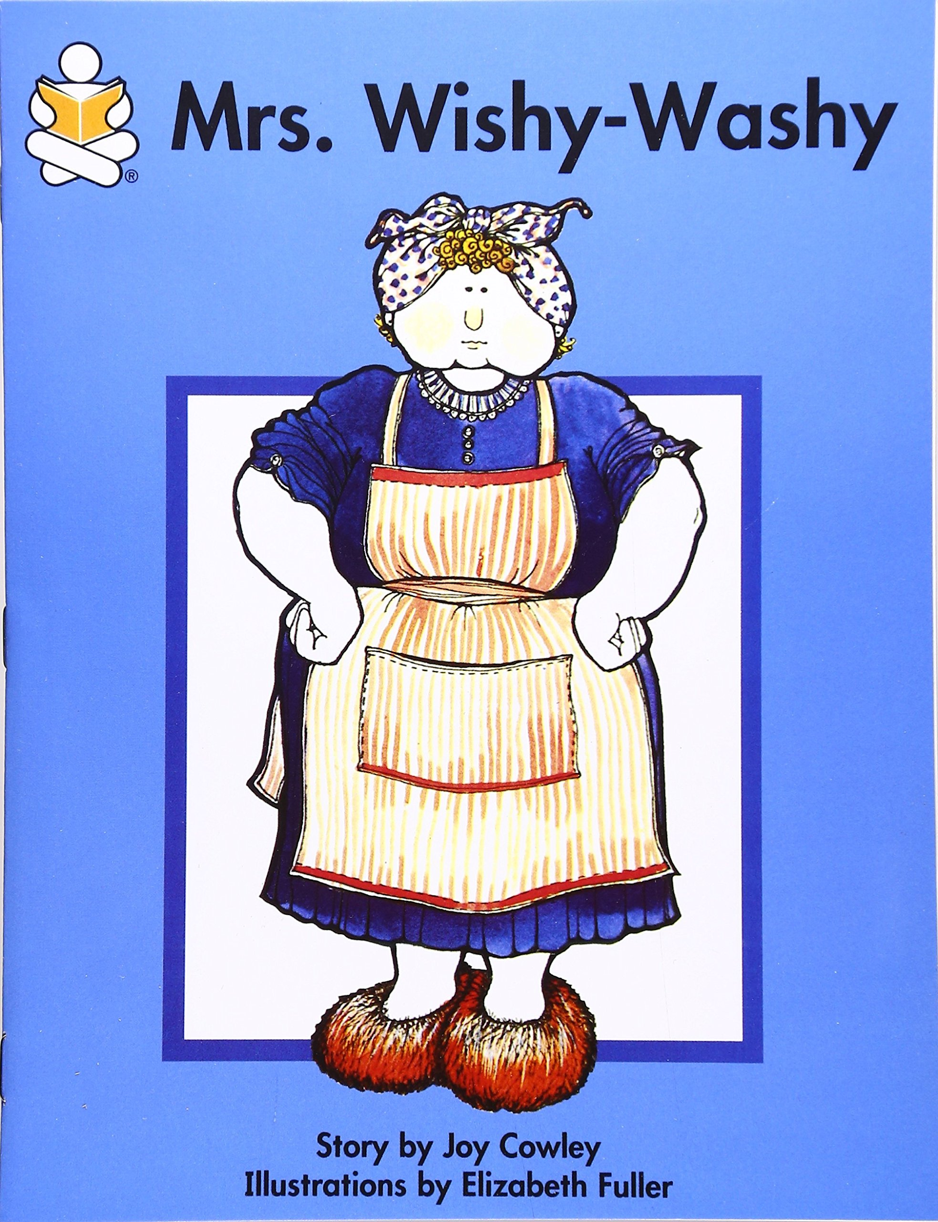
Mentor Texts
Published and classroom authors can be mentor texts
Familiar texts
Various text types and purposes
Inspire students, give them a structure to use
Teacher modelled

Slide 15
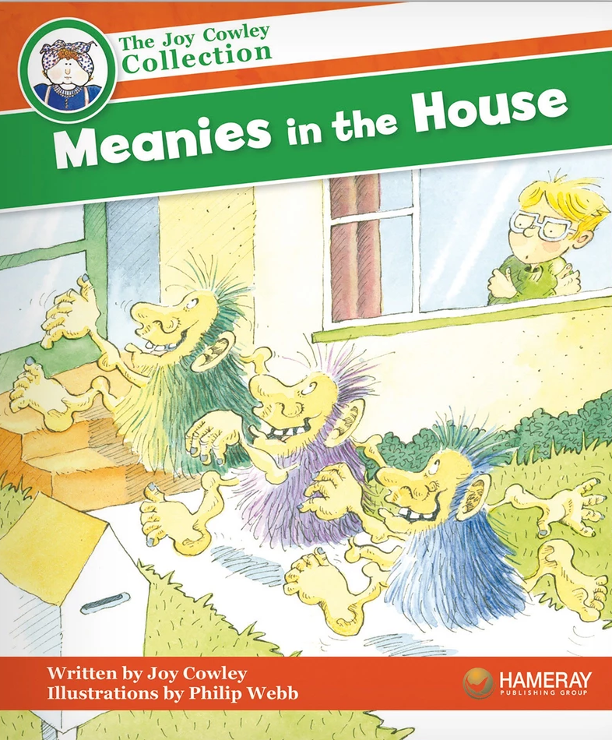
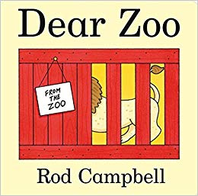
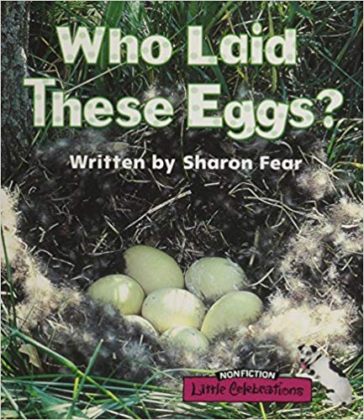
Look at some Mentor Texts
What decisions has the author made?
What has the writer done on purpose?
Word choice
Sentence length/beginnings
Repetition
Structure
Range of punctuation
Text and illustration layout

Slide 16
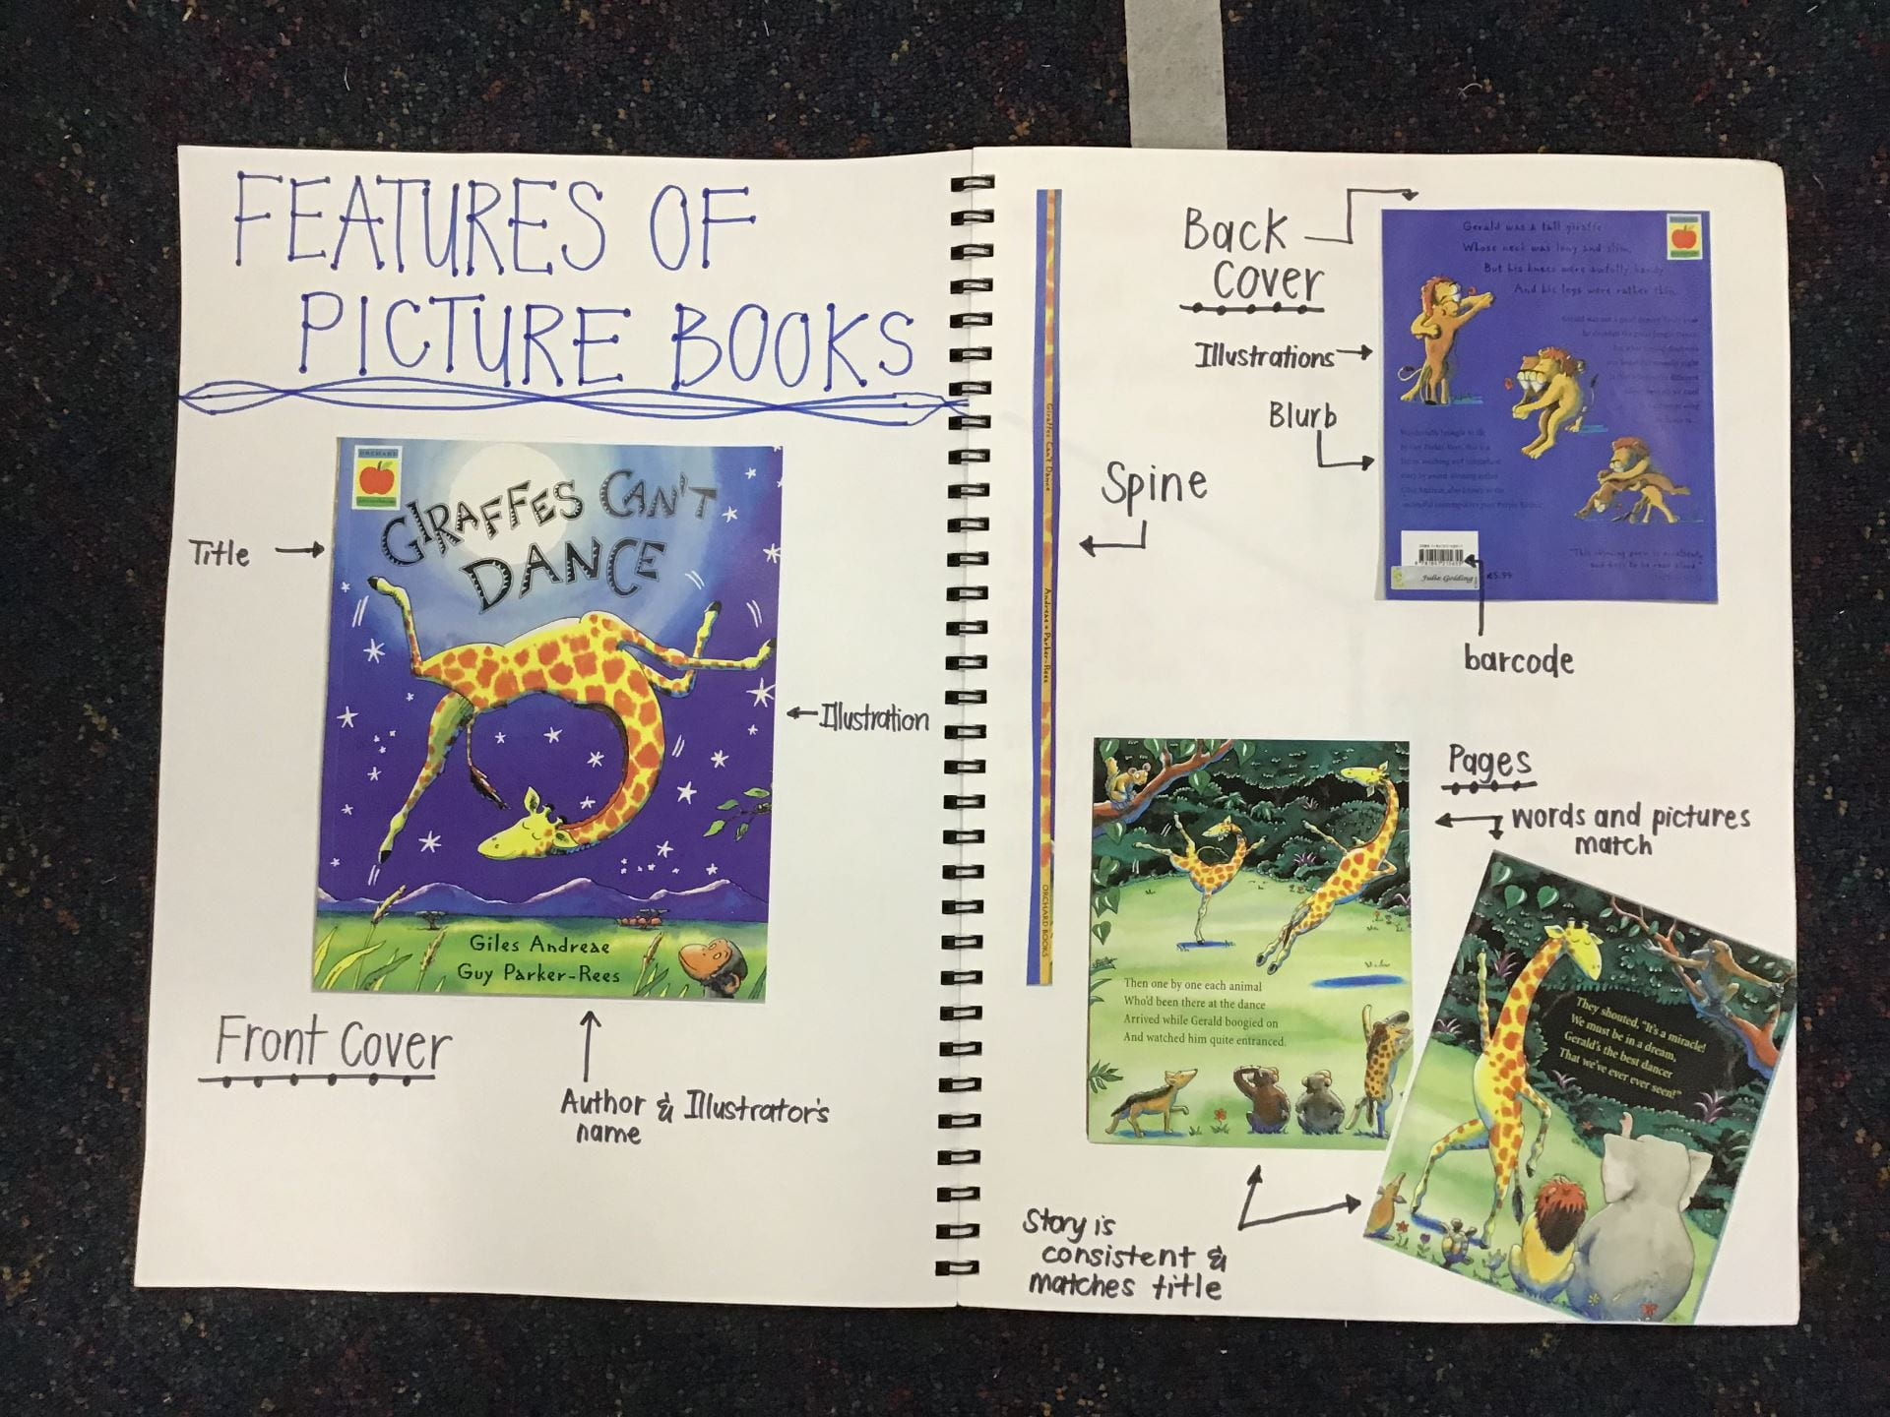

Slide 17
Where to next for us?
PLT for the P-2 team
Pedagogy behind bookmaking
Understand why we do not scribe
Strengthen the mini lessons - powerful use of mentor texts
Refine and embed the use of ‘nudges’
Keep on writing developing our craft...empower children to see themselves as competent writers and celebrate their successes
WHERE TO FROM HERE FOR YOU?
Where to from here for you?
Notes:
Where to from here for you?

Slide 18
Claire Mathieson
cmathieson@smnthmelbourne.catholic.edu.au
Rita Totino
rtotino@smnthmelbourne.catholic.edu.au

