Slide 1
Cluster 4th March 2019
How can student initiated inquiries develop curiosity, creativity and deep thinking?

Slide 2
Welcome
St Mary MacKillop, Keilor Downs
St Paul’s, Kealba
St Catherine of Sienna, Lalor West
St Peter’s, Epping
St Brigid’s, Gisborne
St Anne’s, Sunbury
St Michael’s, North Melbourne
St Mary’s Lancefield

Slide 3
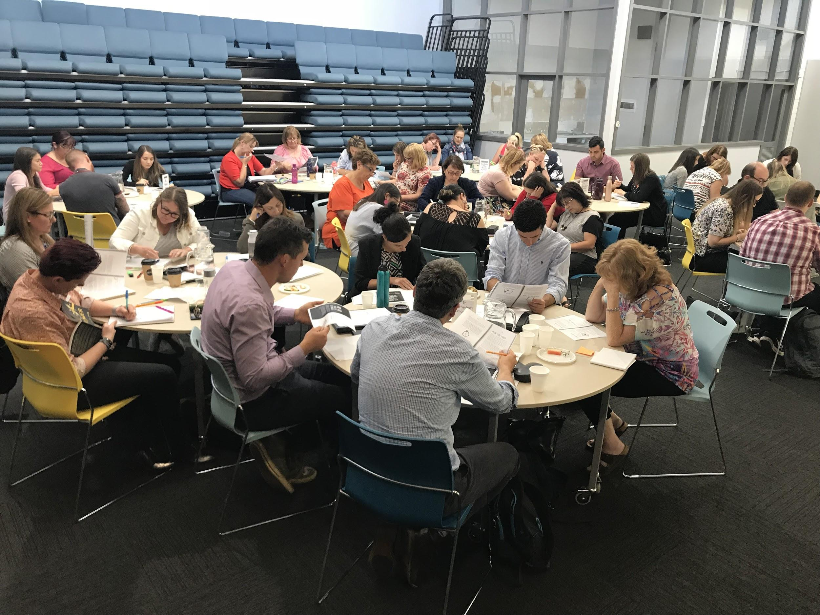
Purpose of the cluster
To engage in Professional Learning with and from each other in order to explore effective ways of using
student-initiated inquiry to; develop learner capabilities, unleash curiosity and creativity, and deepen student thinking.

Slide 4
Outline for today
Focus: How can student initiated inquiries develop curiosity, creativity and deep thinking?
What are the key characteristics of ‘Student-initiated inquiry,’ and why do we do it?
How can we ensure ‘rigour’ in the projects our students undertake? (Curiosity and creativity)
How are we travelling with our implementation? What goals/actions will we set for ourselves in 2019?

Slide 5
What do we mean by the term ‘project’

Slide 6
Clarifying terminology
Genius Time
Passion Projects
iTime
Maker Spaces
Einstein Time
80:20 time
DIY
#makeknowdoact
Student-initiated inquiry
PBL x 2!!!
What you call it doesn’t matter.
Why you do it does!

Slide 7
What it is:
A powerful learning opportunity
Student-owned and student-driven
Relevant/meaningful
Rigorous and strategic
Creative and entrepreneurial
Focussed on developing the student as a competent, curious and capable learner
Strongly connected to and goes beyond the curriculum

Slide 8
What it’s not:
Free-time (for students and/or teachers)
Laissez faire (fluffy)
Electives program
Focussed on the end product
‘Housed’ within your inquiry topic
Contrived to make kids passions connect to the big ideas in your inquiry topic

Slide 9
Why do you do Student-initiated inquiry? What are the learning benefits for your students?
Discuss in groups then write single ideas on cards

Slide 10
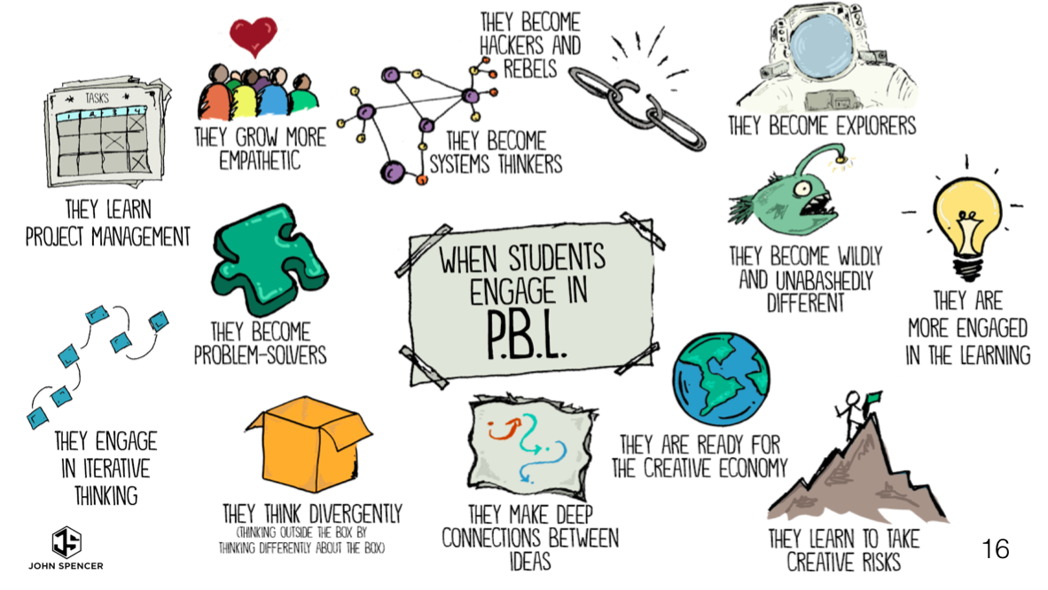

Slide 11
A J Juliani
Your class will be covering all types of common core standards
It’s differentiation at it’s best
You learn by what you do, not by what you hear
It’s a perfect way to model life long learning
Your students will never forget what it’s like to create
You will join a great community of learners
You will allow students to get into depth with a topic that inspires them
There is so much positive peer pressure
It relieves students of the game of school
It’s fun

Slide 12
What are the key characteristics of effective Student-initiated inquiry in Years 3-6?
In cross school groups share the things that you have brought with you to showcase things that you trialled last year, or have already started on this year.
As a group list the things that you believe are the key elements/characteristics of successful ‘student-initiated inquiry’ on a poster.

Slide 13
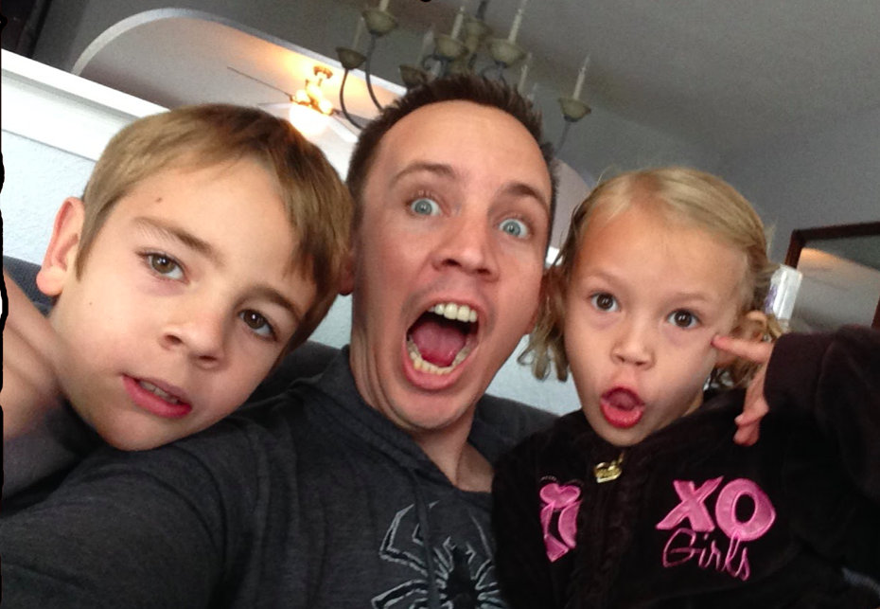
John Spencer
https://www.youtube.com/watch?v=crMM4z3oKmQ
Some further thinking about the key characteristics of effective Student-initiated inquiry in Years 3-6….
And reflecting on our learnings from 2018

Slide 15
Pathways
If our expectations are rigorous, each of these pathways will lead to questioning and inquiring as well as creativity

Slide 16
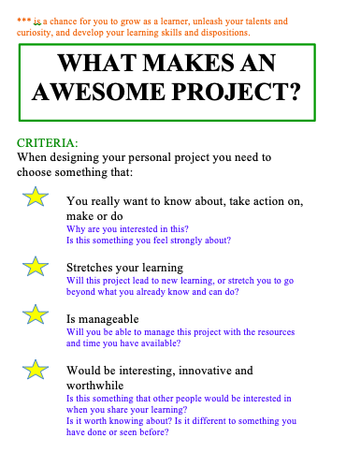
It is critical that each child chooses the right project for them.
This may take some time and they make make mistakes along the way.
Share the ‘why are we doing this’ with them right from the start.
The teacher can provoke, and nudge, and challenge but students need to own, and be accountable for their own decisions.

Slide 17
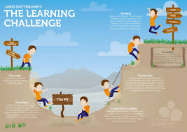
So what is the learning for students?
Personal management skills
Persistence and resilience
Collaboration
Critical thinking
Creative thinking
Flexibility
Questioning
Reflecting and evaluating
Literacy/communication skills
Mathematical concepts
All students, no matter what their ‘project’ will be engaged in developing learner skills and dispositions

Slide 18
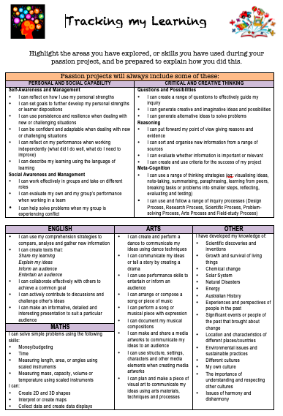
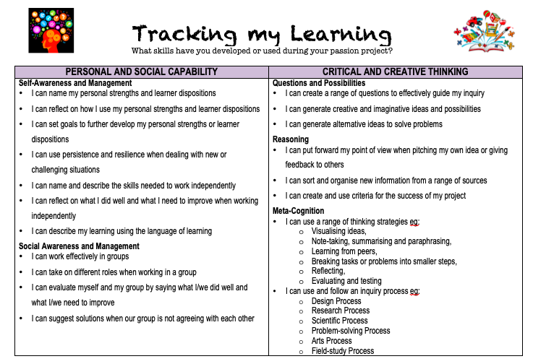
Just because different students will be learning or achieving different outcomes at different times through different projects doesn’t mean we can’t assess and value this learning. We need to think differently about how we do it!

Slide 19
Ways of assessing and documenting
Through learning conversations:
Formalised conferences
Roving conferences
Share times
Google docs
Checklists (what are you looking for)
Anecdotal notes
Peer and self assessment (using criteria)
Tracking tools
Student rubric
‘What makes a good project’
Learning stories
Learning journals (documenting throughout the process)
Photos
Words, diagrams, pictures, flow charts
Voice recordings
Blogging
Warning: Beware of ‘over-scaffolding’!
Don’t kill the project through making the reflection stage too prescriptive and onerous!

Slide 20
LOGISTICS
When
Where
How

Slide 21
Logistics: Timing and structure
When we stop thinking out it as ‘outside’ the curriculum or an extra- how we ‘fit it in’ becomes less of a problem!
Not one size fits all!
Structure of a session: focussed introduction, sharing (students talk), sustained time to work on projects (flow theory) Dedicated session or integrated through the day?
How long should a session go for? Engagement and sustained focus-no less than 1 hour
When to reflect and record? Reviewing your plan, setting goals, reflecting and recording, gaining feedback.
How long should a project go for? As long as it takes!

Slide 22
Sharing
What is the best way to share my project with others?
Purpose and audience!
Sharing the process not just the product (what do we value?)
Presentation - to whom?
Showcase or expo (communal or just in time)
Run a workshop
Written publication- newsletter, blog, website, film premiere, book launch
Visual presentation- Where? Who is the audience?

Slide 23
Role of the teacher Guide on the ride!
Have and communicate high expectations (of their capabilities and their projects)
100% present 100% of the time
Develop a culture and language of learning (risk taking, mistakes are an opportunity to learn, collaboration even when engaging in individual projects, reflection and respectful challenge)
Scaffold the right amount for each learner (ZPD) support, nudge, challenge not rescue
Give constructive feedback (scheduled conferences, roving conferences, share time)
Identify and explicitly teach skills, processes, dispositions eg through introductions, conferences etc

Slide 24
Reflect and discuss
In home school groups reflect on your own key learnings from 2018
I used to think… now I think…. I’m still wondering about…

Slide 25
How can we ensure ‘rigour’ in the projects our students undertake?
For a project to have rigour we assume that it encompasses curiosity/inquiry and creativity
What is creativity???

Slide 26
Making the learning visible
Project choice
Planning
Self management
Collaboration
Dispositions
Reflection
Feedback
Sharing

Slide 27
Individually brainstorm ideas or possible projects you might be interested in under each of the pathways: Make, know, do, act
These projects should be authentic to your interests, not what you think kids might choose!
As a group combine and record your ideas on a poster

Slide 28
Individually or with a partner choose one idea to shape into a possible project
Check your idea matches the criteria for choosing an awesome project
Create a plan of what you would need to do in order to complete this project

Slide 29
What inquiry is present in this project? What questions would you need to ask and explore?
If creativity is about: ‘having an original thought that has value’, what creativity is present in this project?
https://www.youtube.com/watch?v=trUVJfu3XGE

Slide 30
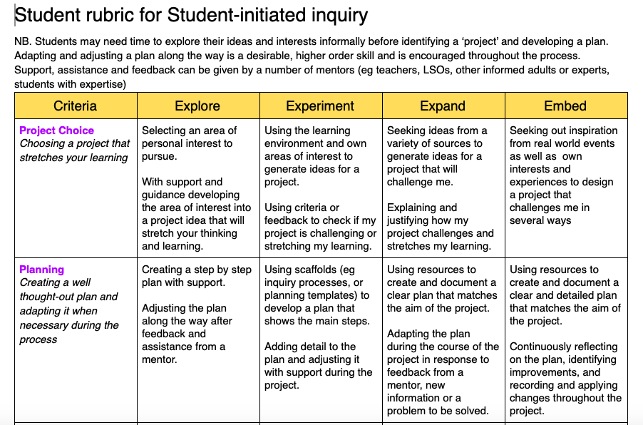
What were the demands of identifying an authentic project for yourself?
What was easy, what was challenging?
What difficulties might this present for children?
What can teachers do to support students moving along this continuum?

Slide 31
Reflection
Use the student rubric to reflect on your current practice and where your students might be ‘sitting’ now.
How do you know (what’s the evidence?)
What does this mean for where you want to take your students next, and what would you need to do in order to support them to take the next step?
Choose one area to focus on that is important for your students in moving forward and suggest some actions you might take.

Slide 32
How are we travelling with our implementation?

Slide 33
Teacher rubric
Vision
Learning Environment
Expectations
Collaboration
Differentiation
Assessment
Culture of learning
Purpose:
To identify stages of implementation in leading student-initiated inquiry.
To support teachers in the implementation of student-initiated inquiry, and identifying personal goals.
NB. Draft!

Slide 34
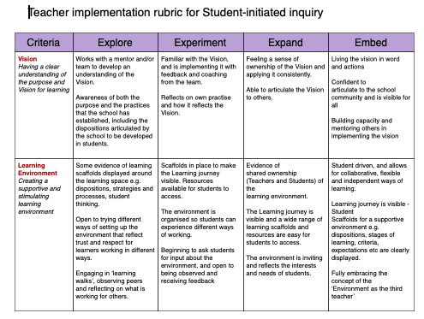

Slide 35
Read and discuss rubric
Take one line of the rubric and discuss
What would each of these stages look like in practice?
Give real life examples from your own experience where possible
What would you need to be doing to move to the next level? What support might you need?

Slide 36
Read and discuss rubric
Feedback
What is sitting well with you?
What questions do you have?

Slide 37
Home school discussion
Where do you see yourselves within the context of the rubric?
What are the implications for your school and individual teachers?
What might you want to work on?

Slide 38
Action planning
Based on everything we have looked at today identify a goal for your school moving forward.
What action steps will you need to take?
How can you support each other with your goals?
How will you know when you are successful?

Slide 39
Plenary
Share your goals with the group

Slide 40
important stuff!!!
Accessing resources: Google + Community closing soon. A new website to be launched!!!
Cancellations
Host school for terms 2 and 4
Next Cluster: Monday 27th May
P-6 Conference August 1st and 2nd @ Moonee Valley- John Spencer, James Anderson and Luke Touhill. We are also looking for practitioners (you guys) to run workshops!!!

Slide 41
Contact us
Deb Vietri
dvietri@bigpond.com
Vanessa Willis
vanessawillis06@gmail.com
Instagram @discoverybasedinquiry
Twitter
@discoverinquire
@debvietri
NB Please inform us if you do not wish your photo to be displayed on social media

