Slide 1
Discovery 18
Tuesday 14th august 2018
@Holy cross, new gisborne
How can we make authentic and explicit links between literacy, discovery and inquiry?

Slide 2
Goals for today
To make stronger, authentic connections between literacy and both teacher-initiated inquiry investigations and Discovery.
To explore some innovative ways of making links across the curriculum and timetable in a more seamless way

Slide 3
If you feel a little uncomfortable today that’s good! It means you are challenging or stretching yourself.
Not more, but different.

Slide 4
Let’s start with the why!
Why do we do what we do?
How do our beliefs shape our actions?

Slide 5
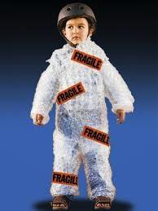
4 views of the child: Lisa Burman
We can view the child in different ways:
Innocent and fragile: They must be protected
Threatening: We must control them or the situation
Empty: We must teach them everything
Competent and capable: We must challenge them, trust them with their learning, listen to their perspective
Which of these images do you connect mostly with?

Slide 6
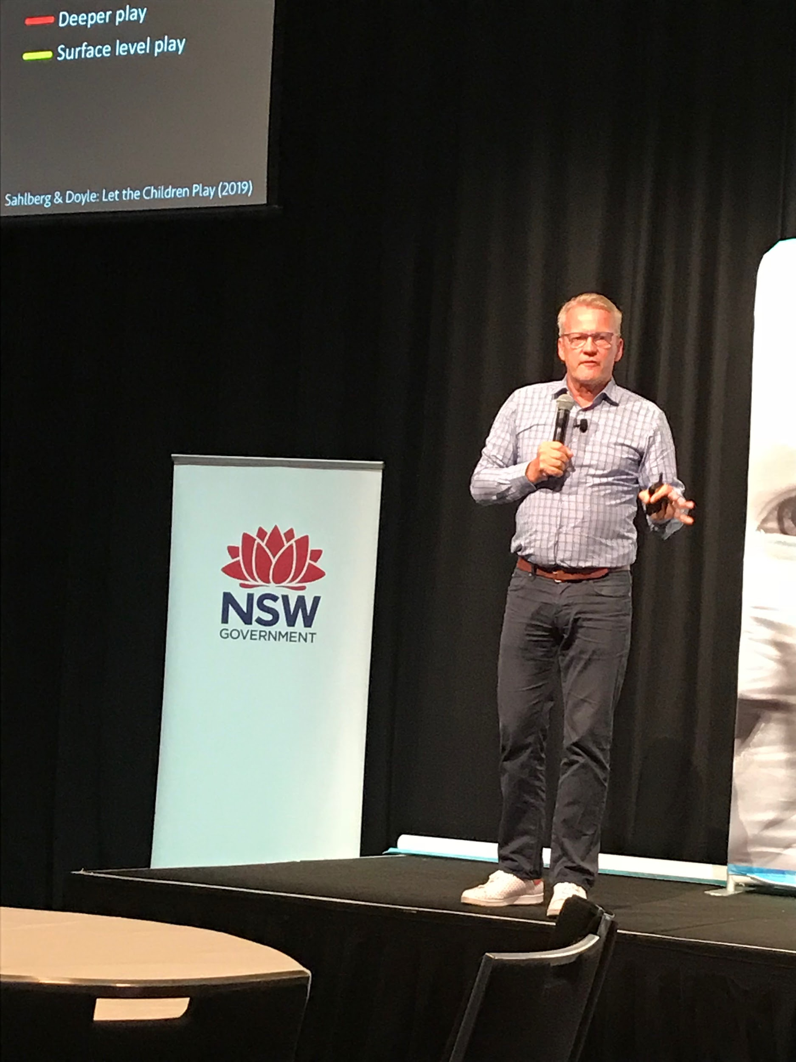

Slide 7
Spotlight on writing

Slide 8
activity
What does this statement mean to you?
What does it make you think about?
If you believe this what are the implications for your teaching?
How might this challenge some of your current practices?
Read the belief statements about writing and discuss the following questions:

Slide 9
Children learn to write by writing
Writing is a process
Writing is thinking
Reading and writing are strongly interconnected
Choice is essential to the writing process
Talk is crucial to the writing process.
Teach the writer, not the writing.
Effective writing instruction involves students writing for authentic audiences and purposes

Slide 10
Learning to write is learning to read. (Children learn to read by writing)
Our words and actions (as teachers) hold the power to create identities as learners for children. If children view themselves as writers then they will be successful writers, if they don’t see themselves as writers it will become a difficult and frustrating endeavour.
While conventions are important, teachers must also look at the intellectual, thinking side of writing.
Children gain knowledge of and interest in writing as they are continually exposed to print and writing in their environment.

Slide 11
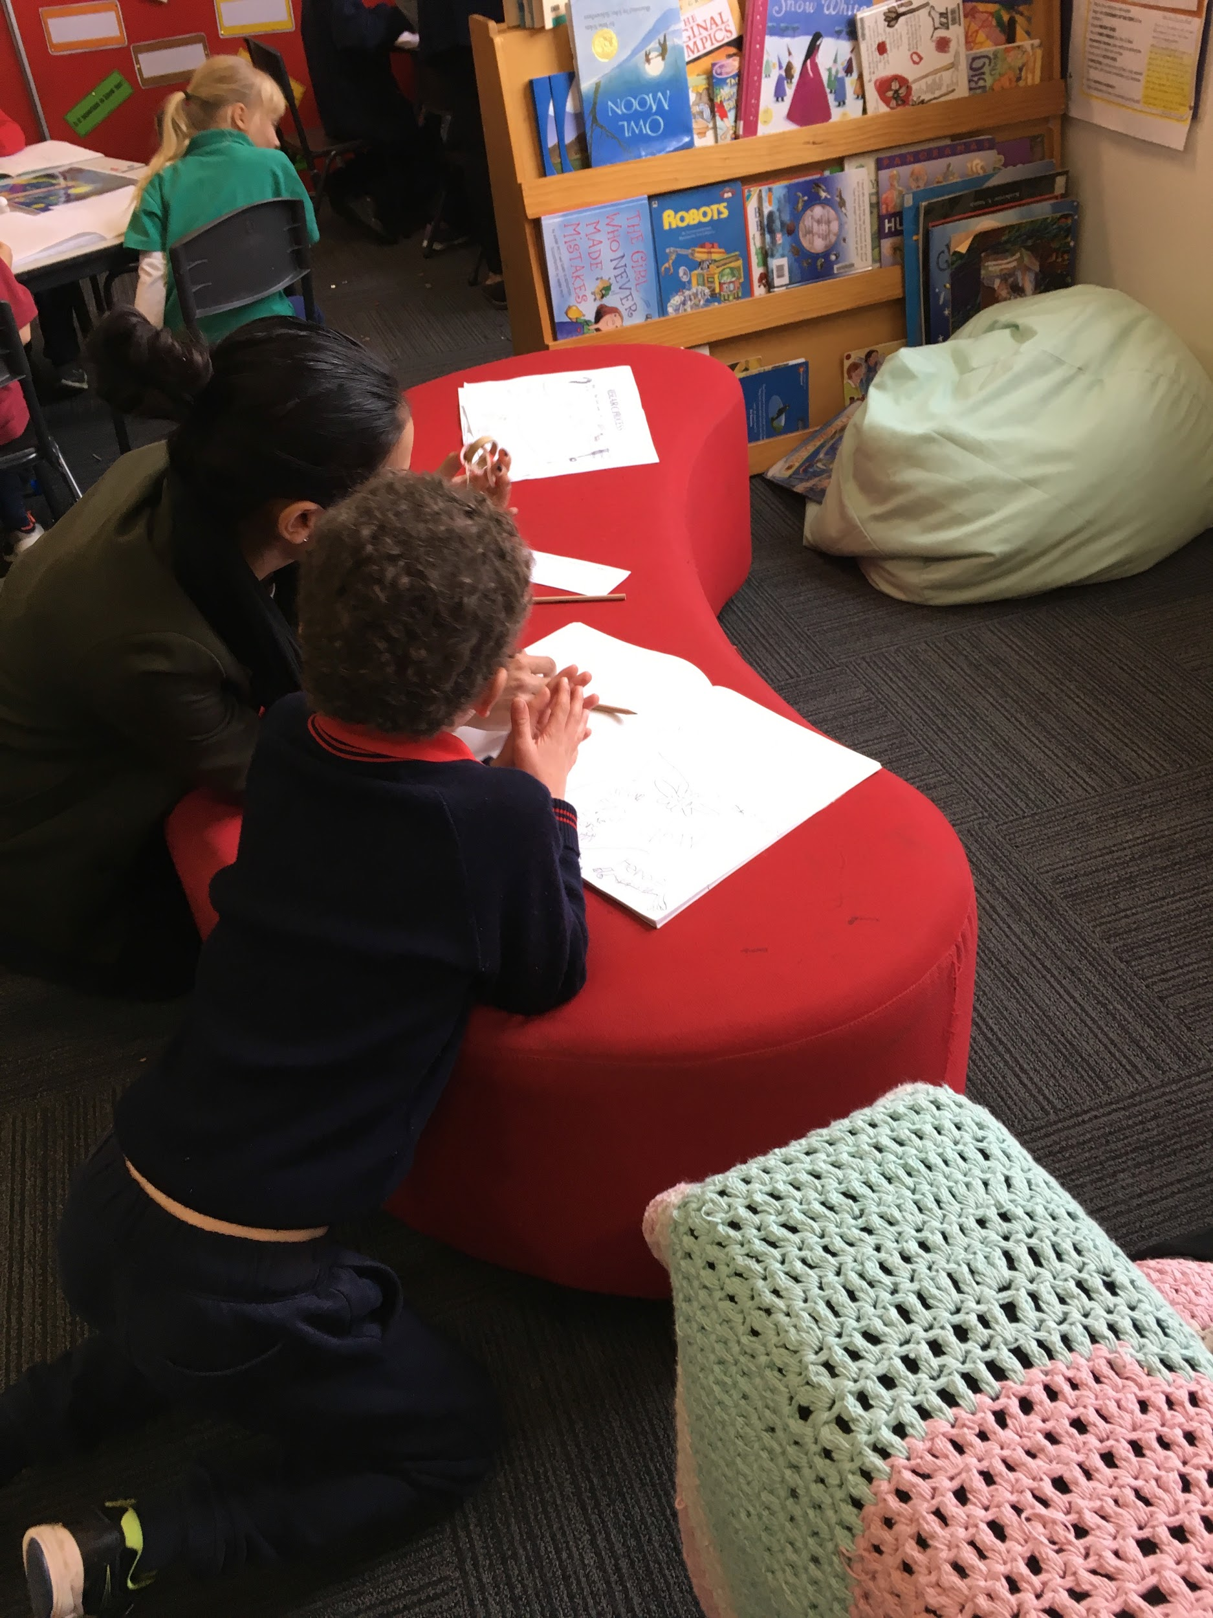
Brainstorm
What do good writers think and do?

Slide 12
Identify the elements on your list that are:
Authorial
secretarial

Slide 13
Professional Reading
How does this connect with your thinking?
How does it extend your thinking?
How does this challenge you?

Slide 14
What would you add to your brainstorm list now?
Young children are capable of remarkable thinking, especially when they are engaged in experiences that foster their intellectual growth as well as their academic growth. Much of what is written about supporting very young writers focuses on the academic aspect of writing...much less is written about the thinking aspect of writing.While the conventions are important, teachers must also look at the intellectual, thinking side of writing.
Matt Glover

Slide 15
6 traits of writing
The six-traits of effective writing are the key characteristics of good writing. When students learn the traits, they are empowered to improve their own writing because it helps them develop the language they need to talk about and examine their own writing and be thoughtful responders to other writers' work.
A research proven tool to aid the teaching and assessment of writing

Slide 16
Ideas: Good writing has clear ideas, a purpose, or focus. It should have specific ideas and details.
Organization: Writing should have a beginning, middle, and an ending and be well organized and easy to follow.
Voice: Writing should connect with the audience, fit the purpose for writing, and reveal writer’s personality and/or sense of humour.
Word Choice: Good writing has specific nouns, adjectives and verbs and strong words that deliver the writer's message.
Sentence Fluency: Sentences should vary in length, with a variety of sentence beginnings. The writing should flow smoothly from sentence to sentence.
Conventions: Strong writing is edited for grammar, punctuation and spelling so the writer's ideas are easily understood.

Slide 17
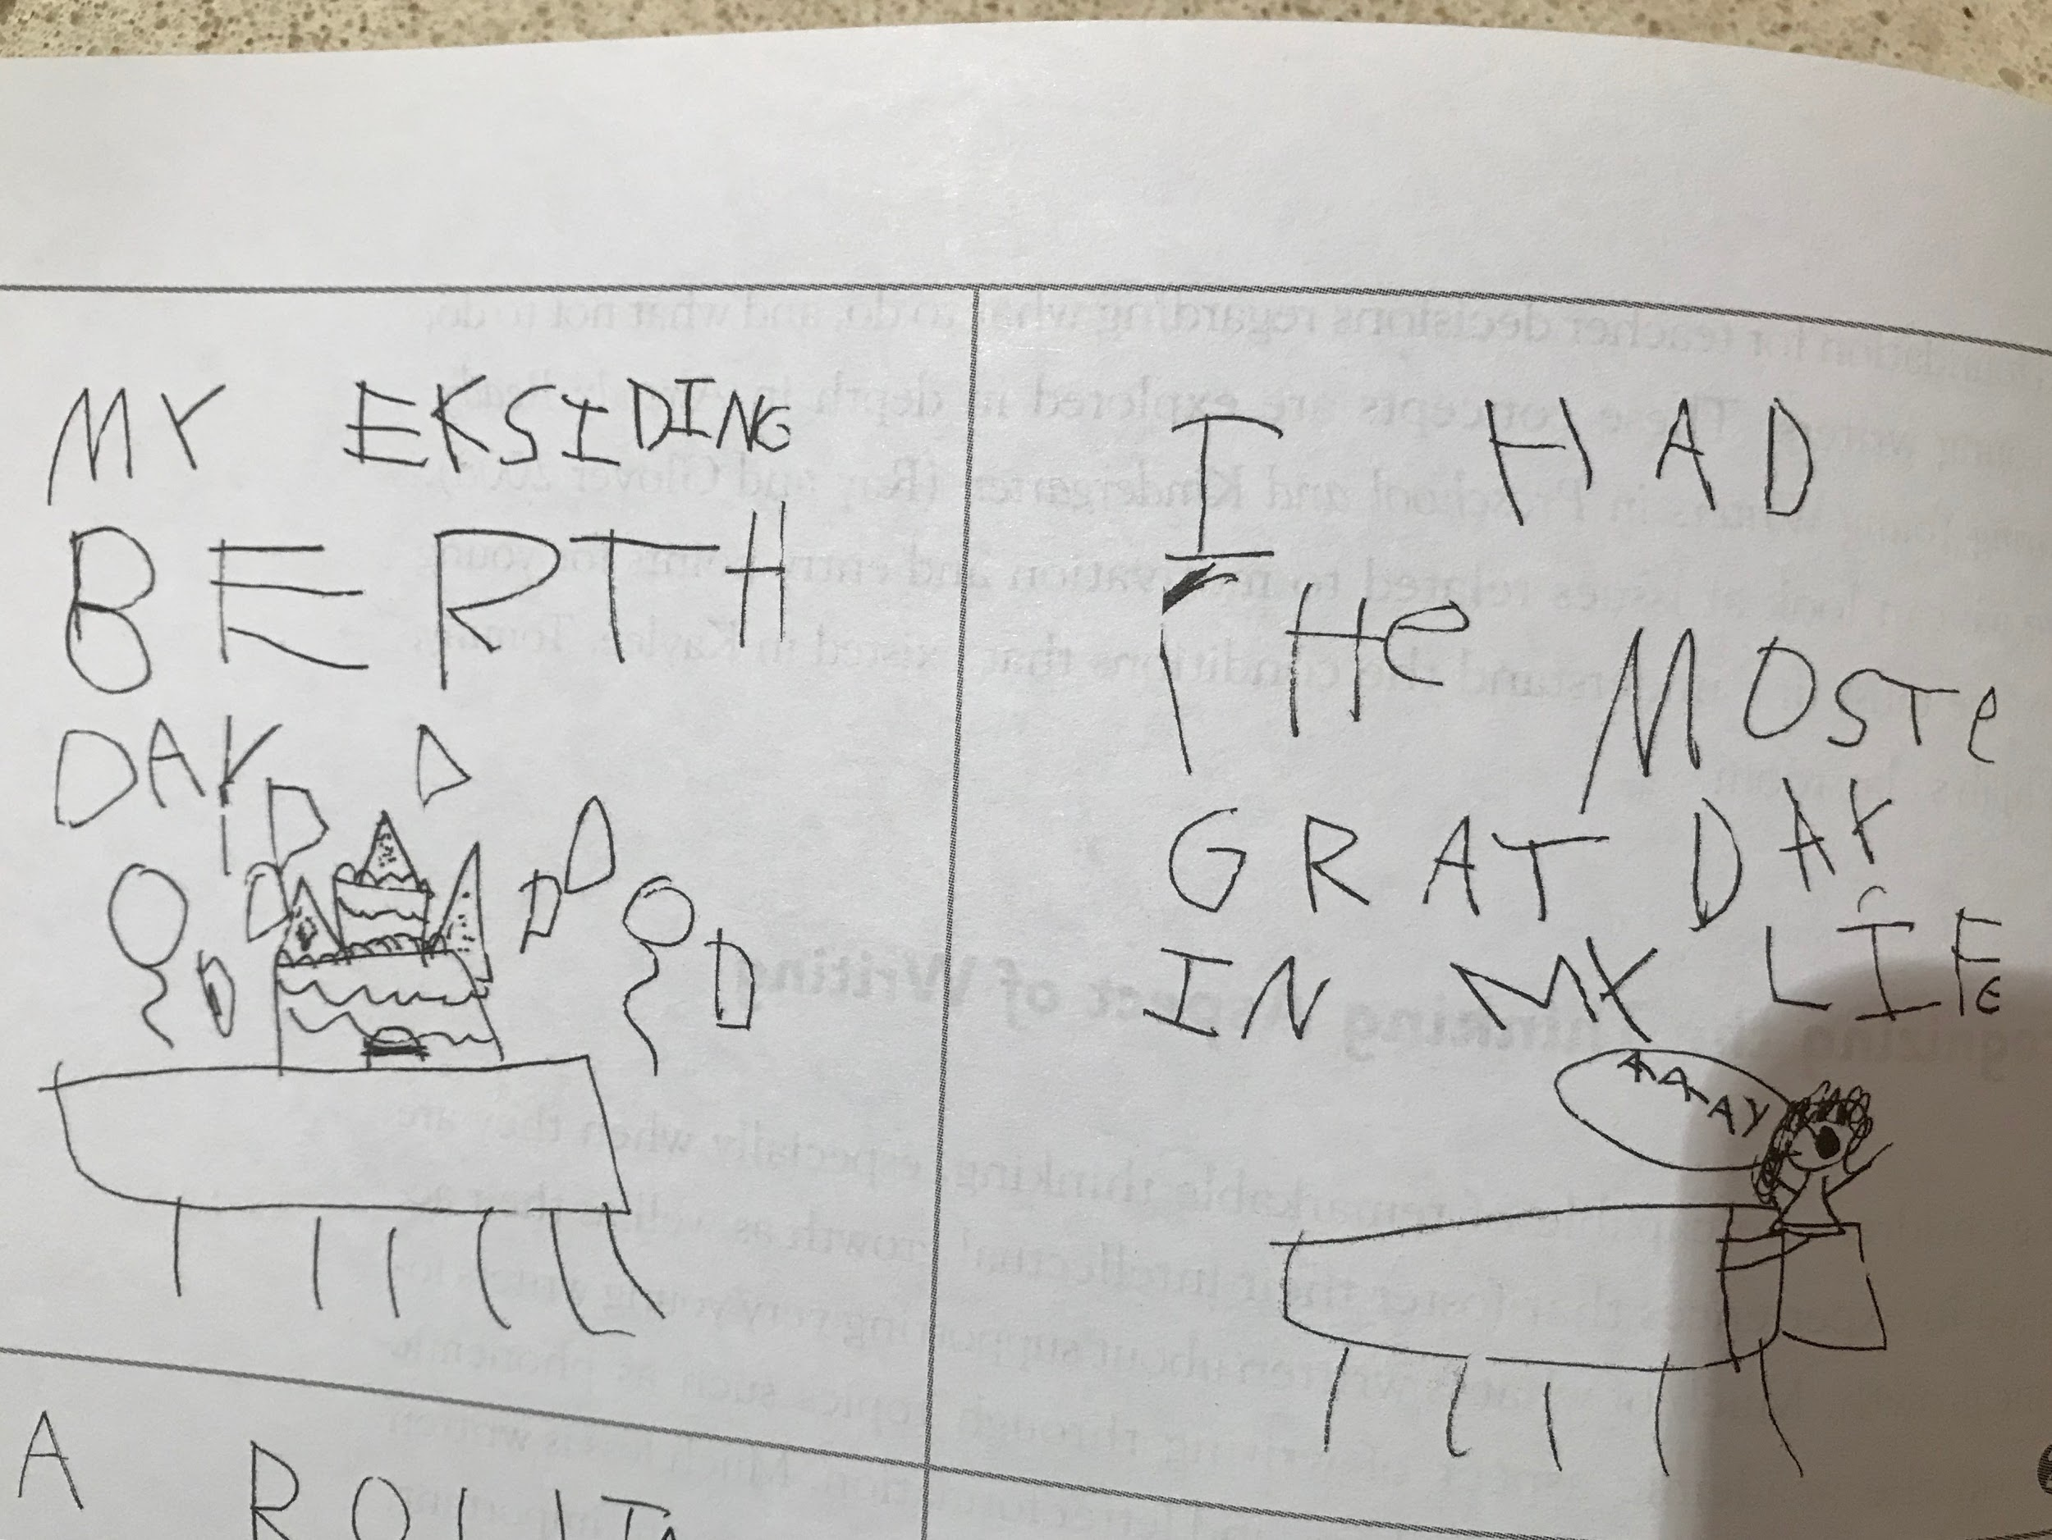

Slide 18
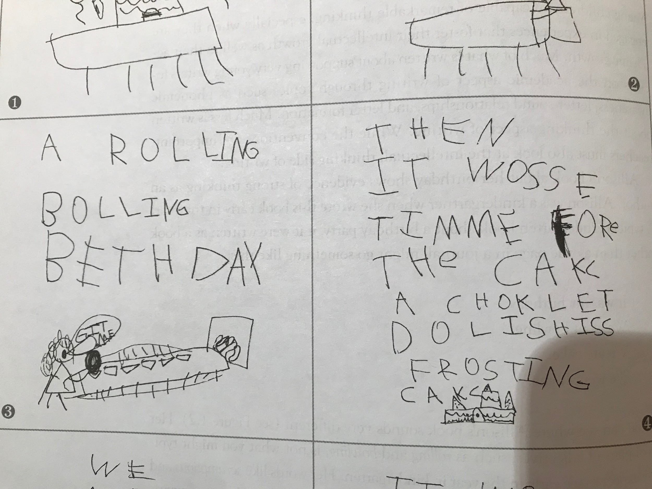

Slide 19
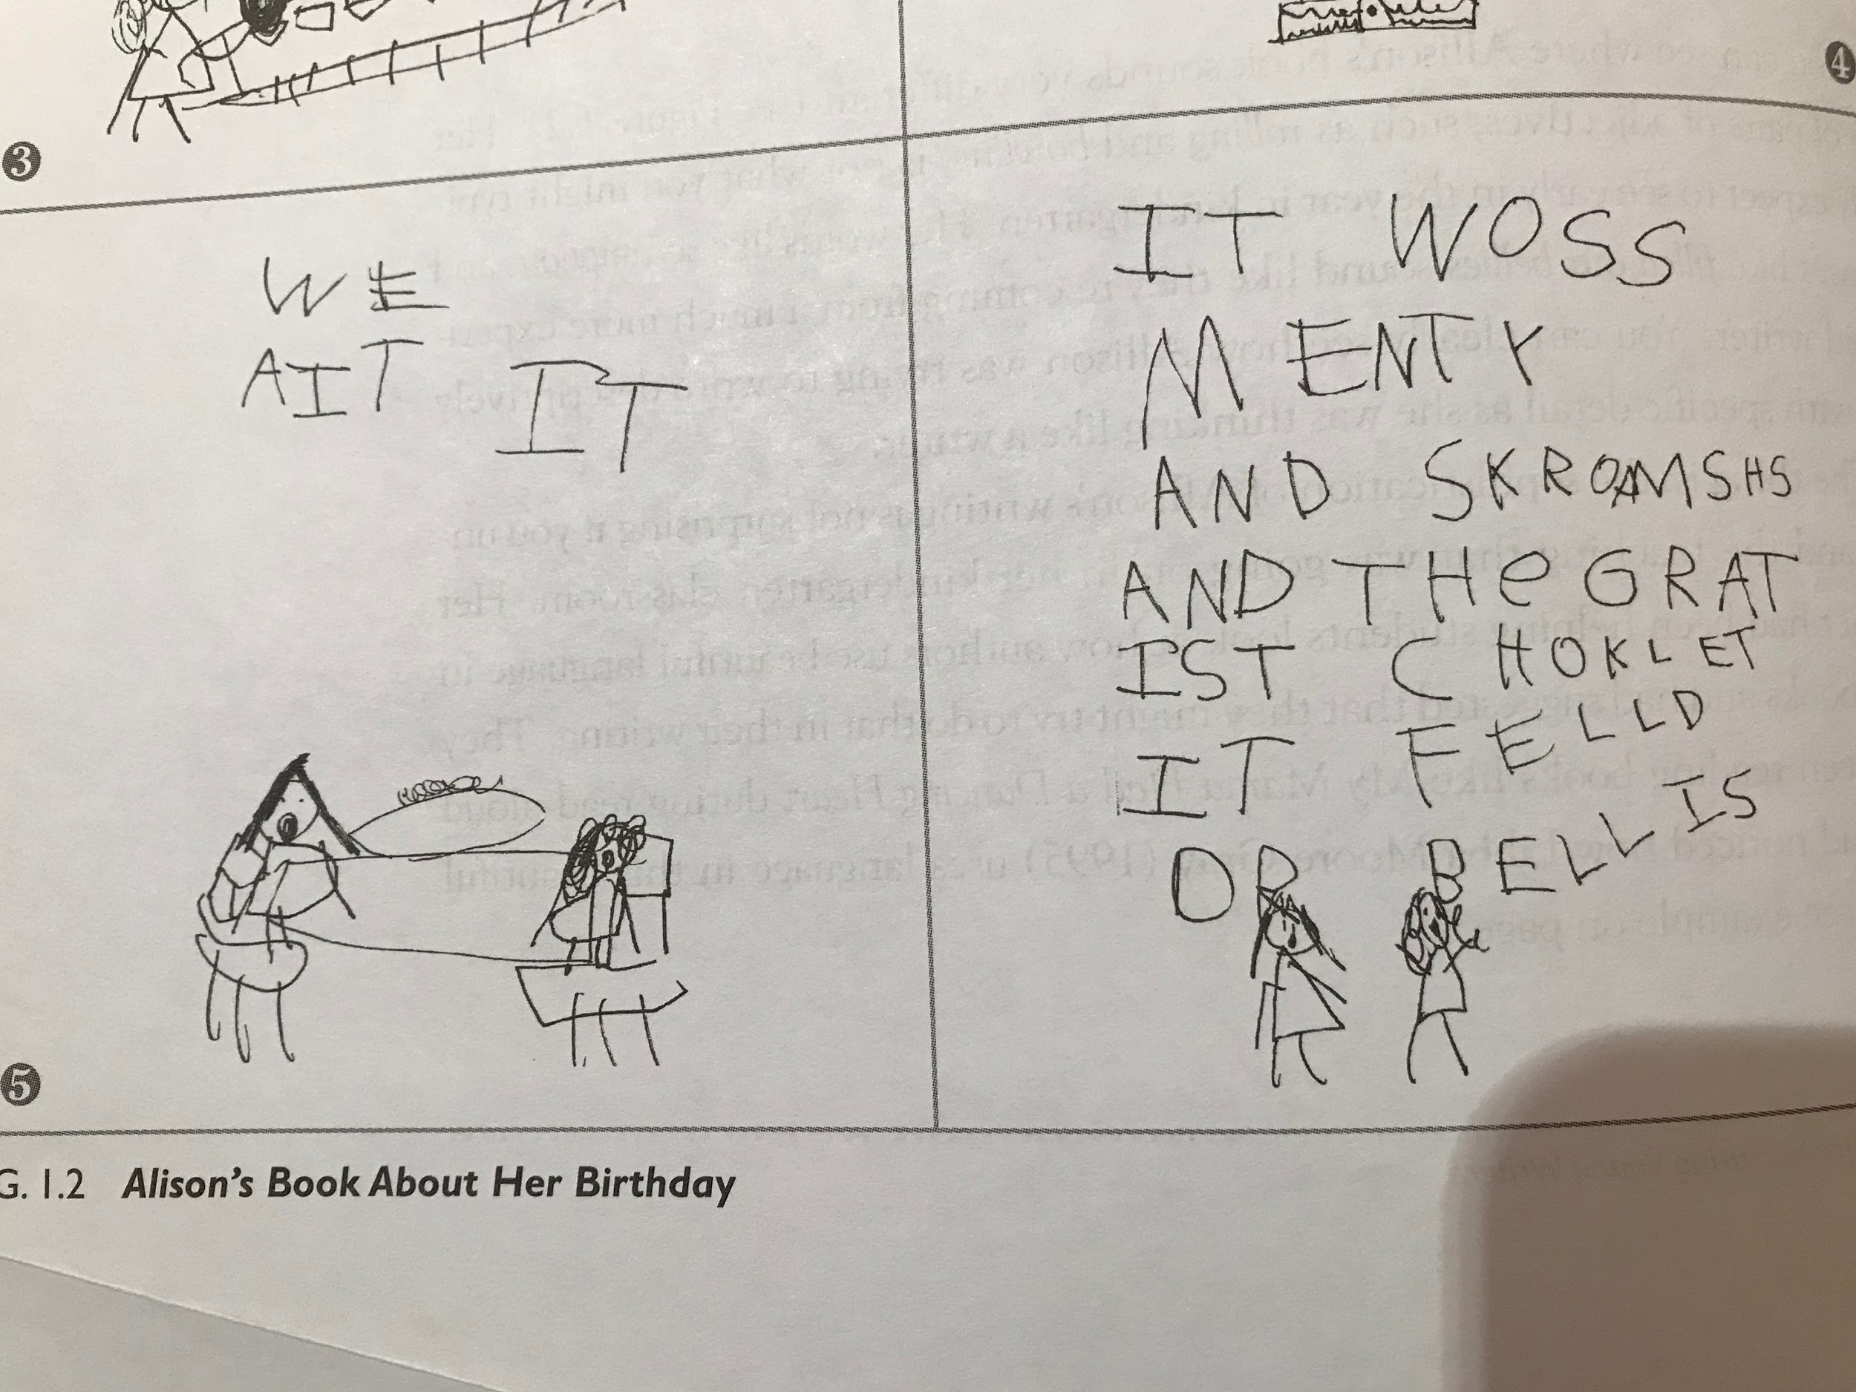

Slide 20
Thinking about this sample of writing:
What does it tell us about what this child can do?
What feedback would you give this child?
What key learning/teaching might come next?

Slide 21
Thinking about your sample of writing:
What does it tell us about what this child can do?
What feedback would you give this child?
What key learning/teaching might come next?

Slide 22
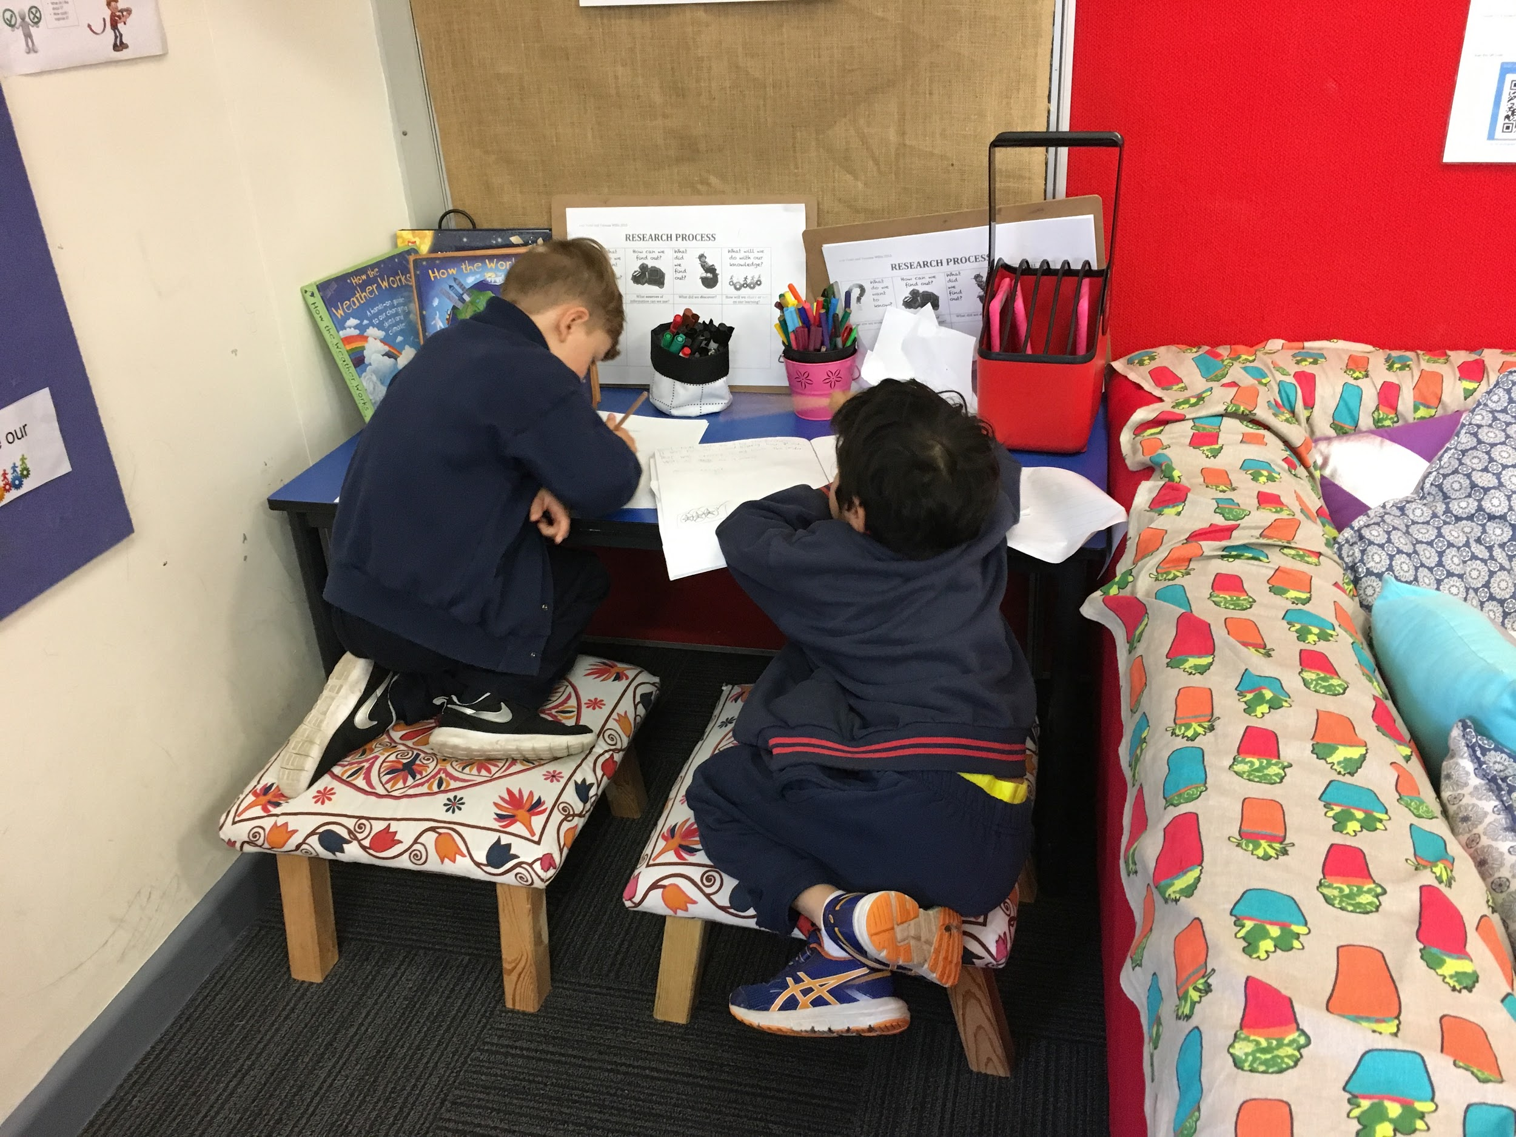
Session 2:
Applying our thinking
Teach the writer not the writing

Slide 23
A few thoughts...
We are learning to…
I can…
How can we use powerful verbs to improve our writing?
Success criteria?
Teachers as writers

Slide 24
So what???
Inquiry- writing after the shared experience: an opportunity to model or co-construct text for an identified purpose and audience (real purpose for writing)
Inquiry- applying researching skills to investigate wonderings and share findings/new knowledge
Read like a writer- exposing children to a wide variety of texts through shared reading to build their knowledge about text types and effective writing
Discovery- springboarding from explorations to write after Discovery (writer’s workshop)
Discovery- writing and reading provocations

Slide 25
What could writing after Discovery look like?
Not just ‘in discovery I…’
If we believe children are confident and capable writers…
Sparks and seeds
Opportunity for children to write for their own purposes (free choice)
Opportunity for teachers to conferencenand provide highly personalised instruction

Slide 26
Instead of writing after discovery…
Writers workshop strategically placed after discovery

Slide 27
Purpose of the writer’s workshop
To create efficient and effective writers, each one with a distinct voice and style. Students develop vocabulary knowledge in an authentic way, while gaining confidence in themselves as writers. Students learn to value the writing process and understand the benefits of being able to express their thoughts in writing.
To develop any new skill, students must receive quality instruction and modelling, attend to think alouds, repeatedly practice in authentic contexts, receive feedback, and be motivated to perfect their work.

Slide 28
Components of a writer’s workshop
Student choice: allowing students to make decisions about writing on topics based on their interests, knowledge and experiences.
Time to write: allowing students the time to effectively plan, record their thoughts, edit, revise and publish their writing.
Constructive feedback: allowing students to confer with peers and adults to gain skills and information that will help them improve as a writer.

Slide 29
components
Which of these do you value?
Which of these do you already incorporate?
What else might you want to include?
What do you need to do more of/less of?
Lisa Burman glossary

Slide 30
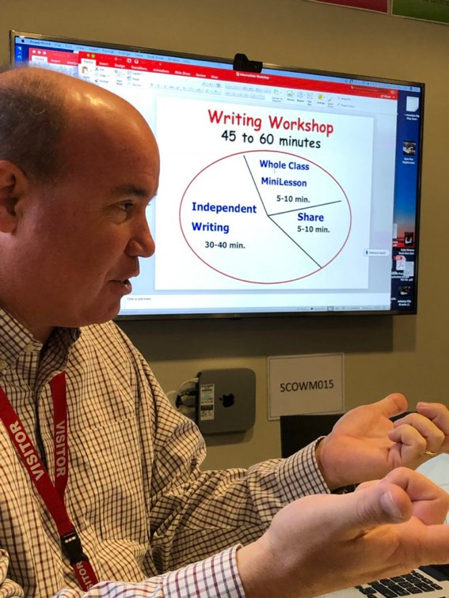
What could a writer’s workshop look like?
After Discovery
Focus on ‘teaching the writer’ not a text type/genre
Not too much ‘teacher talk’
Personalised instruction/explicit teaching through conferencing or focus group
Explicit feedback (authorial and secretarial)
Culture of authors sharing their work and learning together
Use of mentor texts read like a writer

Slide 31
But…
Could it be a literacy workshop?
What is the teacher’s role during independent writing time?
Does it need to be an hour?
Does it need to follow a whole part whole structure?
What does a good conference look like and sound like?

Slide 32
Session 3: Opportunities for explicit literacy
Making the most of Literacy Opportunities during Discovery

Slide 33
What is literacy?
Turn and Talk: Which definition of literacy resonates with you?
… students become literate as they develop the knowledge, skills and dispositions to interpret and use language confidently for learning and communicating in and out of school and for participating effectively in society. Literacy involves students listening to, reading, viewing, speaking, writing and creating oral, print, visual and digital texts, and using and modifying language for different purposes in a range of contexts …
Literacy is the capacity, confidence and disposition to use language in all its forms.
Literacy incorporates a range of modes of communication including music, movement, dance, storytelling, visual arts, media and drama, as well as talking, listening, viewing, reading and writing.

Slide 34
What is literacy?
EYLDF Places emphasis on...
Literacy being multimodal….and more than just speaking, reading and writing
Literacy involves children learning to express themselves and communicate through a range of forms and symbols

Slide 35
How can we make literacy learning visible to our students during Discovery?
Symbolic Functioning: Where literacy begins….
Pretend play and print based literacies have strong connections - imaginative play as well as reading and writing all rely on symbolic functioning….

Slide 36
Symbolic play, along with deferred imitation and language, signals the development of representational thought. The key importance of representational thought is that the child now is able to represent objects and events symbolically. Both literacy and symbolic play require the ability to use words, gestures or mental images to represent actual objects, events or actions. The very nature of symbolic play (first-order symbolism) has an intimate relationship with reading and writing (second-order symbolism) in that children use similar representational mental processes in both. Vygotsky theorizes that symbolic play enables children to develop a variety of represented meanings that serve as a basis for successful literacy development..
Symbolic Play and Emergent Literacy Sandra J. Stone
William Stone

Slide 37
Symbolic Play = Representational Thought
Literacy = Representing symbols to convey message
In print literacies, reading and writing - the symbolism is in the alphabet and pictures
In play - dramatic, construction, imaginative, creative/artistic - the symbolism is in the graphics, colours, and objects being used in the play
Therefore we can view Symbolic Play as Literacy itself

Slide 38
Vygotsky: First and Second Order Symbolism
First order symbolism: play and drawing
Second order symbolism: writing and reading
A mental process and rich thinking is used in both - the more children are exposed to 1st order symbolism the better their success will be with 2nd order symbolism when learning to read and write

Slide 39
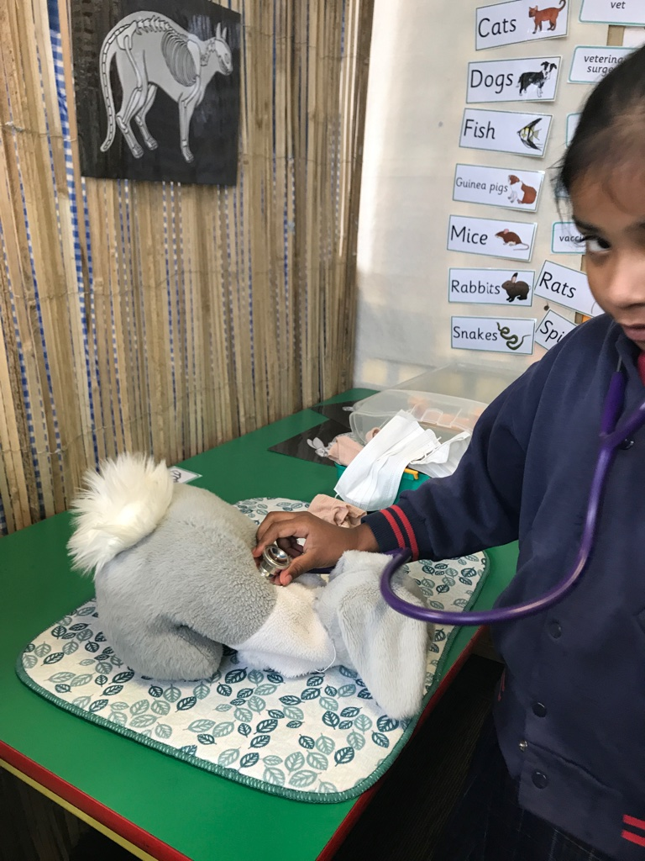
First Order Symbolism: Symbolic Transformation
Object transformation: a block represents a phone
Role transformation: child acting as a nurse in the hospital play space
Ideational transformation: the idea of something - object, event, action, is represented e.g. pretending to eat an ice cream cone that is not really in your hand

Slide 40
Things to consider….Intentional Planning
Intentionally planning contexts for symbolic functioning opportunities to occur will support students literacy development and become a solid foundation when learning about and engaging with print based literacies.
When designing areas for Discovery, articulating the literacy you imagine will develop within the playful contexts and noticing and naming these is important - so you can observe for these while children are at play
The play props and materials we select need to be intentional as they hold more symbolic power than that of others - play props that allow for symbolic transformation will allow for bigger thinking

Slide 41
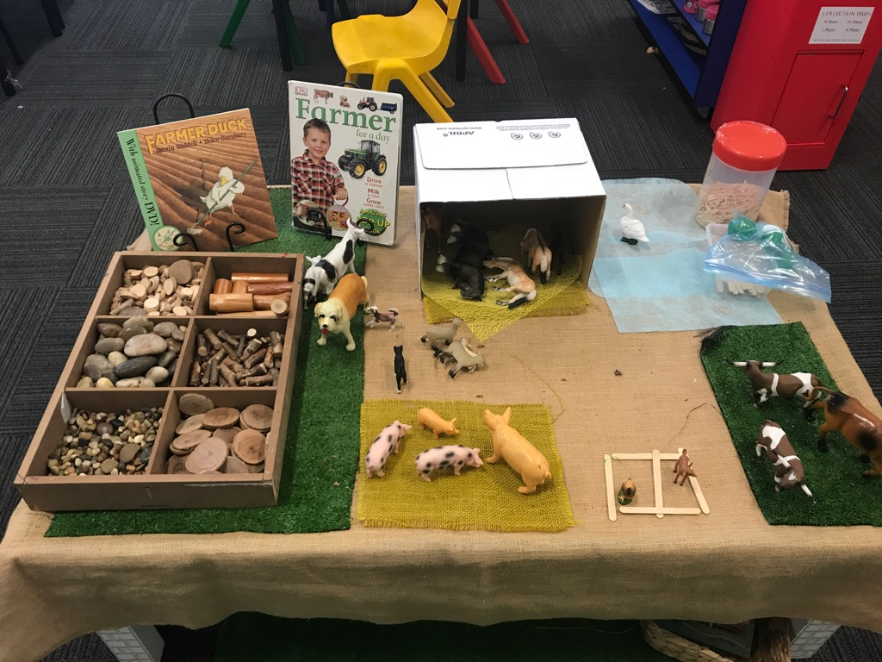
How can we be intentional for symbolic opportunities in this
Small world area?
How can we encourage explicit use of print
based literacies for those students who are ready?

Slide 42
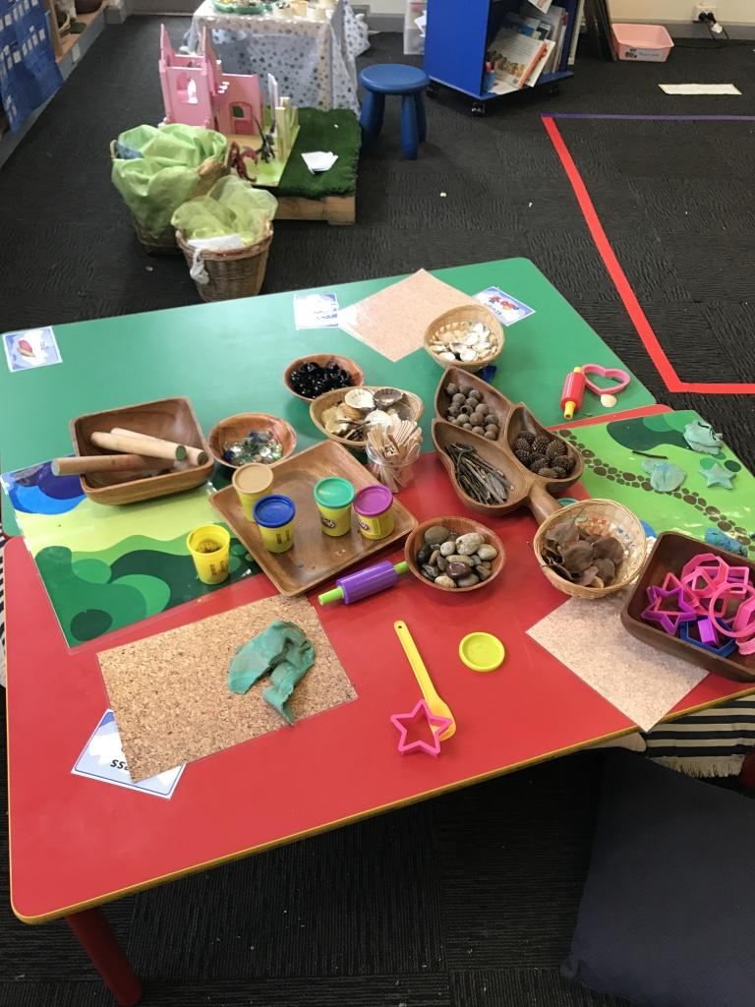
How can we be intentional for symbolic opportunities in this
Sensory Area?
How can we encourage explicit use of print
based literacies for those students who are ready?

Slide 43
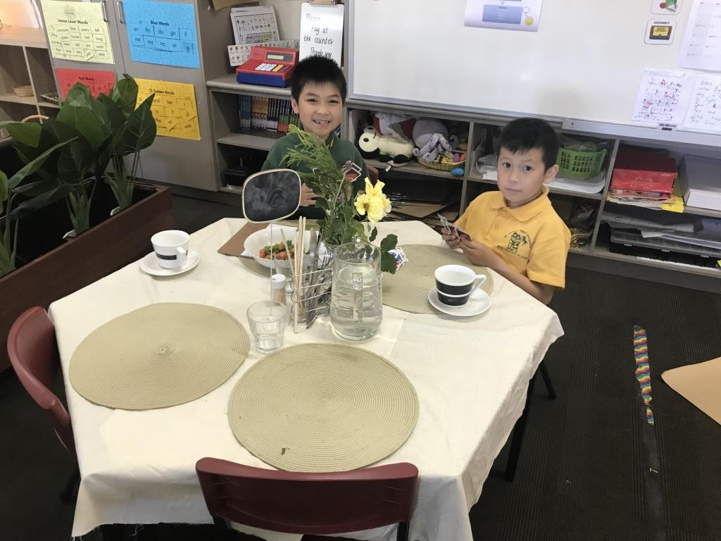
How can we be intentional for symbolic opportunities in this
Dramatic Play area?
How can we encourage explicit use of print
based literacies for those students who are ready?

Slide 44
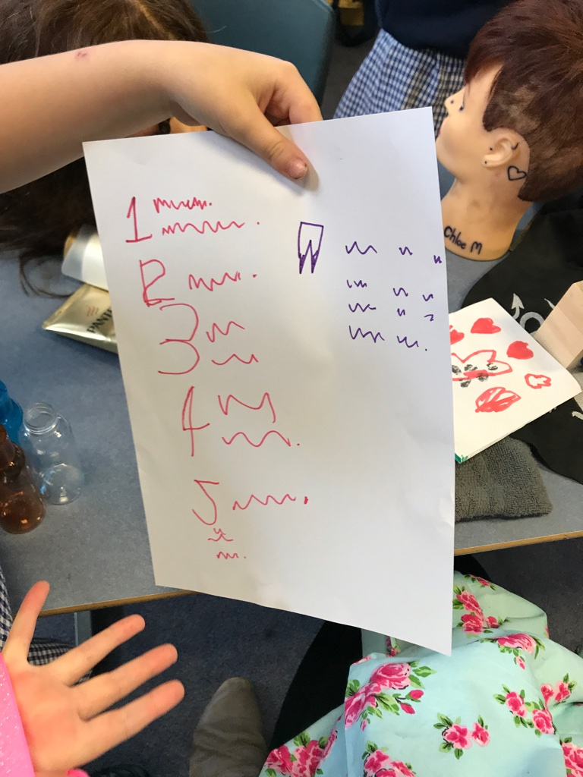
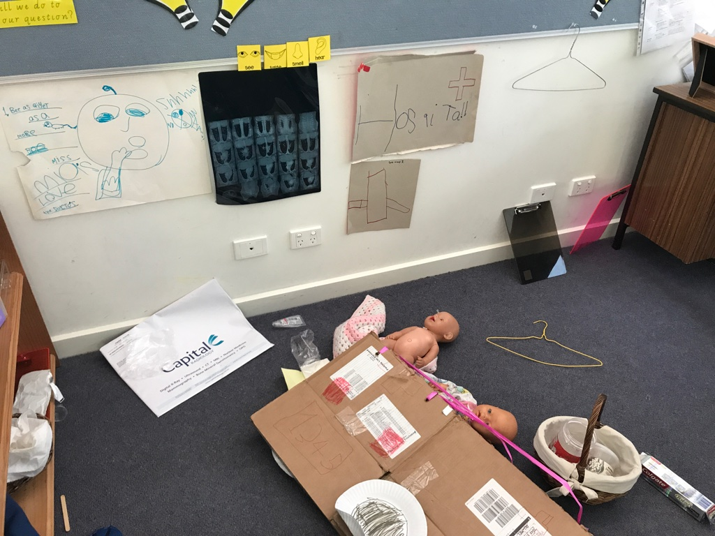
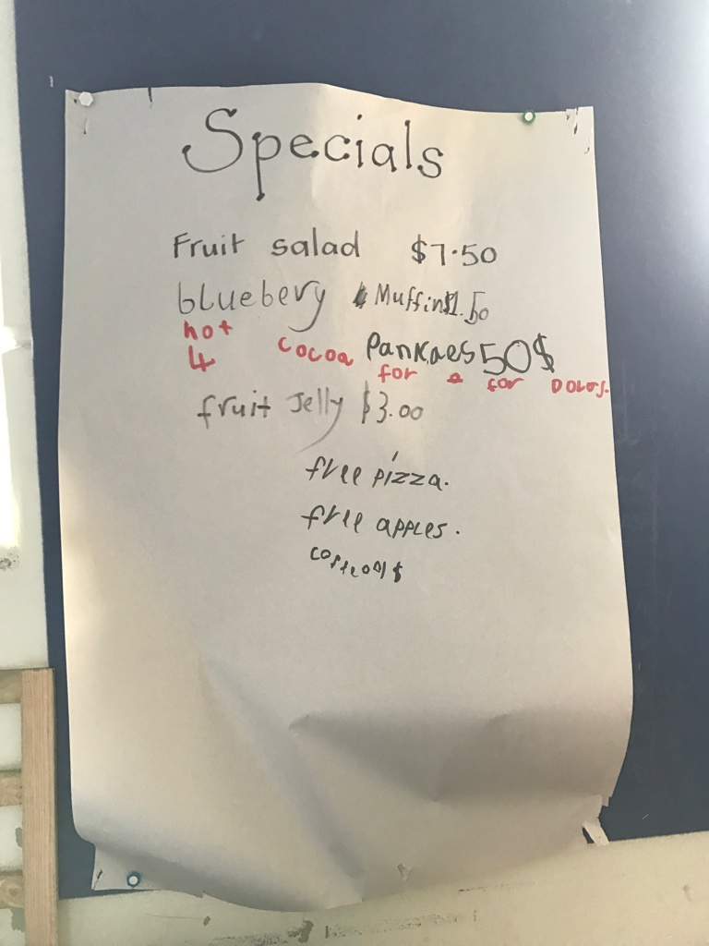
Introductions, Share Times and Learning Conversations as Provocations

Slide 45
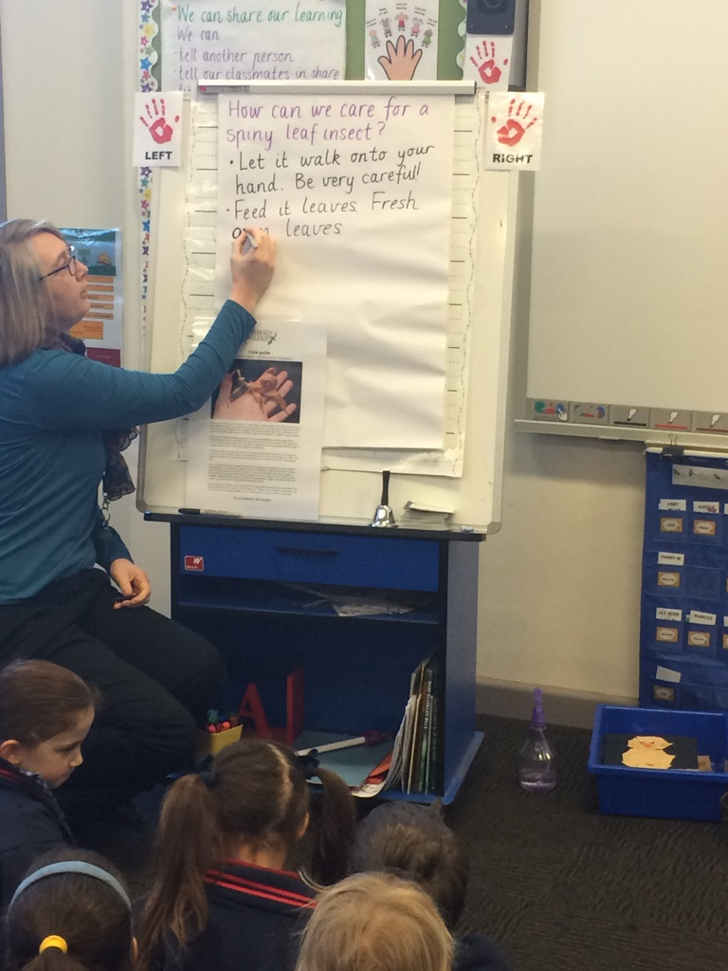
Introductions for Explicit
Teaching Opportunity
Inquiry Investigation into animals and how their needs are met
Spiny leaf insects in the classroom - Research process
Read to: listening for information to answer our question
Recording of new information - shared writing
This was the Introduction time before Discovery….

Slide 46
Bookmaking
A playful approach to writing

Slide 47
Approach
Children choose what they make their books about
Adults DO NOT scribe in the children's books
Children READ their books to others - this places value on their graphic literacy (first and second order symbolism)
Important the children have an audience
Begin with pre stapled books then build up their stamina to children putting their own books together so they decide how long their book will be

Slide 48
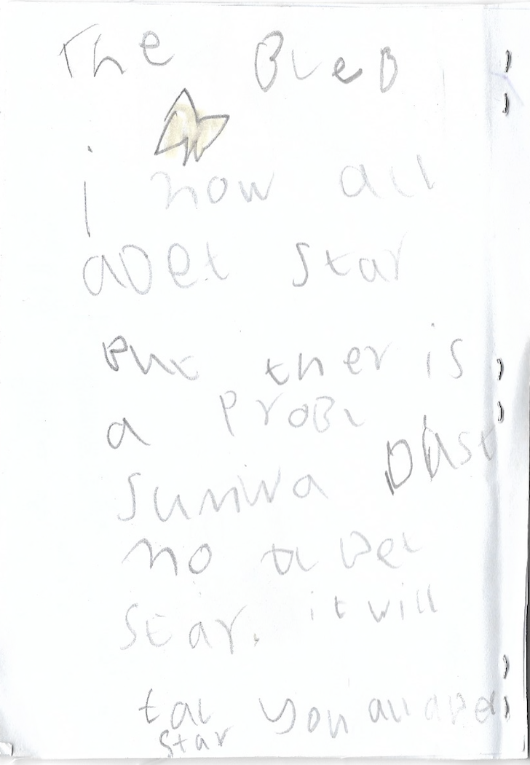

Slide 49
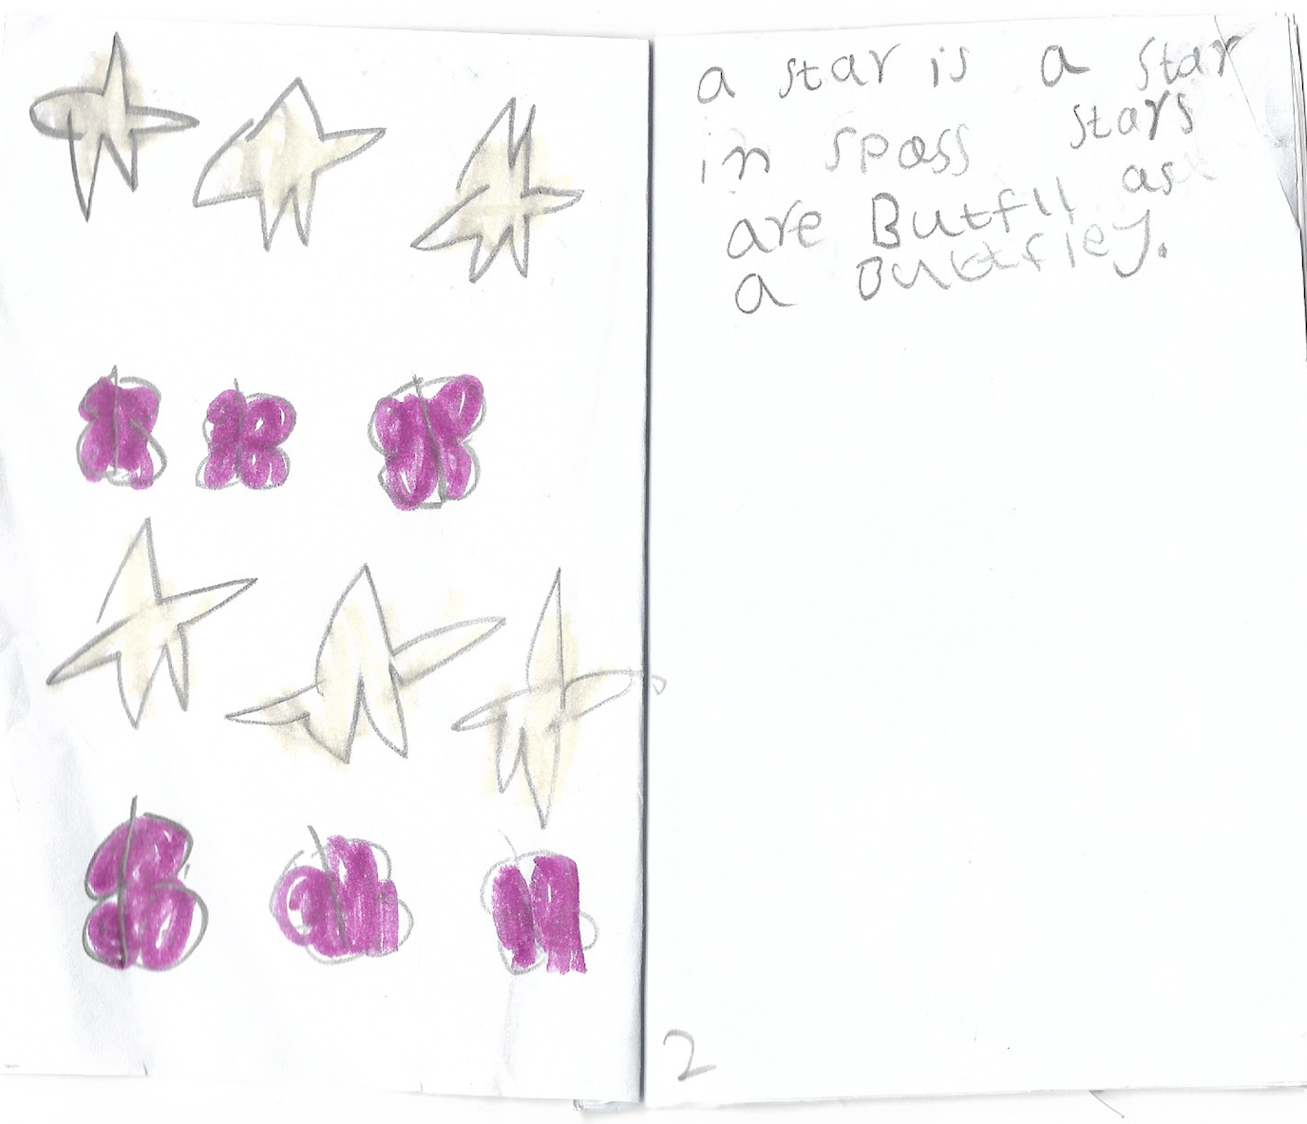

Slide 50
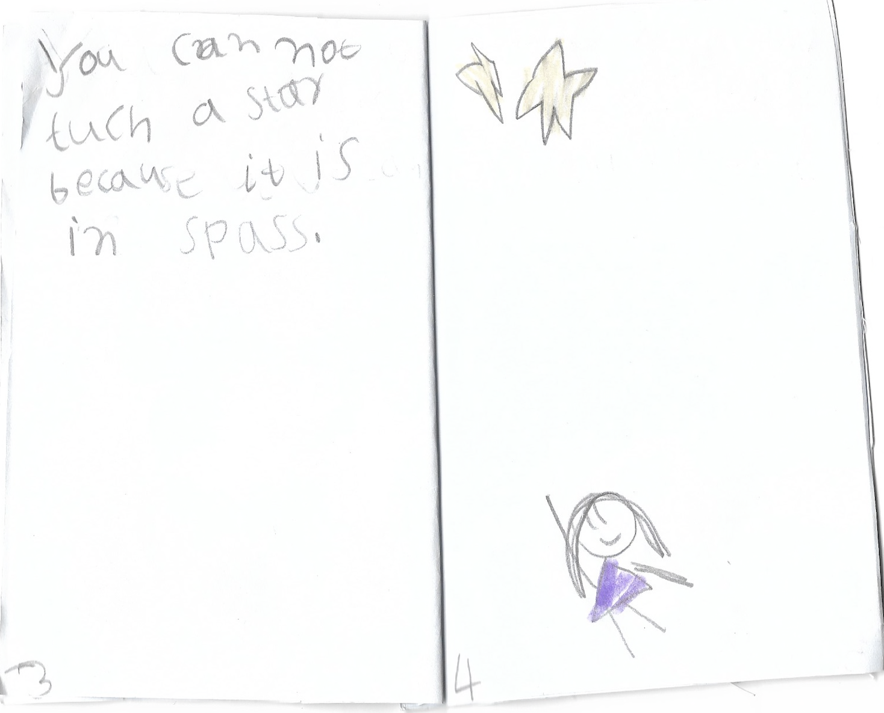

Slide 51
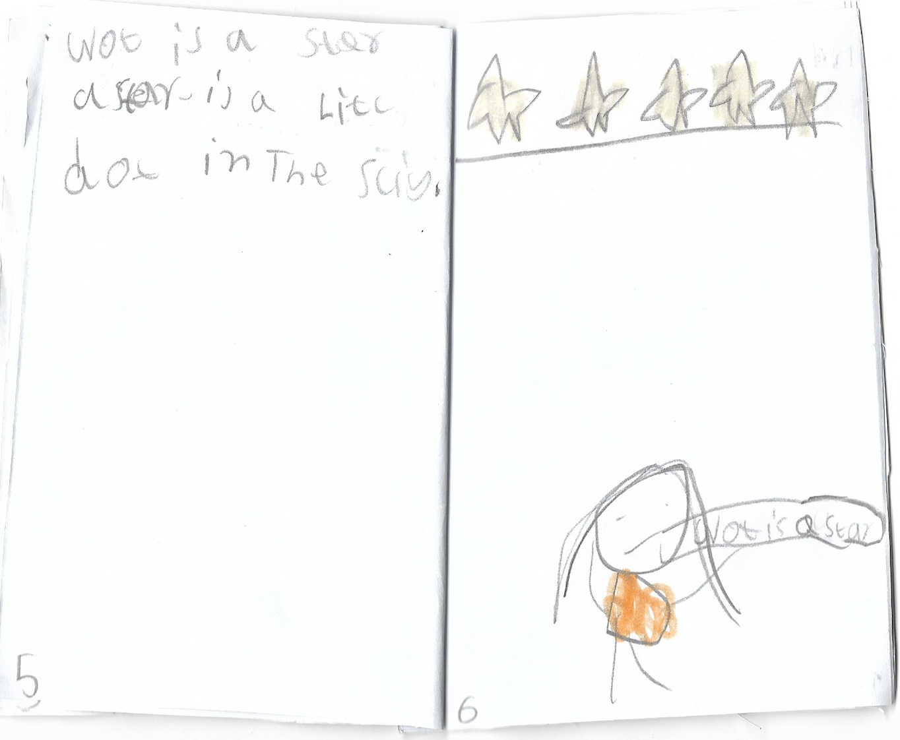

Slide 52
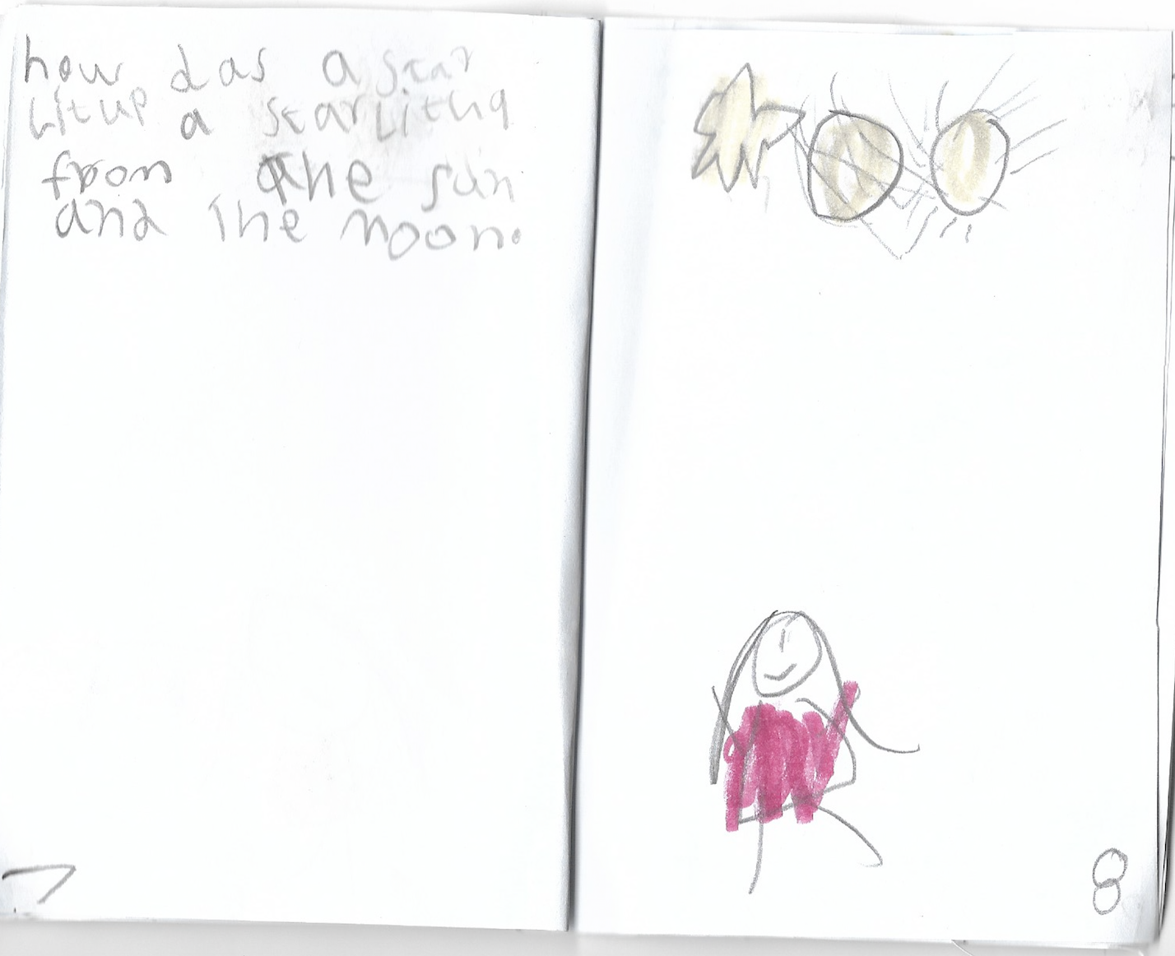

Slide 53
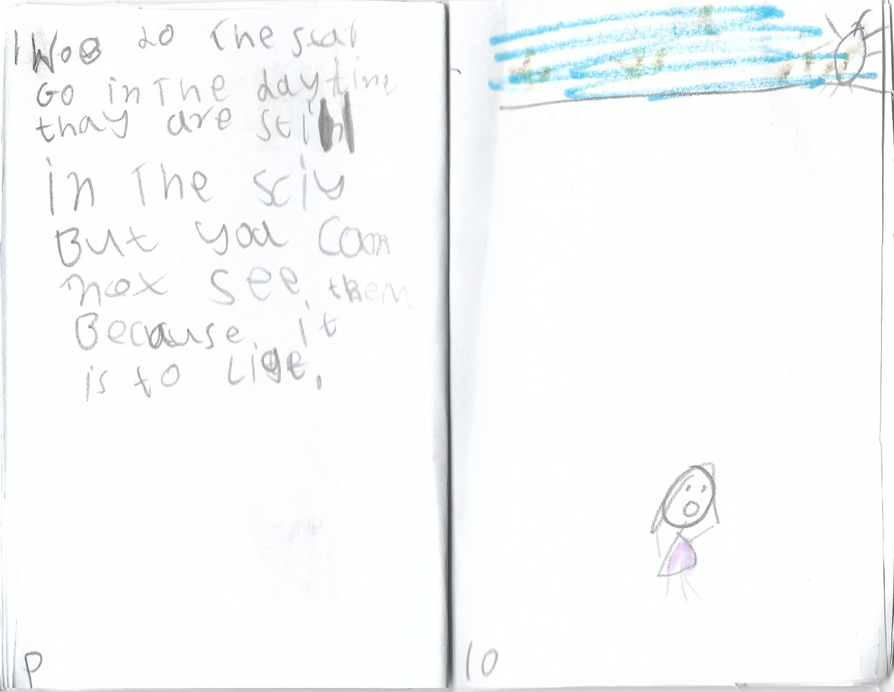

Slide 54
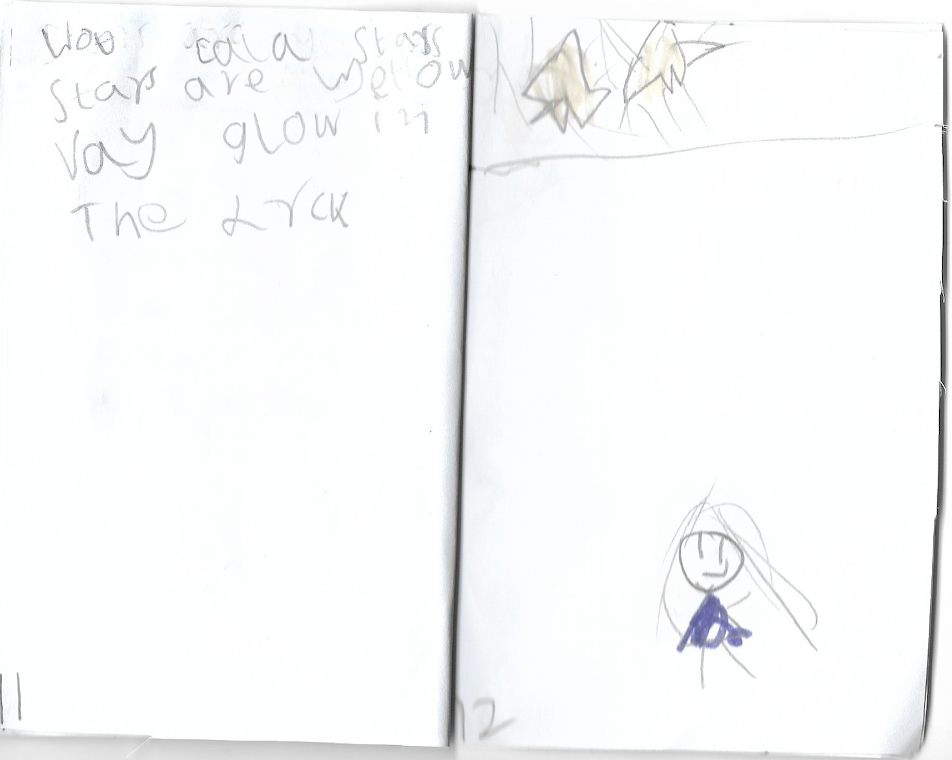

Slide 55
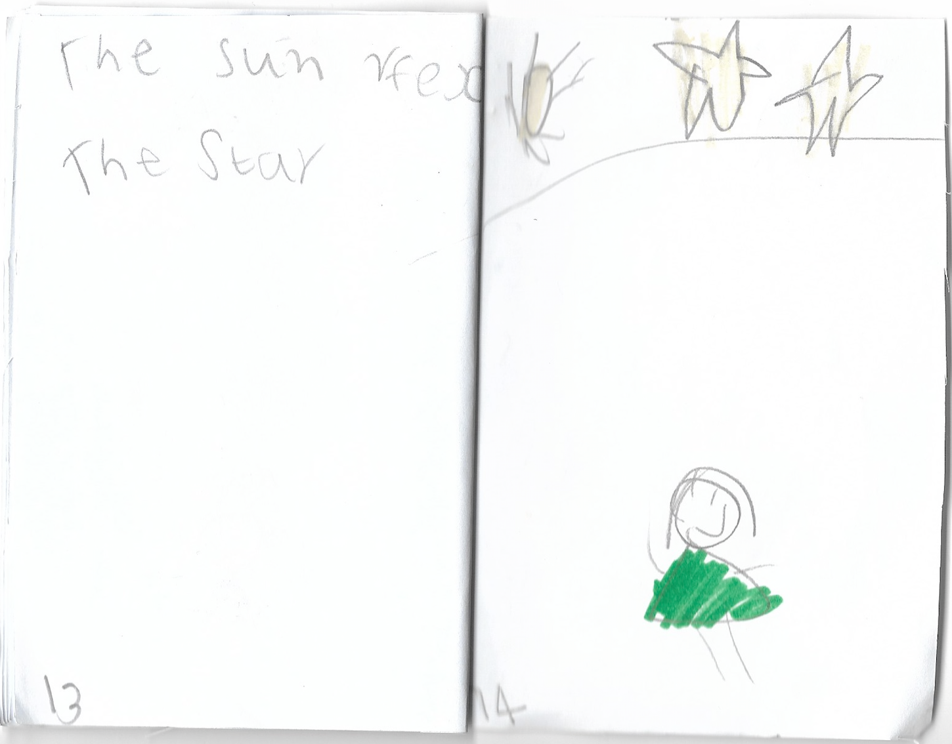

Slide 56
How?
Some ideas for focus….
Word choice
Page organisation
Relationship between written and illustrated text
Opportunity for use of mentor texts
Refer to Alan Wright Blog Post
Introduce idea of bookmaking explicitly in your writing session
Students Inquire into types of books and their features - read like a writer
Model creating your own book think aloud

Slide 57
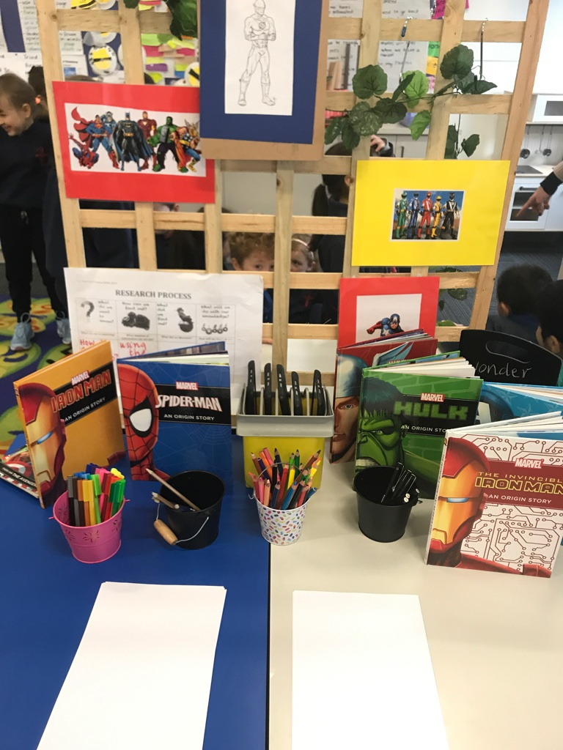
When?
Bookmaking can be linked back into Discovery - place other children's books on the writing table as a provocation, or mentor texts themselves, pre made books as well as materials for them to make their own books
Bookmaking materials on other stations that lend themselves to this - small world, mini beast area, inteerst area (e.g superheros)
Always an opportunity for them to share their books - either at share time or in the book box to read to someone or read to self during daily 5

Slide 58
Exploring effective strategies:
Are we making strong enough connections between reading and writing?
Read like a writer
Select a book and read!

Slide 59
What type of text is this?
What is the purpose?
Who is the audience?

Slide 60
How does the author reveal the main idea in the book?
What types of detail does the author use?
How does the author use illustrations to explore or add to the main idea or purpose?

Slide 61
Consider the words, the story and the illustrations
How does the author convey emotions in this book?
How does the author put ‘personality’ into the book?

Slide 62
Look carefully at the words and phrases the author is using, and consider the effect this has on the reader
What types of words are they using (eg similies, metaphors, strong verbs)
Are they manipulating the text or the graphics (eg bold print, large font)
How does the author vary the length and construction of his or her sentences?
Does the author use ‘sound’ effects like alliteration, rhyme or rythm?

Slide 63
Read like a writer
How could this close reading of texts from the author perspective help children with their own writing?
How and when could you incorporate this strategy in your teaching?

Slide 64
Exploring effective strategies:
Are we making the most of our opportunities during Inquiry investigations?
Researching

Slide 65
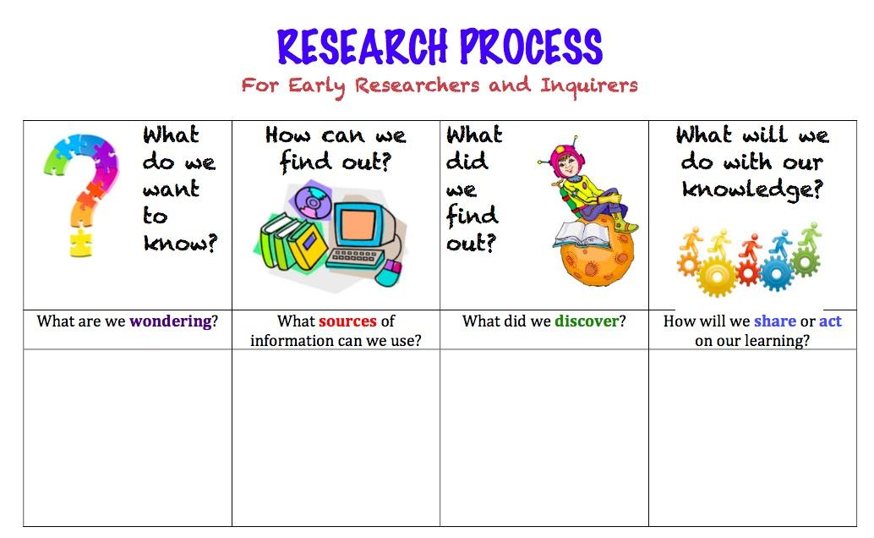
Children as researchers
Focus on process not on content
Supported researching
Ways of finding out: reading, viewing, interviewing, hands on
Ways of sharing our knowledge: ‘list books’ drawing, telling, making
Importance of talking and making connections (working theories

Slide 66
Exploring effective strategies:
Are we making the most of the connections between drawing and writing?
Austin’s butterfly
https://www.youtube.com/watch?v=hqh1MRWZjms

Slide 67
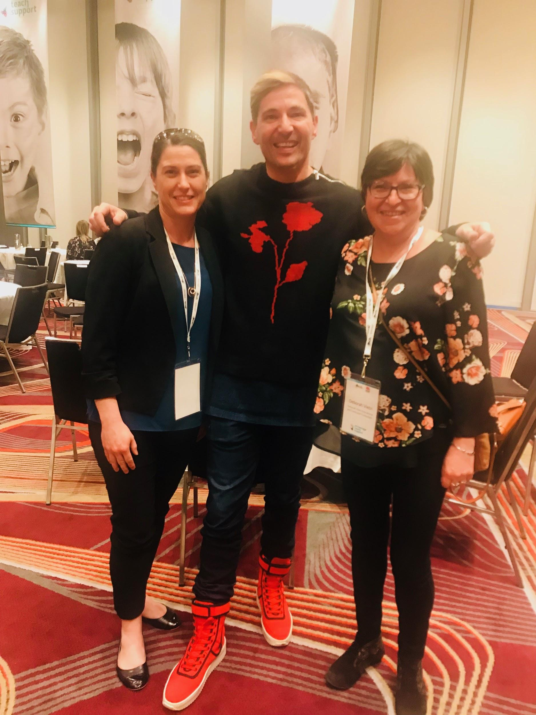
Coming up
John Spencer 12th September
Nathan Wallis 16th November

