Slide 1
An Introduction to
Extended Projects
Introducing Extended Projects in Discovery to students

Slide 2
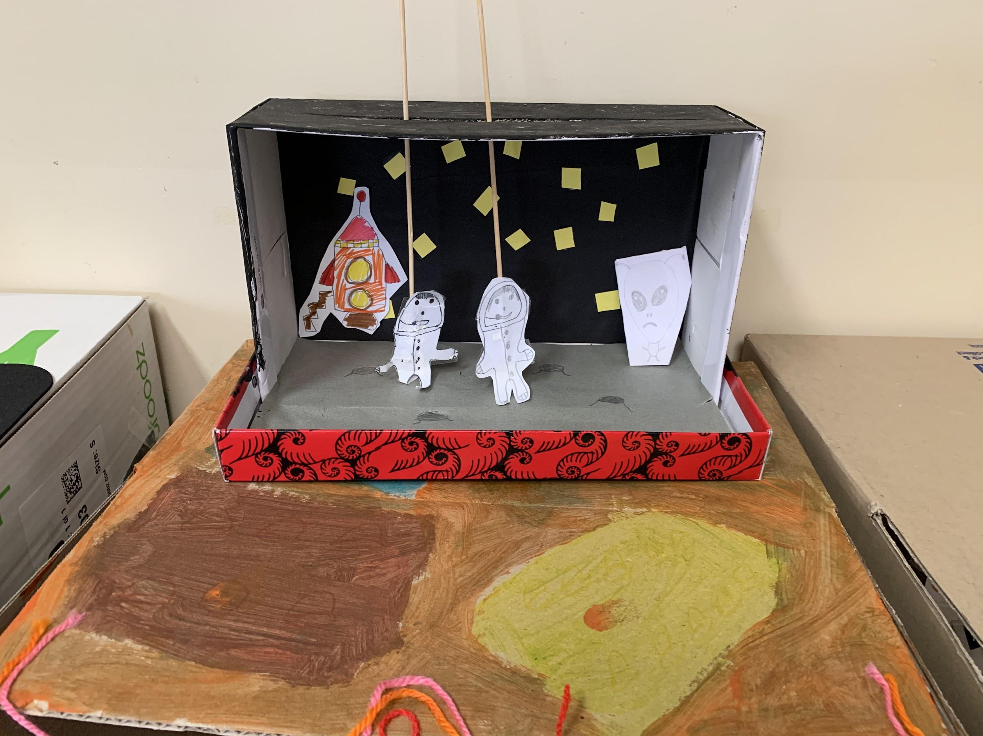
What are extended projects?
Sometimes in Discovery we have an idea or a wondering that we want to work on for longer than one session.
Some of you have already been doing this when…
Something really captured your interest and you wanted to explore further
You started to make something and your idea got bigger and bigger
You had a question in your mind and you just wanted to find out

Slide 3
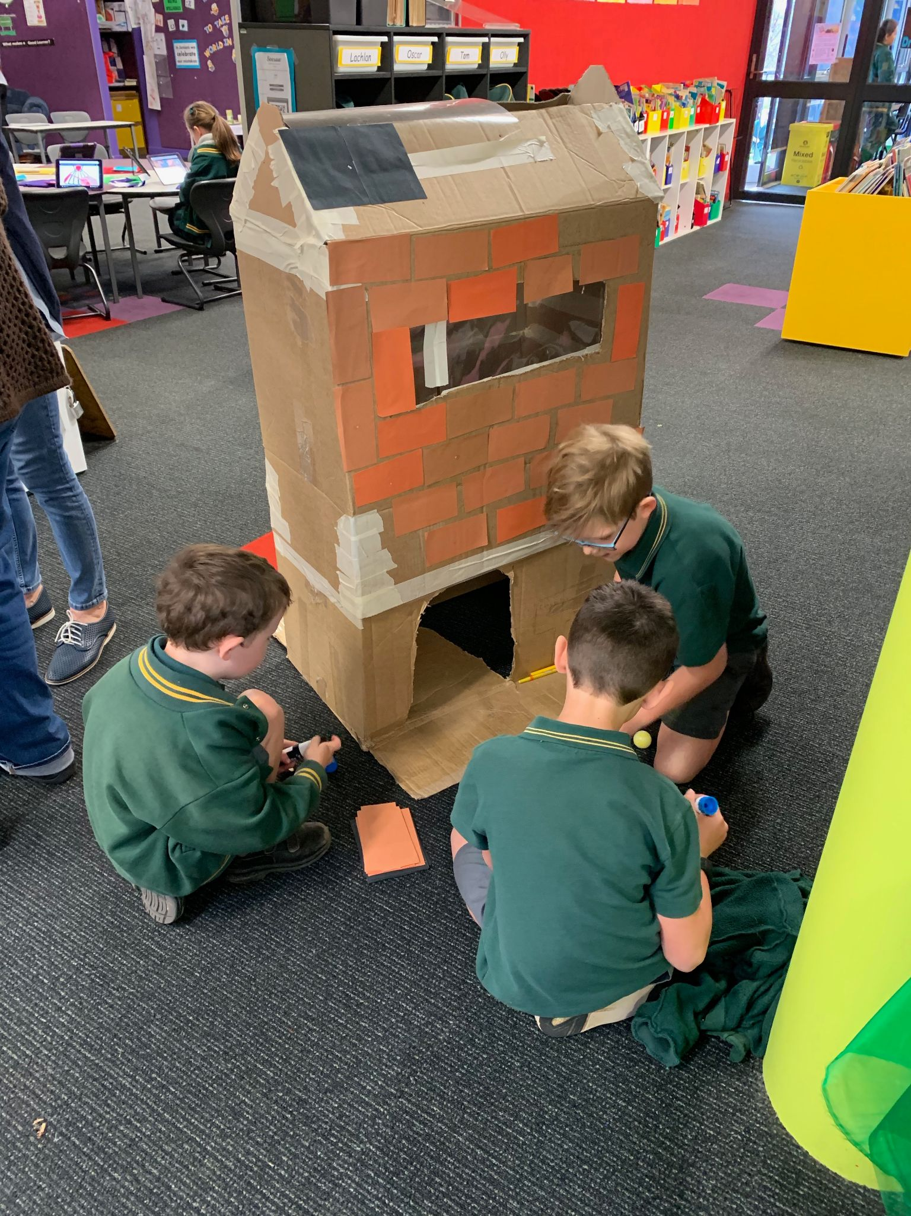
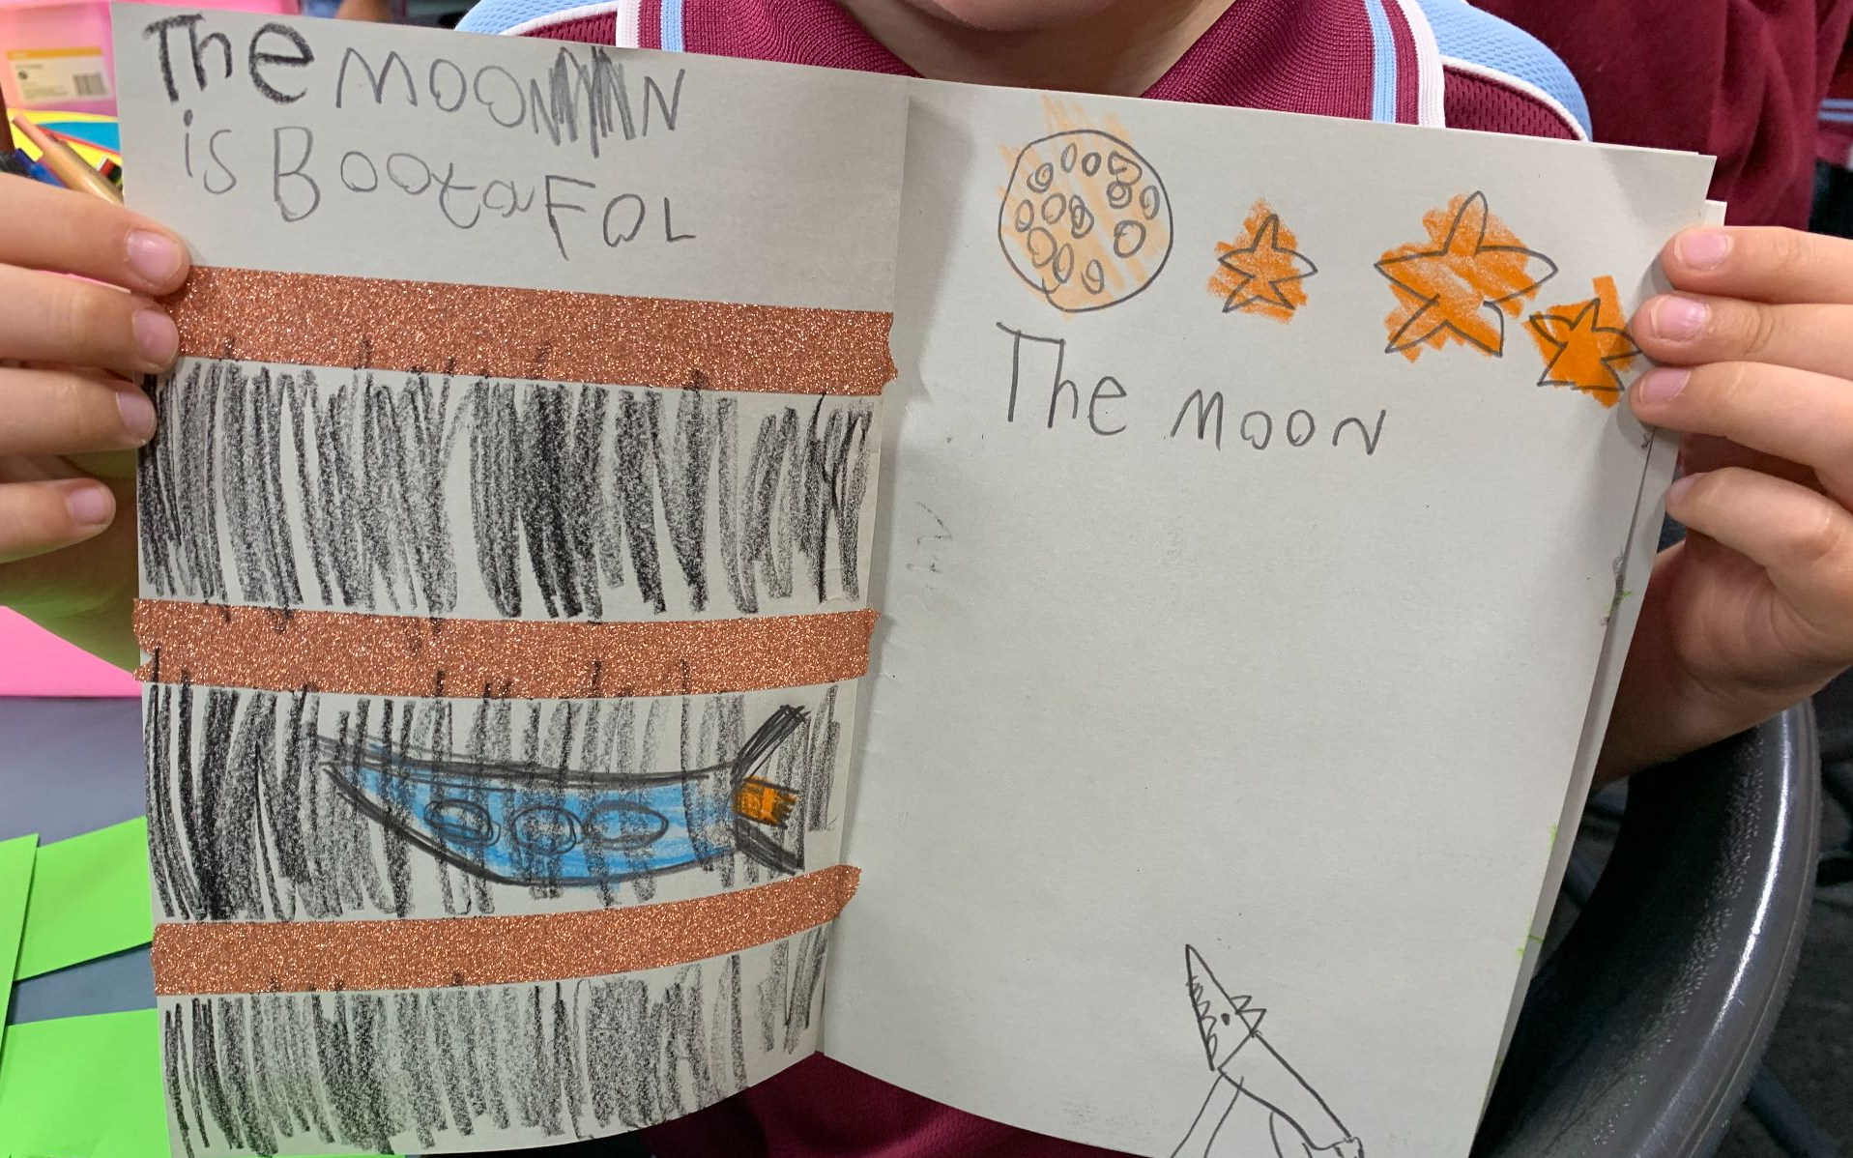
Sometimes curiosity or good ideas just build and build and you want to keep adding and adding!

Slide 4
Maybe you haven’t done this before but you would like to start now.
What am I curious about?
I wonder what would happen if I…?
I would really like to make ...
In Discovery I would love to...
I am fascinated by...

Slide 5
How do I start an extended project!
Think about something that really interests you or that you want to make or do
It may be an idea that comes from Discovery, or an interest you have
Discuss your idea with your teacher
Make a plan
When you have finished share your project with an audience

Slide 6
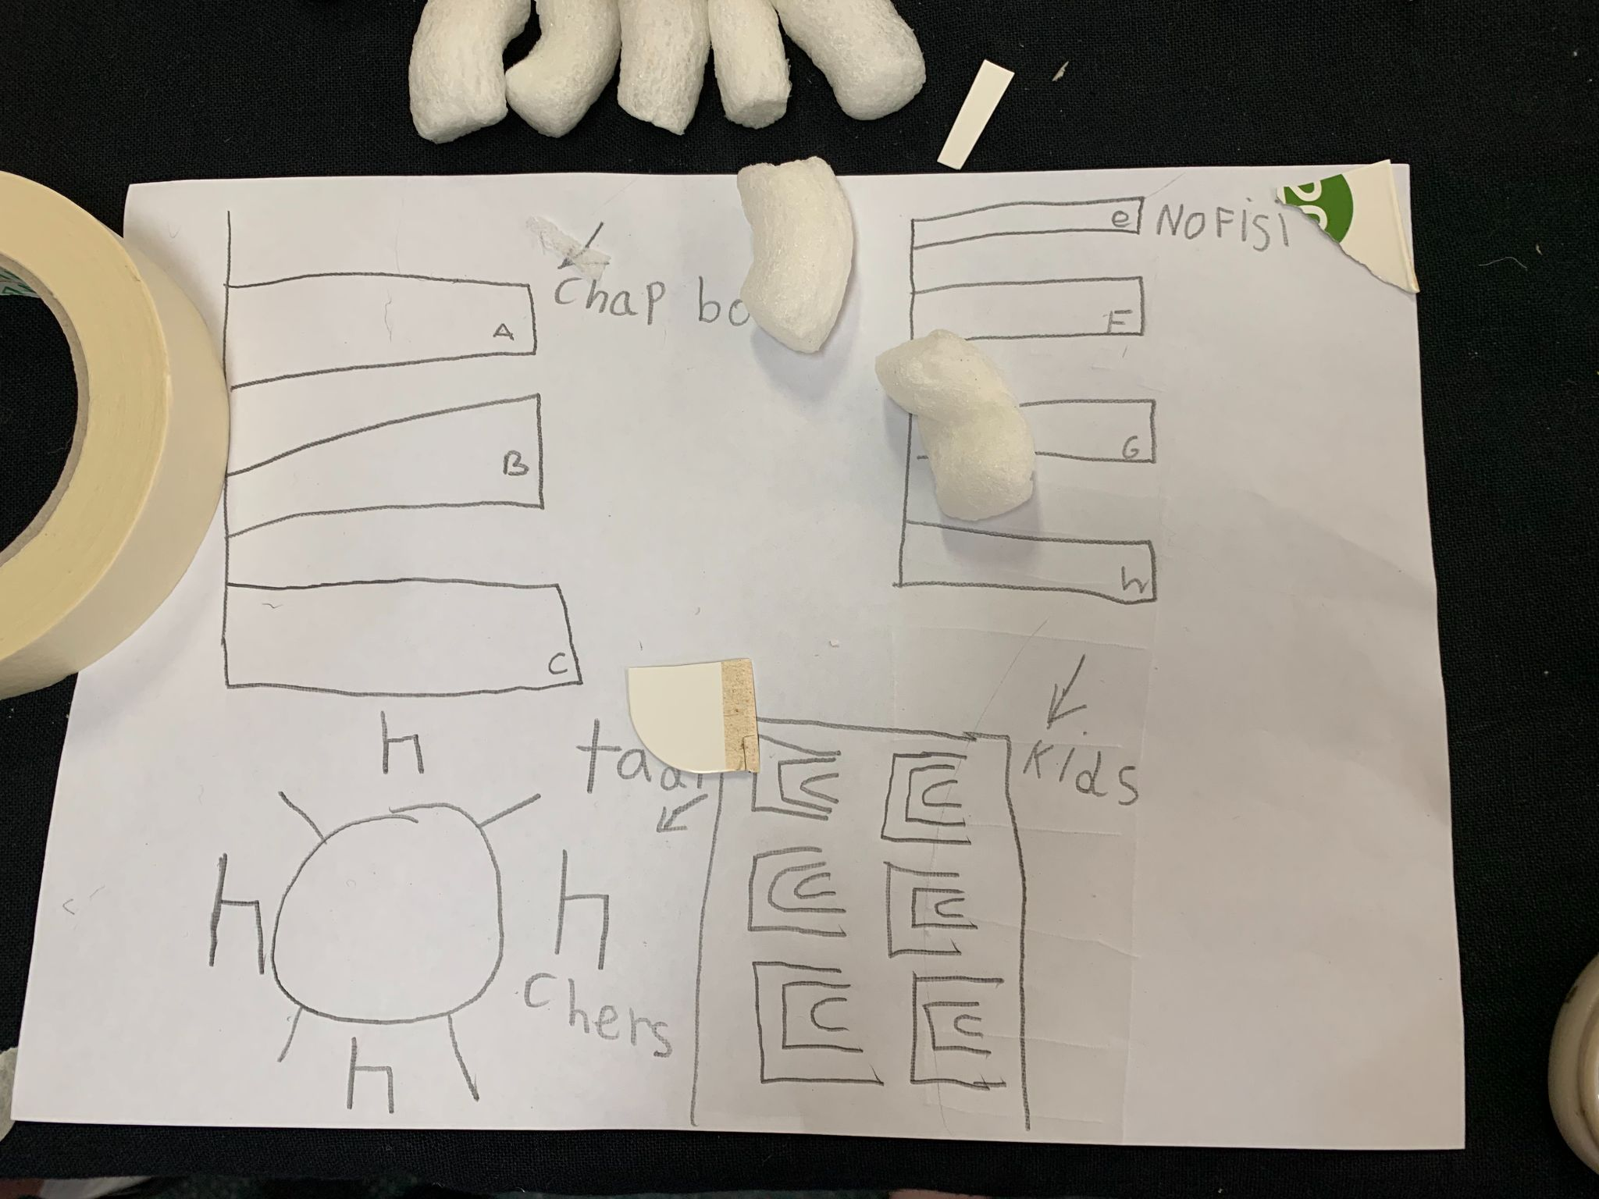
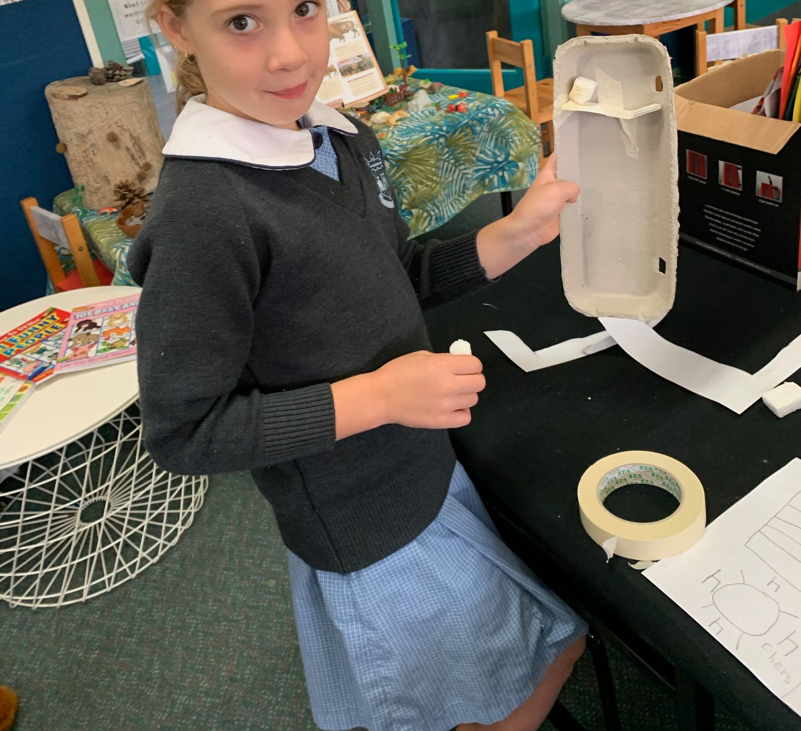
Extended projects can be
Researching a topic or question we are really interested in
OR
Designing and making something unique
Getting better at doing something you really like, or learning to do something new

Slide 7
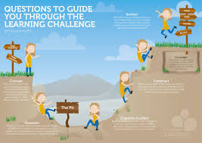
When you take on an extended project it is important you persist and keep at it until you complete it!
Even if you get into the learning pit!!!

Slide 8
Make Projects
How do I do a Maker project?
What kinds of things could I design and make?
Design and Make something unique

Slide 9
Hat or fashion item
Rube Goldberg machine
Model car
MAKE PROJECTS
The possibilities are endless
Puppet show
Musical instrument
Superhero city
Mural
Picture Story Book

Slide 10
Make projects can be created with different materials
Cardboard
Paper
Scissors, glue,
Material/fabric
Boxes
Recycled materials
Loose parts
Lego
Paint, crayons, pastels, charcoal, pen
Art and craft materials
Wood
Natural materials- rocks, leaves, sticks, dirt, plants
Puppets
Modelling Clay,

Slide 11
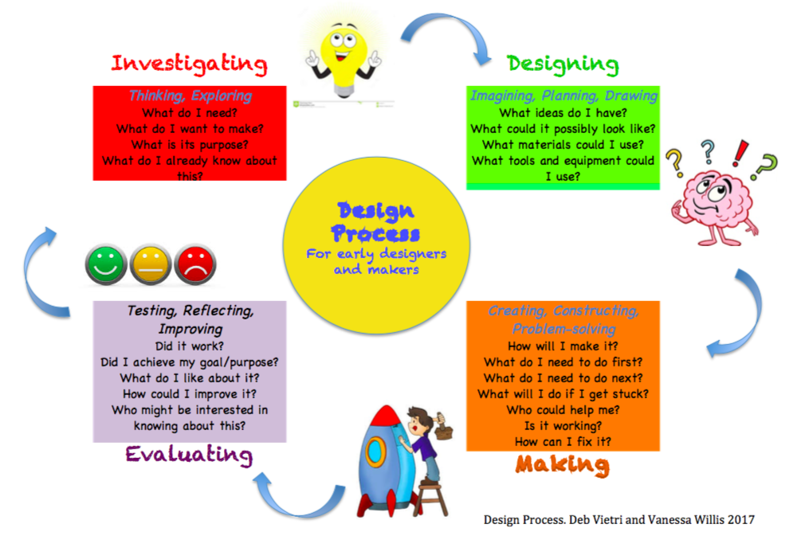
How to do a maker project in discovery
Think of an idea
Fill in a ‘proposal’ and discuss it with your teacher
Plan what you want to make and use the design process to carry out the project
Share your finished project with an audience

Slide 12
Research Projects
How do I do a Research project?
What kinds of things could I research?
Researching a topic or question you are really interested in

Slide 13
An unusual animal
Space
Games or toys
RESEARCH PROJECTS
The possibilities are endless
A person or a place
Music, Art, Dance, Film
Superheroes or a person you admire
Food
Important people in history

Slide 14
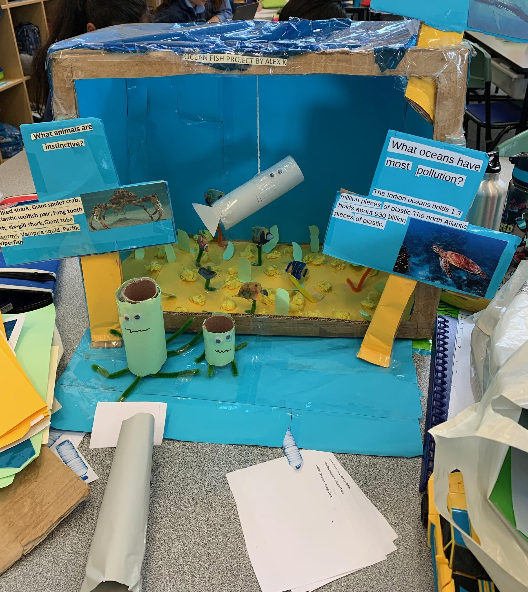
Research Projects
You can find out about your topic or your question by:
Reading a book
Watching a video clip
Finding a website that you can read and understand
Looking at pictures
Interviewing someone

Slide 15
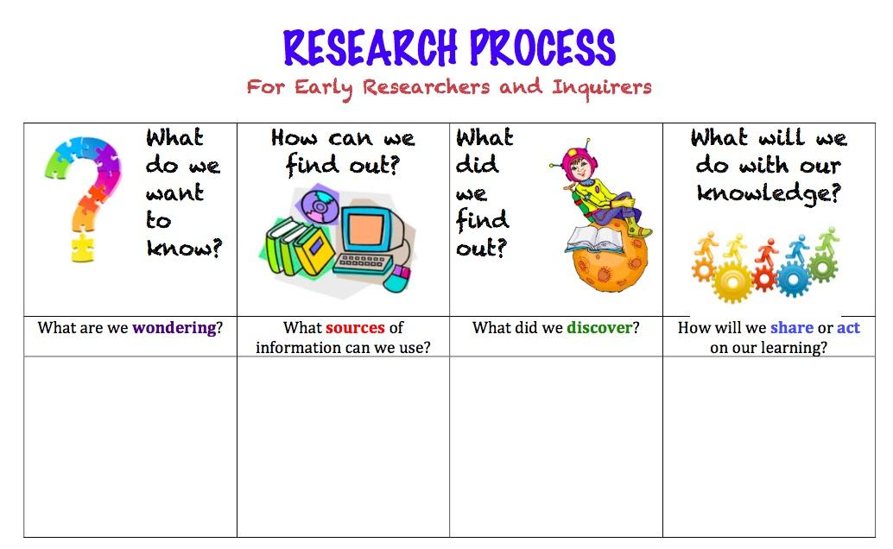
How to do a research project in discovery
Think about what interests you
Create a question or two to guide your research
Fill in a ‘proposal’ and discuss it with your teacher
Follow the research process
Do some finding out and record what you have learned in your own words
Share what you know now with an audience

Slide 16
Learning how to do something you didn’t know how to do before…
Or learning how to get better at doing something you like is a type of research
This needs to be something that you can learn about and practice during Discovery
For example skills like: drawing, painting, cartooning, origami, photography/filming, speaking a language, coding, knitting,
There are some skills that are really great to learn but are better practised at home or in the playground like; cooking, different sports, gymnastics,
First you have to find out how, (learn from someone else, watch a youtube clip, how to books), then you have to practise

Slide 17
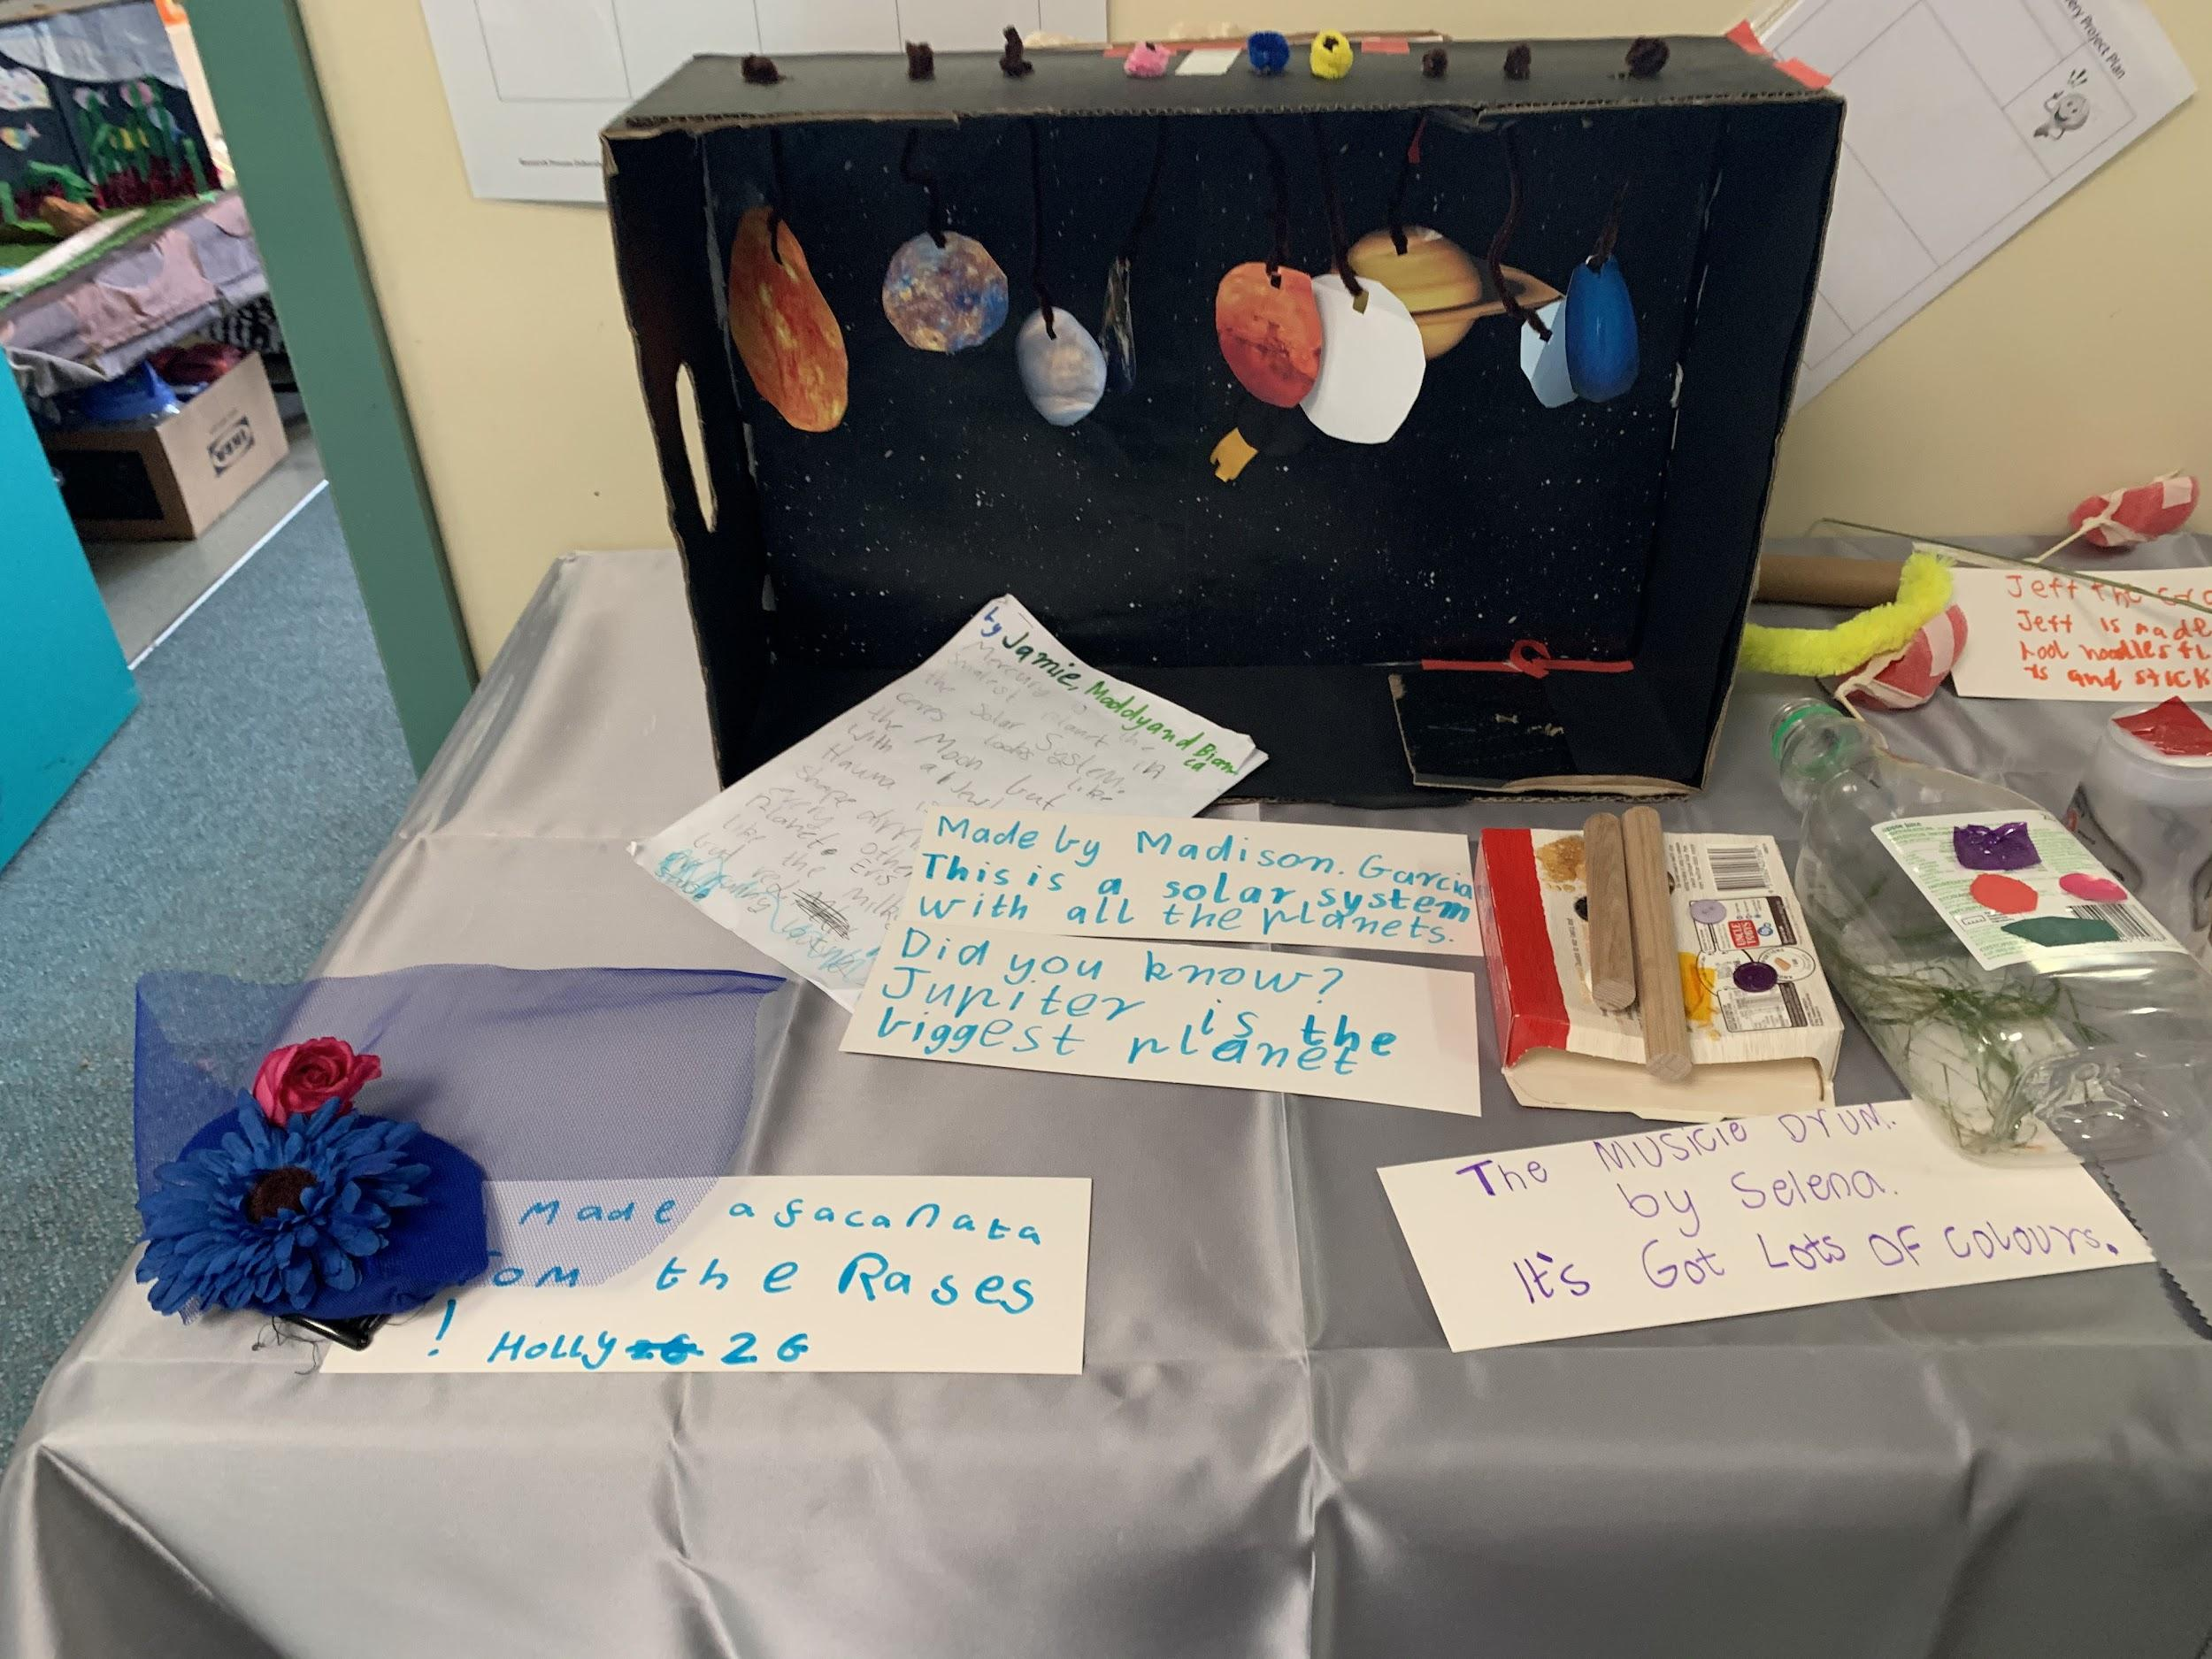
How can you share your information?
Teach someone else about it
Make a brochure, information book or website
Create a model or a visual display
Create a blog or a video or an animation
Give a talk or a demonstration

Slide 18
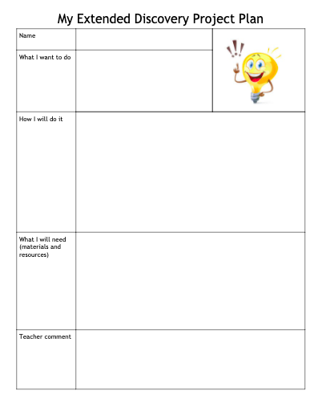
Let’s get started!
All you need to do now is:
Think of an idea- something you really want to make or find out, or learn to do
Discuss it with your teacher
Fill out a plan
Get started
Have Fun!

