Slide 1
3-6 Cluster
26th February 2018
St Mary MacKillop Keilor Downs

Slide 2
Welcome
St Mary MacKillop, Keilor Downs
St Paul’s, Kealba
St Catherine of Sienna, Lalor West
St Peter’s, Epping
St Francis of Assisi, Tarneit
Our Lady of the Rosary, Kyneton
St Brigid’s, Gisborne
St John’s, Footscray

Slide 3
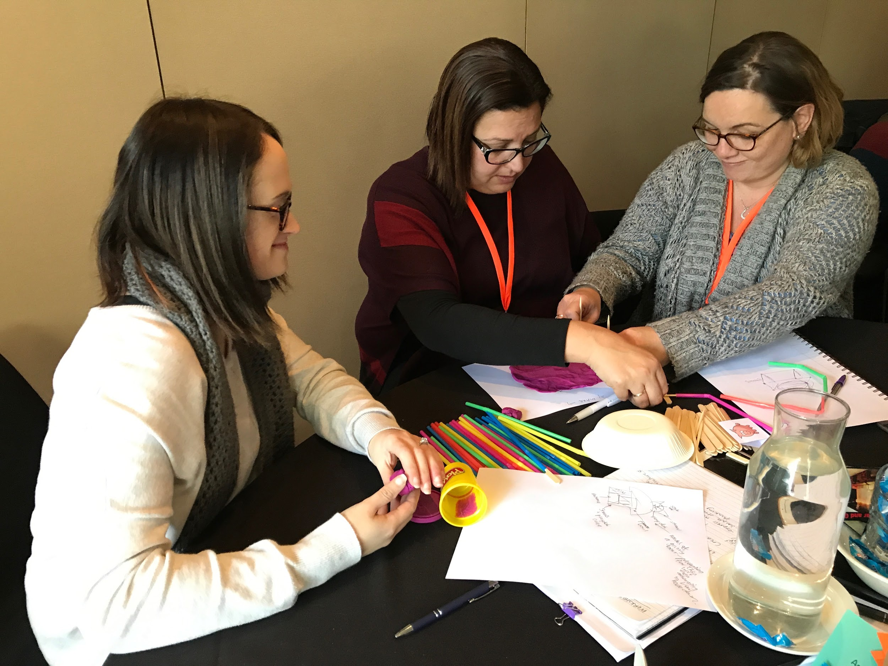
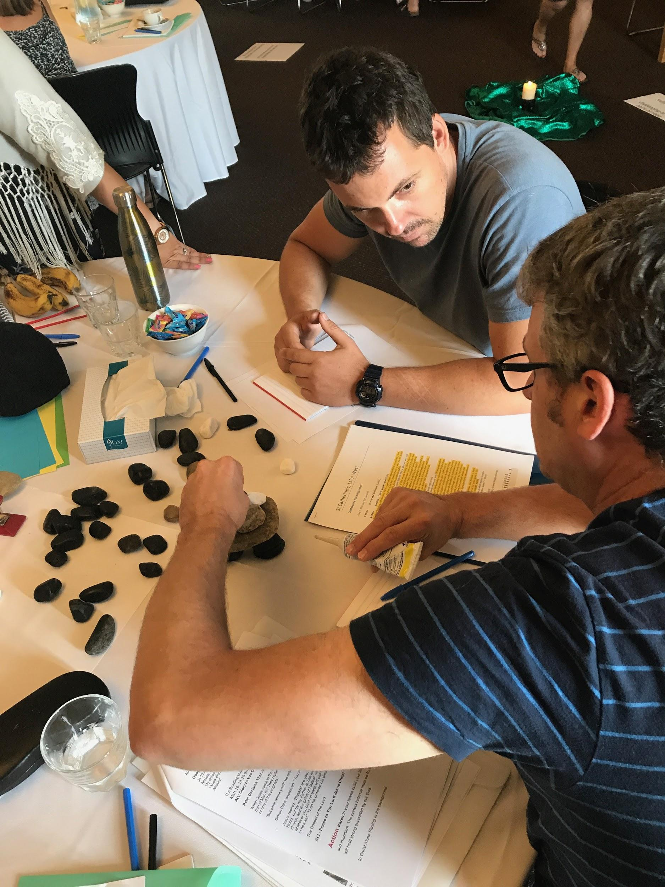
Purpose of the cluster
To engage in Professional Learning with and from each other in order to explore effective ways of using student-initiated inquiry to; develop learner capabilities, unleash curiosity and creativity, and deepen student thinking.

Slide 4
Outline of the year
Term 2: Tuesday 29th May @ Our Lady of the Rosary, Kyneton
Term 3: change of date from Thursday 16th August to Monday September 10th with John Spencer venue TBA!!!!
Term 4: Thursday 8th November possibly @ St Catherine of Sienna, Lalor West TBC
Collaboration via Google Docs: setting up of resource folder

Slide 5
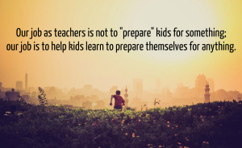
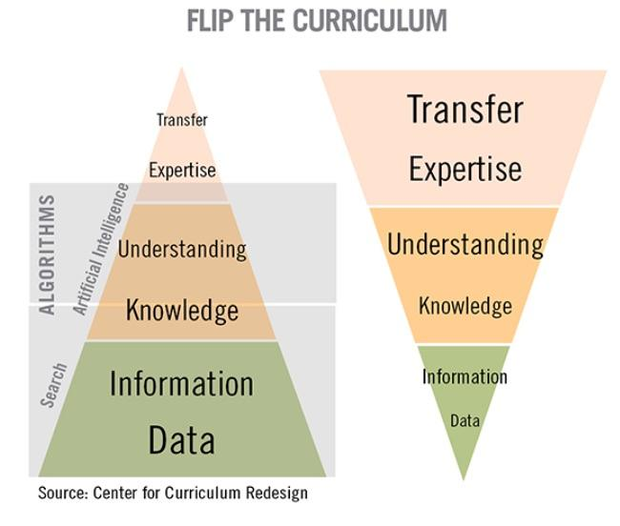
Why? What beliefs

Slide 6
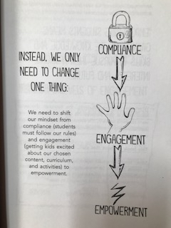
Empowering students means giving kids the knowledge and skills to pursue their passions, interests and future
Bill Ferriter
From ‘Empower’ by A.J Juliani and John Spencer

Slide 7
Clarifying terminology
Genius Hour
Passion Projects
iTime
Maker Spaces
Einstein Time
80:20 time
DIY
Student-initiated inquiry
What you call it doesn’t matter.
Why you do it does!

Slide 8
STUDENT-
INITIATED INQUIRY
Teacher-
initiated inquiry

Slide 9
Student-initiated inquiry
What it is…
What it isn’t…
Student-owned and student-driven
Relevant/meaningful
Rigorous and strategic
Creative and entrepreneurial
Focussed on developing the student as a self-managing, self-motivated learner
Free-time (for students and/or teachers)
Laissez faire (fluffy)
Electives program
‘Icing on the cake’ ie outside the curriculum
Contrived
Focussed on content or an end product

Slide 10
Sharing our stories
Why are you doing this? (What do you see is the value for your students at your school?)
What have you implemented so far and how is it going?
What’s going around in your head at the moment...what are you wondering?
Approx 5 mins per school

Slide 11
Principles that underpin this way of working
Voice and choice leads to higher levels of engagement (purpose and motivation)
The journey is more important than the destination (product)
Owning the process enables students to develop self-management and problem-solving skills
Mistakes are part of the process and great opportunities for learning
Teachers are powerful influencers of learning
Creating a community of learners empowers all members to be learners and influencers

Slide 12
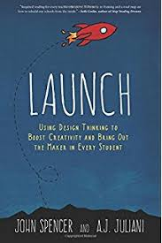
Professional Learning Time

Slide 13
Read and reflect individually
What are the key points in this chapter that connect with my thinking?
What extends and challenges my thinking?
What possibilities are going through my mind?

Slide 14
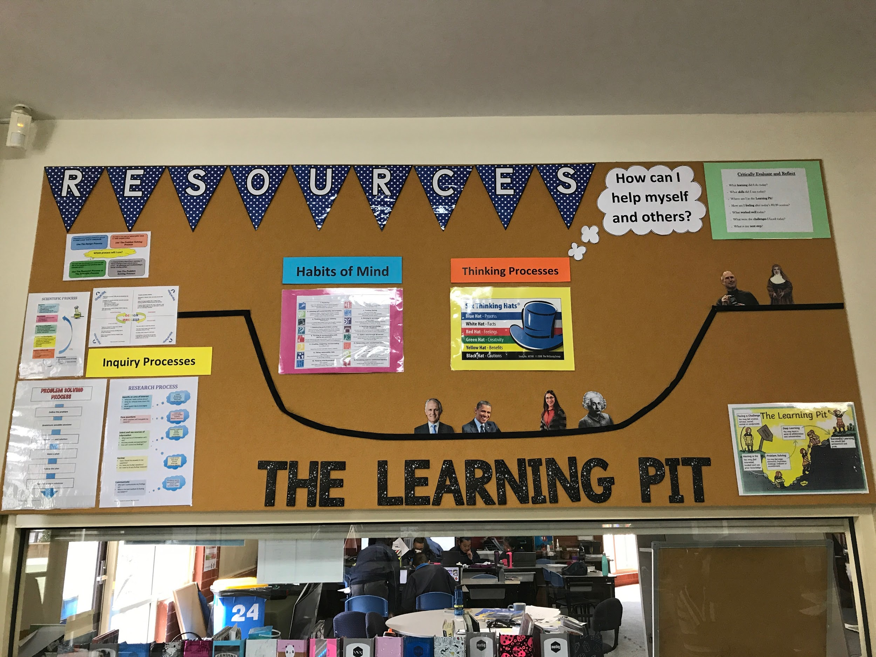
Learning Walk
Setting the context

Slide 15
The discovery walk… What are we looking for?
Environment
What does it feel like?
How does it support/scaffold students’ learning?
What materials and tools are available to students?
How are students using and moving within the environment?
Students
How do you know they are engaged?
What kinds of ‘projects’ are they undertaking?
How are they talking about their learning?
Teachers
How are they interacting with students?

Slide 16
Professional reading expert groups
What are the key points in this chapter that connect with my thinking?
What extends and challenges my thinking?
What possibilities are going through my mind?
What key messages do we need to take back to our teams?

Slide 17
Home group discussions
What are the key messages from my reading?

Slide 18
Considerations
Creating a community of learners
Logistics
When
Where
Who
Resources
What do we need to get started?
The learning environment
Communication
Leadership
Parents
Other staff
students
How will you frame it with students?
Setting the scene
Sparking kids interests
Setting criteria (rigour)
What is the teachers role?
How much scaffolding
When to step in, when to step back
Working as a team

Slide 19
Action Planning
What ideas have you seen, heard or read today that you want to take action on?
How will you do this?

Slide 20
Plenary
What’s going around in your head now?
What are you wondering?
What aspects would you like us to explore further in future cluster days?

Slide 21
What good is having a belly if there is no fire in it? Wake up, drink your passion, light a match and get to work!
Simon Sinek

