Slide 1

Makeknowdoact
27th May 2019
How can we support and challenge students to develop as capable learners and how can we assess their progress?

Slide 2

We respectfully acknowledge the traditional owners of this land, the Wurundjeri people of the Kulin Nation, on which we gather today.
We pay our respects to the elders, past, present and emerging.
We recognise the Wurundjeri people as custodians of this land and respect their culture and identity which has been connected with the land and sea for generations.

Slide 3
Your feedback
Modelling effective conferencing
Assessment and what could this potentially look like
Conferencing strategies/tools/data/anecdotal collection
Assessment and capabilities
Recording the learning journey (Not too scaffolded, enough evidence, what works?)
How do teachers ask/nudge/challenge students to stretch learning eg questioning
Modelling effective conferencing
How to best streamline from Years 3-6 so it is a gradual process (what to expect at each level
Seeing different examples of how children share their learning
Management/time in a 2 hour session: how long do you spend conferencing, how do you manage students who are off task when conferencing
Time to spend process ideas about the how with other schools This gives us an idea and reaffirms what we are doing
Genius time in the classroom eg. what it looks like, visit for teachers how others do it
Examples of wonderings and how these look in a classroom
Ideas for immersion and sprints
Motivate students unable to decide on a project
What we want to explore at the next cluster:
Assessment
Stretching students
Logistics
Strategies for motivating students
Practical ideas, sharing with other schools, seeing it in action (learning walk)

Slide 4
Preparation tasks
One example per person of a student project
Reading: The Power of Student Conferencing by John Spencer
NB Our finishing time today is 3.40pm

Slide 5
Session 1:
Stretching students
How do teachers ask/nudge/challenge students to stretch learning eg questioning
What does an effective conference look like and sound like?
How does it develop from Years 3-6 so it is a gradual process (what to expect at each level)
The researching process
What can we expect of beginning and developing researchers?
How can we challenge and support students to develop as capable learners?

Slide 6
Key points
Learning at the centre (not free time) Community of learners (collaboration)
Learning conversations (conferences) most important:
Teacher as researcher- where are they now, what’s the next step? (do you deal with this in the moment or note for future direction?)
John Spencer- Advice, Reflection, Assessment (requires knowledge and relationship) Moving towards students owning the conference and asking the questions
Students will be at different levels and your knowledge of the student will determine the amount and type of support they need next to move them forward
Yes we want high quality projects… but, focus on empowering the student and developing their capacity as independent learners rather than focussing on the end product.

Slide 7
Determining what they need next:
Help to shape their project (a gentle nudge or a challenge)
Redirection (floundering, lack of rigour, inefficient strategies)
Teaching (new skill, inefficient strategies)
Individual: Further learning conversations or conferences
Group: Teaching workshops
Who? - teachers, experts, other adults, peers
When? - during the session, in literacy or inquiry
Whole class:
Introductions/tuning in sessions (When? Why?)
Time for sharing (building collaboration, using peers as models, opportunity for feedback other than from you
Prioritise. You can’t deal with everything at once. Keep the long term view in mind. Work as a team.

Slide 8
Although we focused on pedagogy and structures, I was reminded that the greatest creative element is the human element. Yes, design thinking is great. True, we need to incorporate project-based learning. Yes, makerspaces are awesome. However, if we want students to develop a maker mindset, we need to build a culture of creativity, where students engage in divergent thinking and problem-solving. We need spaces where students feel comfortable taking creative risks.
John Spencer

Slide 9
Researching
How are we teaching students how to research?
Opportunities for teaching researching skills:
Teacher-initiated Inquiries
Literacy
Workshop sessions (S.I)
What does this look like developmentally?
NB It’s never, ever okay for students to copy slabs of information!!!

Slide 10
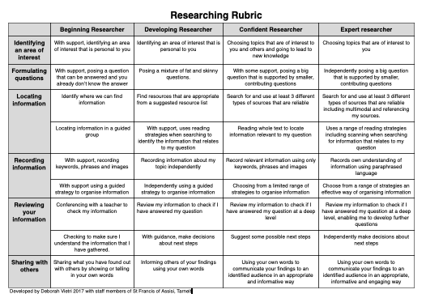
What do good researchers do?
Interested in the world around them
Curious and ask questions
Seek answers and solutions
Judge what is relevant and accurate information
Record information in their own words
Use what they have found out to create something original
Share what they have discovered with a real audience

Slide 11
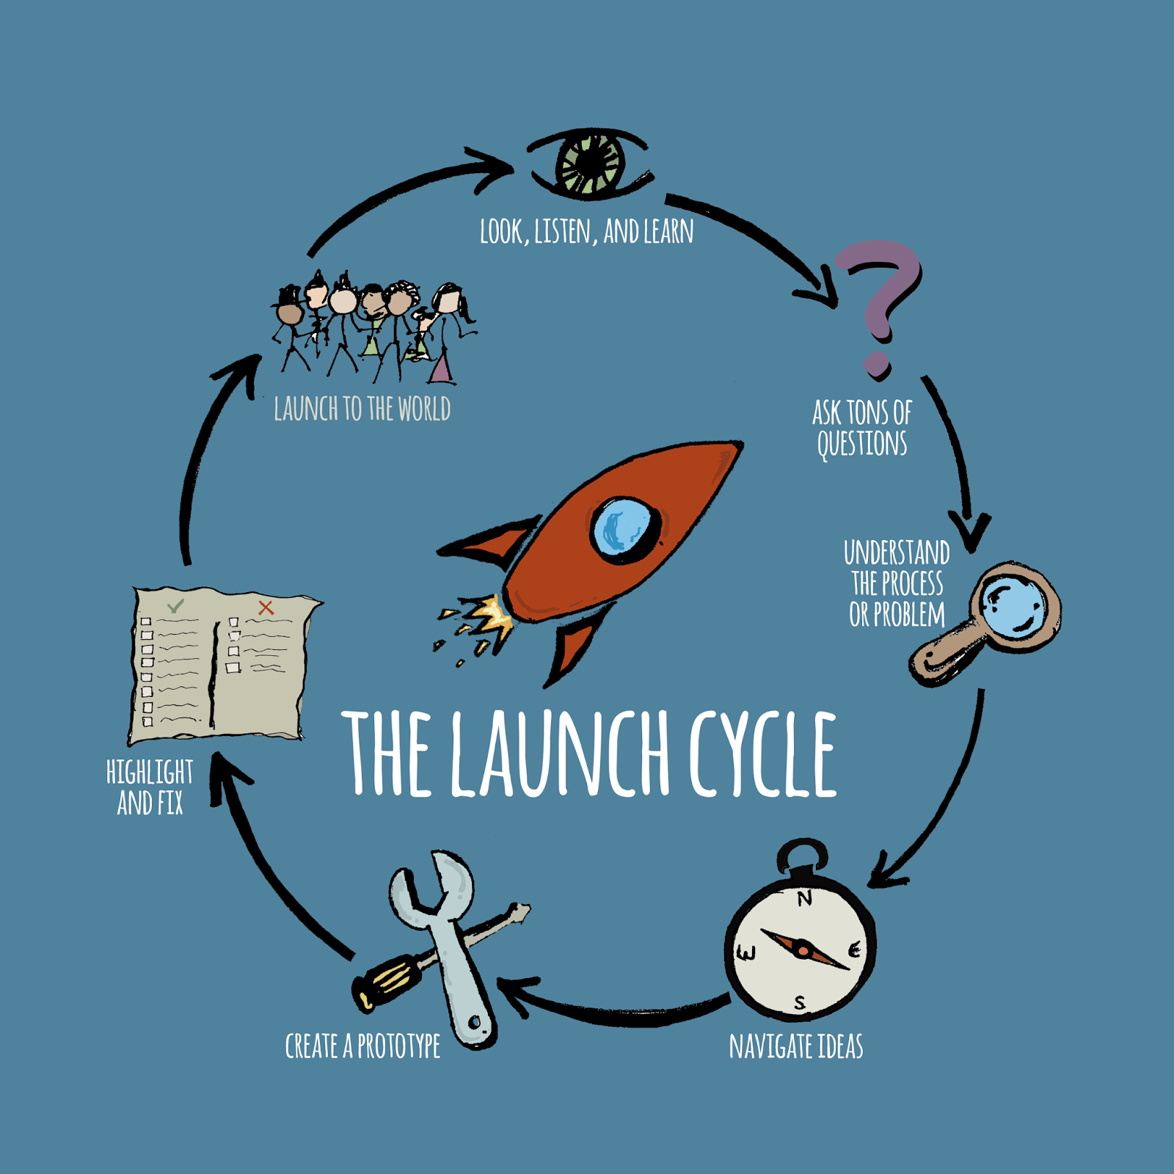
John Spencer and
A. J. Juliani

Slide 12
Ask tons of questions
What questions/wonderings are in your head?
(5 mins no talking!!!)
Scaffold:
What are you really interested in?
What has sparked your curiosity recently?
What’s bothering you?
I wonder sprints….
Questioning and researching

Slide 13
In groups of 4:
Questions that
Are factual or able to be researched
Are interesting/challenging (you don’t already know the answer to)
Relevant (worth knowing)
Quality control (not too big not too small)
On topic (if teacher initiated inquiry)

Slide 14
Learning Walk
What are we looking for?
How are the students developing as independent learners from Years 3-6?
Types of ‘projects’ they take on
Depth of challenge/rigour
How students manage their own projects
How they speak about their learning
How teachers are supporting and challenging the students
The learning environment
Setting the context

Slide 15
Cross school sharing of strategies
Logistics: how do you do it?
Management/time in a 2 hour session: what does a session typically look like?
What does conferencing look like and sound like?
How do you manage students who are off task?
How to motivate students unable to decide on a project?
How can students share their learning in different ways (not just an end of term expo, and not just a ‘presentation’)?
Anything else you would like to discuss?

Slide 16
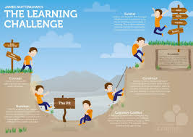
Session 4
Assessment and what could this potentially look like
Conferencing strategies/tools/data/anecdotal collection
Assessment and the General capabilities
Recording the learning journey (Not too scaffolded, enough evidence, what works?)
How can we challenge and support students and assess their progress?

Slide 17
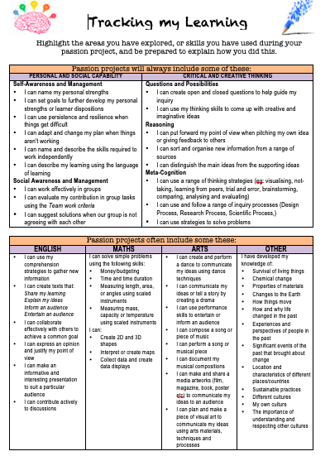
We need to stop thinking of Student-initiated inquiry as outside the curriculum and start valuing the learning that happens through our ‘genius time’

Slide 18
Ways of assessing and documenting
Through learning conversations:
Formalised conferences
Roving conferences
Share times
Google docs
Checklists (what are you looking for)
Anecdotal notes
Peer and self assessment (using criteria)
Tracking tools
Student rubric
‘What makes a good project’
Learning stories
Learning journals (documenting throughout the process)
Photos
Words, diagrams, pictures, flow charts
Voice recordings
Blogging
Warning: Beware of ‘over-scaffolding’!
Don’t kill the project through making the reflection stage too prescriptive and onerous!

Slide 19
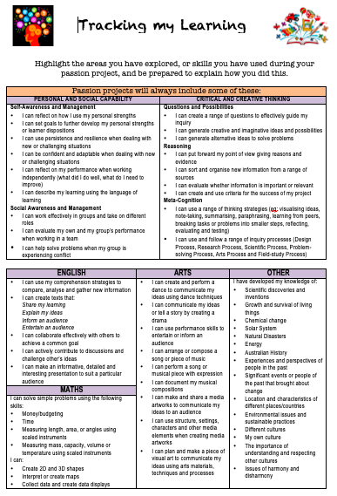
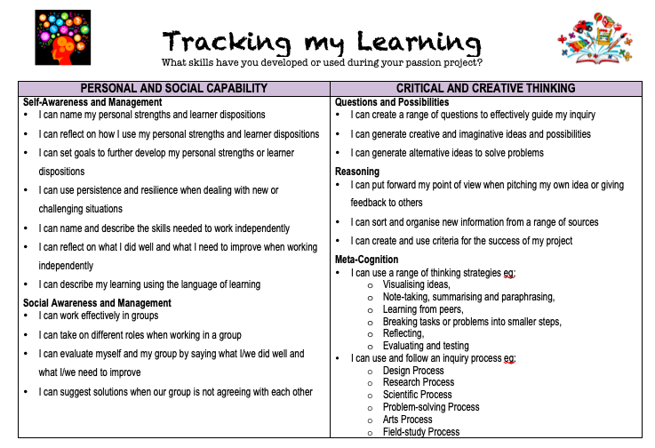
Just because different students will be learning or achieving different outcomes at different times through different projects doesn’t mean we can’t assess and value this learning. We need to think differently about how we do it!

Slide 20

My Learning Story
By ………….

Slide 21
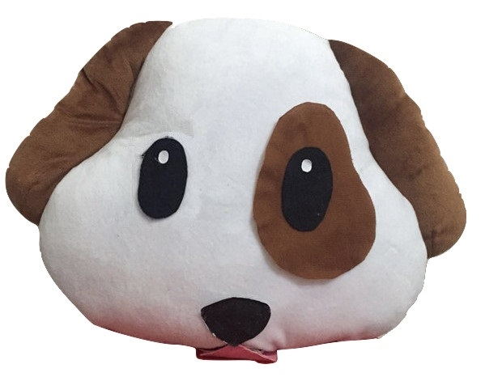



Research
The first step of making my pillow, was to research existing dog emoji pillows. I found 4 different pillows. One was on Ebay and the other 3 were on Google images. The details are below.
Ebay Dog Pillow
Name: Dog Puppy Emoji Pillow Emoticon Cushion Soft Smiley 32cm NEW
Feedback: 99.4% and has postivie feedback
Store: Visit Store: shoeandinsolekings
Price:$99.99US = $100.00 (approximately $132.43AU)
Where from ?: Moorpark, California, United States
Google Images
1.Emojicon Plush Comfy Throw Pillow 14 inches- PUPPY
From: www.toptrenz.com
Price:USD $14.00= US 17.00
2. PIG and DOG EMOJI PILLOW l Decor l Pintereset l Dogs, Pillows and Smoking
From: www.pinterest.com
3. GeekBuds Emoji Pillow, Emoji Dog Plush l GeekBuds LLC
From: geekbuds.com
2

Slide 22
Research
I also researched my materials. The two materials I researched were zips and some fur material.
Zip
I was looking for a white zip to attach to my pillow. I was trying to innovate on my pillow with a zip. Many emoji pillows don’t have a zip to it. I also thought that it would be an easier way to clean the pillow. After discussing my project and ideas for my pillow with my family, my family gave me a few tips about not putting a zip on it. In the end, I didn’t put a zip on it. But as I was researching I found a zip at Spotlight called a Birch white open ended zip for $3.49 to $5.99. There is a range for the zips because the zips come in different sizes.
Fur Material
I looked to find if there was any fur material at Spotlight, but the Spotlight I go to has lots of material, so I thought that it might not be on the website.
3

Slide 23



Plan
As I said in the zips paragraph, that after i discussed my ideas with my family, my family gave me a few tips on why
I shouldn’t put a zip on my pillow. The main reason was that it will be hard to put a zip on the fur material because the fur was a bit thick. I agreed to this, so I asked my family what’s something I could change to this pillow?. My mum gave me a great idea of putting a pocket on the back. As soon as she said that, I had a cool visualisation of the remote and my ipad sitting inside. I then made sure that everything else will work on the pillow. Then I started my designing stage.
4

Slide 24
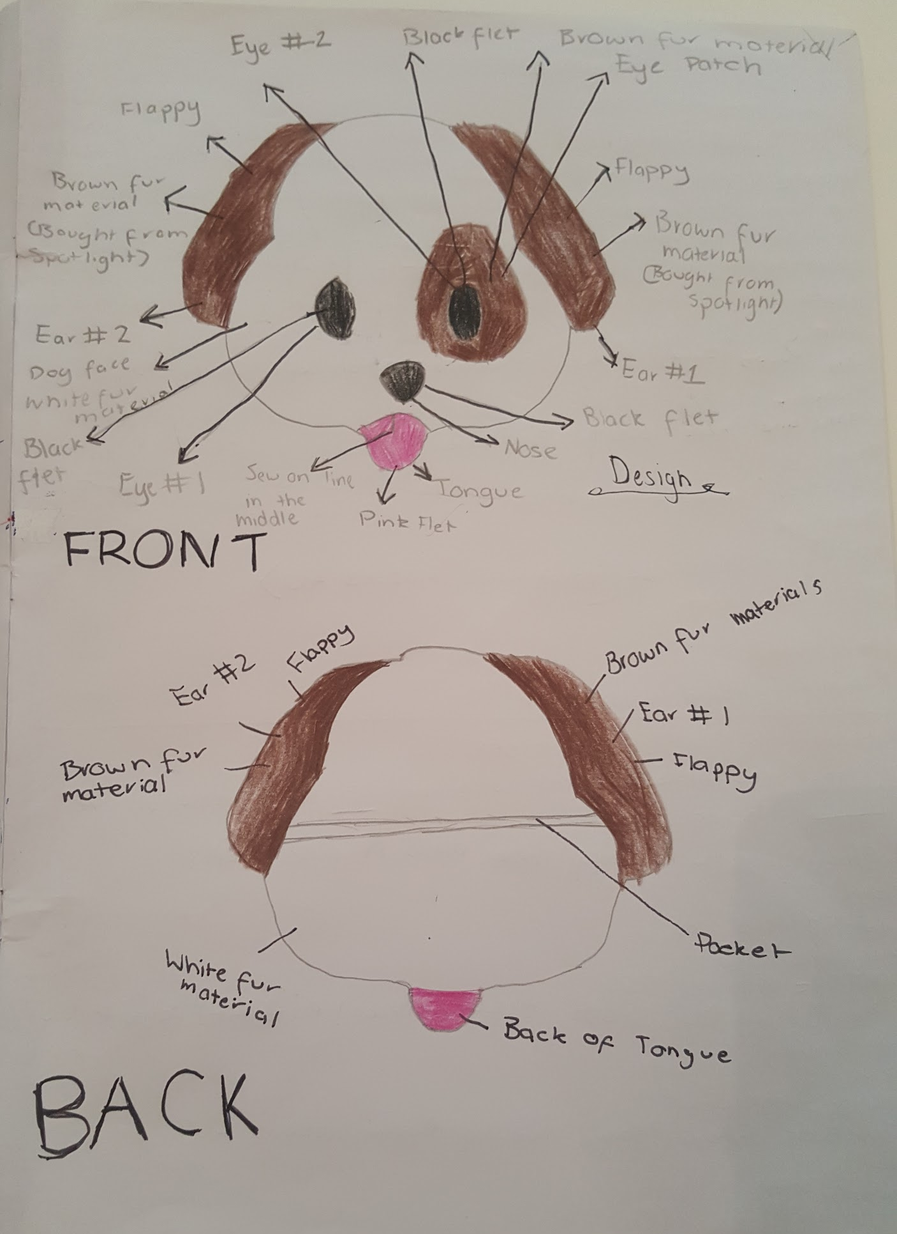
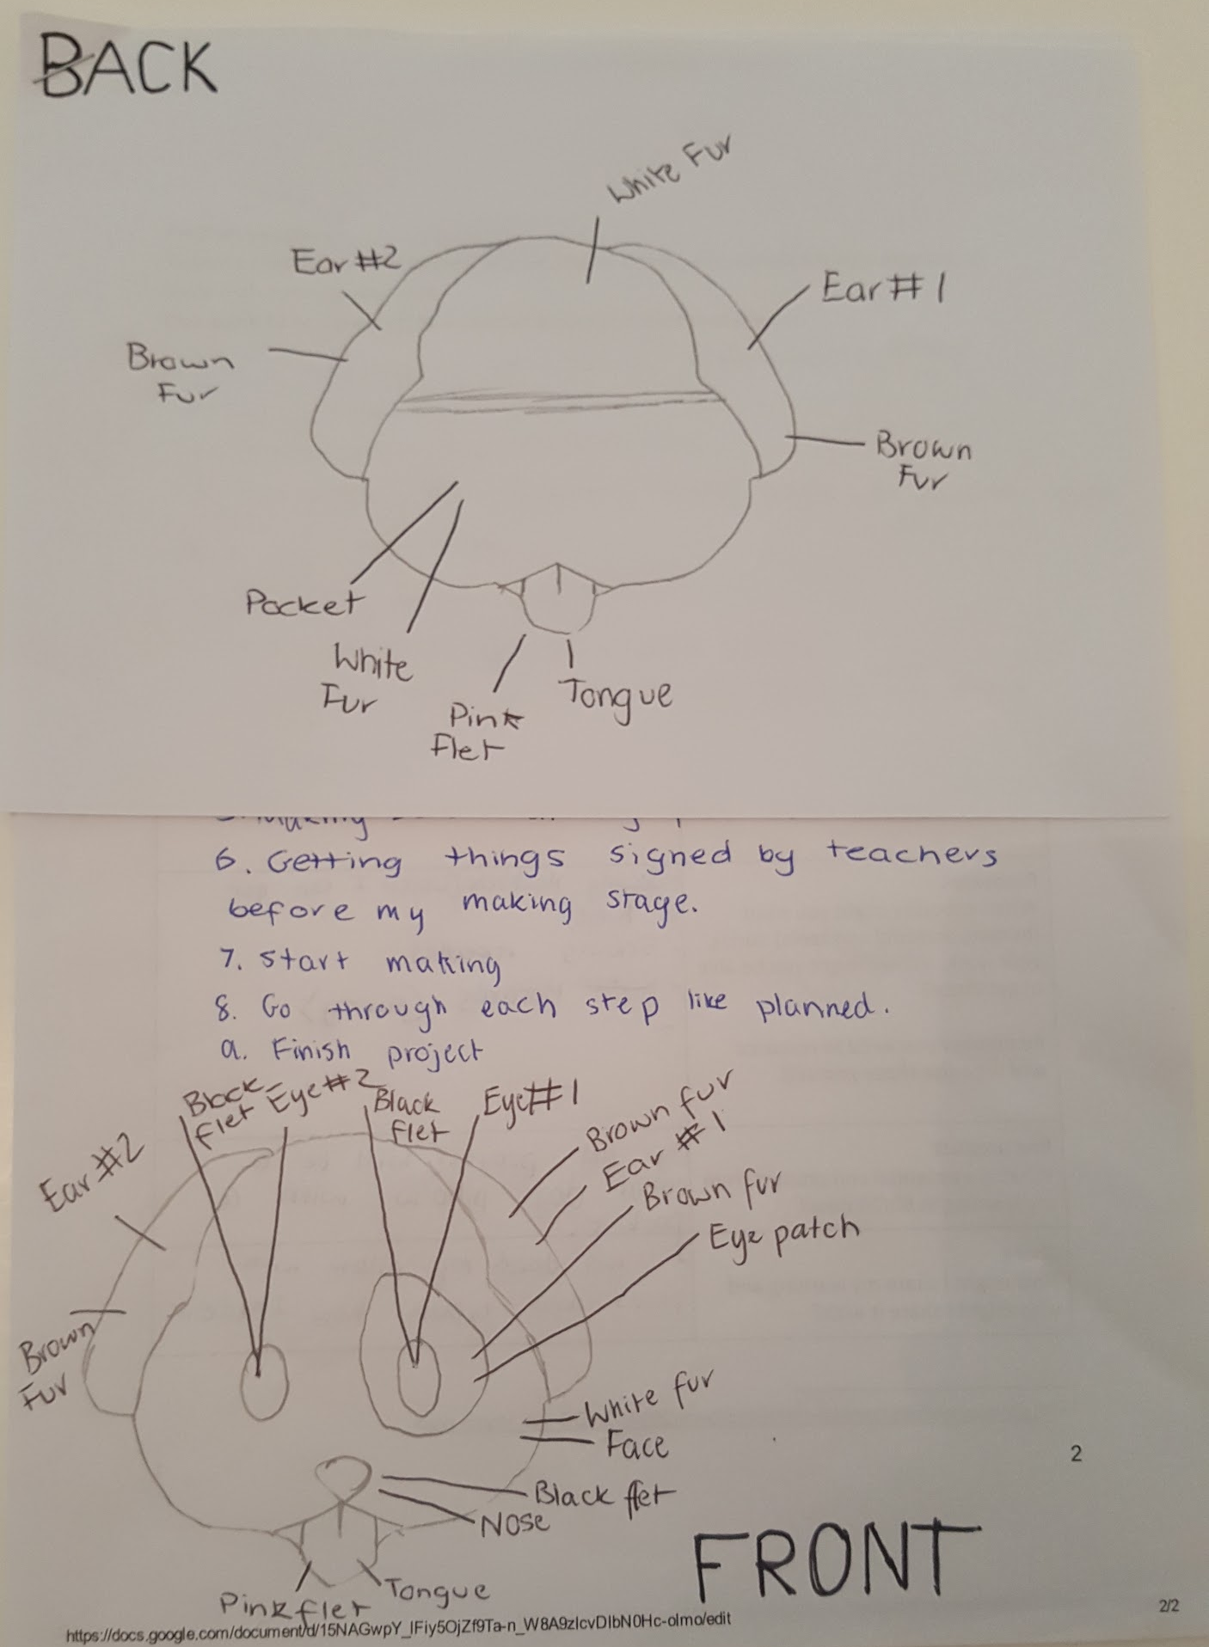
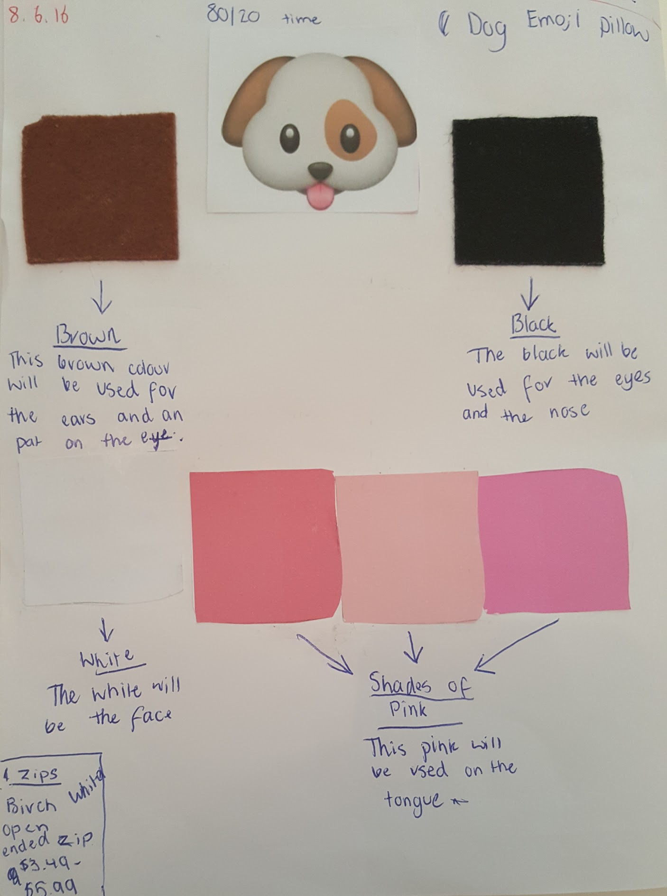
Design
I decided to draw the front and the back of my pillow. I drew a labelled diagram for this design. First I printed off 2 faces
of the dog, just to get the outline. I cut these pictures out and traced them into my book. I then cut the ear off to get the dog face. Then I cut the tongue, then the eyes and the eyepatch and the nose. I then labelled the part of the face and if it is going to be flappy or if I am going to sew it to here or there. I also labelled the material that is going to be used on the part. On the back, I did the same thing , but I didn’t cut out the eyes, eyepatch and the nose. I did this in my book and on the learning proposal too.
5

Slide 25

Evaluate
I changed this emoji pillow by doing a dog emoji (because you can’t buy any in stores, only online) and I added a pocket to the back. I need to thank my mum for the wonderful idea of a pocket and I love it sooo much. On our last 80/20 session (20.7.16) I put my Inquiry book into the pocket. A good thing is that the pocket is big and I can put large and thin objects in it.
6

Slide 26


Highlights + Frustrations
Some of the highlights of making this project, were that I was able to have the opportunity to make this emoji pillow. I think that changing something about a product was a very good idea because it makes people and me, think outside the box. I also loved to see everybody else’s products. Some frustrations were that I was cutting the fur material, it was very messy.
7

Slide 27
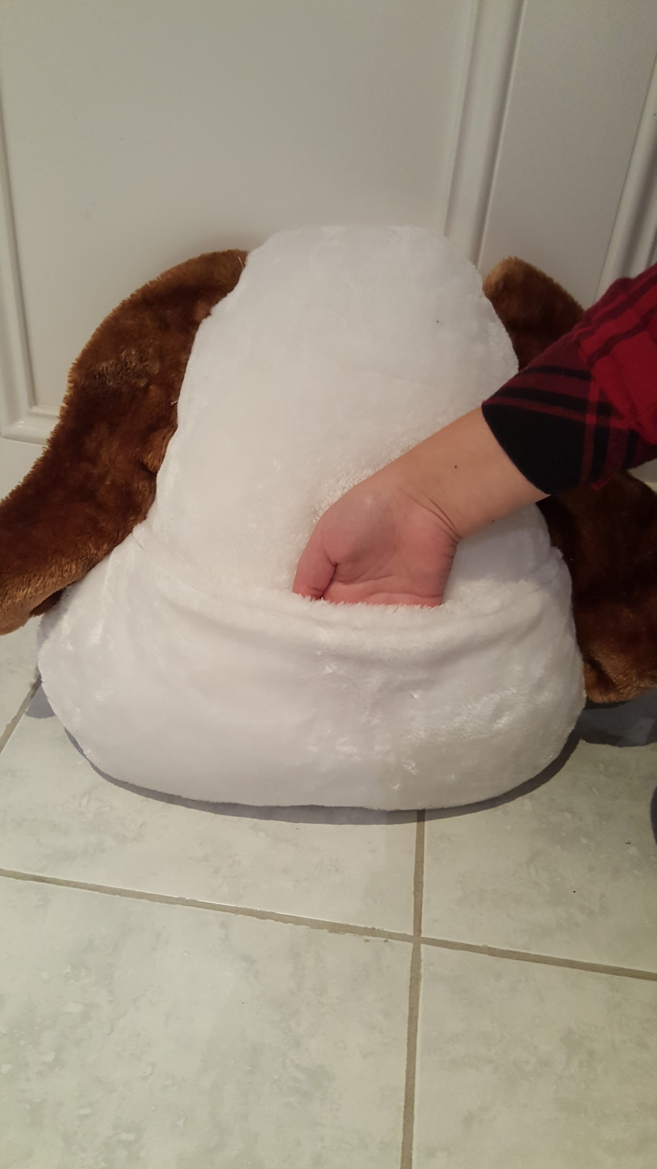
Key Challenges
Learning Pit
One of the problems I had was that the zip would be to hard to put on the fur materials. My mum gave me a great idea of putting a pocket on the back. I didn’t really have many problems while making my pillow. I guess the way I planned it and thought about it worked.
8

Slide 28



Feelings + Thoughts
I had lots of thoughts and feelings throughout the process. As I was working, I was always thinking, will this work? Or what’s going to happen if I do this? As we started this unit, I was really excited because I got to use my sewing, designing and planning skills for a product I really loved. Next year at Ave Maria, I am looking forward to going into Textiles because I will get to show my friends and teachers the skills I have been learning in these types of units. I was also confused sometimes because when I was designing my pillow, I didn’t know how to put it in one piece.
9

Slide 29
What Will I Do After This ?
As I said in the last question, I am going to share my skills with friends and teachers next year at Ave Maria. My skills in sewing can be used again in units like 80/20 time. I can probably help my mum when she is sewing now. My mum might teach me how to use a sewing machine, and that will build on my skills. I guess that having this knowledge means I can teach young students, friends and family how to sew. I will like to share my learning and project with others and I might inspire them to do something similar. I will use my Dog Emoji Pillow and it will be sitting on my bed, so I can always look back to it, and remember the thinking, planning and knowledge that has gone into it.
10

Slide 30
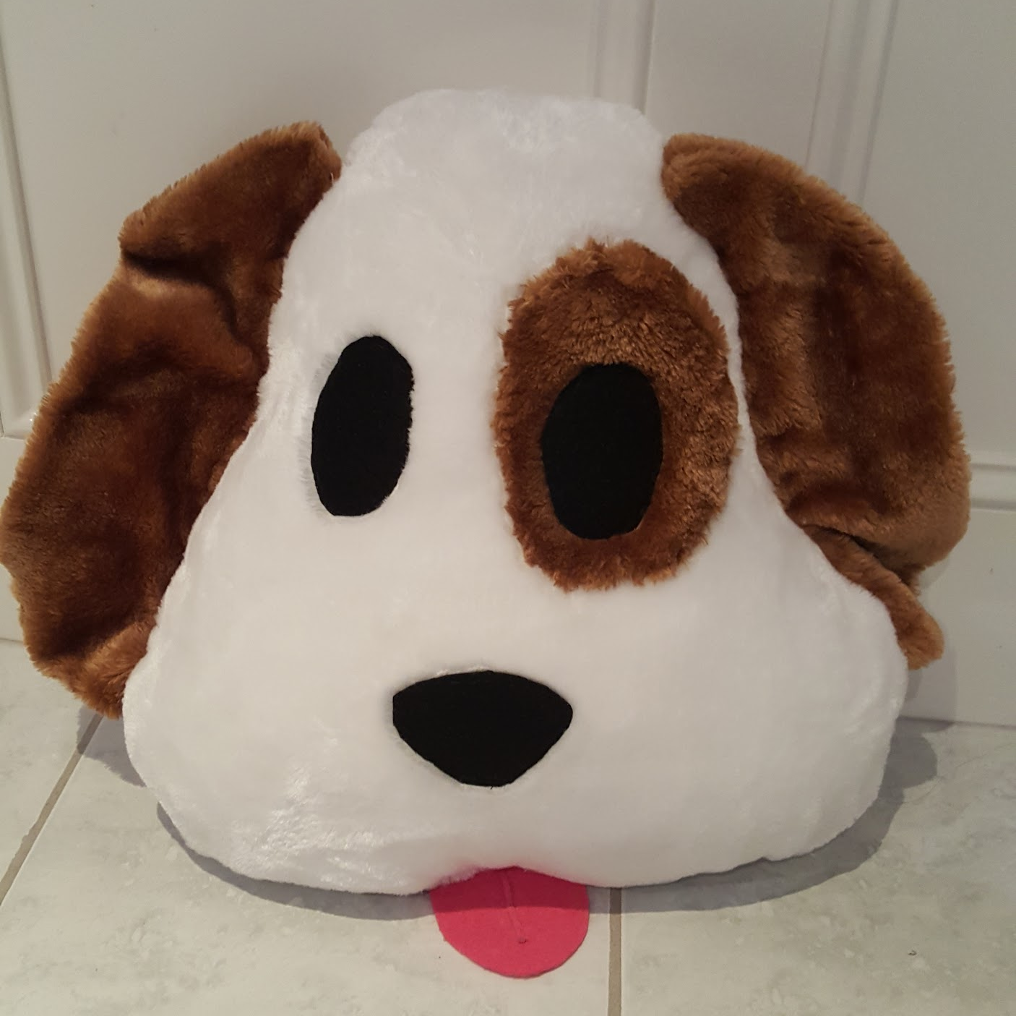
FRONT

Slide 31
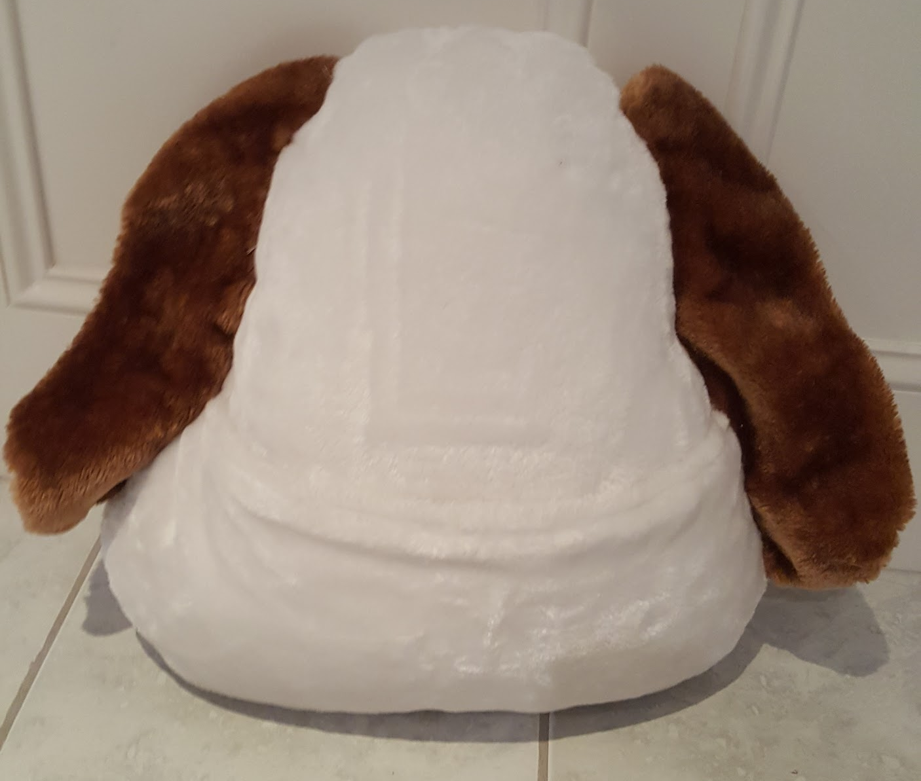
Back

Slide 32
THANKS FOR LISTENING

Slide 33
Sharing our students’ projects
Where’s the rigour? How did this project stretch that student?
What was the learning for that student? What evidence do we get from this?
How to conduct a learning conversation/conference: what makes for good questioning? Are we listening?
Sharing the work and identifying the learning

Slide 34
Process:
Groups of 3 ‘presenting teachers’ with additional facilitator and recorder
Protocol for discussion
Whole group Sharing

Slide 35
Sharing Protocol
Presenting teacher shows the project and briefly describes the context:
  How the student came up with the idea/why they chose to do this
  The process the student went through in developing the project
Other members of the group ask clarifying questions.

Slide 36
Whole group discussion
How did the teacher support the development of these projects?
What role did conferencing and feedback play and what effective strategies or questions did they use?
What evidence is there of student learning/achievement (Use student rubric to track development)
How could this be recorded (by teacher/by student)

Slide 37
Reflection and Action Planning
What are the next steps for your team/school?
How will you go about this?

Slide 38
Plenary
Conference- John Spencer and James Anderson
Deborah Vietri educational consulting
https://www.deborahvietri.com
Members- Makeknowdoact
Password: VietriMake1

