Slide 1
#makeknowdoact
3-6 Cluster Term 4 2018
@ St Catherine of Sienna, Lalor West

Slide 2
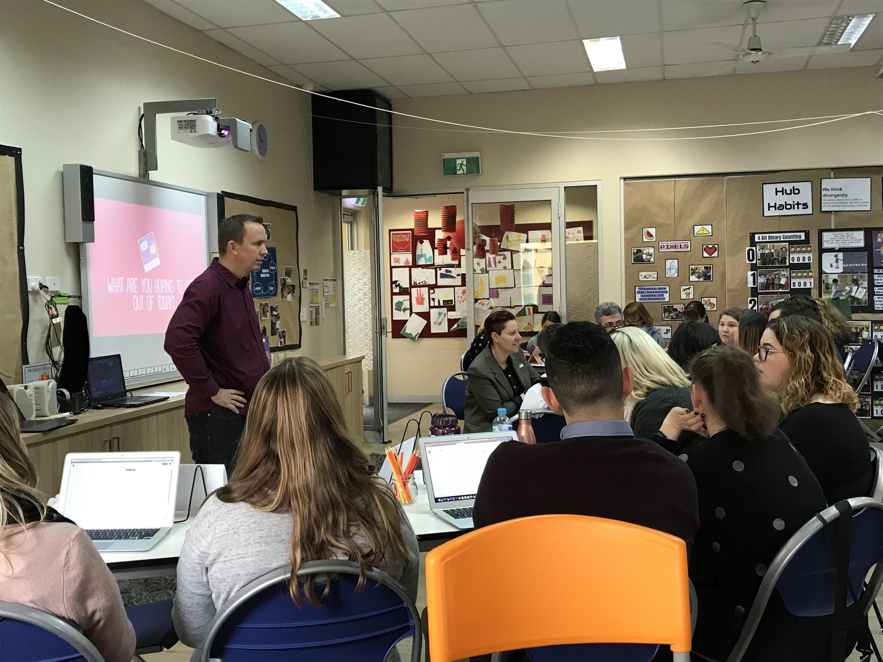
Reflecting on our learning with John Spencer

Slide 3
Recapping key points
Mrs Smoot and Mr Darrow
‘When you hide your voice you rob the word of your creativity’
‘I spent hours on something and it deserved an audience’
Inquiry process has 4 steps:
Orientation
Conceptualisation
Investigation
Conclusion

Slide 4
The child who doesn’t engage in the task/inquiry (I don’t know what to do or how to do it/what it looks like)
Teacher scaffolding- give kids a variety of ways of showing their thinking (but beware of exemplars)
Teachers may need to step in and help kids articulate the question they are grappling with
Design thinking is a structure for doing creative work
Types of conferences: advice, reflection, mastery (goal setting)
Role of the teacher: as an innovator, as a risk taker, you actually have more influence teaching this way!!! (Power of the teacher as influencer)

Slide 5
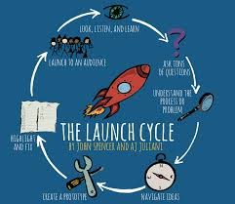
If you want to innovate as a teacher you need to step into the unknown
Rubrics- need to be specific but still open to creativity (ask the kids to convert the rubric into a checklist)
A project could take 3 days, it could take a year
The expert in the room is the collective wisdom within the room!
Importance of building rigour into the process

Slide 6
Session 3:
Rubrics workshop

Slide 7
Why do we need/want rubrics?
To make our expectations clear:
  Student rubric: What criteria ensures the learning is explicit and the ‘projects’ are rigorous?
  Teacher rubric: How do we know our approach as teachers to Student-initiated inquiry is challenging and supporting

Slide 8
What criteria ensures the learning is explicit and the ‘projects’ are rigorous?
Choosing and completing a project that is meaningful to you and stretches your learning
Creating a well thought-out plan and adapting it when necessary during the process
Managing yourself effectively throughout the project
Collaborating with others in order to achieve a high quality project
Using learning dispositions, especially persistence, resilience and problem-solving throughout the project
Reflecting on work and learning throughout the project
Seeking out and acting on feedback throughout the project
Sharing your finished project and your learning journey with an audience

Slide 9
How do we know our approach as teachers is challenging and supporting?
Having a clear understanding of the purpose and Vision for learning
Creating a supportive and stimulating learning environment
Establishing high expectations and making these clear and visible to students
Collaborating with colleagues in planning, reflecting and implementing Student-initiated inquiry
Being a role model and inspiring students by being a creative and courageous learner
Differentiating support to students at the point of need
Collecting evidence of student learning and communicating this to students, parents and others
Providing structured opportunities for collaboration, sharing and feedback between students

Slide 10
Cross school sharing
In small groups share the projects you have brought with you
In light of the rubrics we have just created what makes this project successful?
What has the student demonstrated/achieved
How did the teachers support and facilitate this learning?

Slide 11
Session 5
Reflecting on 2018 and planning for 2019

Slide 12
Knowing what you know now, how do you want to begin in 2019?
How will you set up the learning environment?
What protocols and expectations will you set up for your students?
Logistics!!! Eg: When, where, who, how often, for how long?
Consider the criteria we have exploring in the teacher and student rubrics

Slide 13
Plenary
What’s ahead in 2019
Host schools
Any specific focii you would like addressed for 2019

