Slide 1

New Teachers to
Discovery 20
Friday March 13th
St Michael’s,
North Melbourne
How does the Discovery-based inquiry approach support early years students to become effective learners?

Slide 2
discovery cluster 2020 member schools
St Carlo Borromeo, Greenvale
St Michael’s, North Melbourne
St Joseph’s, Collingwood
St Mary’s, Lancefield
Holy Cross, New Gisborne
St Bernard’s, East Coburg
Marymede, South Morang
St John Bosco, Niddrie
Sacred Heart, Fitzroy
St Peter’s, Epping
St Mary MacKillop, Keilor Downs
St Anne’s, Sunbury
St Gabriel’s, Reservoir
St Brigid’s, Gisborne
St Mark’s, Fawkner
Holy Spirit, Thornbury East

Slide 3
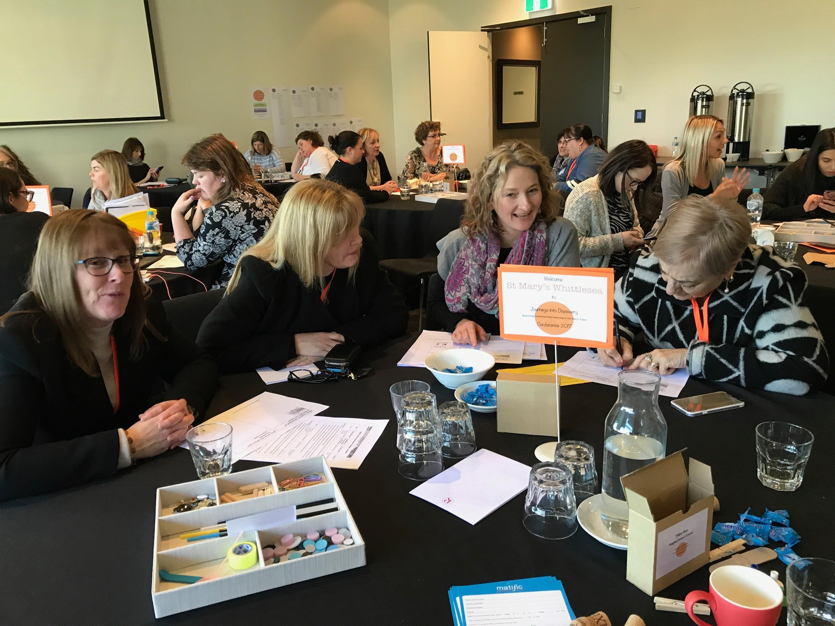
The Discovery Cluster
To engage in Professional Learning with and from each other in order to explore best practice, design powerful learning, and empower our Early Years Students to become highly capable learners.

Slide 4

Email, instagram, twitter, website
Resources available on our website- Members areas- Discovery 2020
www.deborahvietri.com
Password: 2020Discover
Contact us

Slide 5
outline of the day
february 2020
Focus on the WHY
Building the pedagogical base
Extending the HOW
Expanding the frame of DBI
What does this look like in practice?
Expanding the teacher’s role in Discovery
Sharing a school story
Discovery Walk P-2
Going deeper: what is the teacher doing to strategically scaffold the learning: Introductions & Share Time
Debrief/planning along the way
December 2019
Brief introduction to Discovery-based inquiry
Focus on the HOW - Discovery
What makes a great Discovery station?
Types of areas/stations you could set up
Brief overview of introductions and share time
Setting up for the beginning of the year
Role of the teacher

Slide 6
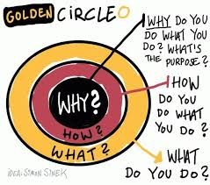
Why do we do what we do???
What does your school value about students and learning?
Whole and encompassing way of thinking about children and about learning that influences our words and our actions

Slide 7
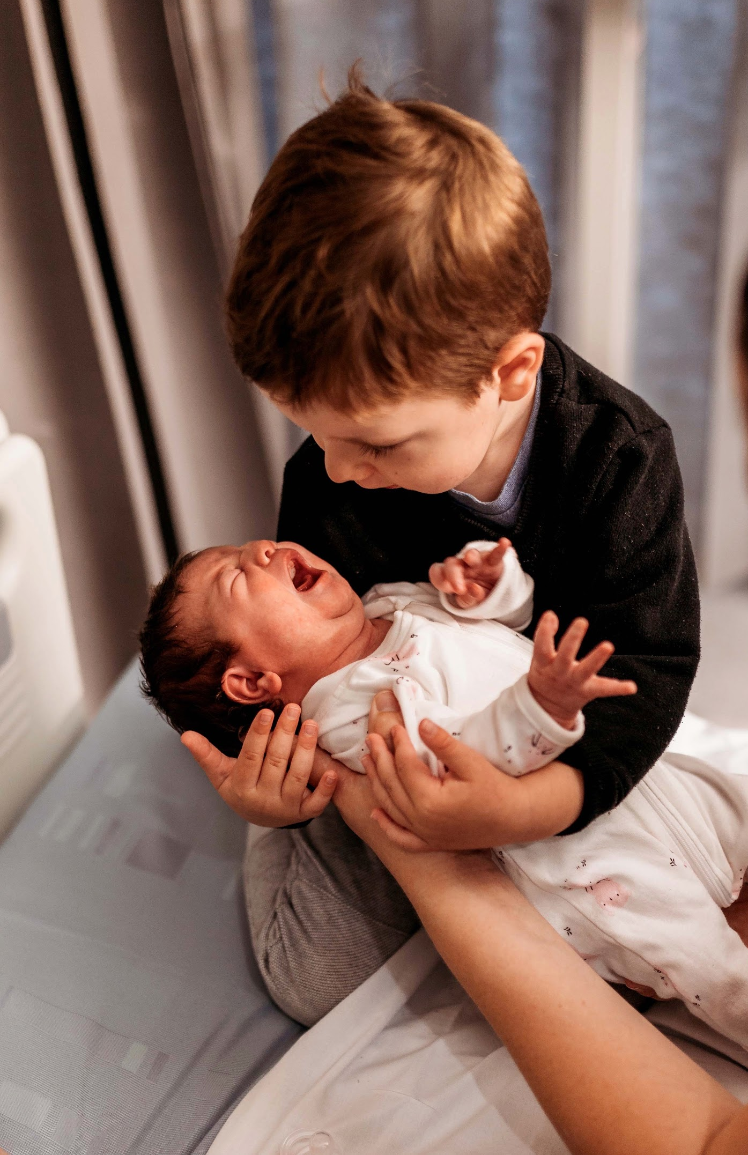
Innocent or fragile
We must protect them
Threatening
We must control them or the situation
Empty
We must teach them everything
Competent and capable
We must challenge them, trust them with their learning, listen to their perspective
Lisa Burman
Image of the child

Slide 8

We can view children in different ways
Subconscious, internal view
Influences our words, actions, and the teaching decisions we make
I
If we believe this then what should be our default response … what would we think, say, and do?

Slide 9
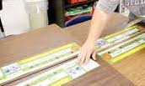
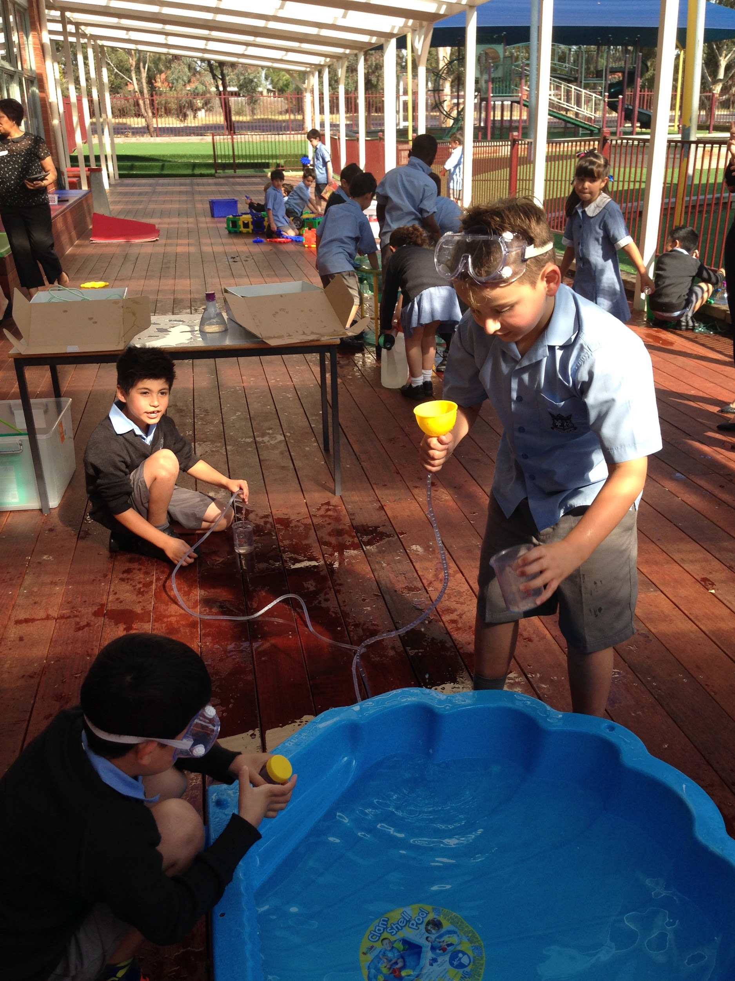

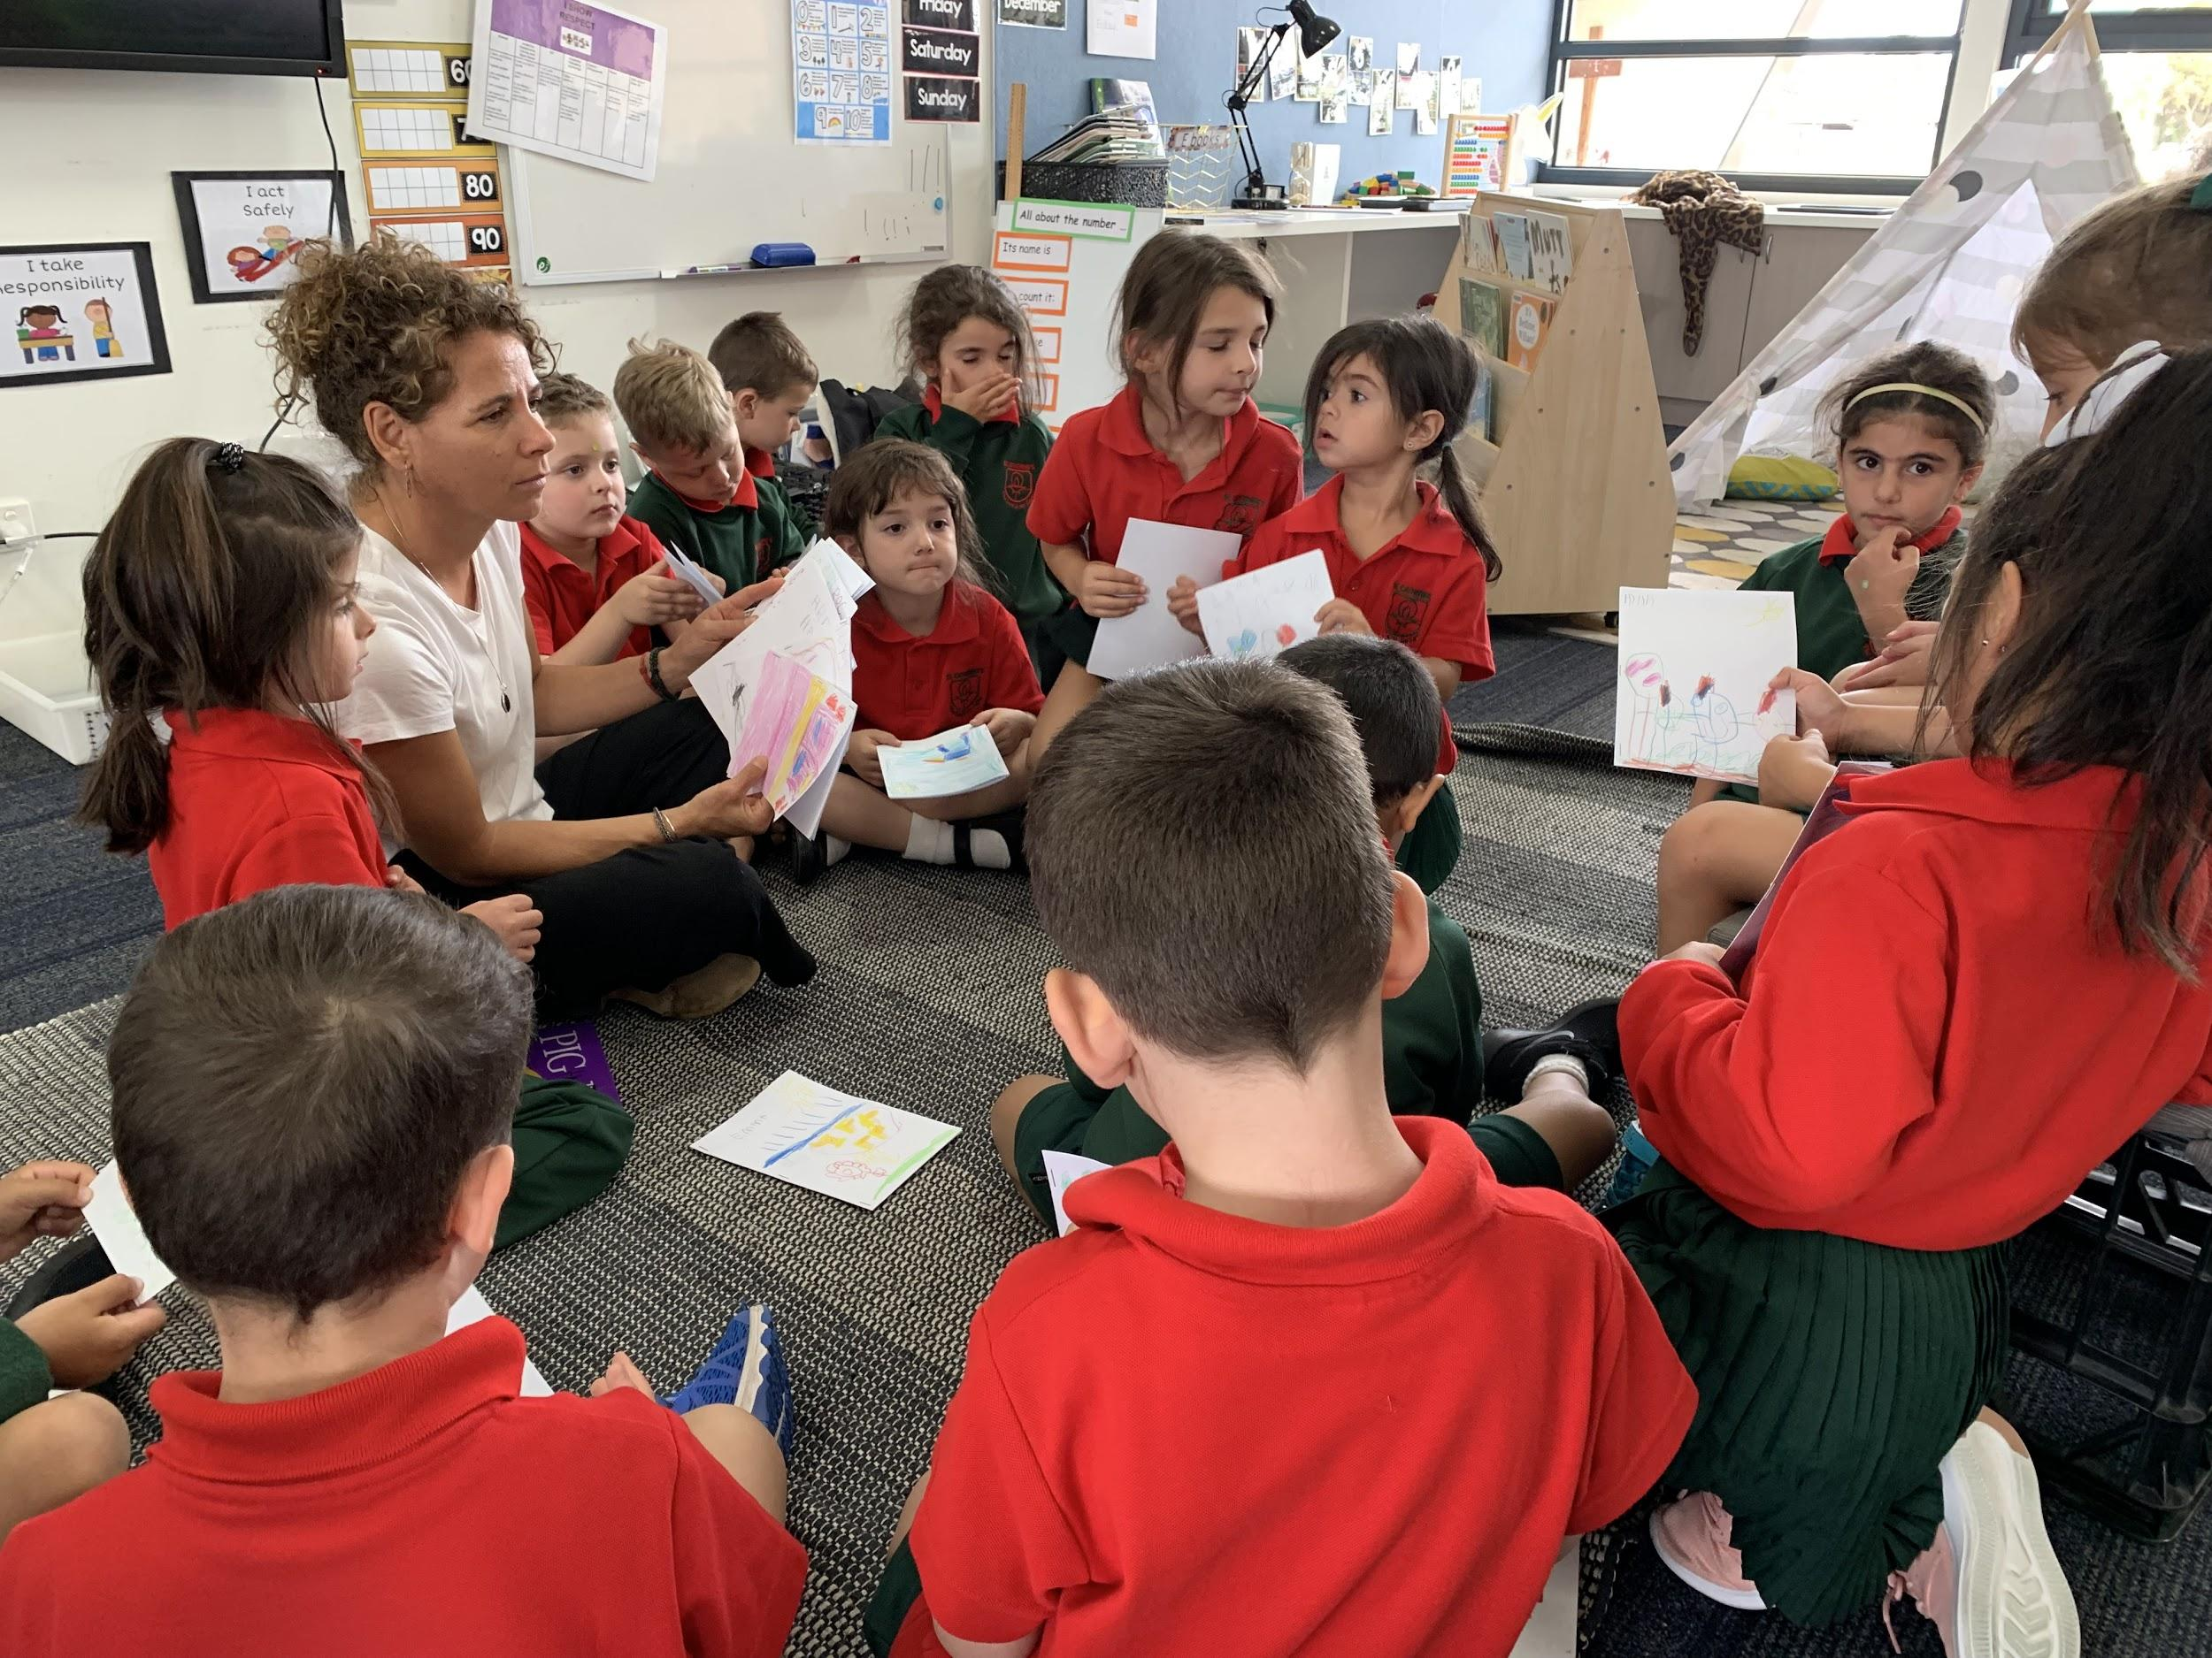

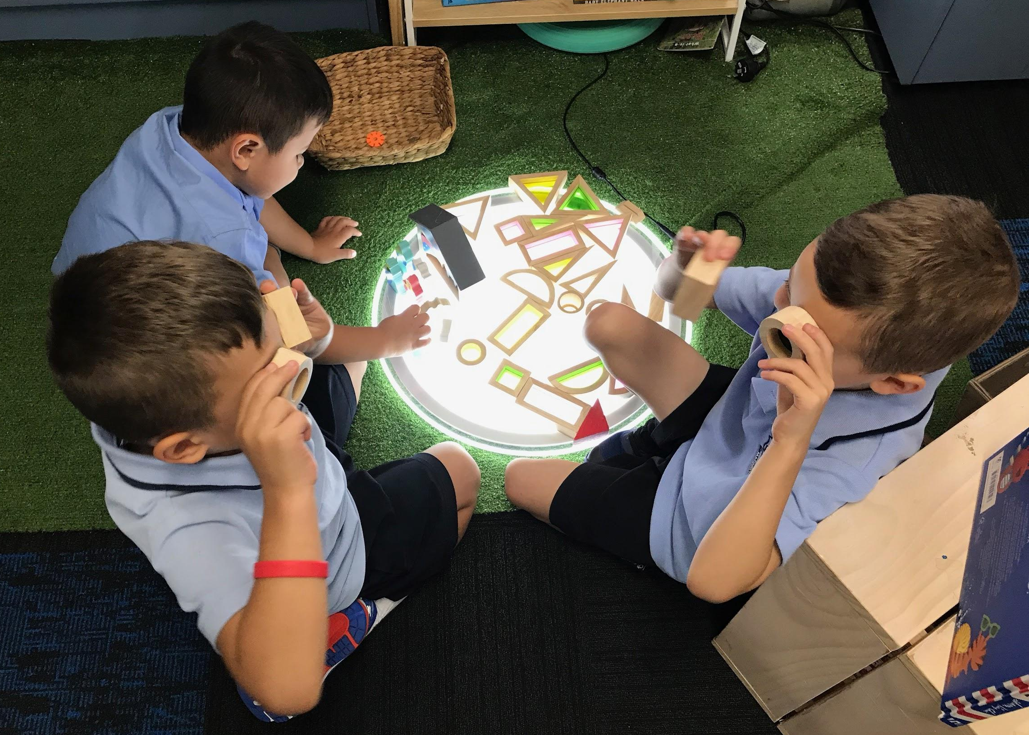
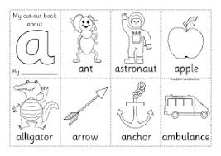
What image of the child/beliefs are present?

Slide 10
If you embrace the view of the child as competent and capable then...
...what would you be doing and saying?
One small thing you could start doing.
...what wouldn’t you be doing and saying?
One small thing you could stop doing.

Slide 11
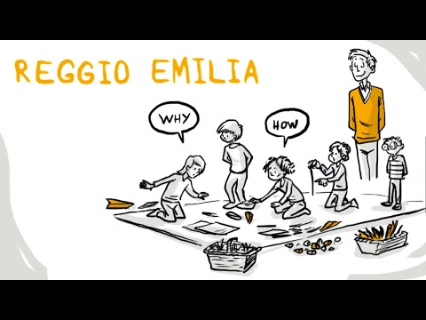
Reggio Emilia (Loris Malaguzzi)
Jerome Bruner ‘Discovery Learning’
Constructivist approach (inquiry learning)
Ken Robinson (creativity)
Influencers
Our own experiences, collective experiences in ‘the room’ look, listen, learn!

Slide 12
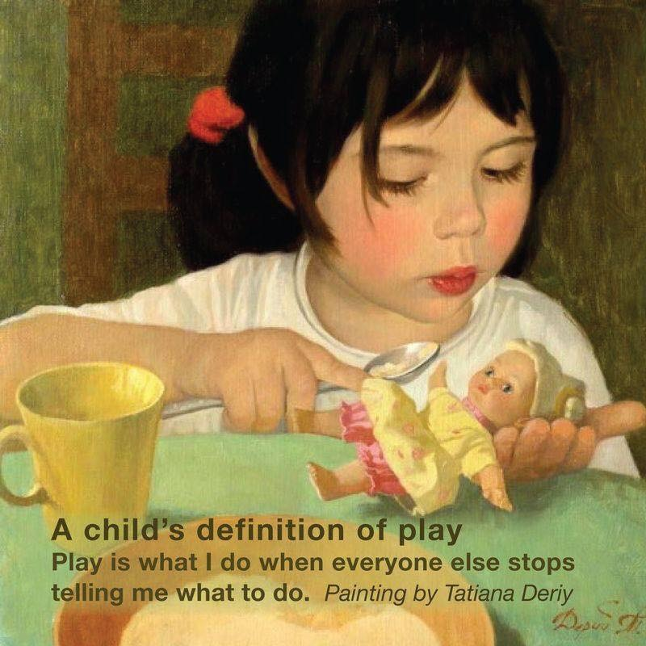
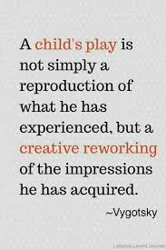
Influencers
Lev Vygotsky
Lisa Burman
Kathy Walker
Inquiry gurus- Kath Murdoch
Pasi Sahlberg
Nathan Wallis

Slide 13
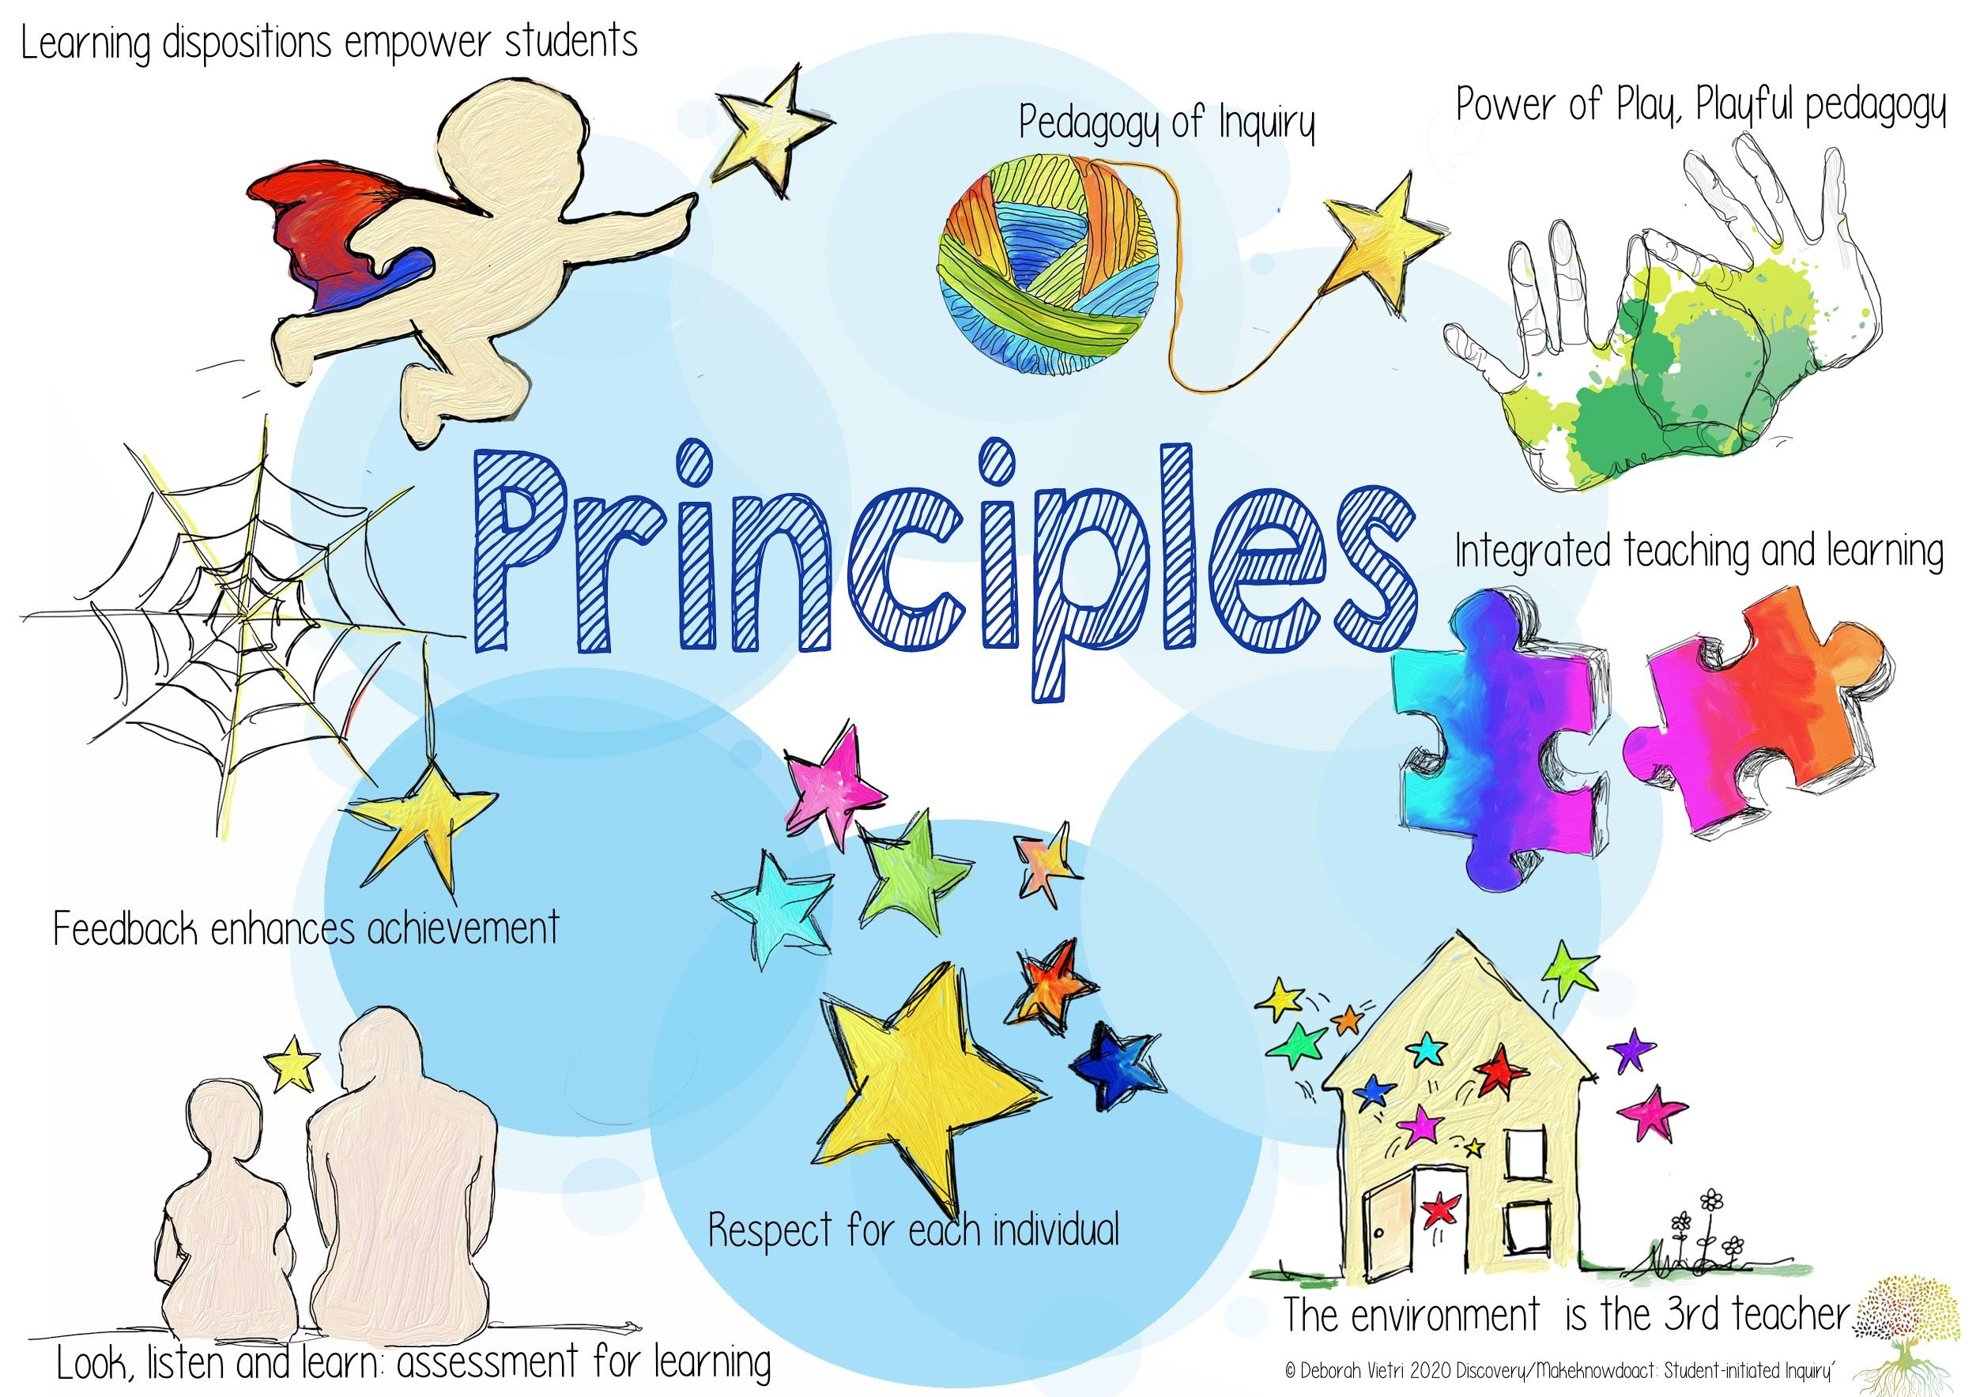

Slide 14
How?
Drilling down!!!
What does this look like in practice?
Expanding the teacher’s role in Discovery- Rita
Sharing a school story- Claire
What thinking goes into setting up for Discovery
Discovery Walk P-2

Slide 15
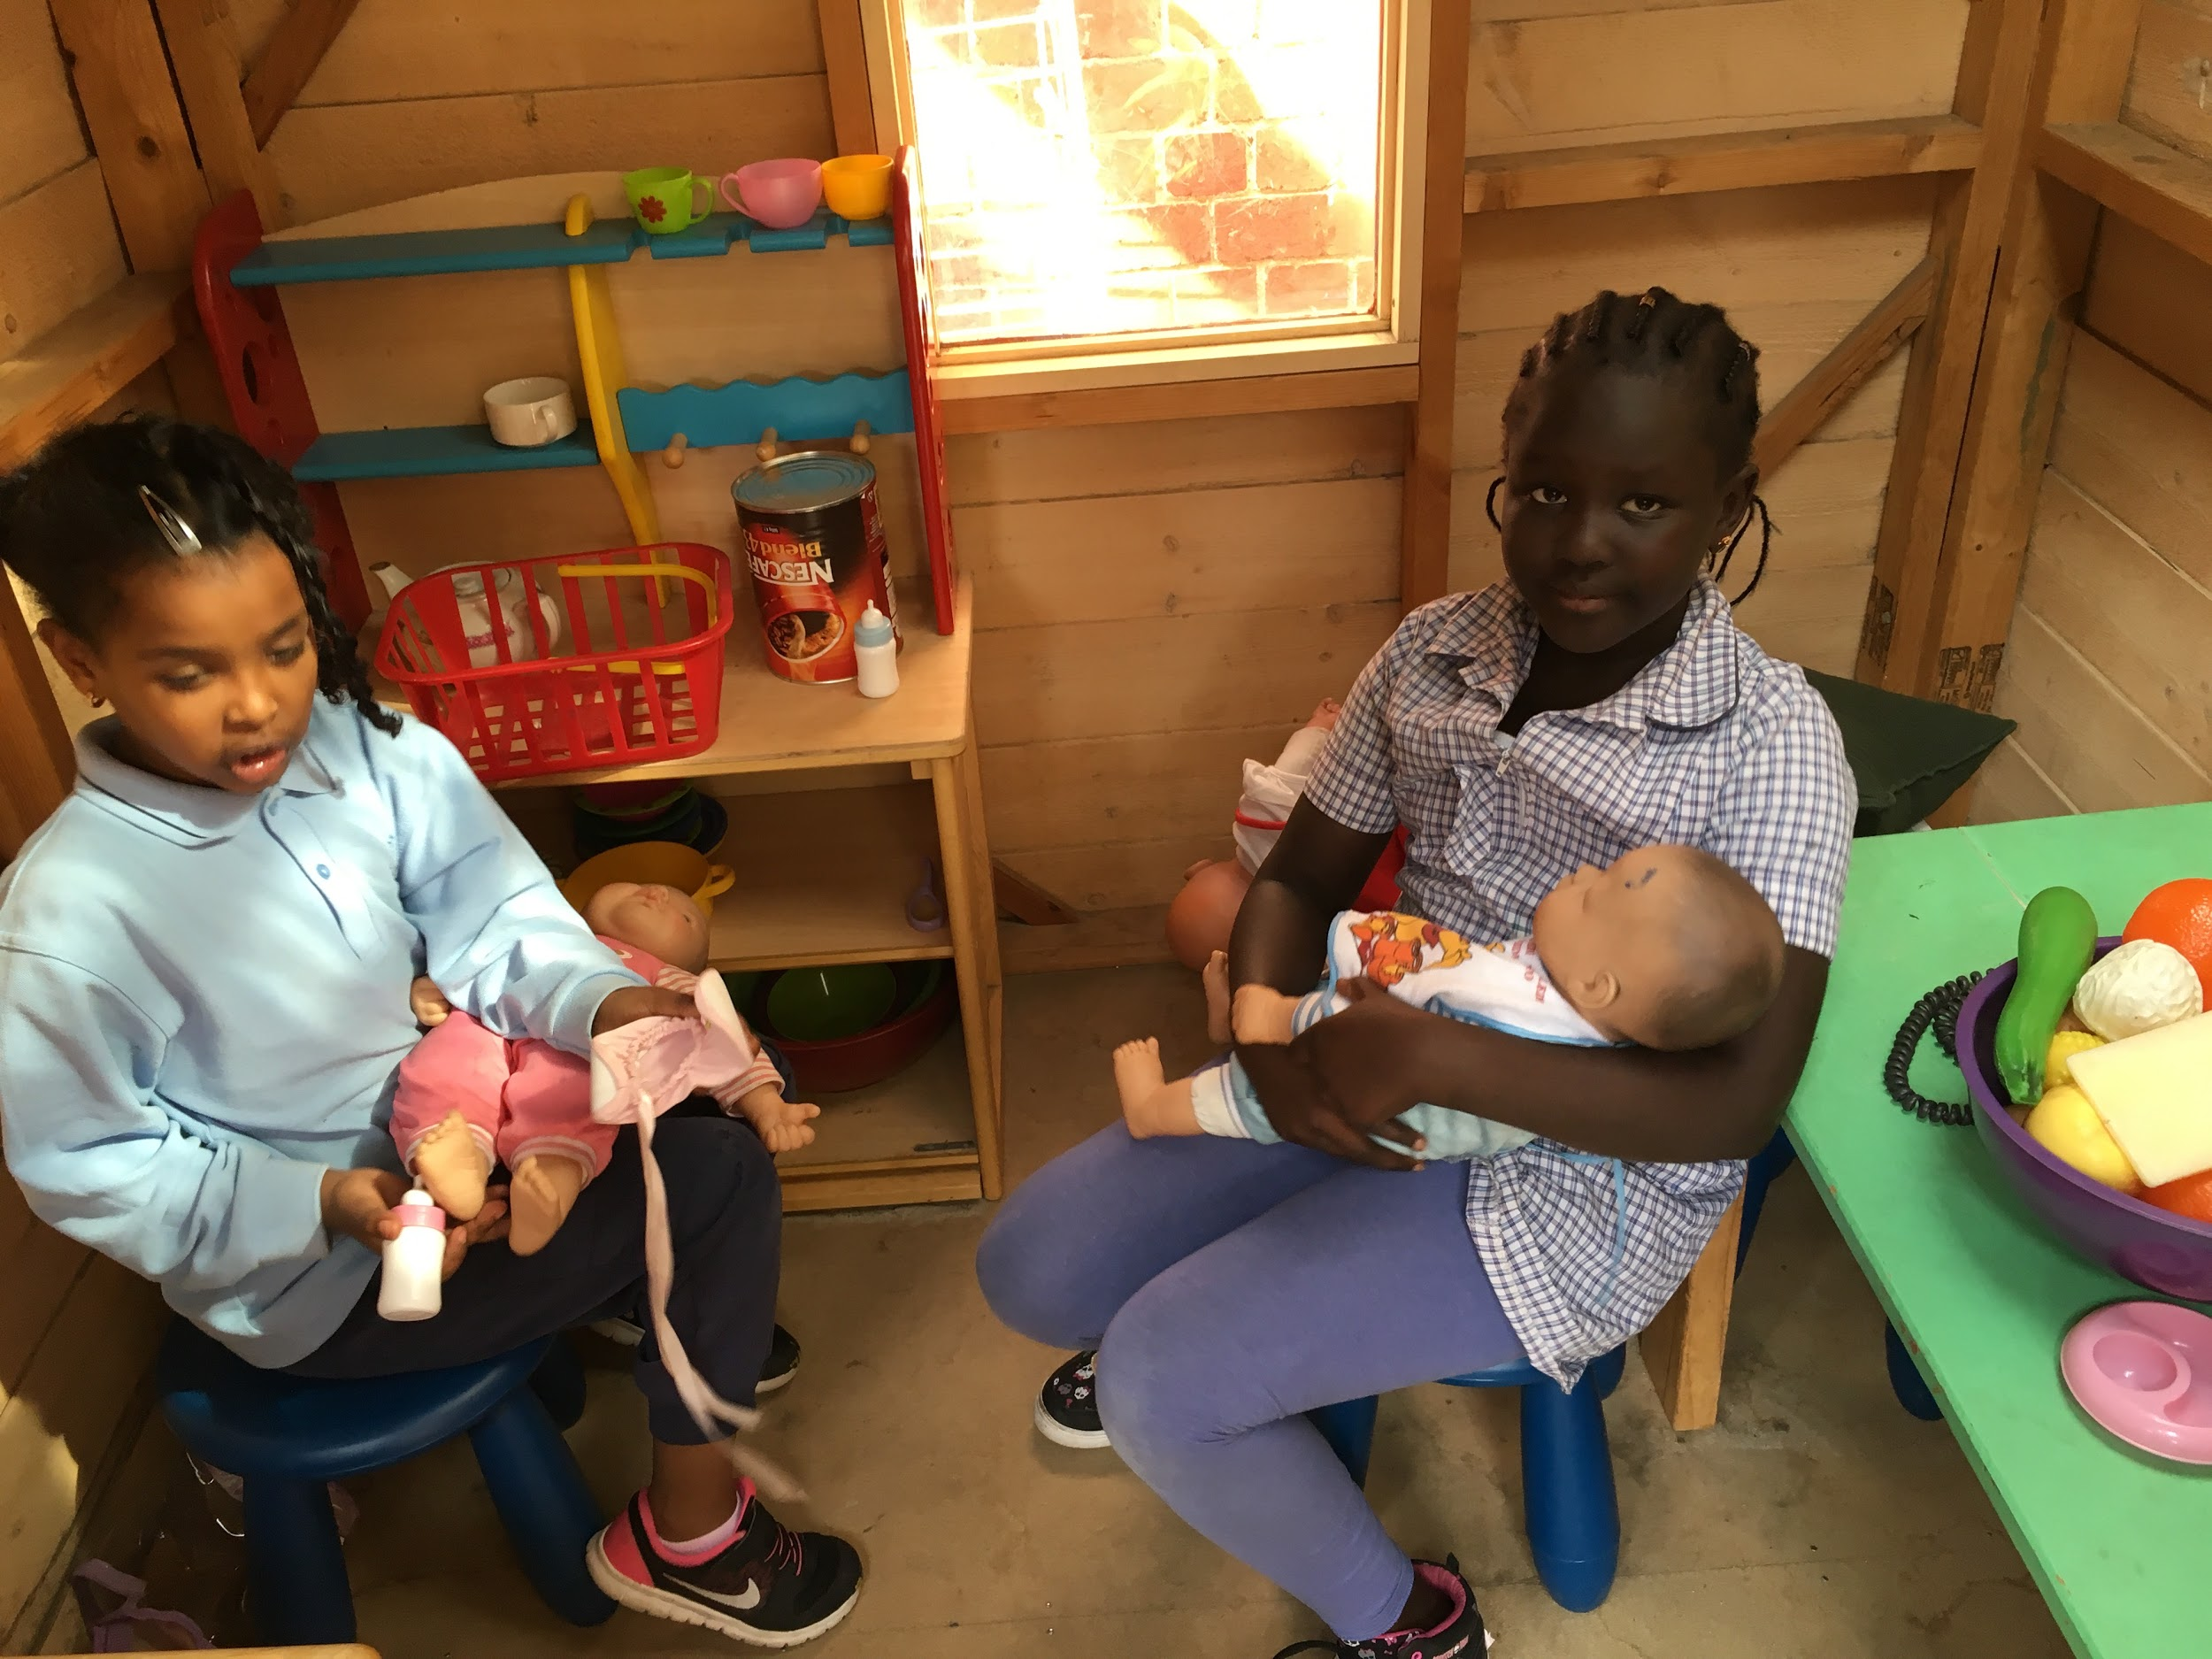
The power of play: a playful pedagogy
Play is a powerful context for early inquiry. Through play children can engage in exploring and making discoveries about:
Themselves, their identity as a person and a learner and as a social being
Living in community with others
The amazing world they live in
‘Being playful’ as a disposition when exploring, testing out ideas and working theories in a safe and familiar contexts, making choices without fear of failure.
Discovery is an opportunity for playful exploration!
Play is the highest form of research. Albert Einstein We believe that learning should be joyful and playful

Slide 16
What is the teacher doing to strategically scaffold the learning during Discovery?
The role of the teacher

Slide 17
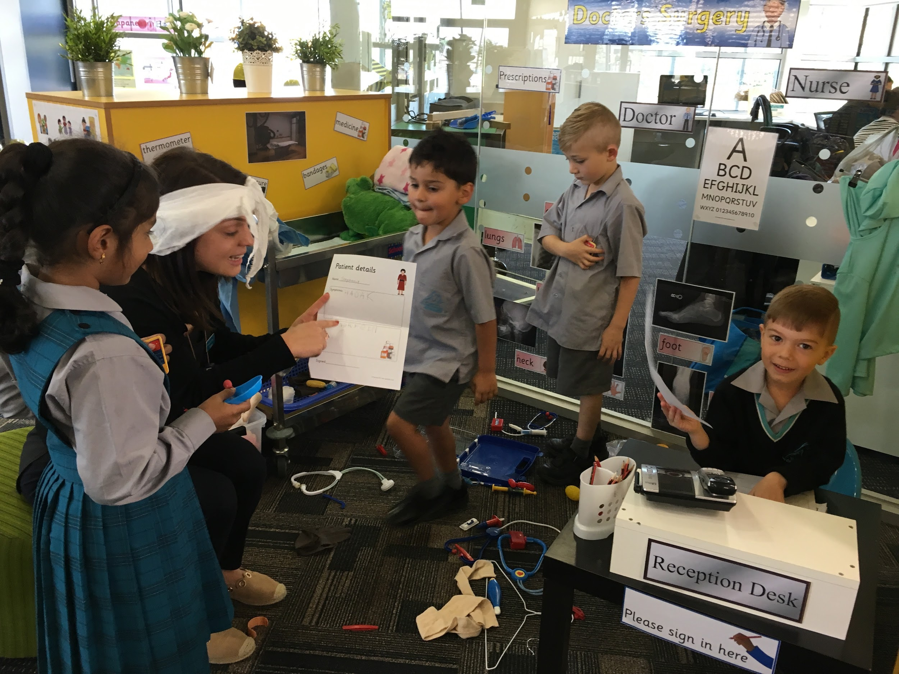
What is the teacher’s role during discovery?
100% present 100% of the time

Slide 18
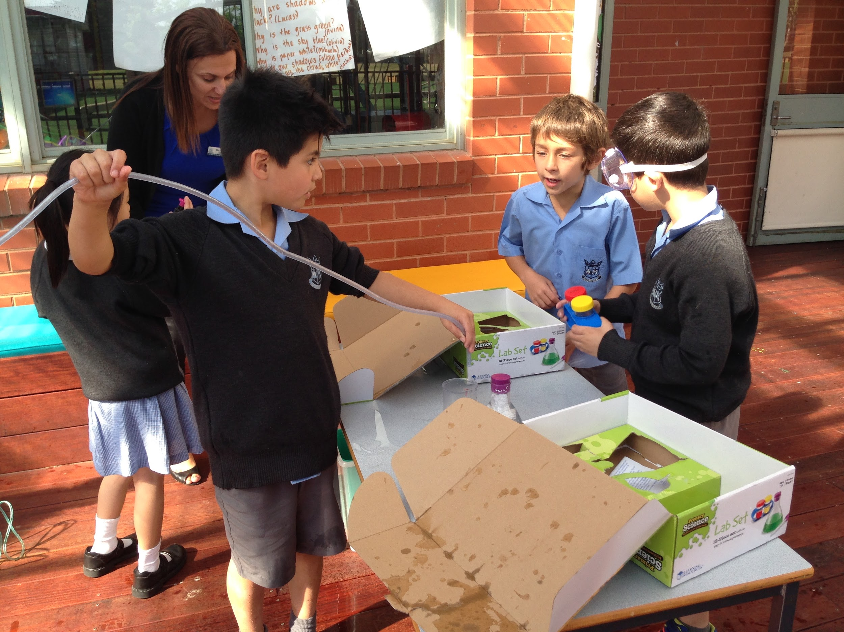
Teachers should be fully engaged
with the students at all times
during the session
Teacher as observer/researcher
Teacher as co-player
Teacher as influencer

Slide 19
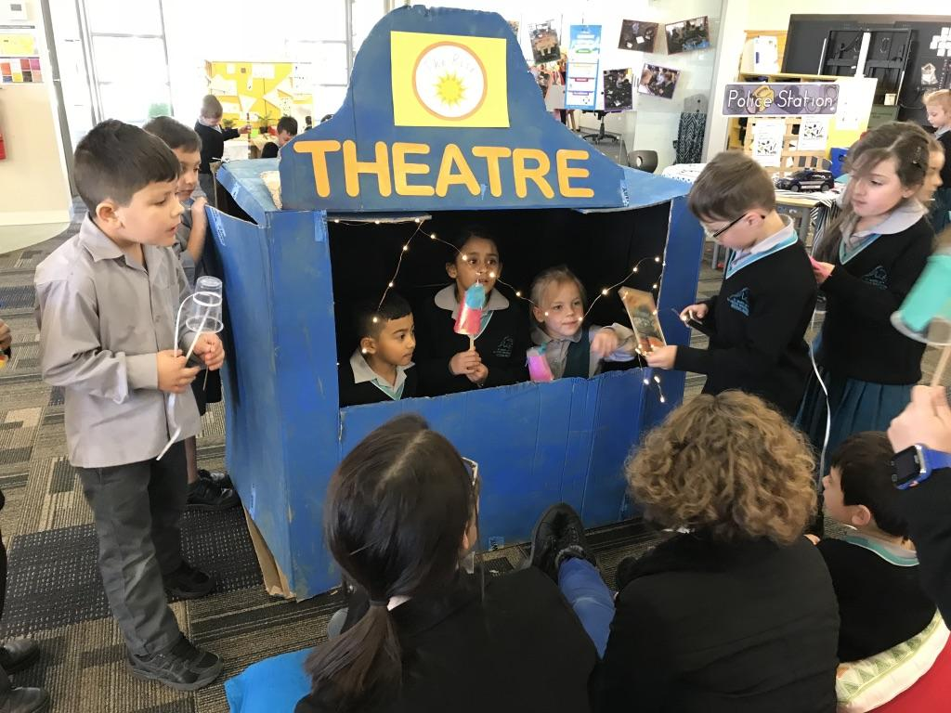
Teacher as observer/researcher
Cycle:
Watching and listening, thinking and analysing, documenting, responding
What is really happening here?
What might they be thinking?
What are they demonstrating/revealing (skills, curiosities, capabilities)?
What does this tell me about the child/children?
What might they need to facilitate/extend their thinking and learning?
Documenting: anecdotal notes, google docs, sticky notes, photos, see-saw, learning stories

Slide 20
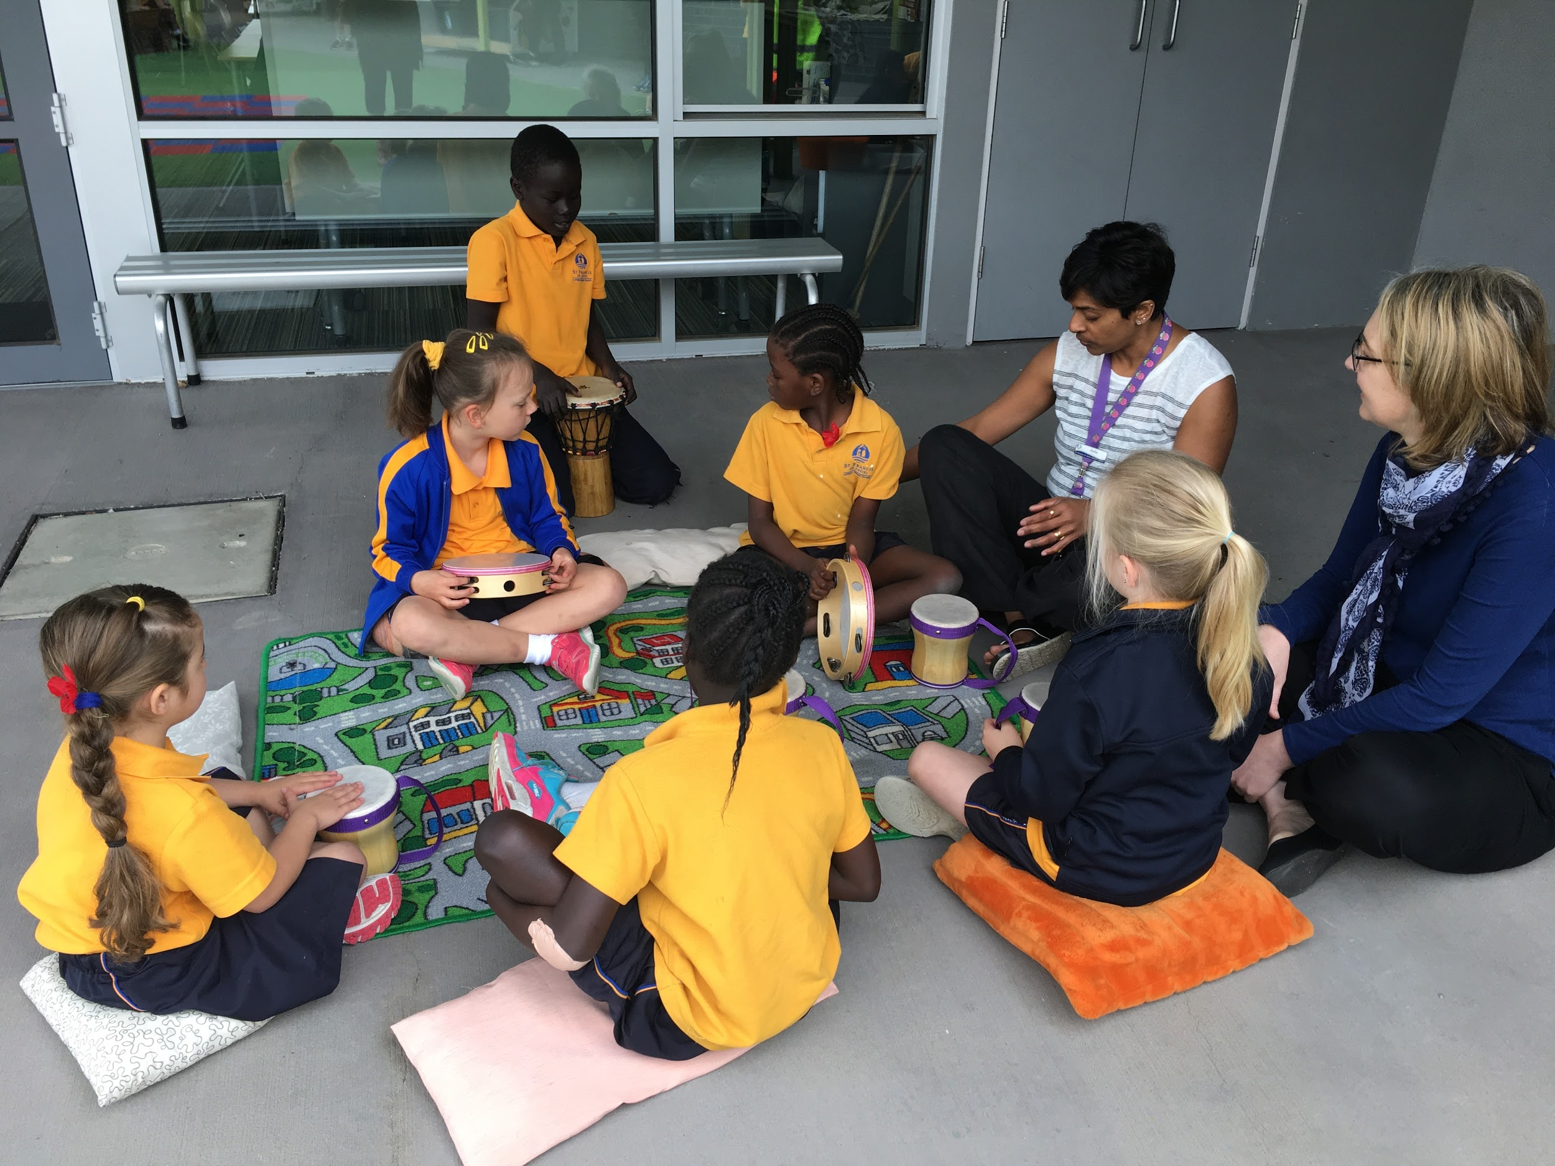
Don’t jump in too quickly to ask questions, and if you do it’s gentle probing not an interrogation!!!

Slide 21
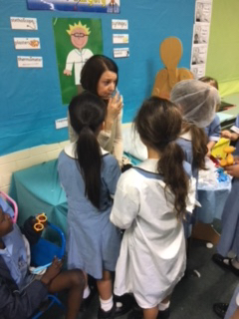
Teacher as co-player
Initiating a play situation or enticing reluctant students into play scenarios
Teaching play skills to students
Modelling how to interact with and use materials and props in an appropriate way

Slide 22
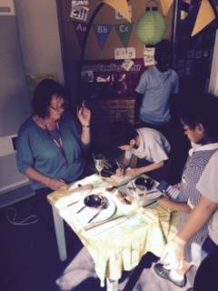
Teacher as co-player
Modelling specific skills or strategies (eg problem solving, construction techniques)
Providing scaffolding to support learning and development of particular students (eg oral language, social skills)

Slide 23
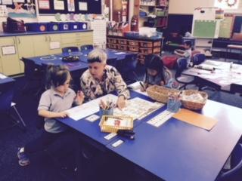
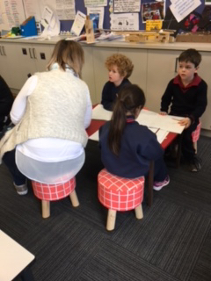
Teacher as influencer
Narrating the play (helping them to clarify thought processes)
Encouraging desired behaviours
Redirecting non-desired behaviours!
Giving feedback
‘Just in time’ teaching of a particular skill
Questioning to clarify, provoke, extend, challenge, reflect, help make connections (Learning Conversations)
Making the learning visible (noticing and naming)

Slide 24
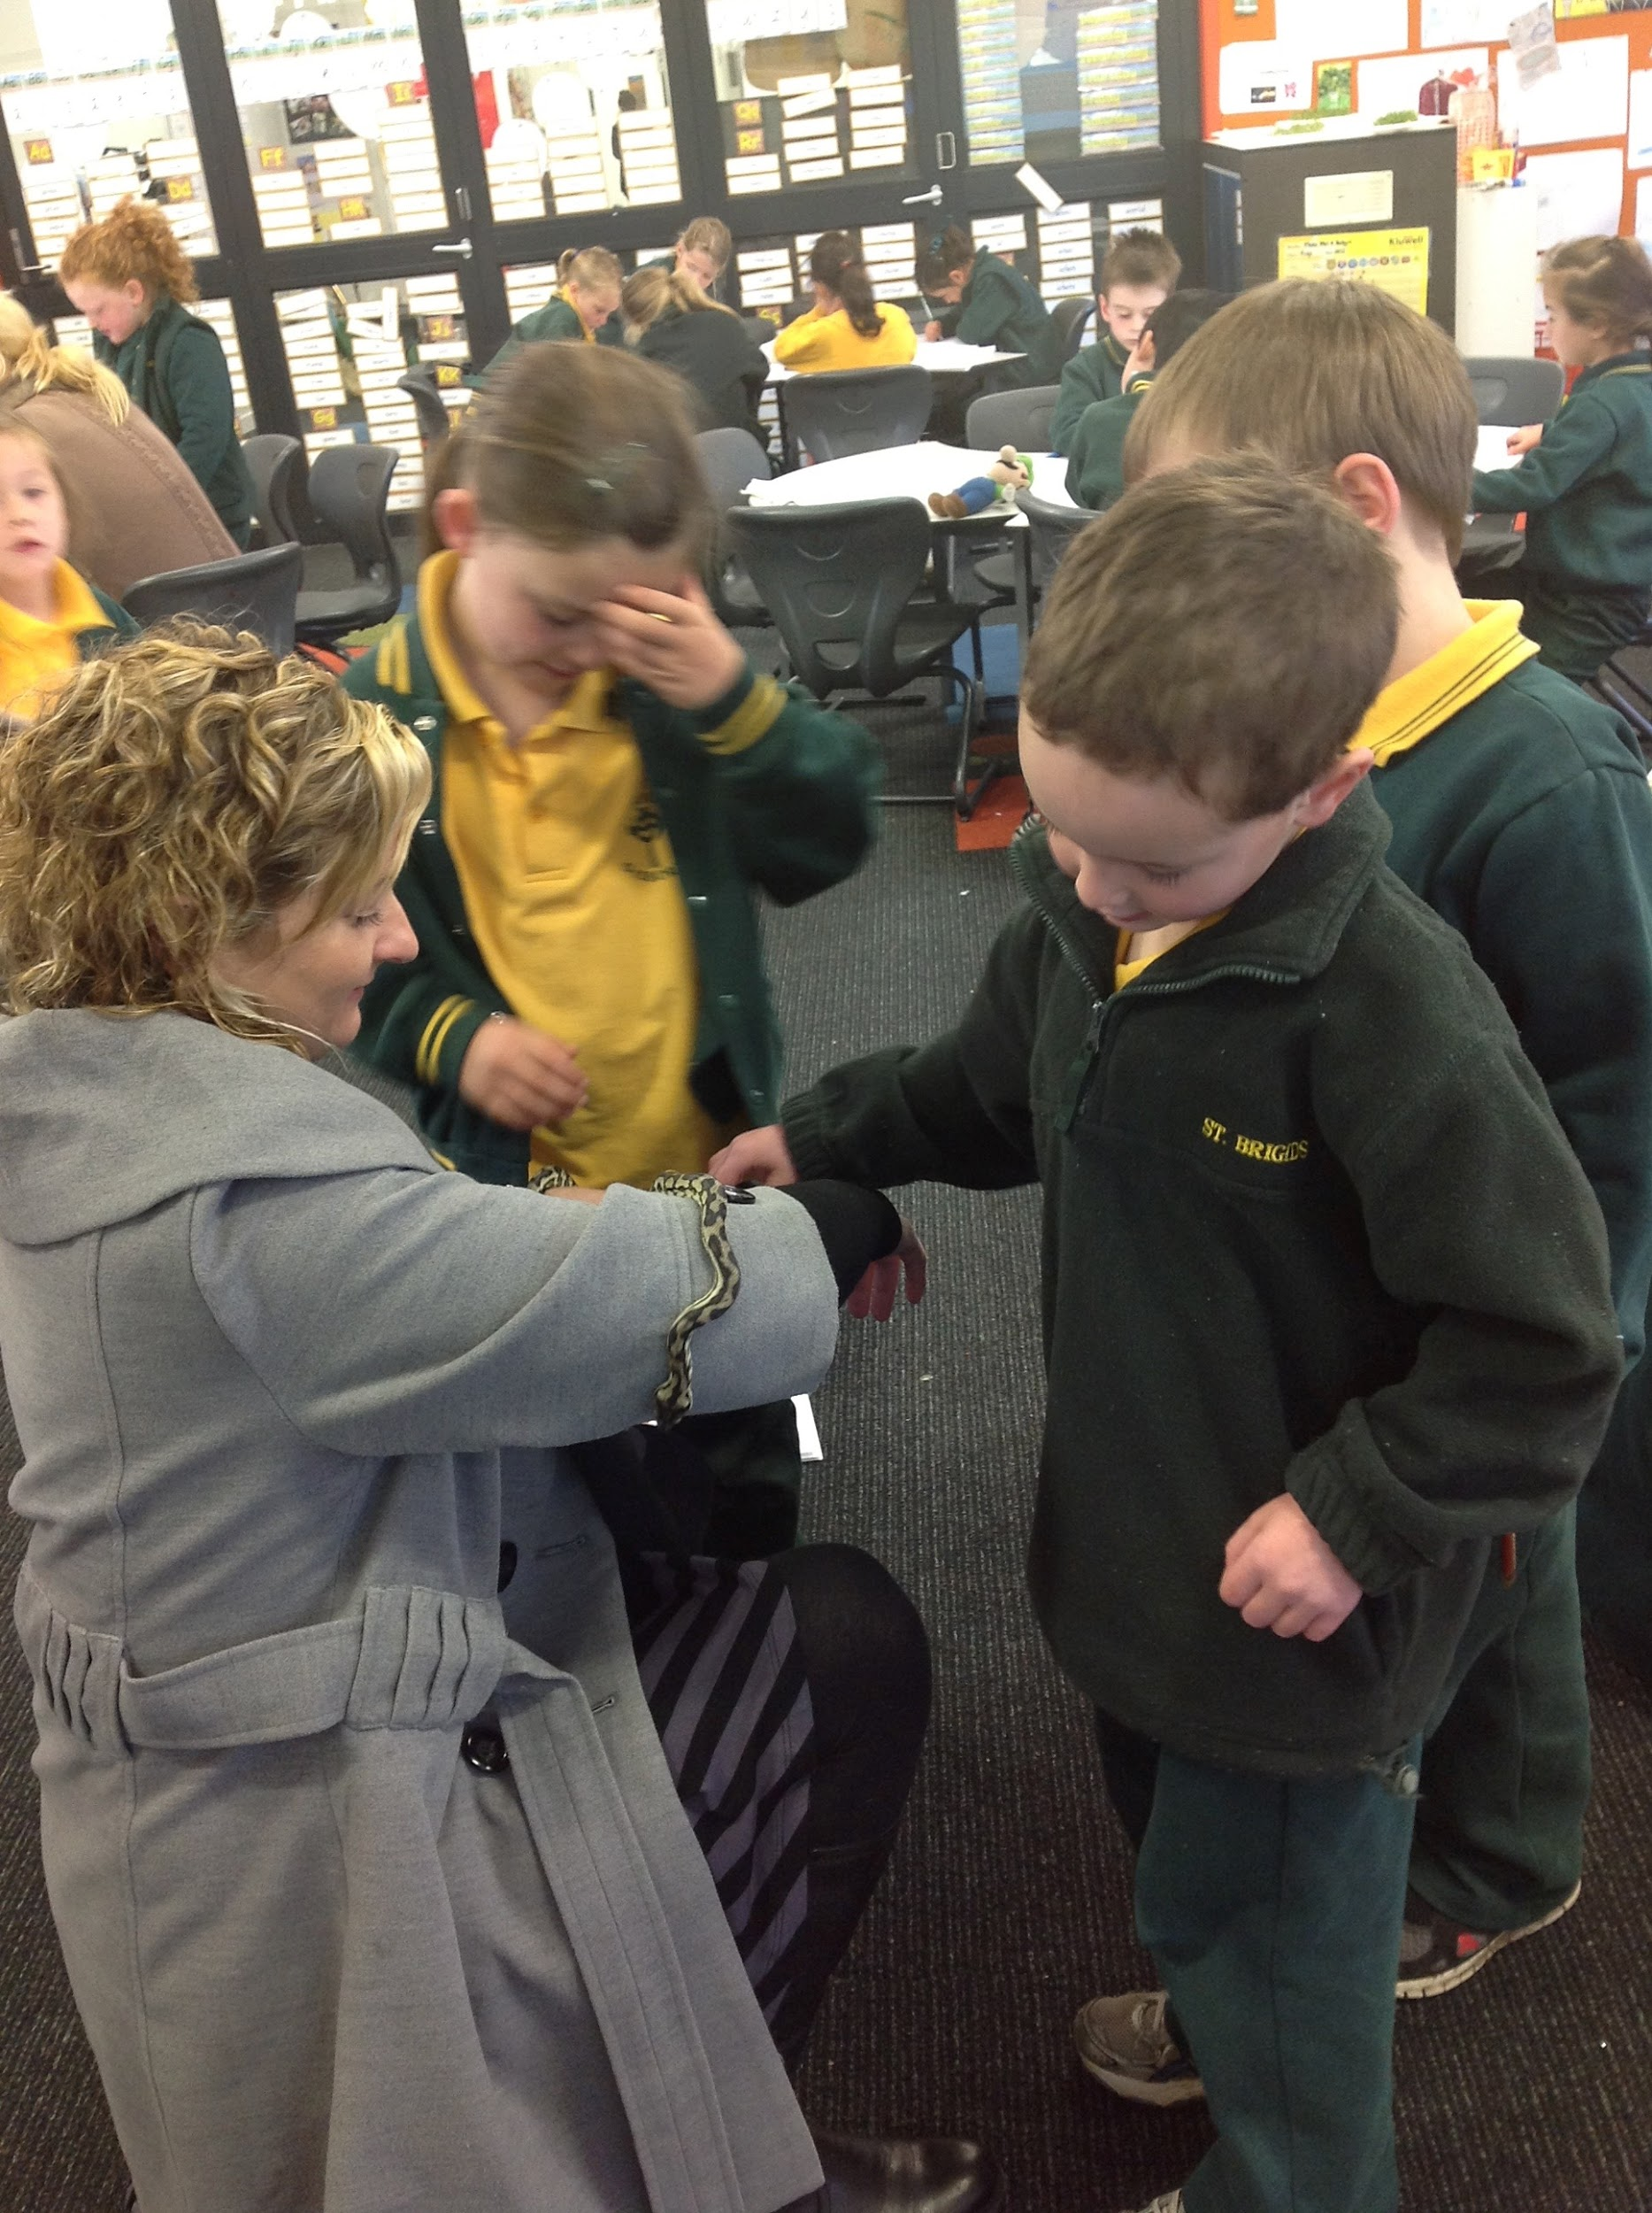
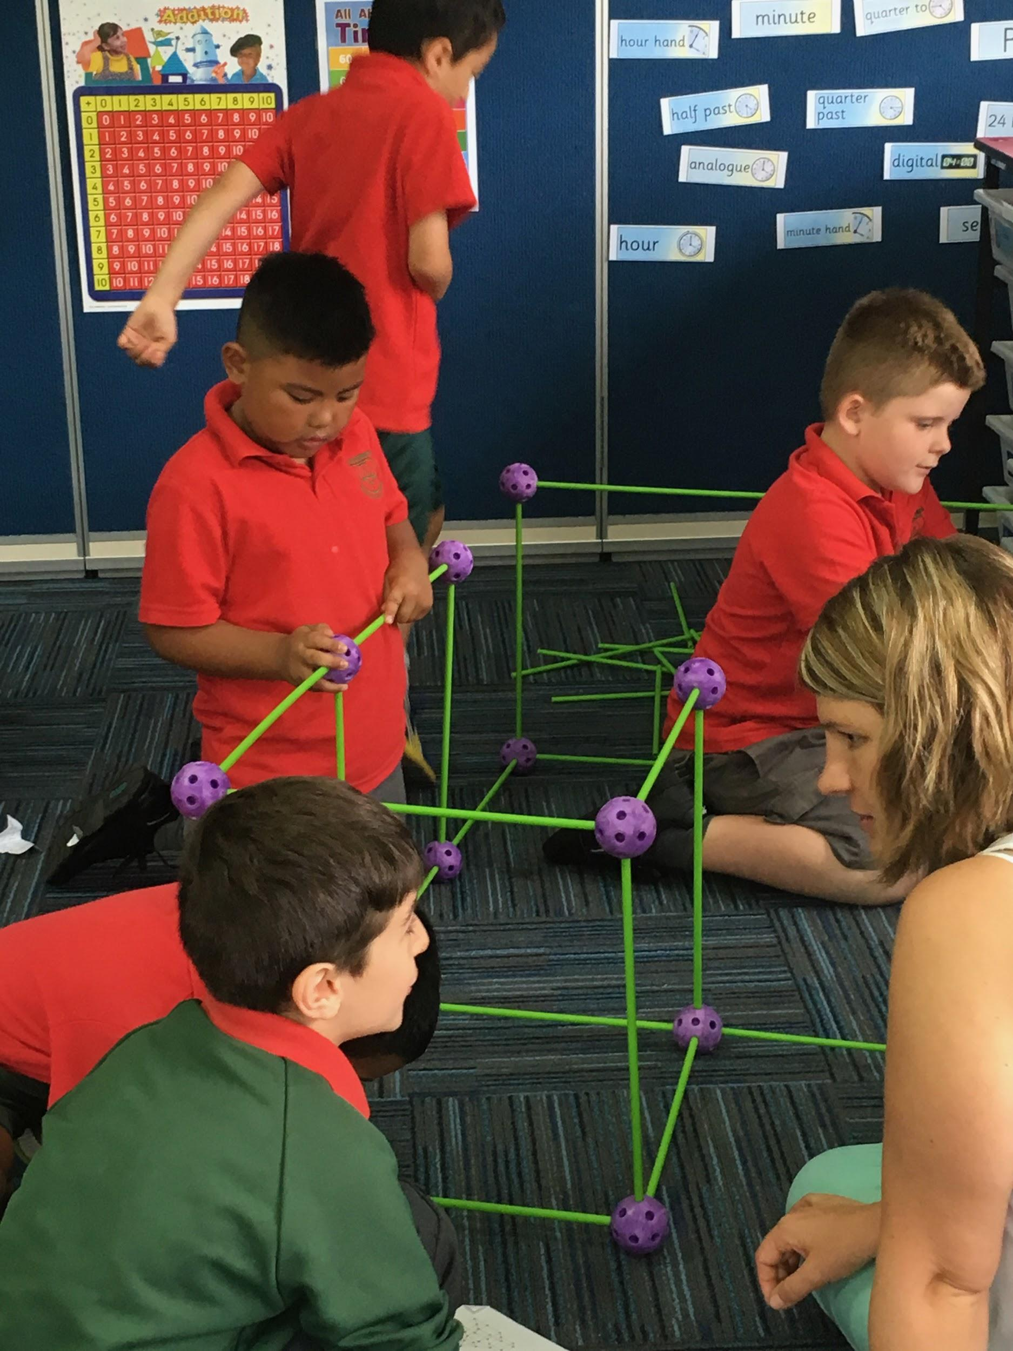
Noticing and Naming the learning process, skills and dispositions is a vital role of the teacher in helping children understand what they are learning and why it is important.
I noticed that you …
I can see you…
Looks like you…

Slide 25
Reflection
What am I thinking about now?
What ideas do I have?
What questions do I have now?

Slide 26
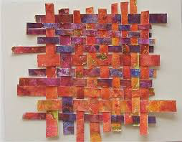
Learning
Exploring The Frame
Inquiry investigations
Authentic opportunities for Literacy
Early Years Model-
Discovery-based inquiry
Authentic opportunities for Mathematics
Discovery
School story
Prep @St Michael’s

Slide 27
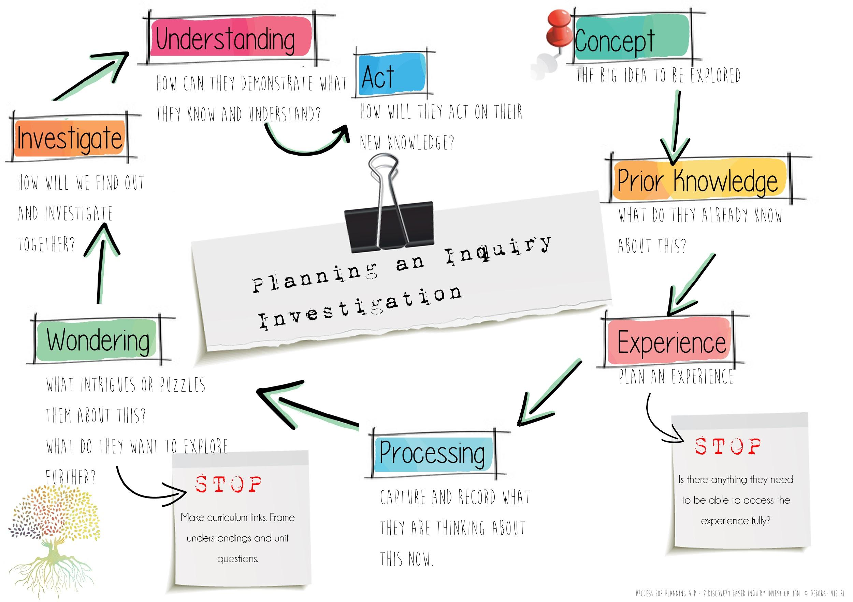

Slide 28

School story
Claire Mathieson
St Michael’s
PREP INQUIRY & DISCOVERY

Slide 29
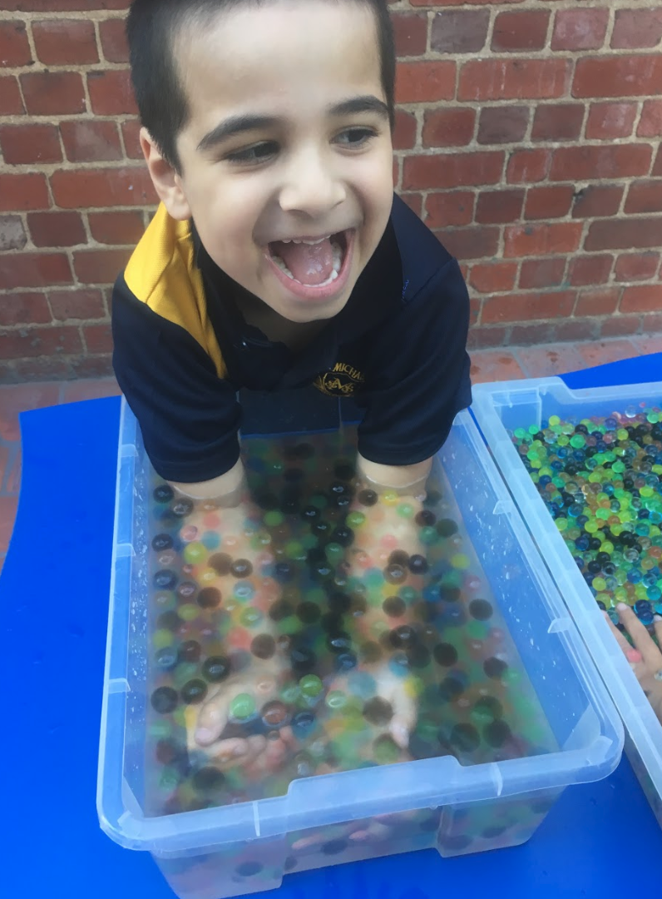
Links between Inquiry & Discovery
Plan for Inquiry with possible Discovery areas in mind
Design our Discovery areas to make connections to our Inquiry unit
Think about ways to incorporate Inquiry vocabulary into Discovery

Slide 30
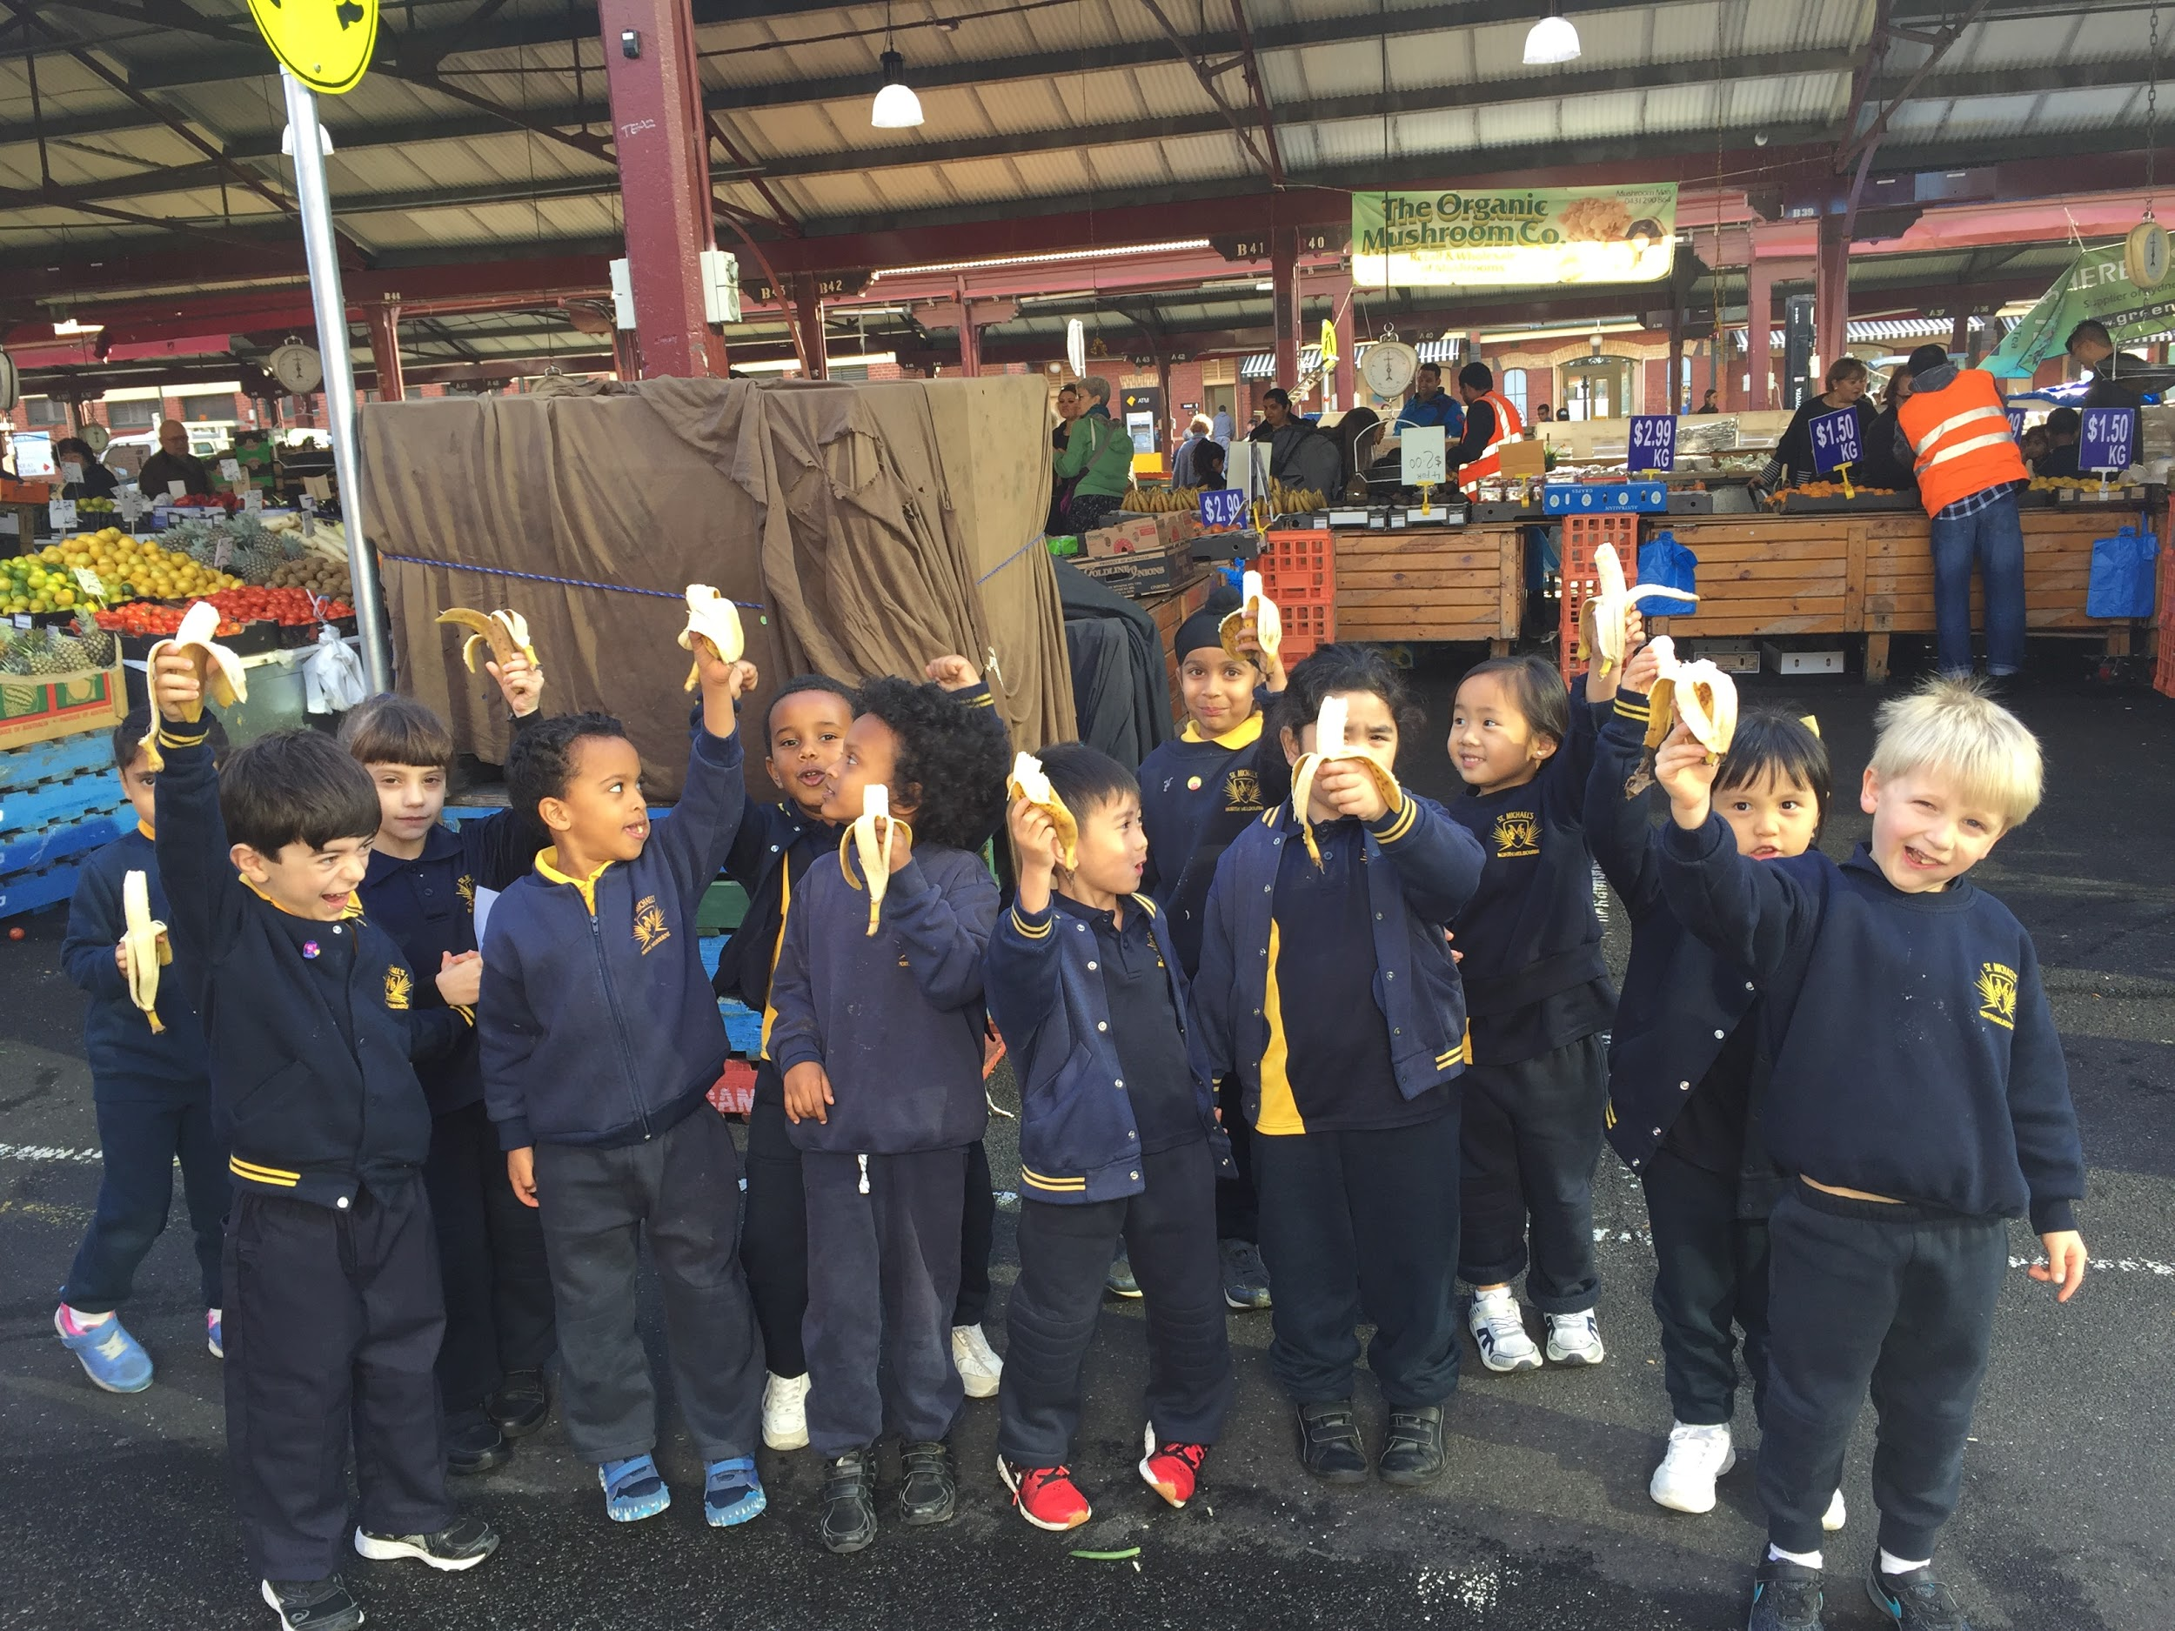
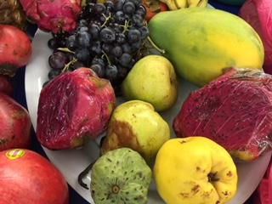
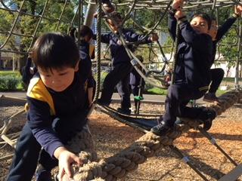
“How Can We Be Healthy?”

Slide 31
Mini Inquiry Units of Learning
Body Systems (parts) Wk1-4
Food Wk5-7
Safety Wk8-11

Slide 32
Understandings:
Our bodies have many parts that make it work.
Our bodies need food to help keep them working.
There are people who can help us keep healthy and safe.

Slide 33
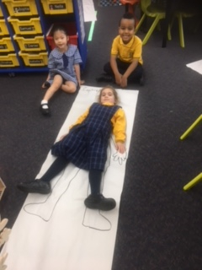
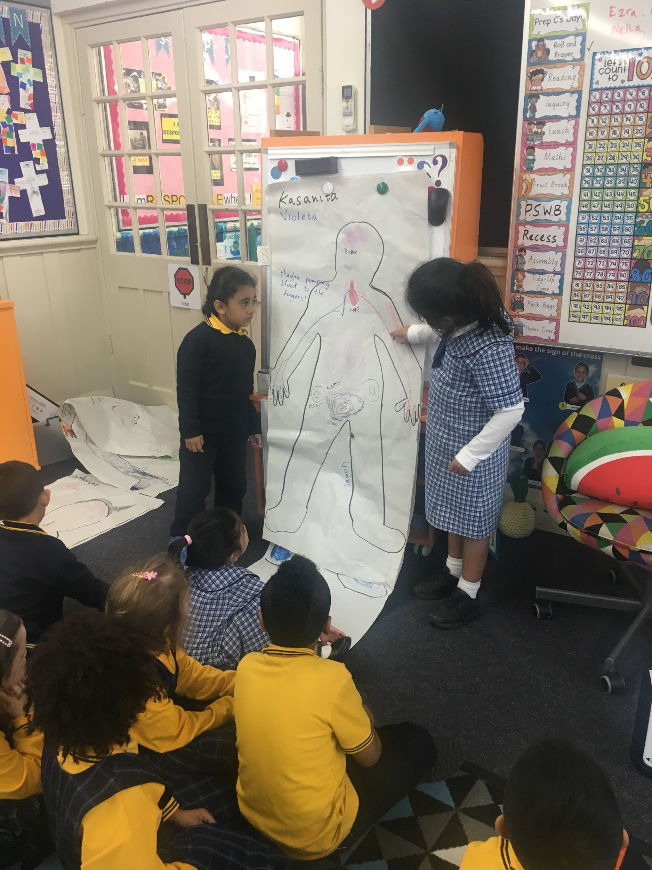
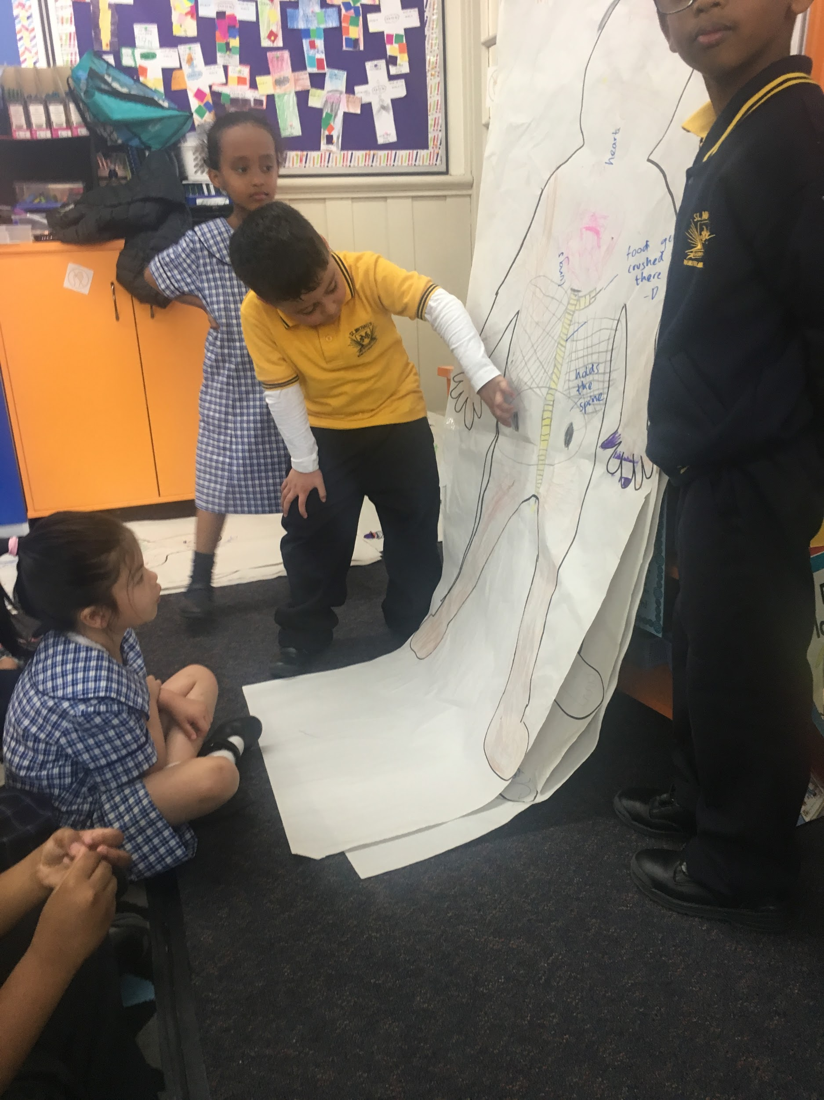
BODIES: Assessment
Bodies tracing - compare pre and post

Slide 34
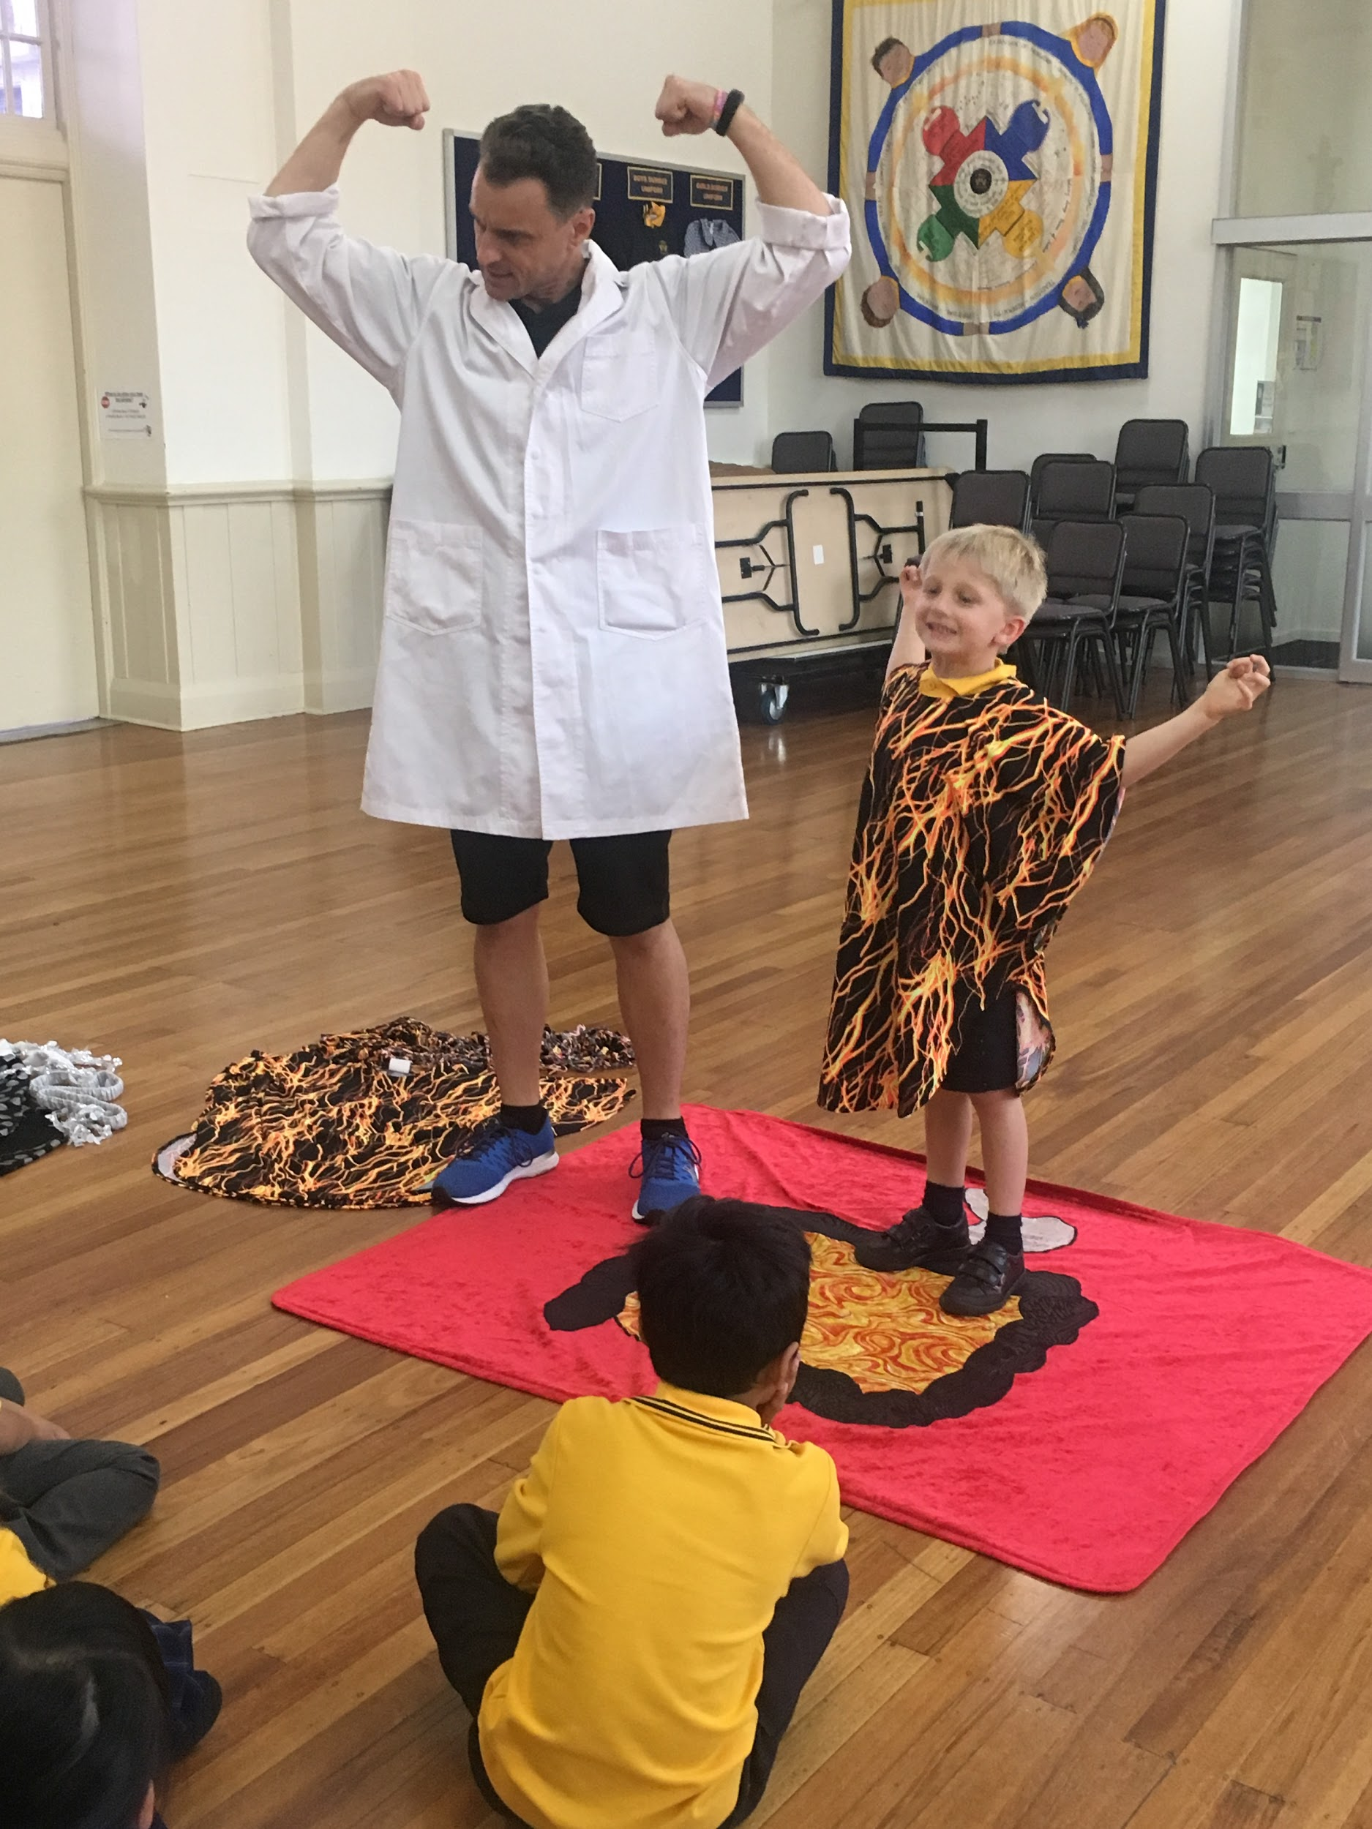
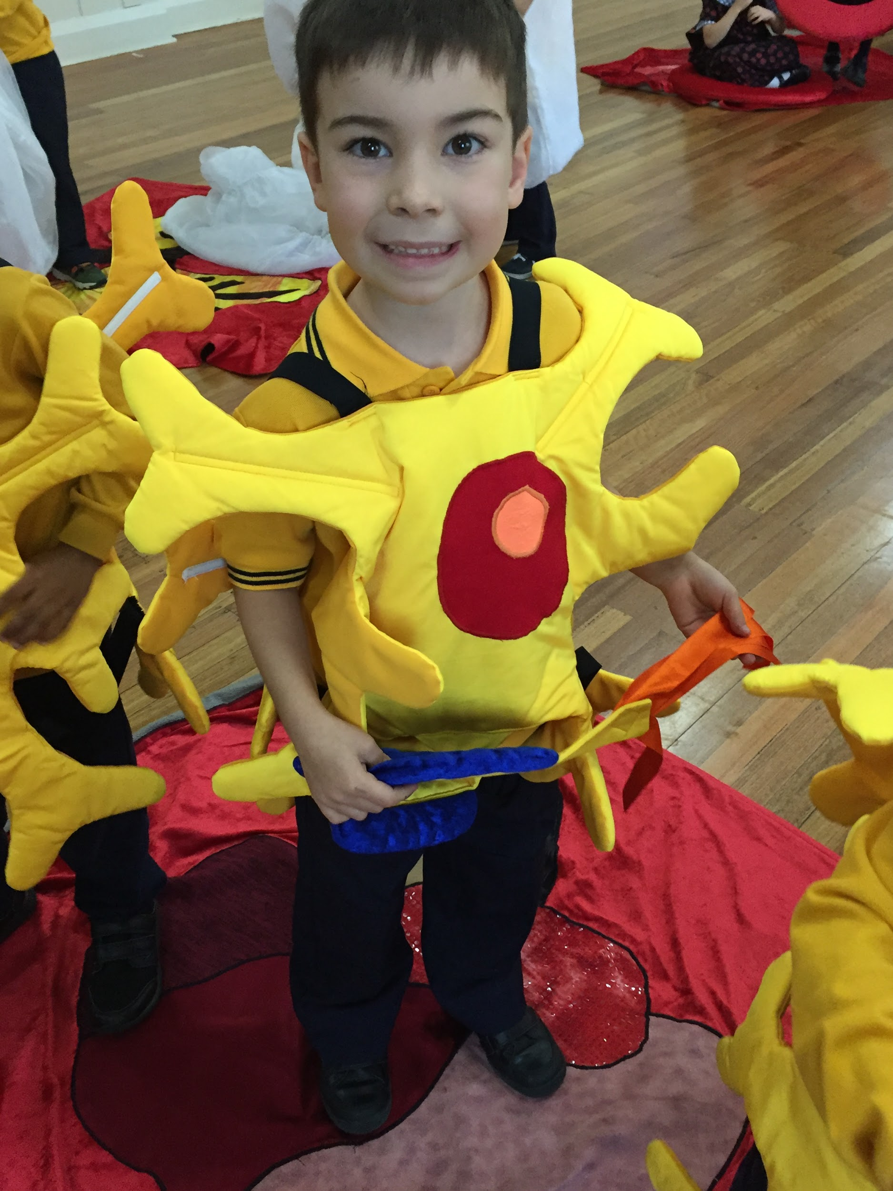
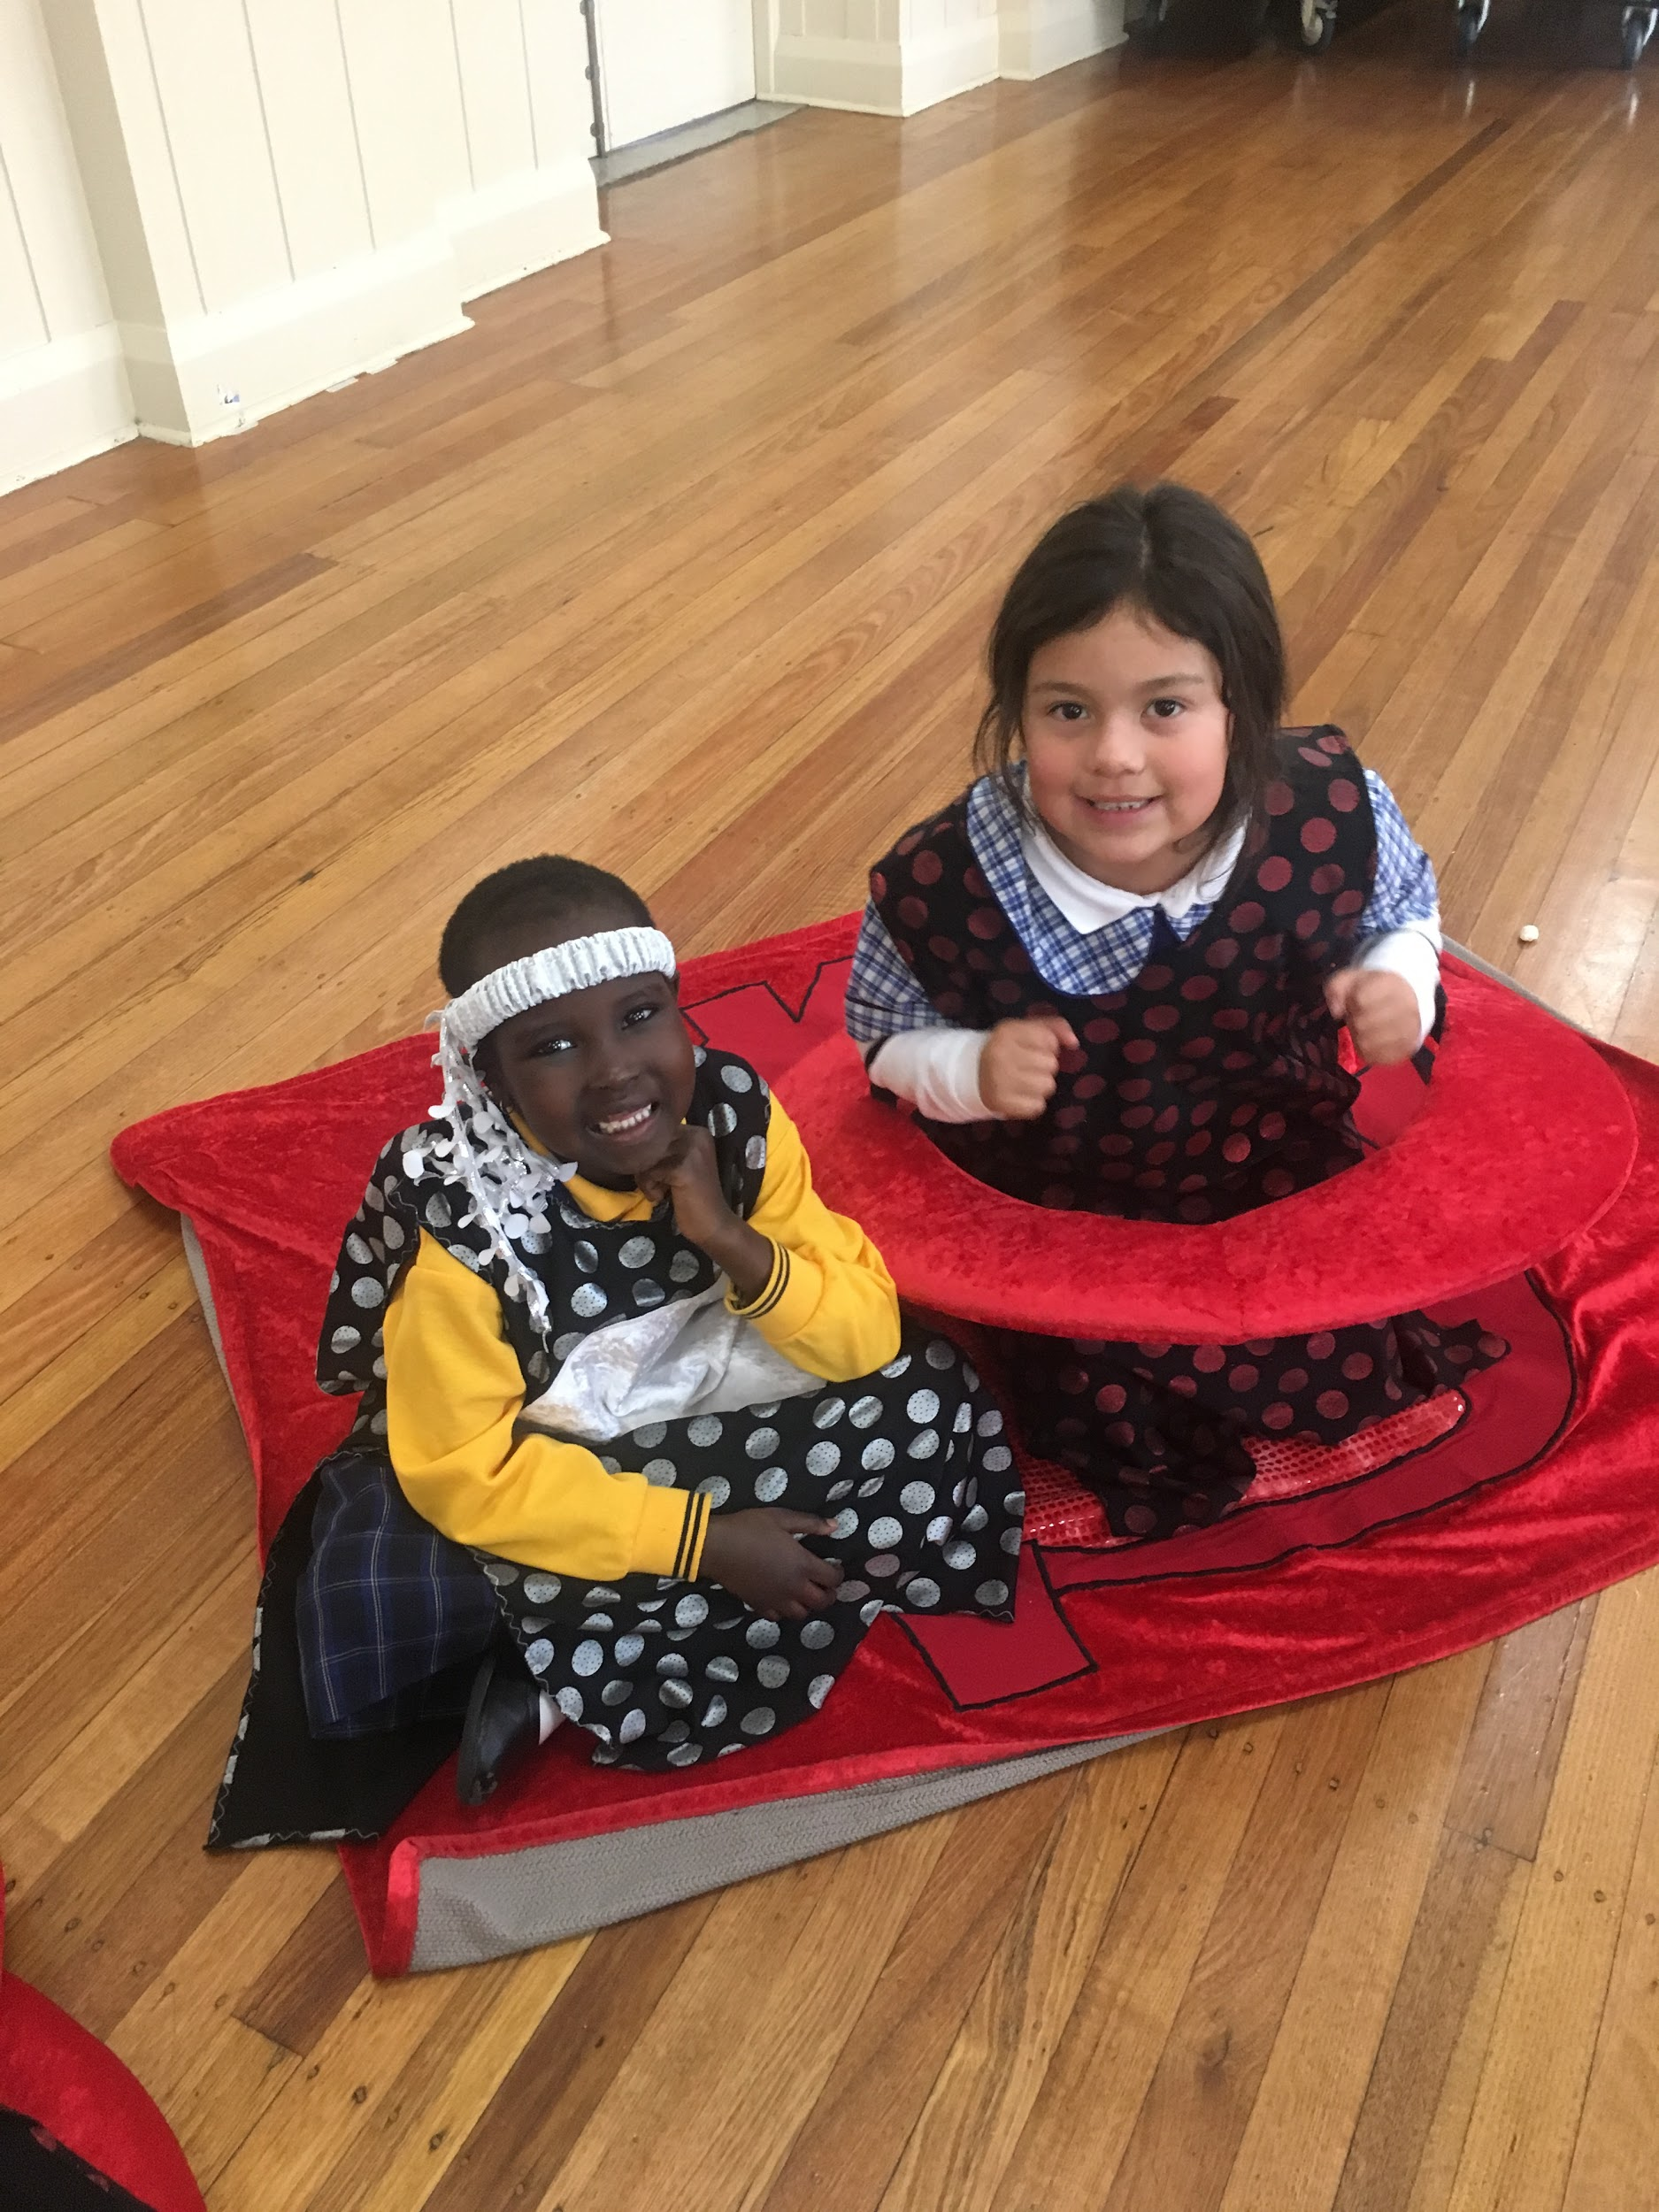
BODIES: Shared Experience
Body Investigators Incursion

Slide 35
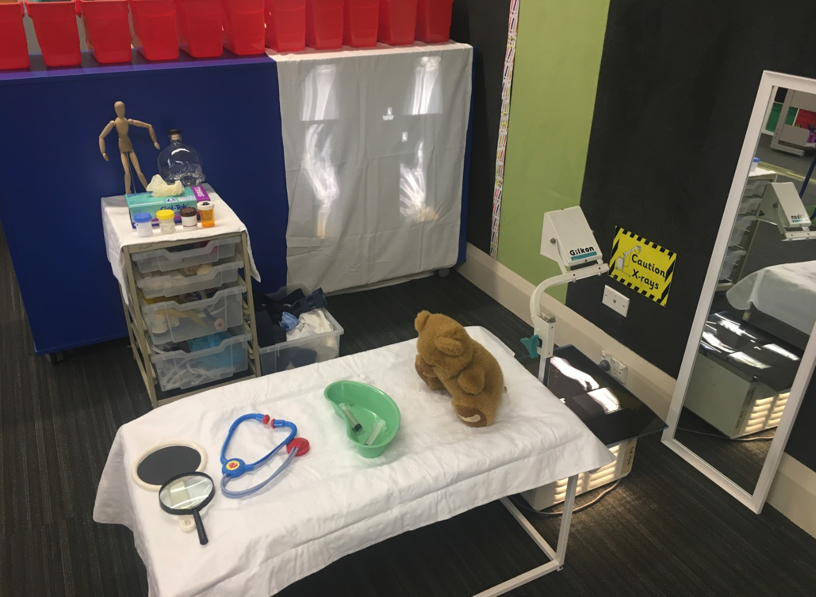
Links to Discovery
Doctor’s area

Slide 36
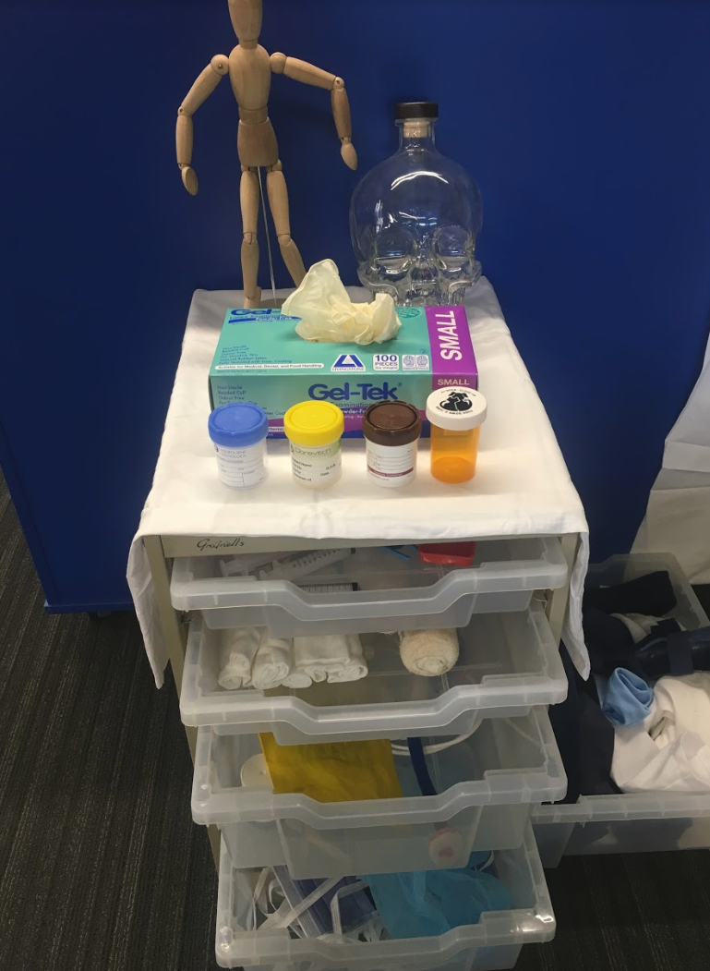

Slide 37
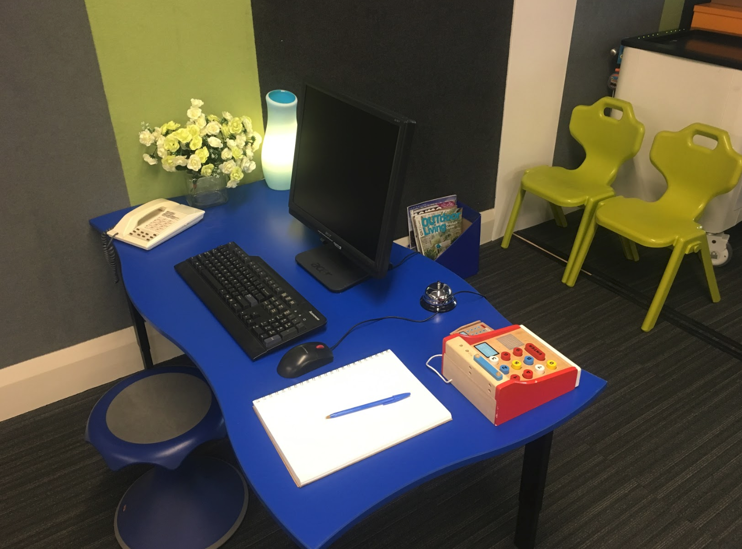

Slide 38
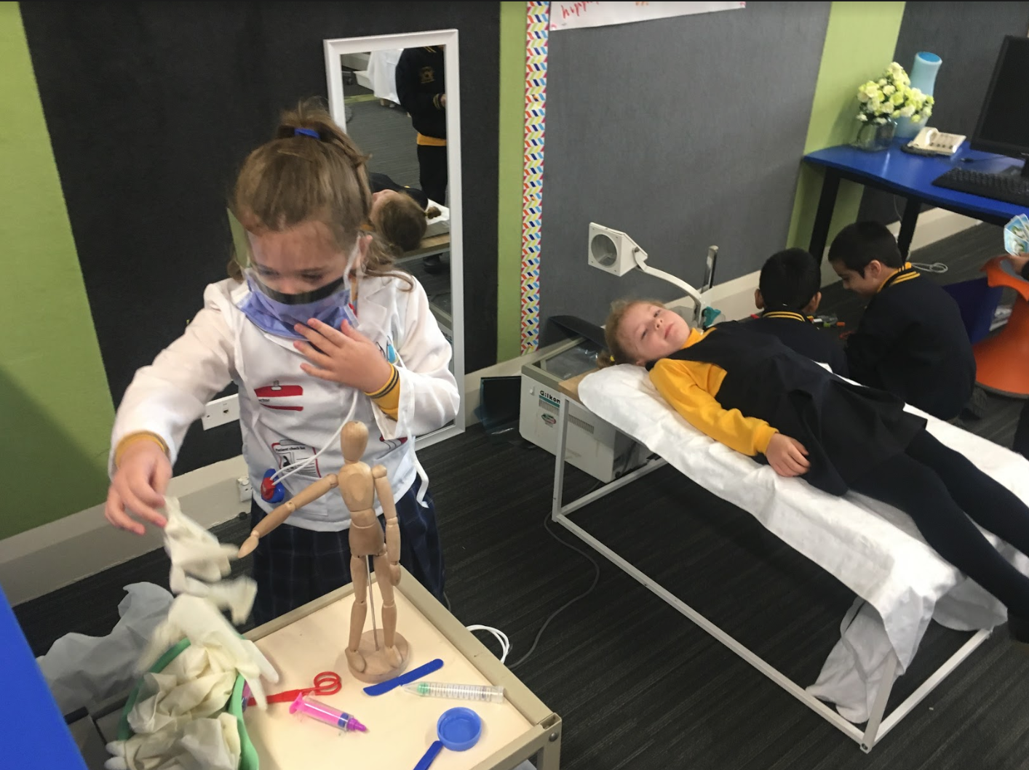

Slide 39
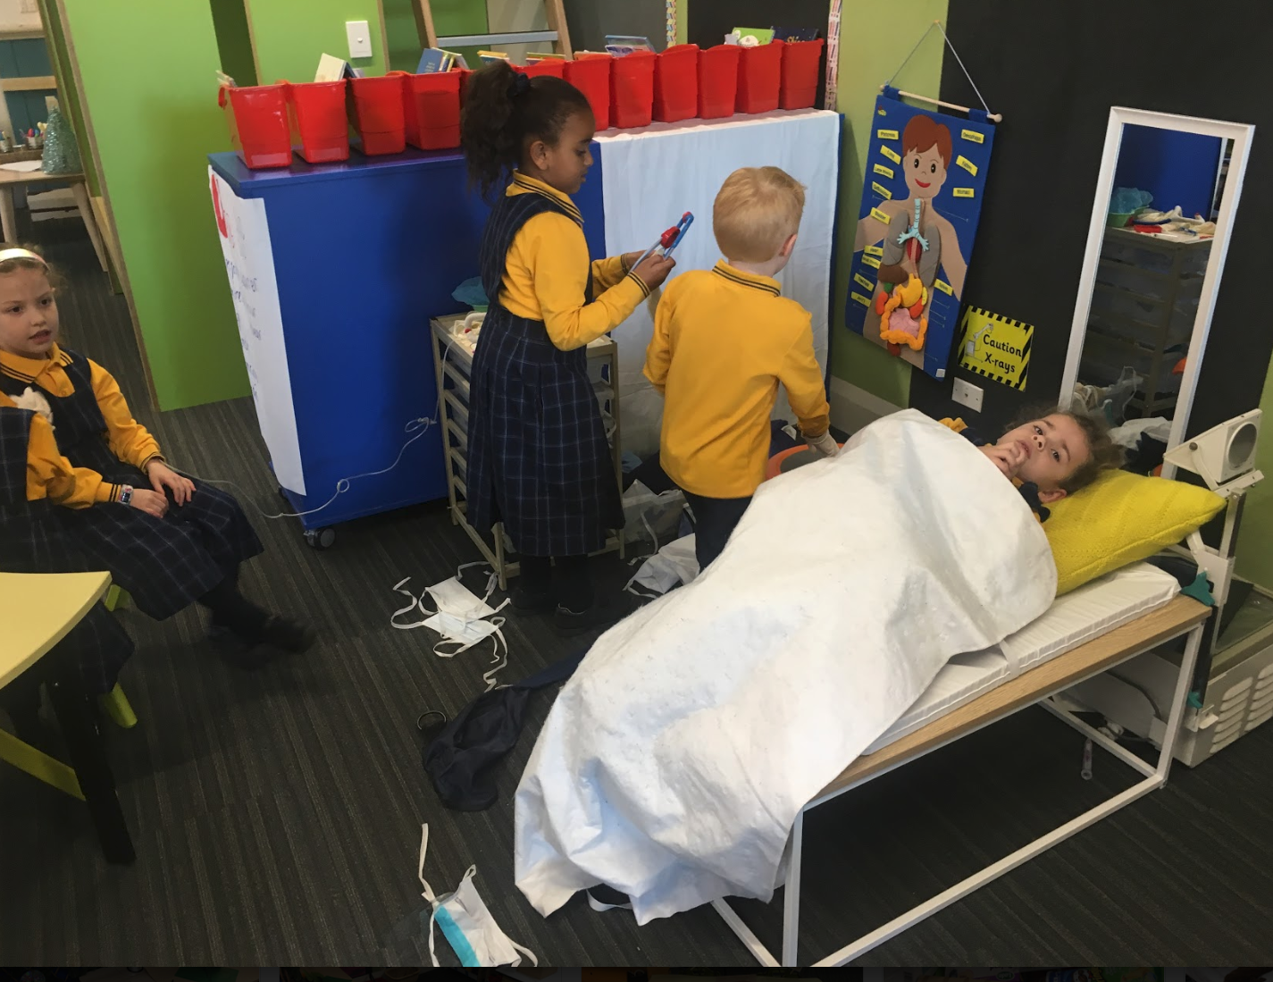

Slide 40
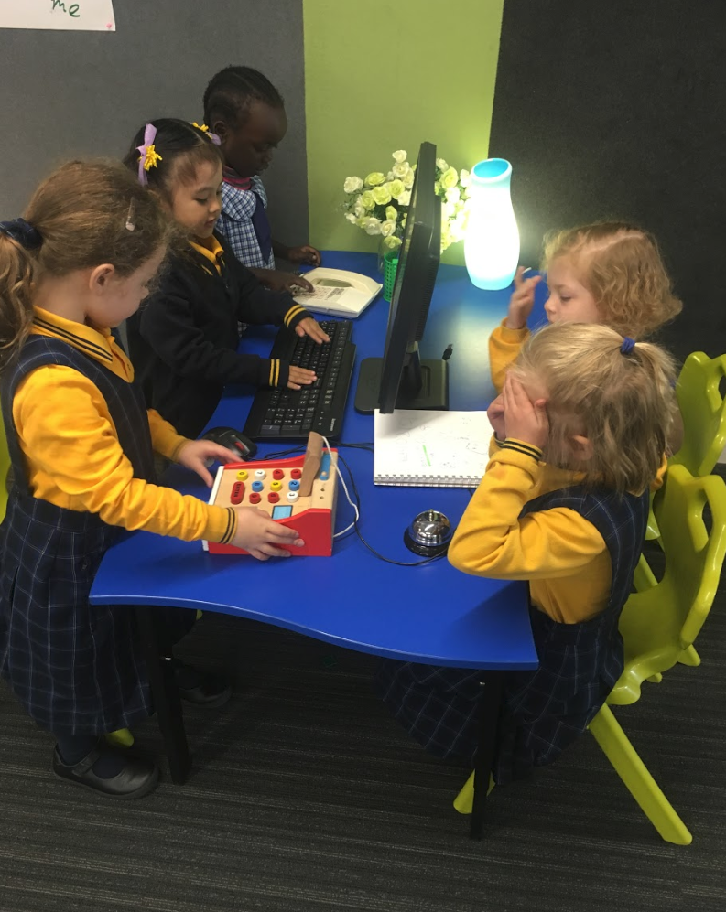
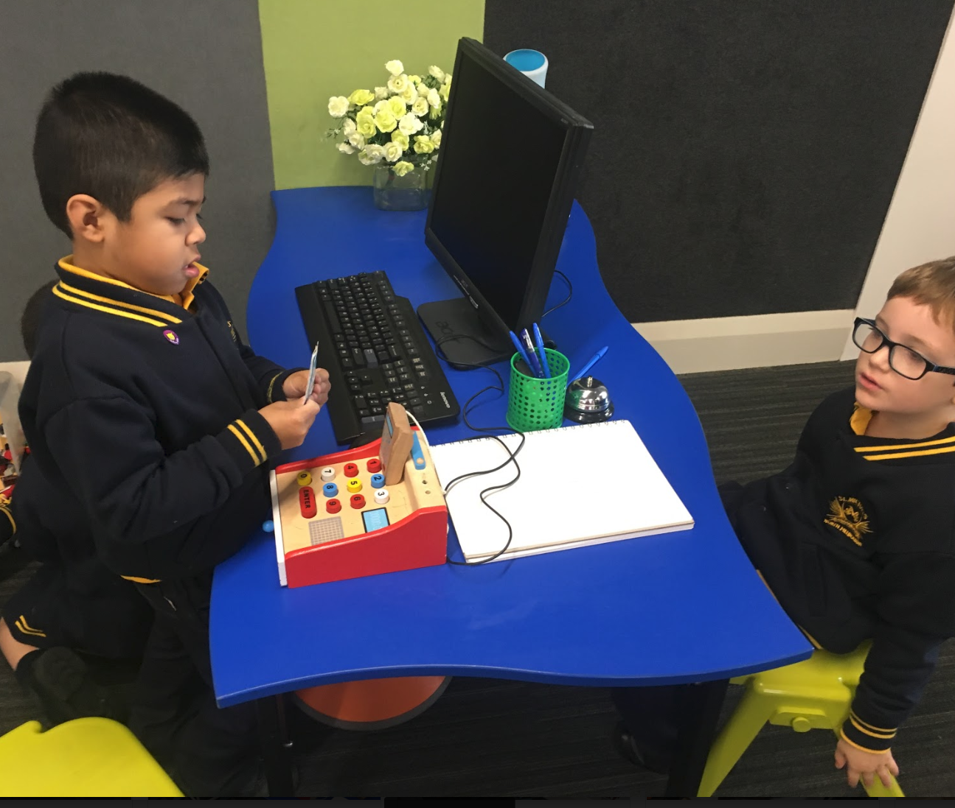

Slide 41
Links to Discovery
Other areas we had:
Play dough area
  Provocations: statues, body model, real-life body parts
Paint area
  Provocations: diagrams of the body, body parts etc.
Reading area
  Lots of non-fiction books about the body
Observational drawing
  Provocations: mirrors

Slide 42

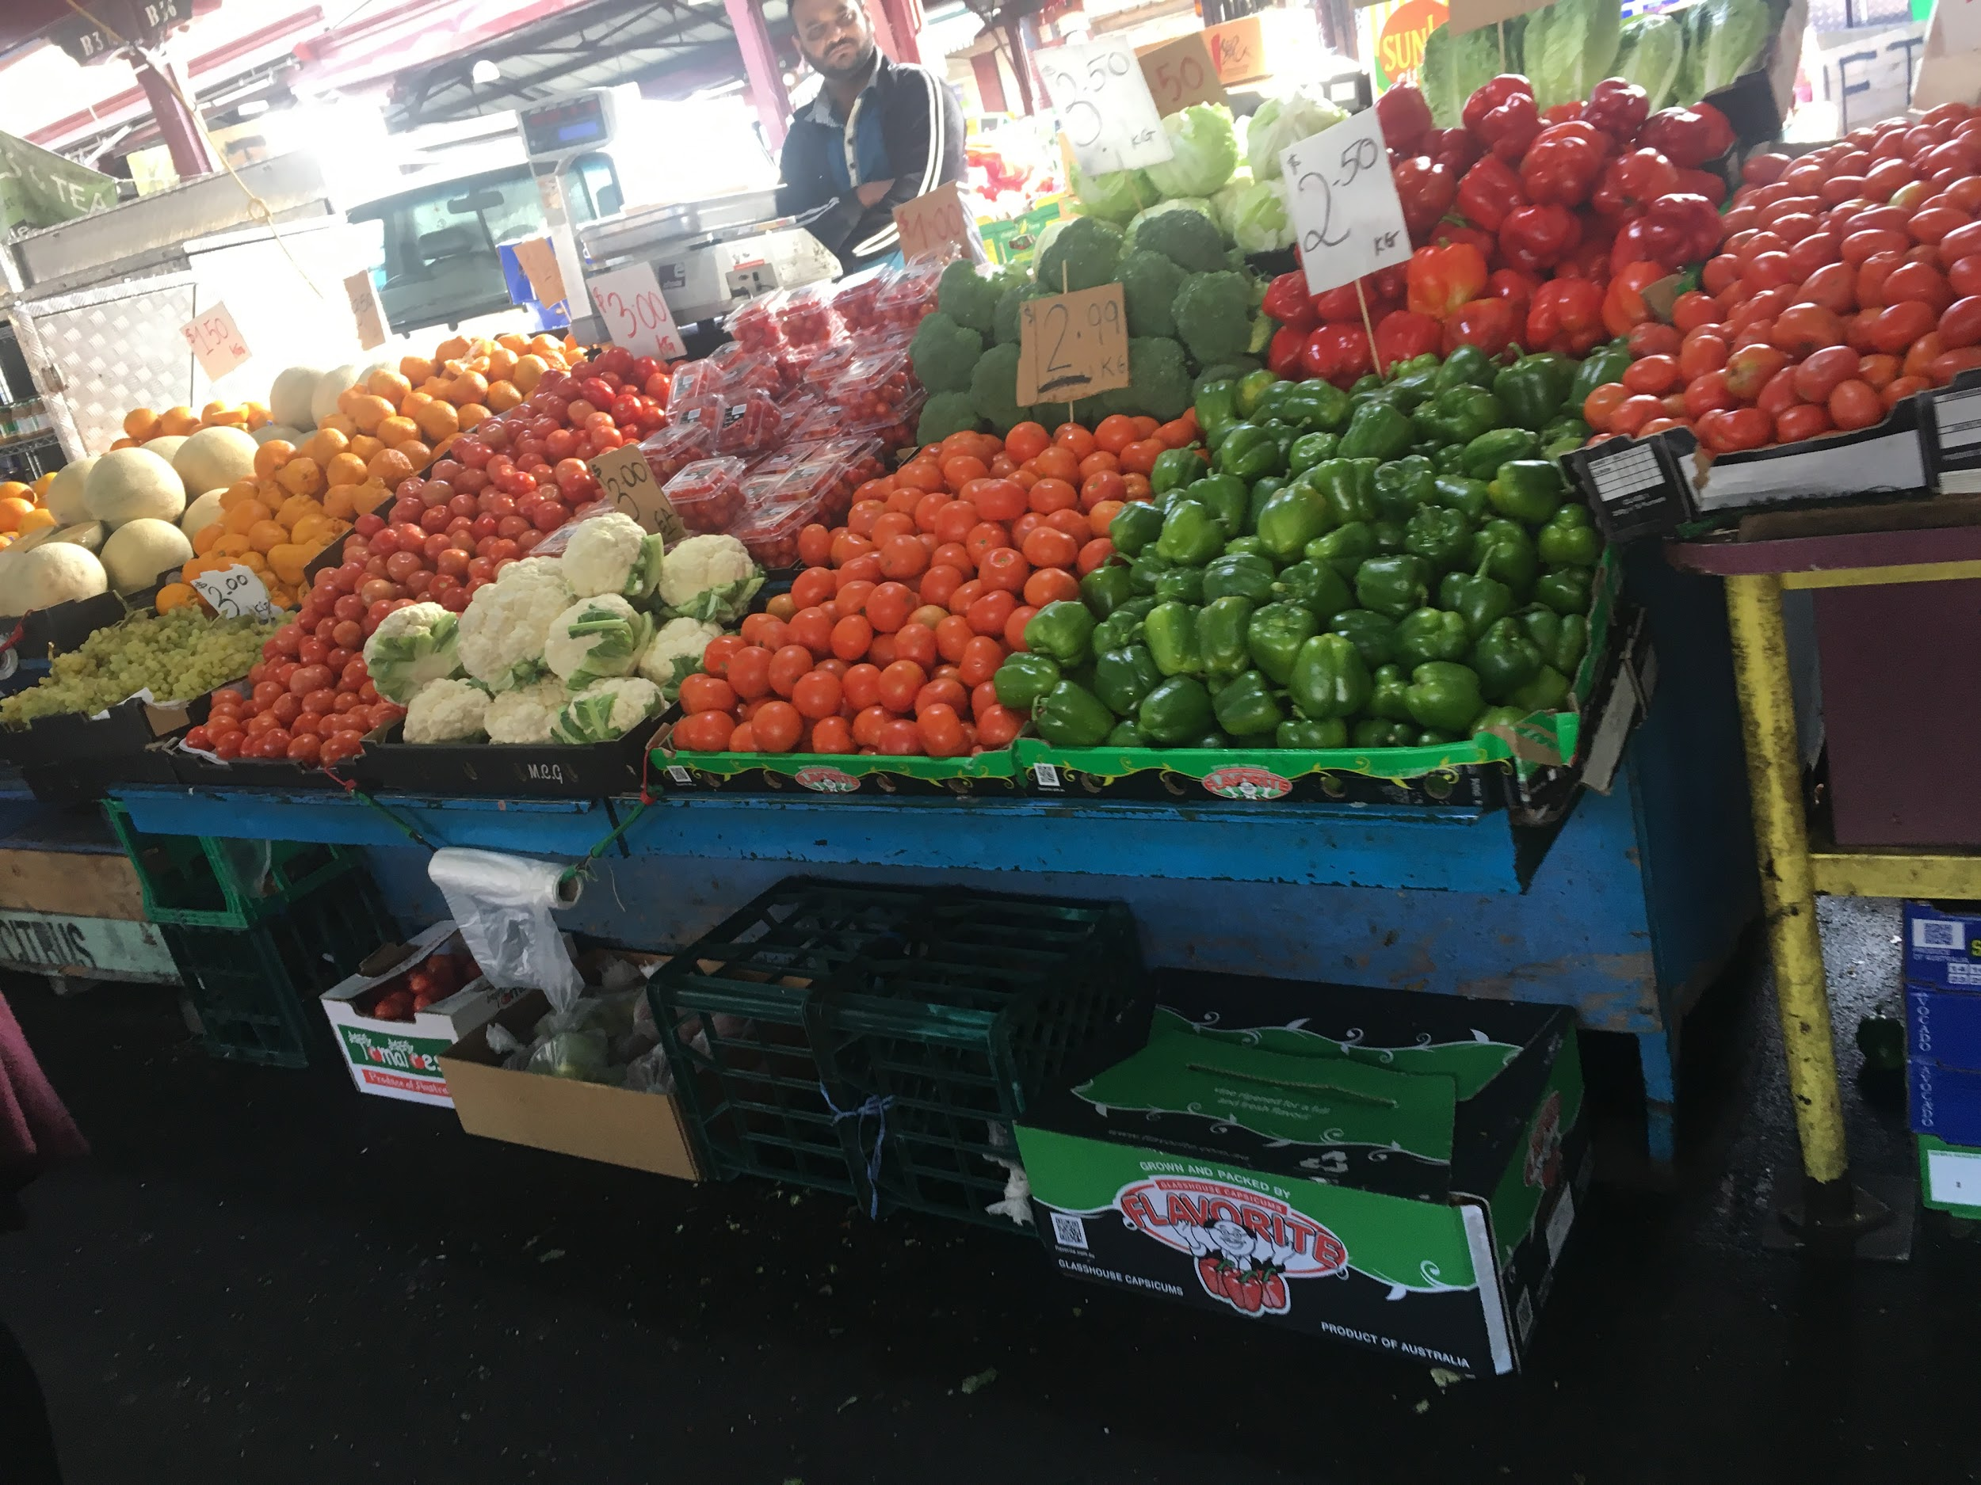
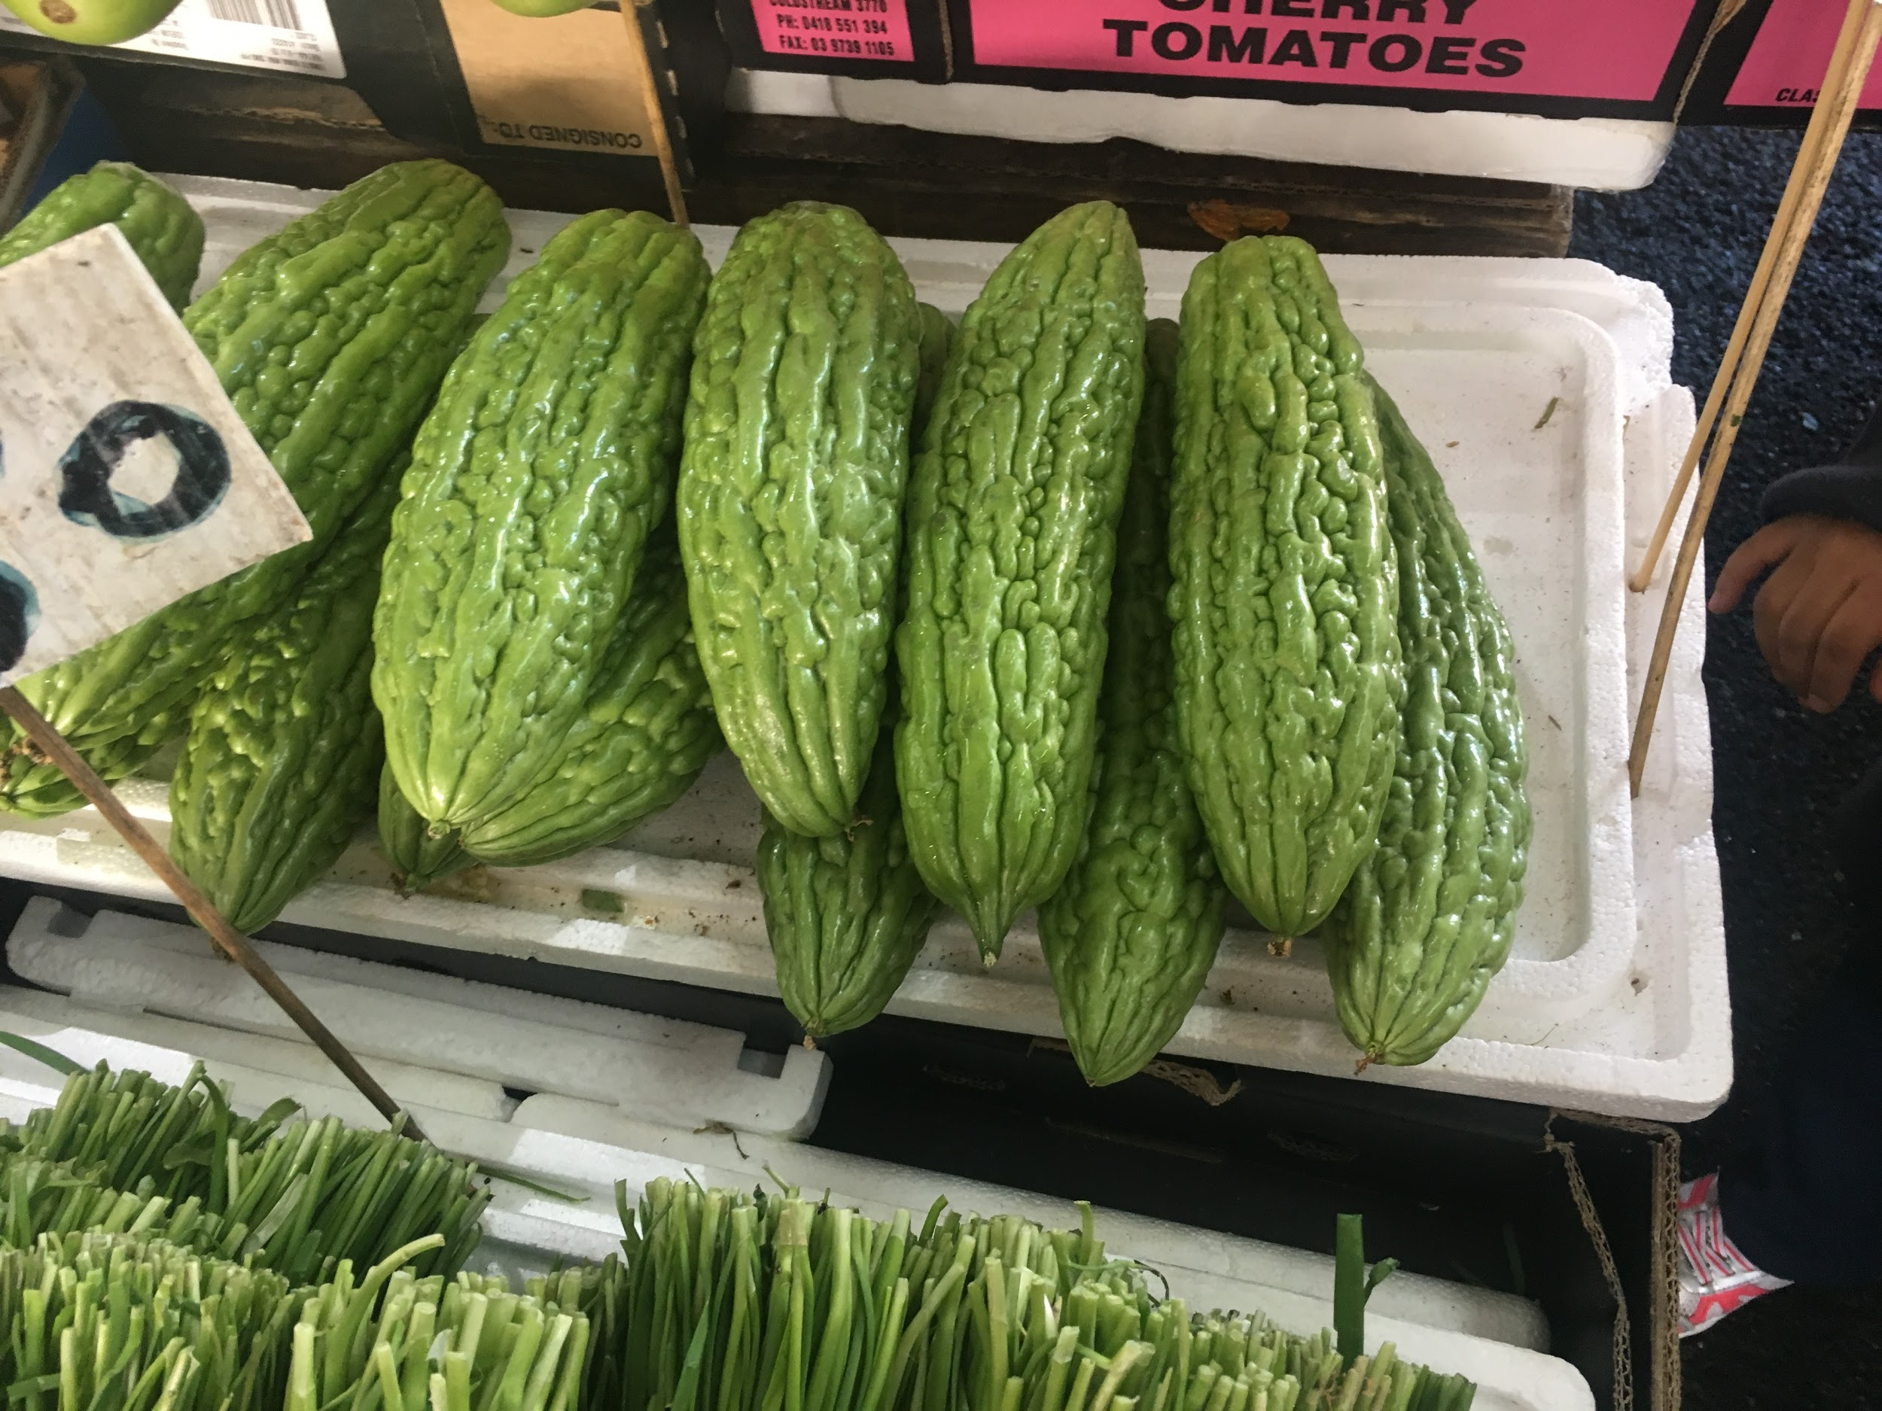
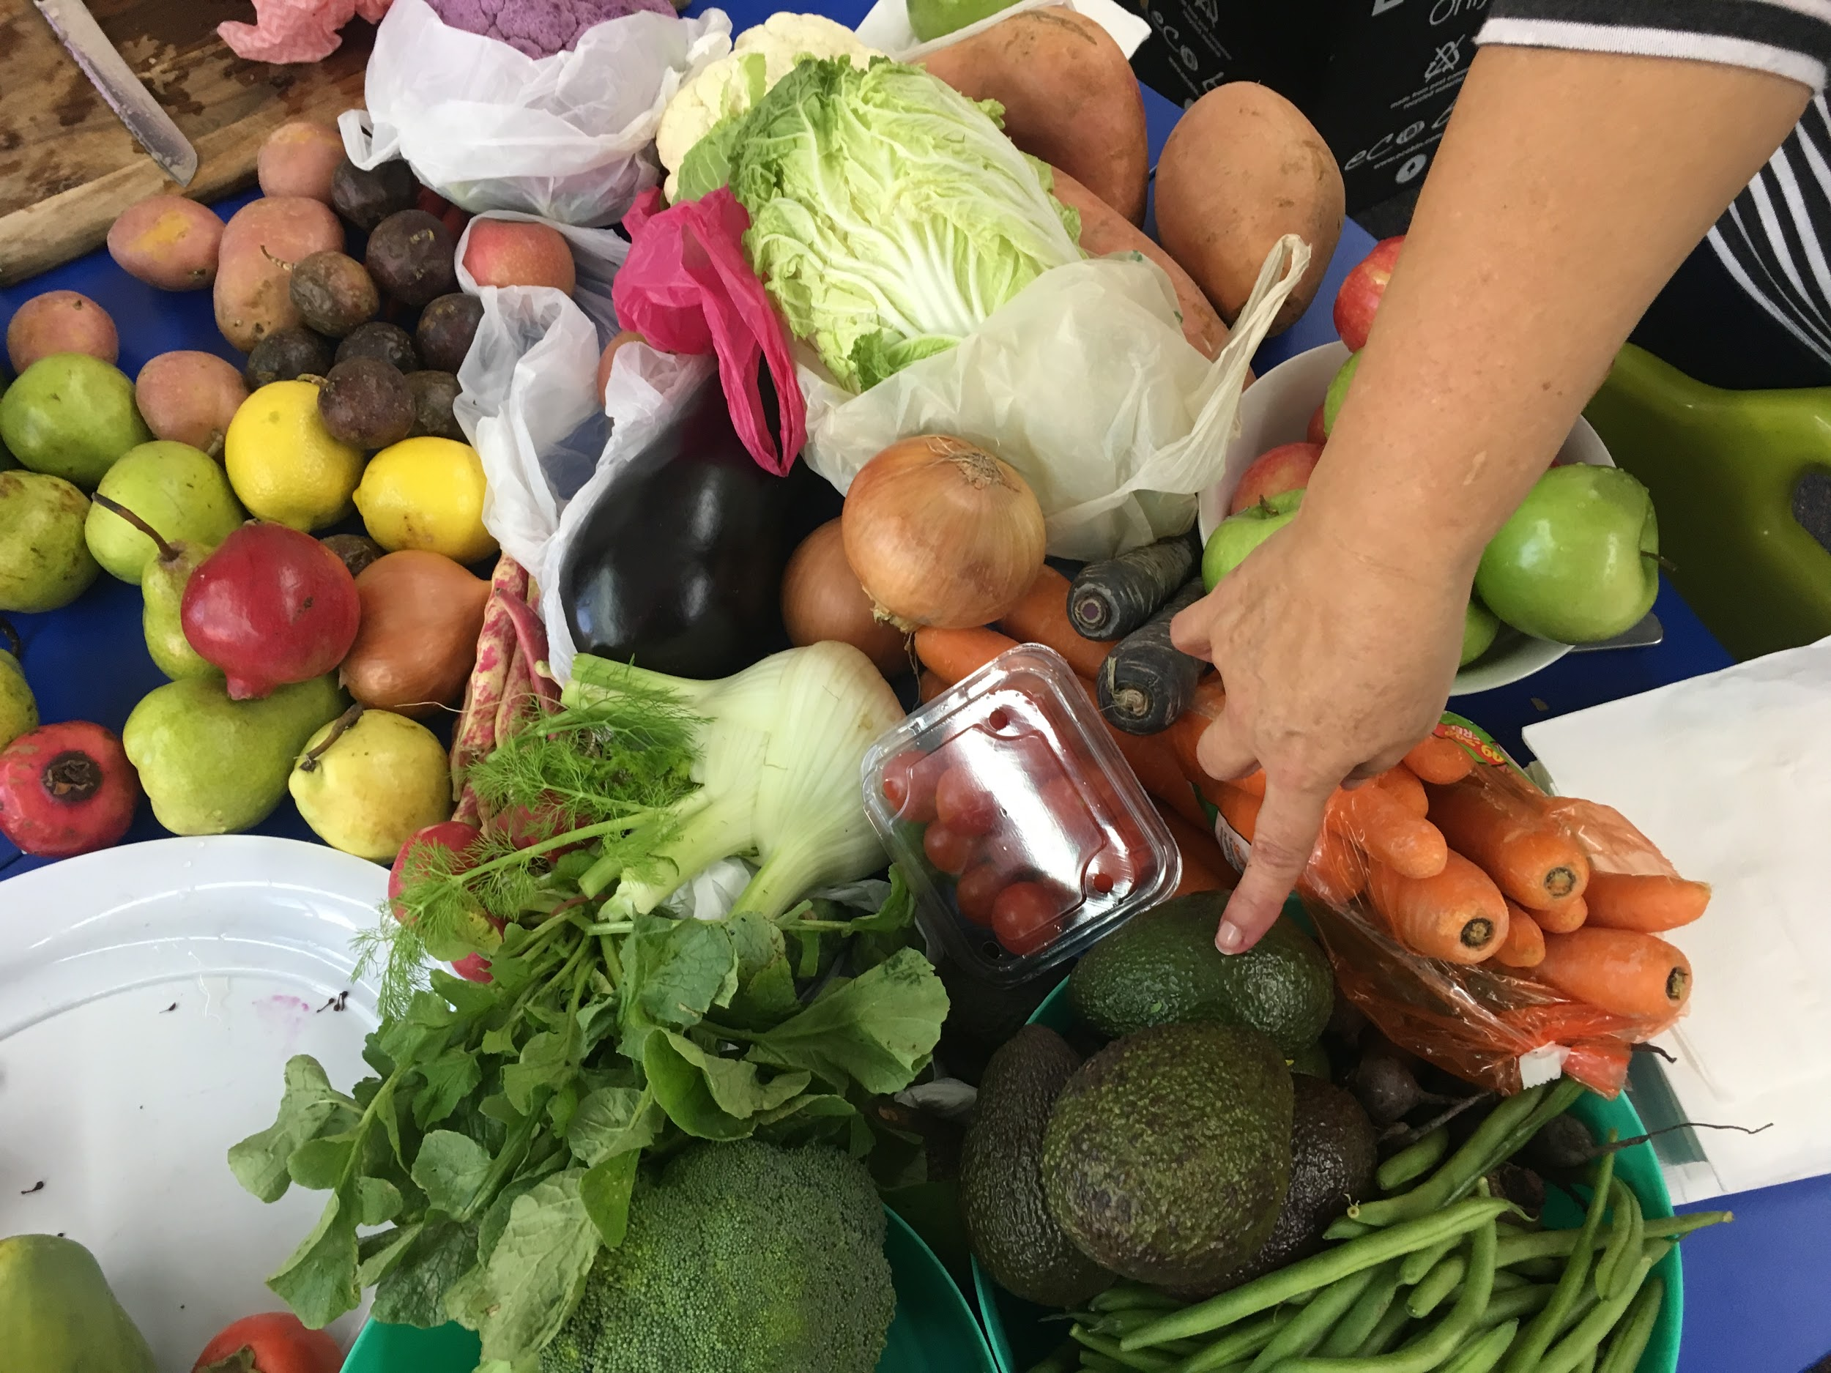
FOOD: Victoria Markets Shared Experience

Slide 43
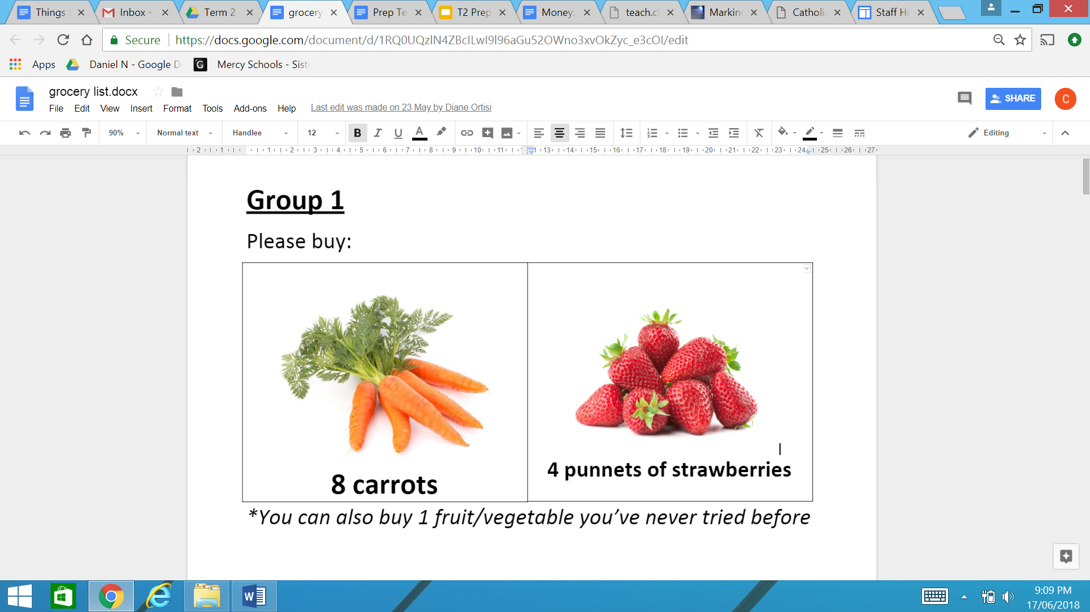
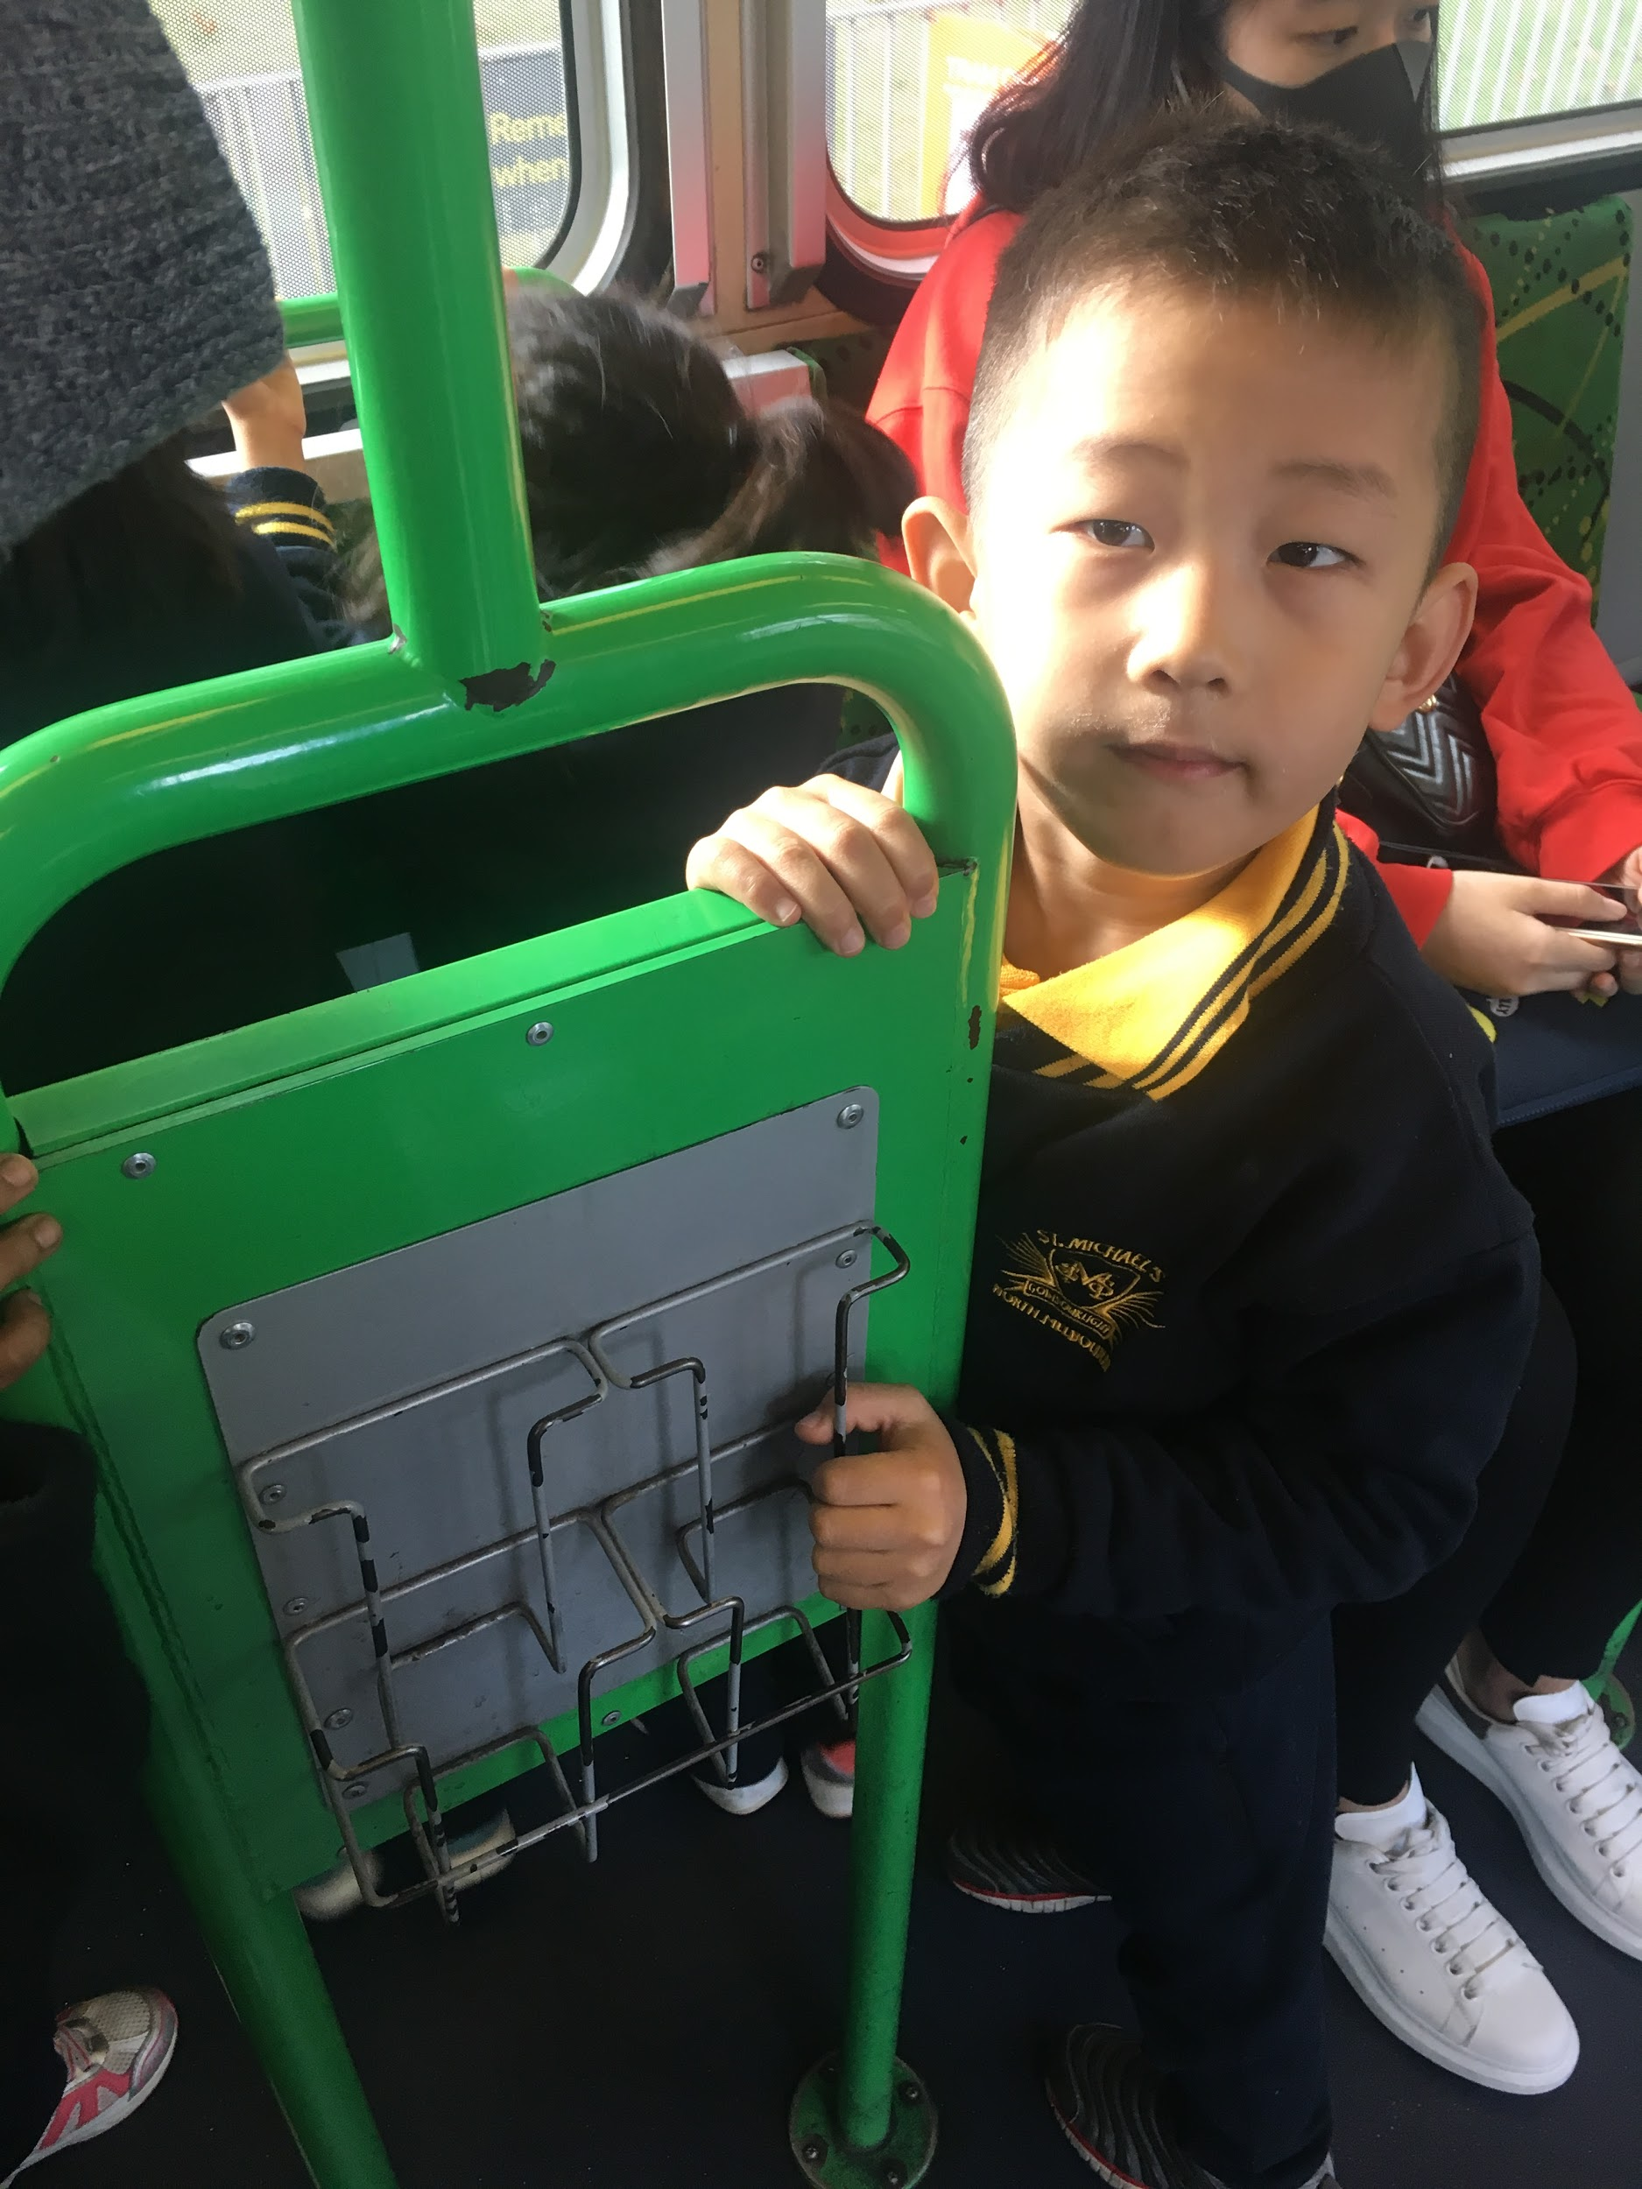
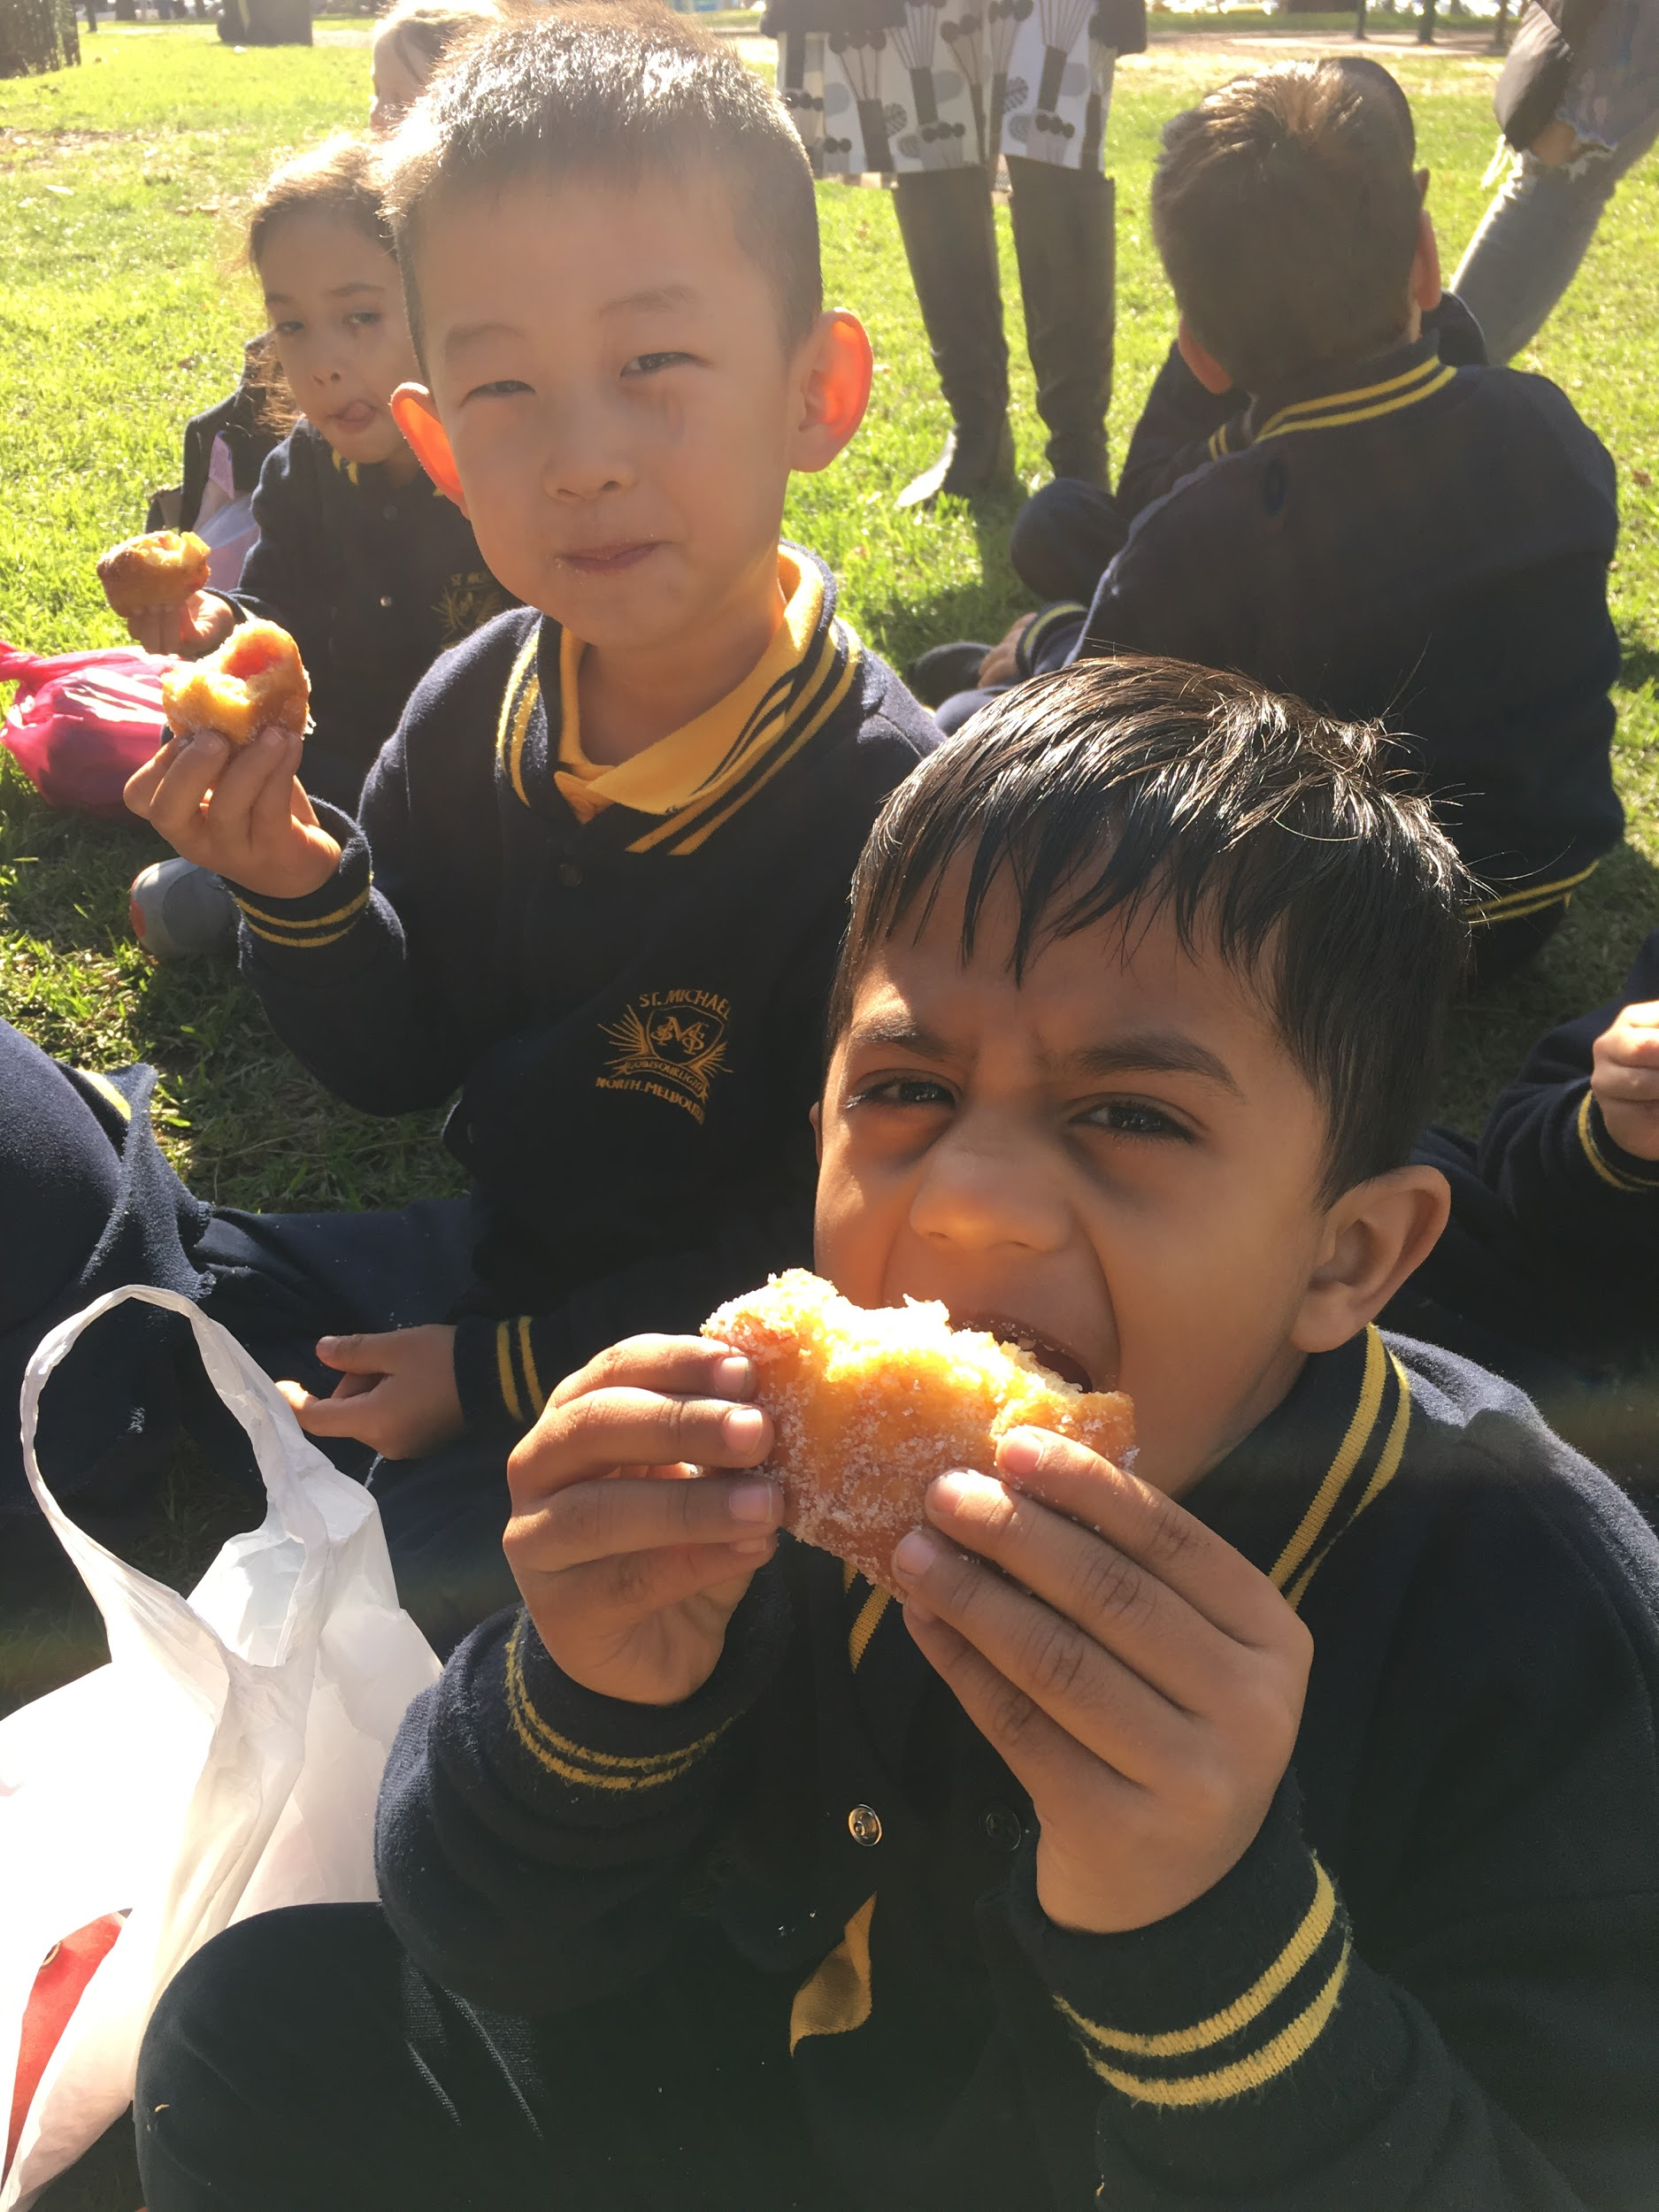
FOOD: Victoria Markets Shared Experience

Slide 44
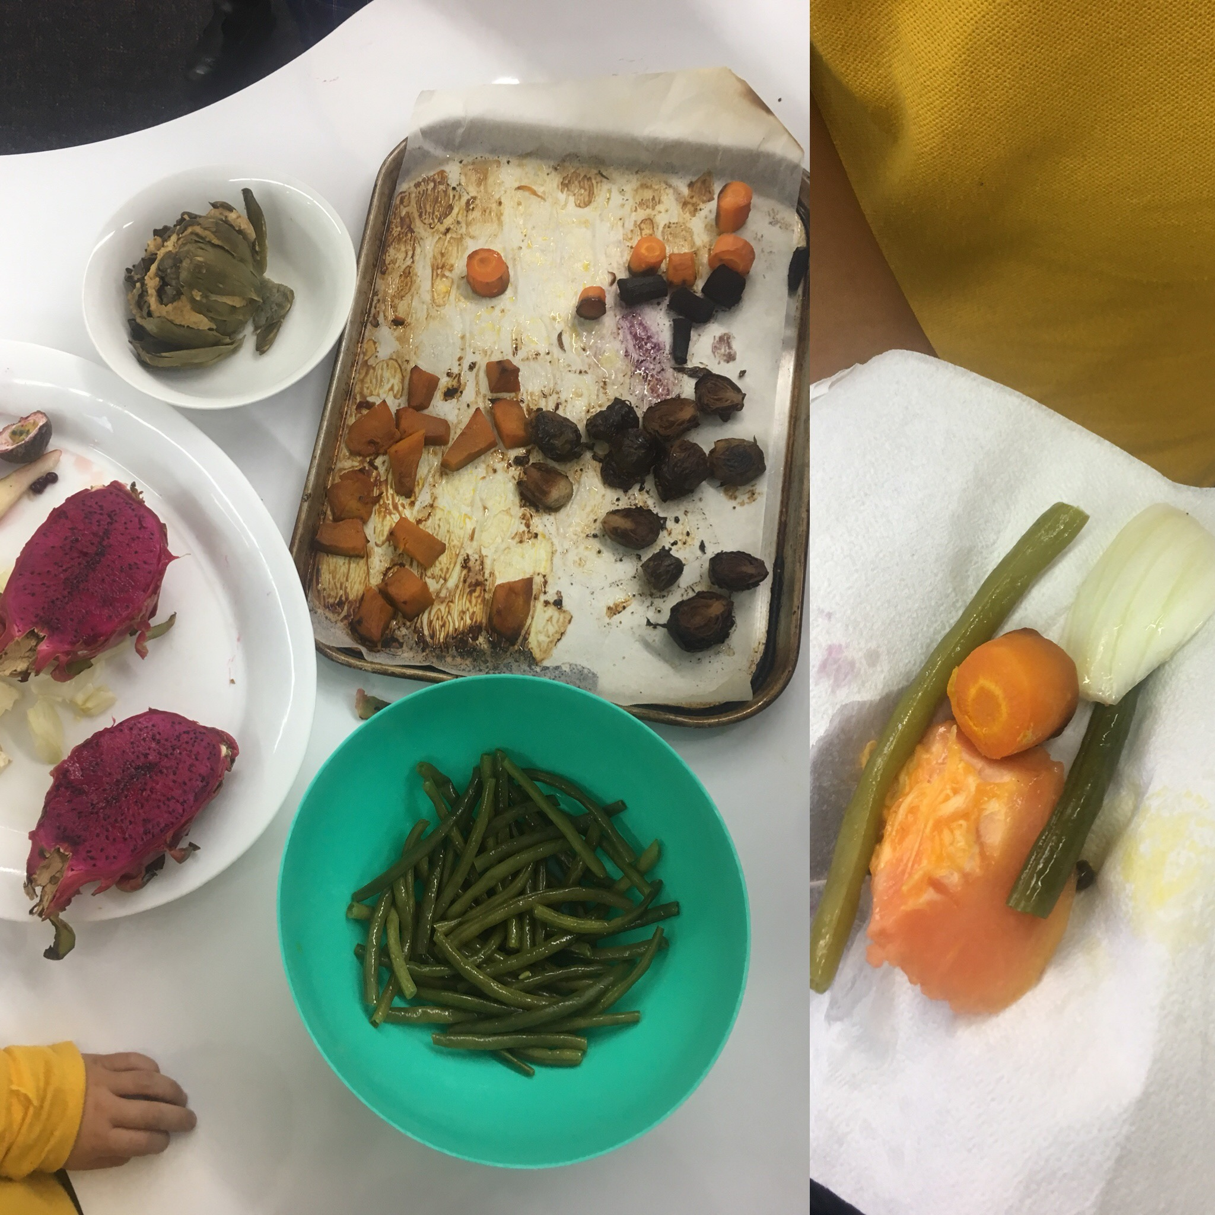
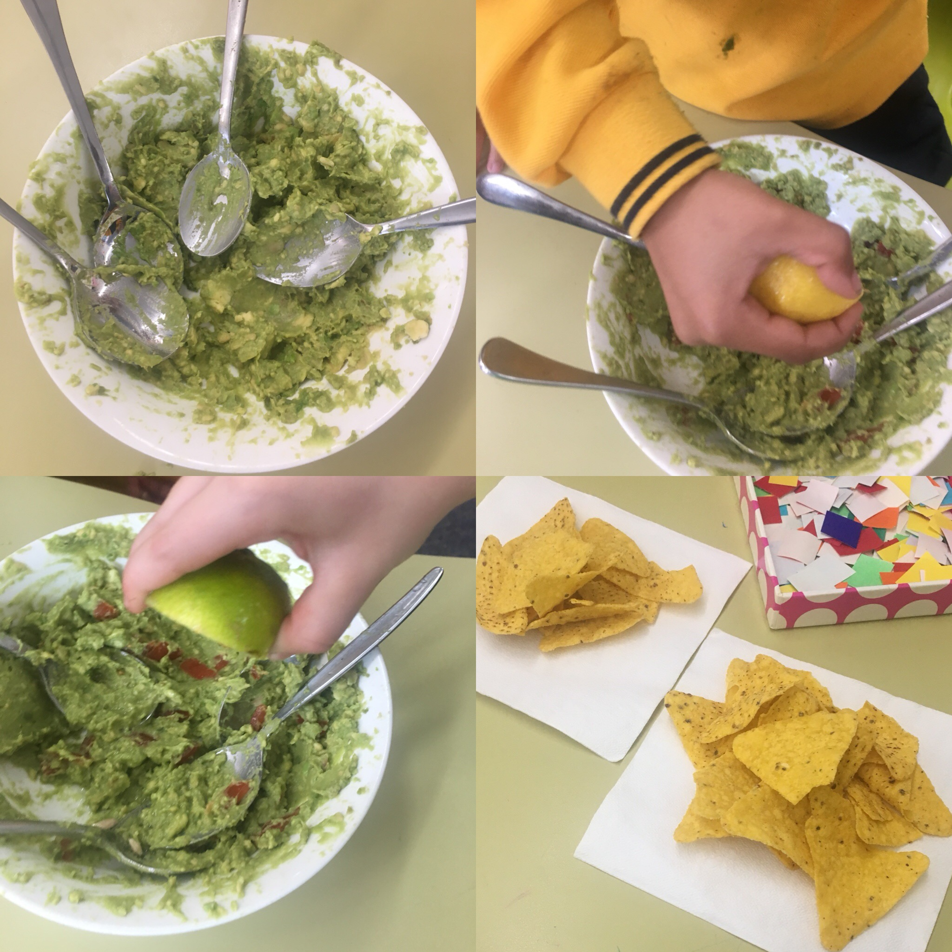
FOOD: Making a Roast & Guacamole
Maths: data collection- vote for the recipes we want
Writing: Procedures & Recipes
Using the 5 senses to describe food
Reading: Information texts

Slide 45

FOOD: Linking to Discovery
Creating a shop off the back of Vic Markets excursion

Slide 46


FOOD: Linking to Discovery
Home corner: cooking real food

Slide 47
FOOD: Linking to Discovery
Other areas we had:
Home corner
  Provocations: food, recipes that we had written together
Observational drawing
  Provocations: real food
Reading area
  Lots of fiction & non-fiction books about the food
Shop
  Smoothie shop

Slide 48

LIVING THINGS: Linking to Discovery
Butterfly area

Slide 49

LIVING THINGS: Linking to Discovery
Observational drawing

Slide 50

LIVING THINGS: Linking to Discovery
Box construction

Slide 51

LIVING THINGS: Linking to Discovery
Vet surgery

Slide 52


LIVING THINGS: Linking to Discovery
Small world

Slide 53

LIVING THINGS: Linking to Discovery
Play dough area

Slide 54

LIVING THINGS: Linking to Discovery
Sensory small world

Slide 55

LIVING THINGS: Linking to Discovery
Farm small world

Slide 56
Things to remember:
- Think about links from Inquiry to Discovery
- Capitalise on your ‘real life’ experiences or excursions
- Link in vocabulary wherever possible
The lines between Inquiry and Discovery
often start to blur…
which is when really powerful learning happens!

Slide 57

‘Favourite’ areas

Slide 58


‘Favourite’ areas

Slide 59

‘Favourite’ areas

Slide 60

‘Favourite’ areas

Slide 61

‘Favourite’ areas

Slide 62

‘Favourite’ areas
Florist

Slide 63


‘Favourite’ areas

Slide 64
If you have any questions:
claire.mathieson@smnth
melbourne.catholic.edu.au

Slide 65

what’s going around in your head?
Home group discussion time.
How are you integrating across the ‘frame?’
How are you letting students’ interests drive the learning?
What ideas do you have now?

Slide 66
11am Morning Tea in the hall
11.30am St Michael’s teachers to talk about the thinking behind the construction of an area in rooms
11.50am Back to home base- setting the context
12.15pm Discovery Walk
12.45pm Home group debrief and discussions bake at base!
1.15pm Lunch in hall until 1.55pm

Slide 67
setting the context
Rita Totino
St Michael’s

Slide 68
Tuning in: The Discovery Walk
Prep, Year 1 and Year 2
No introductions or share times
What are we looking for?
How is the environment set up?
What links across the curriculum are being made?
What learning are the students engaged in?
How are teachers supporting this?
How are the principles and elements of the Discovery-based inquiry approach evident in Discovery at St Michael’s?
Role of the the leader in commentating what they see during Discovery for their colleagues

Slide 69
what’s going around in your head?
Home group discussion time.
How are the principles and elements of the Discovery-based inquiry approach evident in Discovery at St Michael’s?
How is the environment set up?
What links across the curriculum are being made?
What learning are the students engaged in?
How are teachers supporting this?
What ideas do you have now?
Affirmations
Wonderings

Slide 70
What is the teacher doing to strategically scaffold the learning during Discovery?
Introductions and share times

Slide 71

Introductions and share time
Structure: Introduction - Discovery Time - Share time (10-40-10)
Smaller groups much more powerful (class not level)
Relaxed, conversational and interactive

Slide 72

Introductions
Introductions are strategic, focussed and planned. They are an opportunity to establish high expectations and rigour in the learning.
The introduction focusses the students into a particular aspect of their learning, and sets the scene (tuning in) for the Discovery time.
Explicit focus (LI) that is planned (can be ahead of time or in response to something that happened last time)

Slide 73
The focus of the Introduction can include……
Explicit teaching of a learning intention (oral language, social skills, language of learning, personal management or subject specific)
Modelling of desired behaviours
Modelling of, or exploring ways to engage with particular materials and stations (ie what is possible here)
Introduction to new stations or provocations
Problem solving something that happened during Discovery last time
Explicit teaching of a skill that might help students to increase the quality of their ‘work’ eg a construction technique, an art skill, a researching tip
Sparking of ideas and curiosity… I wonder if…. Could we… I noticed...

Slide 74

Share time
Noticing and naming learning
Be on the lookout for ‘teachable moments’
Ensuring that all children get the opportunity to share regularly (focus children, spontaneous)
Role of the teacher (monitor your air time!Depthing the conversation through questioning and commentating)

Slide 75
The focus of Sharetime is to...
Revisit and reinforce the focus of the introduction
Make learning visible
Provide authentic opportunities for children to share (purposeful talk) with a real audience
Showcase some great ideas, strategies or dispositions demonstrated by children during the session
Plant a seed (provocation) for next session
Rehearse orally before writing
Value the process (rather than focus on the product)
Make connections to prior knowledge, real life contexts and learning across curriculum

Slide 76
Open Ended Questions
Tell me about your construction or creation..
Why do you think…?
How do you know…?
Can you do it another way?
How do you think it could work?
I wonder why…?
Why did you….?
What ideas do you have to solve that problem?

Slide 77

Introduction
What was the teacher’s purpose and how was this made explicit to the students?
How did the teacher prepare the students to enter into Discovery?
How was the environment set up to facilitate conversation during the Introduction?

Slide 78

Prep Introduction Video

Slide 79
Share Time
How did the teacher support students to share their thinking during Share Time?
How did the teacher make links back to the focus of the Introduction?
How was the environment set up to facilitate conversation during Share Time?
If you were this teacher what did you see or hear that you might follow up next time?

Slide 80

Prep Share Time video

Slide 81


Slide 82


Slide 83

Discussion and Planning Time
What are the needs of your children now?
What focus for introductions would suit your children in the next few weeks?

Slide 84
Deb Vietri
dvietri@bigpond.com
Vanessa Willis vanessawillis06@gmail.com
Rita Krnac rkrnac@mmkeilordowns.catholic.edu.au
Instagram @discoverybasedinquiry
Twitter @discoverinquire @debvietri
Plenary
What’s going around in your head now...what have been your key learnings for today?
What are you wondering about now?
What actions will you take back at school?
What aspects would you like us to explore further in the next cluster days?
A big thank you to our hosts St Michael’s, North Melbourne
NB Please inform us if you do not wish your photo to be displayed on social media

