Slide 1
Let’s get inspired!!!
Virtual inspiration station to help you select your personal project!

Slide 2
How to use this resource...a message for students
Dear Students,
This slideshow has been designed for you. It is like a virtual inspiration station that you can use if you are trying to find ideas for your next project. You don’t need to read every slide or click on every link. The idea is you browse through it and stop at something that takes your interest. It has been divided into sections that match the pathways of Make, Know, Do and Act. So if you know what pathway you want to take you could jump straight to that section.
You may see something here that you want to explore further, or you might see something that sparks a different idea and sends you off on a tangent! There are so many possibilities and just a few ideas presented here. Sometimes we just have to open our eyes and look around us to find so many more.
Good luck, be curious, be persistent, and have fun!!!

Slide 3
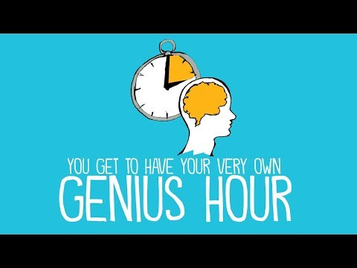
This is great!
You get to design and complete your own personal project on a topic of your choice!
What will you choose???

Slide 4
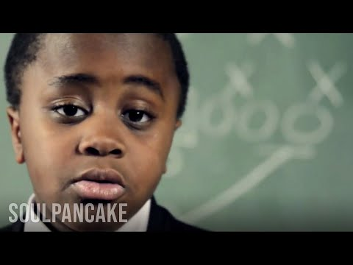
Give the world a reason to dance!
Create something that will make the world awesome!
What will be your space jam?
Kid President

Slide 5
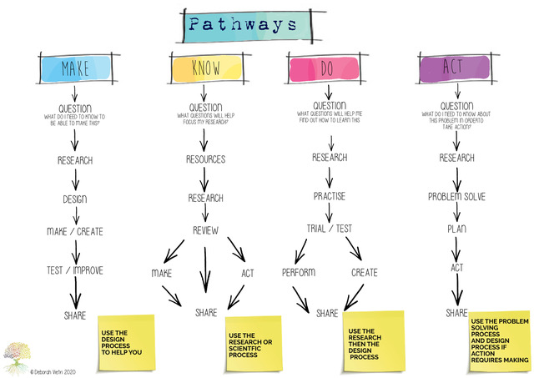
Choose your own pathway

Slide 6
Where do ideas come from?
Make Projects
Design and Make something unique
The aim of a Make project is to design and make a product, or a prototype, or a service for yourself or others. Make projects have a purpose, and that can be a need, a want, or an opportunity.
A need or a solution to a problem- personal, local or global
Your own interests, something you really want to make.
Your imagination, something that’s ‘out there’-be creative!
Something you have seen or done that sparks an idea!
A competition that appeals to your maker skills

Slide 7
There are many different types of make projects:
Construction using; wood, cardboard, recycled materials, metal, textiles, lego, papier mache, modelling clay, natural materials eg. sticks, logs, stones, plants.
Craft projects such as tie-dyeing, fabric, sewing, jewelry-making, pottery, origami, mask making.
Engineering or mechanical projects such as making simple machines, things that move, robotics, electronics, circuits.
Making with technology eg. apps, websites, games, coding, spheros.
Arts projects using a range of mediums: paint, pastels, charcoal, photography, printing, sculpture, graffiti, music, dance.
Media projects; making a movie, puppet show, stop motion, soundscapes
Literary projects; write a novel, picture story book, graphic novel, script.
Projects involving food; growing your own food, designing recipes, designing a restaurant.

Slide 8
Hat or fashion item
Model car
Rube Goldberg machine
Musical instrument
Puppet show
MAKER PROJECTS
The possibilities are endless
Game
Furniture
Superhero city
Video
Picture Story Book

Slide 9
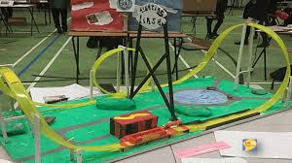
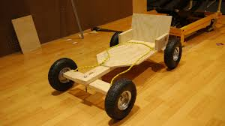
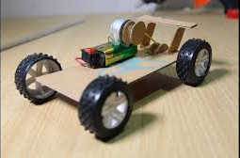
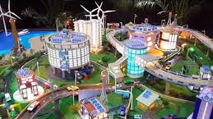
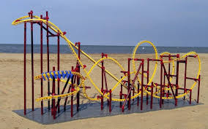
construct

Slide 10
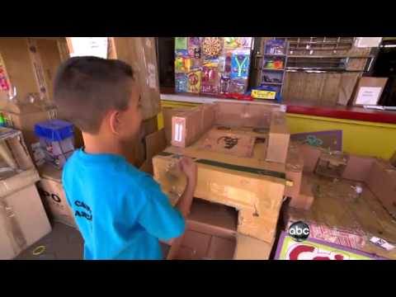
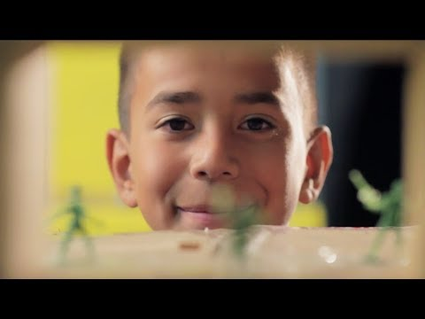
This 9 year old boy built a whole games arcade from cardboard boxes. Find out how he did it.
2 minute news clip
If you want to find out more watch this longer 10 min version

Slide 11
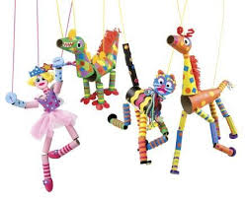
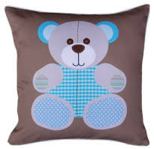
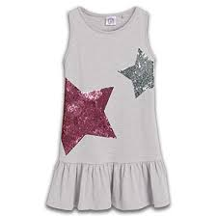
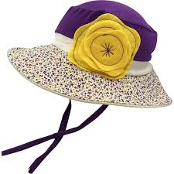
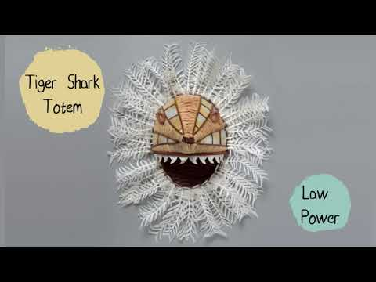
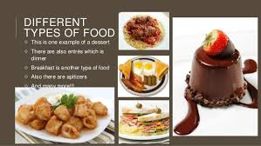
create

Slide 12
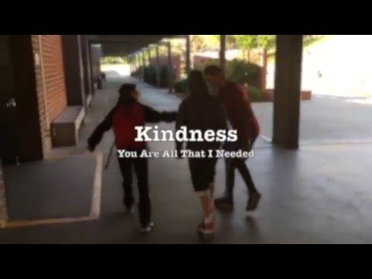
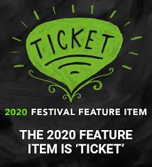
Find out more on The 1-Minute Film Competition: Home
website
Find out more on the MyState Student Film Festival
website
You might like to design and create a video like this one to spread a message, or tell a story. Your video could be animated or use live actors. You could even enter a film competition!

Slide 13
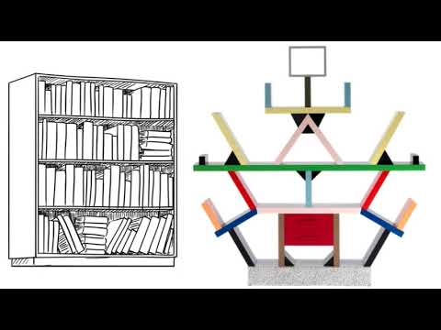
Go wild with your design ideas! Learn how the Memphis design group went about designing something not boring!

Slide 14
Know Projects
A Know project requires you to research and gather information, leading you to know and understand more about the topic than you did before.
You might want to research something you don’t know much about but it makes you curious
What kinds of things could I research?
You might already know a lot about a topic because you are passionate about it but you want to learn more

Slide 15
Know projects can explore many different topics
Animals; wild, zoo, farm, pets, ocean, land, sea, endangered.
Countries; places, cultures, food, arts, language, cities.
People; famous people, heroes, villains, people you admire.
History; events, people, lifestyles (eg. fashions, food, transport, technology), change, family stories, migration stories, ancient civilisations.
Mysteries of the natural world; different environments, ocean, outer space, solar system, natural disasters.
Mysteries of the built world; 7 wonders of the world, landmarks, buildings.
Sports; sportspeople, teams, Olympics, types of sports, world records, games.
Arts; music, dance, film, 2D, 3D, street art, arts movements, famous artists.
Science projects- using the scientific process and setting up experiments to answer a scientific question is another form of research. Eg. How do different drinks affect your teeth? Does hot water freeze quicker than cold water? Does playing music to your plant affect its growth?

Slide 16
Why did dinosaurs die out?
Are there other planets that could sustain life?
How did AFL begin?
Why is Nelson Mandela so admired?
How do they create special effects in film?
RESEARCH PROJECTS
The possibilities are endless
What do plants need to thrive?
Why are Rhinos endangered?
Which superhero has the greatest power?
What would it be like to live in India?
How did Rosa Parks change the world?

Slide 17
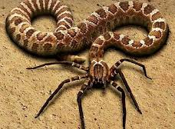
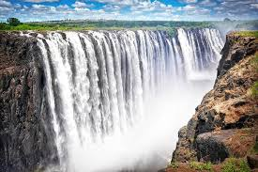
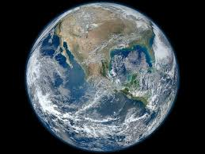
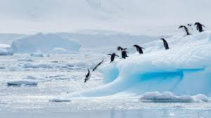
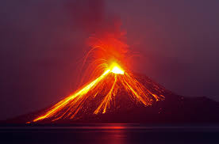
What do you want to know about the natural world?

Slide 18
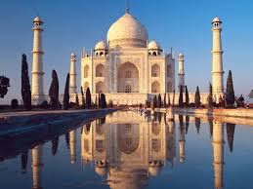
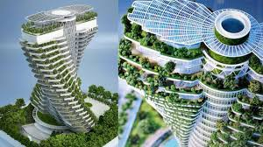
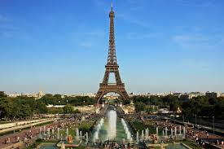
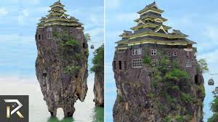
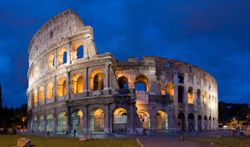
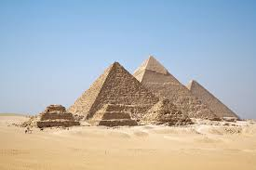
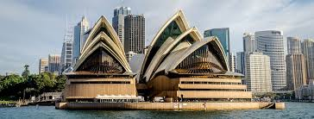
What is so amazing about these structures?

Slide 19
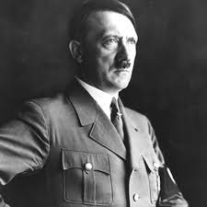
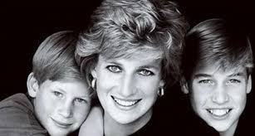
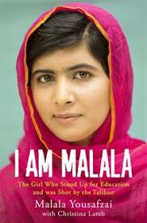
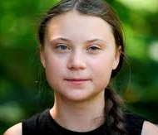
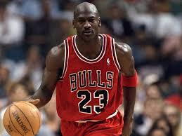
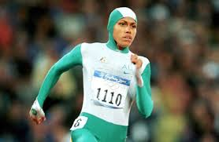
Who are these people and what is their claim to fame?

Slide 20
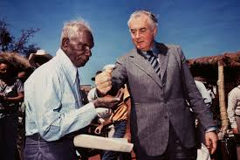
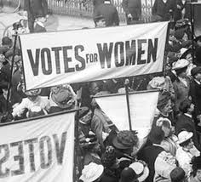
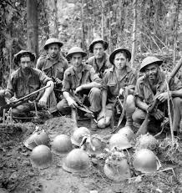
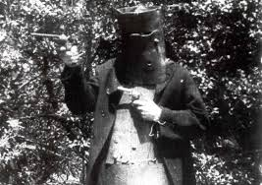
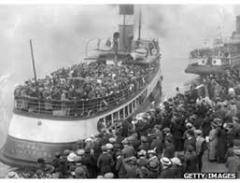
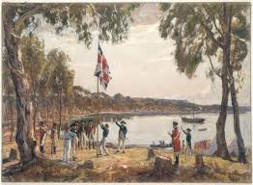
Why are these moments in history so important?
Check out this Australian history timeline to see more Defining moments timeline

Slide 21
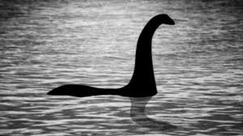
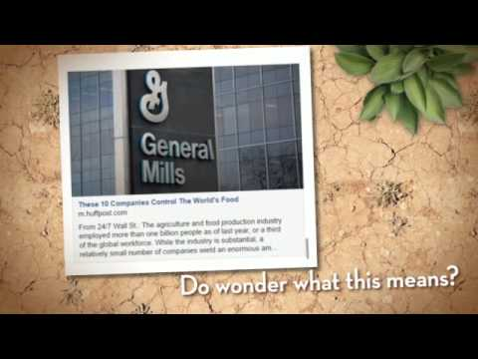
What makes you curious?
Is the Loch Ness monster real???
Ever wondered about some of the greatest mysteries of the world? Read about the top 10 in an article written by kids for kids. The Greatest Mysteries of History

Slide 22
Do Projects
Learn how to do something you don’t already know how to do
Once you have learned how to do something new you can teach someone else, or use your new skill to make something, or create a performance
What kinds of things would I like to learn how to do?

Slide 23
How to create an animation
How to bake cakes
How to knit
DO PROJECTS
The possibilities are endless
How to dance
How to play chess
How to sew
Learn a language
How to code

Slide 24
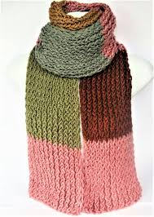
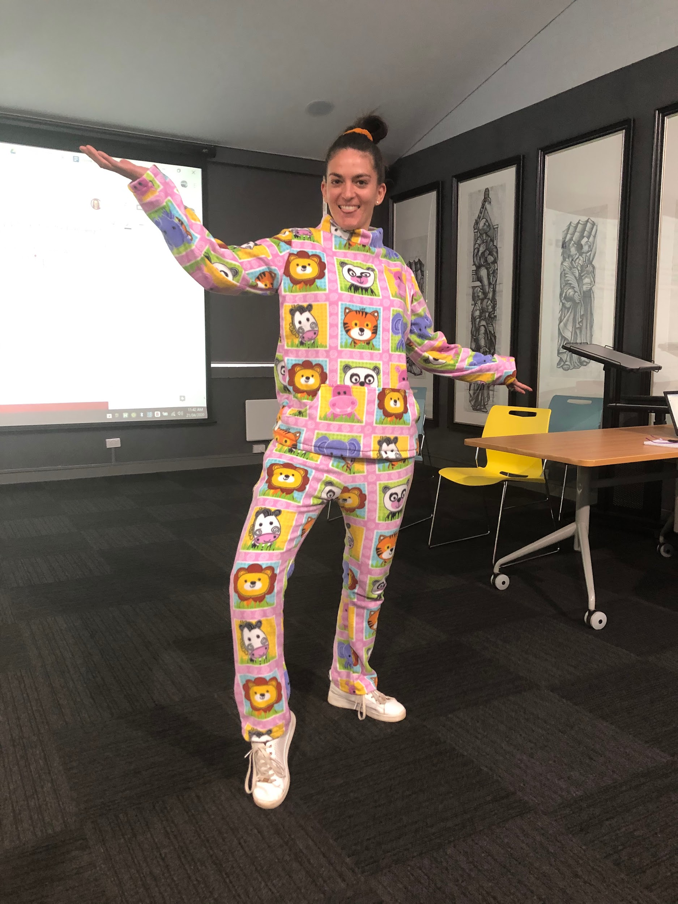
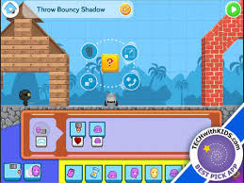
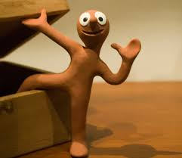
Anthony Year 3 wanted to learn how to SEW. Then he used his new sewing skills to make his teacher a pair of pyjamas!
Knitting
Coding
Sometimes learning to do then leads to Make
Claymation

Slide 25
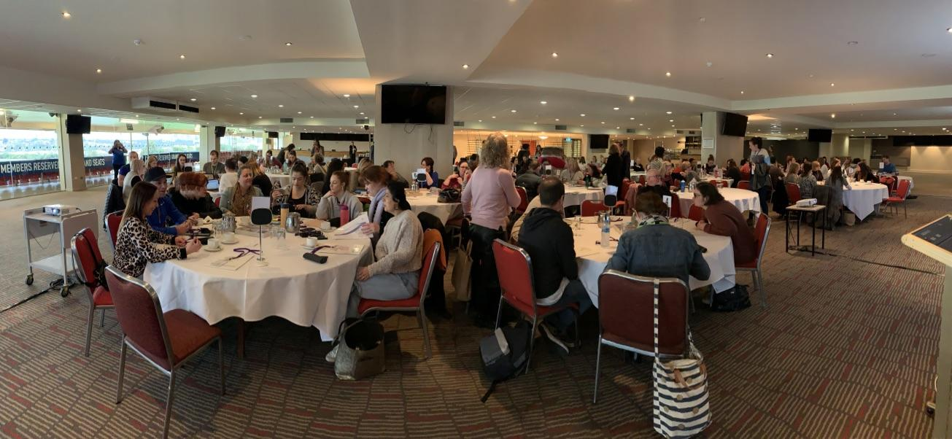
Sometimes learning to do leads to performing
Aaron (Y6) learned how to play the guitar. He did this by watching youtube tutorials. He discovered a shared passion with Levi for Queen music. They watched videos of Queen and learned how to play Queen songs then practised really hard. They became so good they were asked to play in front of an audience of 200 people.

Slide 26
Sometimes learning to do leads to teaching someone else
Sketch up

Slide 27
Where do ideas come from?
Act Projects
Brainstorm solutions to a need or a problem and take action!
A need or a solution to a problem.
An issue at home,school or in the local community.
Something you personally feel strongly about.
A campaign that you want to join.
How can I make a difference and help to make the world a better place?

Slide 28
Save an animal in danger
Create a native garden
Support a local food locker
ACT PROJECTS
The possibilities are endless
Promote alternatives to palm oil
Perform a ‘random act of kindness’
Reduce, reuse, recycle
Bring awareness of an issue to the community
Promote the use of use ‘fair trade’ products

Slide 29
Actions can be global or local. What things do you want to change at home or at school? Can you see a need or a problem you can fix?

Slide 30
Mobilemuster want you to create a one minute film encouraging your community to recycle their old mobile phones. The theme for our 2020 competition is Small actions. Big Impact.Find details on this website: https://www.mobilemuster.com.au/competition/
Do you feel strongly about making the planet more sustainable? Here are some alternative ways of taking action to help spread the message and help save the environment!
How can switching to recyclable toilet paper save wombats, koalas and many other Australian animals? Could you convince other people to ‘give a crap???’Find out about this and more on this website: Community Conservation Campaigns

Slide 31
7 year old boy makes a difference!
Kids of any age can make a difference! Seven-year-old Jake Croker's mission to save sleepy lizards has become a success after road warning signs inspired by his design have been installed at Innes National Park.
For more than a year, the young lizard advocate has been trying to get a sign he designed to warn road users of shingleback lizard populations erected around his local area.
What could you do to make a difference?
Read more about it: Save the sleepy lizards!

Slide 32
Racism doesn’t just happen in America! Who is affected in our country or local community? What can you do? Learn more on this website: Share Our Pride
Sometimes current events can cause strong feelings and challenge us to take action to change something we know is not right. Recently racism has been in the news and the ‘Black Lives Matter’ movement has inspired us all to end racism. What do you feel strongly about? What could you do to bring about change?

Slide 33
Helping the Homeless
Approximately 116,000 people across Australia classified as homeless. In winter living on the streets can be a very challenging time. There are many ways you can help the homeless including donating warm coats, scarves, hats, blankets, non-perishable foods. Imagine if you started a campaign amongst your class, school, local community…. How many homeless people could you help.
Here are a few organisations and campaigns you can investigate, but there are many more:
300blankets.org.au
XTM heat the homeless
Salvation Army
Lighthouse foundation

Slide 34
Sometimes an action can be as simple as a random act of kindness or ‘paying it forward!

Slide 35
Take Action to End Poverty
Actions for Justice - Advocacy Campaigns and Action to help children and their families, here and around the world
Kids take action |
There are many organisations you can support with actions and current campaigns that you can join. Here are some of them! Check out the links to the websites.

