Slide 1
Discovery19
How can we explicitly plan for developing student learning across the play continuum?
May 21st 2019

Slide 2
Exploring the play continuum and the learning continuum
What do these look like in Discovery?
How can we support students to move along these continuums?

Slide 3
What is the role of play in Discovery?
Discovery is about self-directed learning
It is mostly playful
Play is the entry point
But we don’t refer to it as developmental play or play-based learning

Slide 4
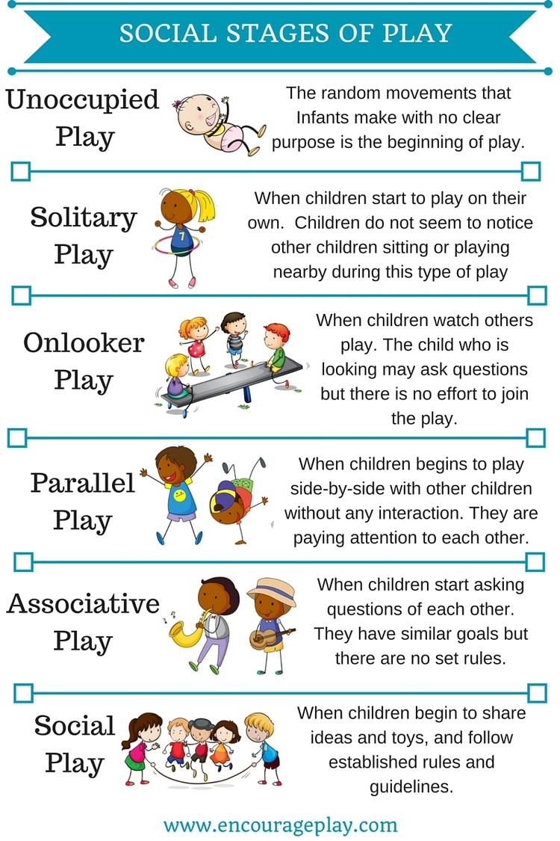
Parten’s stages
of play
Mildred Parten’s (1932) research is still cited today. She researched the development of social play in children (2-5 years of age). She discovered that a child’s development of his/her social skills is reflected in the way they play. She also found that once a child has developed the ability to participate in a particular stage of social play, he/she will use different variations and combinations of that stage, and earlier stages, throughout play.

Slide 5
Can you identify particular children you work with who sit along this continuum?

Slide 6
What about the kids who appear ‘stuck’?
Why might they be ‘stuck’?
How do we move children along the play continuum?

Slide 7
What does the continuum of LEARNING look like in Discovery?
Match and sequence the descriptors to build a picture of how the child is developing
Beginning
Developing
Extending
What would you add or change to build a comprehensive picture?

Slide 8
Building stamina
Curiosity and creativity
Emergent inquiries
Metacognitive thinking
Mastery of skills
Play is the entry point
Extended projects
What comes before? What is their pre-school experience?
What comes after?
How will they continue to ‘exercise’ their experience of self-directed learning?

Slide 9
What can teachers do to support students along through this continuum?

Slide 10
Continuity of Learning
by Luke Touhill
What key points does Luke Touhill make about how to ensure continuity and development of learning?
What are the implications for us? How can we act on these ideas in our own settings?

Slide 11
Summary of key points
More fluidity across the day- connected and integrated learning opportunities
Extended opportunities for exploration
Not continually changing materials and experiences and allowing children to re-engage and master materials and ideas
Open-ended and rich opportunities, not closed tasks
Leaving things set up, not packing them all away therefore allowing them to sustain and build on ideas
Building relationships with students enables the adults to engage children in meaningful and significant learning
Development of a permanent ‘maker table’ to encourage children to make their own resources

Slide 12
Discovery Walk
11.30am - 12.00pm
What evidence did we see of stages of play or the learning continuum?
How were learning areas/opportunities set up strategically to support this?

Slide 13
Design strategies for ‘engineering’ deep learning in Discovery
How can we be strategic in our planning and ‘teaching’ during Discovery in order to support children to move along the learning continuum?

Slide 14
‘Leverage points’
Introductions and share times
The learning environment
Provocations and invitations
Assessment for learning opportunities
Making strong connections to Literacy, Maths, Inquiry etc.
Introducing ‘extended projects’

Slide 15
Introductions and Share Times: Whole class
The Introduction focusses the students into a particular aspect of their learning, and sets the scene (tuning in) for the Discovery time.
Introductions are strategic, focussed and planned. They are an opportunity to establish high expectations and rigour in the learning.
Share time is an opportunity to Notice and name the learning: making learning visible (and audible)
Showcase some great ideas, strategies, behaviours demonstrated by some children that you would like to further encourage.
How are you deciding on the focus for introductions and share times? Are you using these times for explicit teaching and modelling of more sophisticated skill sets or ideas and behaviours?

Slide 16
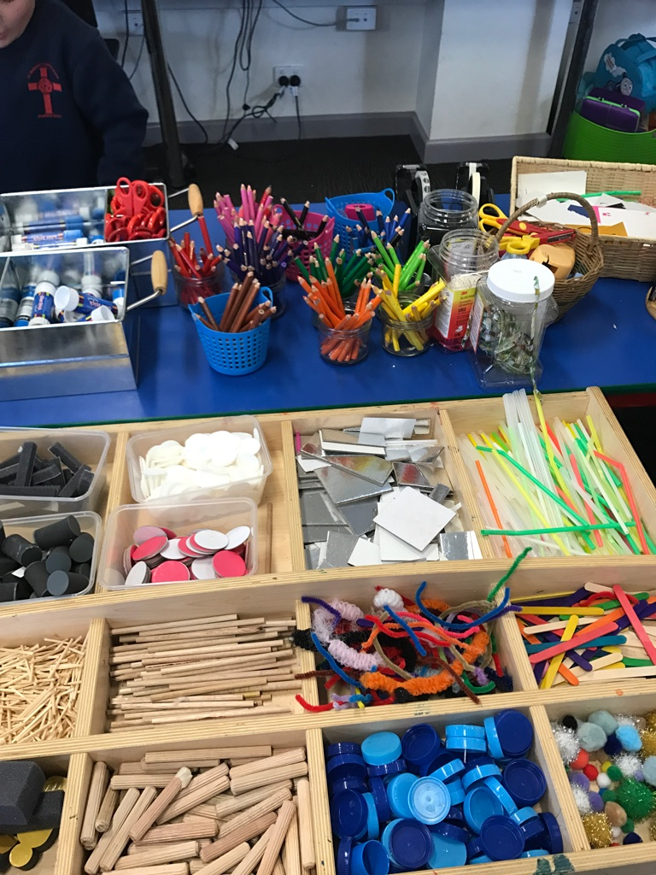
The Learning Environment
Creating a balance of areas that students can access and use for their own purposes that exist in their own minds, as well as creating areas that spark ideas for kids and stimulate new ideas, taking them beyond where they are already operating.
Stimulating but not cluttered or overpowering
Permanent areas….. Purposeful areas
Quality materials, attractive, inspiring
Developmentally appropriate resources

Slide 17
Are you offering a range of open-ended possibilities?
How are children able to access resources and materials in an ongoing manner?
Is the environment attractive and enticing?
Whom does this environment serve?
How can the environment encourage independence?
Purposeful Areas
Construction
Dramatic Play
Arts Play
Outdoor Play
Opportunities to Practise skills
Opportunities for Investigation
Quiet areas
Collaborative areas

Slide 18
Thoughtful provocations and invitations
Can be invitational (entice them, or plant seeds) or can be a more intentional and compelling provocation
Can be introduced from the beginning to provoke students in particular ways
Can be introduced as a result of watching and listening (working theories)
Can be artefacts, materials, books, questions, visuals, could be something that’s not there
Your words and actions can be provocations (groups or individual)

Slide 19
And interventions???
When and how do we intervene? When do we stand back and let it flow?
Don’t let them flounder. Differentiated support and challenge (know your kids)
Creating high quality work: Setting high expectations. Specific skills sets eg for construction, art, dramatisation, tinkering
What place do invitations and provocations have in your planning?
How are you watching and listening to children so you can add in provocations?

Slide 20
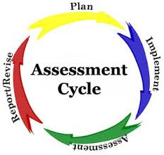
Assessment (for and of learning)
What are the possibilities?
What are we looking for? Being specific and selective, knowing our stuff!!! (CCT)
How do we do it? How will we record? Checklists, observations, anecdotal notes, learning conversations, self-assessment, photographs
What do we do with the information? Feedback, goal-setting, communicating with parents eg seesaw, displays. Discussion with colleagues. Informing future planning.
How does assessment inform your planning of Discovery?

Slide 21
Making strong connections to Literacy, Maths, Inquiry etc.
aka integrating more seamlessly, aka ‘continuity of learning’
Recognising the learning that happens throughout Discovery;
Exploring new ideas, practising previously taught skills
Planning for it
Provoking it
Making connections visible to students
Assessing it (see previous !!! Just because not every student might engage with this doesn’t mean we can’t track it!)
Exploring concepts not tasks
Adding reading writing and math opportunities to every area where applicable (as well as dedicated areas)
Texts, storybooks, information texts
Pen, paper, clip boards
Charts
Vocab
Signs (student made not commercial)
Measuring tools (tape measures, clocks, scales, stop watches)
Researching area/tools for developing and extending students

Slide 22
Teacher mindset
Thinking more wholistically about learning and the learner rather than what I need to teach them in Math, in Reading etc…. When else in life do we put things into little boxes to deal with separately???
Tackling the big issue- the constraints of the timetable. How can we be more creative about this and work smarter?
Leaving Discovery ‘set up’ so children can access it at different times of the day
Can you use the materials around the room to;
Show me 5 groups 4
Respond to this text
Show me your understanding
How can you address the timetable more creatively?
Are you maximising connections across the curriculum (and making them explicit)?

Slide 23
Extended projects
What are they? How do we know children are ready to move into more extended projects? How do we introduce them?

Slide 24
Extended Projects
Have a stated goal or intention
Initiated by the child (but can be in response to a nudge from the teacher)
Go beyond a session
Involve discussion/conference with the teacher
Can come from an emergent inquiry
Can be sparked by a desire to make or explore
Developmental not a blanket approach- introduce gradually
Look for good candidates to role model
Apply structure without over scaffolding
Focus on the process over the product
Work towards documenting the process and the learning
Focus as always is on developing students’ capacity to manage their own learning

Slide 25
How can we shape extended projects?
Ease children in to the structure
Determine if they are ready through learning conversations (watch, listen, learn)
Suspend judgement- It’s not always ‘the high achievers’ who take to this first
Use a couple of students as role models and back map the project
Allow students to dip in and out of the process
Emphasise the learning journey not the end product
Celebrate mistakes!!!!

Slide 26
Extended discovery Projects
Year 2

Slide 27
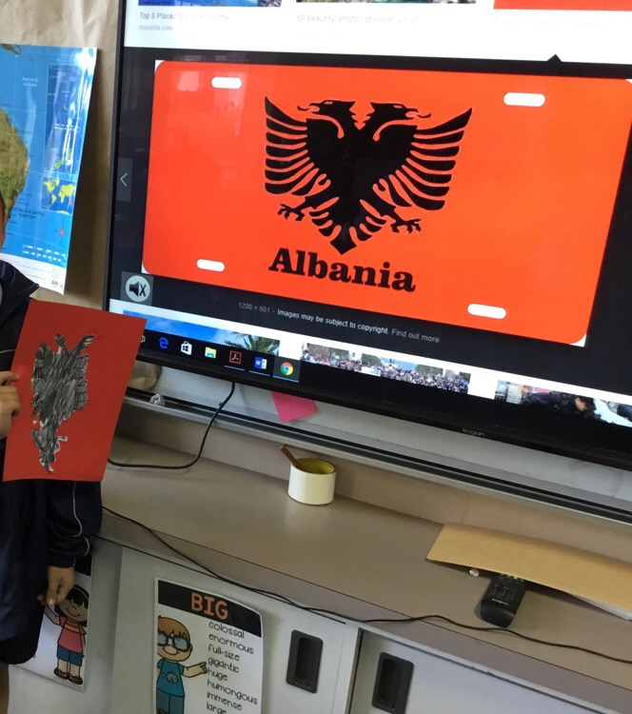
Giving a friendly “nudge”
Give them a friendly ‘nudge’
What station does the child seem drawn to?
Engage the child in a chat and find out what they are thinking.
Give them a friendly nudge… help inspire them!
Show them a book, look on-line together… give them some suggestions
Let them go… and don’t forget to check in

Slide 28
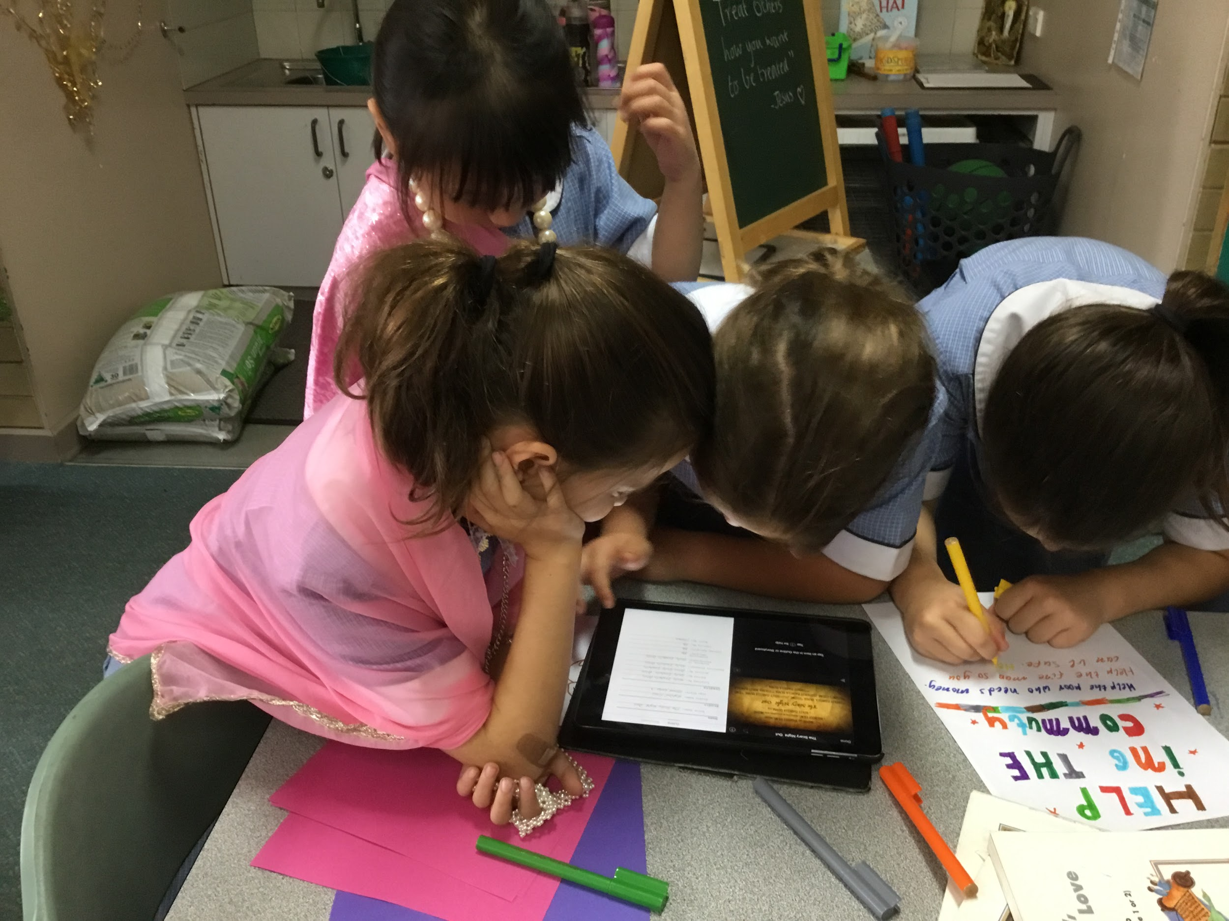
Allow the freedom to incorporate personal interests
Costumes camera person script
director
timing movement
audience

Slide 29
Developing students as self-managing learners beyond Year 2

Slide 30
Pathways
If our expectations are rigorous, each of these pathways will lead to questioning and inquiring as well as creativity

Slide 31
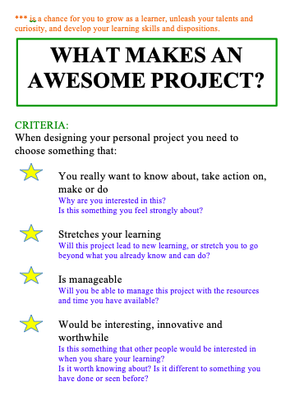
It is critical that each child chooses the right project for them.
This may take some time and they make make mistakes along the way.
Share the ‘why are we doing this’ with them right from the start.
The teacher can provoke, and nudge, and challenge but students need to own, and be accountable for their own decisions.

Slide 32
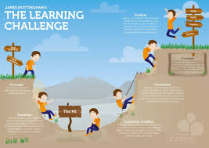
So what is the learning for students?
Personal management skills
Persistence and resilience
Collaboration
Critical thinking
Creative thinking
Flexibility
Questioning
Reflecting and evaluating
Literacy/communication skills
Mathematical concepts
All students, no matter what their ‘project’ will be engaged in developing learner skills and dispositions

Slide 33
Drilling down- What is the value of particular interactions and areas, and what is possible…
The Arts, tinkering and construction and dramatic play

Slide 35
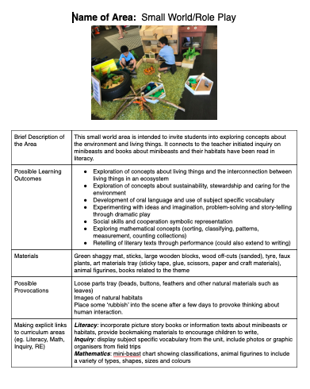
Unpacking the readings
Personal responses to the article: A sentence, a phrase, a word
What are the learning benefits/possibilities of this kind of play?
How can we take the learning deeper through this area/station?
What different contexts for this kind of ‘play’ are possible?
What might an exemplary area/station look like? Design an area/station in small groups and record on the planning template. (Add photos later)

Slide 36
Sharing session

Slide 37
Action Planning
Where to from here for your team?

