Slide 1
3-6 Cluster
#Makedoknowact
29th May 2018
@ Our Lady of the Rosary, Kyneton

Slide 2
Welcome
St Mary MacKillop, Keilor Downs
St Paul’s, Kealba
St Catherine of Sienna, Lalor West
St Peter’s, Epping
St Francis of Assisi, Tarneit
Our Lady of the Rosary, Kyneton
St Brigid’s, Gisborne
St John’s, Footscray

Slide 3
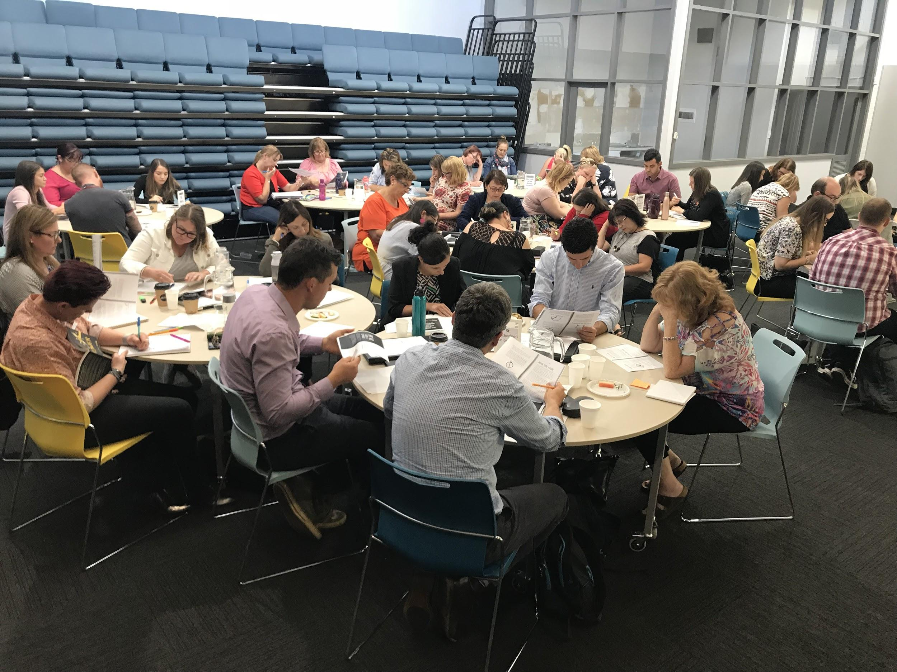
Purpose of the cluster
To engage in Professional Learning with and from each other in order to explore effective ways of using
student-initiated inquiry to; develop learner capabilities, unleash curiosity and creativity, and deepen student thinking.

Slide 4
Your feedback
What we want to explore further:
How does it look different from Year 3 to Year 6?
How might we ‘evolve’ this 3-6 like we did with P-2 Discovery
What to assess and how do we assess the learning?
How to scaffold their recording eg. possible template
Seeing examples of learning journals
Learning stories
Samples of documentation, planning for student-initiated inquiries
How to create a balance between letting go and being supportive
What is the role of provocations?
How to deepen their learning- expectations
What does deep learning look like?
How to ask good probing questions
Inspiration stations
Timetabling
How do our current throughlines fit with our new thinking?
Getting parents and teachers on board
What we want to do at the next cluster:
More doing, hands on
More conversations
More exposure about what is happening in other schools
Share and hear what others have tried. What worked, what didn’t work?
Action planning with team

Slide 5
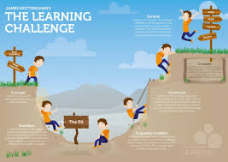
Session 2
How to deepen their learning- expectations
(Ensuring rigour!)
How can we ensure the ‘projects’ our students engage in are high quality?

Slide 6
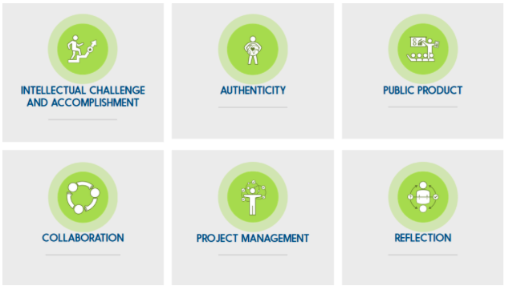
High quality project based learning framework
“People are calling a lot of things project-based learning that aren’t necessarily high quality learning experiences for kids,” said Bob Lenz, executive director of the Buck Institute for Education. That’s a concern for many educators, like Lenz, who have worked on project-based learning for decades and know there’s danger in an education trend that goes wild, but isn’t implemented well. “One of the most common things that's missing from what people call projects is that it’s not intellectually challenging.”
The Framework for HQPBL is intended to stimulate reflection and conversation about ways that projects can be improved and deepened… Also important is the fundamental belief that all students can learn, and that their voices should be heard in their own education. Bob Lenz

Slide 7
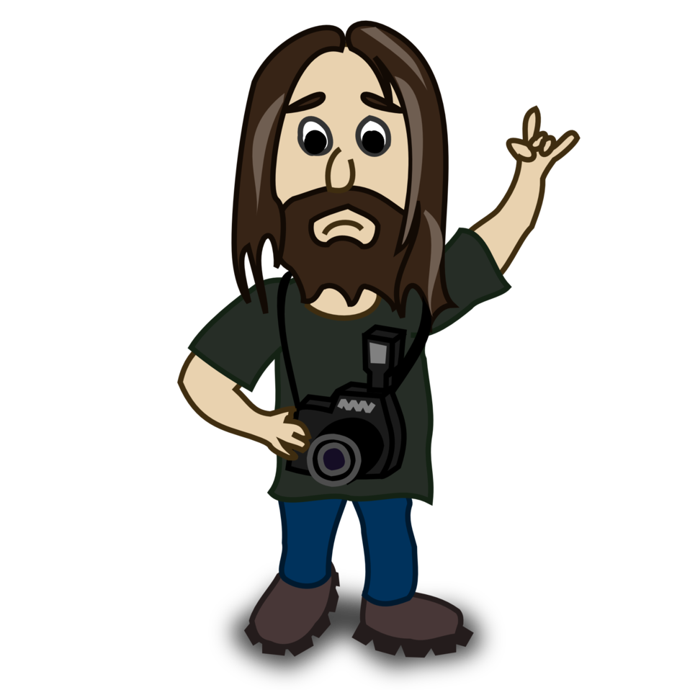
Read, Discuss, Record
In groups read each of the 6 elements and the guiding questions and discuss your thinking
Record thinking on a reflection organiser
Further reading: Defining HQPBL: A look at the research

Slide 8
Whole Group Sharing
One success
One challenge

Slide 9
Inspiration #makedoknowact
Use of inspiration stations/provocations
Transitional not permanent
Not for everyone
Encourage students to contribute things they notice/are interested in
Leading wide-awake lives
Thanks Tarneit- Human Body provocation

Slide 10
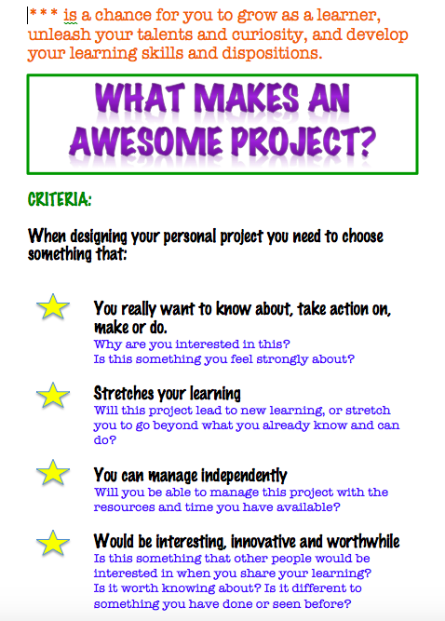
How can we ensure the ‘projects our students engage in are high quality?
Engagement + Rigour = powerful learning
Criteria
Showing the whole community this learning is valued
Scaffolding but not over-scaffolding the process
Teacher’s role in guiding and and challenging students
Having high expectations
Watching, listening and intervening (100% present 100% of the time)
Quality provocations
Quality time
Creating a culture of collaborative learning and thinking
Each student is an individual
Strategic use of introductions and share time

Slide 11
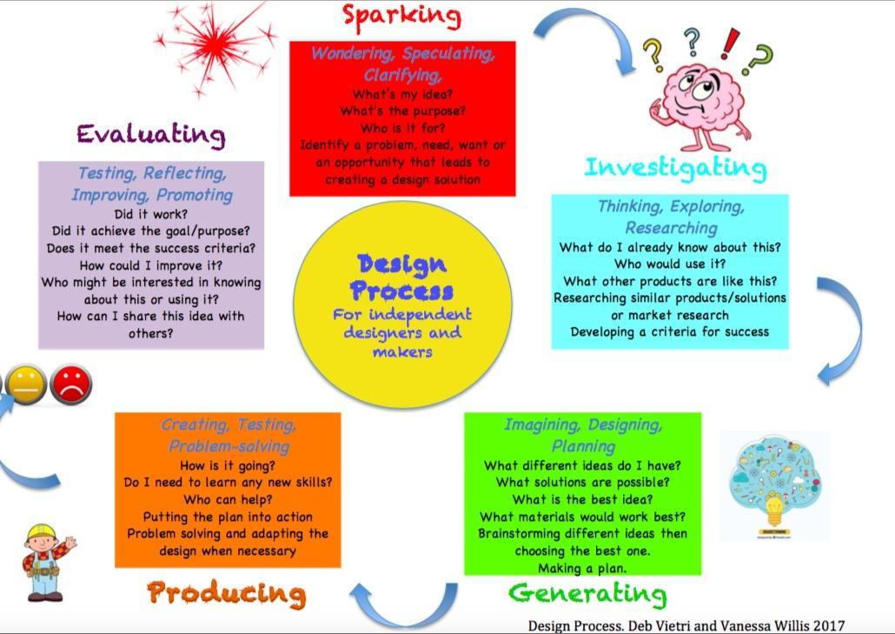
Session 3
What learning opportunities does a ‘student-initiated inquiry’ approach present?
How does Design Thinking stretch students?
What’s important to learn?
If we want to support our students to develop their capacities as self-managing and self-motivated learners, what learner skills and dispositions will they need?
What strategies and resources can we put into place?

Slide 12
Design challenge
Learning Intentions:
To identify the learner skills and dispositions required when engaging in design thinking
To think about the role the environment plays in supporting our philosophy of learning (Claxon)
Design and create your ideal classroom

Slide 13
Design brief:
The learning space you are designing needs to support a belief about learning that encourages students to become:
Curious/Inquisitive
Independent
Confident
Self-reliant
Creative
Cross school groups of 4
Not passive, compliant, anxious about making mistakes (Guy Claxon)

Slide 14
No talking!!!
Think about what you already know about;
What kids need to be creative, curious, independent, confident and self-reliant (empathise)
Elements of effective learning spaces you have seen before (prior knowledge)
5 mins to individually reflect, brainstorm and record your own ideas

Slide 15
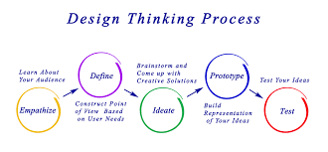
In your group
20 mins
Take turns to share your ideas
Consider how these ideas match the criteria
Decide on the best ideas and create a design you all agree on
Now create the prototype using any available materials

Slide 16
Test/evaluate
Pair up with one other group.
Group A shares their design solution
Group B gives Group A feedback based on the criteria
Swap roles
5 mins per group
The learning space you are designing needs to support a belief about learning that encourages students to become:
Curious/Inquisitive
Independent
Confident
Self-reliant
Creative

Slide 17
Reflect and discuss
What demands did the process of design thinking place on you as a learner?
What learner skills and dispositions were you required to use?
How important do you think it is to ensure your environment matches and reflects your beliefs about learning?
What are you thinking now with regard to the role the environment plays in supporting your students in their learning?

Slide 18
Guy Claxon
Learning Power
What does Claxon believe is important for students to learn?
What are the ‘little things’ we need to attend to that will make a difference?
https://www.youtube.com/watch?v=JxWybvns1jg

Slide 19
Points to consider
‘What am I doing for my kids that they could be doing for themselves?’
Lisa Burman- image of the child (innocent or fragile, empty, threatening, competent and capable)
Researching: small steps, googleable and non-googleable, bunny hopping, John Spencer
Don’t kill the joy of learning by overdosing on documentation that is overwhelming or rigid
Understanding of our role

Slide 20
Session 4
If we were to help kids build a learner toolkit, what would we put in it?

Slide 21
What to put in the toolbox?
We are facing unprecedented challenges – social, economic and environmental – driven by accelerating globalisation and a faster rate of technological developments. At the same time, those forces are providing us with myriad new opportunities for human advancement. The future is uncertain and we cannot predict it; but we need to be open and ready for it. The children entering education in 2018 will be young adults in 2030. Schools can prepare them for jobs that have not yet been created, for technologies that have not yet been invented, to solve problems that have not yet been anticipated. It will be a shared responsibility to seize opportunities and find solutions.
To navigate through such uncertainty, students will need to develop curiosity, imagination, resilience and self- regulation; they will need to respect and appreciate the ideas, perspectives and values of others; and they will need to cope with failure and rejection, and to move forward in the face of adversity. Their motivation will be more than getting a good job and a high income; they will also need to care about the well-being of their friends and families, their communities and the planet.
Education can equip learners with agency and a sense of purpose, and the competencies they need, to shape their own lives and contribute to the lives of others. Andreas Schleicher Director for Education and Skills OECD
Our job as teachers is not to ‘prepare’ kids for something; it is to help kids learn to prepare themselves for anything. A.J Juliani

Slide 22
What nuggets of knowledge or content understandings (curriculum) float past on the surface
What are those skills and multiliteracies that sit just below the surface?
What are the dispositions that lurk in the murky depths of the river?
Guy Claxon’s analogy of the river

Slide 23
Sharing our students’ projects
Where’s the rigour? How did this project stretch that student?
What was the learning for that student?
What makes a good ‘project’?
How to conduct a learning conversation: what makes for good questioning? Are we listening?
Sharing the work and identifying the learning

Slide 24
Process:
Groups of 3 ‘presenting teachers’ with additional facilitator and recorder
Protocol for discussion
Whole group Sharing

Slide 25
Sharing Protocol
Presenting teacher shows the project and briefly describes the context (factual/without commentary):
How the student came up with the idea/why they chose to do this
The process the student went through in developing the project
Other members of the group can ask clarifying (not probing) questions.
The presenting teacher then shares the discussion they had with the student during the ‘learning conversation’
Each member of the group comments on what learning they believe happened for the student during this project.
The presenting teacher has the ‘last word’ and adds what they believe the learning was for this student with the benefit of knowing the child and having been part of the journey.
After each person has shared the reporter to feedback the learning they have recorded (knowledge, skills and dispositions) and the team to agree on the final list.

Slide 26
Whole group discussion
Tell me about your project….
What are you really proud of and why?
What is/was your most significant learning during the project?
Did this project stretch your learning?
How do you know?
What might you do next?
What might you do differently if you were to do this again?
On a scale of 1-10 how challenging would you say this ‘project’ is/was for you?
What are/were your challenges?
How have you tried to overcome them?
Next time would you choose something more challenging or less challenging- why?
What was the learning for the students you showcased?
How did the projects stretch these students?
What questions were helpful in the learning conversation?
What are you thinking now about what makes a good project?

Slide 27
Reflection and Action Planning
If we were to help kids build a learner toolkit, what would we put in it?
What will you take away from today to work on?
If you were to design a toolkit for your kids what would it look like?

Slide 28
Plenary
Sharing our Actions
Contributing to the community
Next session- John Spencer
What questions do you have for John?
What would you like him to address?
What would you like him to know about your work before he comes?

