Slide 1

Discovery19
New Teachers to Discovery 2020
Discovery based inquiry… What’s it all about? How can I get started?
December 3rd 2019

Slide 2
welcome
St Carlo Borromeo, Greenvale
St John Bosco, Niddrie
St Mary’s, Whittlesea
St Bernard’s, East Coburg
St Mary’s, Lancefield
Holy Cross, New Gisborne
Marymede Catholic College, South Morang
St Peter’s, Epping
St Gabriel’s, Reservoir
St Brigid’s, Gisborne
St Mark’s, Fawkner
Sacred Heart, Fitzroy North

Slide 3
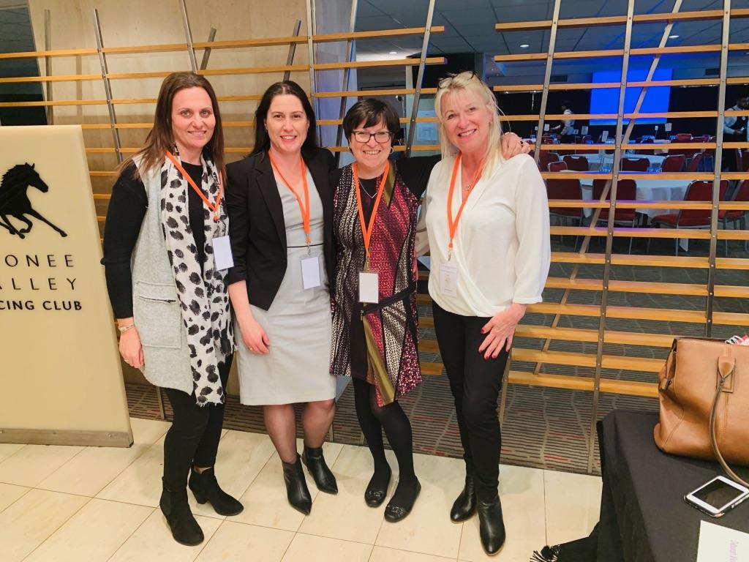
Our Team!!!

Slide 4
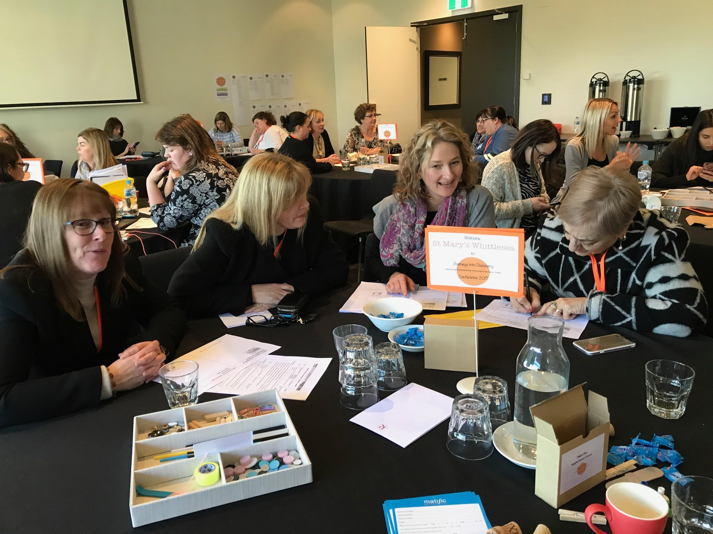
The Discovery Cluster
Aka: what the heck have I signed up for???

Slide 5
Key features of the cluster
16 Catholic Primary schools across Northern, Southern and Western regions of Melbourne
Over 150 Prep-Year 2 teachers and leaders
Choice of 3 different cluster days per term
Deb Vanessa and Rita facilitators
Bi-annual conference
Website for sharing of resources and ideas
Option of mentor visits and planning support
2013-2019
Commenced in 2014 with 8 schools

Slide 6
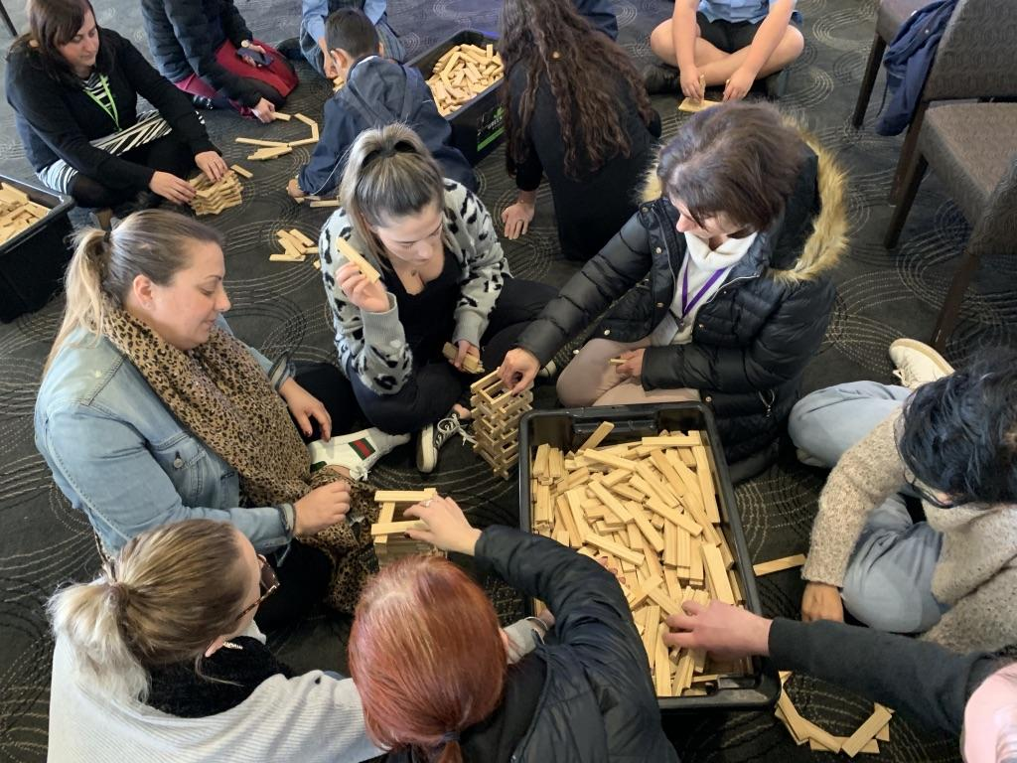
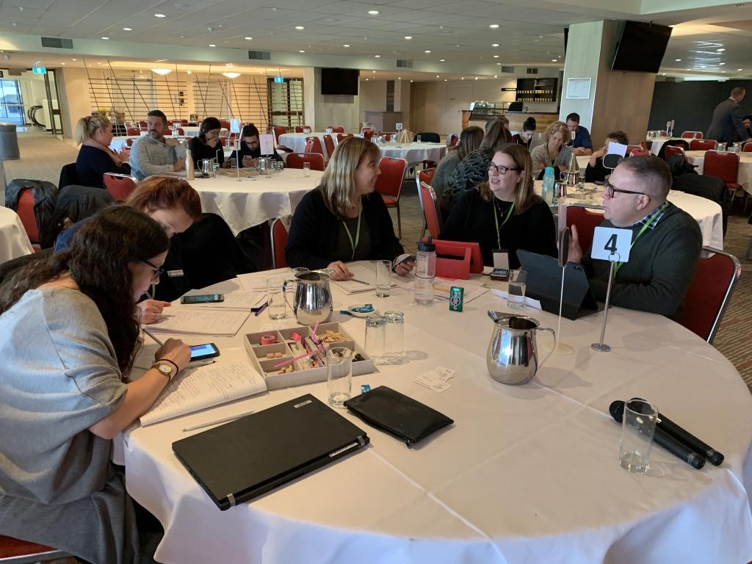
purpose of the cluster
To engage in Professional Learning with and from each other in order to explore best practice, design powerful learning, and empower our Early Years Students to become highly capable learners.

Slide 7
Contact us
Deb Vietri
dvietri@bigpond.com
Vanessa Willis
vanessawillis06@gmail.com
Rita Krnac
rkrnac@mmkeilordowns.catholic.edu.au
Instagram @discoverybasedinquiry
Twitter
@discoverinquire
@debvietri
NB Please inform us if you do not wish your photo to be displayed on social media

Slide 8
Website
Resources available on our website
Password: VietriDis2
www.deborahvietri.com

Slide 9
Session 1:
Introduction to Discovery-based inquiry

Slide 10
What is the Discovery-based inquiry approach?

Slide 11
An approach to learning (not a program):
… that values the natural curiosity and individuality of young children.
… that acknowledges the prior knowledge, interests and experiences that young children bring with them to school
… that is aimed at developing the capacity of every child as a capable, creative and confident learner
… that is underpinned by 8 core principles and looks different in every school
… that is backed by research

Slide 12
What DBI is NOT
Just about adding play
Easy (a laissez faire approach to teaching and learning)
Just about oral language and social skills
Only for EAL students
Only suitable for open plan schools
Throwing explicit teaching out of the window

Slide 13

Learning
Early Years Model-
Discovery-based inquiry
Inquiry investigations
Authentic opportunities for Literacy
Authentic opportunities for Mathematics
Discovery
The Frame

Slide 14
Principles that underpin the approach
Learning dispositions empower students
A pedagogy of inquiry
The power of play: a playful pedagogy
Integrated learning and teaching
Respect for the individual
The environment is the third teacher
Look, listen and learn, assessment for learning
Feedback enhances achievement

Slide 15

Learning dispositions empower students
Our job as teachers is not to ‘prepare’ kids for something; it is to help kids learn to prepare themselves for anything. A.J Juliani
The National Goals for Australian Schooling as outlined in the Melbourne Declaration (2008) identified 2 goals for Australian students. Goal 2 is: All young Australians become successful learners, confident and creative individuals, and active and informed citizens.
Development of Australian (Victorian) Curriculum: General Capabilities
Education can equip learners with agency and a sense of purpose, and the competencies they need, to shape their own lives and contribute to the lives of others. (OECD The Future of Education and Skills 2018)
We believe: teaching students ‘how to’ learn and developing learning dispositions that will empower them to become self-motivated, self-managing learners

Slide 16
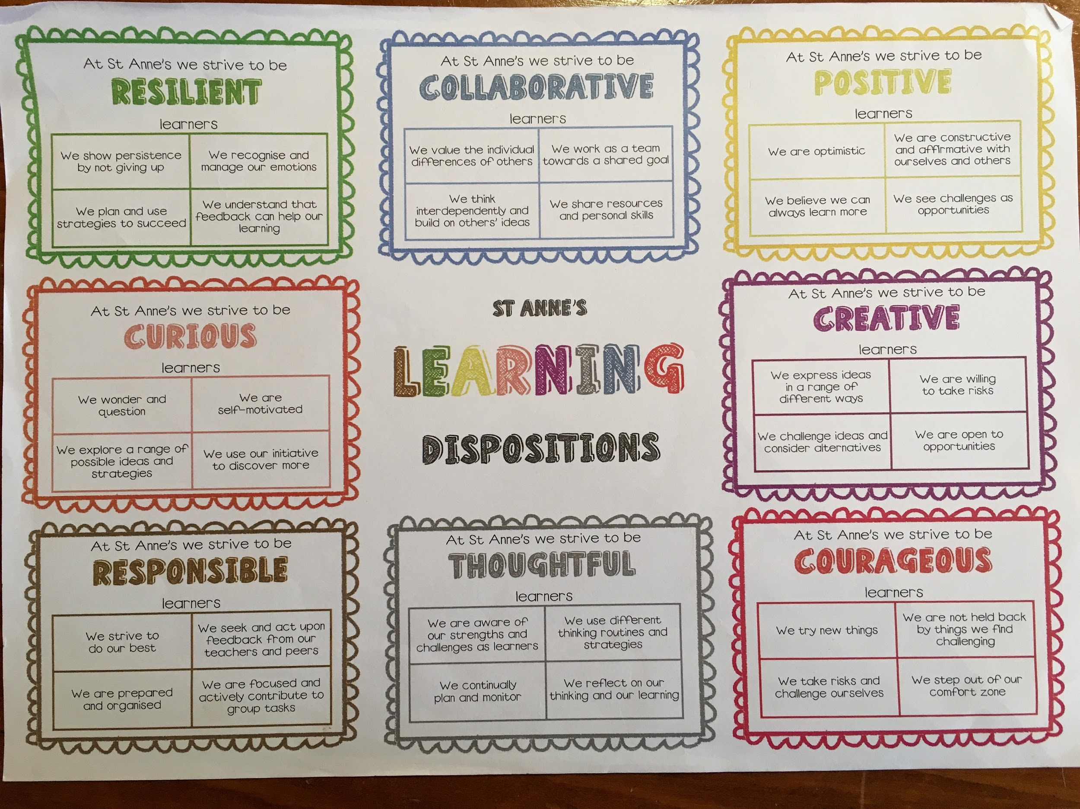
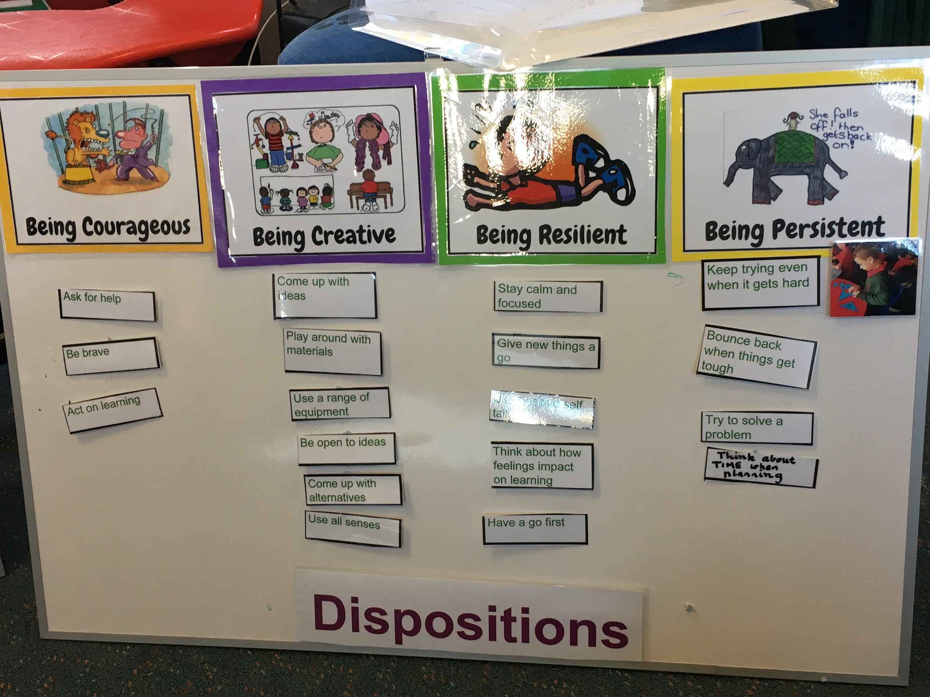
Guy Claxton calls it ‘Learning Power’ Art Costa calls them ‘Habits of Mind’ Carol Dweck’s ‘Growth Mindset’ is infused with learning dispositions.
Dispositions are mentioned as key learning in the VEYLDF, and the Victorian Curriculum.
There is an overwhelming body of thinking that dispositions can be encouraged and developed through explicit teaching and feedback.
Consistent feedback we receive from teachers about students is their ability to articulate their learning.

Slide 17
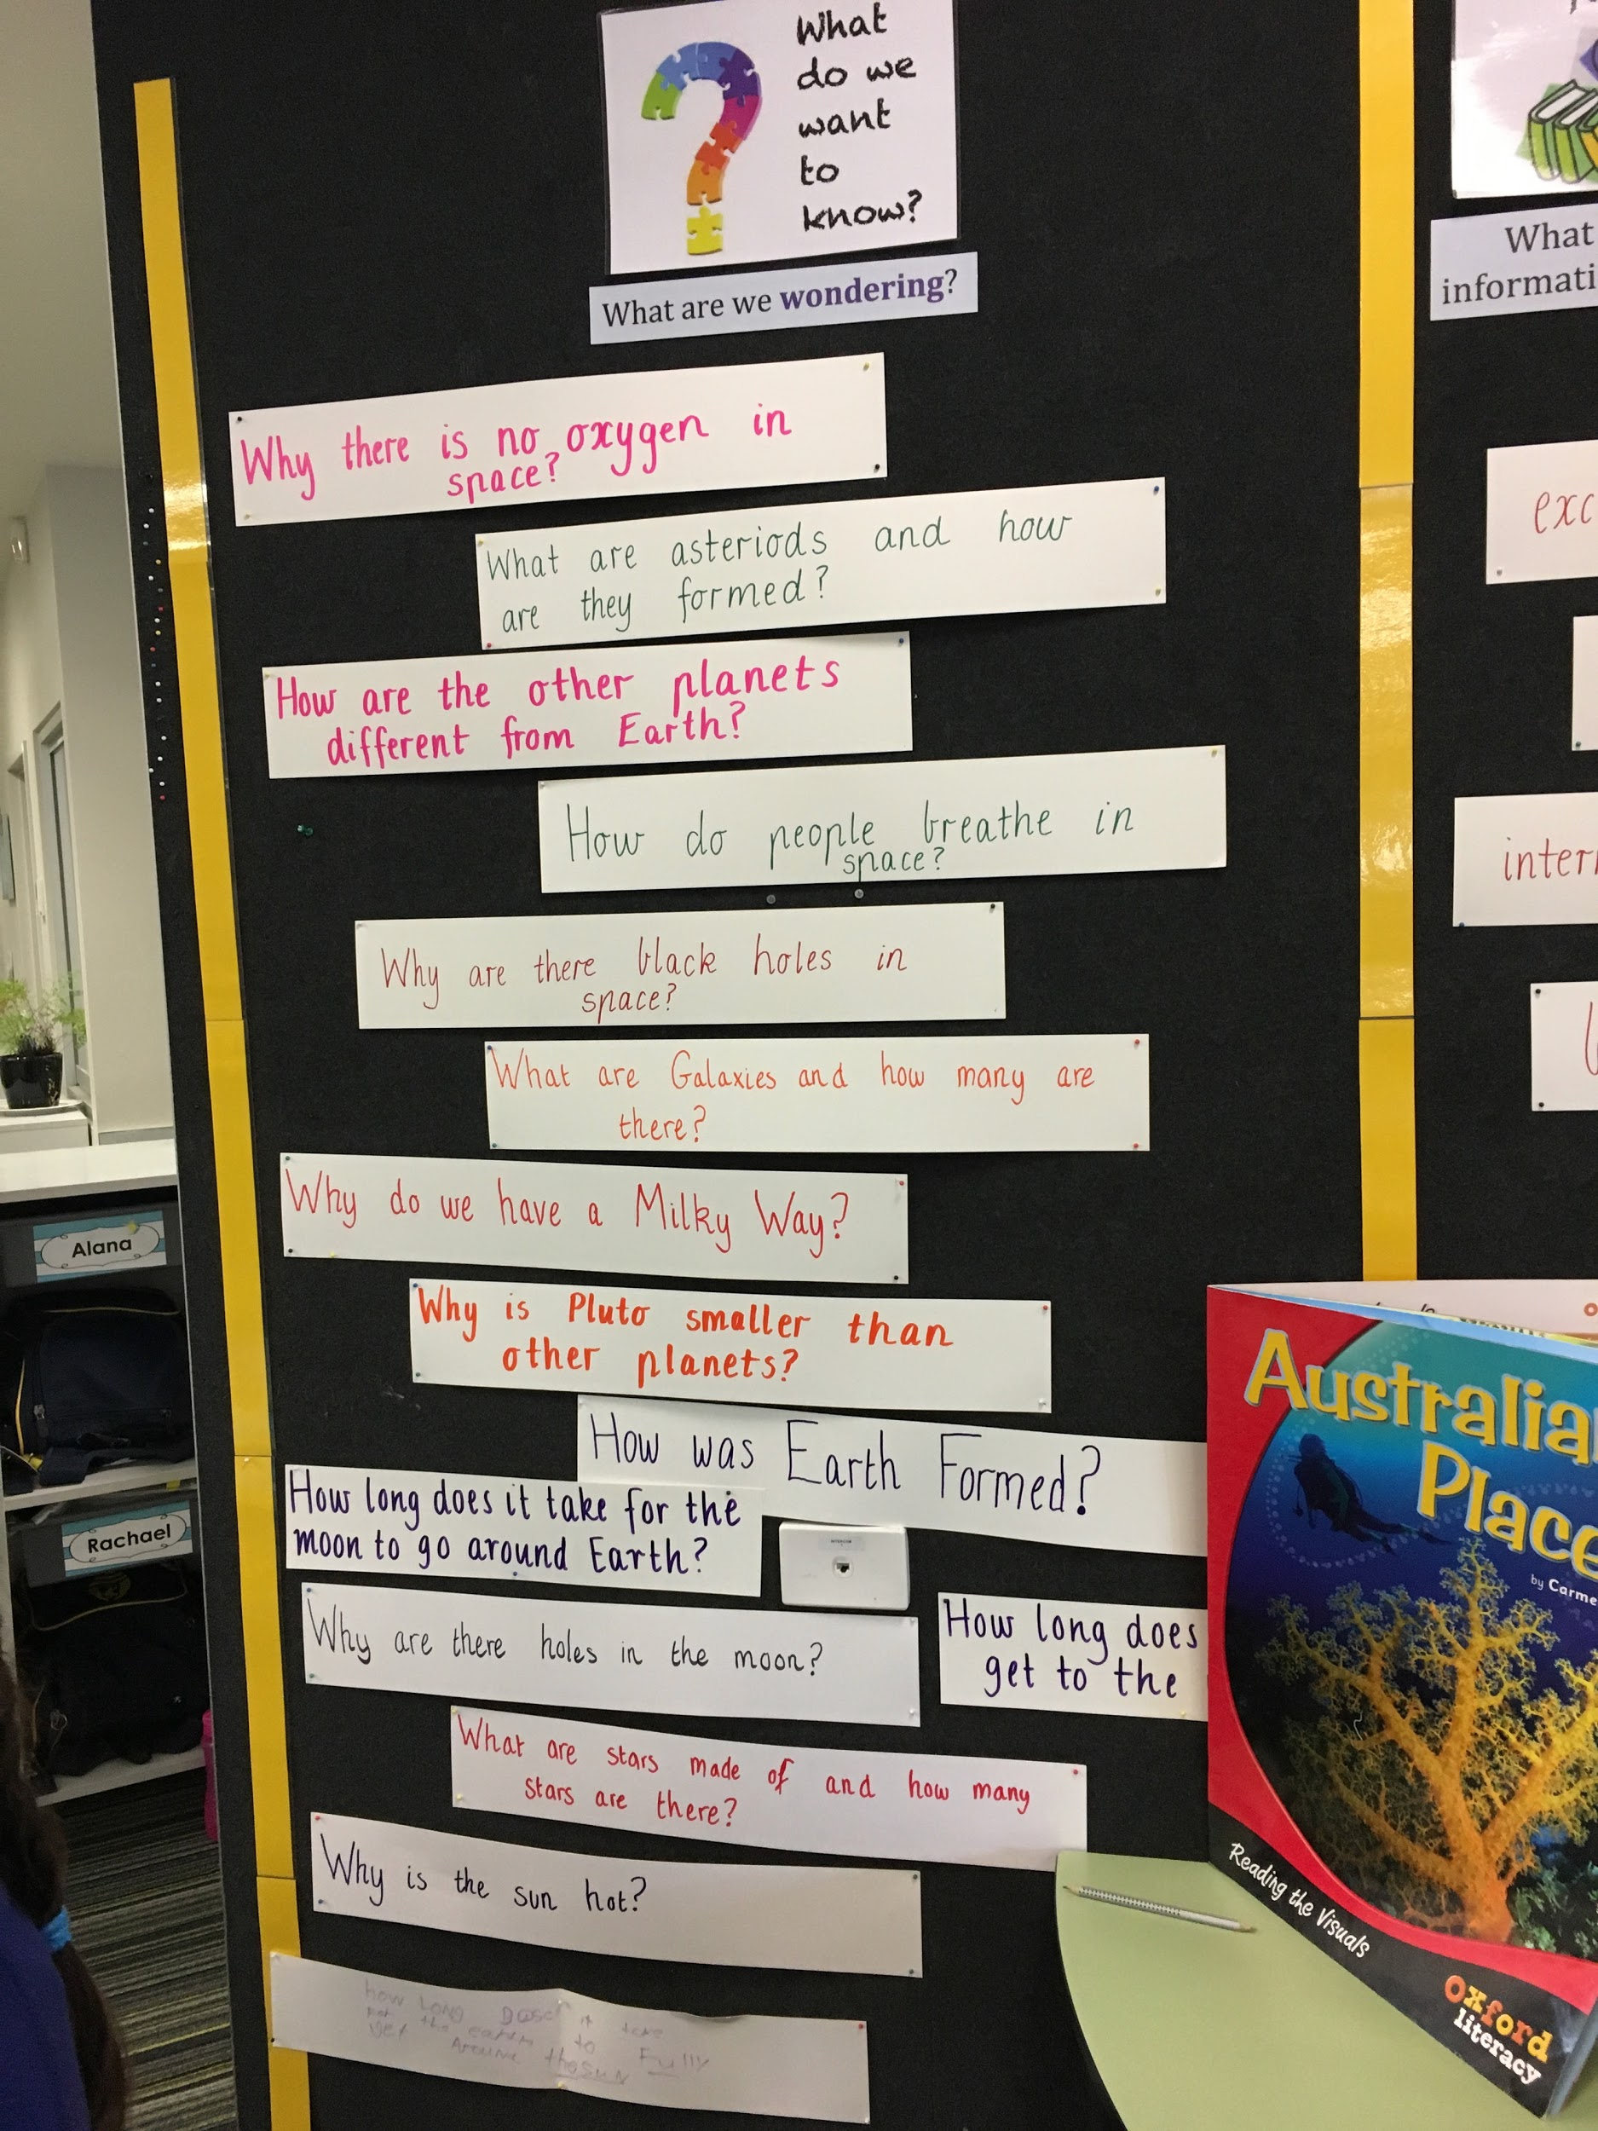
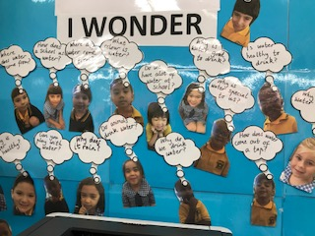
A pedagogy of inquiry
If you can light the spark of curiosity in a child, they will learn without any further assistance, very often. Children are natural learners. Sir Ken Robinson
Giving purpose to learning, harnessing children’s natural curiosity, creating wonder and awe, questioning and seeking answers enables students to construct new knowledge in a way that is meaningful
… a growing body of research suggests that students learn more deeply and perform better on complex tasks if they have the opportunity to engage in more “authentic” learning (Edutopia: Teaching for meaningful learning)

Slide 18
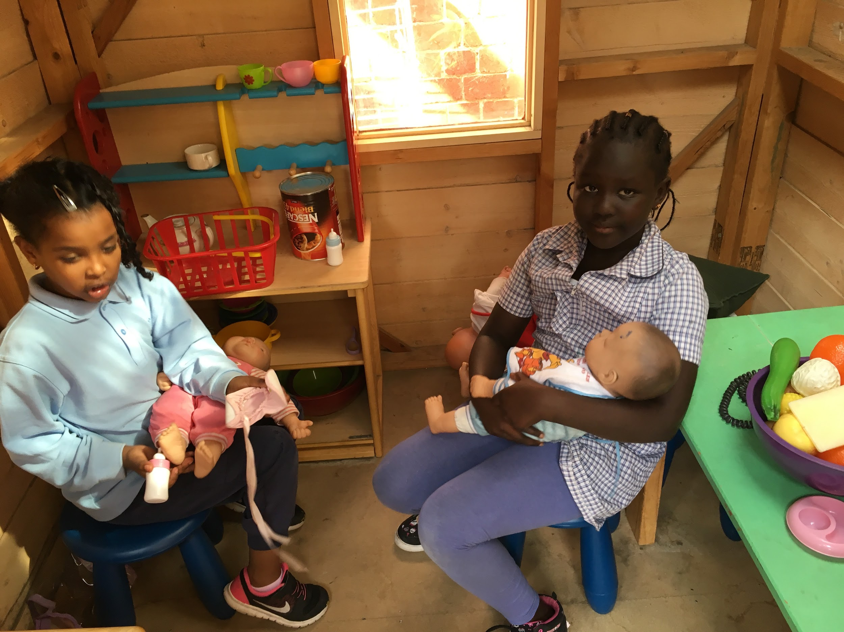
The power of play: a playful pedagogy
Play is a powerful context for early inquiry. Through play children can engage in exploring and making discoveries about:
Themselves, their identity as a person and a learner and as a social being
Living in community with others
The amazing world they live in
‘Being playful’ as a disposition when exploring, testing out ideas and working theories in a safe and familiar context, making choices without fear of failure.
Play is the highest form of research. Albert Einstein We believe that learning should be joyful and playful

Slide 19
So what does this look like in action?
Touching base with Inquiry investigations but with a focus today on Discovery

Slide 20
Inquiry Investigations
Teacher-initiated
Starts with a real experience
Opportunities for students to explore their ideas and theories and own interests
Student wonderings inform the direction the investigation
Focussed on developing students as inquirers and learners rather than filling them with knowledge
Explicit teaching of inquiry skills and processes
We want to give our students time to explore what intrigues them, and we want to make sure they visit the important sites they might miss without guidance. Teachers need to map out the landscape and highlight some of the most important places to stop.
Tina Blythe.

Slide 21

discovery
Student-initiated
Opportunities for students to explore the things that interest them
Play is the entry point
Leading towards student directed, extended projects
Teachers play a strategic role
Learning journeys and learner dispositions are made visible

Slide 22
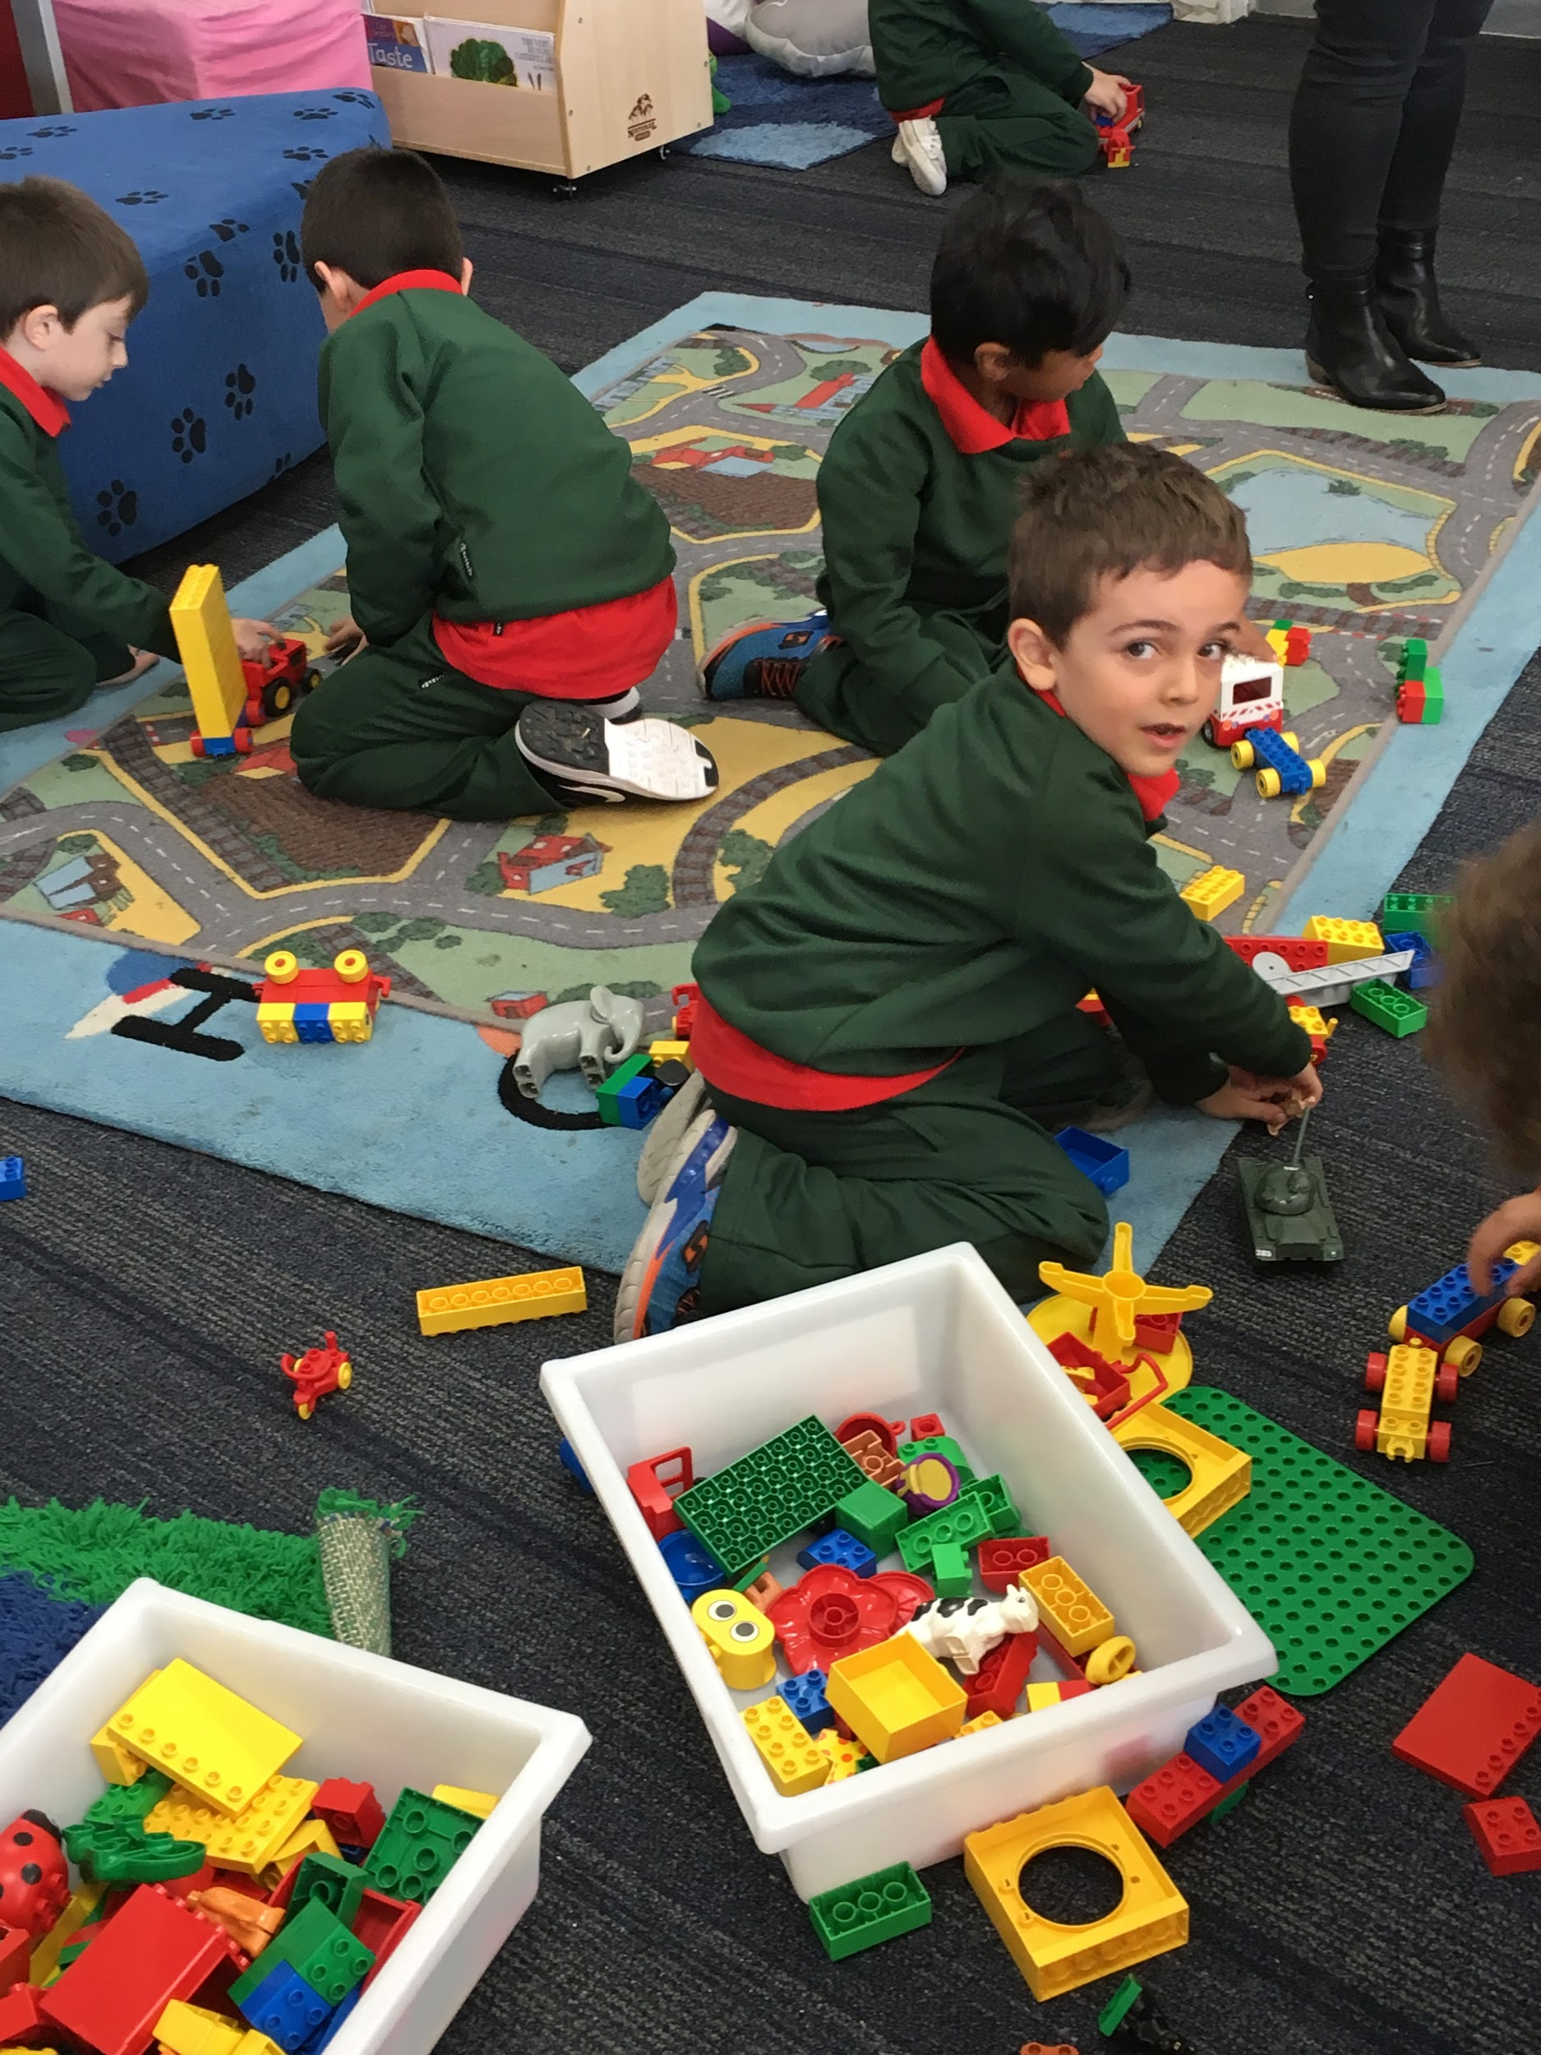
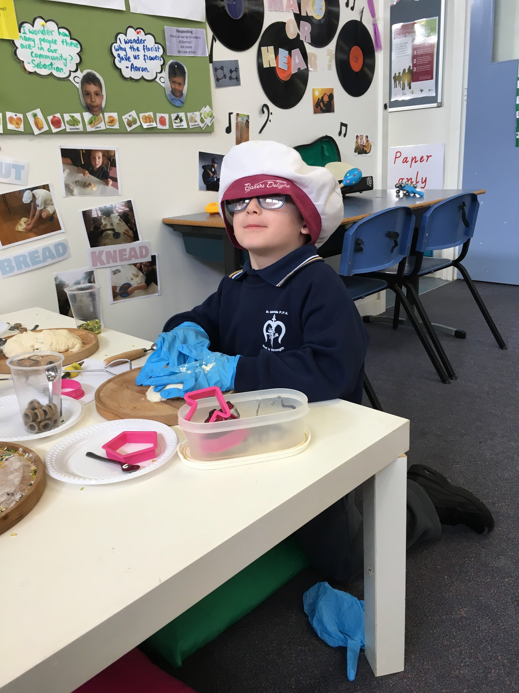
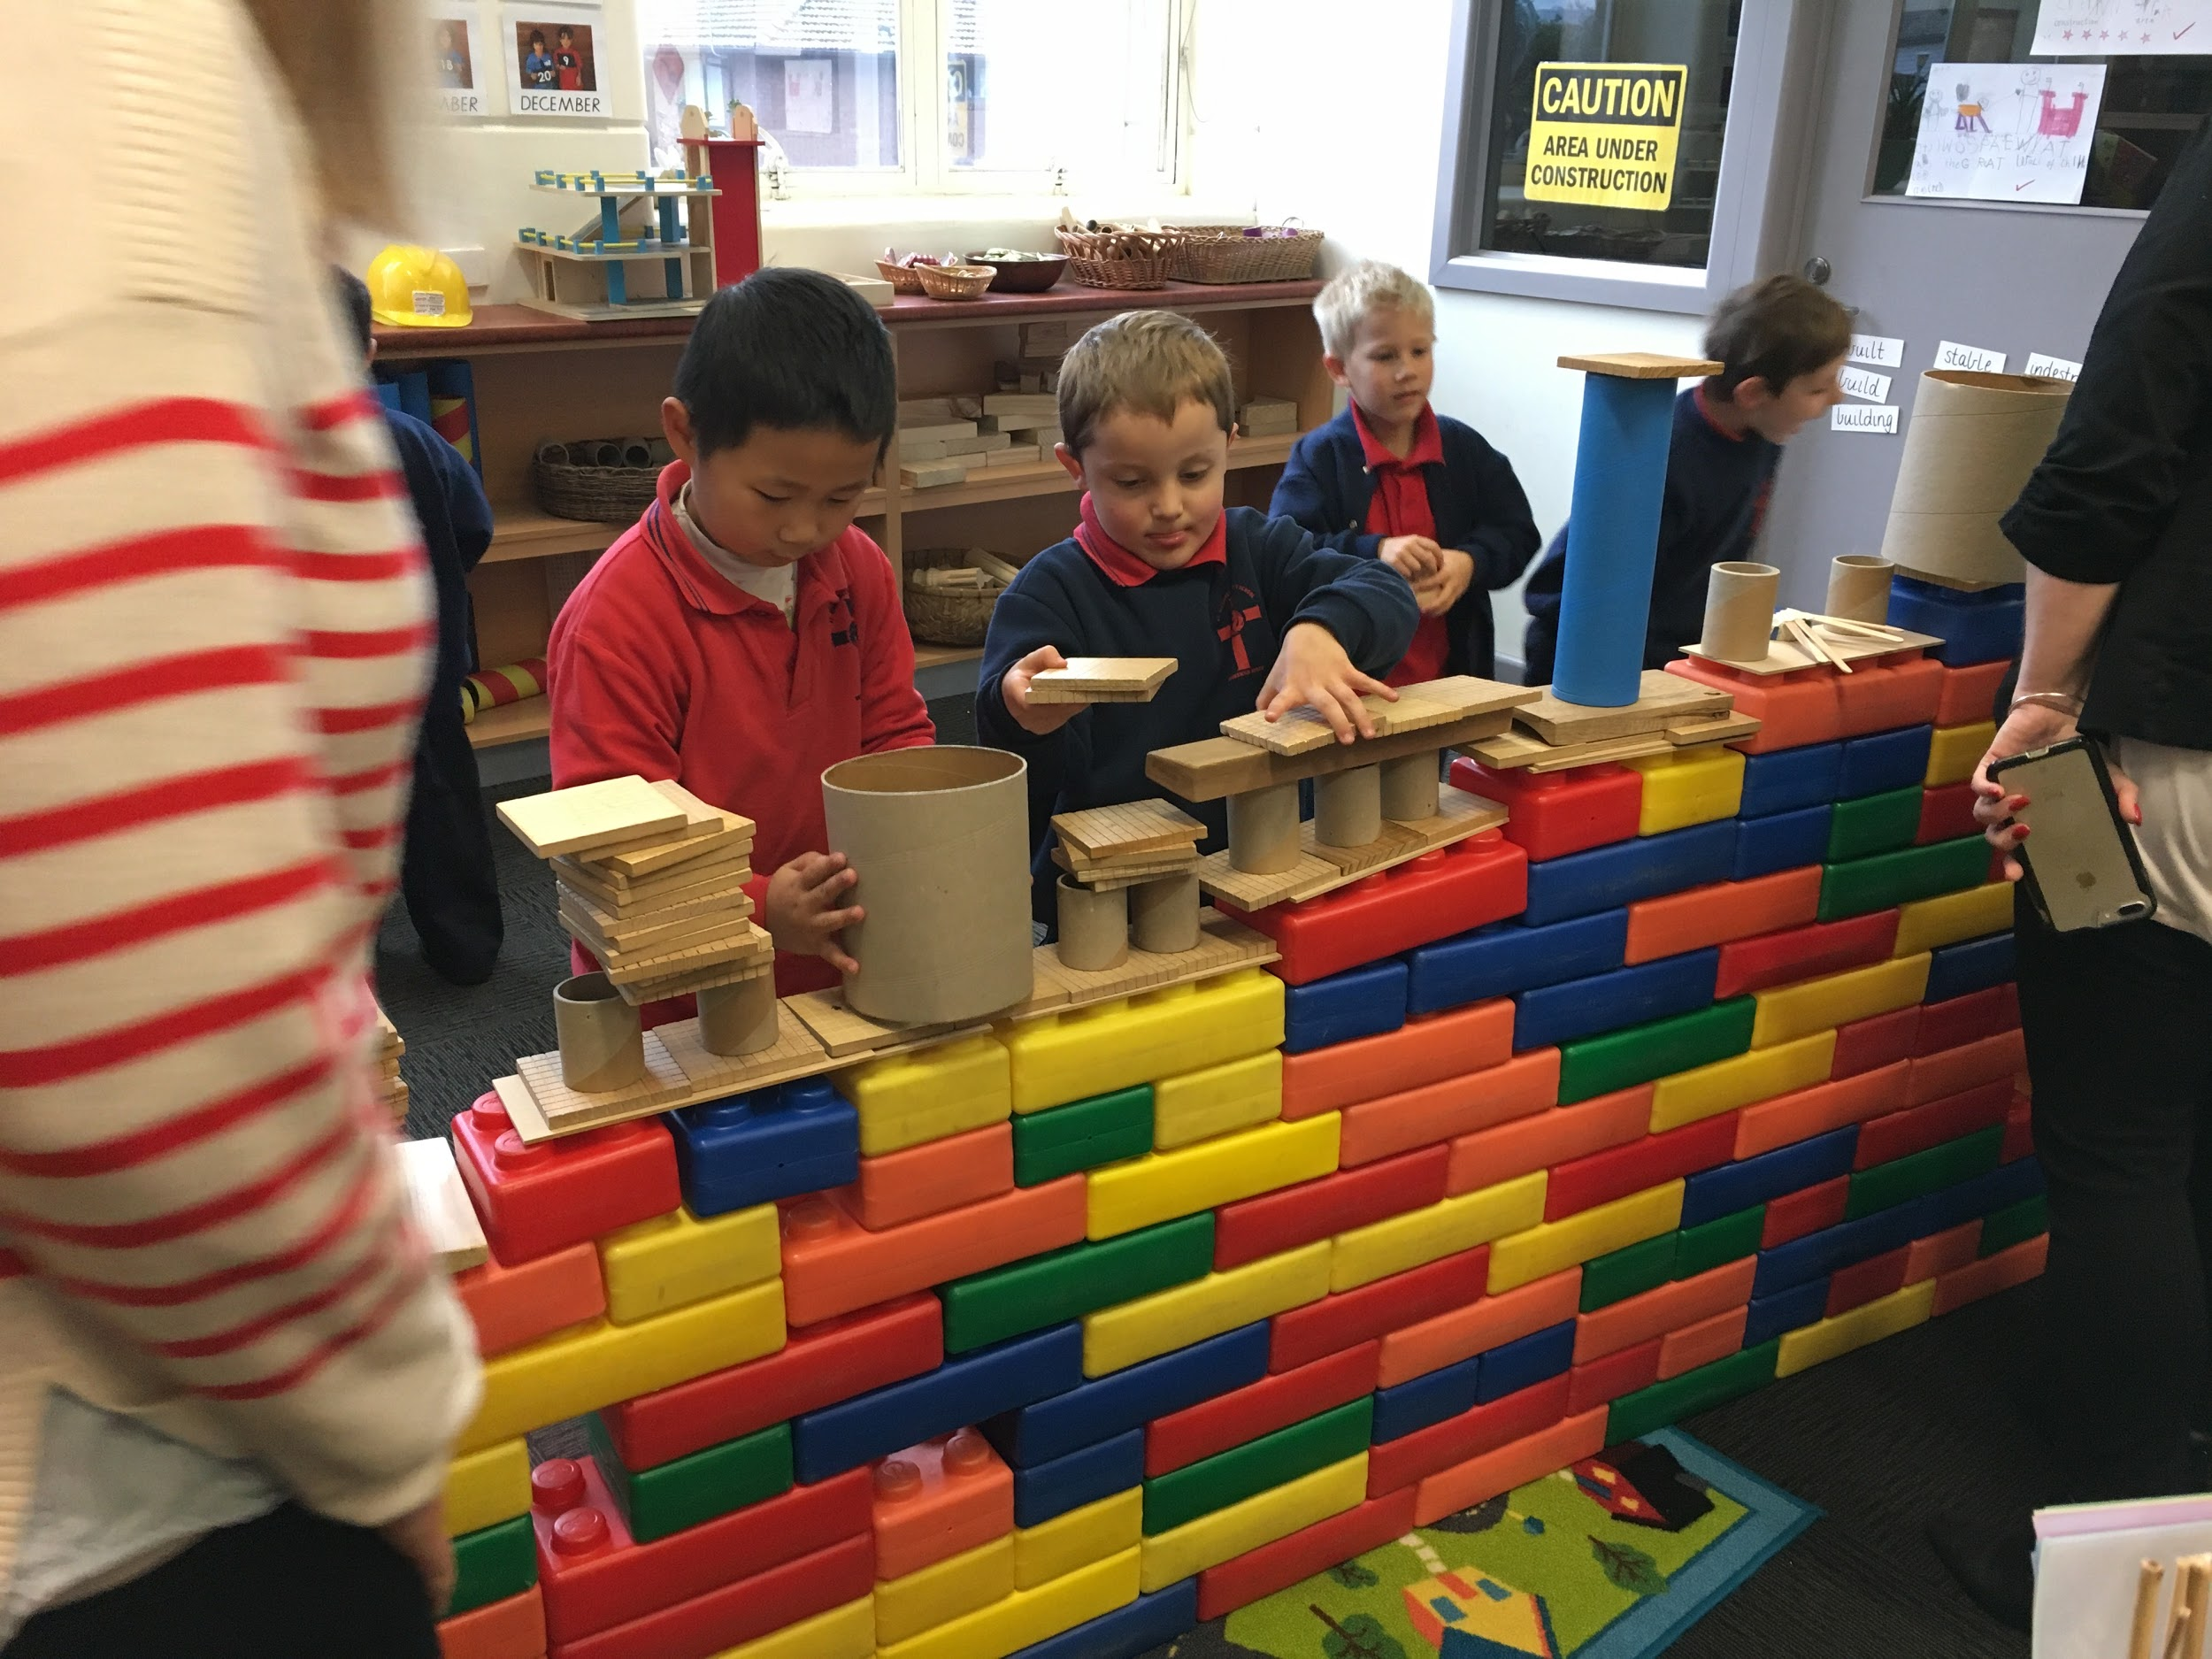
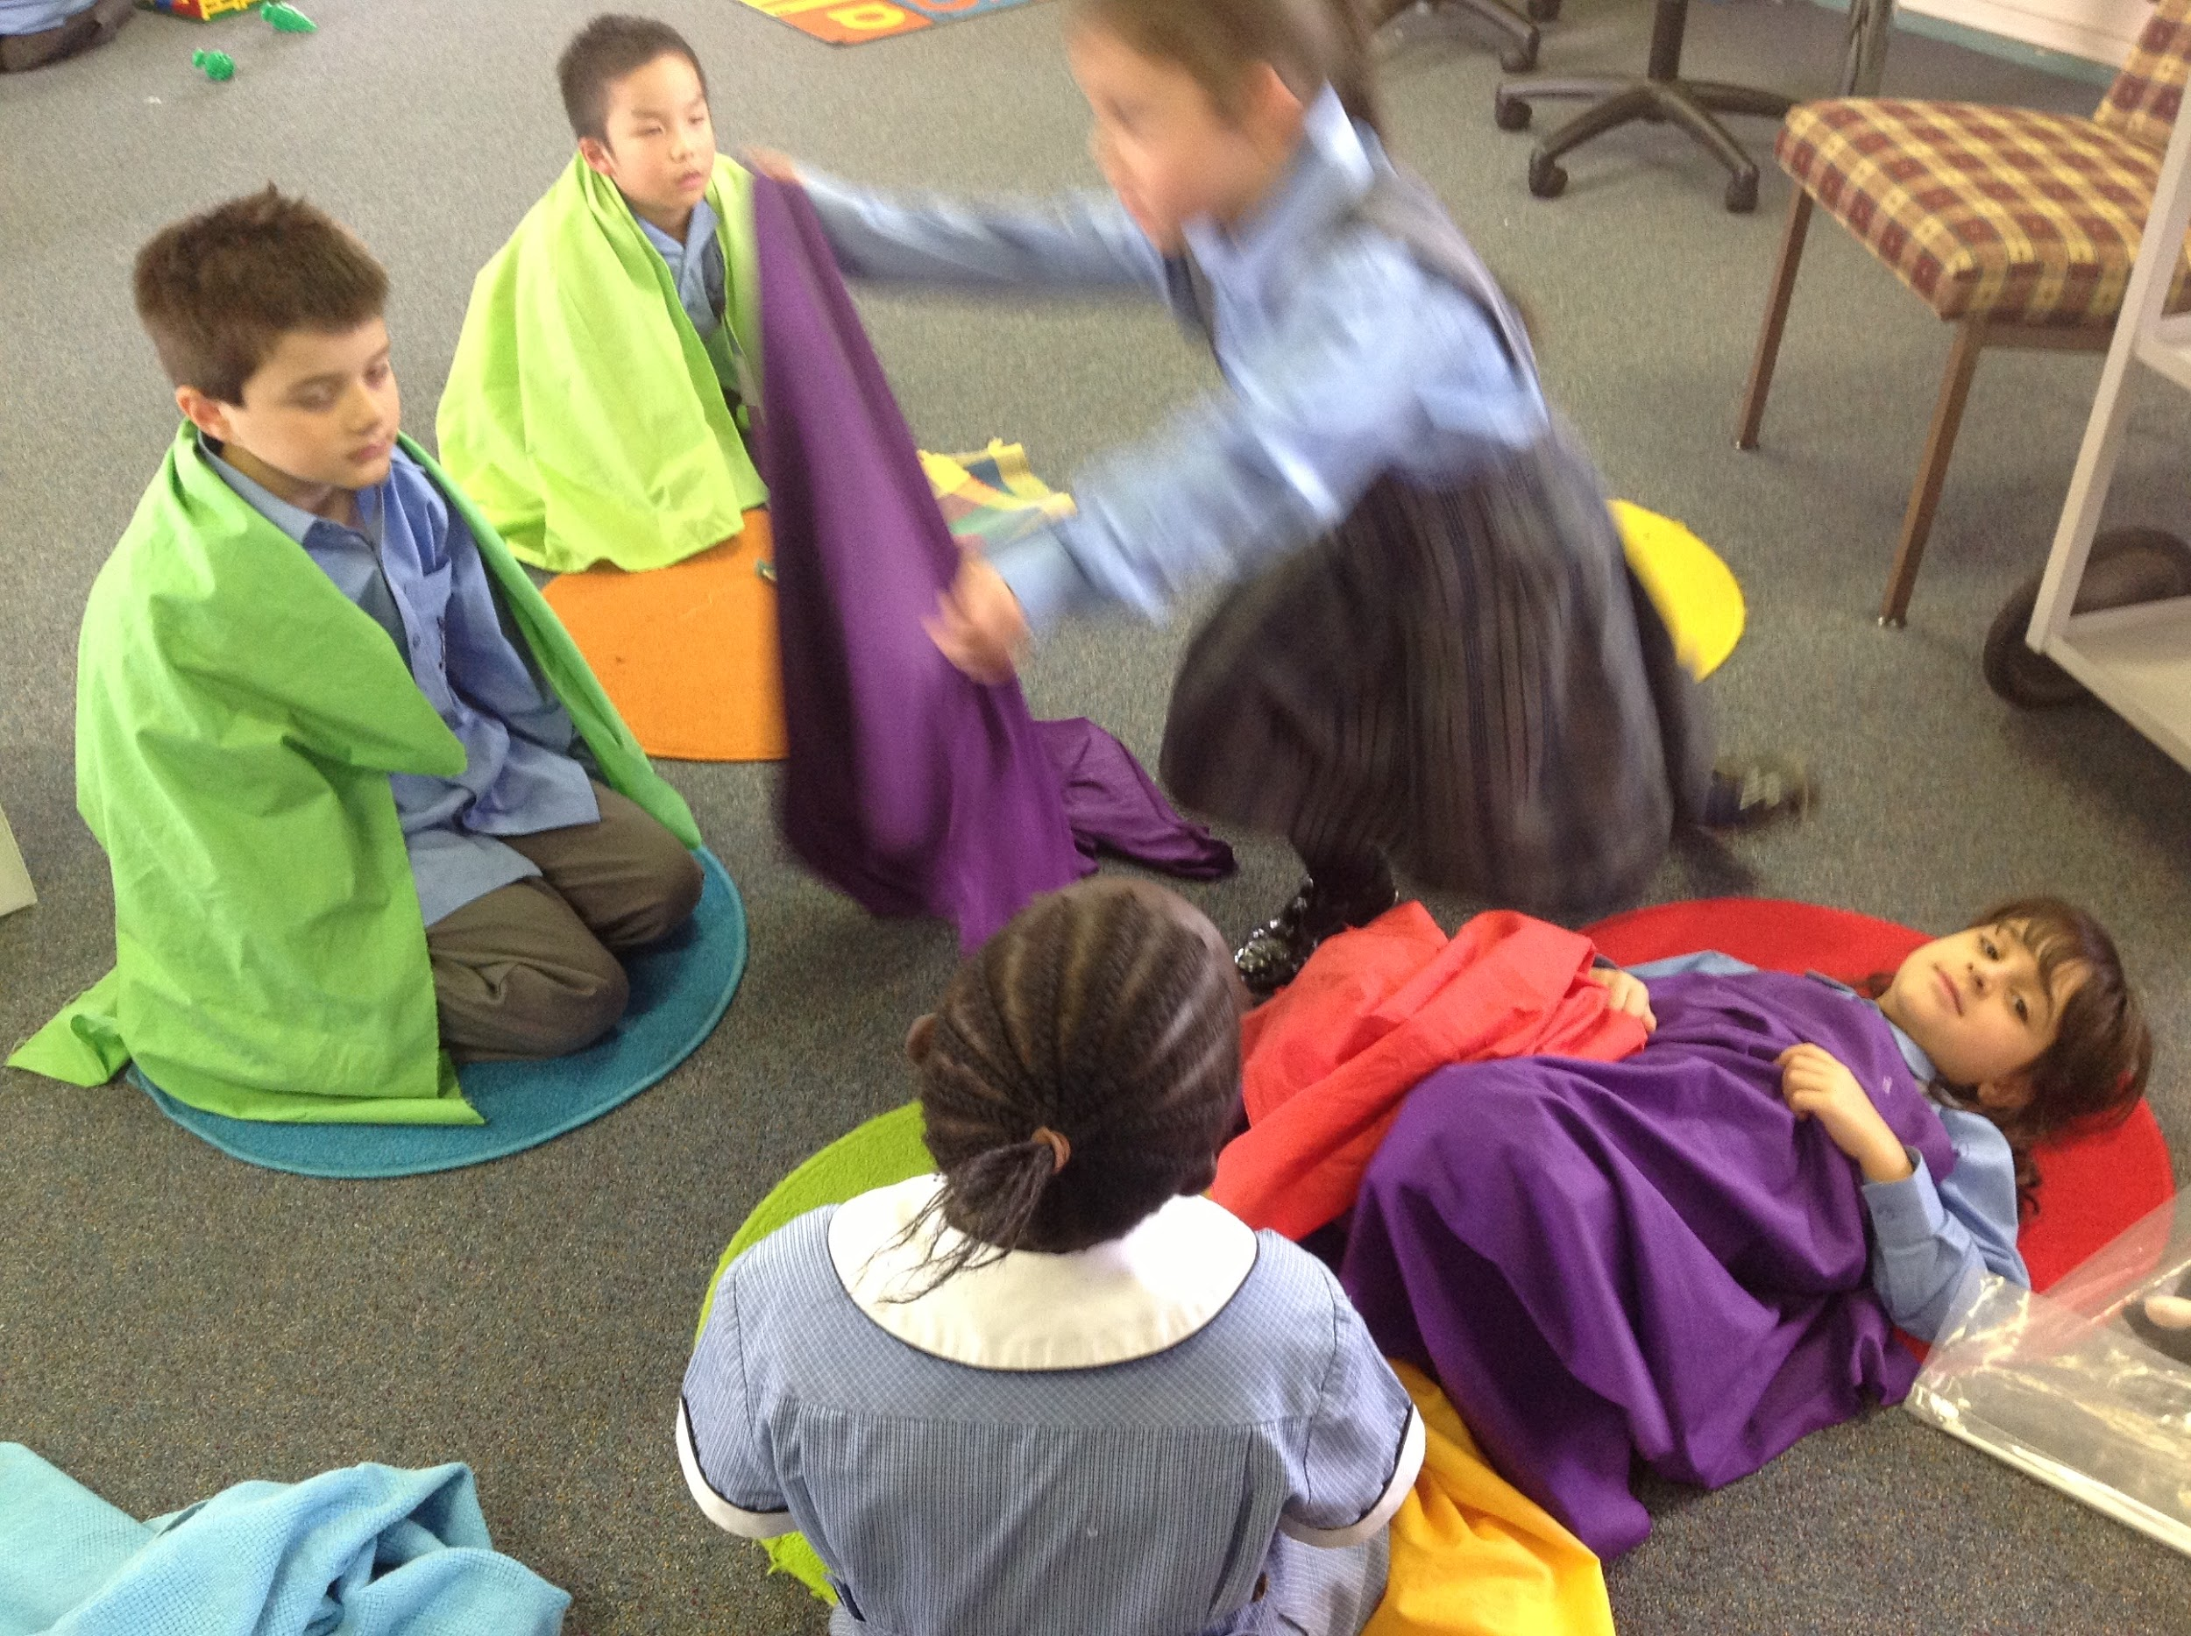
Play is the entry point

Slide 23
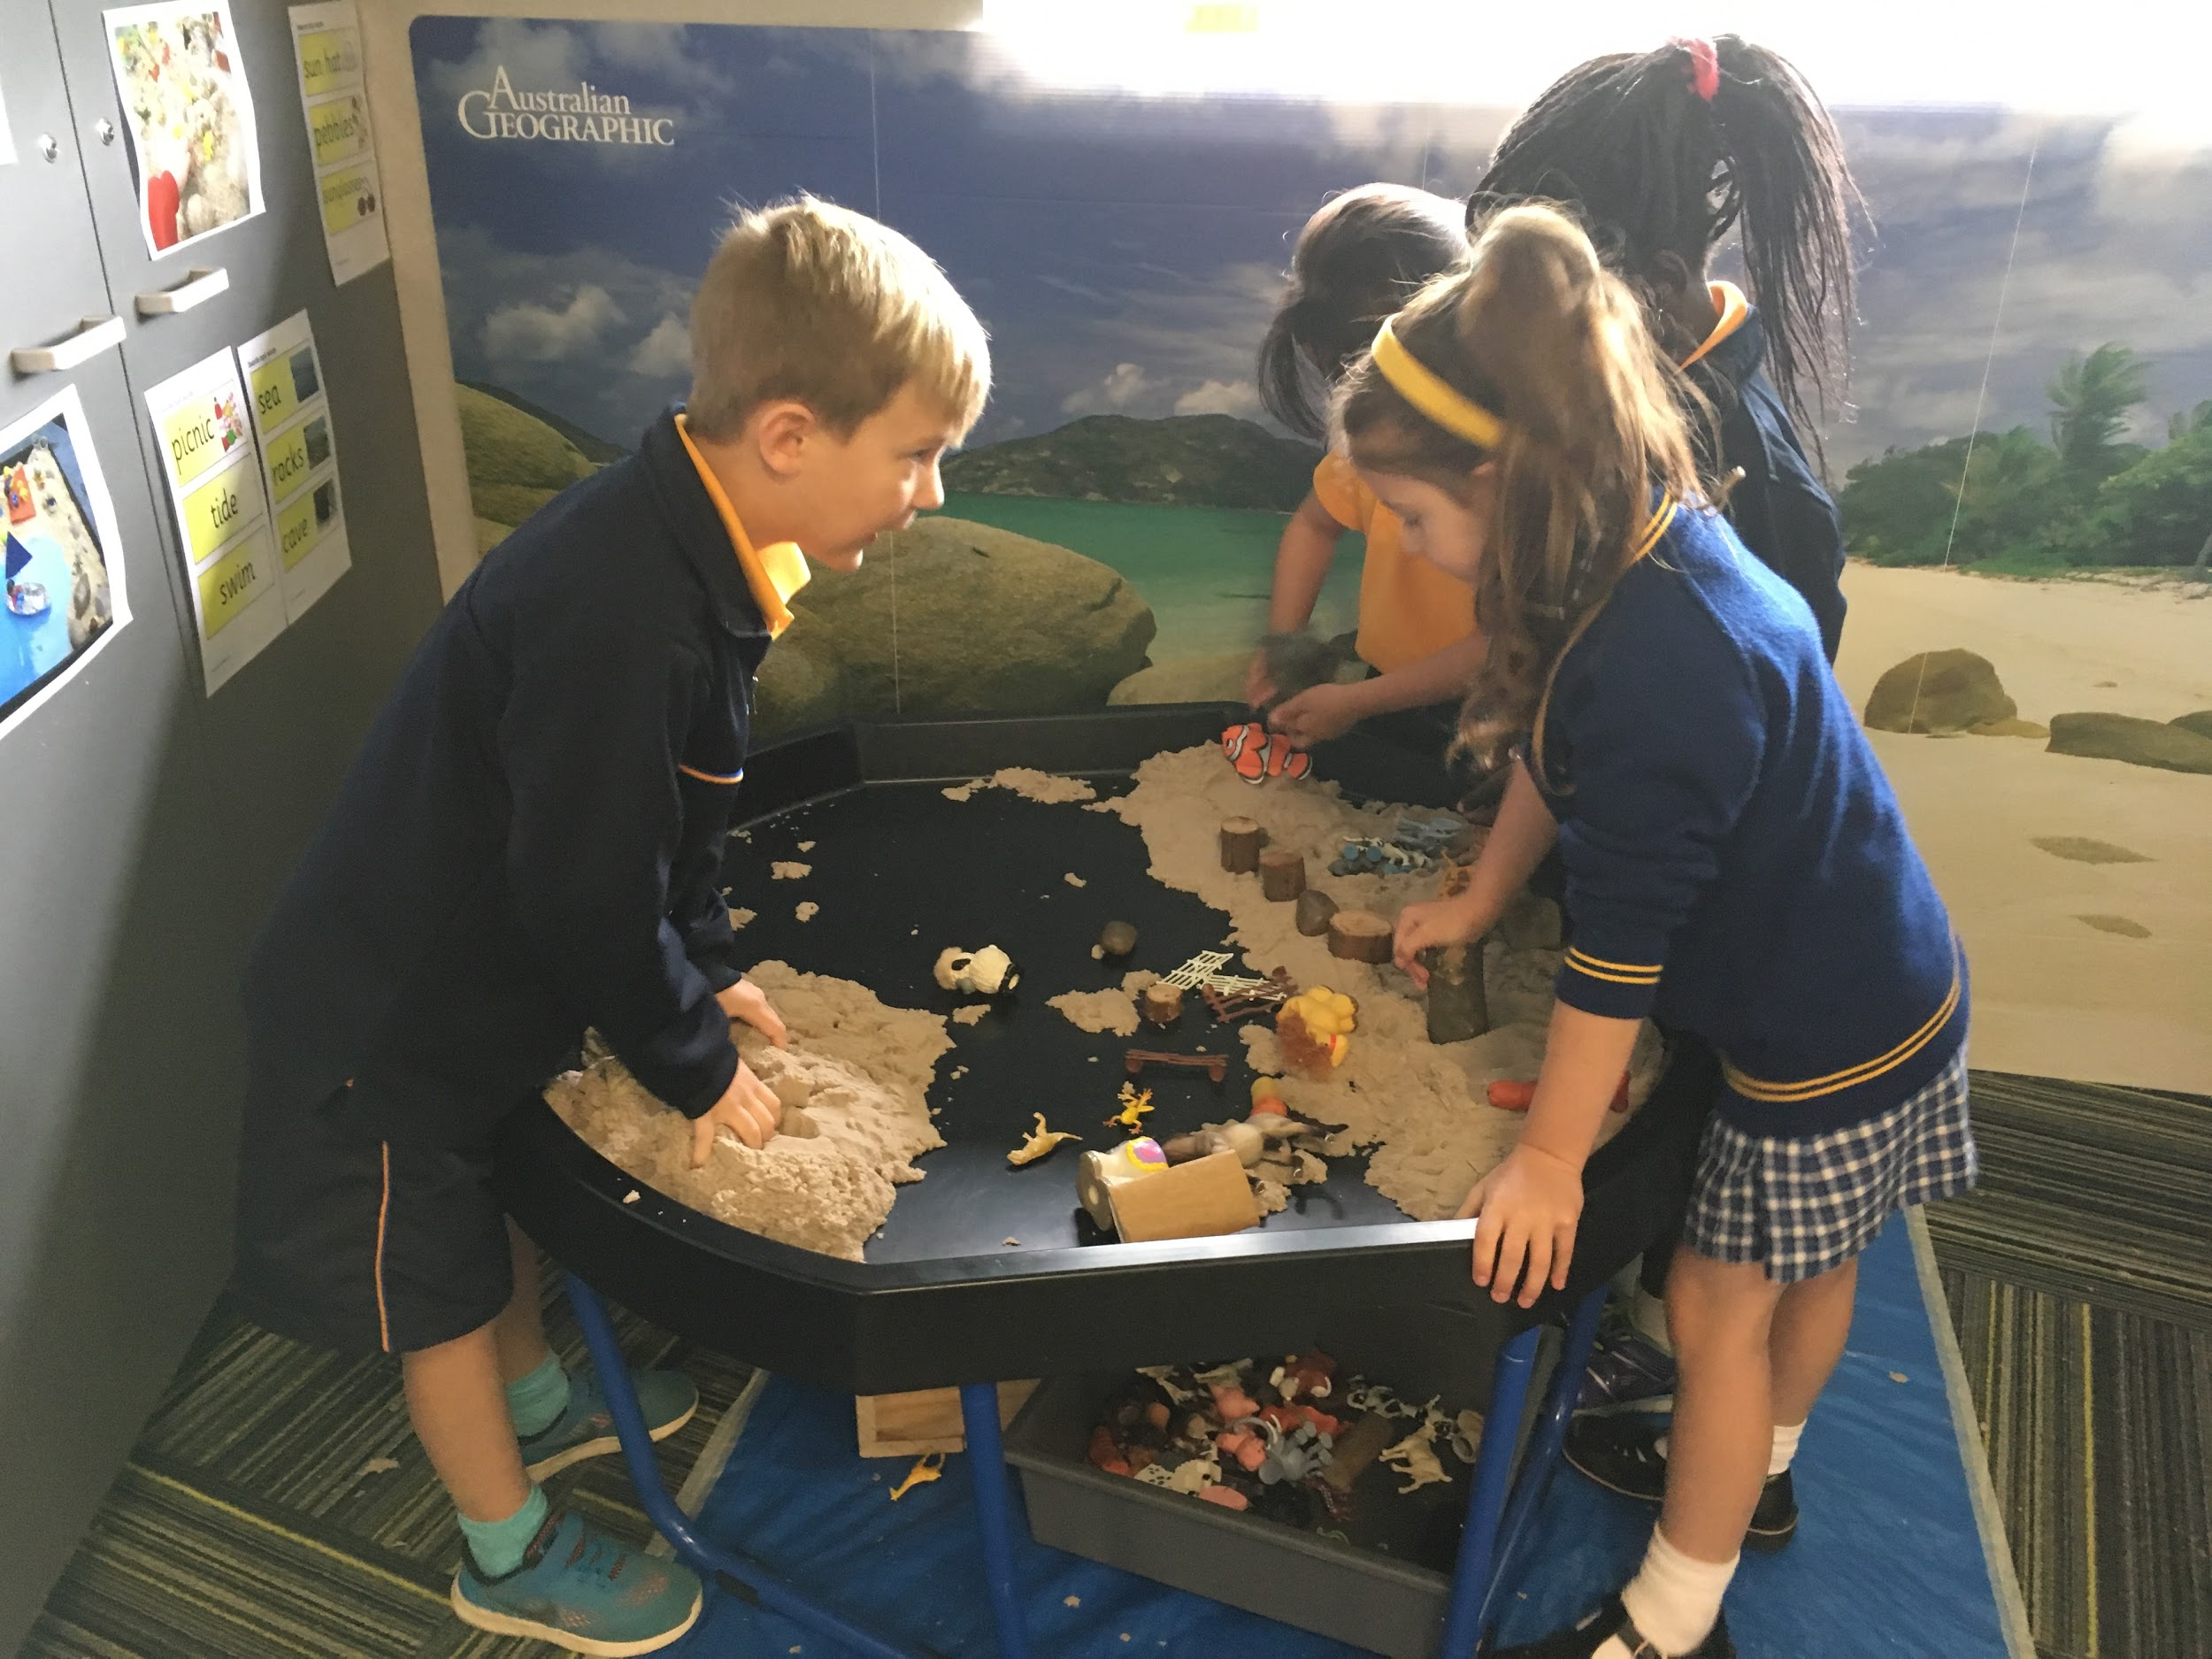
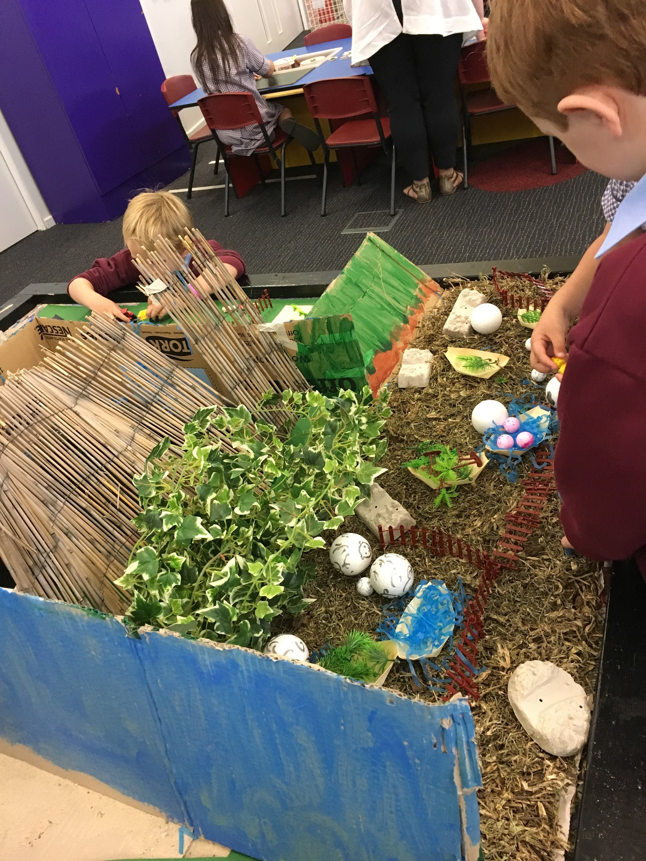
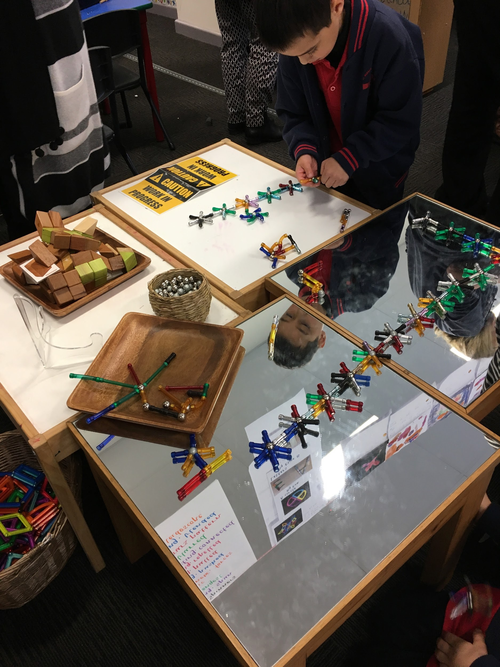
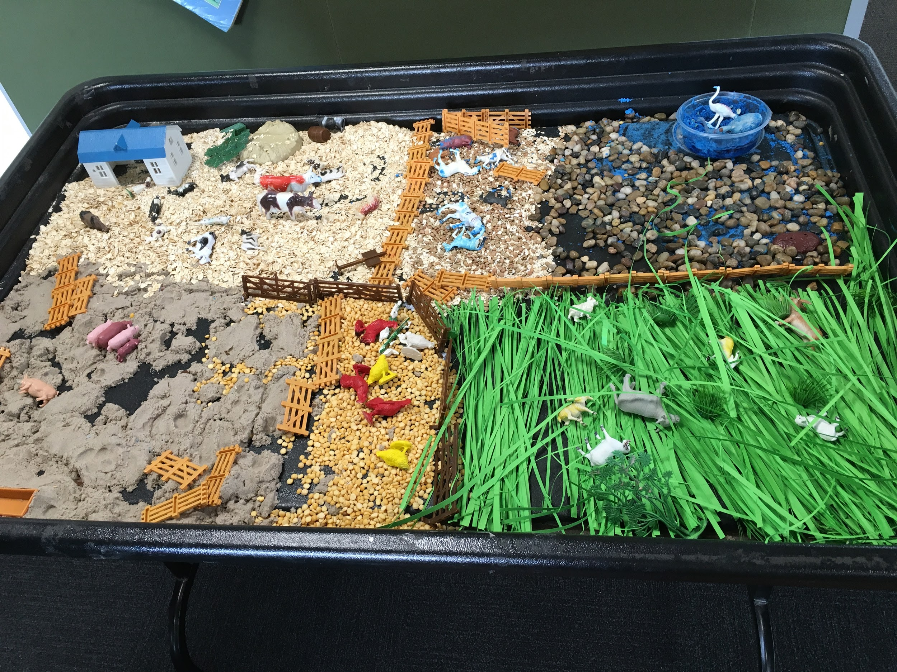
Using our senses to explore

Slide 24
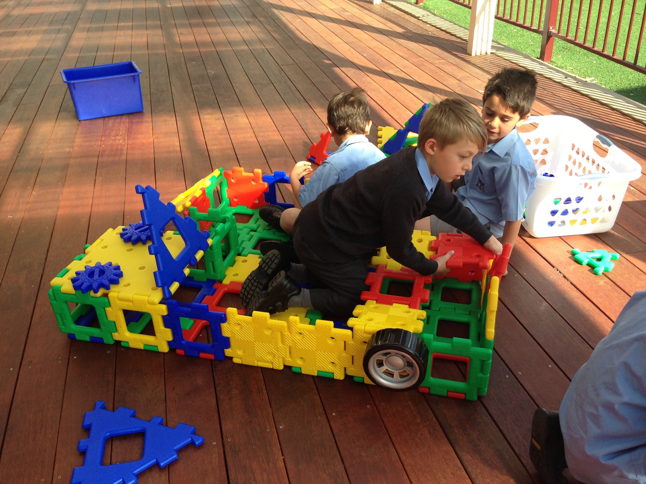
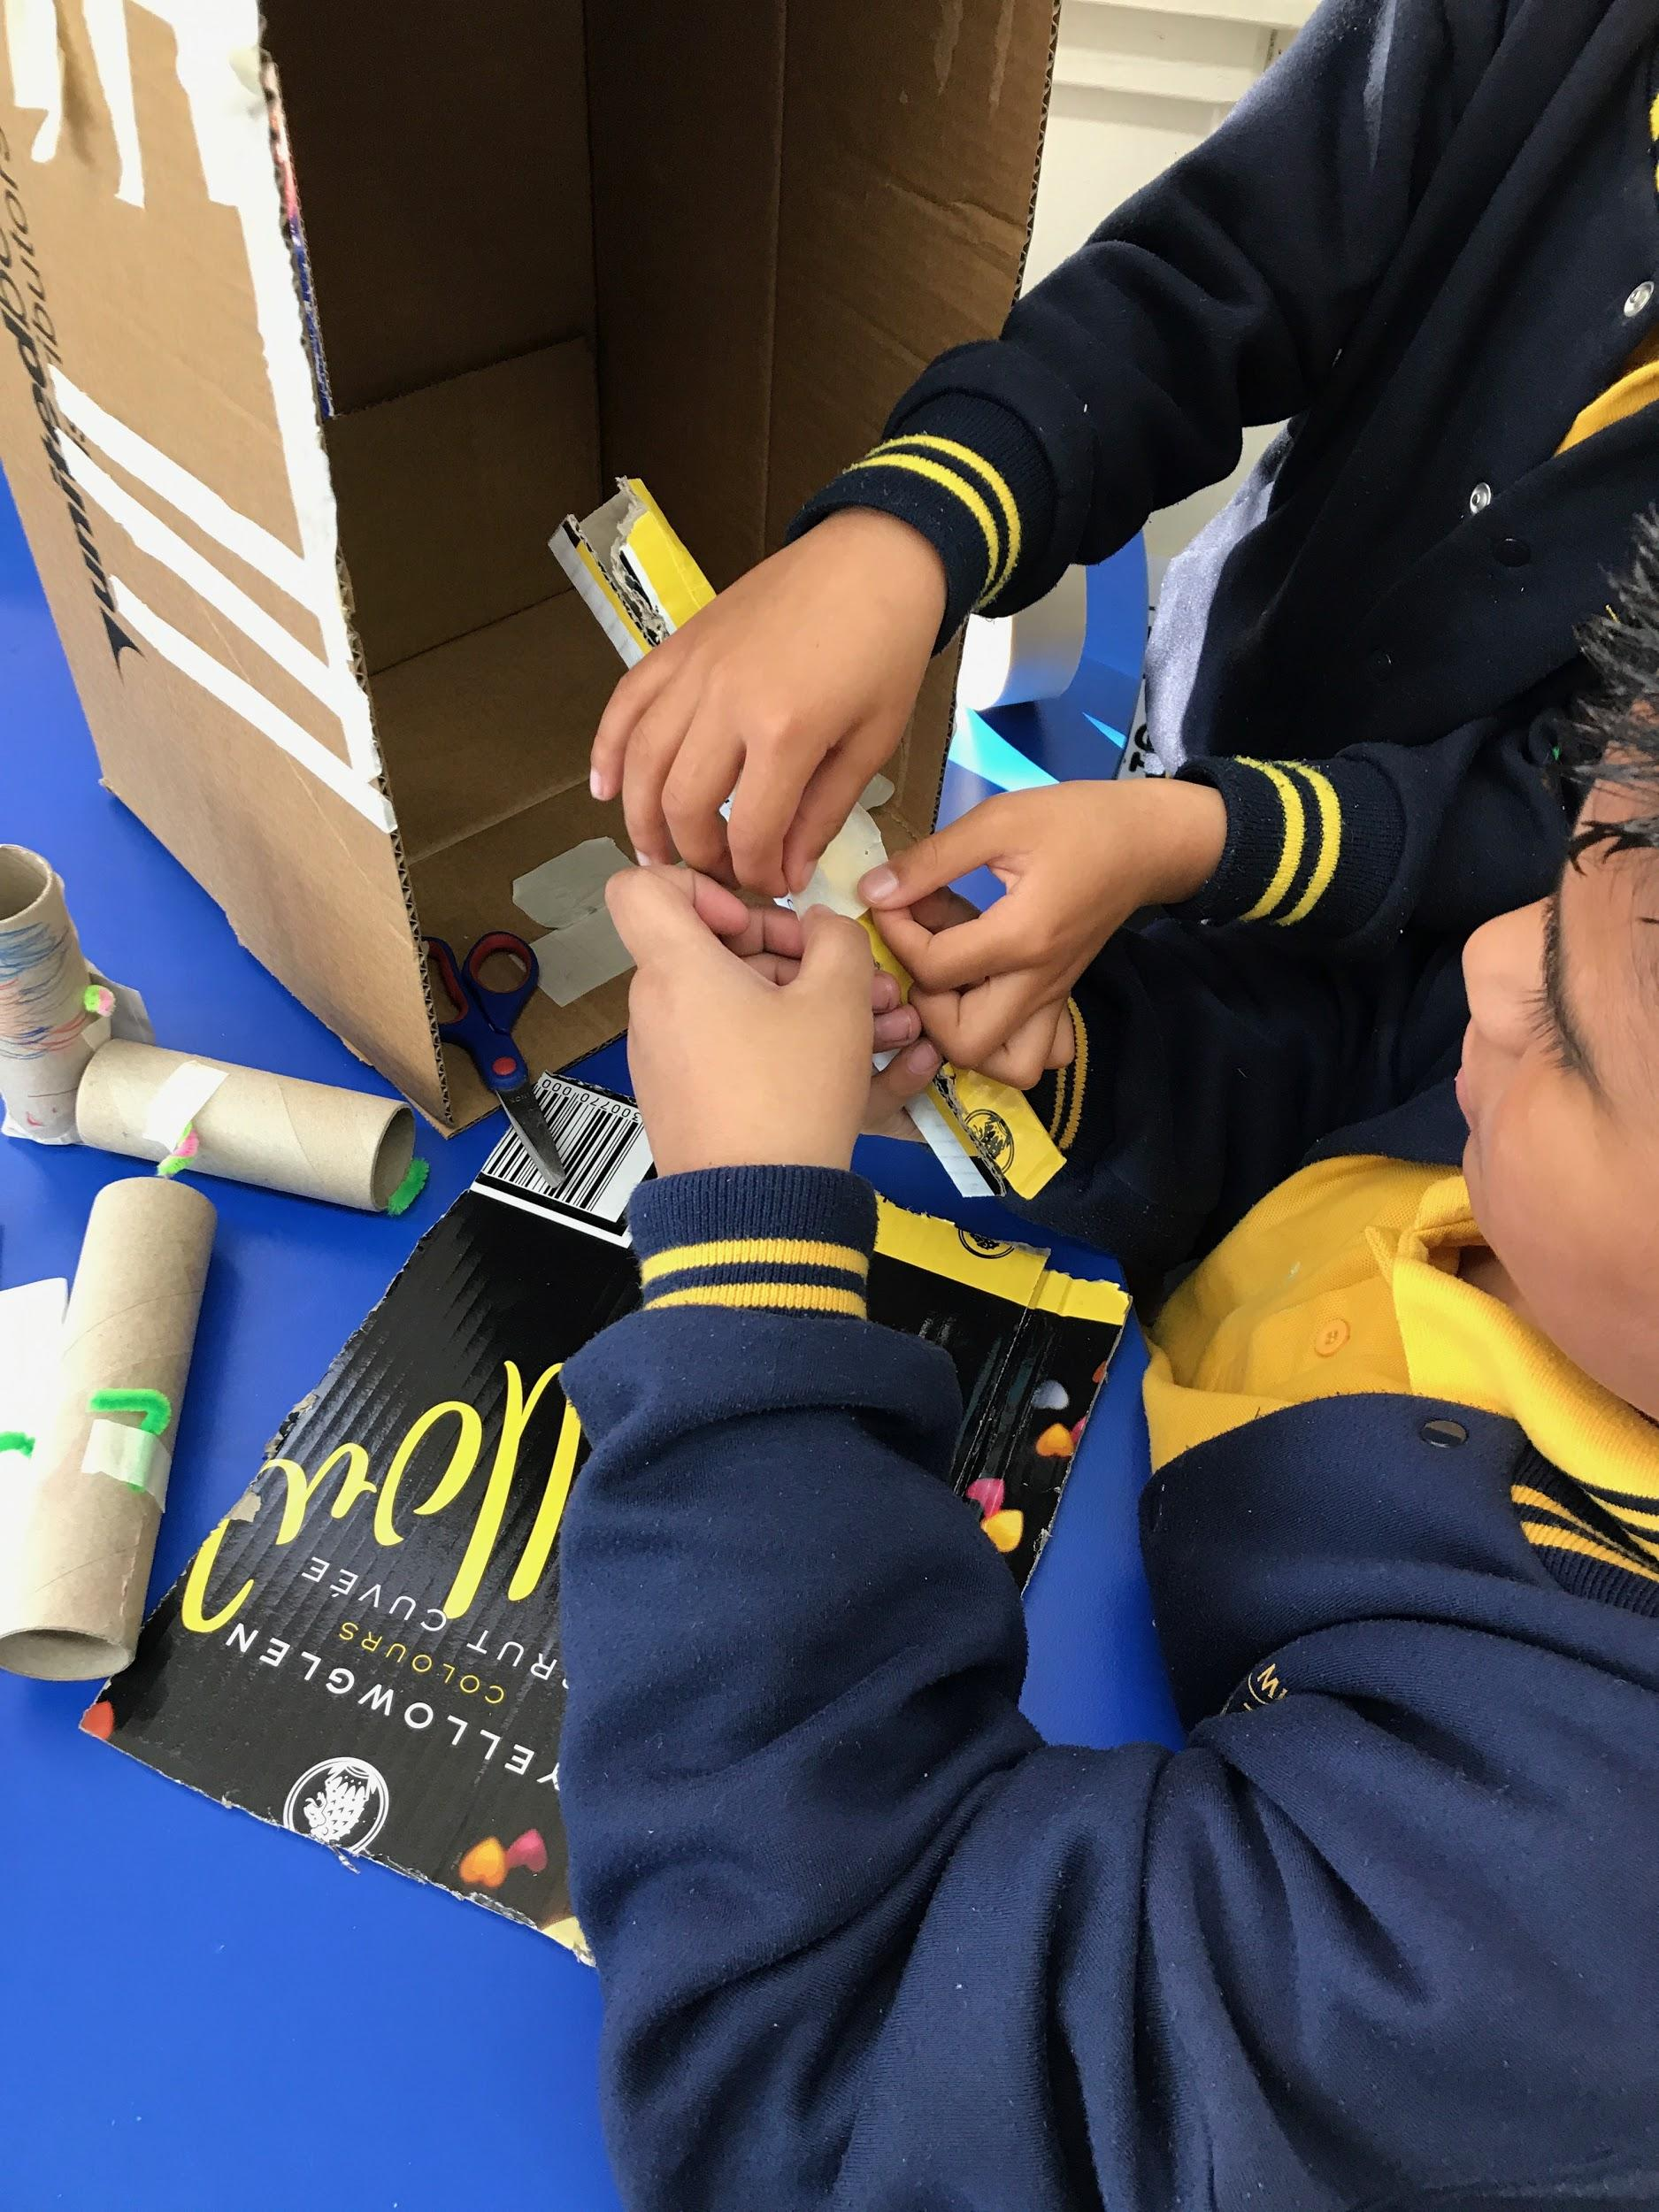
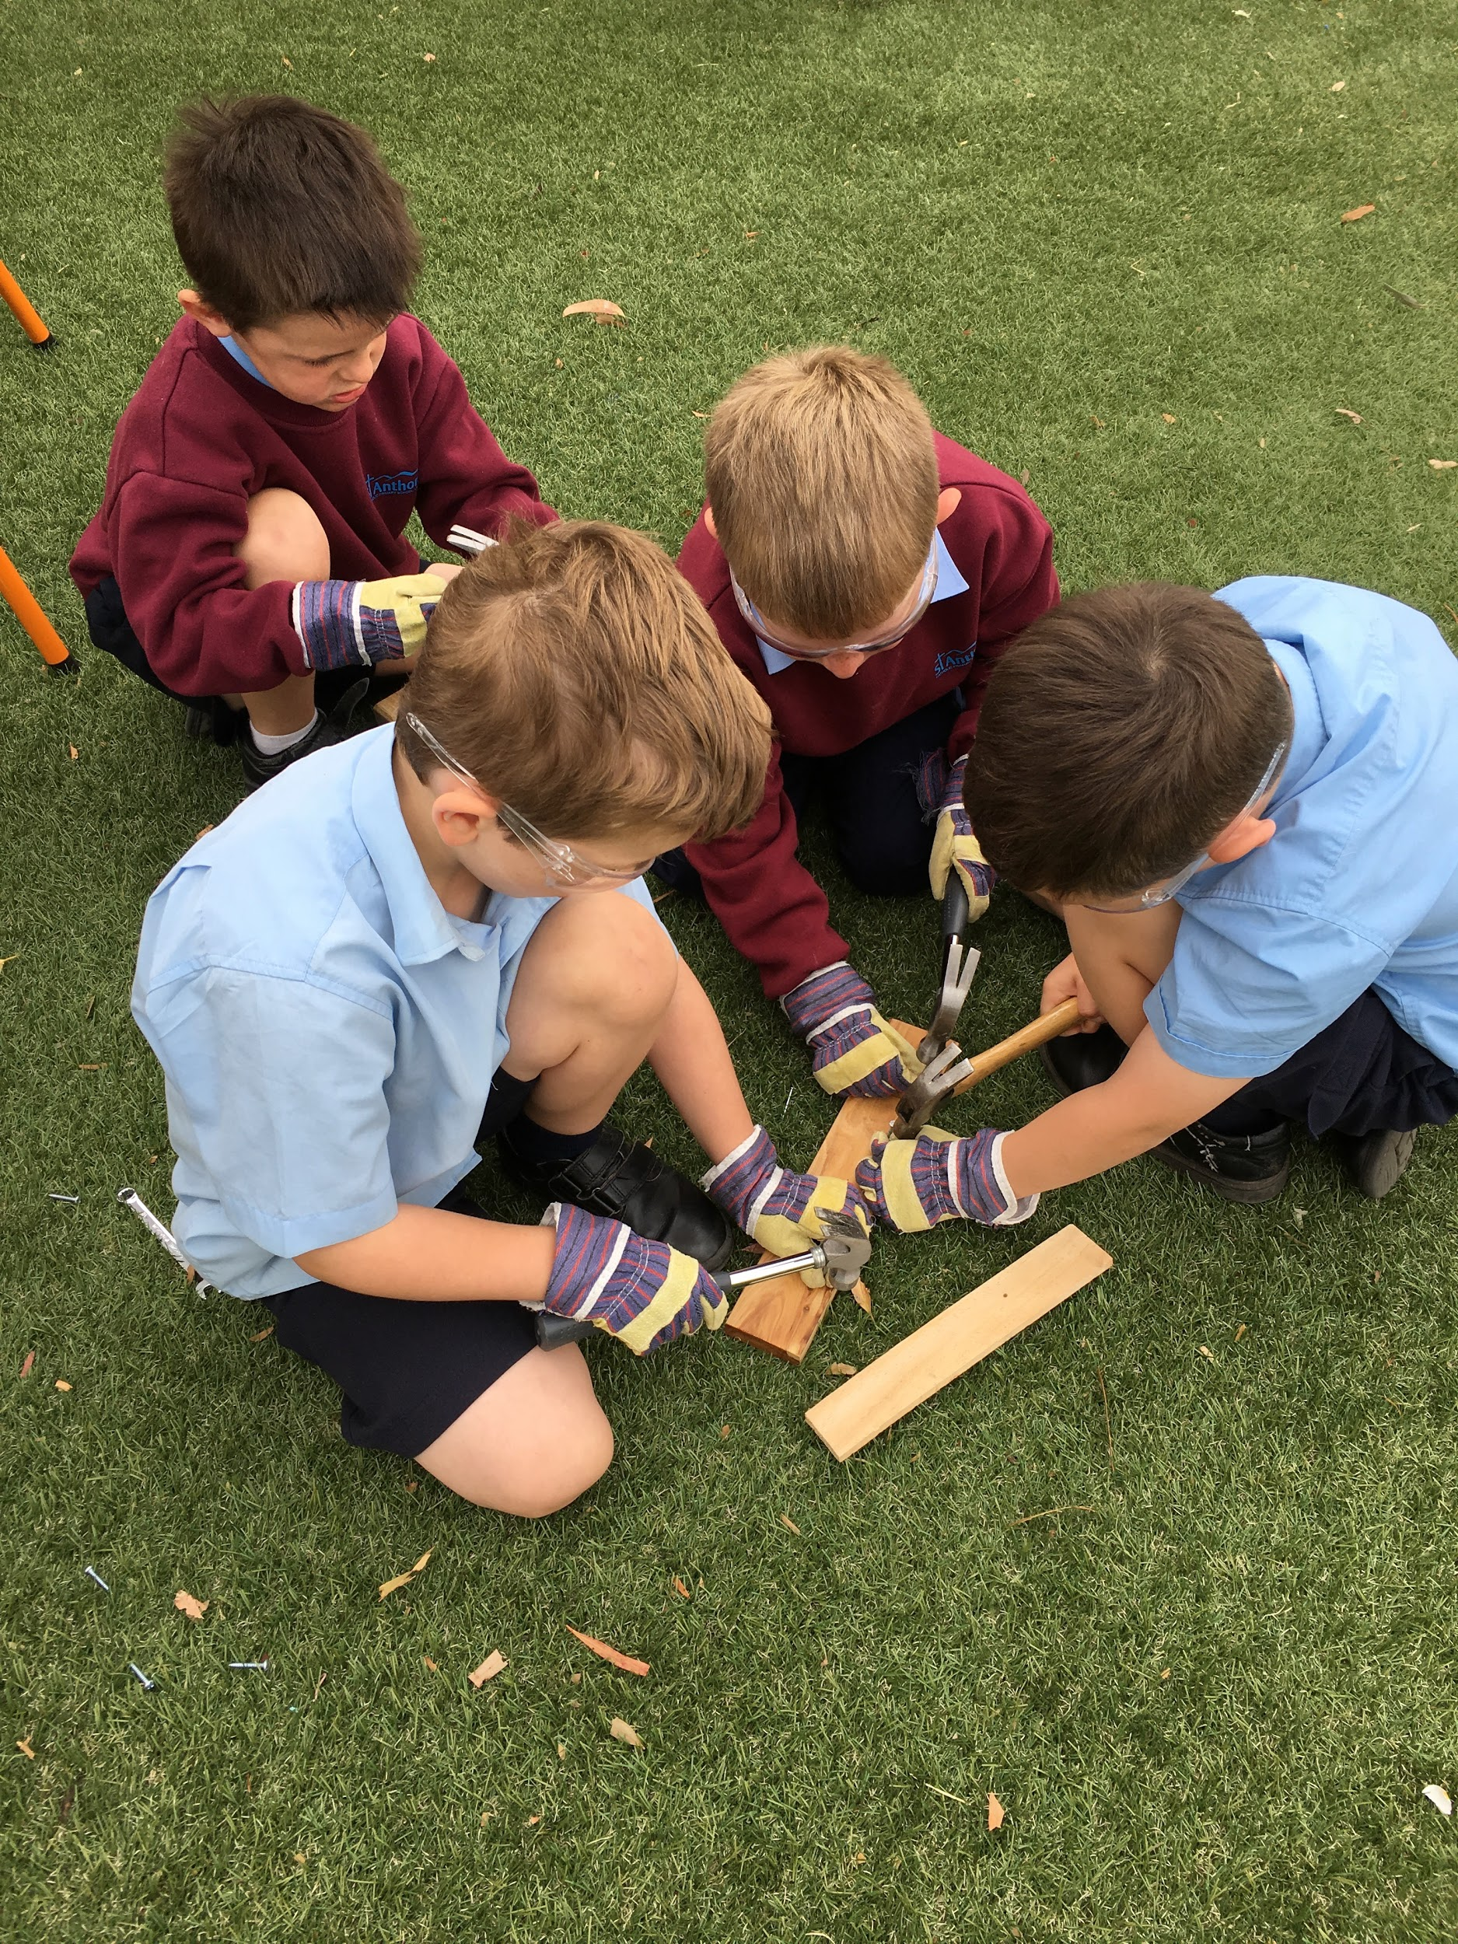
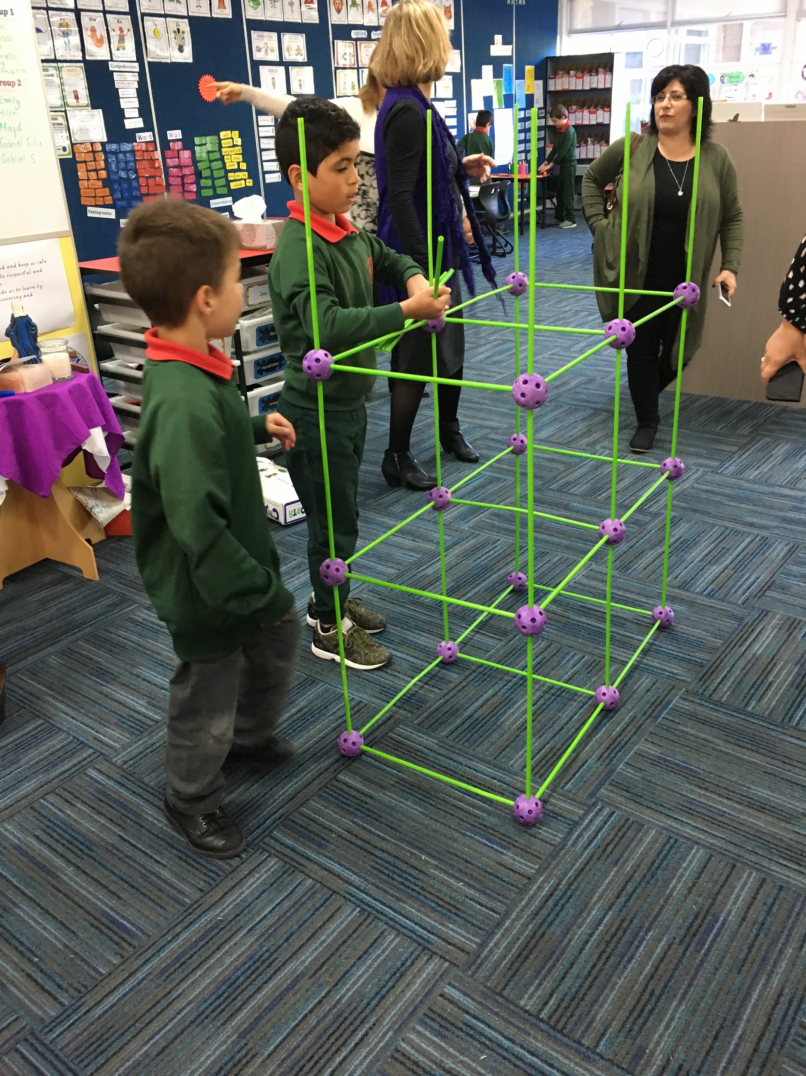
Designing, constructing and problem-solving

Slide 25
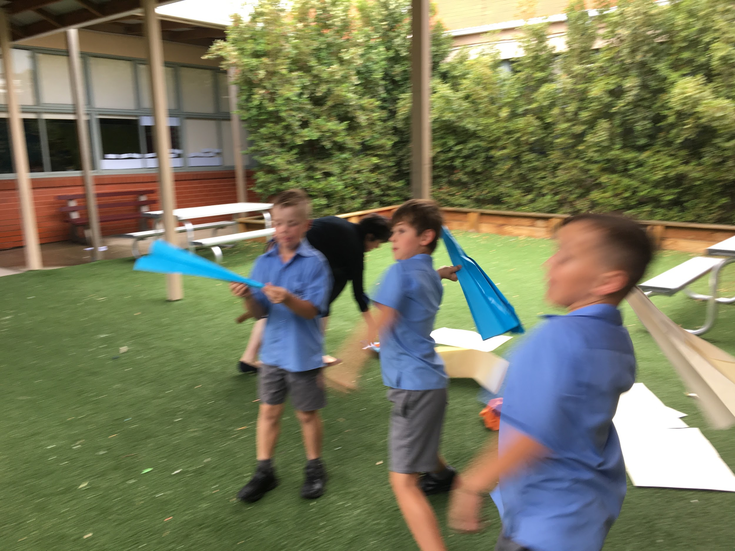
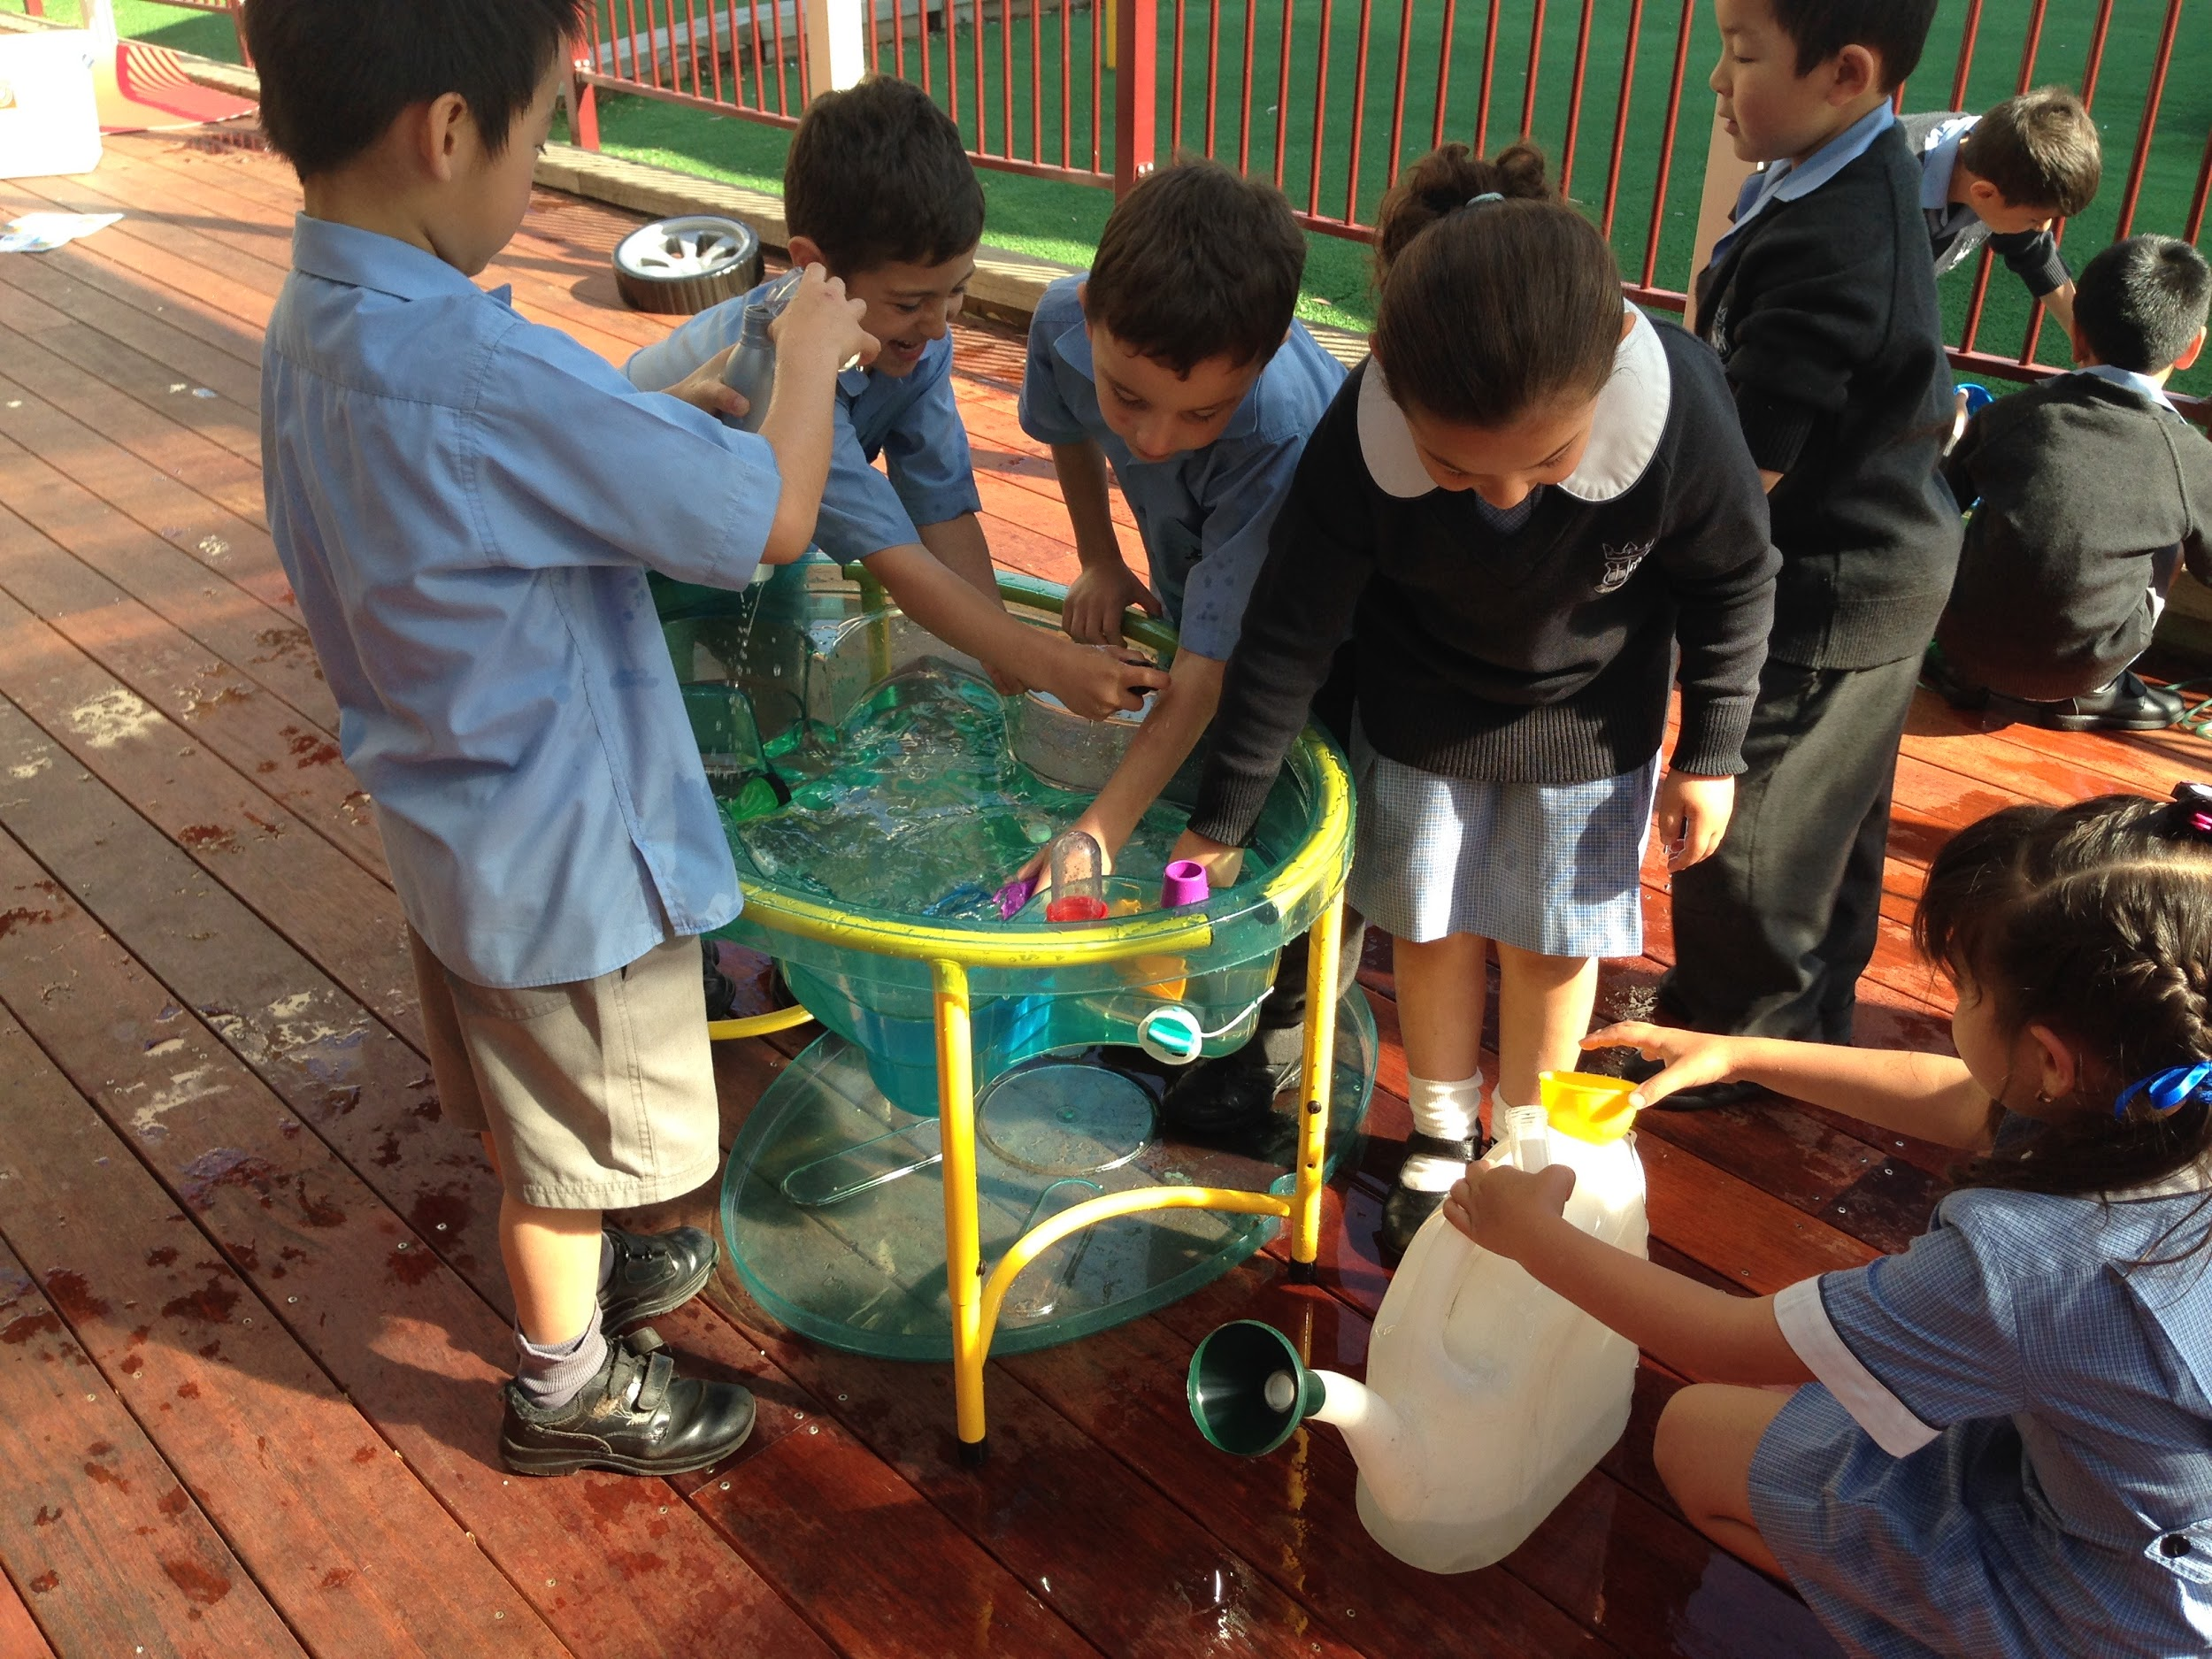
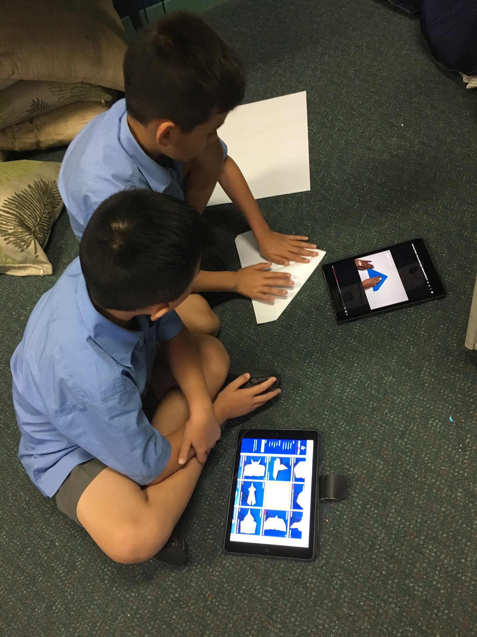
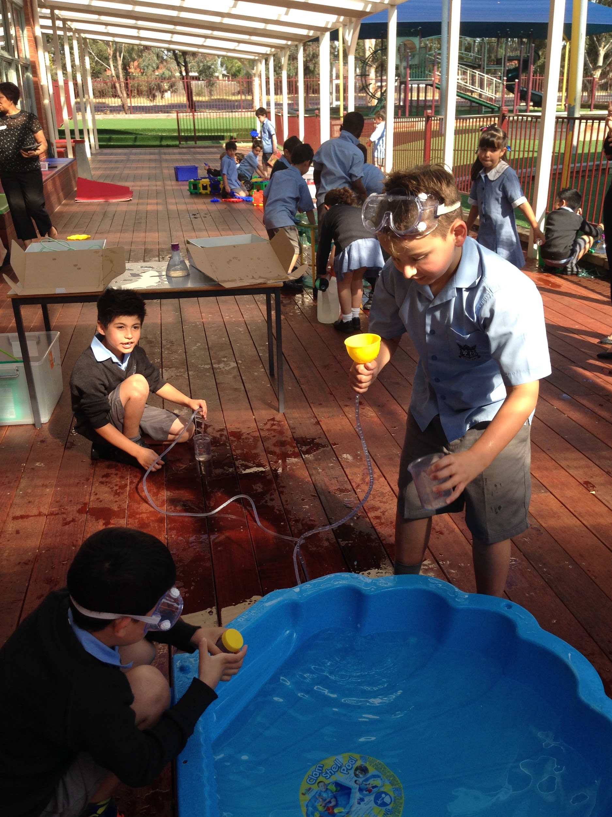
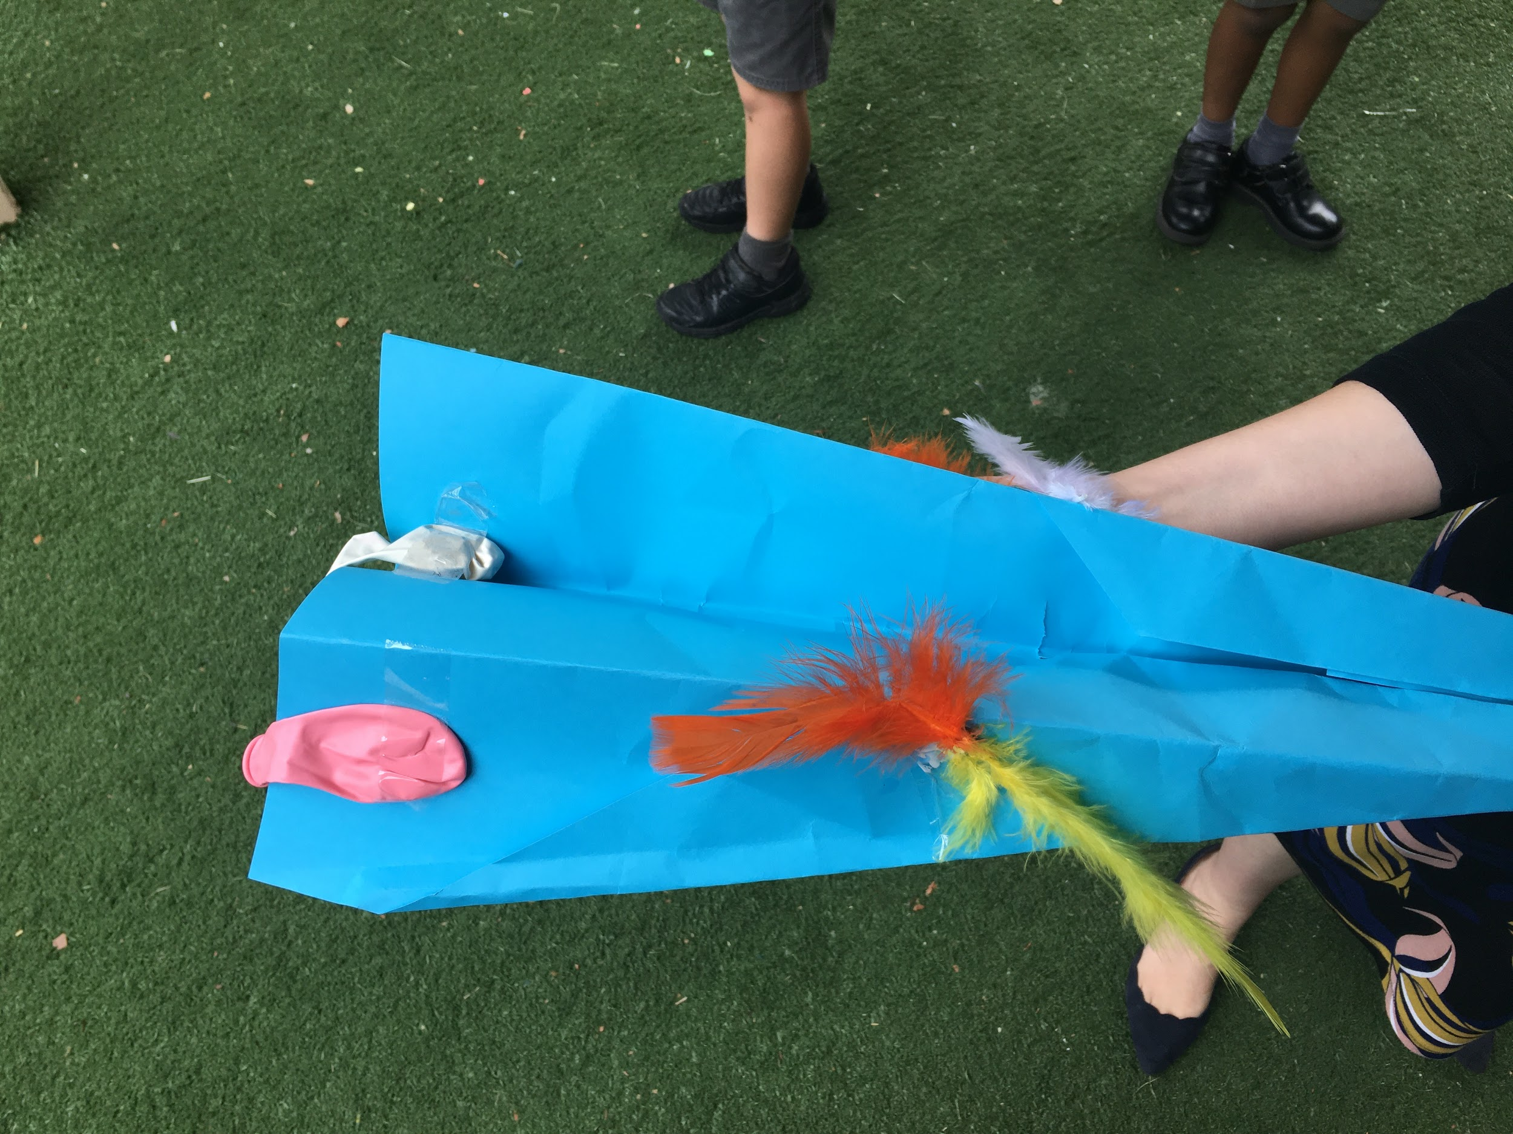
Researching and testing
like scientists

Slide 26
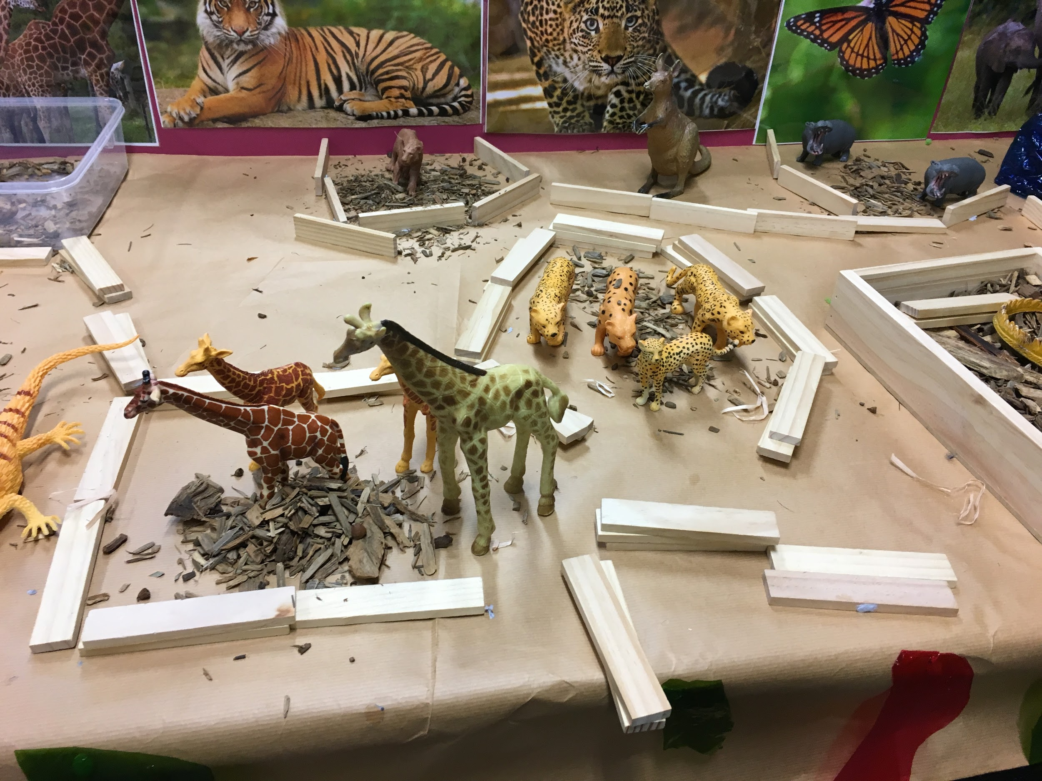
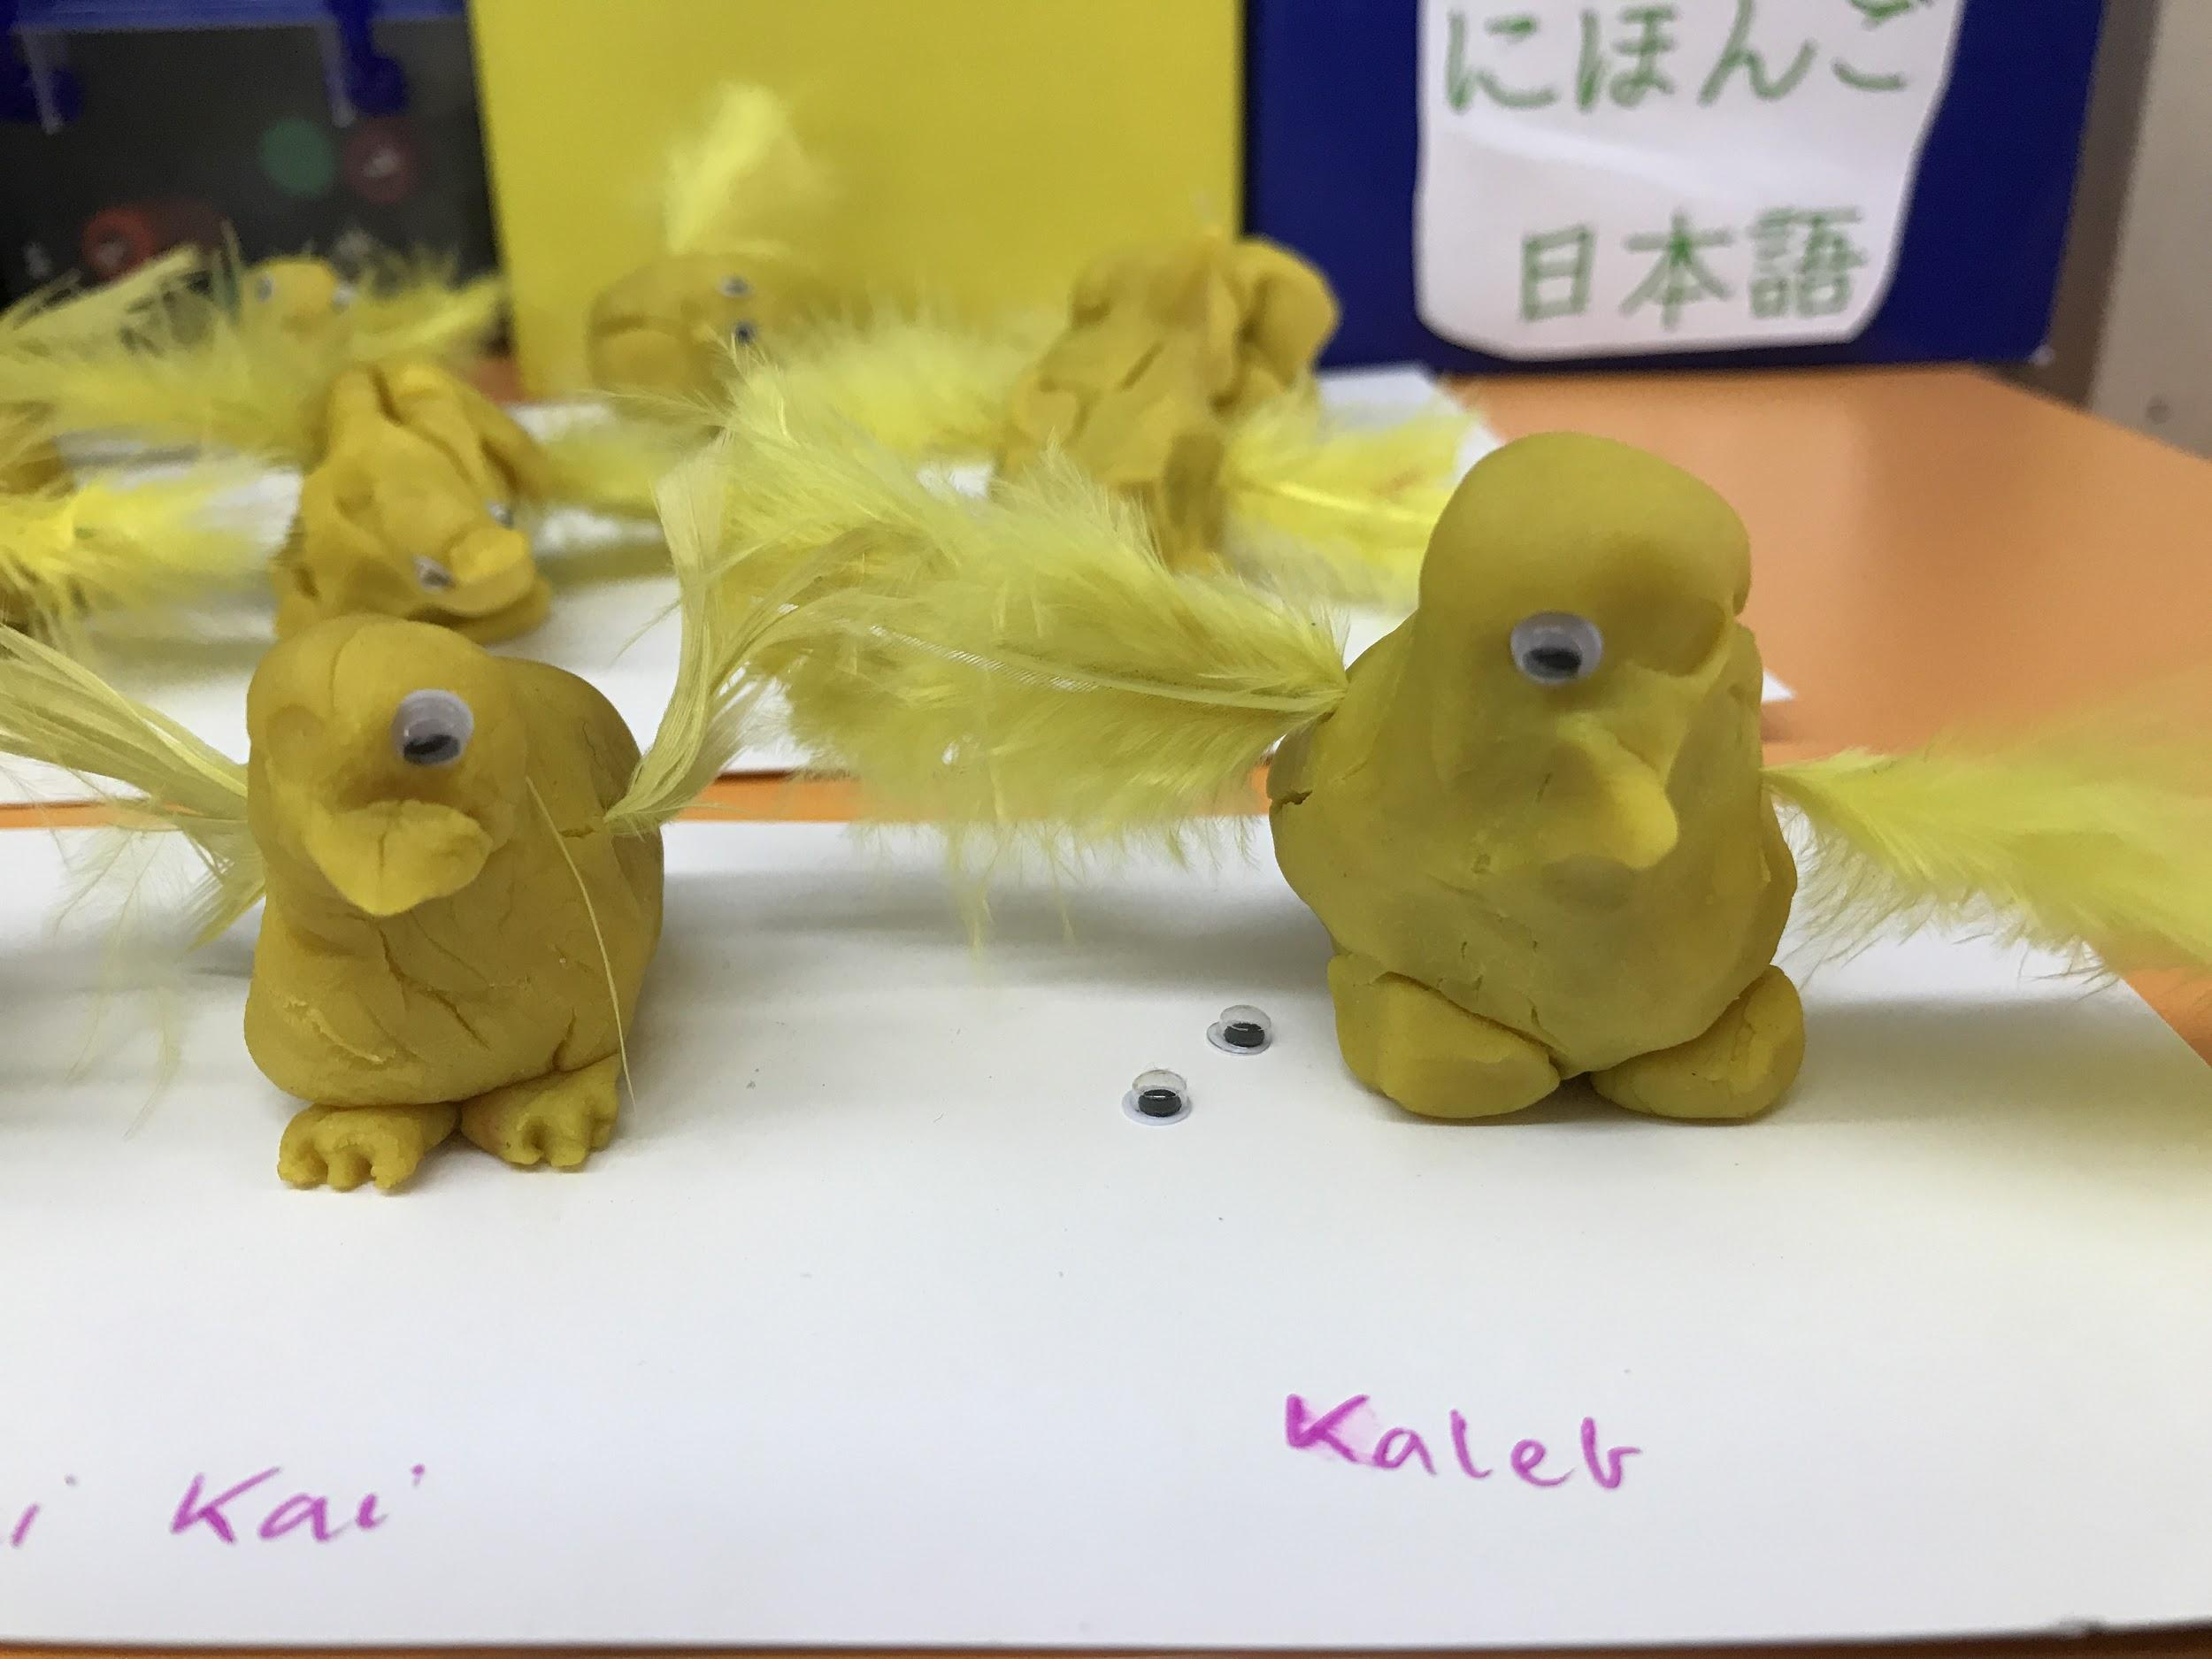
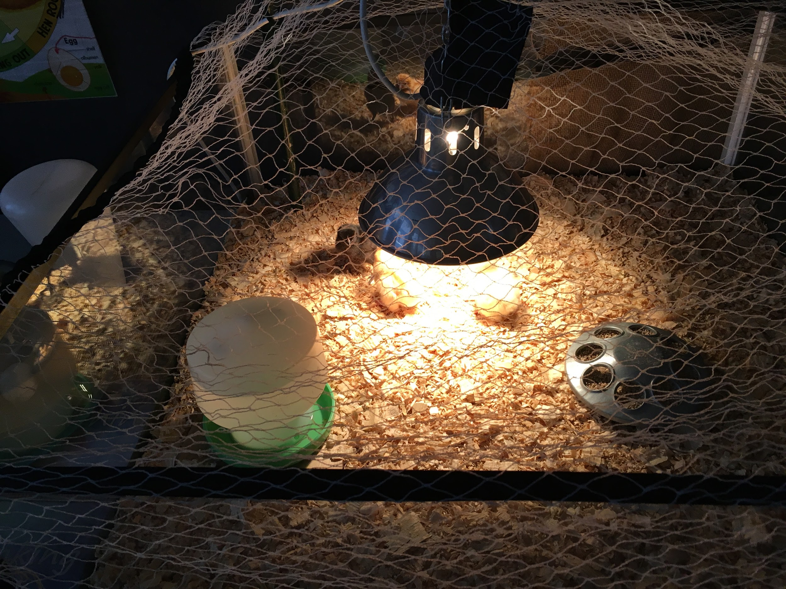
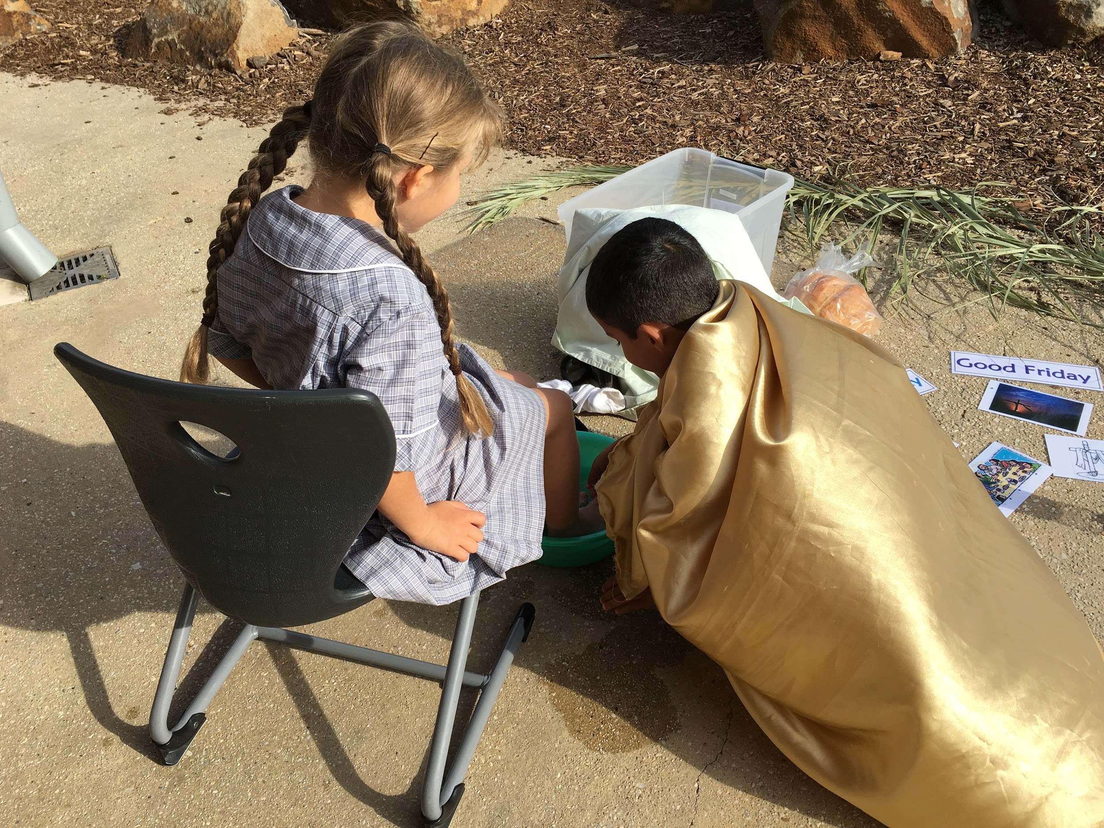
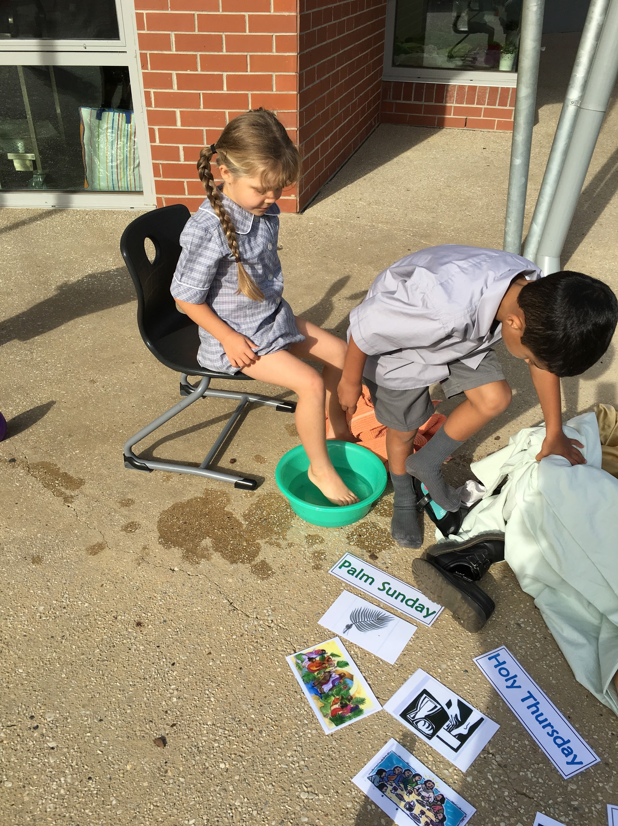
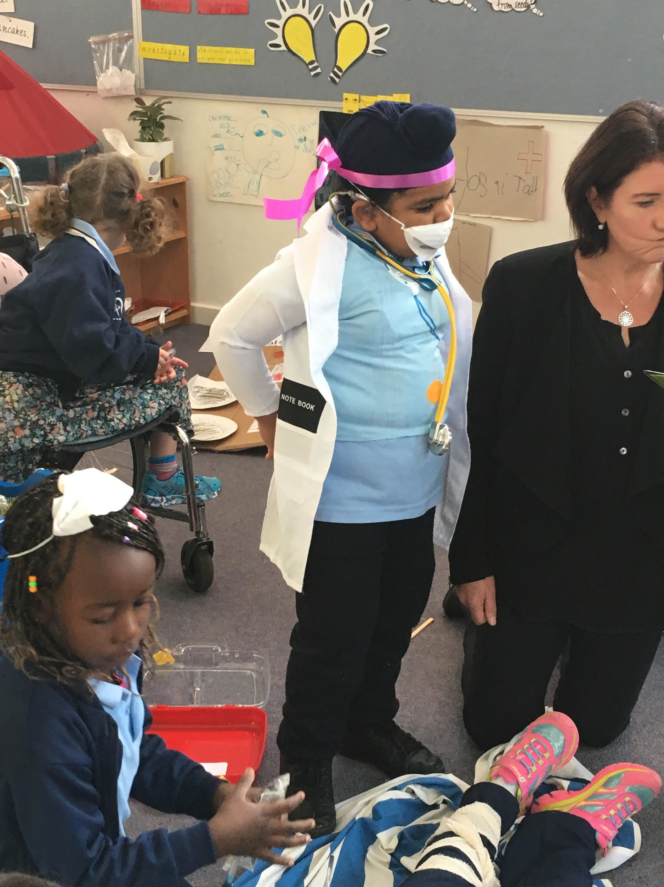
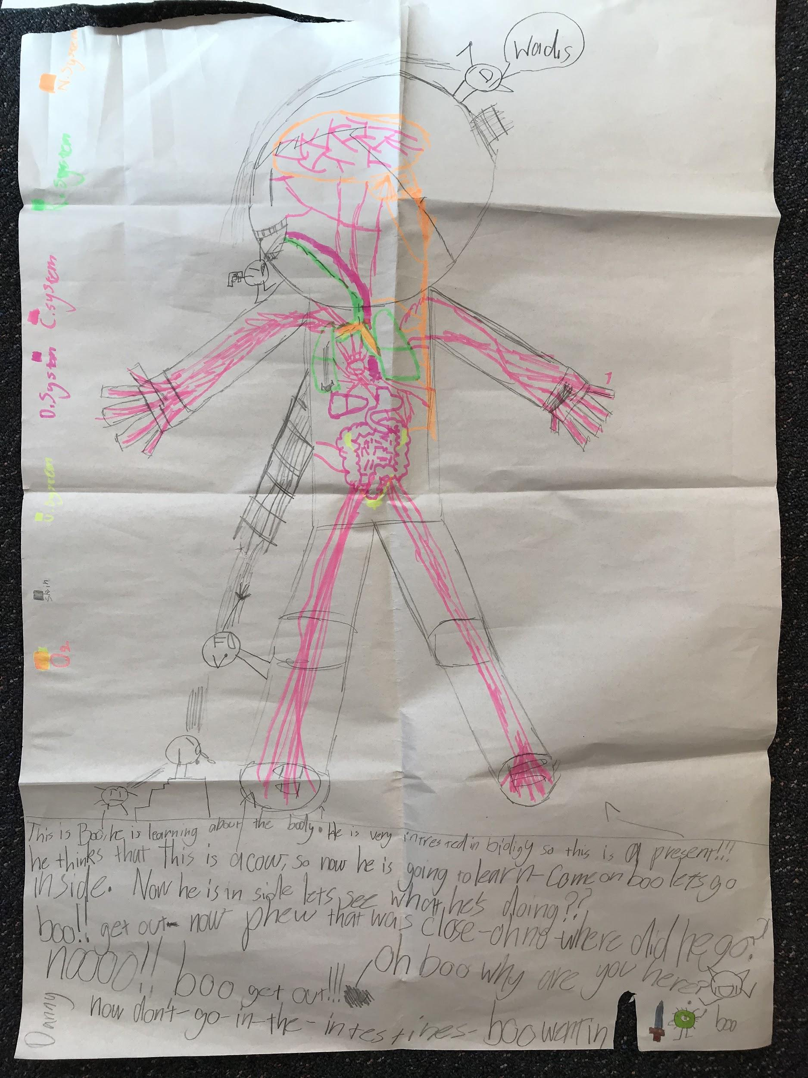
Making connections

Slide 27
Things to consider when setting up for discovery
We design some areas to link with things we are teaching across the curriculum: Inquiry, RE, Maths and Literacy
We design some based on what we know about the kids and their interests
We ensure we have areas that will allow kids to investigate/ learn/ explore in different ways ie constructing, problem solving, role playing etc.
Permanent areas/stations are a game changer!

Slide 28
Criteria for Discovery
Engages different types of learners (Multiple intelligences/VAK)
Make authentic links to literacy and mathematics
Opportunities for indoor and outdoor play
Balance between student interests and links to curriculum
Opportunities to;
  be creative
  solve problems
  use imagination
  be collaborative or work alone
  be quiet or be rowdy
  construct and design
  investigate or to explore new ideas,
  try and fail and to develop resilience
  practise skills
  role-play/dramatise

Slide 29
Criteria for each area/station
Has purpose
Open-ended/ allows for multiple possibilities
Has defined spaces
Developmentally appropriate
Not too much/not too little
Attractive and inviting to students (don’t judge on adult standards)
Real materials whenever possible
Allows students operating at different developmental levels to engage

Slide 30
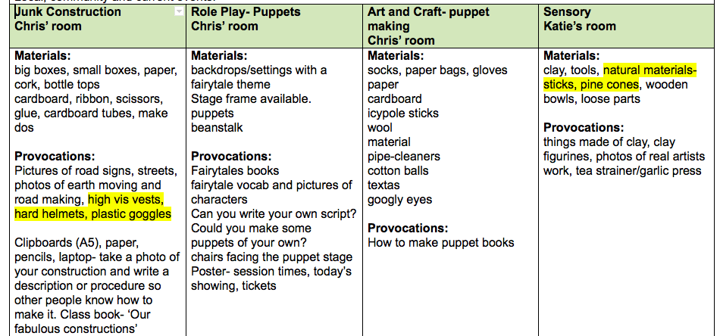

Slide 31
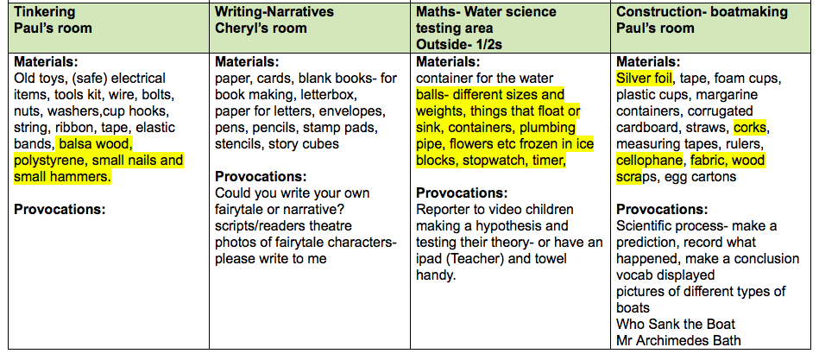

Slide 32
Teachers role
Very strategic- 100% present 100% of the time
Introductions and share time
Setting high expectations from the start- this is a learning time, expected behaviours, routines eg resetting
Teacher can take many roles but at the beginning of the year it’s about having conversations with students (teachers as researchers: what can I find out about my students?)

Slide 33
Session 2
The discovery walk

Slide 34
What should we be looking for?
Introduction
What is the focus?
What strategies is the teacher using to make it explicit?
How are students contributing?
Share Time
What are children sharing?
What questions are being asked?
What language of learning are you hearing?
Environment
How is the environment set up?
How does the environment encourage children to participate?
How are defined and purposeful spaces created/delineated?
Stations/Areas
What are the purposes of each station/area?
What different things could children possibly do/explore at each station/area?
How do the materials that have been provided enable/encourage children to engage?
Students
How are children engaging with the opportunities provided?
How are children engaging with each other?
What learning can you see and hear?
How is the teacher supporting student learning?
Leaders can you please commentate what you see.

Slide 35
Session 3:
Introductions and share time- Vanessa
Making links to Literacy- Rita
Teacher role- Deb
Planning time

Slide 36
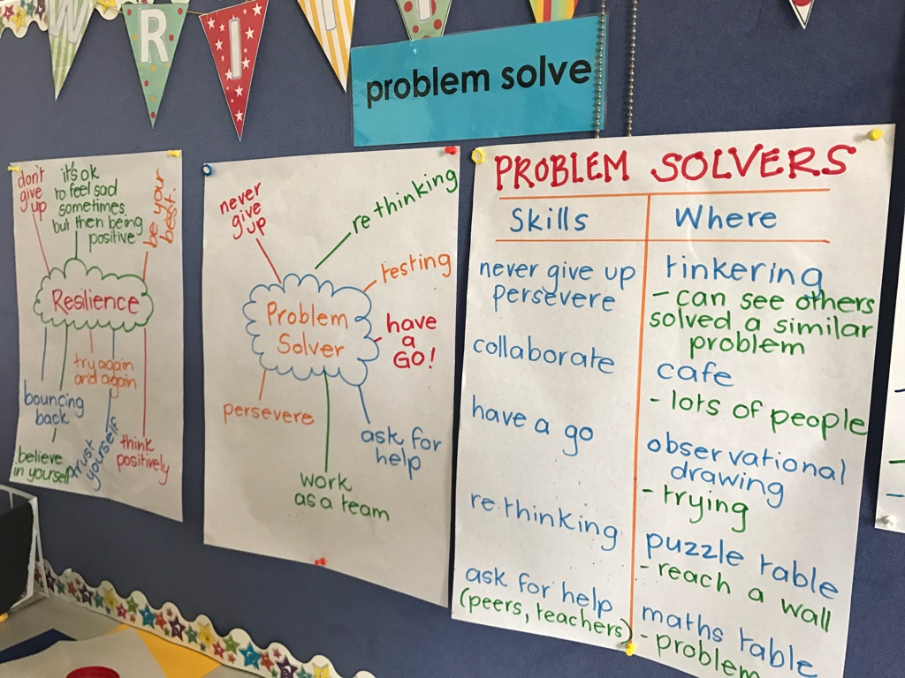
Introductions and share times
Explicit teaching times at the beginning and end of each Discovery session
Beginning of the year would centre around;
Spotlighting areas - what is possible here?
Links to dispositions and desired learning behaviours - what does this look like, sound like, feel like?
We then build up to layering in desired skills and behaviours relating to students developing as inquirers -
E.g. modelling story telling
Drawing techniques
Research skills

Slide 37
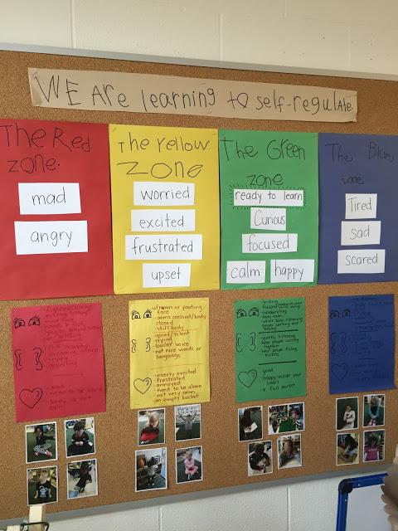
Explicit focus around SEL or SWPBS
Discovery is an authentic opportunity for students to practise and apply skills and focus from our SEL or SWPBS
We select focus appropriate to the age group as well as what is relevant to context of Discovery and beyond

Slide 38
Introductions
Refer to learning foci handout for ideas - particularly around Social Interaction, Oral Language and Personal Management
Possibility of using Role Play scenarios with students as co players or with your colleague - examples and non examples
Consider literacy links with picture story books themed around problem solving, creativity, resilience, collaboration etc
We are building students agency as effective learners

Slide 39
Introductions then shift their focus so they are not so dispositional heavy - rather the dispositions become embedded in what we are modelling in these times
E.g Modeling using design process - planning an idea - how might these materials SPARK my thinking, how might I put them together? This could incorporate a discussion around problem solving, or collaboration, or creativity
E.g. Using the research process - explicit teaching of research skills - listening for information, using features of a nonfiction text, locating a keyword, paraphrasing etc

Slide 40
Share time
Introduction and share times are “bookends” to discovery
Through the share time we are able to notice and name the learning that has occurred during the discovery session
We invite students to share their learning with their audience in a conversational way it’s not an interview - e.g. consider how we place ourselves during this time
We link back to our Introduction where possible
SMALL GROUP NOT EN MASSE- class groupings much more effective

Slide 41
Introductions and Share time
Planned focus and direction with where you are heading - we are intentional and explicit in what we do and say during introduction and share times
However…
We also allow some flexibility to respond to needs, issues or opportunities as they arise

Slide 42
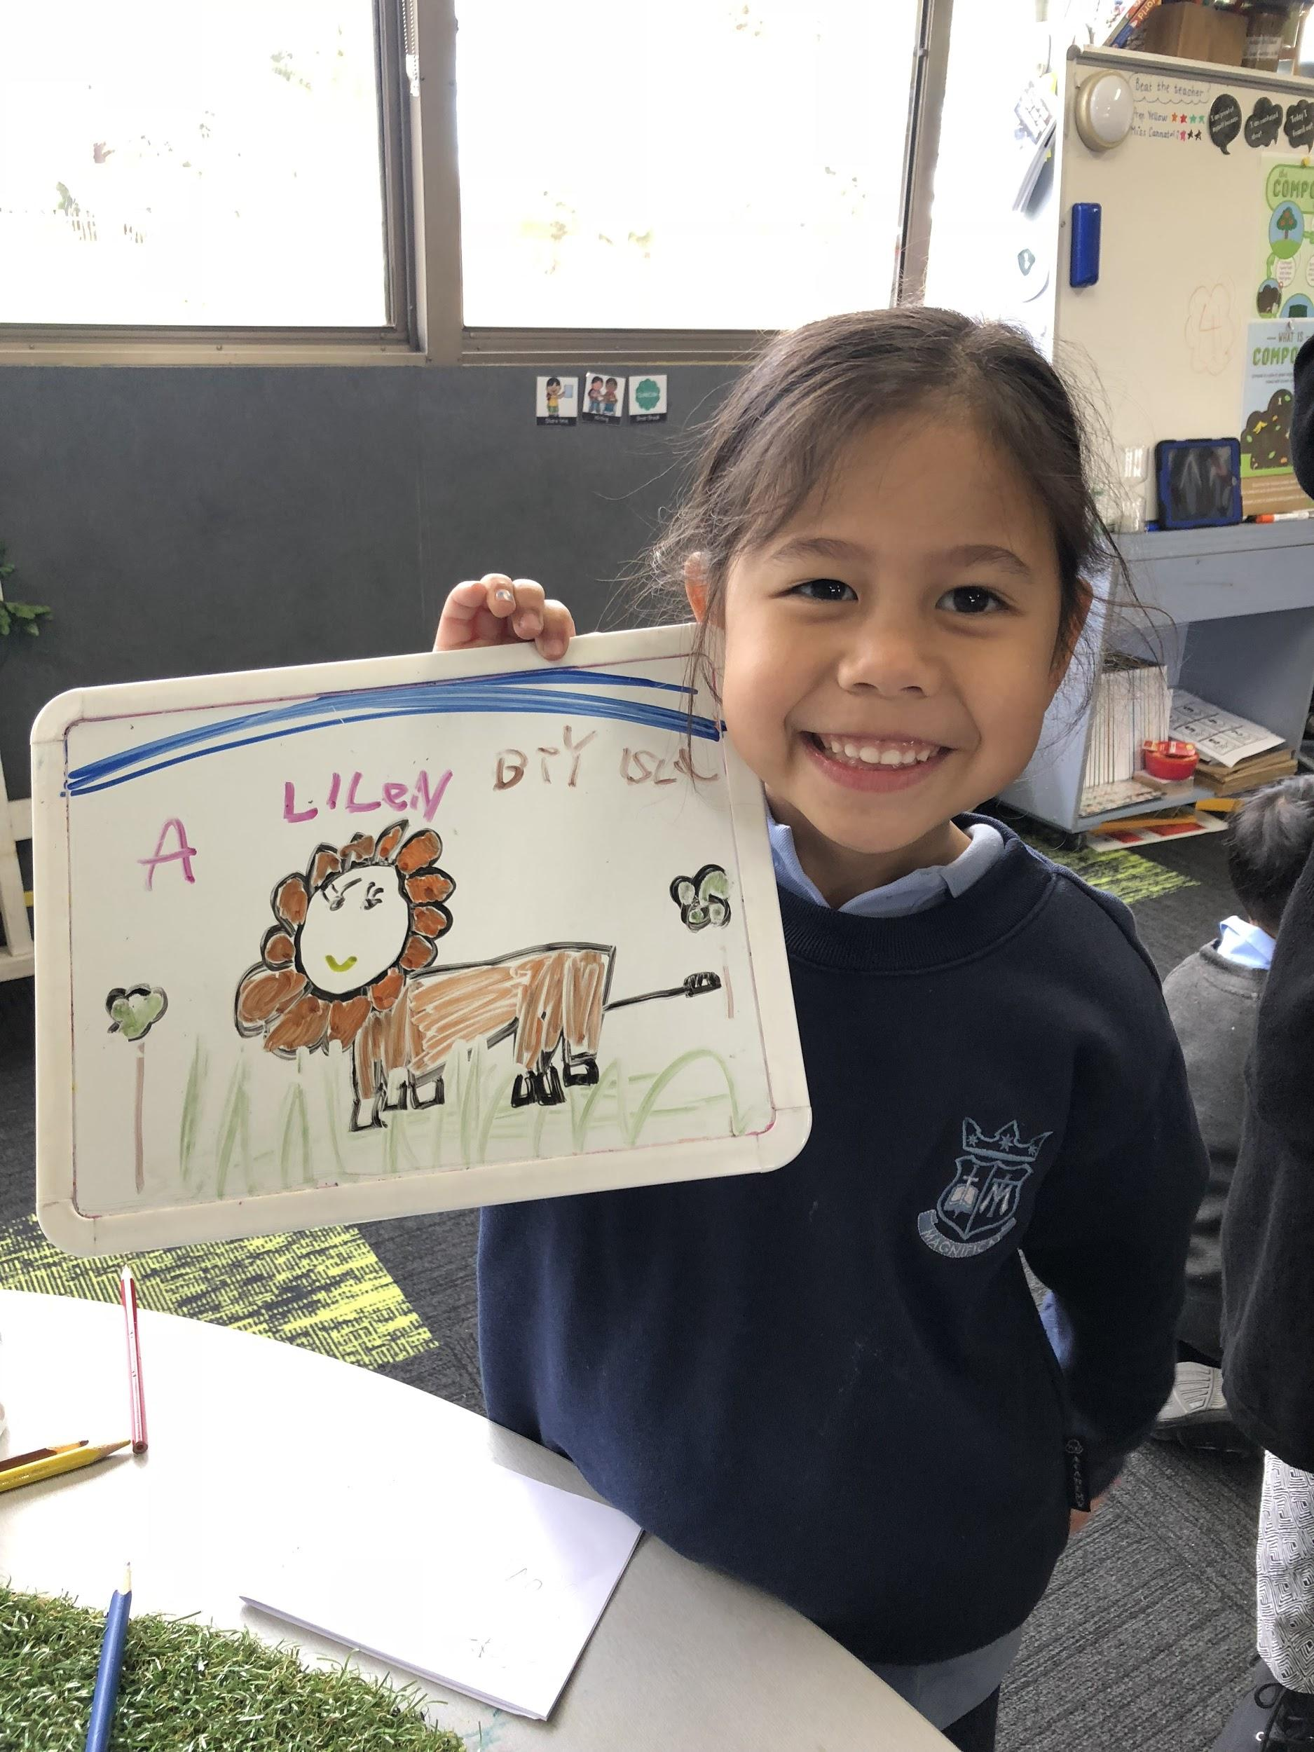
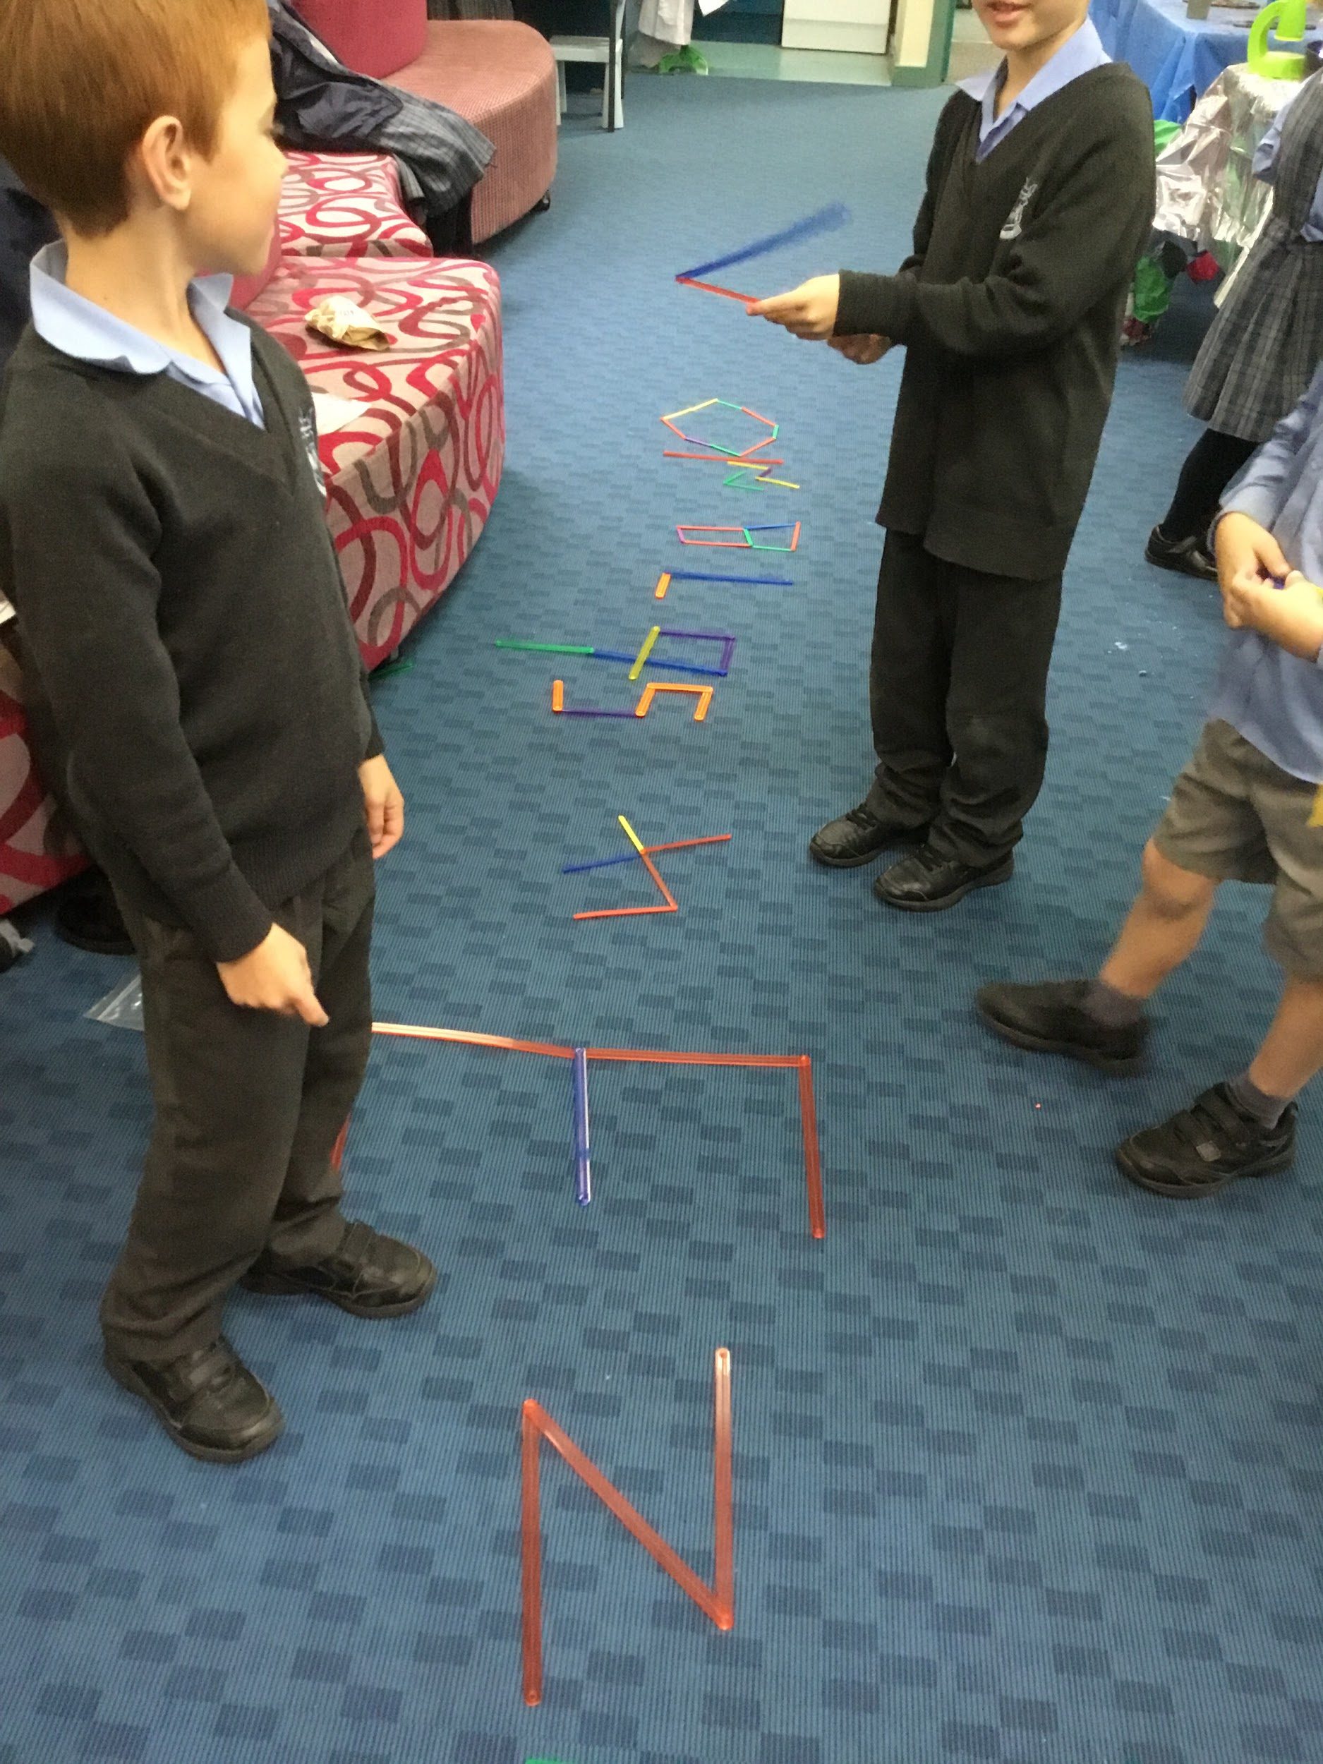
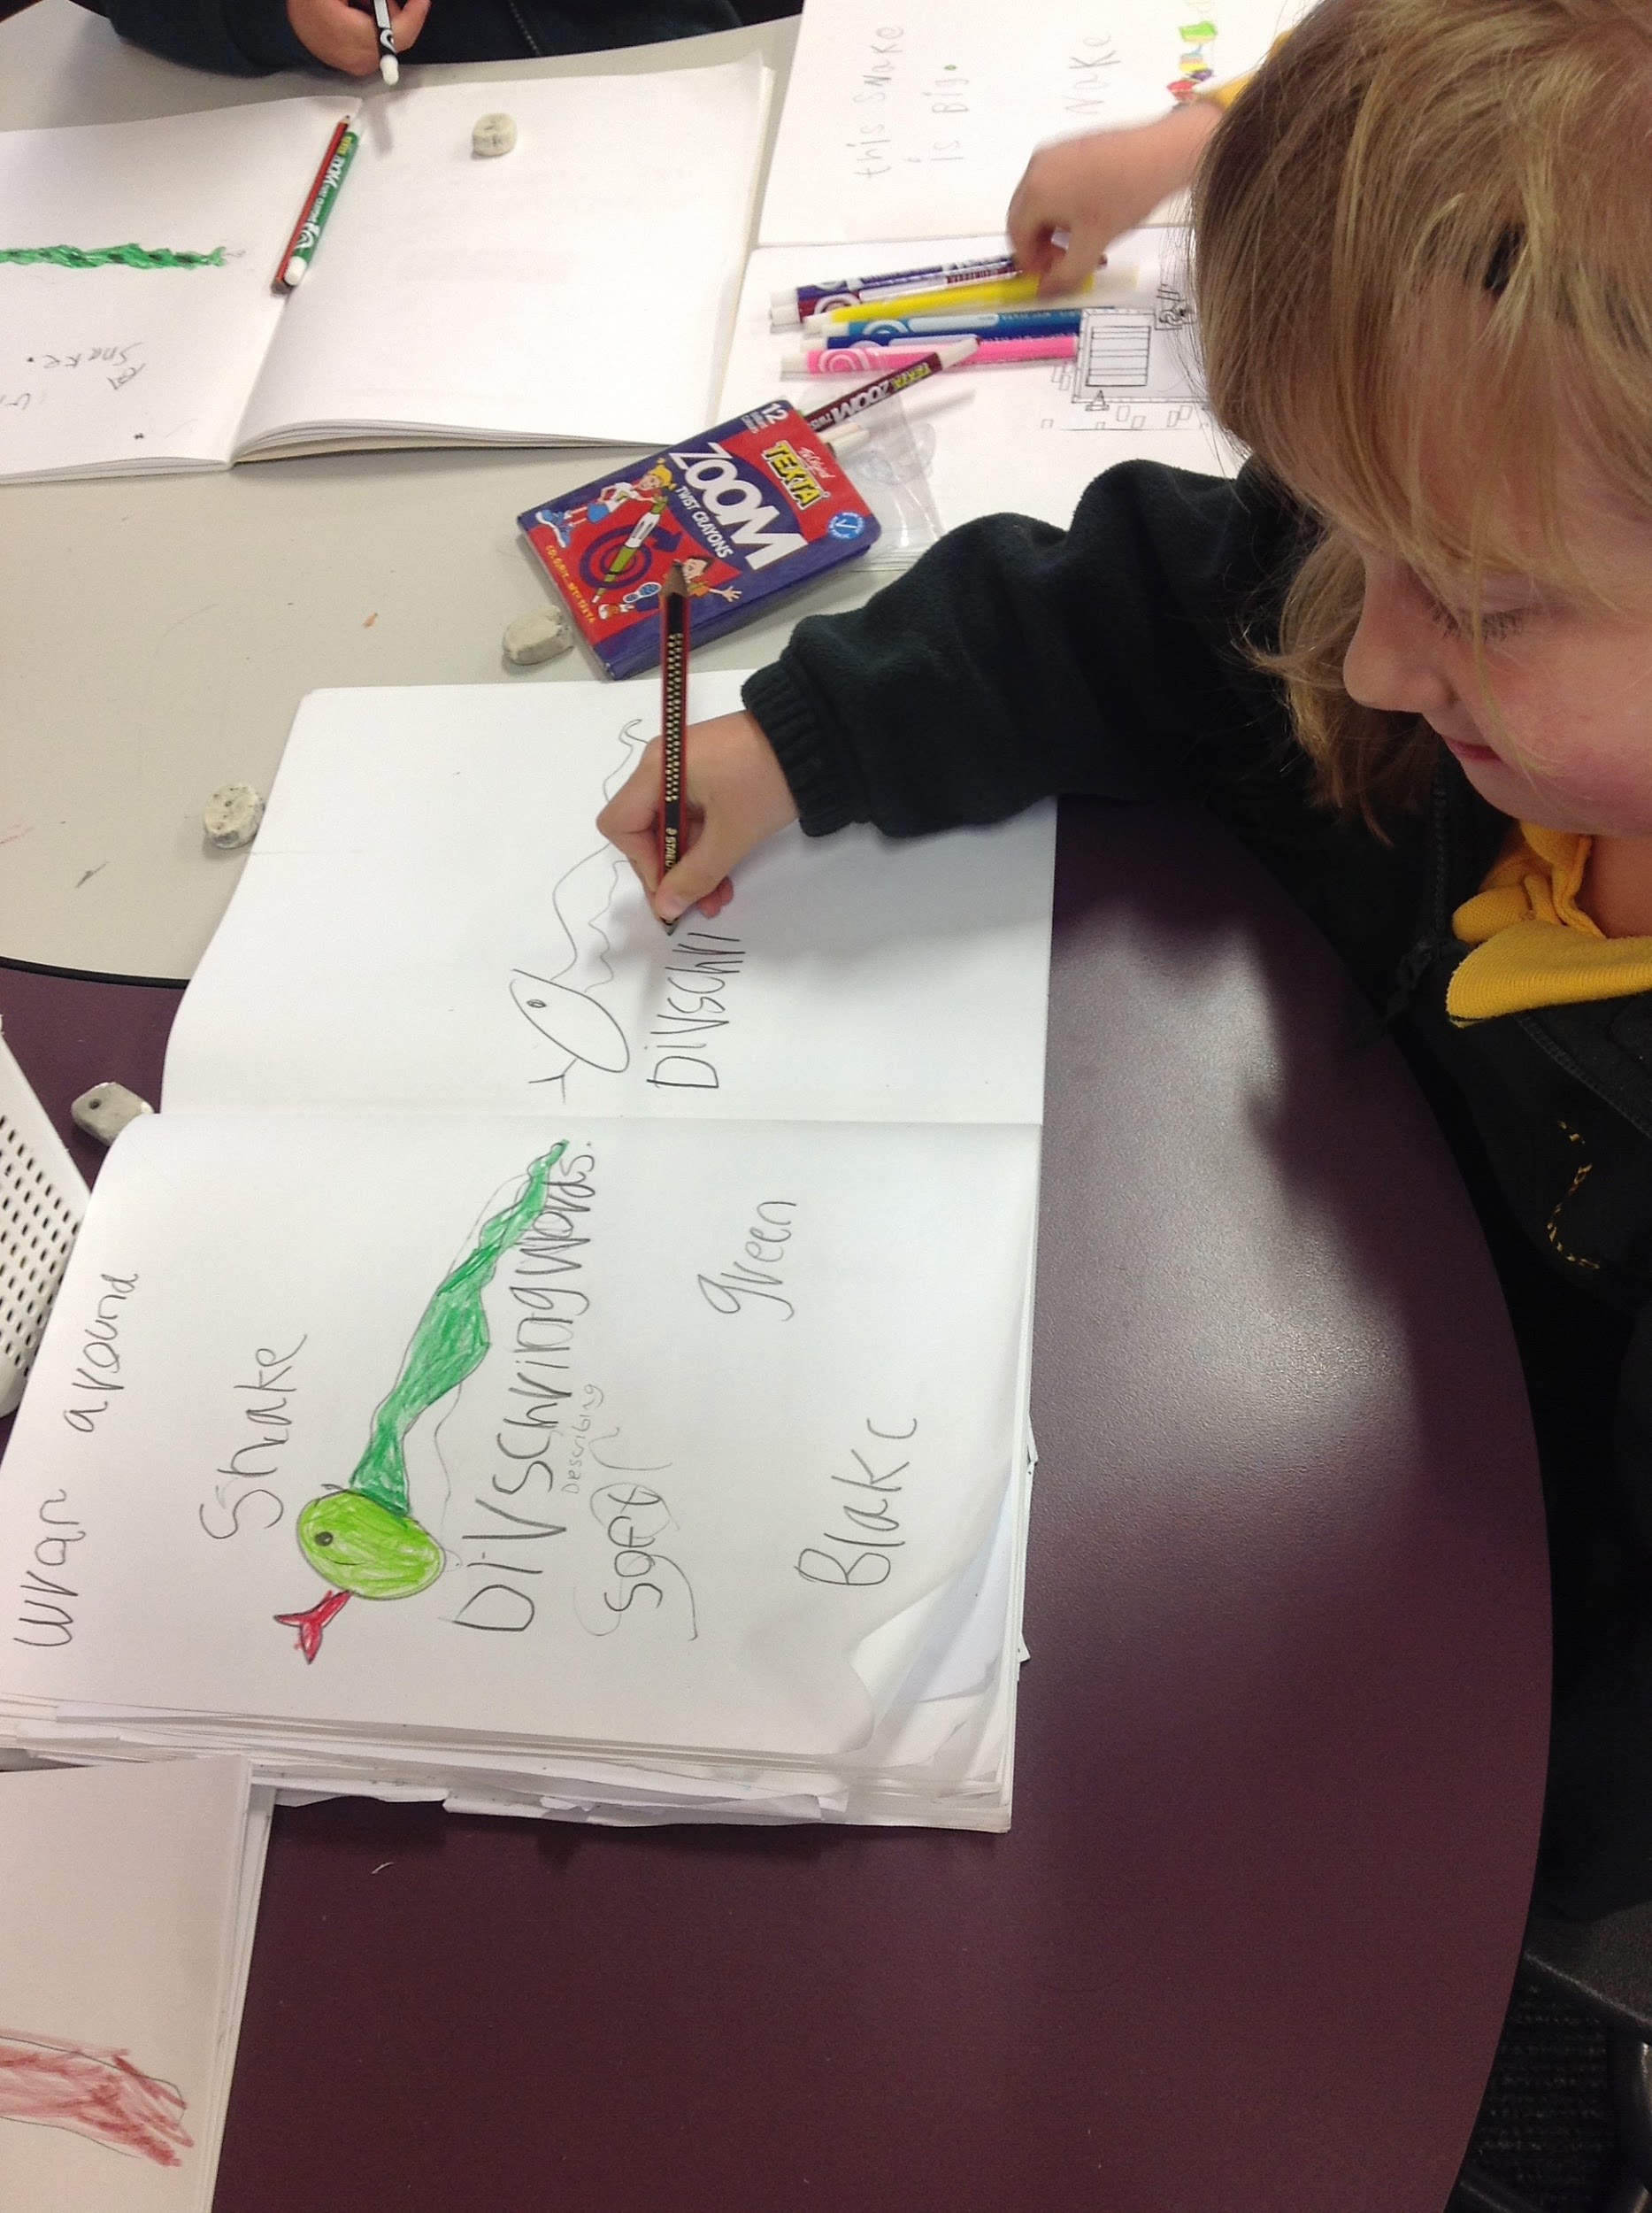
How can we maximise Literacy and Numeracy opportunities through Discovery?

Slide 43
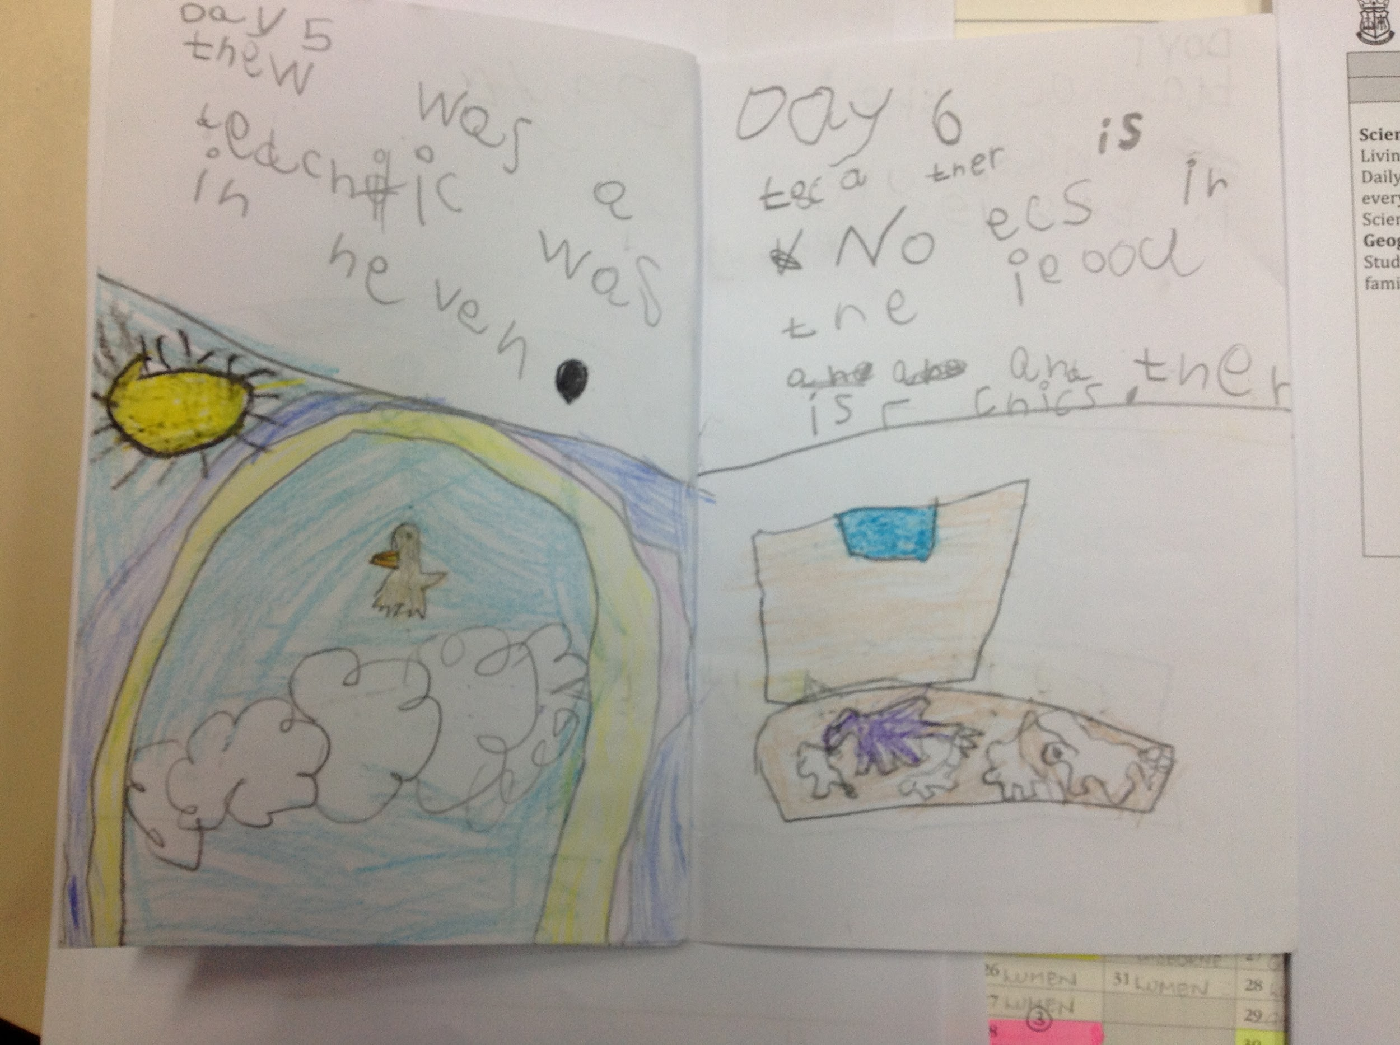
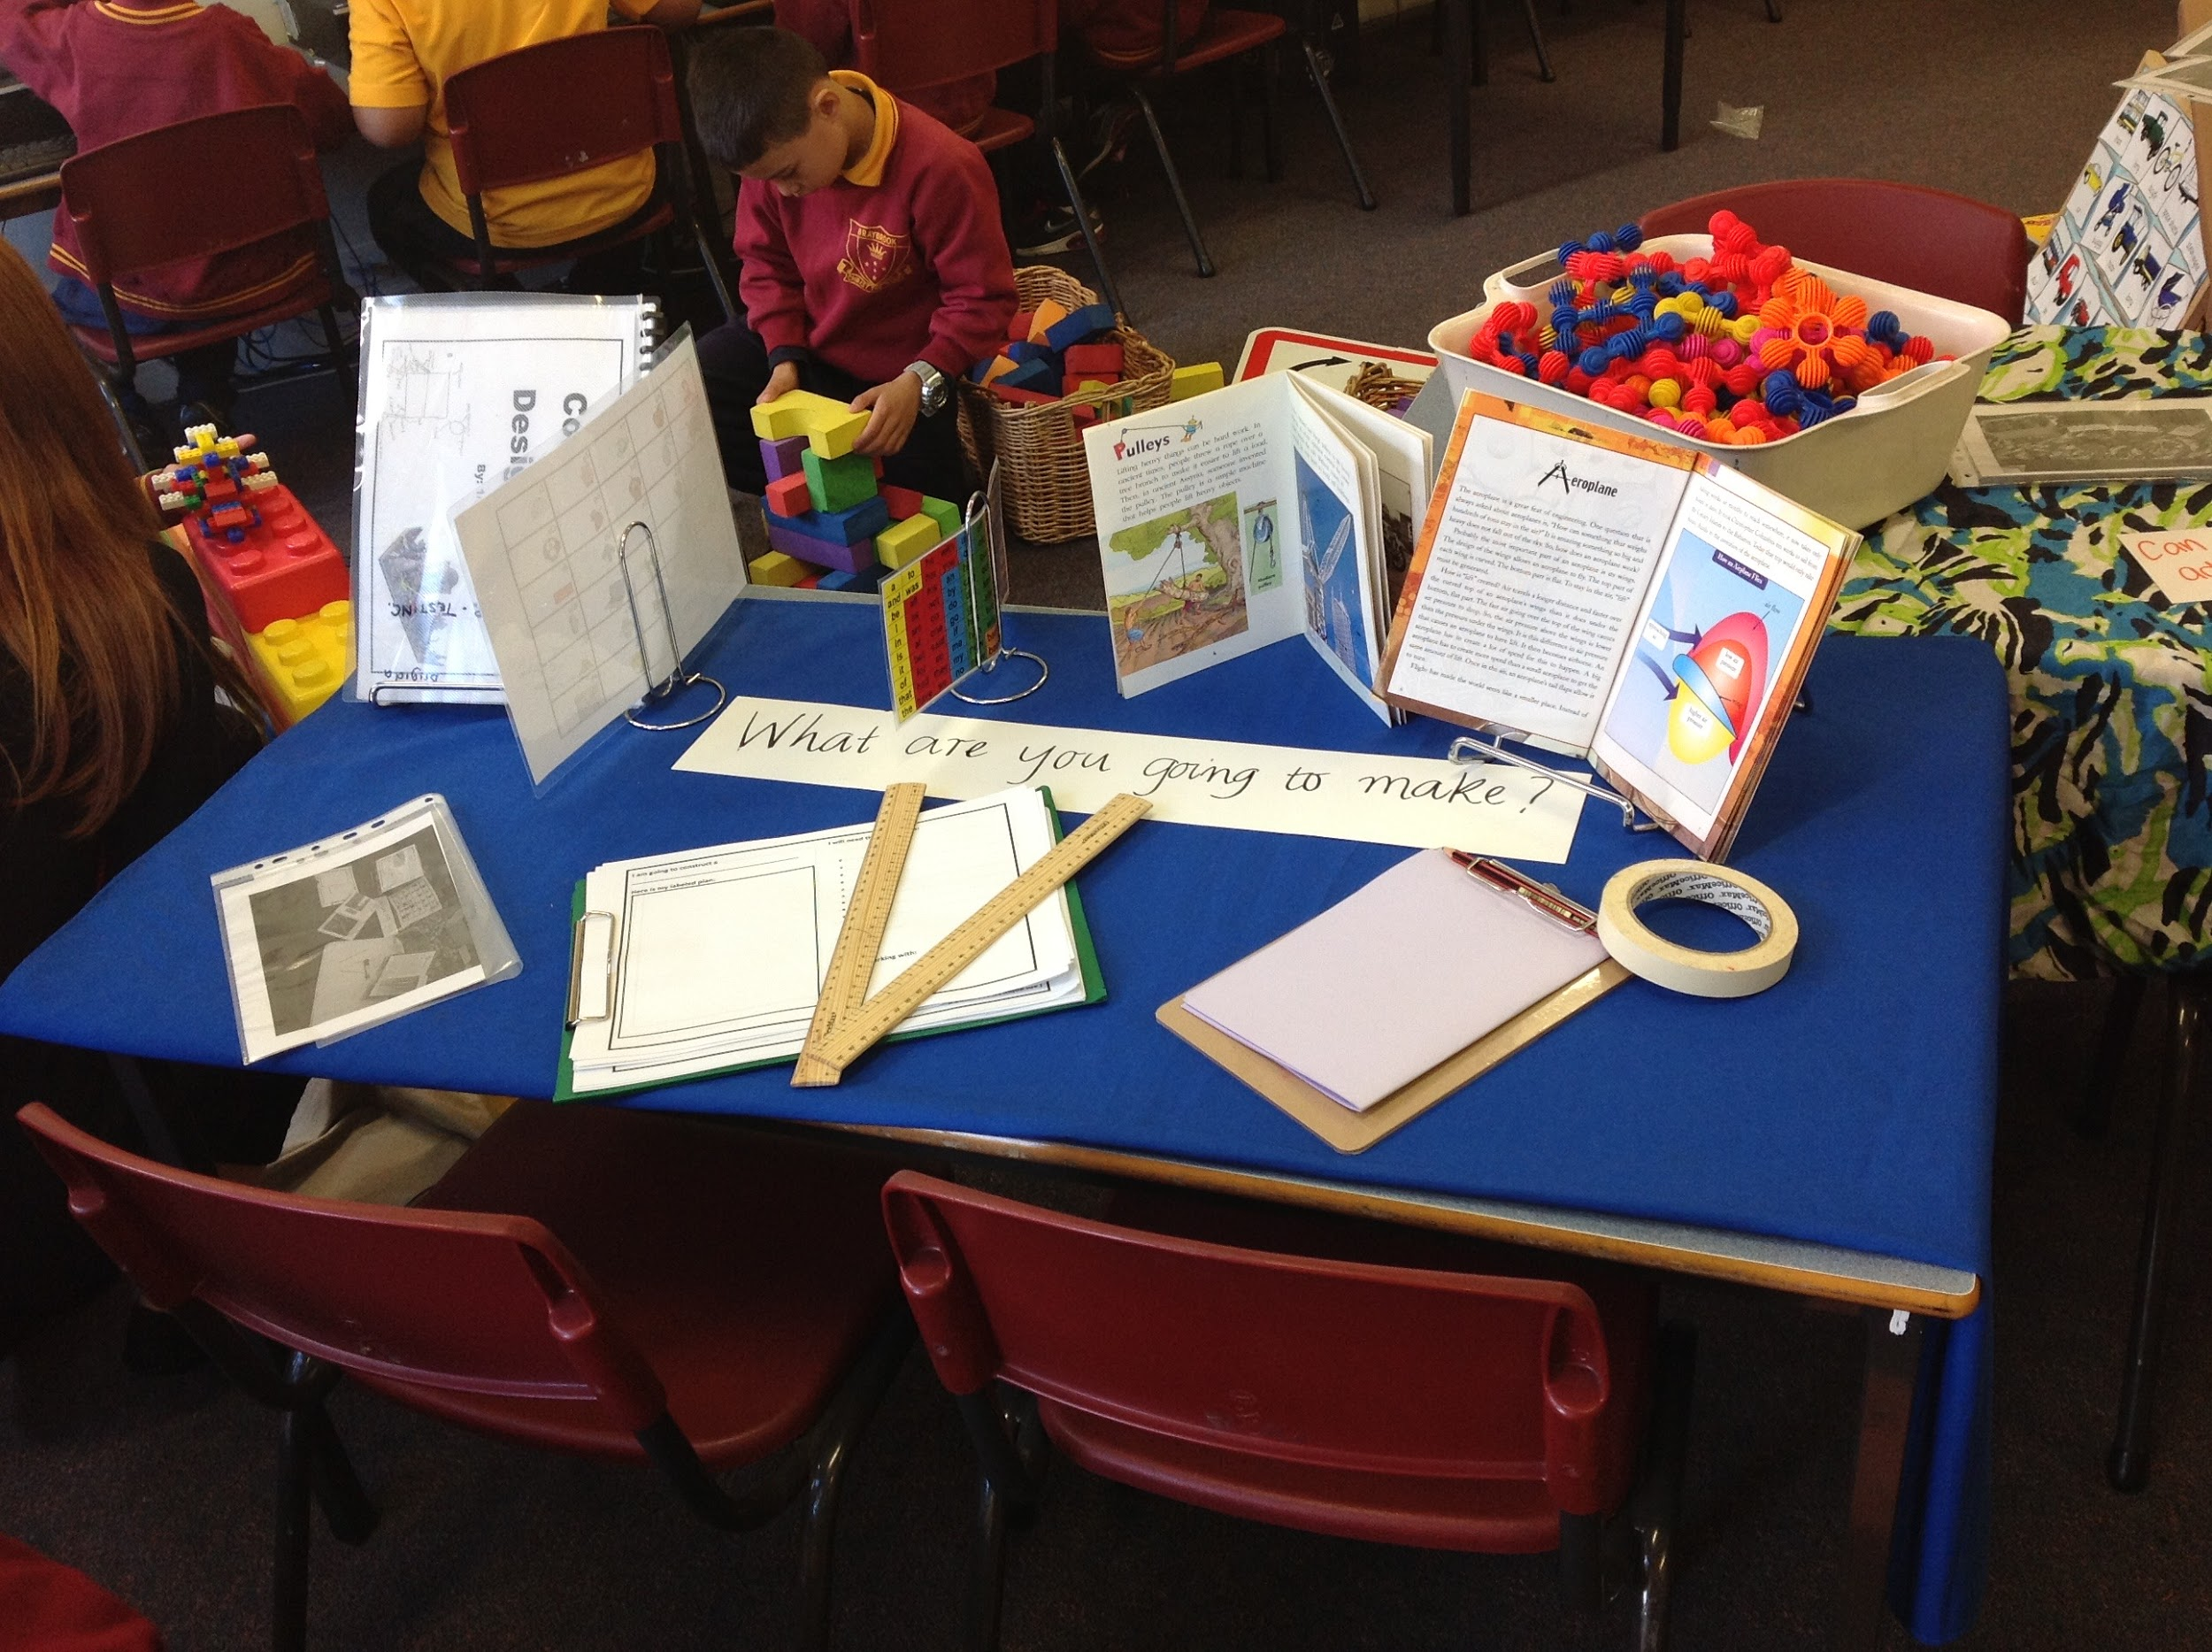
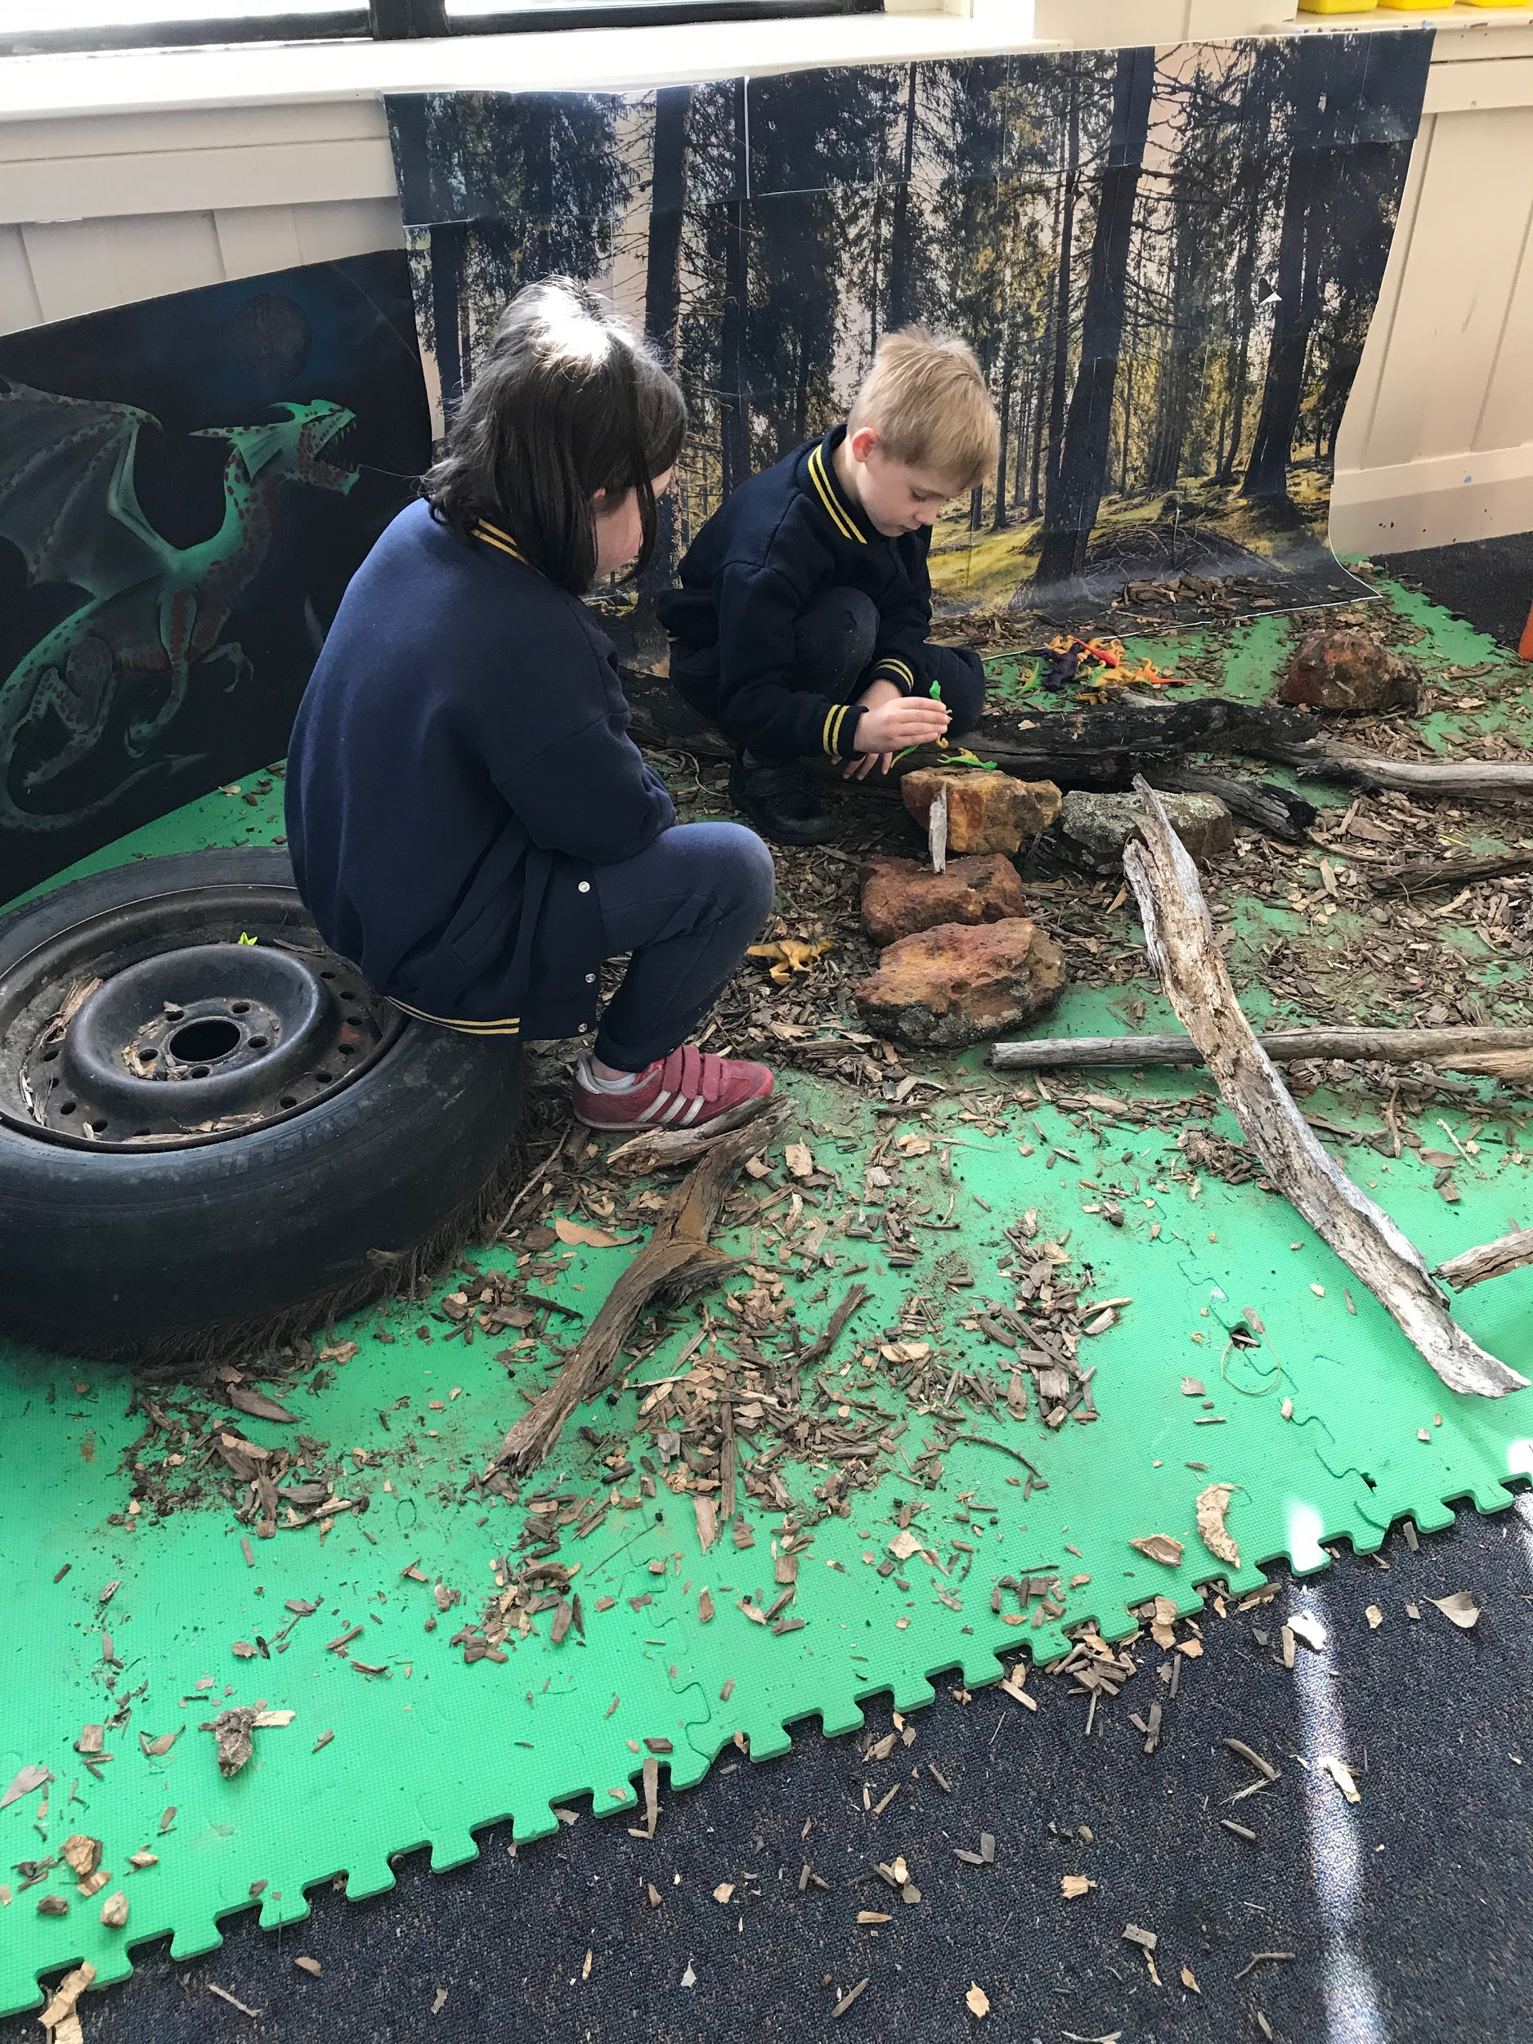
Children’s play offers meaningful and authentic contexts for emergent Literacy and Numeracy learning and development.

Slide 44
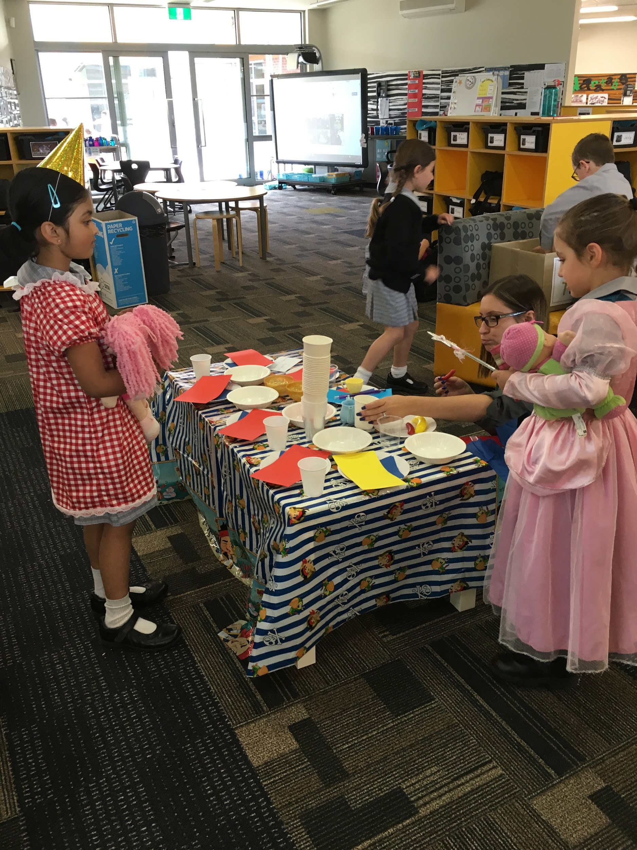

ORAL LANGUAGE
Play provides a context for speaking and listening.
Vocabulary is first developed and enriched through play

Slide 45
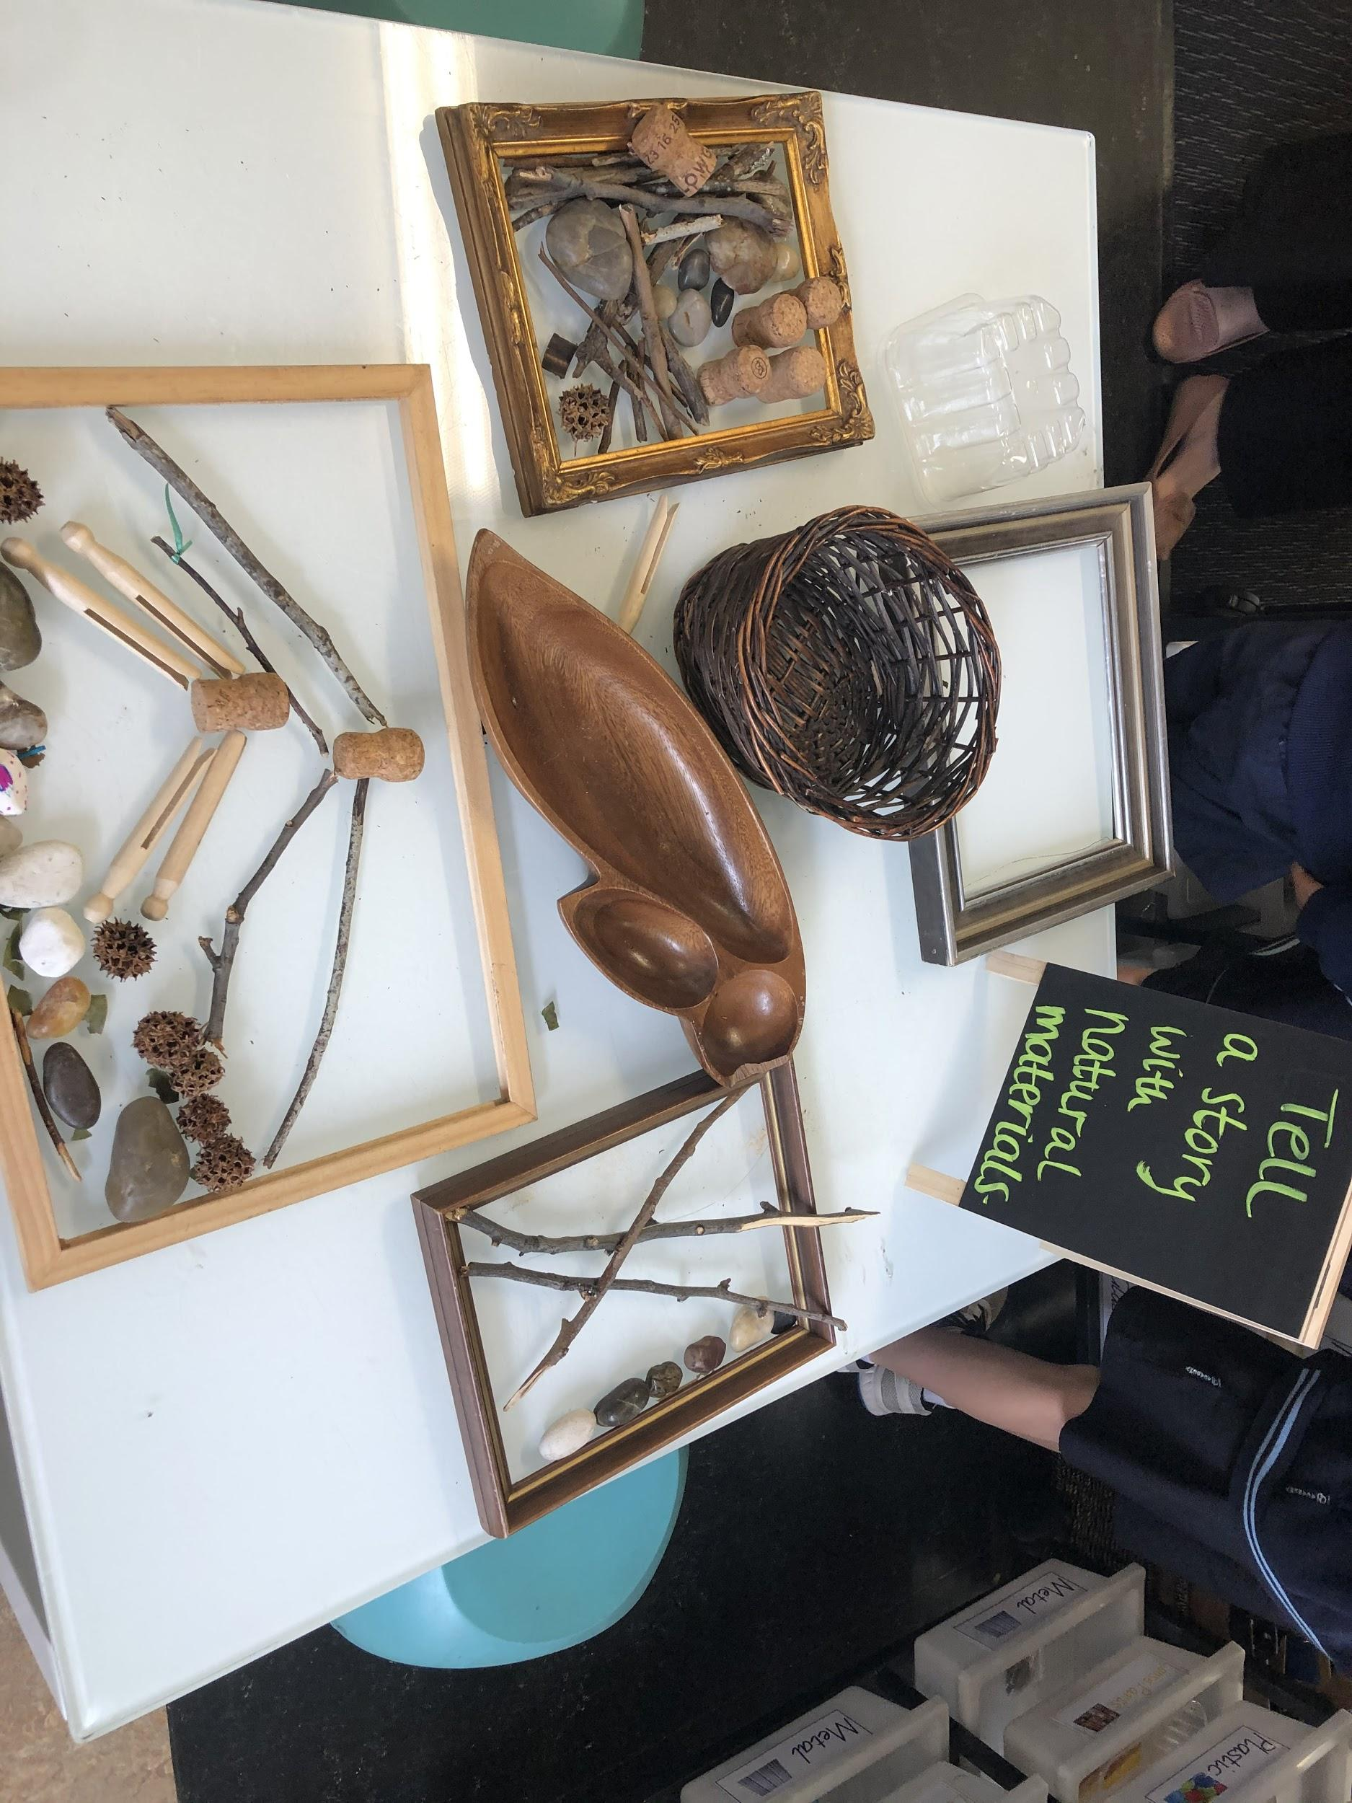
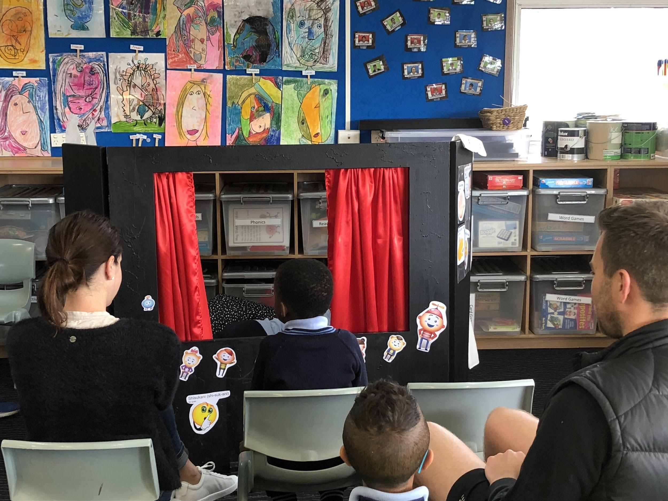
Oral Language opportunities

Slide 46
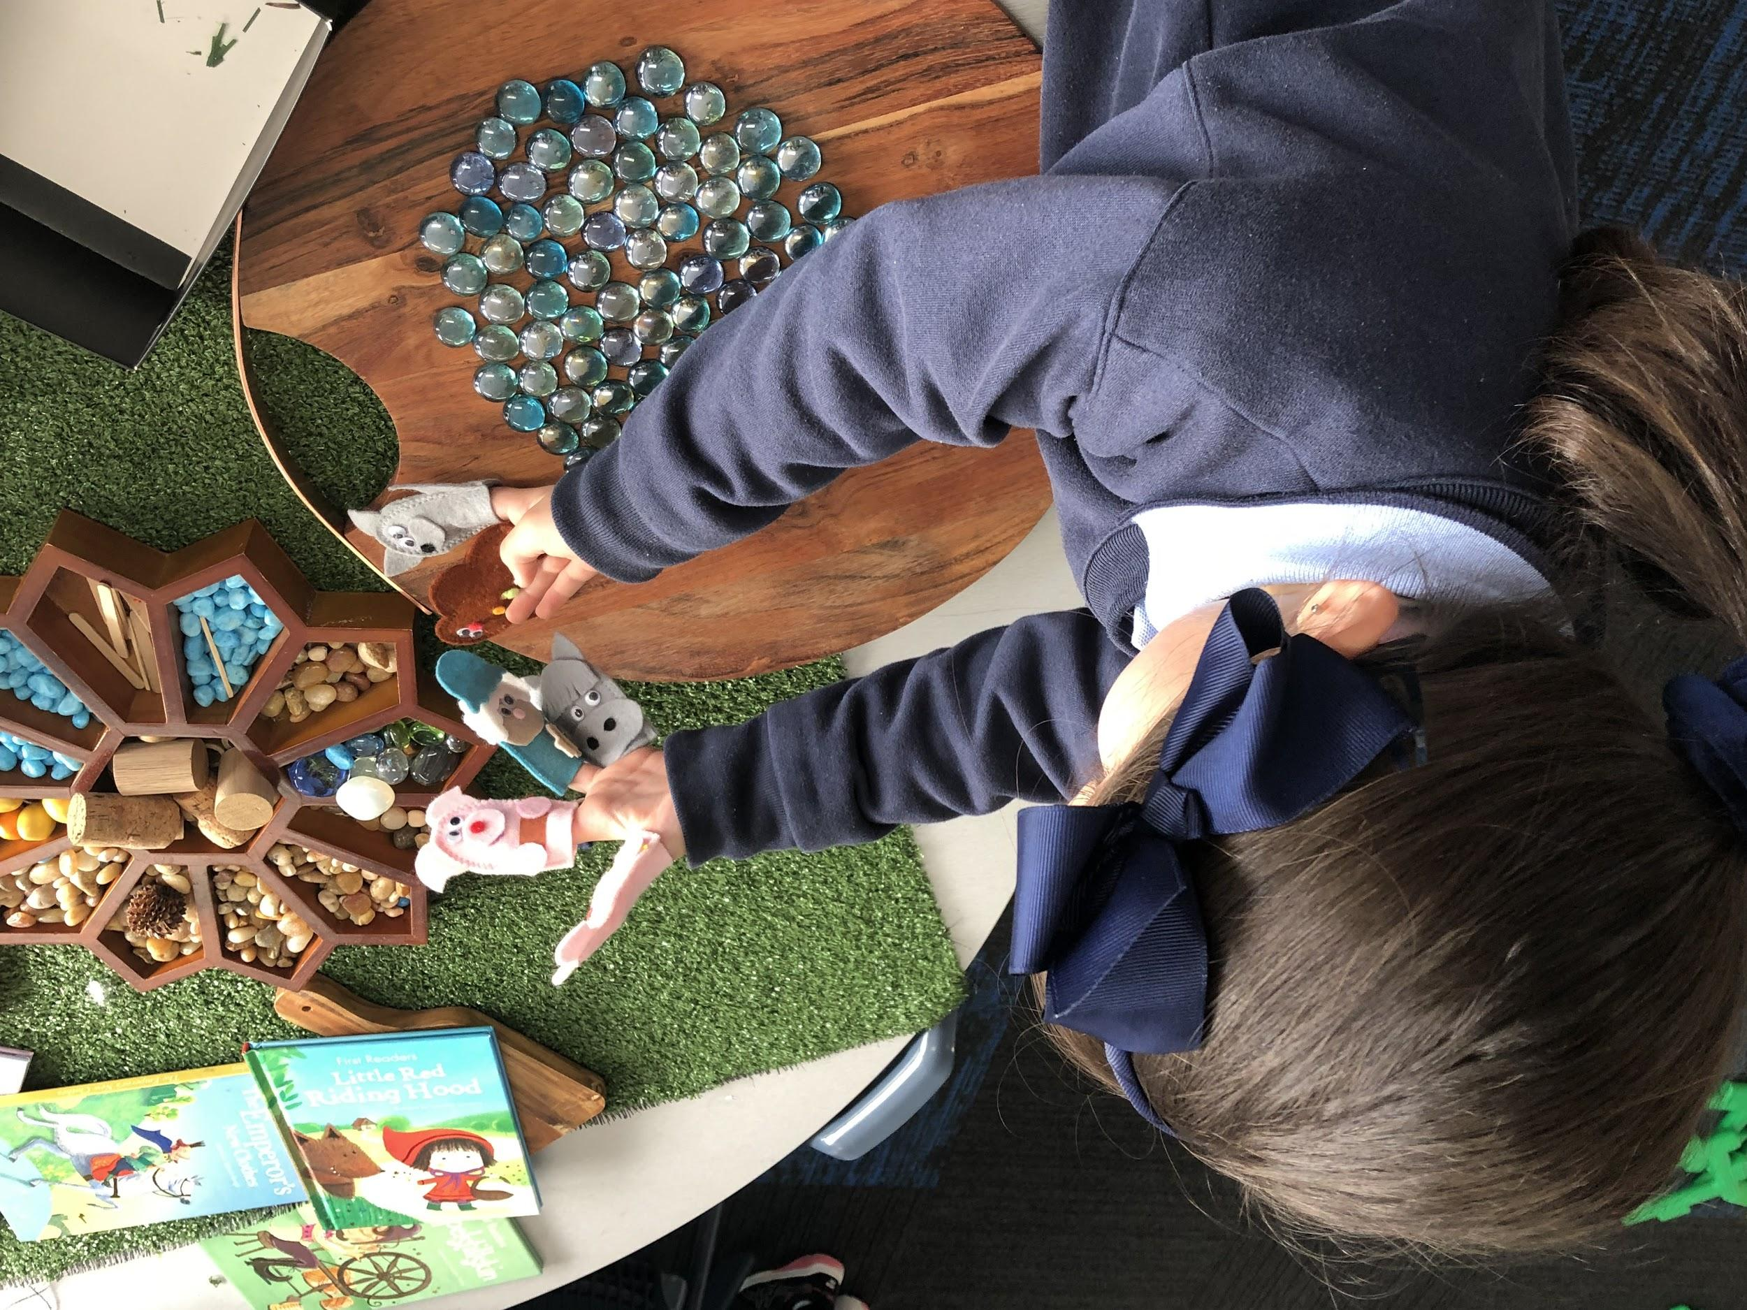
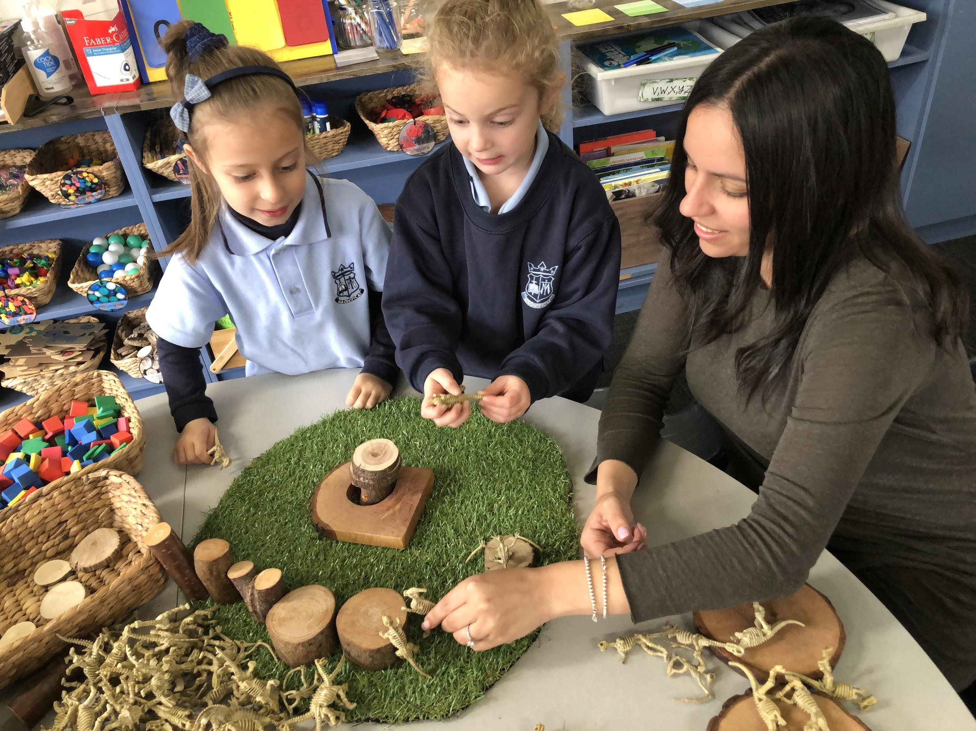
ORAL LANGUAGE
What are the possible Numeracy opportunities?
Children have opportunities to practise expressive and receptive language in a meaningful context.
Over time children’s vocabulary will develop as they revisit familiar play scripts and engage in purposeful discourse eg:In the home corner.
We can extend the oral language of children in natural and meaningful ways.

Slide 47
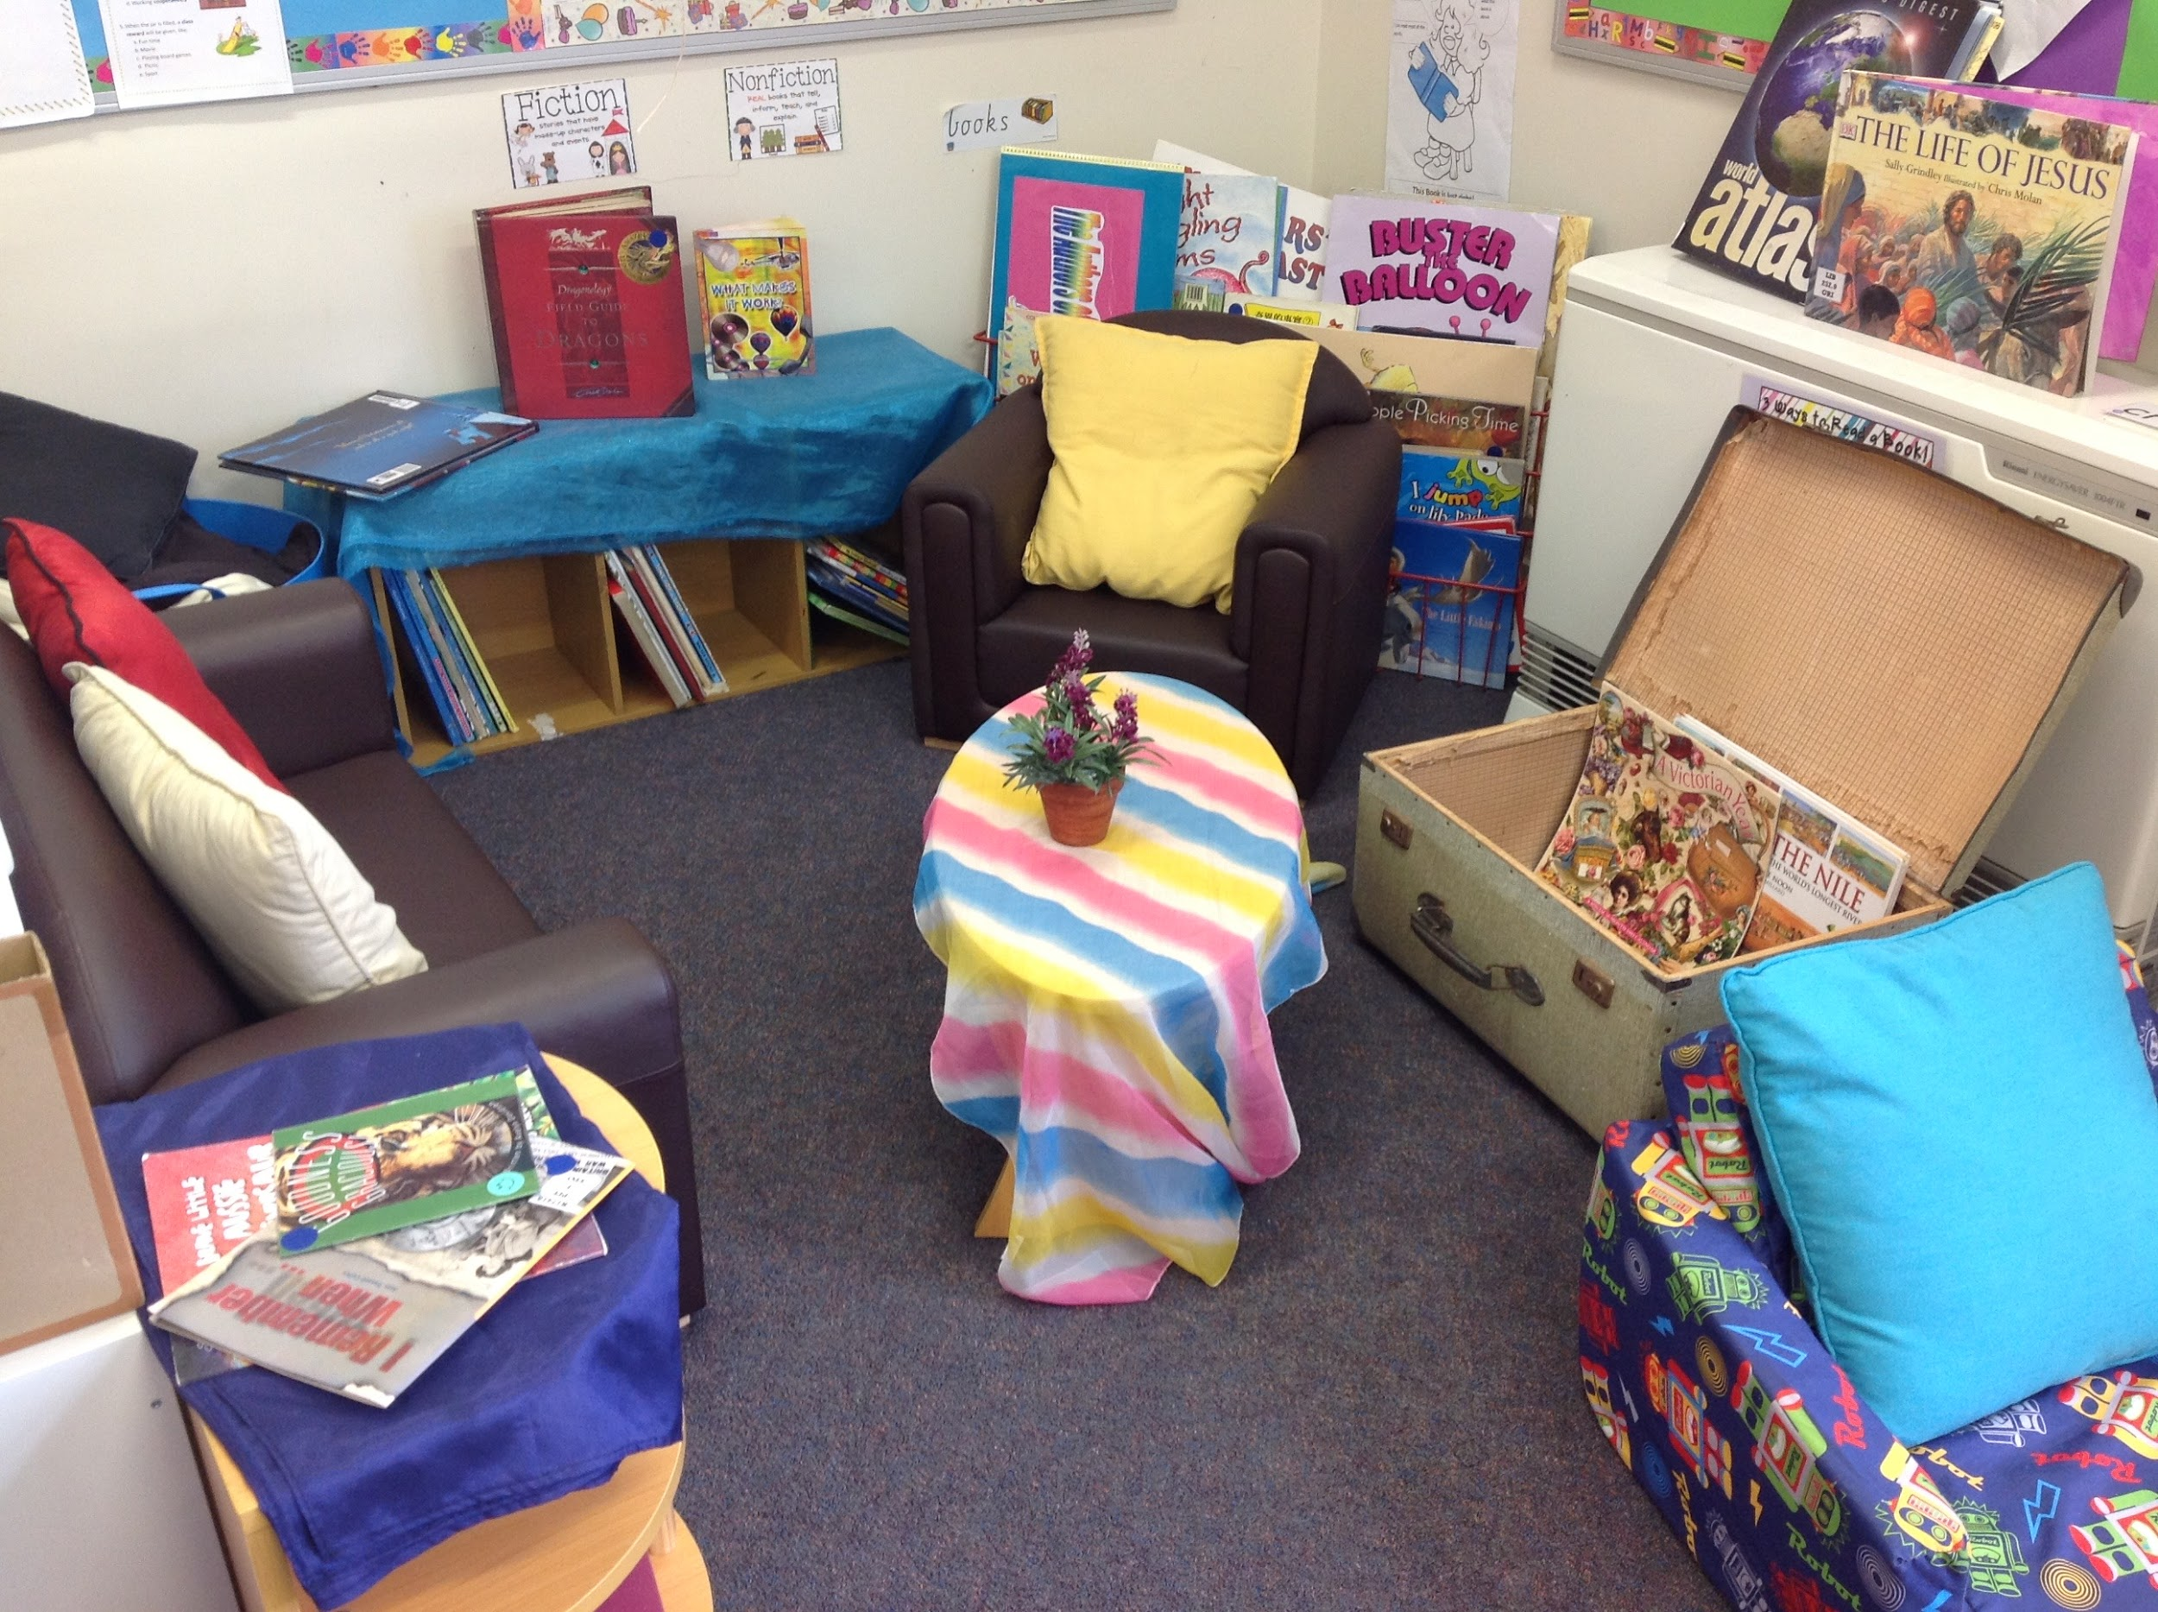
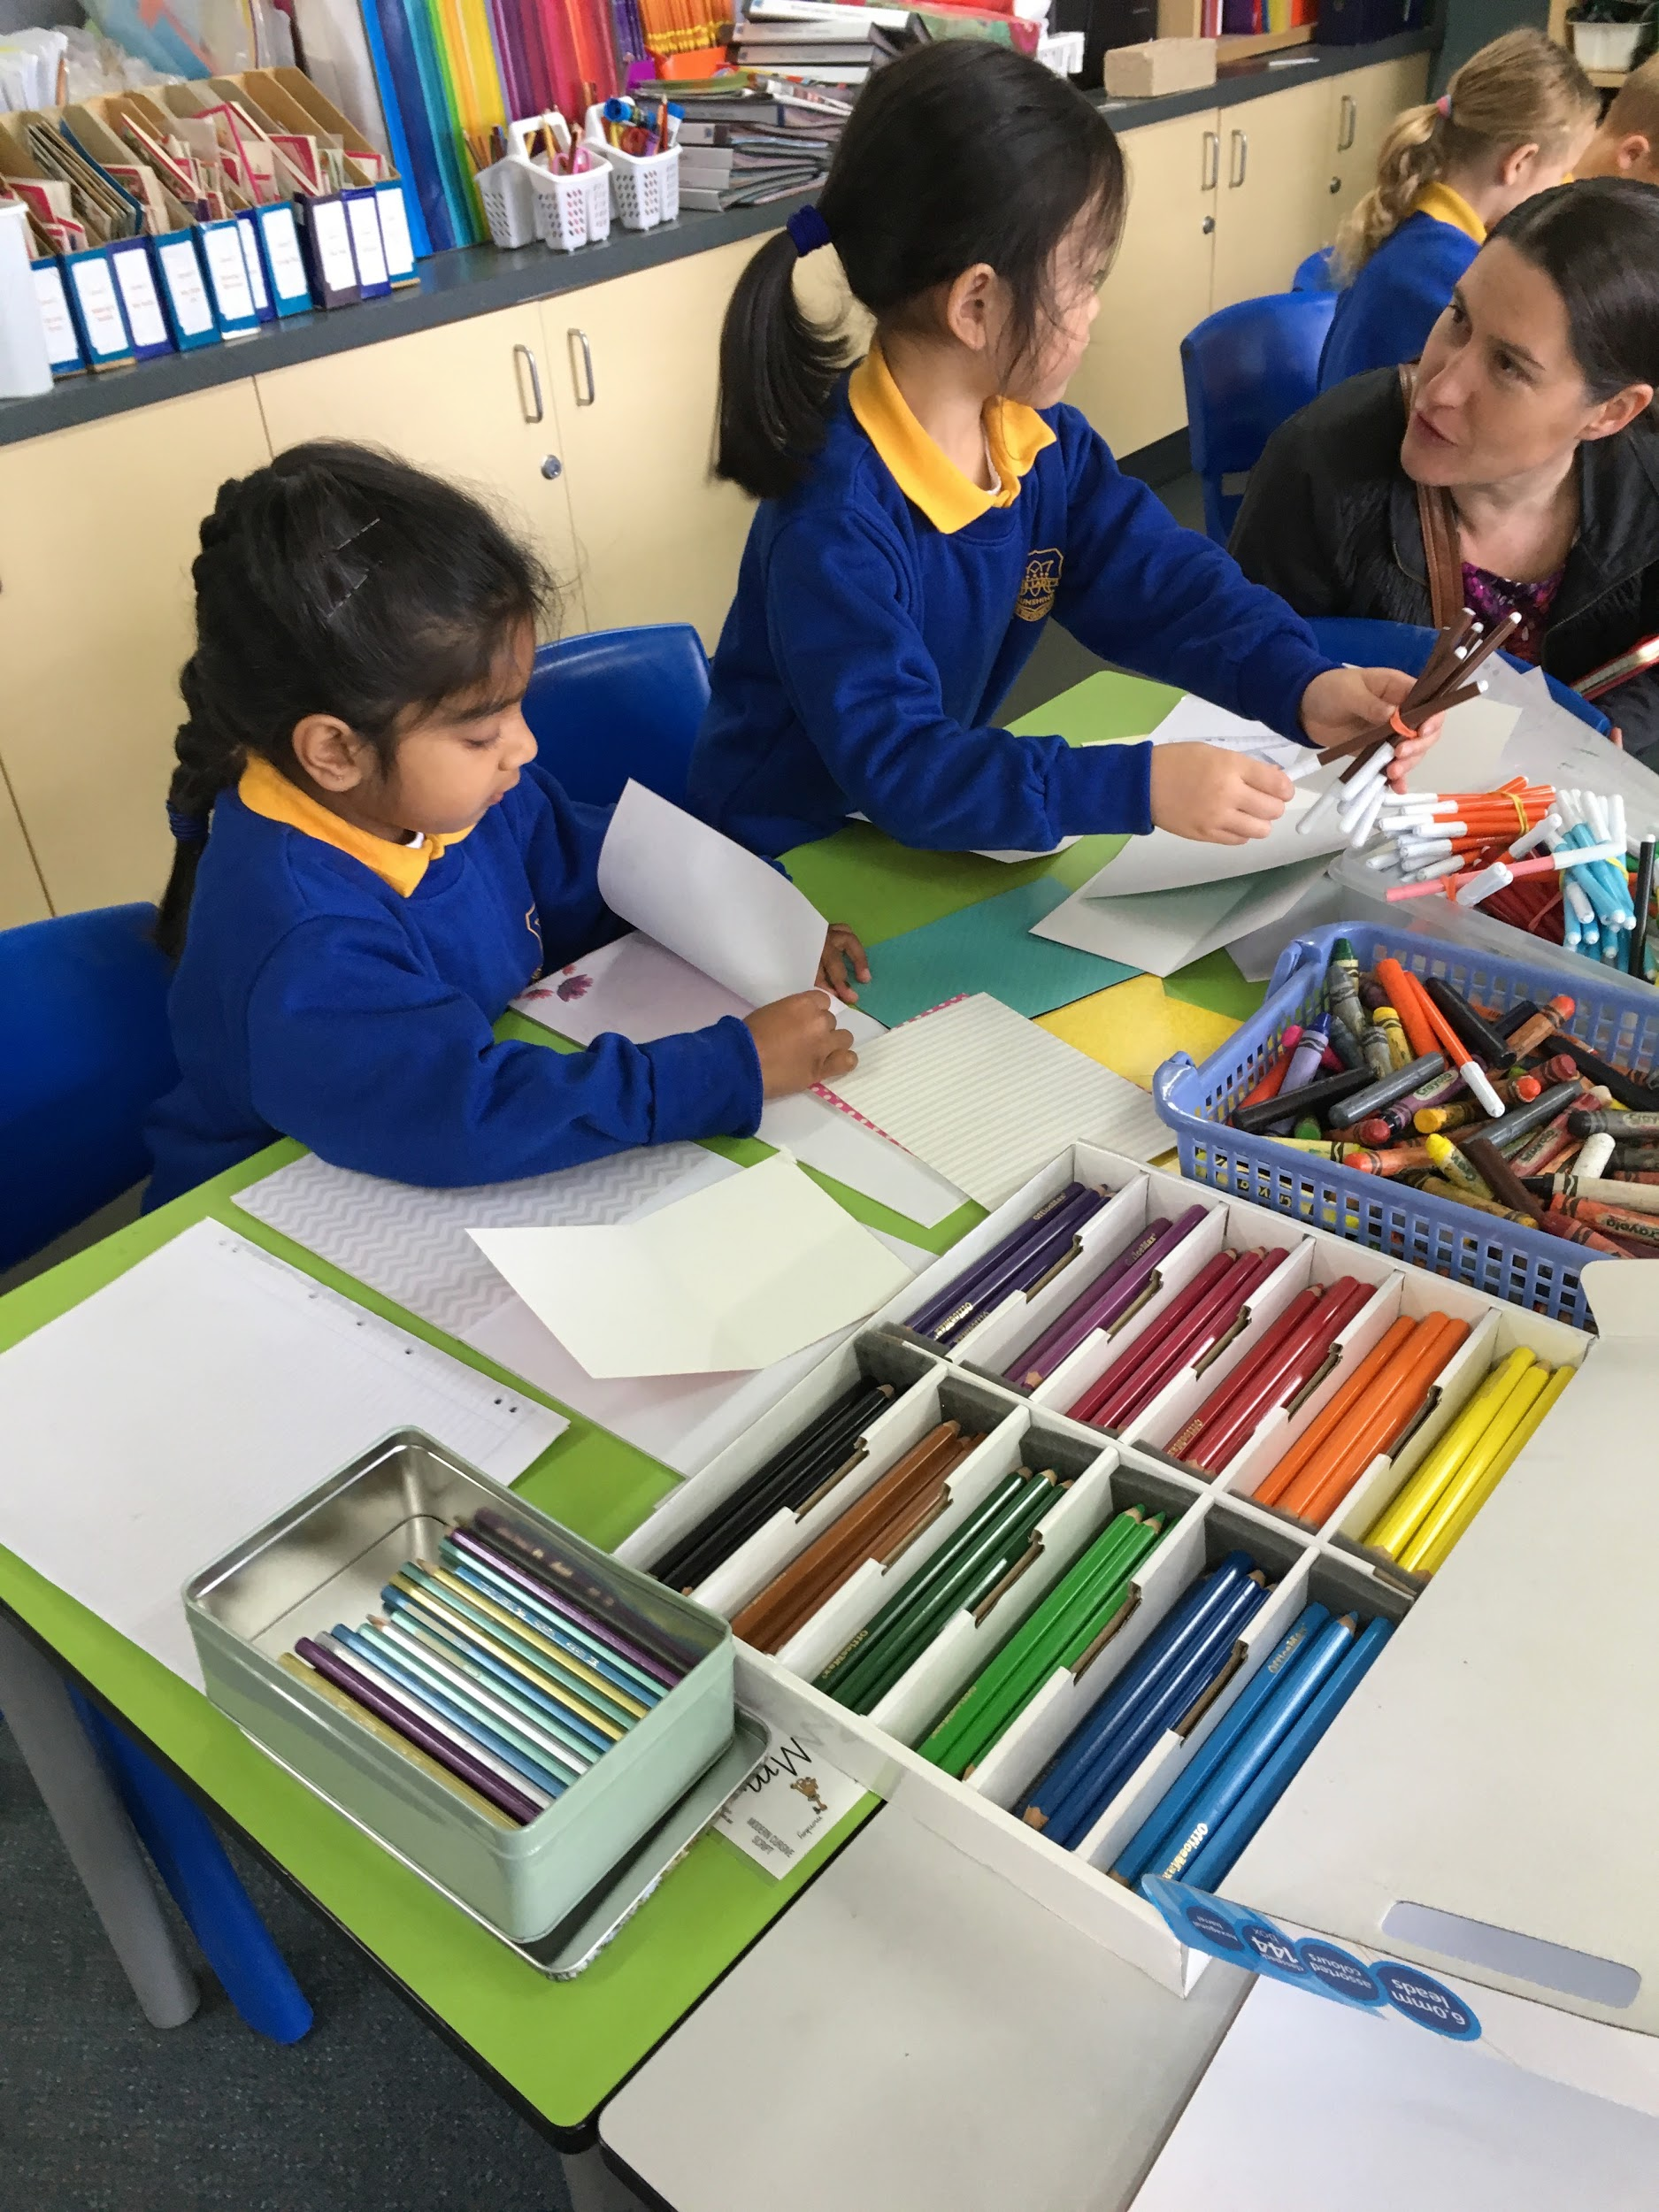

Reading and Writing
In Discovery you can have a dedicated reading area or a library, as well as, a writing station. Our challenge is to think about how we can include opportunities for reading and writing through provocations or props in the other stations we set up.

Slide 48


What are the possible Literacy or Numeracy opportunities through these stations?

Slide 49





Slide 50



Materials or provocations to enhance Numeracy opportunities
Numbers, geometric shapes, paper, straws, blocks, rulers ....

Slide 51




Loose parts, measuring tapes, calculators, money, measuring containers, scales...

Slide 52

Materials or provocations to enhance Literacy opportunities
Whiteboards and markers
Blackboards and chalk
Blank paper
Small card
Clipboards and paper
Paper stapled together to make a book
Mailbox
Fiction and non-fiction texts
Posters
Brochures

Slide 53






Slide 54


Guiding questions may be asked by the adult during play, “I wonder what I can order from your cafe?”
Menus Recipes
Cook books Notepad and pen
ipad
Explicit provocations can be used as part of a focused Introduction. For example, the teacher may say, “I noticed we didn’t have any menus at our cafe. I wonder what a menu looks like? What does it need to include?”

Slide 55


Slide 56



Slide 57

Story tables
Story tables are a form of small world play and provide a context for developing oral language, reading and writing skills
Picture story book
story stones with pictures from the text (may be used for retelling the text)
props (one apple, two pears etc)
clipboards with paper
stapled books
loose materials (polystyrene balls, pipe cleaners)

Slide 58

Teacher role
The teacher’s role is very strategic
100% present 100% of the time
Are you one of a team? How will you work together in Discovery?
Set the purpose and the expectations from the start
Don’t jump in too quickly to solve problems but never loose your ‘teacher hat’

Slide 59
Article: 10 ways to interact with children in play
Noticing and Naming- vocab and language structures, reinforcing and stretching
Narrate
Encourage
Feedback
Inform
Limit- never loose your teacher hat! Agree with your team about the limits
Nudging- direct intervention in subtle ways! Just in time teaching, stretching
Model
Show (or tell) inefficient strategies
Question
Challenge
Join- modelling play behaviours, building relationships

Slide 60
Teacher as researcher
Many possible roles but at beginning of the year: Teacher as researcher (Reggio)
Your goal- to find out as much about your children as you can
Discovery provides an opportunity to find out things you don’t necessarily find out at other times: social skills, oral language, likes and dislikes, personality, family, prior experiences, personal attributes, strengths
So we:
Watch
Listen
Play with
Engage in conversation

Slide 61
Plenary
Bookmaking with Lisa Burman Day 1- Feb, Day 2- May
New Teachers Day in term 1 and 2
LSO day early Term 2
Website. Password VietriDis2

