Slide 1
Makeknowdoact 2020
Why is student agency so important in today’s world? How does “student initiated inquiry” enable agency?
Term 1 Cluster @ Holy Cross, New Gisborne

Slide 2
We Welcome
Holy Cross, New Gisborne
St Michael’s North Melbourne
St Brigid’s, Gisborne
Our Lady of the Rosary, Kyneton
St John Bosco, Niddrie
St Mary MacKillop, Keilor Downs
St Mark’s, Fawkner
St Anne’s, Sunbury
St Peter’s, Epping
St Gabriel’s, Reservoir
Sacred Heart, Fitzroy North
Deb and Vanessa

Slide 3
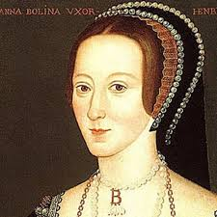

Slide 4
Looking Backwards, Moving Forwards!

Slide 5
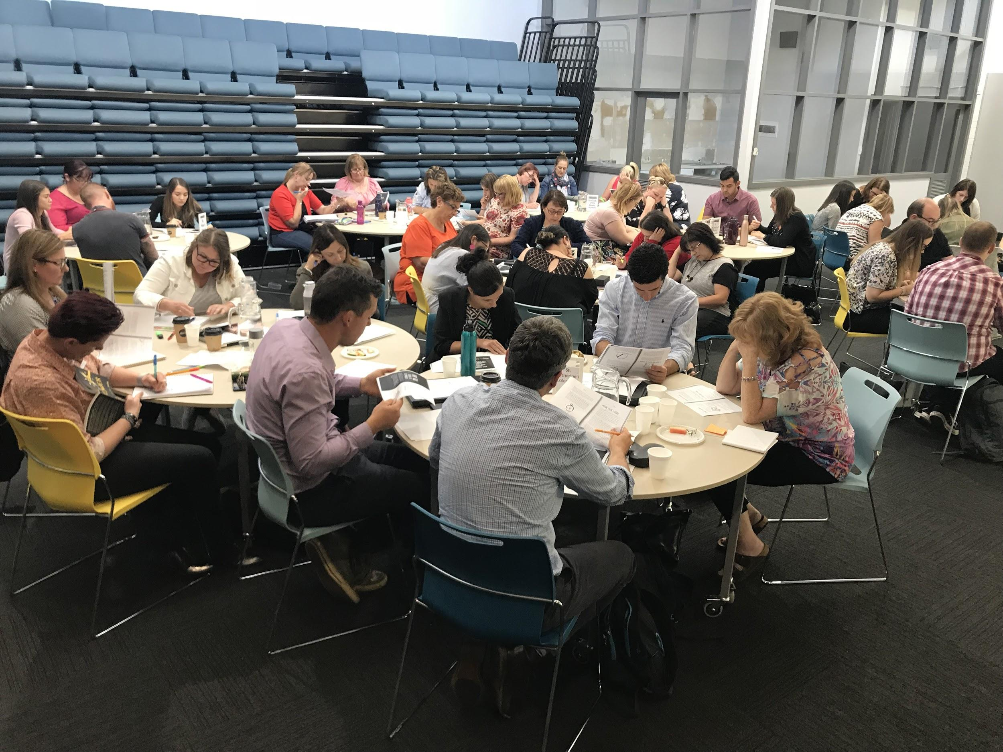
Purpose of the cluster
To engage in Professional Learning with and from each other in order to explore effective ways of using
student-initiated inquiry to; develop learner capabilities, unleash curiosity and creativity, and deepen student thinking.

Slide 6
Terminology
Student-initiated inquiry
MAKE KNOW DO ACT
Genius Time
Passion Projects
iTime
Maker Spaces
Einstein Time
80:20
DIY
CSI
#makeknowdoact
PROJECT is not a dirty word!
What you call it doesn’t matter.
Why you do it does!

Slide 7
What it is:
A powerful learning opportunity
Student-owned and student-driven
Relevant/meaningful
Rigorous and strategic
Creative and entrepreneurial
Focussed on developing the student as a competent, curious and capable learner
Strongly connected to and goes beyond the curriculum

Slide 8
What it’s not:
Free-time (for students and/or teachers)
Laissez faire (fluffy)
Electives program
Focussed on the end product
‘Housed’ within your inquiry topic
Uncontrolled/chaos

Slide 9
Why? Agency
What is student agency and why is it important in today’s world?
Student agency refers to the level of autonomy and power that a student experiences in the learning environment. Student voice and agency are intrinsically linked. Agency gives students the power to direct and take responsibility for their learning, creating independent and self-regulating learners.
Department of Education Victoria
How do the 2 articles relate to each other and to Student initiated inquiry?

Slide 10
A J Juliani- Genius Time
Your class will be covering all types of common core standards
It’s differentiation at it’s best
You learn by what you do, not by what you hear
It’s a perfect way to model life-long learning
Your students will never forget what it’s like to create
It’s fun
You will join a great community of learners
You will allow students to get into depth with a topic that inspires them
There is so much positive peer pressure
It relieves students of the game of school
How does “student initiated inquiry” enable agency?

Slide 11
How?
How does “student initiated inquiry” enable agency?
What would it be like to be a student in your class? What is it like to experience the MKDA process?
What might this feel like for your students?
What support and structures do you need to create in order to make this a valuable and enjoyable learning experience for them?

Slide 12
WOW
We get to choose our own project!!!
What are you interested, curious or passionate about?
What do you want to make, know, do or take action on?
PS
Do this on your own.
No talking!!!

Slide 14
Pathways
Brainstorm possibilities

Slide 15
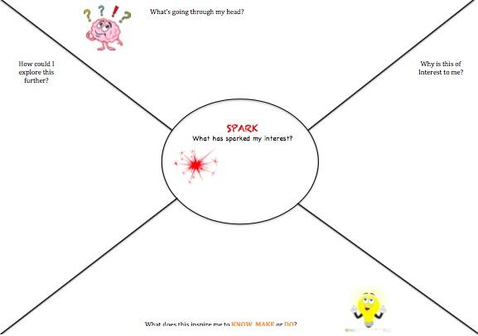
What are you interested, curious or passionate about?
What do you want to make, know, do or take action on?
You could…
Browse the inspiration stations
Explore the brainstorms
Chat to others
Use the spark chart to help you.

Slide 16
What possible difficulties or challenges could this present for students?
How could we support students with this part of the process?

Slide 17
excursions,
come and try workshops,
video clips,
visiting another school,
personal reflections/teacher modelling,
inspiration stations,
carousel activities,
children from higher grades sharing their projects,
class brainstorms under MKDA,
provocations at the start or ongoing,
I wonder sprints,
design challenges,
conferences (peer or teacher)
focus group workshop
Other suggestions

Slide 18
Frame up your project
Choose one idea you would really like to run with. Think about these things-
Why have you chosen this?
What would you need to know more about in order to do this? What questions might you need to investigate?
How would it stretch you as a learner?
How will you go about it? What steps might you need to take (Plan)
What are you not sure about? What would you like advice or feedback from others about?
Preliminary planning
Formalising ideas

Slide 19
Pitching your project
Criteria:
What are you intending to make, know do or act on?
Why is this important to you?
How it stretches your learning
How you think you will go about it
Is there anything you would like specific advice or feedback on?
Pitching encourages students to clarify their thinking, adds a layer of accountability, builds collaboration.

Slide 20
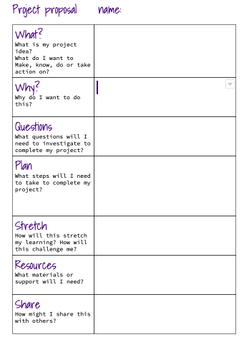
Project proposal
Based on your preliminary planning and the feedback you got from your pitch you are now ready to put your ideas into a formal proposal
This proposal forms the basis of a conversation/conference with the teacher (checkpoint)
Accountability
Sign off- teachers, parents could involve others.

Slide 21
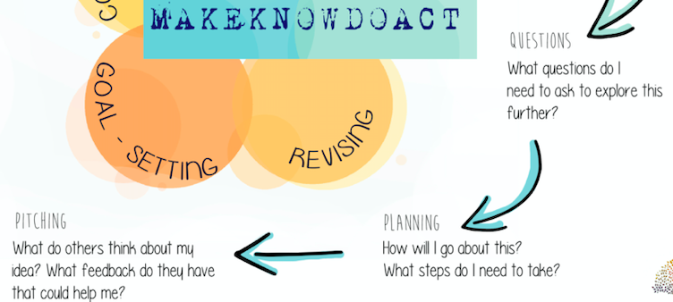
What possible difficulties or challenges could this present for students?
How could we support students with this part of the process?

Slide 22
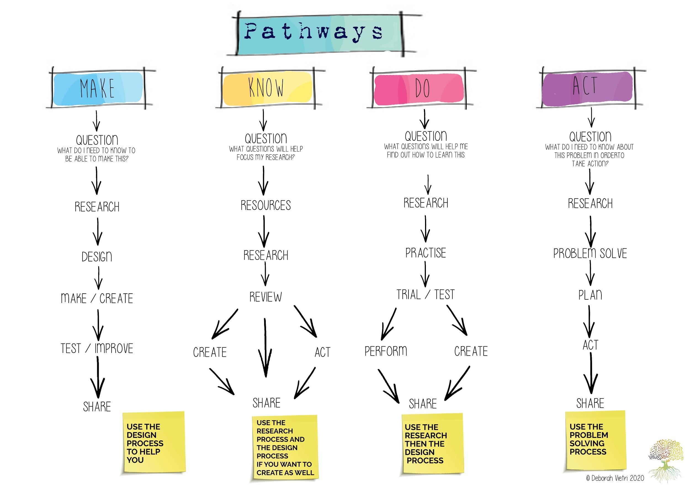
Depending on the pathway the process will be different.
Each pathway draws upon inquiry processes previously taught.
What support might students need in each of these pathways?
What could teachers be doing?

Slide 23
Sharing
Think about your own projects.
If you were to share with an authentic audience what could this look like? (Process and product) Expanding our ideas beyond an expo. (Purpose and audience)
Brainstorm as a group and record on a poster- gallery walk.

Slide 24
Workshops
Workshop A: Getting started with Makeknowdoact (new schools and teachers) with Vanessa
Workshop B: How can we move from ‘Novice to Expert’ (ongoing schools and teachers) with Deb

Slide 25
Action planning
Based on everything we have looked at today identify a goal for your school moving forward.
What action steps will you need to take?
How can you support each other with your goals?
How will you share this with your colleagues
How will you know when you are successful?

Slide 26
important stuff!!!
Accessing resources: Website https://www.deborahvietri.com
Cancellations
Host school for terms 2, 3 and 4
2 clusters in each of terms 2 and 3
We need your input:
Goal and action steps
Areas you would like us to address in future Clusters
Any other feedback

Slide 27
Contact us
Deb Vietri
dvietri@bigpond.com
Vanessa Willis
vanessawillis06@gmail.com
Instagram @discoverybasedinquiry
Twitter
@discoverinquire
@debvietri
NB Please inform us if you do not wish your photo to be displayed on social media

