Slide 1
How can we support students with special needs during Discovery?
How might we solve some possible hurdles we can be faced with when working alongside our special needs students?
A professional learning Module for Learning Support Officers
Module 2
Part A

Slide 2
Overview
Explore some strategies for supporting students with special needs during a Discovery session
Consider some possible solutions to common problems that we may experience during Discovery

Slide 3
How can we support students with special needs during Discovery?

Slide 4
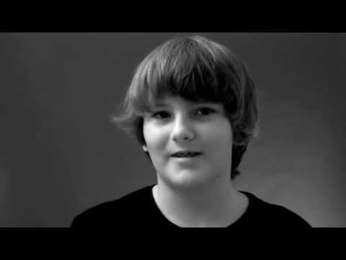
Many of the children you work with have different mindsets and ways of working than other students.
Not more, not less, just different!
Understanding and respecting how they operate, and what makes them tick is often the key to helping them make the most of learning opportunities.

Slide 5
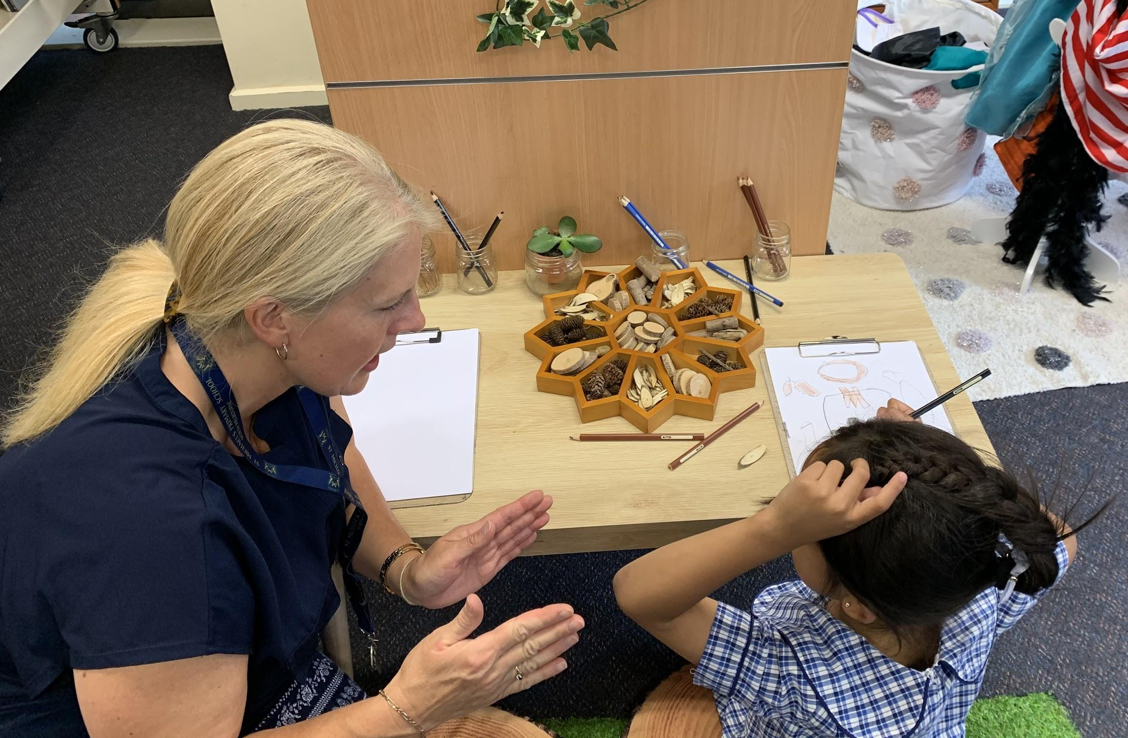
The important role of the LSO!
Often the LSO will be asked to;
Support students with special needs during Discovery OR all students in general
Observe and record behaviours of specific children
Support a particular area requiring adult supervision

Slide 6
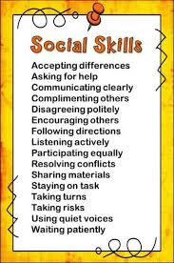
The important role of the LSO!
When supporting individual students, Discovery is an opportunity to work towards some of the goals set for the student in the PLP in an authentic way
using their strengths, talents and interests
Discovery may also provide an opportunity for scaffolded application or trying out of skills and strategies that may have been a focus at another time in the day e.g. an explicit social skills group

Slide 7
The important role of the LSO!
Many special needs students THRIVE during Discovery as they can move around and pursue areas that directly interest them
Use this time to encourage them by
giving positive reinforcement
engaging with them in conversation to develop oral skills
Prompt them to problem solve or to work with others (as appropriate)
What works for one student may not work with others so we need to take a ‘trial and error” approach to find out what works best for the student you are working with

Slide 8
Image of the Child
4 Views of the Child
Innocent and Fragile We must protect them | Threatening We must control them or the situation
Empty We must teach them everything | Competent and Capable We must challenge them, trust them with their learning and listen to their perspective

Slide 9
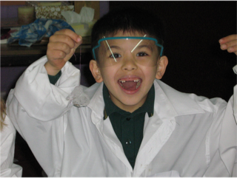
Image of the Child
4 Views of the Child
When we are clear on what view influences our beliefs then we can use this to view to inform and drive our approach when working with special needs students in Discovery

Slide 10
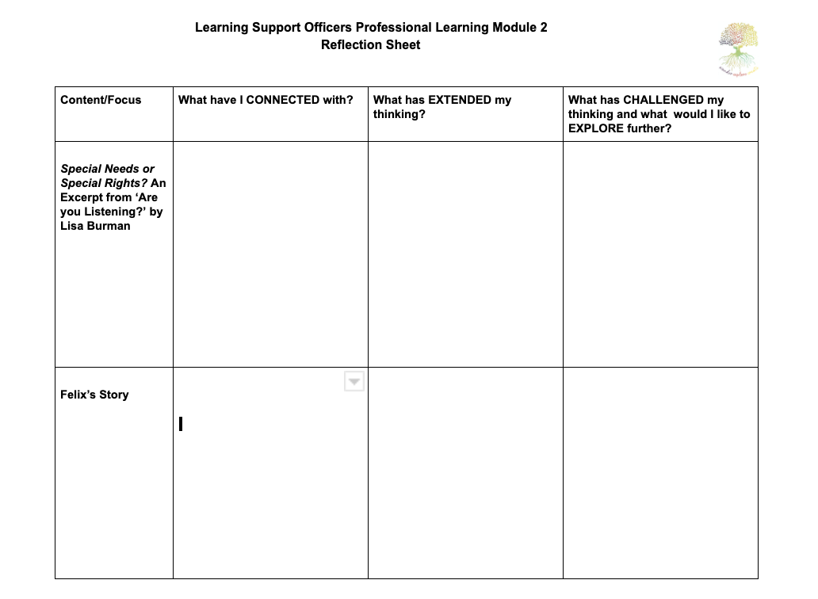
Read Reflect Discuss
Reading: Special Needs or Special Rights?
By Lisa Burman

Slide 11
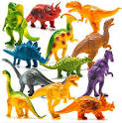
Felix’s Story
Prep Student on the Autism Spectrum
Attended a kindergarten with a specialised early intervention program
Likes
Playing in the sandpit and exploring nature
Humour and laughing - loves playing tricks on people
Block construction
Looking at books particularly non fiction
Pretend play - has a vivid imagination but also likes to incorporate his general knowledge into the play
Dinosaurs and prehistoric times

Slide 12
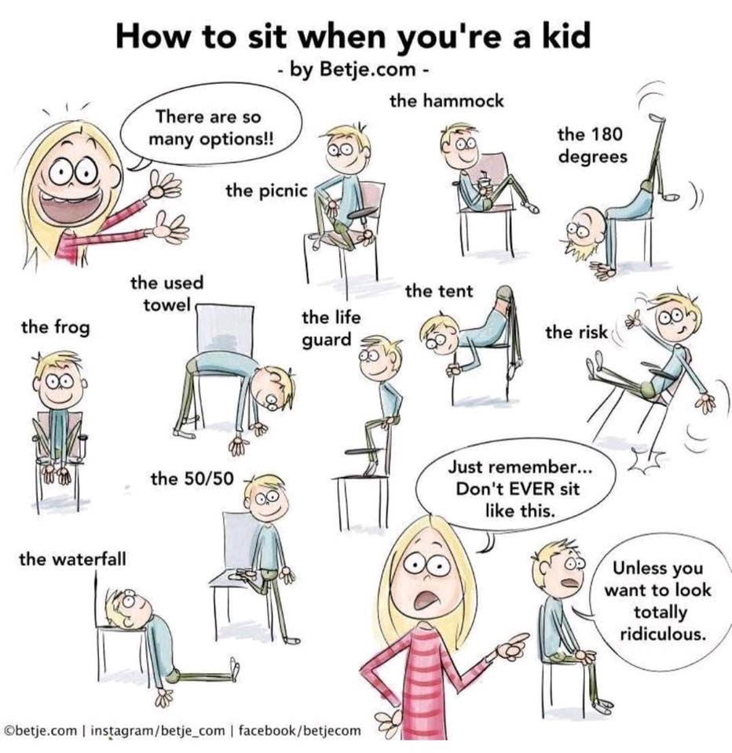
Felix’s Story
Dislikes
Being the centre of attention
Being asked to do something he has no interest in
Loud people
Having to sit still for a long time
Having other people (usually children) watch over his shoulder when working

Slide 13
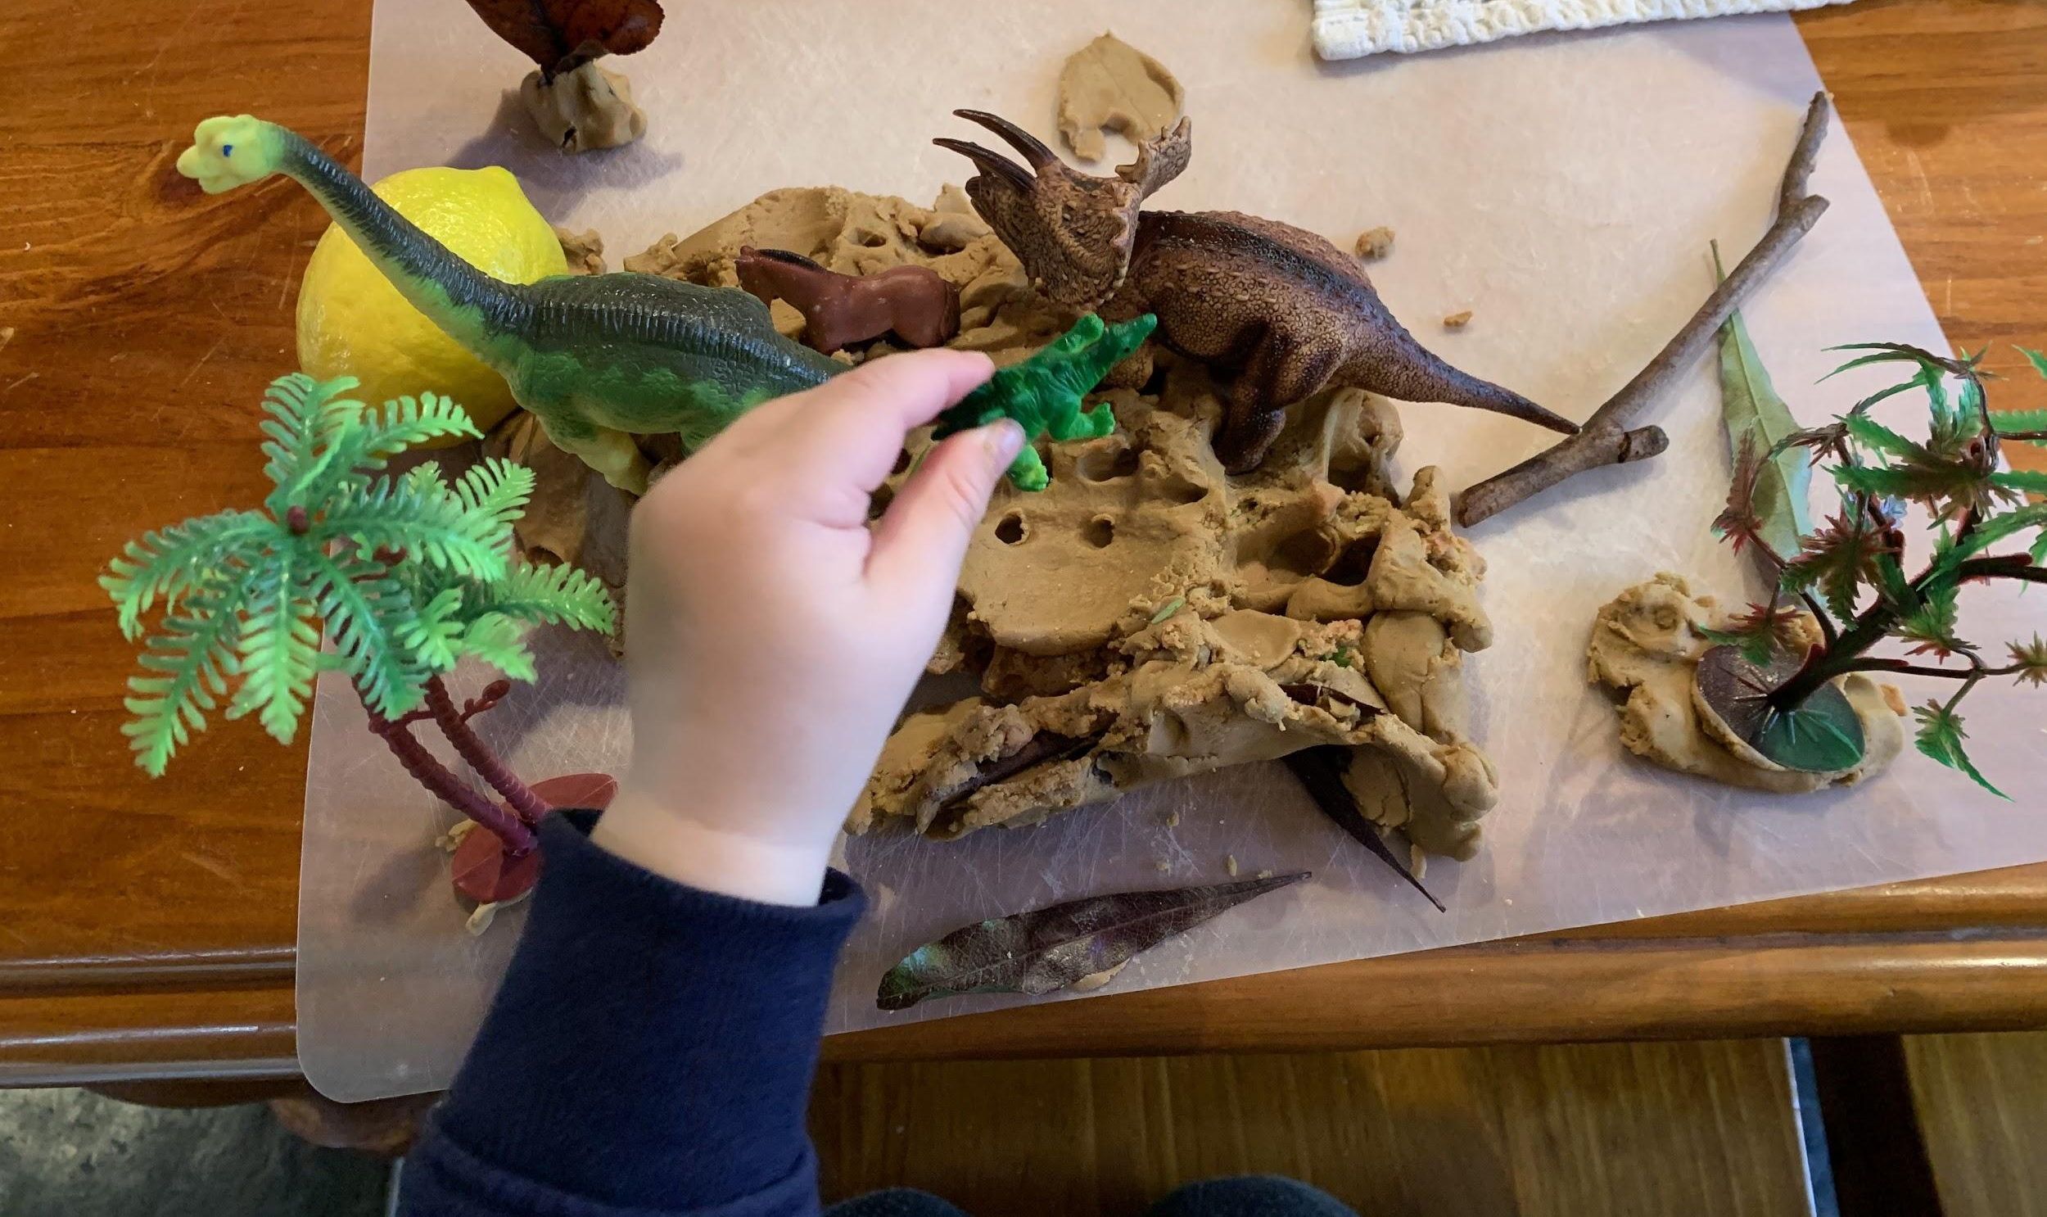
Supporting Felix in Discovery
ACTION
Tapped into his interest in Pretend Play, Dinosaurs, nature and the sand pit
Small World Play with Dinosaurs and made sure there was sand. Invited Felix to join the LSO and one other child for a nature walk to collect items the Dinosaurs might need
This enabled him to contribute to the area as well as talk about his extensive knowledge in a supported way

Slide 14
Supporting Felix in Discovery
Felix was supported to understand other children might join him at the small world over a number of weeks - numbers were monitored - social skills were the focus here
Provocation 1
Placement of non fiction books at the small world the following week
Provocation 2
Paper and pencil - could you record down some of your knowledge to share with others? Drew pictures and talked about the dinosaurs

Slide 15
Supporting Felix in Discovery
Felix was encouraged to share his expertise and knowledge with a small group of classmates who expressed an interest - this group was facilitated by the LSO
This enabled him to practise communication and social skills
The goal was not to build
Felix’s content knowledge but to help and assist him to build on the social skills and communication skills he needed to be successful in school and in life.

Slide 16
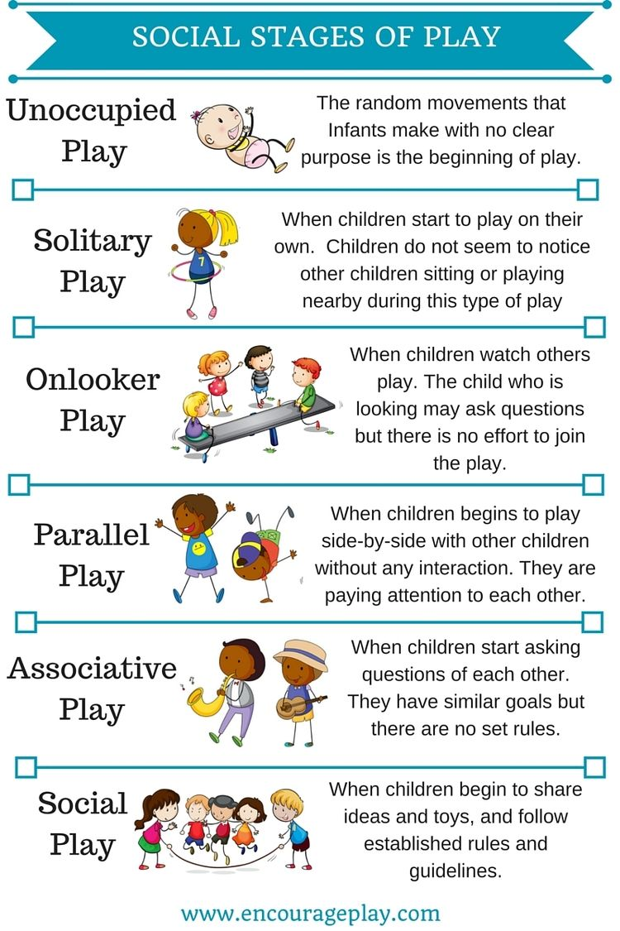
Supporting Felix
in Discovery
The goal was not to build
Felix’s content knowledge but to help and assist him to build on the social skills and communication skills he needed to be successful in school and in life.
Strategic placement of some blocks close by to where the Small World was placed to encourage his interest
He took this invitation and he was observed in parallel play in that area but watched others - again social interactions became the focus for him here as he provided tips to others (with support of LSO)

Slide 17
Your turn!
Stop and think about a child that you work closely with:
What are their strengths?
What do they like?
What do they dislike?
What have you noticed about them during Discovery?
How might you use their strengths and likes to ‘nudge’ them to take the next step?
What goal might you set for them?
How could you support them with this?
What else do you need to know?

Slide 18
How was Felix viewed as Competent
and Capable?
His teacher and LSO provided opportunities for learning the skills identified on his PLP in contexts that were familiar
His teacher and LSO allowed him to show what he could do and provided opportunity for that e.g. having others join in, sharing knowledge with others in supported ways
His LSO was a co-player and influencer, providing enough of a nudge that he was able to try things that were a little outside his comfort zone

Slide 19
Reflect Record Discuss

